Slide 1

My Taxi Project Analysis
Authors:
Giovanni Bucci
Riccardo De Togni

Slide 2
Description of the Problem
Improve Taxi Service of large cities: GOALS
Simplify the access for customers
Grant Fairness in queue assignments

Slide 3
Simplification of Access
Requirements introduced:
People will use the service through a Web Application or through the Mobile Application
People will book taxis in advance without any phone call

Slide 4
Queue Assignment Fairness
Requirements introduced:
Taxi Drivers will access the service through a mobile device
Taxi Drivers will get into FIFO queues ordered on entrance Timestamp

Slide 5

Actors
Guest
User
Taxi Driver
Administrator

Slide 6
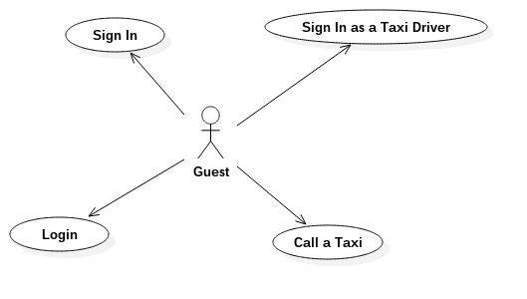
Guest

Slide 7
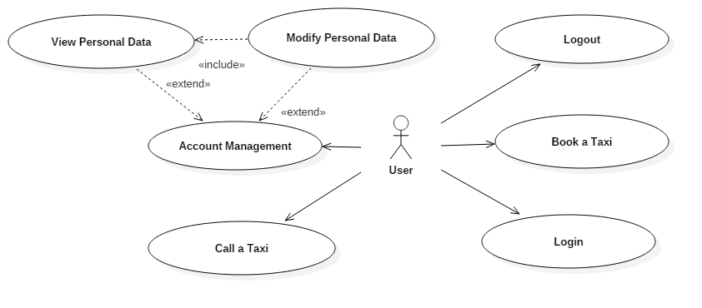
User

Slide 8
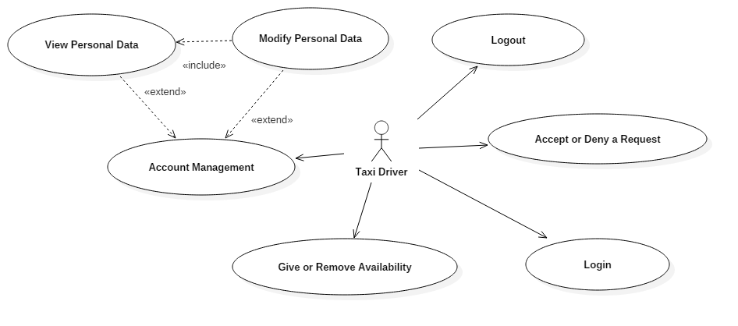
Taxi Driver

Slide 9
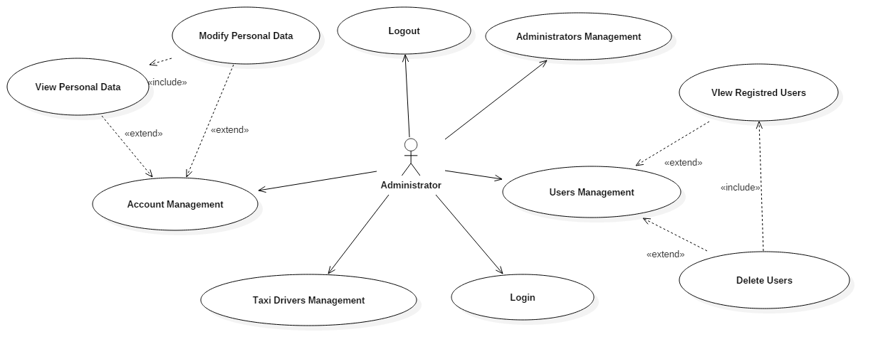
Administrator

Slide 10
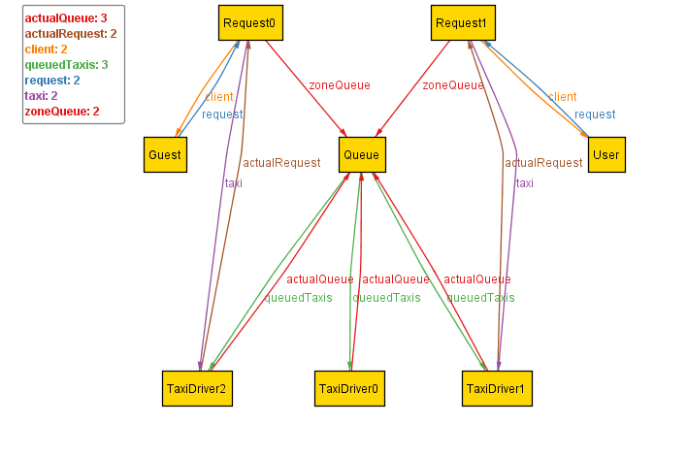
Model Verification
Alloy Analysis

Slide 11
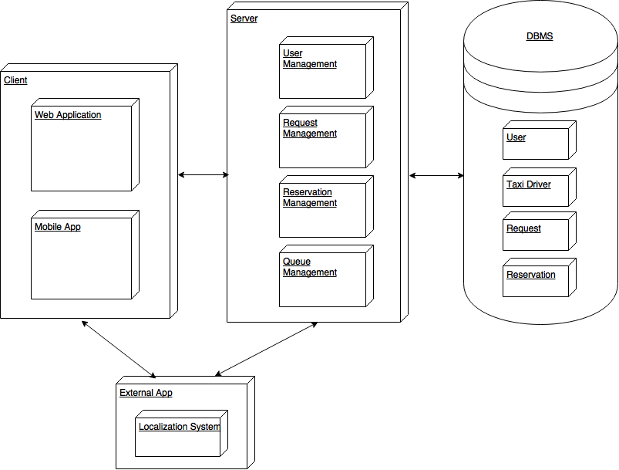
Design & Architecture
Three-tier architecture:
Client-tier
Business Logic-tier
Entity-tier

Slide 12
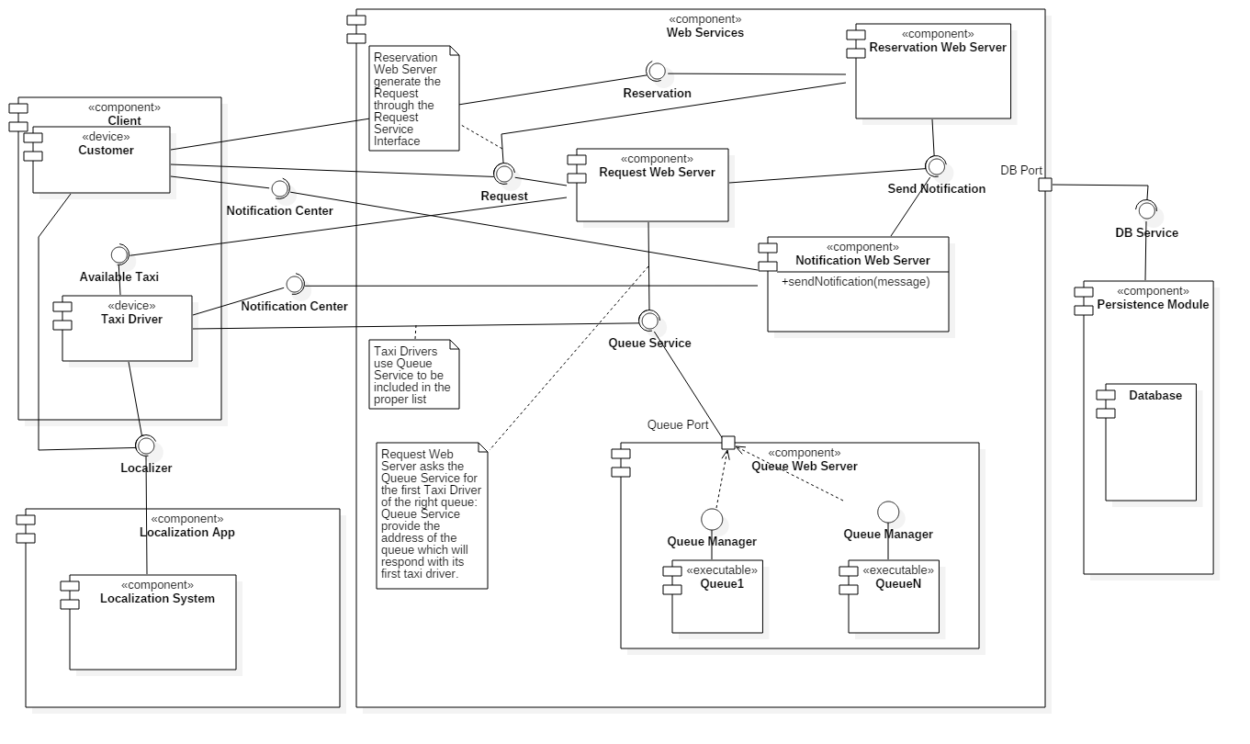
Design & Architecture
Component Diagram:

Slide 13
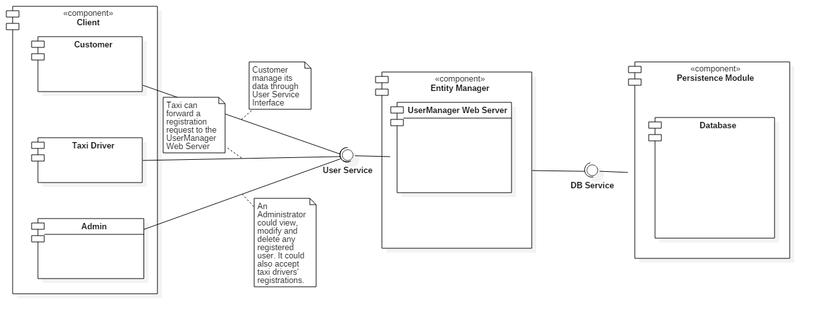
Design & Architecture
Component Diagram: User Management

Slide 14
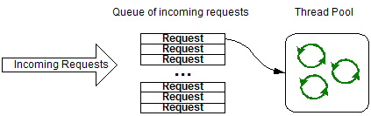
Architecture Details
Patterns:
Thread Pool
Façade
Observer
Read-Write Lock

Slide 15
Integration Test: Plan
Created in order to have a reference on the verification of functionalities, performances, and reliability requirements of the project
Individual software modules are combined and tested as a group
Requires Unit Test
Based on a bottom-up approach

Slide 16
Integration Test: Sequence

Slide 17

Project size and cost evaluation
Estimate the project size through Function Point Analysis
COCOMO II analysis to calculate Effort and Duration

Slide 18
Function Points
Identify all the features of the project, assign them a weight
Resulting total function points: 134
Source Lines of Code calculated multiplying function points by language-based converting factor (JEE)
SLOC: 6164

Slide 19
COCOMO II Analysis
Effort and duration based approximation using parameters derived from previous experiences
Effort (in Persons-Month): 11.52
Expected Duration of the project: 8 months

Slide 20
Project Timeline

