Slide 1

Simulating a quantum circuit on GPU
Annechini Alessandro
Fiorentini Riccardo

Slide 2
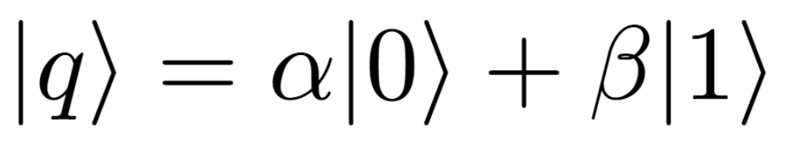
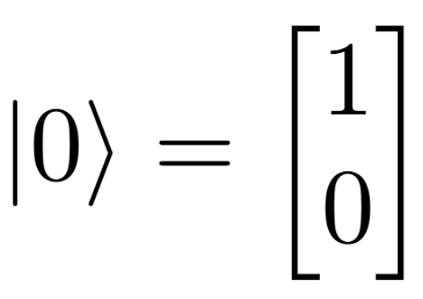
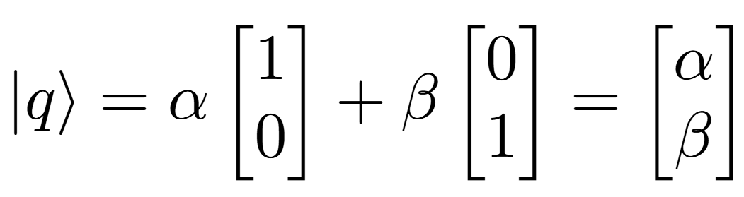
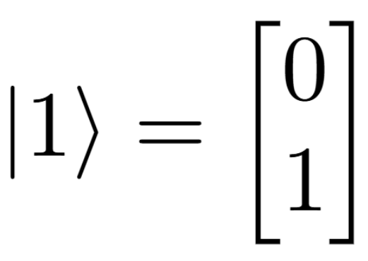
The problem: qubits

Slide 3
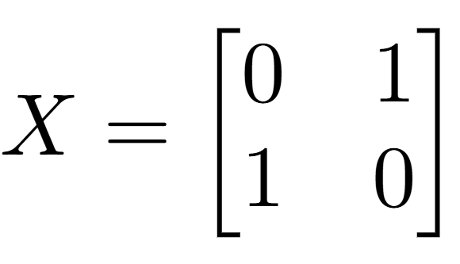
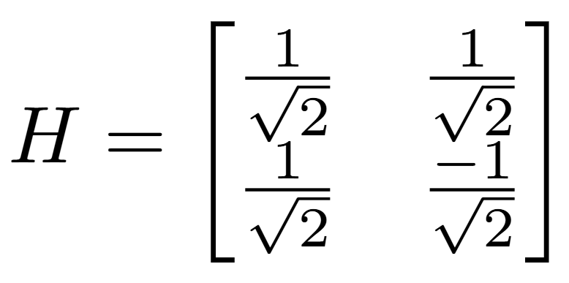
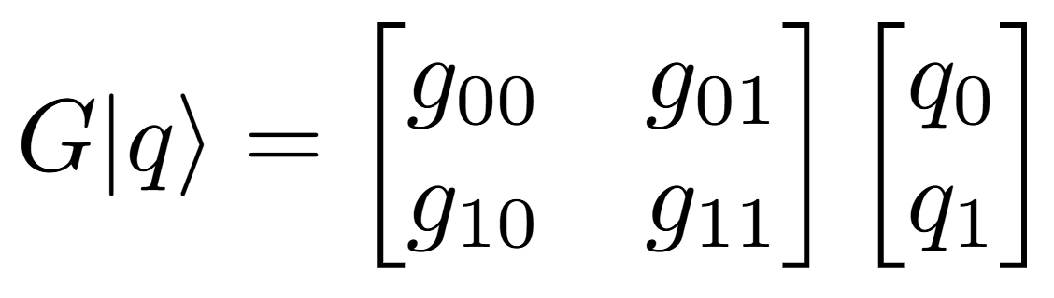
The problem: quantum gates

Slide 4
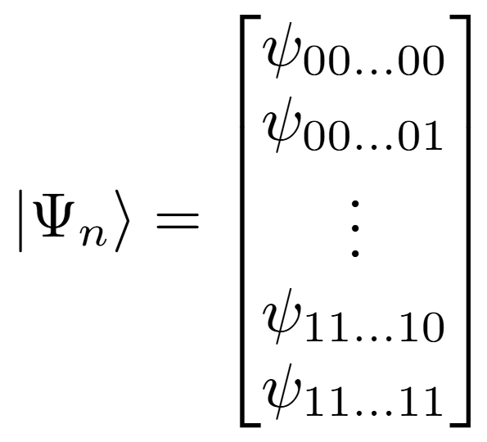
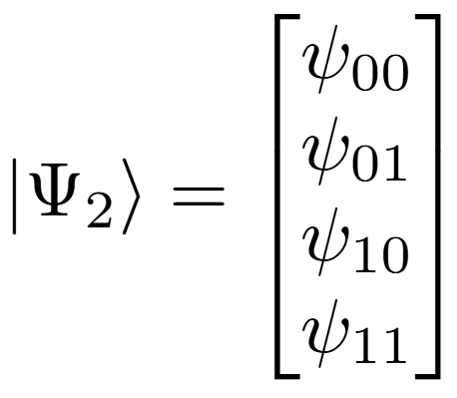
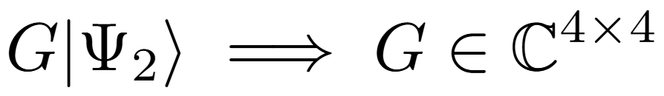
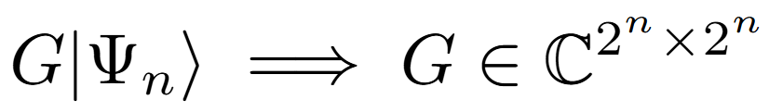
The problem: multi qubit systems

Slide 5
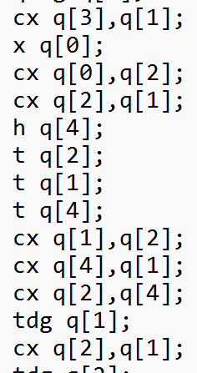
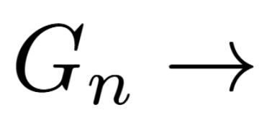
The problem: circuit decomposition

Slide 6
Naive approach
Each thread computes one cell of the state vector
Requires double buffering
Data riutilization is hard to optimize
Thread 0
Thread 1
Thread 2
Input Vector
Outpur Vector

Slide 7
Naive approach - optimized
Example: single-qubit gate on the most significant bit
Thread 0 reads and modifies indexes: 000000 and 100000
Thread 1 reads and modifies indexes: 000001 and 100001
Thread 2 reads and modifies indexes: 000010 and 100010
...
Thread 0
Thread 1
Thread 2
real_vector
imaginary_vector
Notes:
The state vector is divided in two float vectors: real and imaginary
Each thread modifies two cells of each vector
No data riutilization is needed: each thread reads unique data
No synchronization/double buffering is required
Building the indexes bit-wise allows for coalesced memory accesses

Slide 8
Preprocessing
h q[0]
t q[1]
s q[2]
x q[0]
z q[2]
cx q[0], q[1]
cx q[2], q[1]
7 kernel calls
5 kernel calls
Notes:
Goal: reduce the number of kernel call
Idea: the application of multiple gates to the same qubit is equivalent to the application of a single gate composed by multiplying together all the gates
Implementation: while the GPU performs state-vector operations, the CPU applies commutativity rules to collapse different kernel calls into a single one

Slide 9
Preprocessing + collapsed __device__ calls
If(!isIdentity(gateA))
kernel_gate<<<nb, nt>>>(gateA)
If(!isIdentity(gateB))
kernel_gate<<<nb, nt>>>(gateB)
kernel_cnot<<<nb, nt>>(target, arg)
kernel<<<nb, nt>>>(
gateA,
gateB,
target,
arg)
3 kernel-call vs 1 kernel-call
Notes:
Reduce the number of kernel calls to 1/3 when executing two-qubit operations
Requires syncronization to execute 3 operations "device side"
The accumulated gates of the first operand
The accumulated gates of the second operand
The two-qubit gate
The reduction in the overhead does not compensate the cost for synchronization

Slide 10
Preprocessing + collapsed __device__ calls
If(!isIdentity(gateA))
kernel_gate<<<nb, nt>>>(gateA)
If(!isIdentity(gateB))
kernel_gate<<<nb, nt>>>(gateB)
kernel_cnot<<<nb, nt>>(target, arg)
kernel<<<nb, nt>>>(
gateA,
gateB,
target,
arg)
Many blocks + no __syncthread() vs 1Block + __ syncthread()
Notes:
Reduce the number of kernel calls to 1/3 when executing two-qubit operations
Requires syncronization to execute 3 operations "device side"
The accumulated gates of the first operand
The accumulated gates of the second operand
The two-qubit gate
The reduction in the overhead does not compensate the cost for synchronization

Slide 11
Reducing kernel calls to one
numOp < Threshold
Costant Memory
1 Kernel-call
1 Block
__syncthread()
Preprocessing
Reduced lists of operations
Texture Memory
numOp >= Threshold
Notes:
To compensate synchronization cost, we reduce the number of kernel calls to just one
The entire circuit is executed on the GPU, by executing one kernel call with 1 thread block for syncronization
Memory: if the number of operations is low enough we can fit it in costant memory, otherwise we employ texture memory
Still inefficient due to the need for synchronization

Slide 12
Using constant memory only
Texture memory
1 kernel call
Constant memory
N kernel calls
Notes:
To further improve this approach, we increased the number of kernel calls to place the operations to execute in constant memory
Each block of the quantum program is placed in constant memory and executed

Slide 13
Enchance preprocessing: 4x4
h q[0]
t q[1]
s q[2]
x q[0]
z q[2]
cx q[0], q[1]
cx q[2], q[1]
7 kernel calls
3 kernel calls!
Notes:
Riduciamo le chiamate a kernel rispetto al primo preprocessing di circa 1/10 fondendo le computazioni delle coppie di matrici in un unica matrice di dimensioni doppie
Più arithmetic intensity meno call, no needs of synchthread
Tooop figa

Slide 14
Enchance preprocessing: 4x4
Single qubit kernel:
Data movements: 8B
FLOPS: 28
Arithmetic intensity: 28/8 = 3.5 FLOP/B
Two qubit kernel:
Data movements: 16B
FLOPS: 120
Arithmetic intensity: 120/16 = 7.5 FLOP/B

Slide 15
Further explorations
Dynamic parallelism
Collapses to sequential since tasks must be computed in series
Permutation of most used qubits to enhance coalesced accesses
The number of transactions to global memory is the same
Thread 0
Thread 1
Thread 2
real_vector
imaginary_vector
real_vector
imaginary_vector
Notes:
Permutation

Slide 16
Execution time comparisions
■ CPU
■ Naive_optimized
■ Preprocess + 3in1
■ Preprocess

Slide 17
Execution time comparisions
■ CPU
■ Costant
■ Read Only

Slide 18
Execution time comparisions
■ CPU
■ 4x4 + permutation
■ 4x4

Slide 19
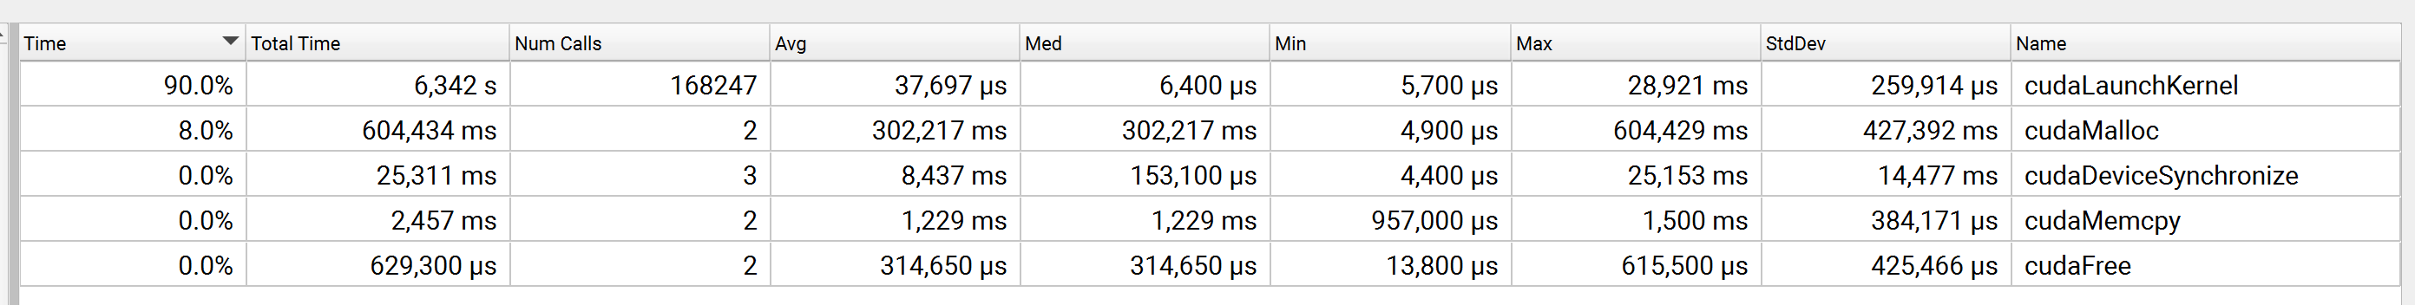
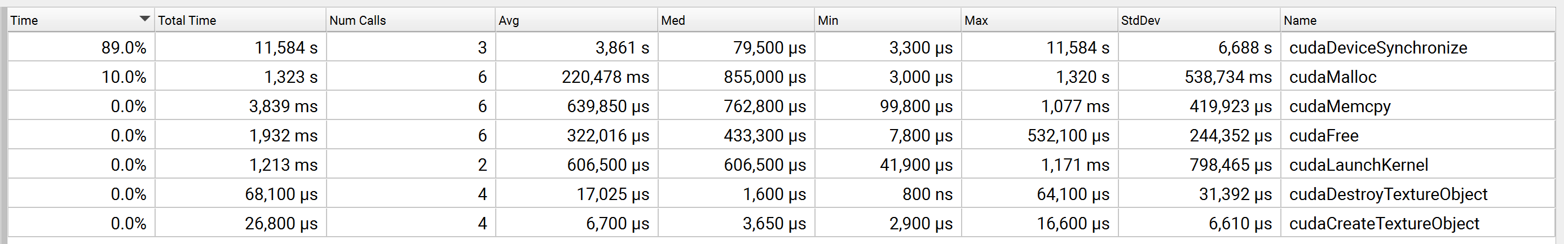
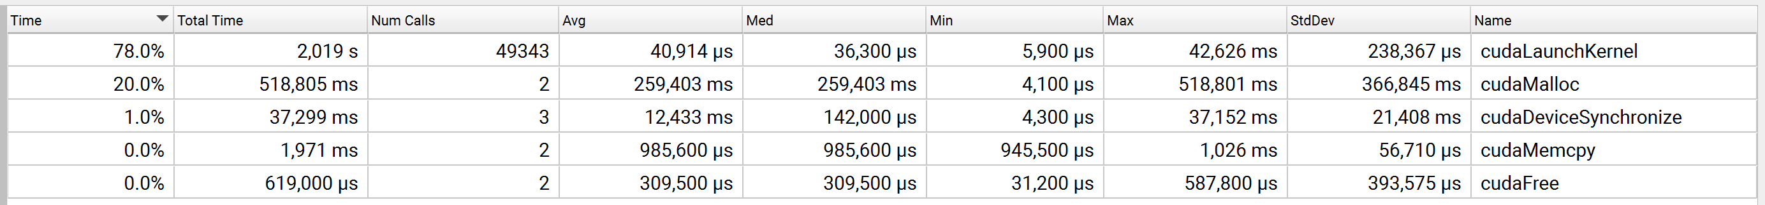
Profiling: kernel calls
Preprocess:
Read only:
4x4:

Slide 20
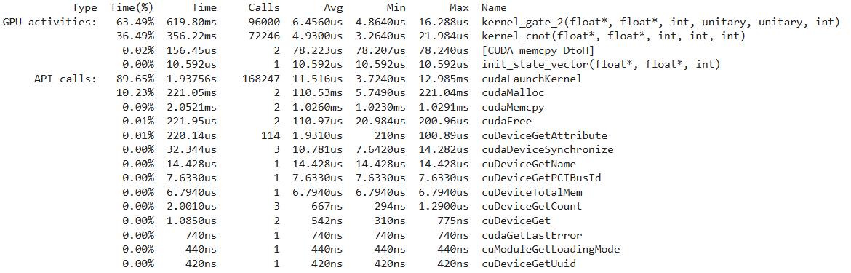
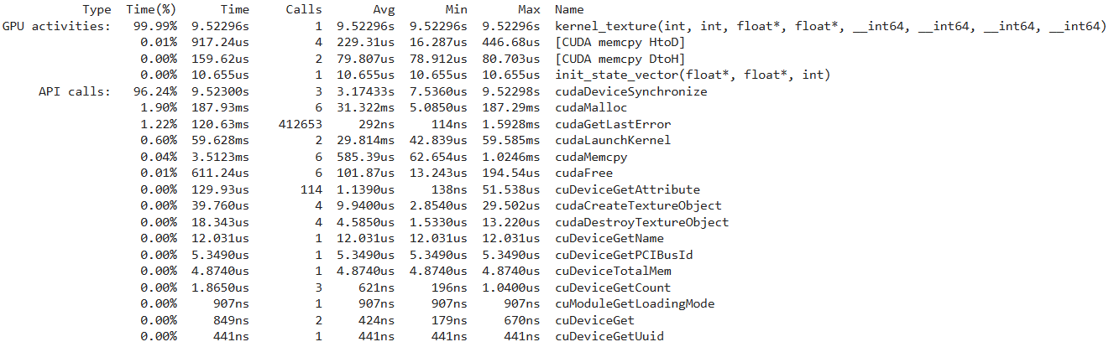
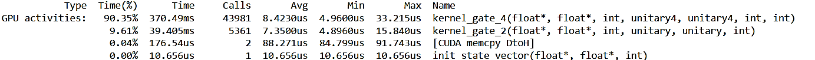
Profiling: kernel calls
Preprocess:
Read only:
4x4:

Slide 21
Execution time comparisions
■ CPU
■ Read only
■ Preprocess
■ 4x4

Slide 22
Execution time comparisions
Implementation | Speedup against CPU
CPU | 1
Naive Optimized | 37,82
Preprocess | 79,19
Preprocess 3in1 | 35,19
Read only | 73,37
Costant only | 20,63
Dynamic | 9,98
4x4 | 347,34
4x4 permute | 184,77
All tests are performed on 18 qubit to test slower algorithms too

Slide 23
Thank you for the attention!
Annechini Alessandro
Fiorentini Riccardo

Slide 25
- Preprocess
- Texture
- 4x4

Slide 26
- Preprocess

Slide 27
- Texture

Slide 28
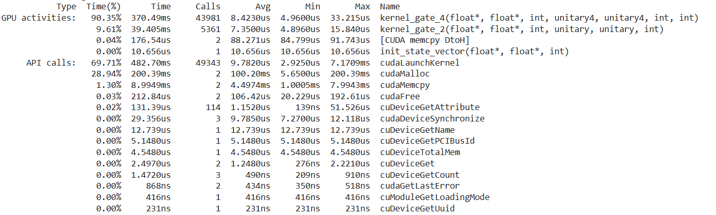
- 4x4

