Slide 1
GTZAN Genre Recognizer
VR450977
Fundamentals of Machine Learning
(A.Y. 2024/2025)

Slide 2
Dataset
GTZAN (well-known dataset)
1000 songs, 30 seconds each, 100 files for 10 genres
22050Hz, mono, 16bits, wav or au compression
Random split 70/15/15
5-fold cross-validation

Slide 3
Extracting features
Following state of the art directive (MIR = Music information retrieval)
MFCCs
Chroma
Spectral descriptors (contrast, centroid, bandwidth, rolloff)
Zero-crossing rate
Root Mean Square
BPM

Slide 4
Model used and hyperparameter
SVM (RBF)
C
γ
KNN
Neighbors #
Weights
RF
Estimators #
Max depth

Slide 5
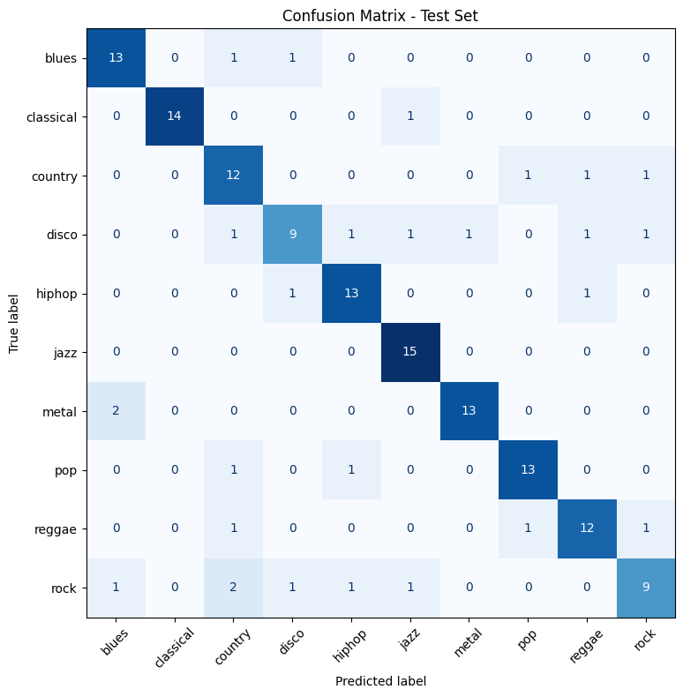
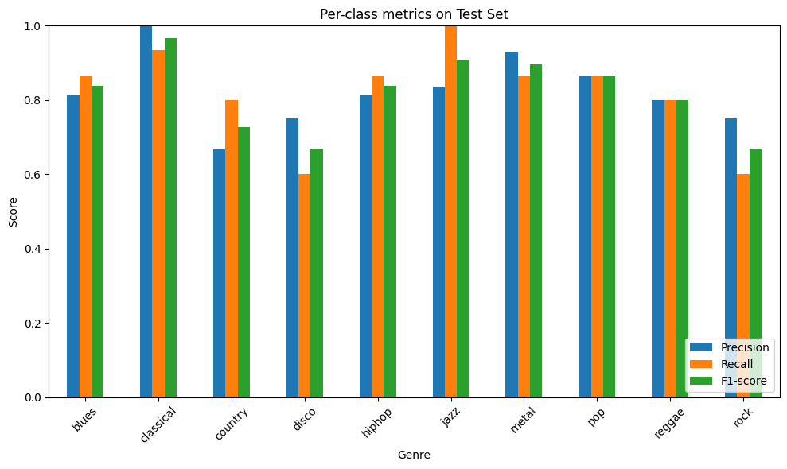
Result models (best) SVM-rbf with C=10, γ=0.01
Accuracy (validation) = 81.3%
Accuracy (test) = 82.0%

Slide 6
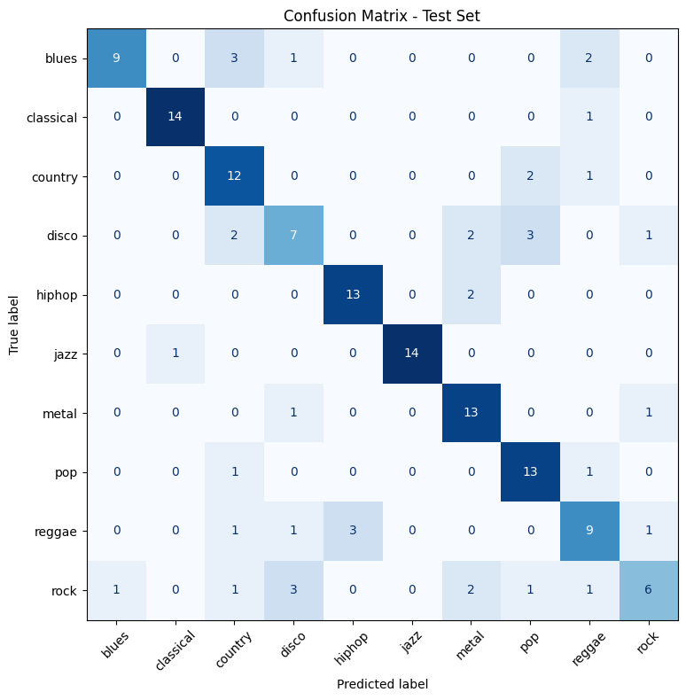
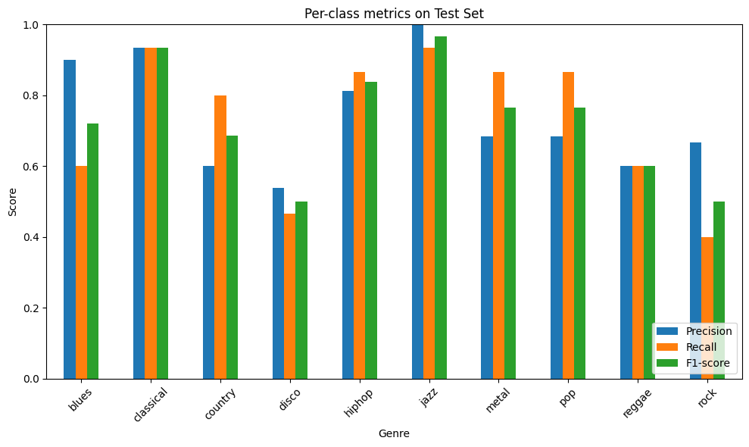
Result models (second) RF with Estimators=200, Max depth=10
Accuracy (validation) = 78.0%
Accuracy (test) = 72.0%

Slide 7
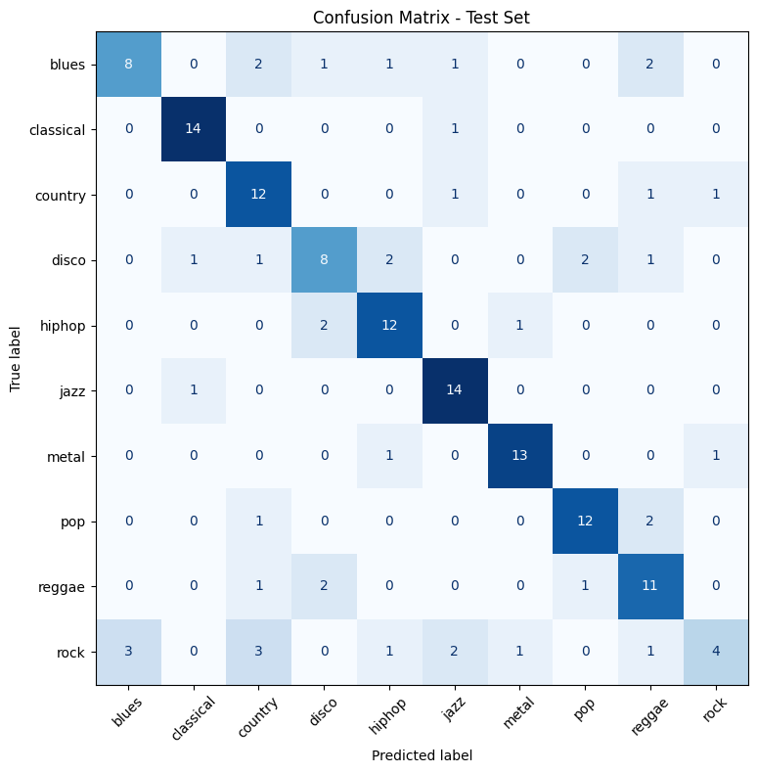
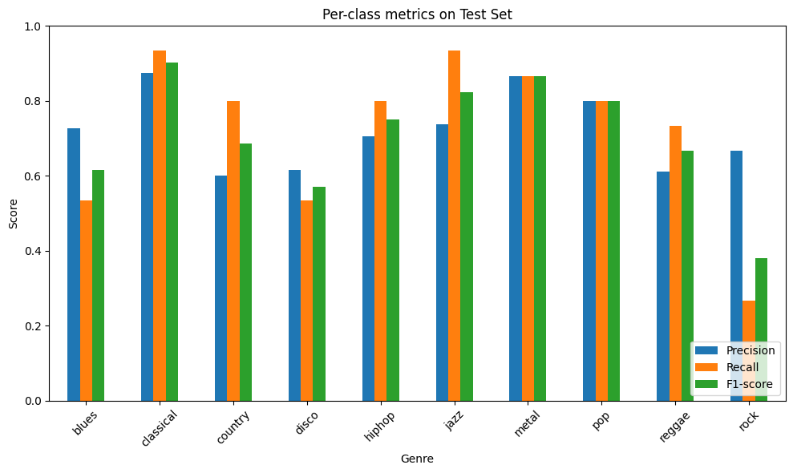
Result models (third) knn with k=7, distance=weighting
Accuracy (validation) = 71.3%
Accuracy (test) = 73.3%

