Slide 1
Parallel Triangle Counting Algorithms
Michele carloni - s338856
Riccardo revalor – s339423

Slide 2
Abstract
In our research we conducted a comprehensive analysis of various algorithms for triangle counting in graphs.
We’ve investigated the Forward algorithm, implemented with both node-centric and edge-centric iteration strategies. For each of these, we test two distinct data repre-sentations: an adjacency matrix and an adjacency vector. All Forward algorithm variants are evaluated across sequential, parallel C++ (CPU threads), and parallel CUDA (GPU threads) implementations.
Furthermore, we explore a third algorithm based on matrix multiplication, which is also implemented and benchmarked using both parallel C++ and parallel CUDA approaches. This work provides insights into the performance characteristics and scalability of these diverse methodologies for triangle enumeration.

Slide 3
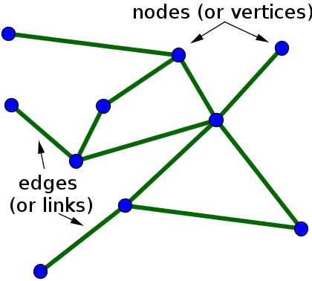
The Basics
Suppose that we have at our disposal a given graph G = (V, E ), where G is the graph itself, V denotes the set of all vertices (also called nodes), and E represents the set of edges (also called links or arcs). An edge connects two nodes between them.
The primary goal is to detect and count the number of triangles that can be formed inside the graph. More specifically, a triangle in graph G = (V, E ) is a set of three distinct vertices {u, v, w} ⊆ V such that the edges (u, v), (v, w), and (w, u) all exist in the set of edges E .

Slide 4
Node Iterator/Forward Node Iteator
The simplest and most naive version of the Node Iterator Algorithm iterates over all nodes in the graph and for each pair of neighbors of each node, checks whether they are connected by an edge and they share a common neighbor.
We implemented the Forward Algorithm (in various versions: sequential, parallel, CUDA) using these following strategies:
1) Graph Representation: adjacency matrices (implemented as std::vector<std::vector<int») and adjacency lists (implemented as std::map<int,std::vector<int» to handle potentially sparse or non-contiguous node IDs).
2) Auxiliary Sets: used to store a specific subset of neighbors for each node (std::vector<std::set<int»). Intersected to identify the third vertex composing each triangle.
3) Ordering/Rank: crucial for pruning and to guarantee that each triangle is counted exactly once

Slide 5
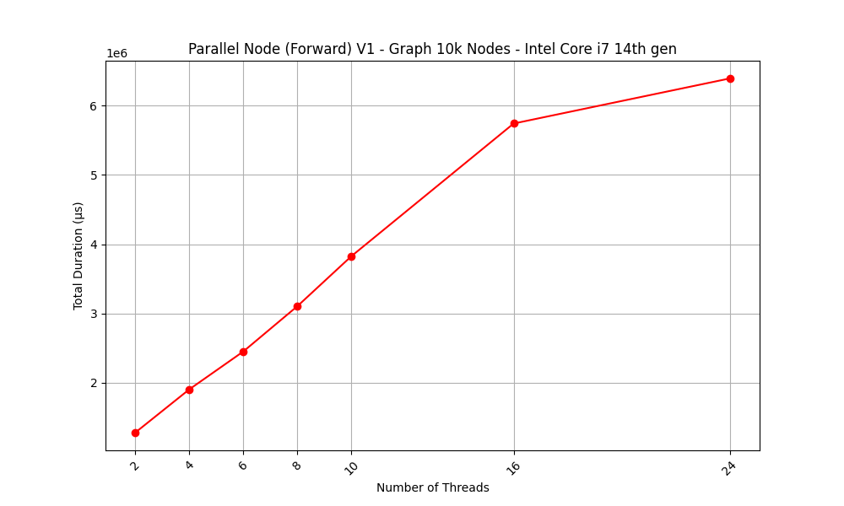
Parallel (C++) Forward Node Iteator Algorithm, V1
In the first version of the algorithm, more naive and simple case, the part that gets parallelized is the Forward algorithm function. More in detail, the outer loop that iterates through the nodes in the ordered list is still sequential, running N times, but the iteration over each node neighbors t is parallelized: this is achieved by dividing the neighbors of s into chunks, with each chunk processed by a separate worker thread.
Using multiple threads with mutexes to operate on shared data is often counterproductive. The mutexes force the operations to run one after another (serially), which eliminates the speed advantage of using parallel threads. Also, the process of creating and managing the threads adds its own computational overhead, further slowing down the entire process.

Slide 6
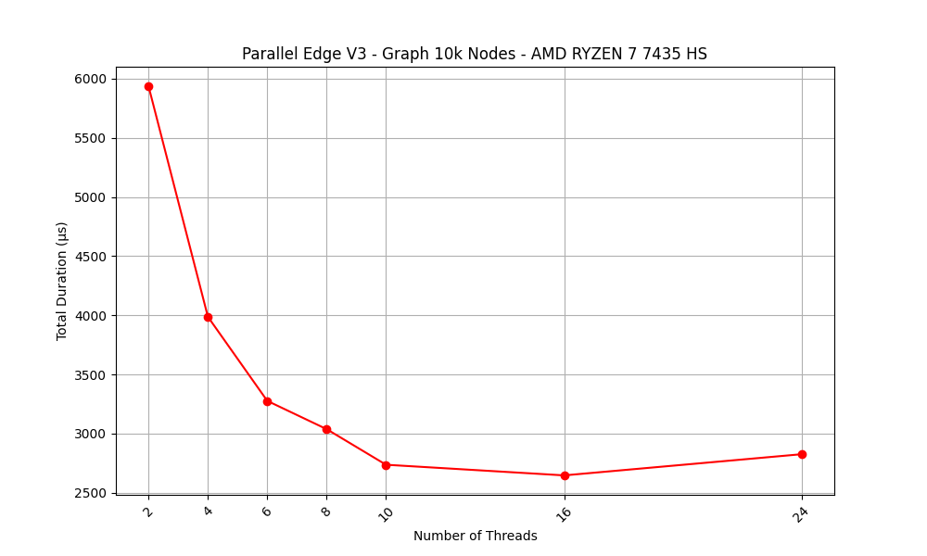
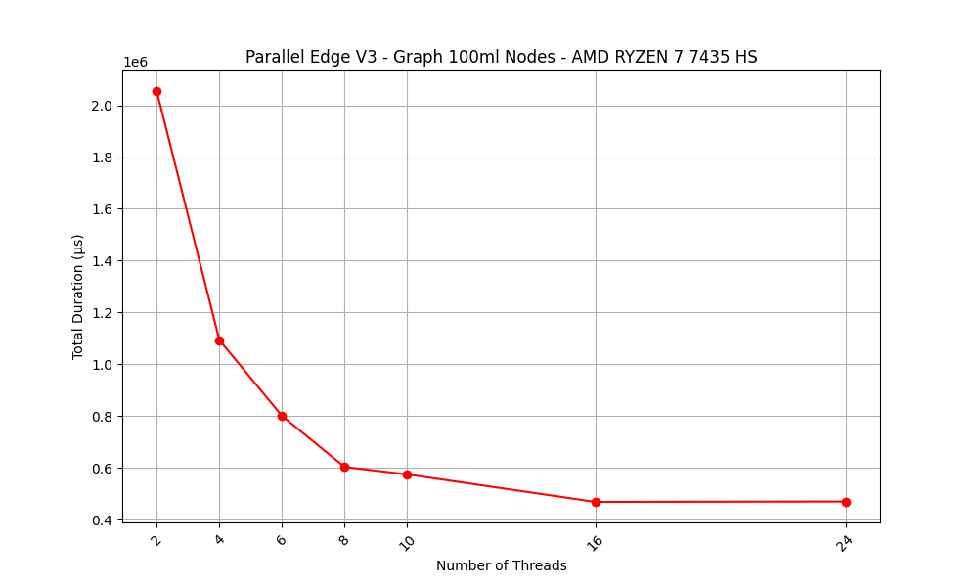
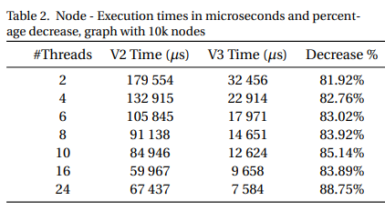
Parallel (C++) Forward Node Iteator Algorithm, V3 (Final Version)
The final version of our algorithm is the most efficient and scalable. Amdahl’s Law states that the speedup of a program from parallelization is limited by the sequential fraction of the program. The new algorithm has a much smaller sequential fraction.
We parallelized the whole algorithm (not just the inner loop), resorted to C++ std::async tasks, and thread-local counts were used to eliminate contention between them (mutexes not needed anymore). Each worker processes a chunk of nodes. The core algorithm was also rewritten using a Merge Like approach for fast intersection of the two neighbors vectors. std::unordered_set, which dramatically improved data lookup speeds from O(logN) to an average of O(1) and made memory usage more efficient.
We immediately see the scalability issues are solved: if we increase the thread number, the execution time always gets lower. This also represents a substantial performance gain over the first versions, with a time reduction of approximately 82-89% observed across all thread configurations for a 10k node graph.

Slide 7
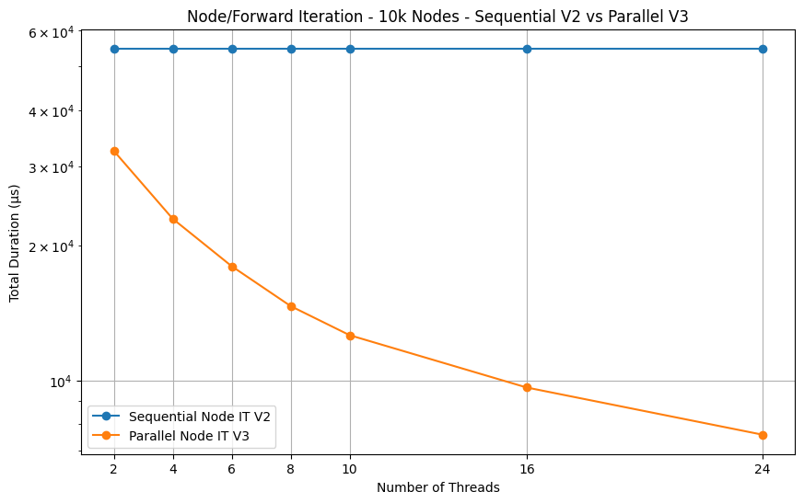
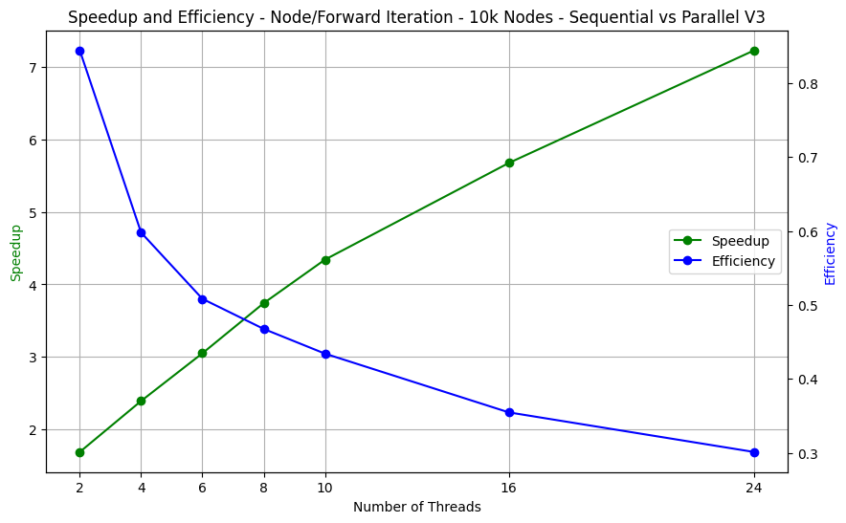
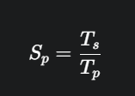
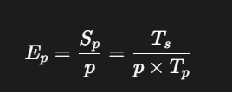
Node Iterator Algorithms, final comparison
The final version of the Node Iterator (Forward) algorithm always beats the sequential version, and if we add up more threads, the speedup keeps increasing, because the execution time gets lower.
Speed-up
Efficiency (p = numThreads)

Slide 8
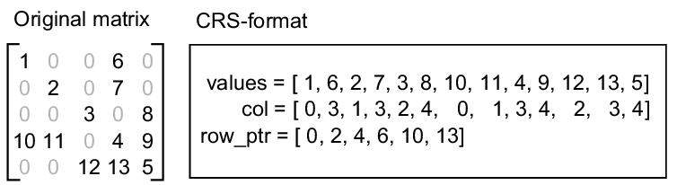
CUDA Parallel Forward Node Algorithm V1
The Forward Algorithm was adapted to run on GPUs using CUDA, leveraging their massive parallelism to significantly speed up processing for large graphs. To achieve this, the graph's data is converted into a GPU-optimized Compressed Row Storage (CRS) format. This dense storage format is well suited for coalesced memory access.
The core of the algorithm is performed inside the ForwardAlgorithmKernel kernel function, where we assign each GPU thread to a graph node. Within the function, the approach to identify a potential triangle formed by vertices (s, t, v) remains the same as with the C++ versions. To handle concurrent updates to the global triangle counter from multiple threads, the atomicAdd function is used.
This strategy is heavily dependent on the configuration of its launch parameters, particularly the blockSize, which serves as a critical hyperparameter for performance tuning. Since, in current architectures, a warp is composed of 32 threads, using multiples of 32 can result in the block containing an exact number of full warps, so the GPU can schedule them more efficiently.
values contains all the non-zero elements read row-by-row from the original matrix; col stores the corresponding column index for each element in the values array; and row_ptr indicates the starting index in the values and col arrays for each row's data

Slide 9
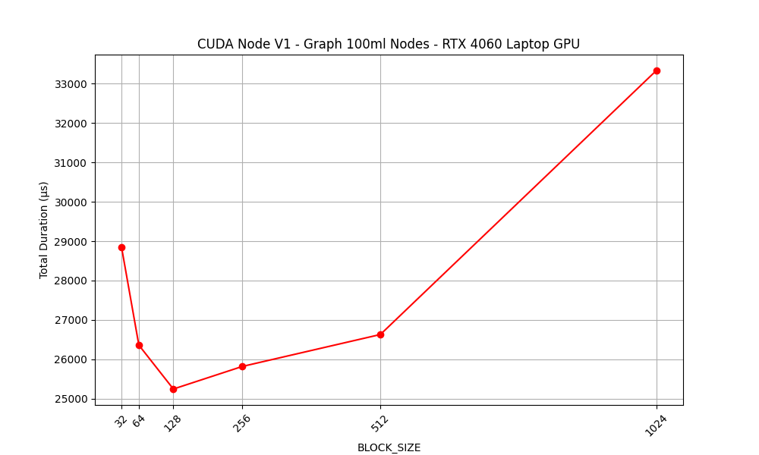
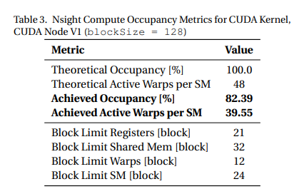
We can see that the best performance is achieved setting blockSize to 128, resulting in approximately 25 ms of execution time (this includes also the time spent copying data using from the Host to the Device using the PCIe buffer). Then, the execution time significantly worsens as the size of a block increases to 256, 512, and 1024. In facts, when blockSize is small to moderate (i.e. 64 or 128) the blocks are "lightweight" and many can be scheduled simultaneously on an SM. This leads to high occupancy. In facts, we almost saturate the SM (achieving an excellent occupancy of 82.39%)

Slide 10
CUDA Parallel Forward Node Algorithm V2
The second version of the algorithm introduces a much faster, merge-like method to find triangles using two pointers. This new approach is a major algorithmic improvement over a simple nested loop, significantly cutting down on computation.
However, this method creates a GPU-specific bottleneck called warp divergence. This happens when threads in the same execution group take different if-else paths in the code, forcing the GPU to run them one by one and reducing the benefits of parallelism.
Despite this, the new algorithm is a substantial upgrade, even though its full speed is sometimes limited by this divergence.

Slide 11
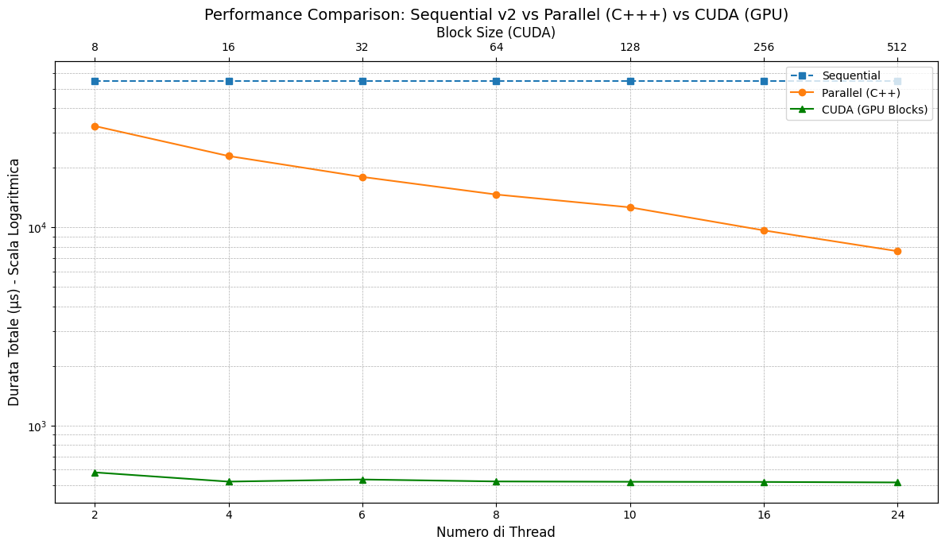
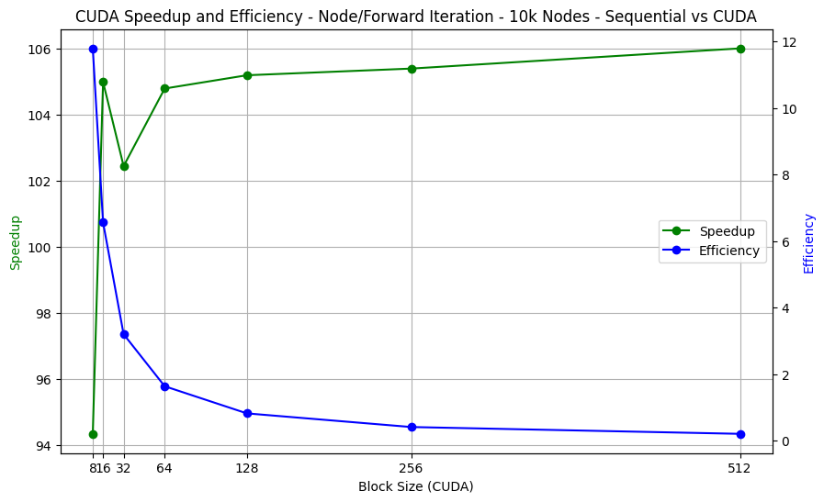
CUDA Parallel Node: Final comparison

Slide 12
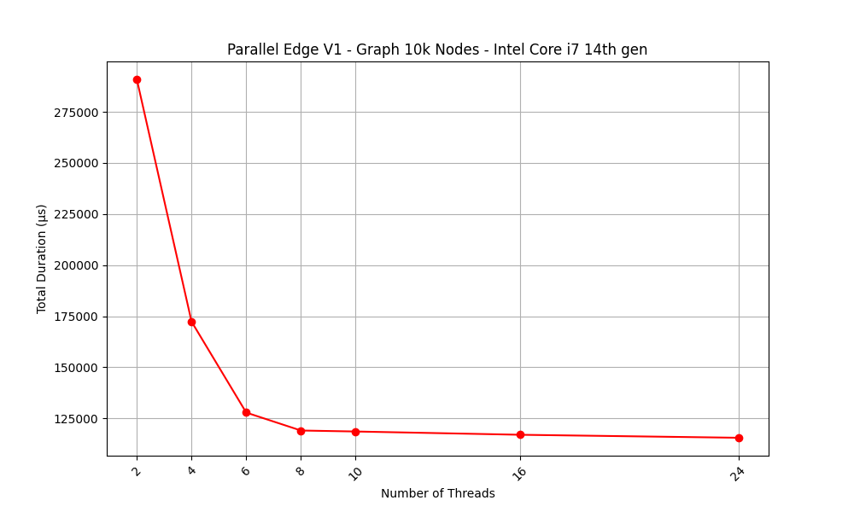
Parallel Forward Edge Iterator V1
In this more naive version (Parallel Edge V1), we parallelize the outer loop that iterates over each edge. We distribute the edges among threads, and each thread is responsible for processing its assigned chunk. For a given edge (s,t), the thread finds common neighbors by performing a naive nested-loop intersection on the neighbor lists of s and t. This method of finding common neighbors has a worst-case time complexity of O(d(s) · d(t)) per edge, where d(s) and d(t) are the degrees of the vertices. The total count of triangles is managed using an std::atomic, which significantly reduces contention compared to using mutexes. However, as shown in our experimental tests, the effectiveness of this approach is highly dependent on the graph size.

Slide 13
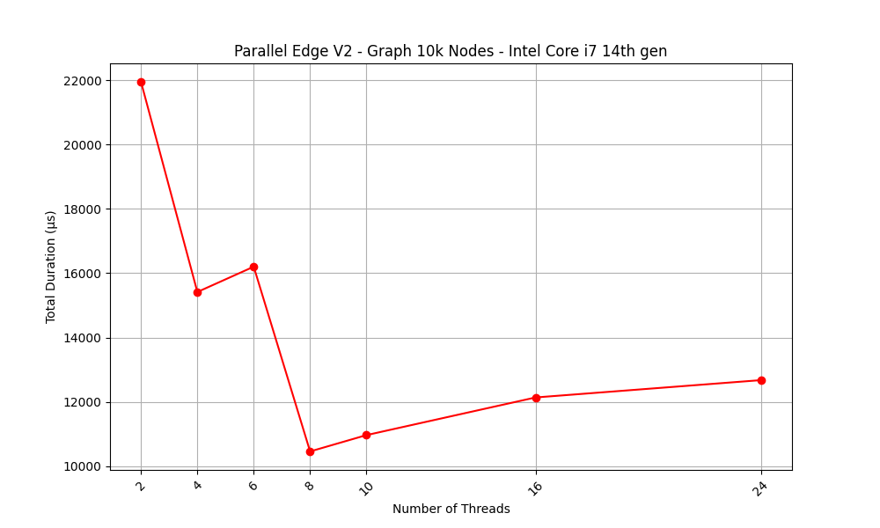
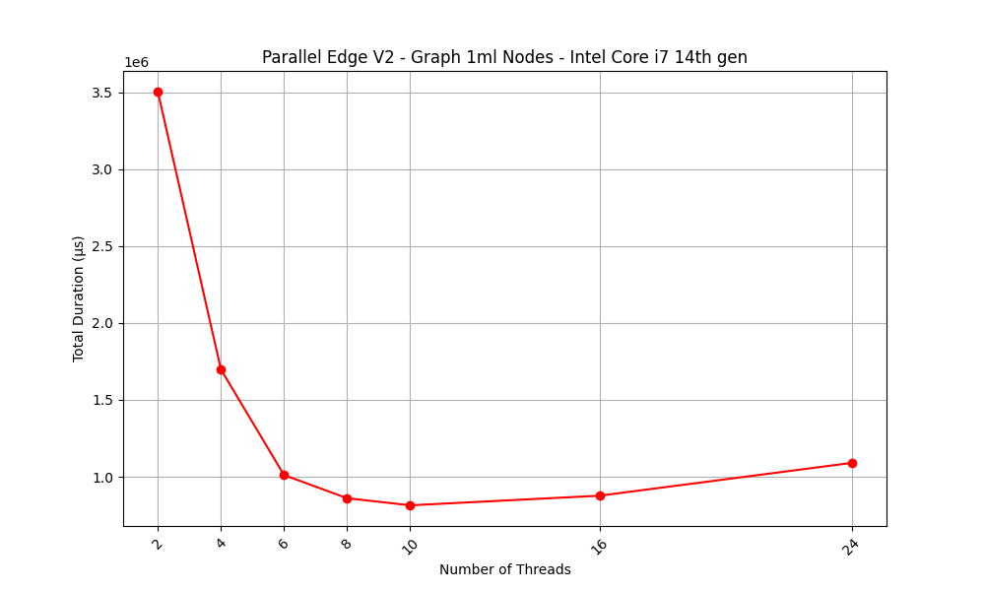
Parallel Forward Edge Iterator V2
This version uses an adjacency list representation and employs a crucial preprocessing step to ensure all neighbor lists are sorted. With sorted lists, each thread can find the common neighbors for its assigned edges using a two-pointer merge-like algorithm, which has a linear time complexity of O(d(s) + d(t)). This significant improvement in the intersection process allows the algorithm to achieve a speedup proportional to the number of threads used, P, with very low synchronization overhead from the std::atomic variable.
On a 10k-node graph, we observe a dramatic and consistent drop in execution time as the number of threads increases, with an optimal point around 8 threads. The performance is consistently better than the V1 version on the same graph, demonstrating that the linear-time intersection is far superior to the naive nested-loop approach.
The scaling benefits of the V2 algorithm become even more apparent on extremely large graphs. For a graph with 1 million nodes, the performance curve shows a near-linear decrease as the number of threads increases up to 8. This indicates a near-perfect parallel speedup where the workload is large enough that the benefits of parallelization far outweigh the overhead.

Slide 14
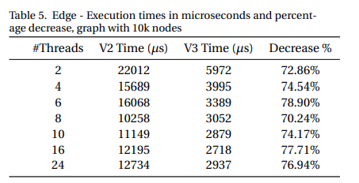
Parallel Forward Edge Iterator V3
This highly optimized version of the Edge Algorithm incorporates several key enhancements for maximum performance.
First, it uses std::unordered_map for data storage, which provides near-instantaneous O(1) average lookup times, a significant improvement over the O(logN) of previous versions. For parallelism, it uses std::async to create tasks managed by the OS. Crucially, each thread uses a local triangle counter, completely eliminating the need for slow synchronization tools like mutexes or atomic operations. ⚡
Further optimizations include:
1) A fast two-pointer intersection method to find common neighbors on pre-sorted lists.
2) Pre-filtering edges at the start to remove redundant checks from the main loop.
3) Passing data by constant reference (const &) to avoid expensive data copying between threads.

Slide 15
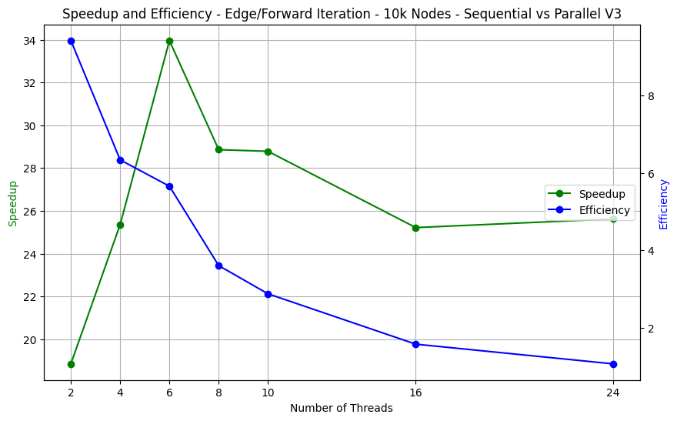
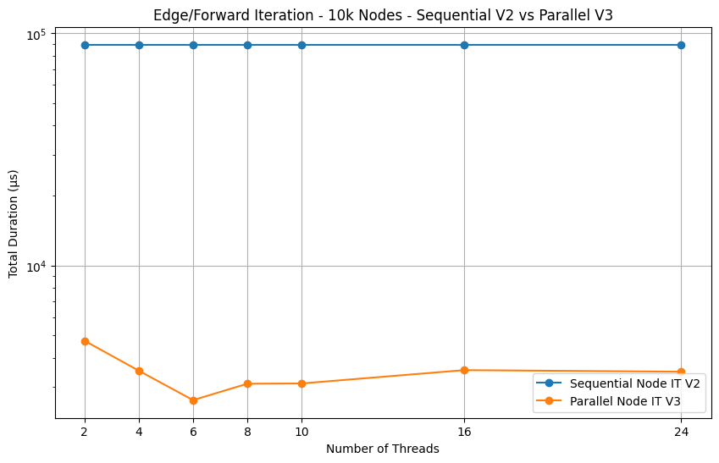
Comparison between Parallel Edge v3 and sequential version

Slide 16
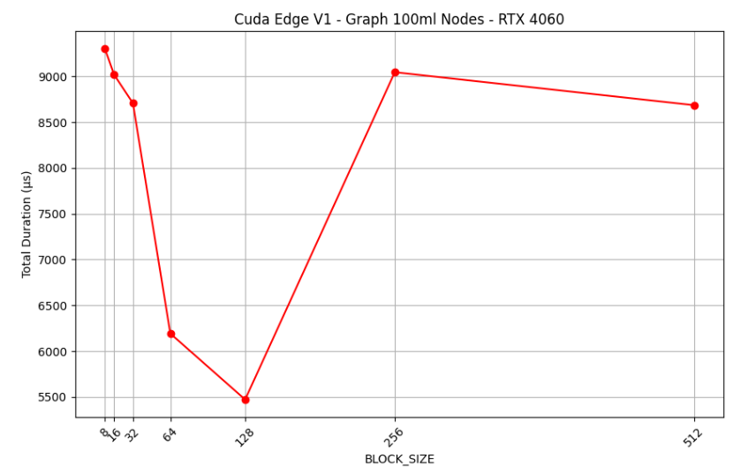
CUDA Parallel Forward Edge Iterator V1
The Forward Edge Iterator has also been implemented in CUDA, similar to the Forward Node Algorithm. It uses the CRS (Compressed Row Storage) format to represent the graph data. The implementation assigns one thread to manage one edge, handled through the function EdgeIteratorAlgorithmKernel. Since each edge connects two nodes in the graph, the function iterates over the neighbors of both nodes, and whenever two neighbors match, a new triangle is counted.

Slide 17
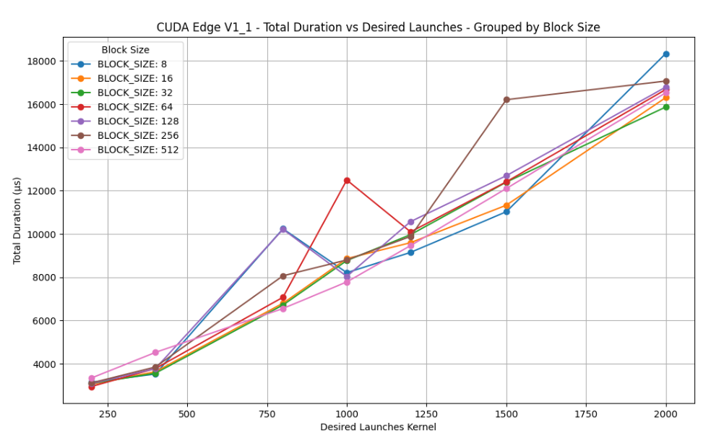
CUDA Parallel Forward Edge Iterator V1_1
The V1_1 version builds directly on the original CUDA Forward Edge Iterator. The core function (EdgeIteratorAlgorithmKernel) remains unchanged. The key modification is in how edges are assigned: Instead of one thread handling exactly one edge, the full edge set is divided into chunks, with each thread responsible for one chunk. This design aims to improve GPU resource utilization and reduce latency by lowering the number of tasks the scheduler must manage in parallel.

Slide 18
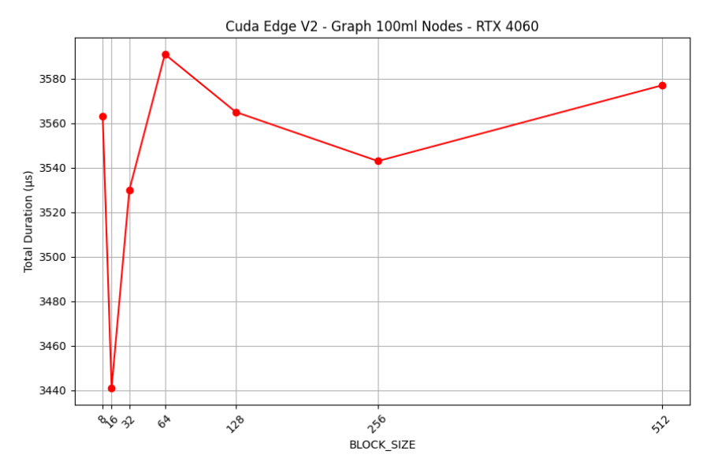
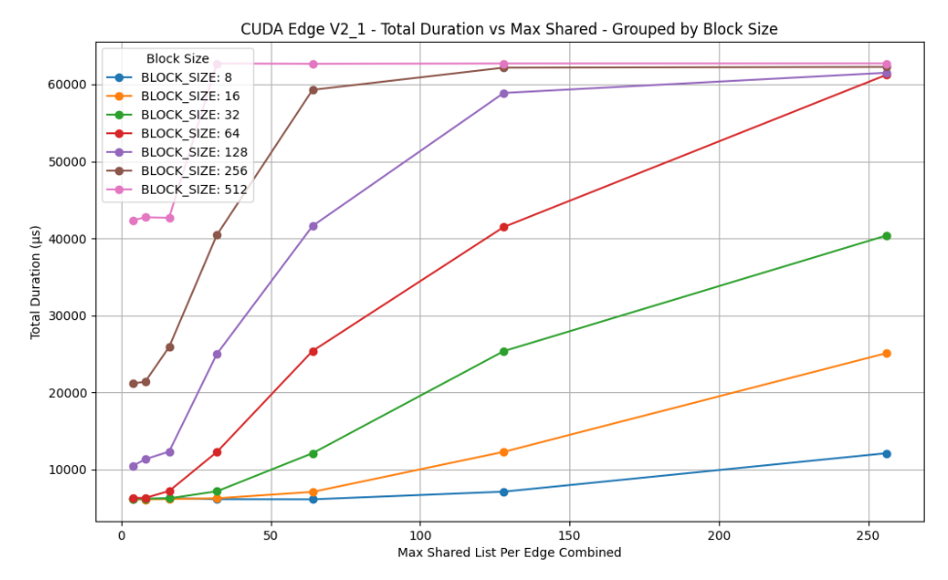
CUDA Parallel Forward Edge Iterator V2, V2_1
Unlike V1, the V2 CUDA Edge Iterator uses a two-pointer merge-like algorithm for neighbor intersection with linear complexity (d(u) + d(v)). Each thread still processes one edge, and all edges are handled in a single kernel launch, which greatly improves efficiency, especially for high-degree nodes.
The V2_1 CUDA Edge Iterator extends V2 by adding a shared memory optimization. Instead of one thread per edge, each block manages a single edge. Threads cooperatively load the adjacency lists of the edge’s endpoints into shared memory, synchronize, and then a single thread performs the two-pointer merge-like intersection on this faster local data. This reduces global memory latency when neighbor lists fit in shared memory.

Slide 19
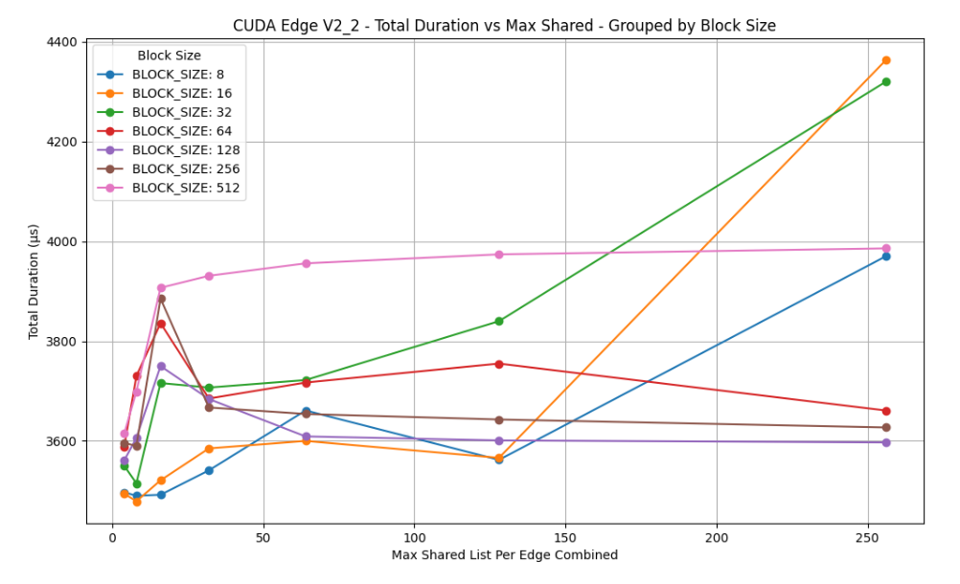
CUDA Parallel Forward Edge Iterator V2_2
The V2_2 CUDA Edge Iterator keeps the two-pointer merge-like algorithm and also uses shared memory, but with a different mapping than V2_1. Here, one thread manages one edge (like V2), but each thread tries to load its edge’s adjacency lists into a dynamically allocated portion of shared memory before performing the intersection. This allows multiple edges to be processed in parallel within a block, each gaining faster access if their lists fit in memory.

Slide 20
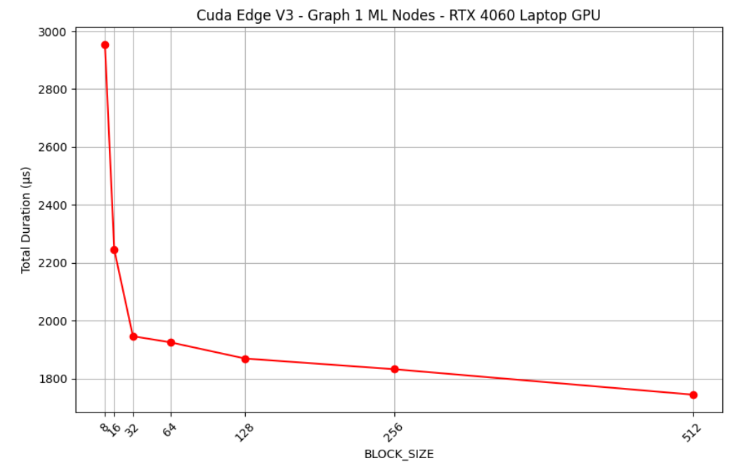
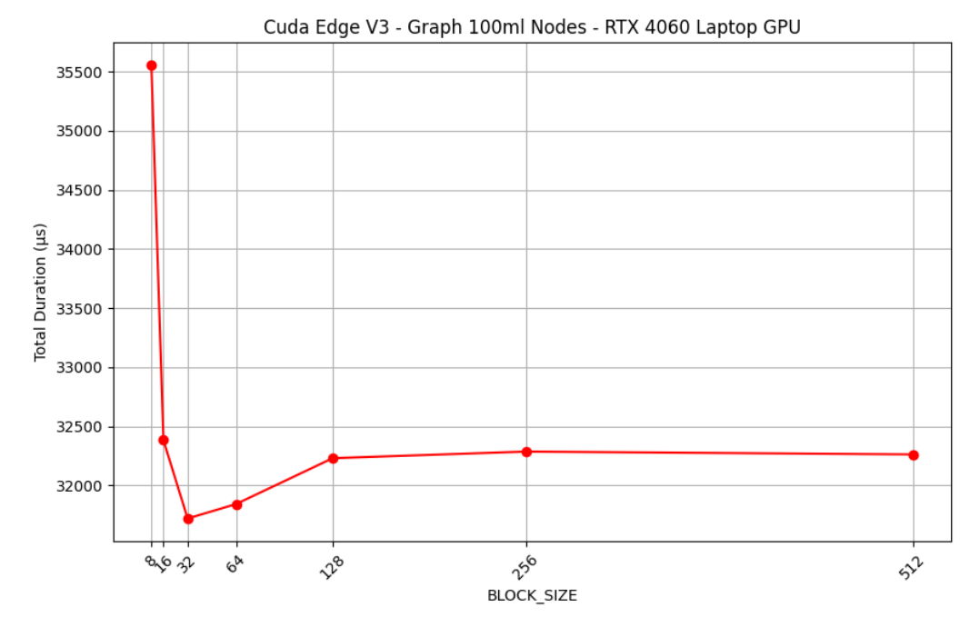
CUDA Parallel Forward Edge Iterator V3
The V3 CUDA Edge Iterator addresses the scalability issues of previous versions, where larger block sizes caused performance degradation. V3 introduces a dynamic work queue for edge iteration: threads fetch new edges from a global queue as they finish previous work. This improves load balancing, since threads handling lighter edges can continue working instead of remaining idle, leading to better resource utilization.
A hybrid variant (V3_1) combines static block assignment with dynamic scheduling inside each block using shared memory, reducing execution time by ~15% (from 35 ms to 30 ms at BLOCK_SIZE = 8).

Slide 21
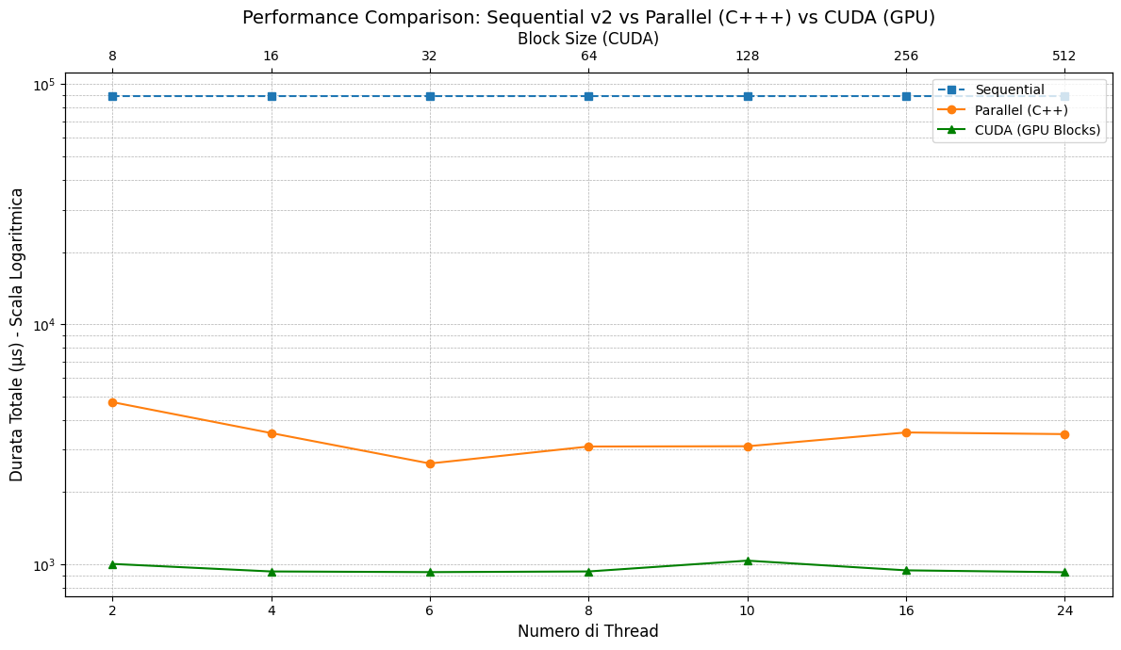
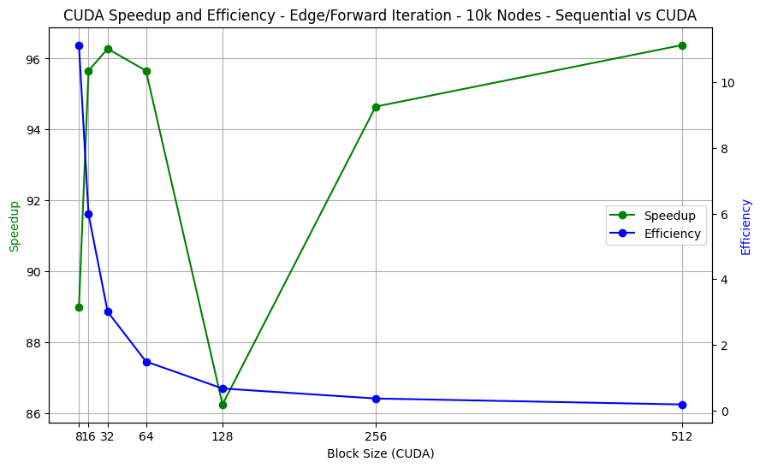
CUDA Parallel Edge V3: final comparison

Slide 22
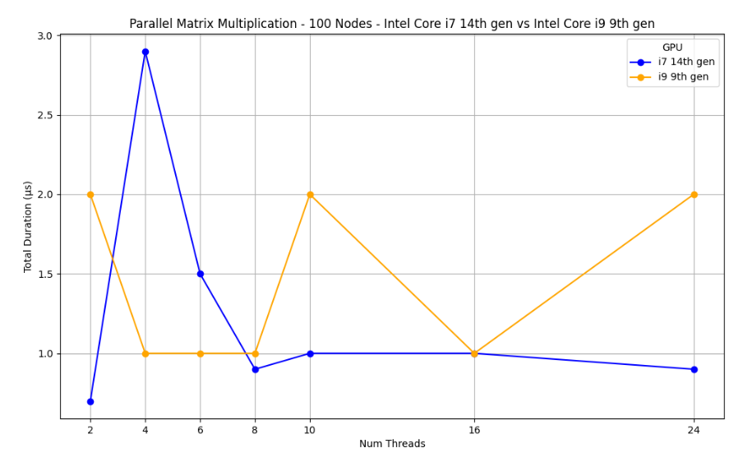
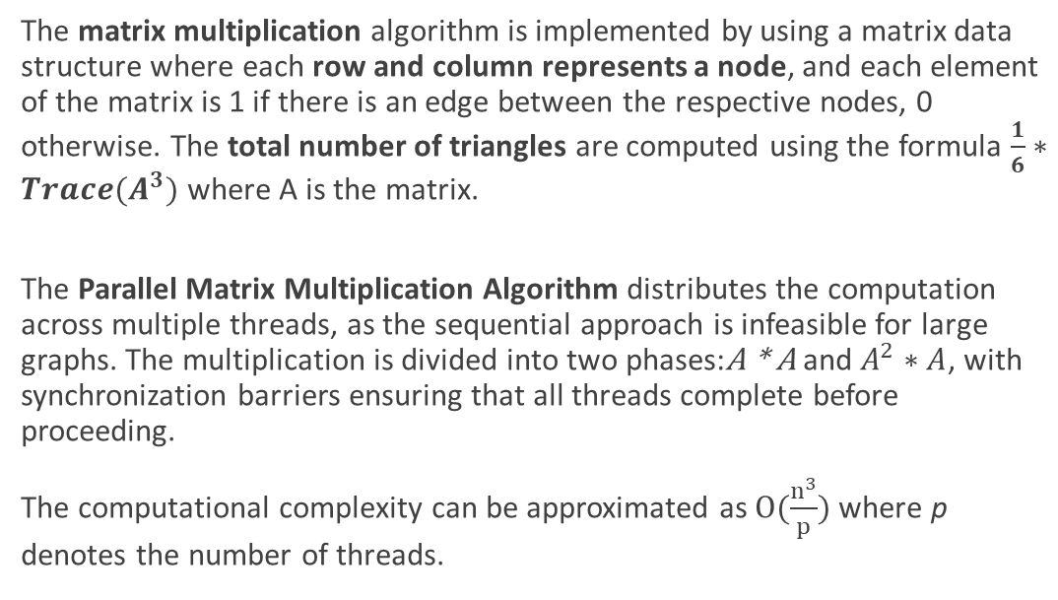
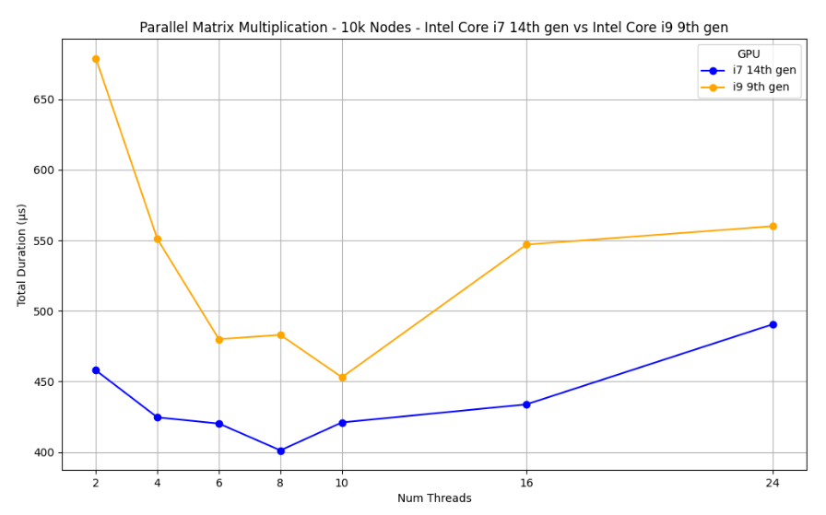
Parallel (C++) Matrix Multiplication Algorithm
fffffff

Slide 23
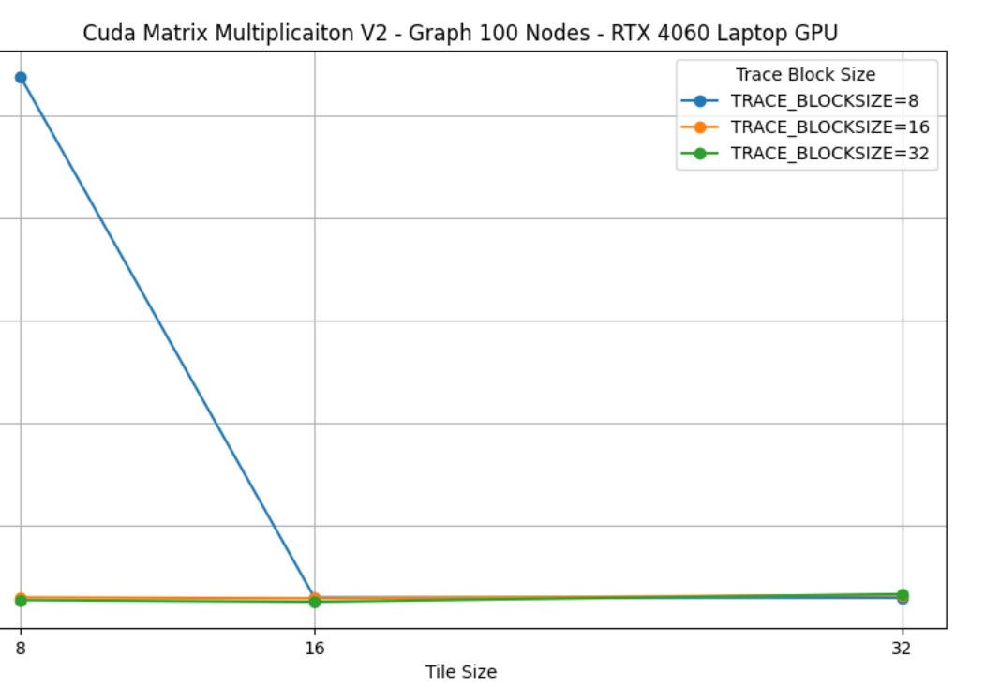
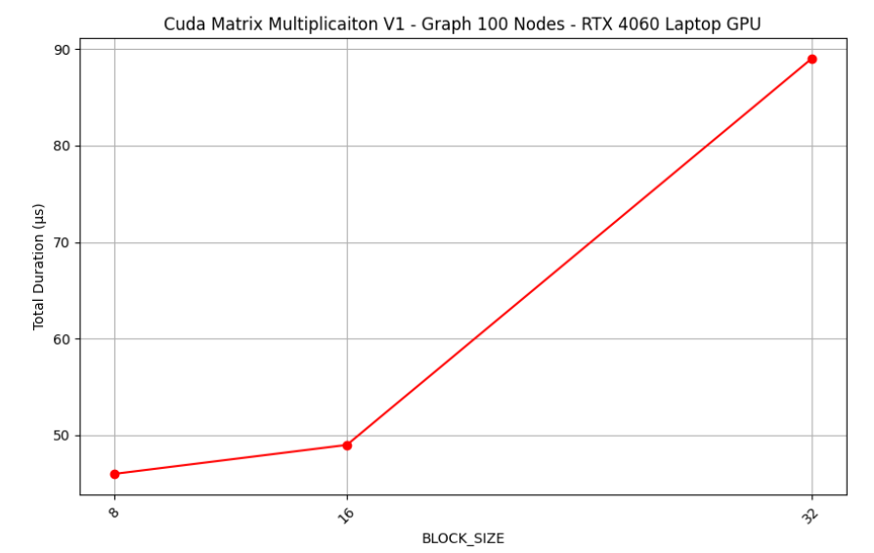
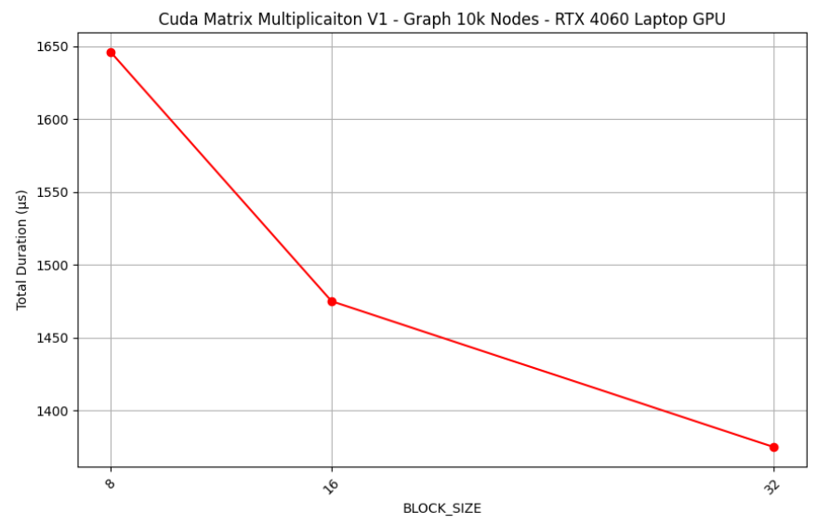
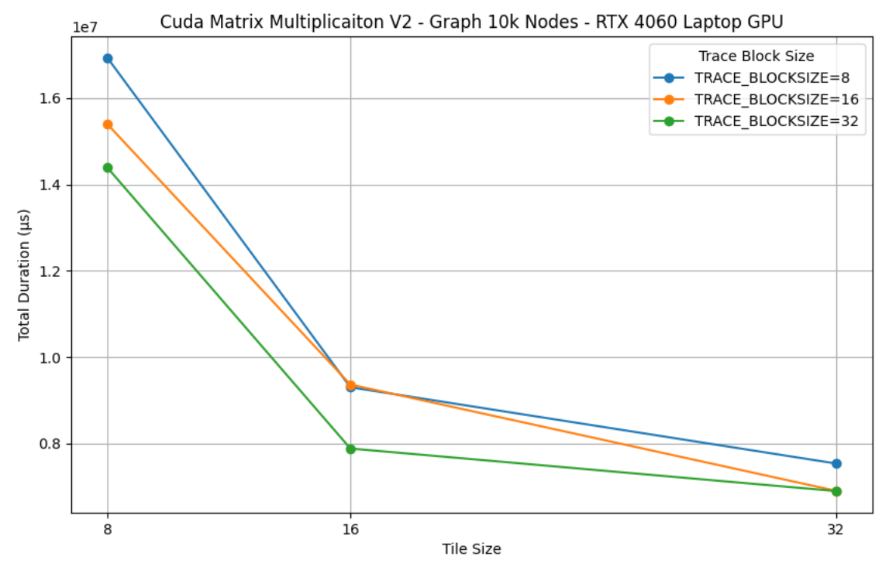
CUDA Parallel Matrix Multiplication V1, V2
In the V1 version, the algorithm assigns each GPU thread to compute one output matrix element via a dot product. Its primary performance bottleneck is inefficient memory access. Specifically, uncoalesced global memory reads from the second input matrix severely limit memory bandwidth.
The V2 algorithm dramatically improves performance by using a tiled strategy that leverages the GPU's fast shared memory. Instead of numerous slow global memory reads, each thread block first cooperatively loads sub-matrices (tiles) into this on-chip shared memory. After synchronizing, all threads perform their calculations using this much faster local data.
This approach is highly efficient because it dramatically reduces global memory traffic and maximizes data reuse from the fast shared memory. Overcomes the primary performance bottleneck found in the V1 algorithm. The TILE_SIZE is the crucial tuning parameter, which dictates the size of these sub-matrices. TRACE_BLOCKSIZE is another hyperparameter which can affect the performances, influencing the second kernel function (trace comp)

