Slide 1
Big Data Analytics and Text Mining Project
Testing GraphAny on a RelBench task
Riccardo Romeo
University of Bologna

Slide 2

01
The Context

Slide 3
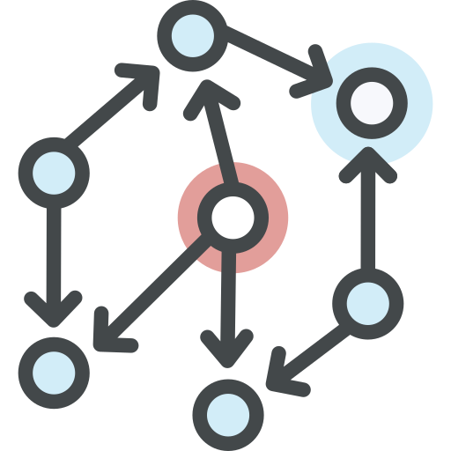
GraphAny
A fully-inductive Node Classification on Arbitrary Graphs
It is trained to perform node classification on:
Any graph.
With any feature.
With any number of labels.
Totally Inductive Node Classification!

Slide 4

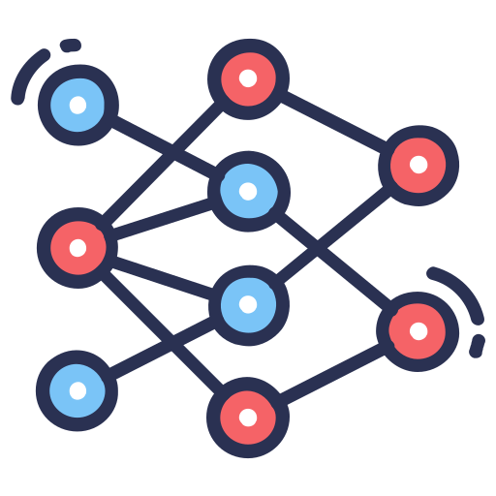



Some other fancy aspects
GraphAny is a young model, (june 2024 on Arxiv)!
Built on only 5 LinearGNNs!
And the number of parameters?
Tested on 27 datasets.
4 different checkpoints available.

Slide 5
RelBench
Open benchmark for machine learning over relational databases
Full of interesting tasks to perform on relational graphs
More importantly: we have some Binary Node Classification Tasks!

Slide 6


Project Idea
Import a task from RelBench and test GraphAny on it!
But How?

Slide 7

02
The Approach

Slide 8

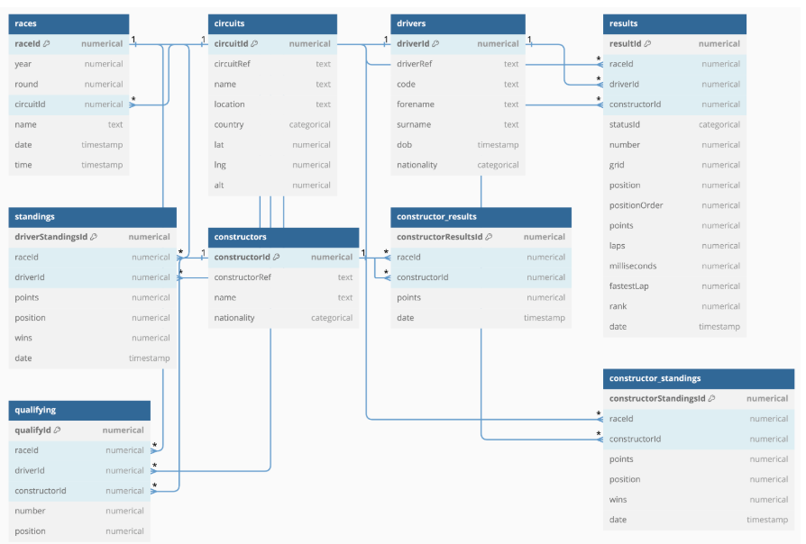
The choice: F1 Database
The smallest dataset with a node classification task.
The task: For each driver predict if they will DNF (did not finish) a race in the next 1 month

Slide 9
The HeteroGraph problem
HeteroData(
constructor_standings={
tf=TensorFrame([13051, 4]),
time=[13051],
},
results={
tf=TensorFrame([26080, 11]),
time=[26080],
},
circuits={ tf=TensorFrame([77, 7]) },
drivers={ tf=TensorFrame([857, 6]) },
races={
tf=TensorFrame([1101, 5]),
time=[1101],
},
standings={
tf=TensorFrame([34124, 4]),
time=[34124],
},
qualifying={
tf=TensorFrame([9815, 3]),
time=[9815],
},
constructors={ tf=TensorFrame([211, 3]) },
constructor_results={
tf=TensorFrame([12290, 2]),
time=[12290],
}
Different nodes with different features…
Solution: Linearization and Glove embedding!

Slide 10

03
Experimental Setup

Slide 11
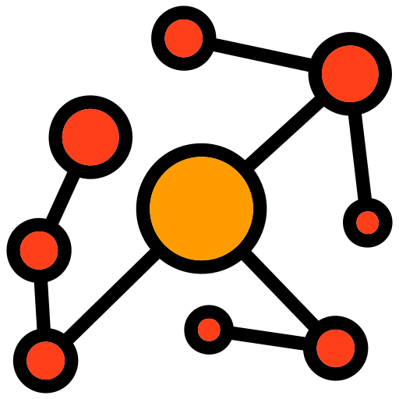
Our Dataset
A HUGE Knowledge Graph:
97605 nodes.
455432 edges.
but only 3 labels.

Slide 12

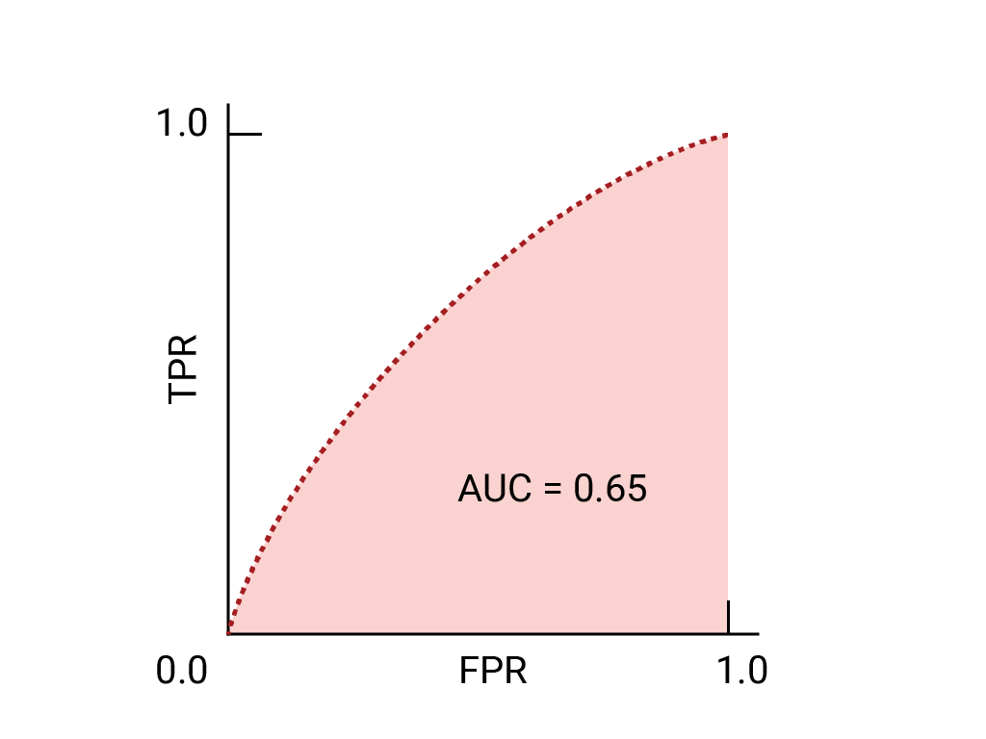
The Metrics
F1-Score
2. Binary ROC AUC
3. One-vs-rest ROC AUC

Slide 13

04
The
Results

Slide 14
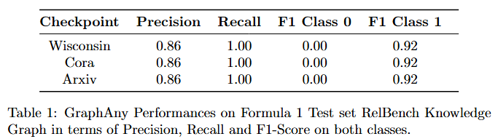
GraphAny performances on Task
Precision, Recall and F1 per class.

Slide 15
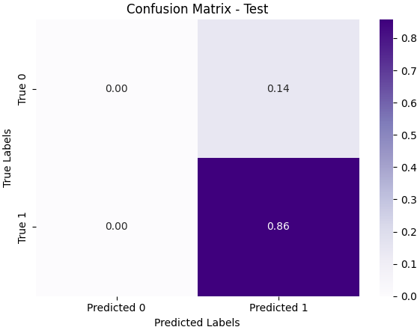
GraphAny performances on Task
Confusion Matrix.

Slide 16
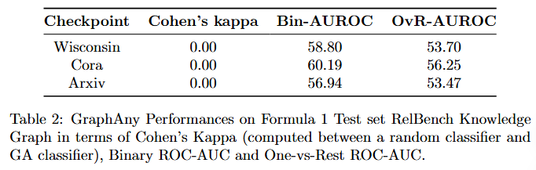
GraphAny performances on Task
Cohen’s Kappa Score, Binary ROC-AUC and One-vs-Rest ROC-AUC.

Slide 17
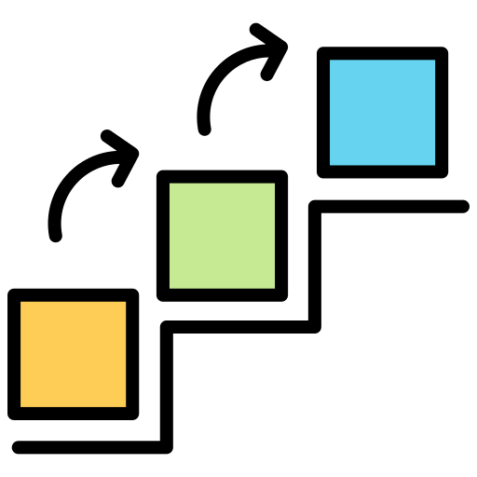
05
Future
Project
Improvements

Slide 18


Some critical aspects
We tested the model on only one task.
We tested the model on only one dataset.
Our metrics could be biased by the task choice!

Slide 19

Thank you for your attention!

