Slide 1
OPEN OPTICAL NETWORK LABoratory
OPEN OPTICAL NETWORK master degree course 2019/2020
The line system
ANDREA D’AMICO – ANDREA.DAMICO@polito.it

Slide 2
The line system

Slide 3
Line system
A Line System is defined as a sequence of Fibers and Optical Amplifiers
OA
OA
OA
SET GAIN
NOISE FIGURE
OA
OPERATION MODE
SET OUTPUT POWER
ATTENUATION COEFFICIENT
LENGTH
Fiber
DISPERSION
NONLINEAR COEFFICIENT

Slide 4
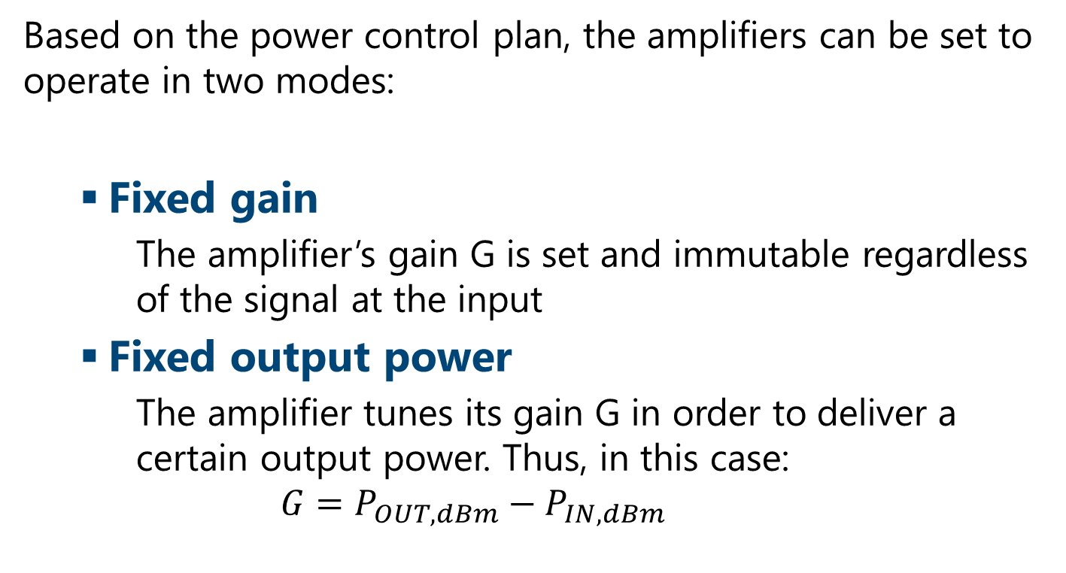
Amplifier’s working mode
Based on the power control plan, the amplifiers can be set to operate in two modes:
Fixed gain
The amplifier’s gain G is set and immutable regardless of the signal at the input
Fixed output power
The amplifier tunes its gain G in order to deliver a certain output power. Thus, in this case:
$$G=P_{OUT,dBm}−P_{IN,dBm}$$

Slide 5
Power control
In the line system abstraction we define a POWER CONTROL PLANE which sets the working point of the amplifiers
Different strategies can be set for the power control, for example:
Transparency: amplifiers recovery exactly the previous span loss
Custom Output Power: set the amplifiers to always output a certain total power.
LOGO: input power of each fiber span is set in order to minimize NLI

Slide 6
SNR

Slide 7
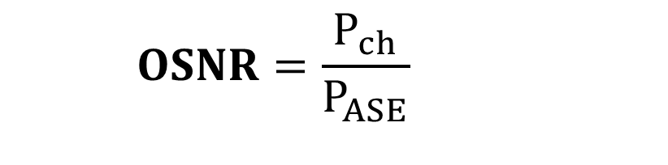
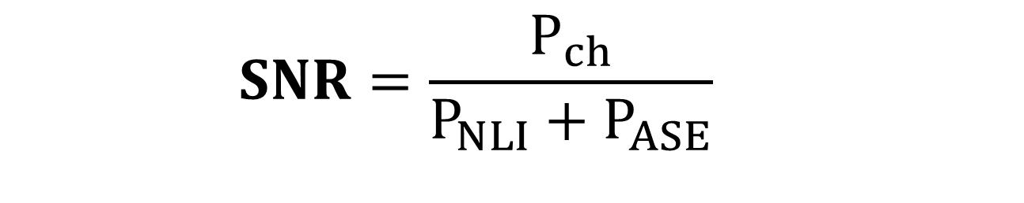
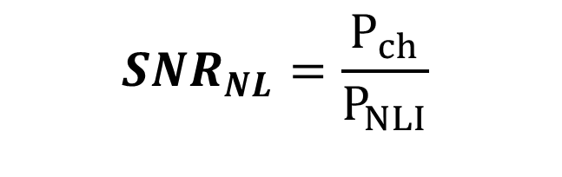
Signal Noise ratio
$$SNR=\frac{P_{ch}}{P_{NLI}+P_{ASE}}$$
$$OSNR=\frac{P_{ch}}{P_{ASE}}$$
$${SNR}_{NL}=\frac{P_{ch}}{P_{NLI}}$$

