Slide 1
DDS Case Study 2 Talent Management
Ricco Ferraro, April 2021

Slide 2
Dataset:
Collection of Employee data from over 870 Employees.
Properties including:
Age
Education
JobLevel
Gender
Attrition
MonthlyIncome

Slide 3
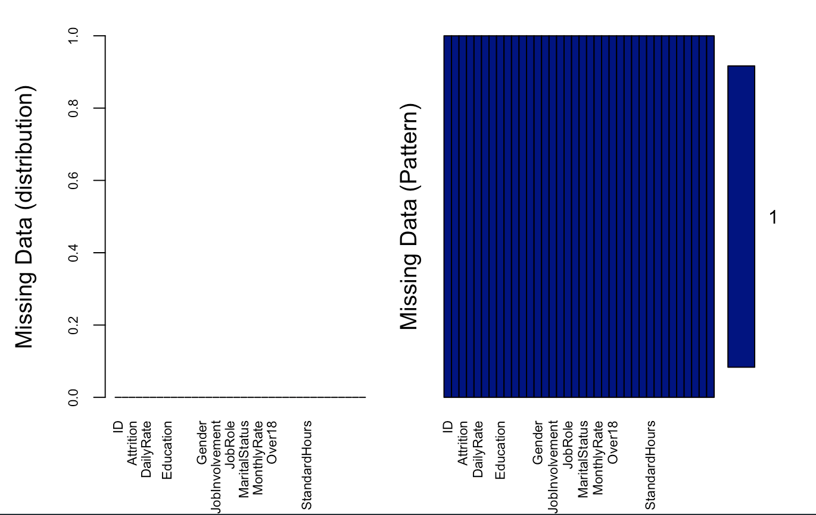
Missing Data

Slide 4
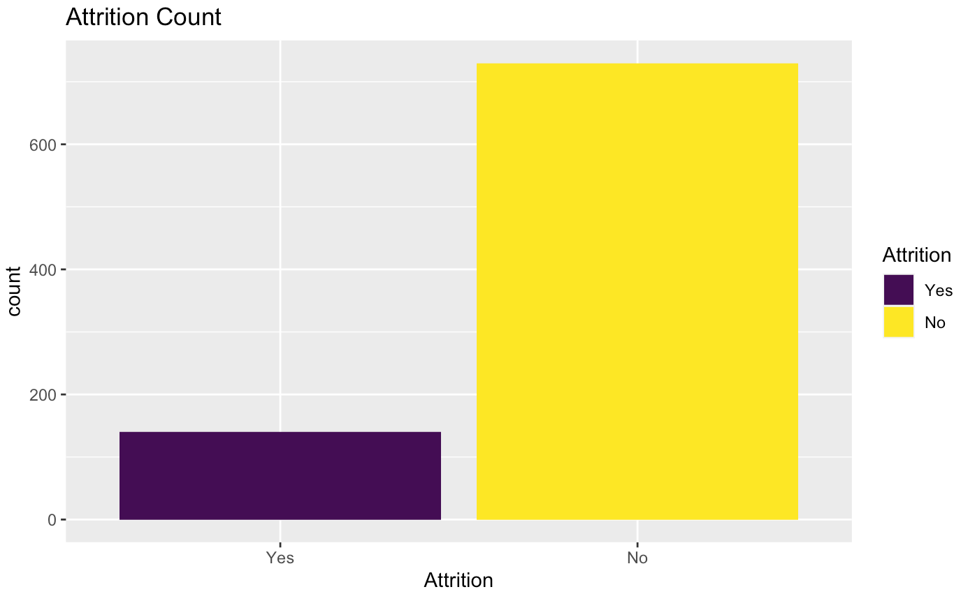
Attrition

Slide 5
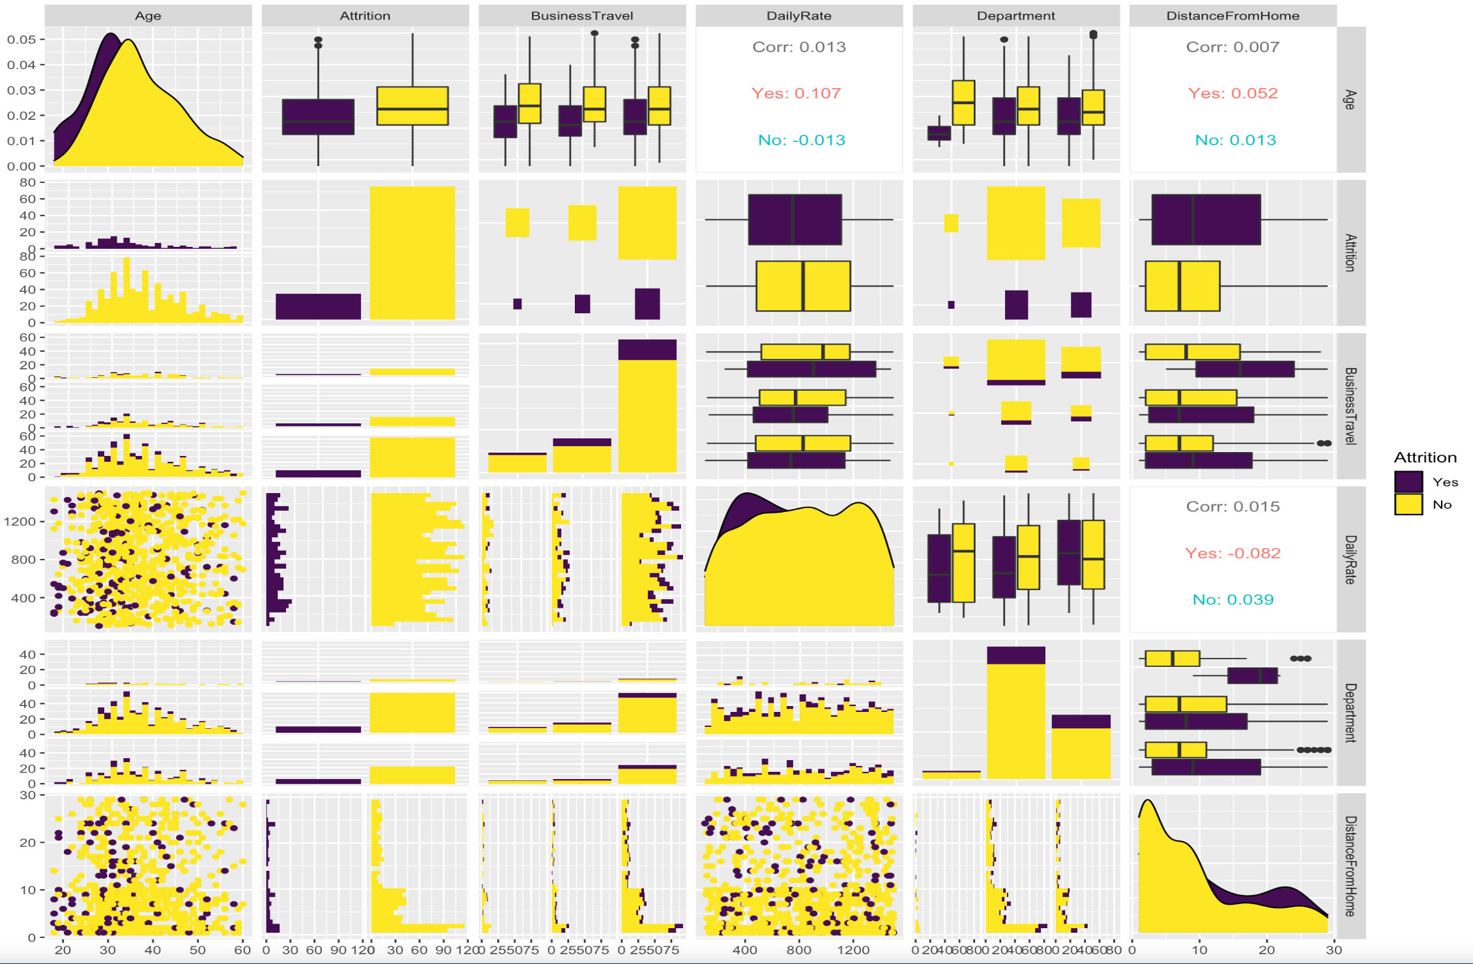
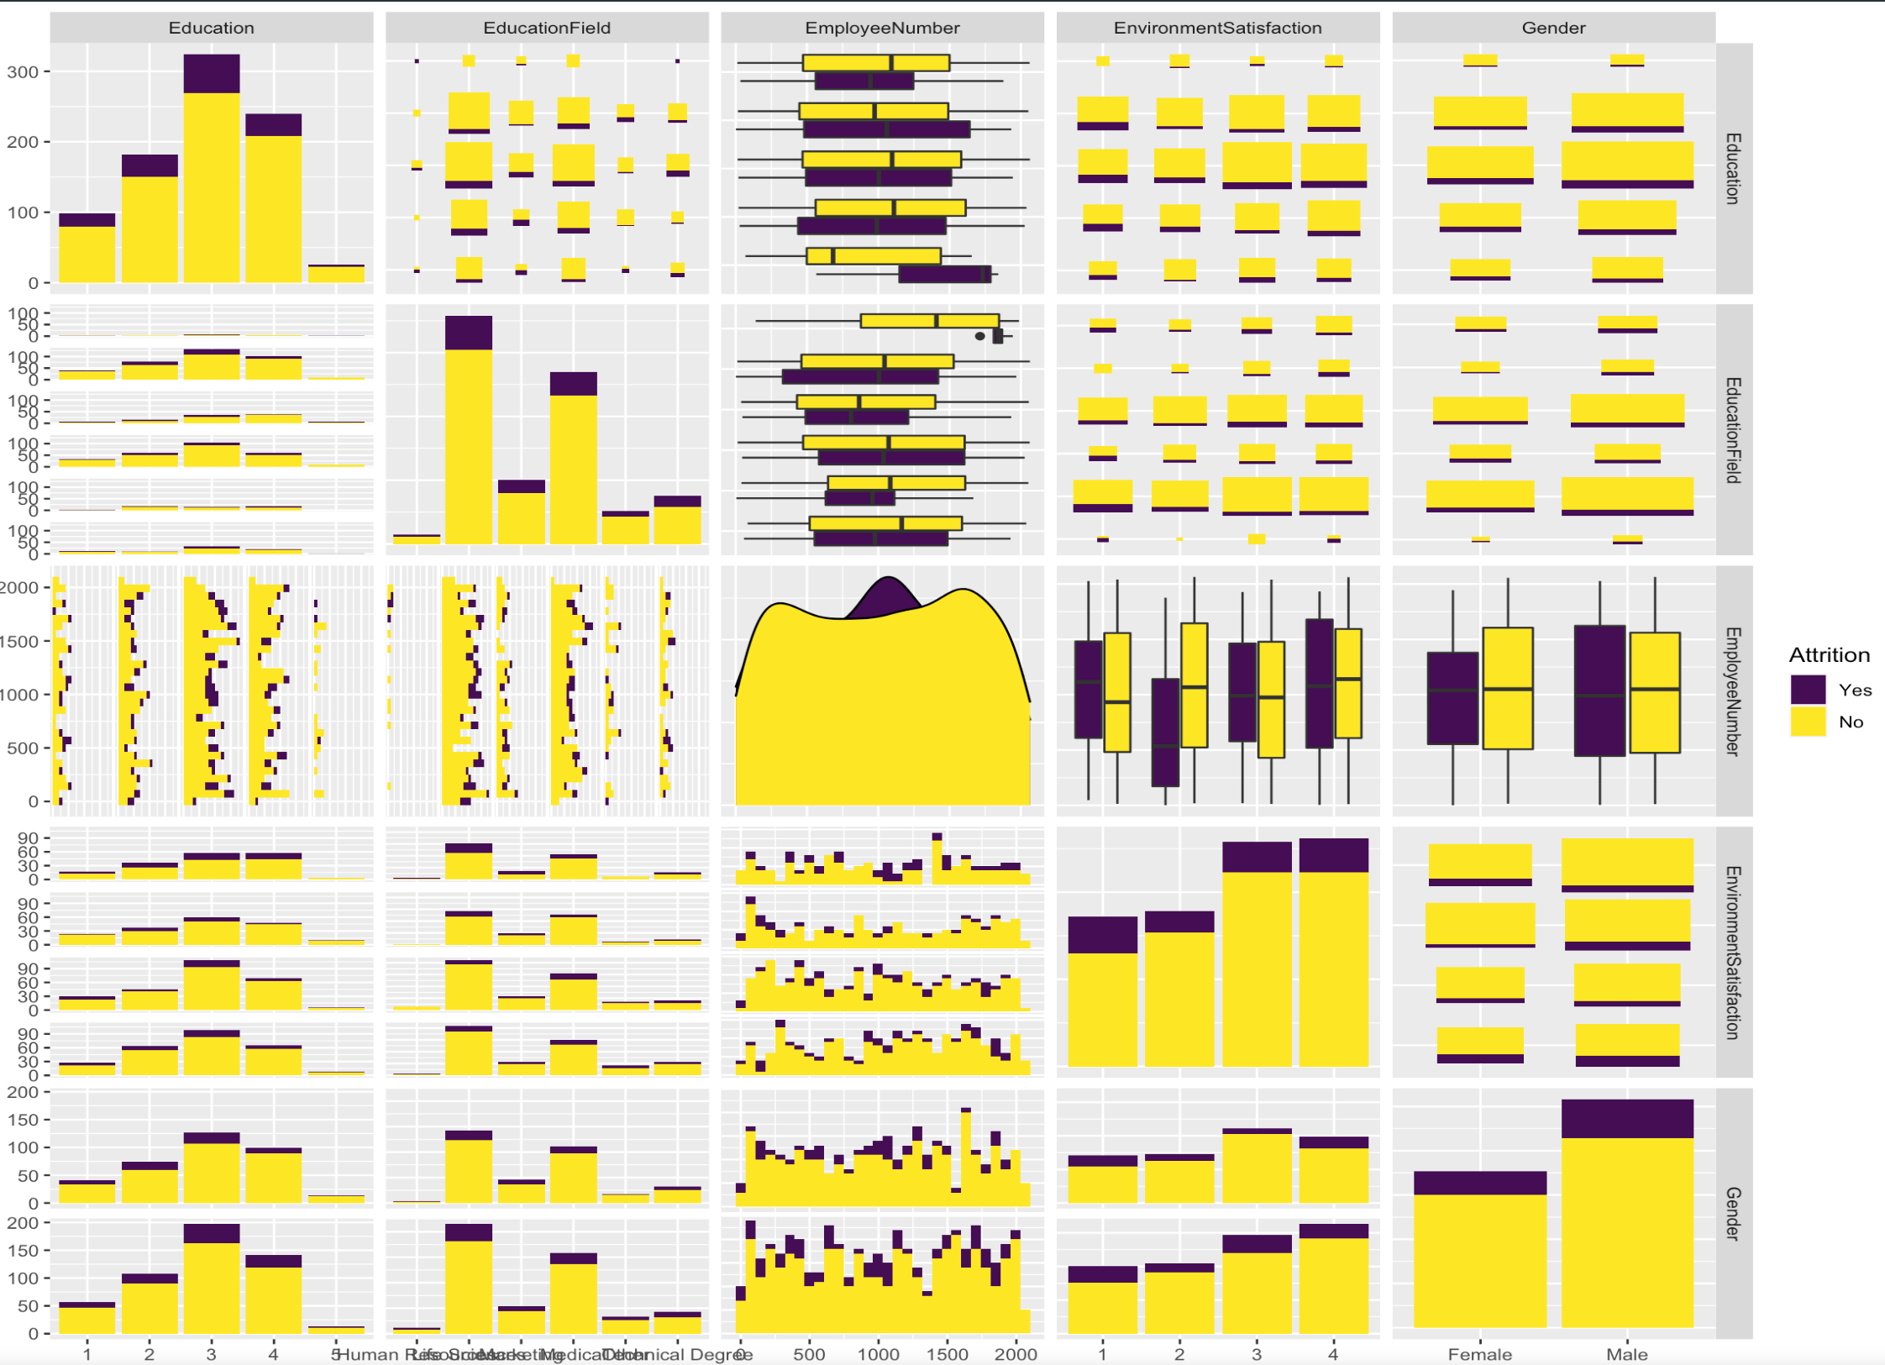
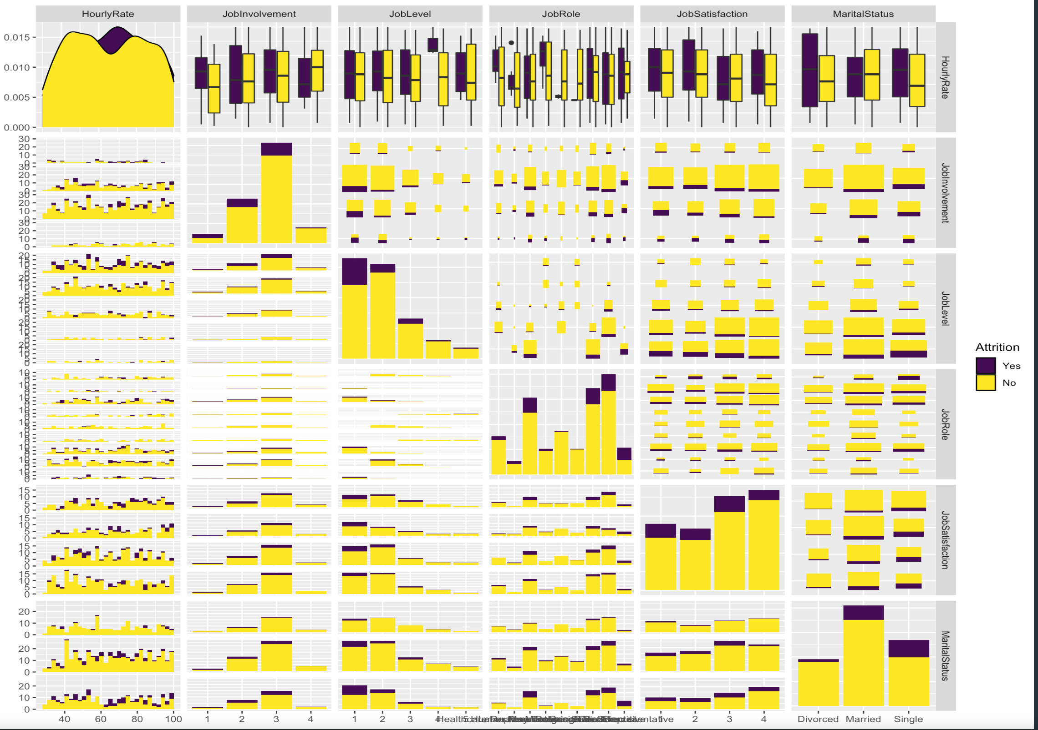
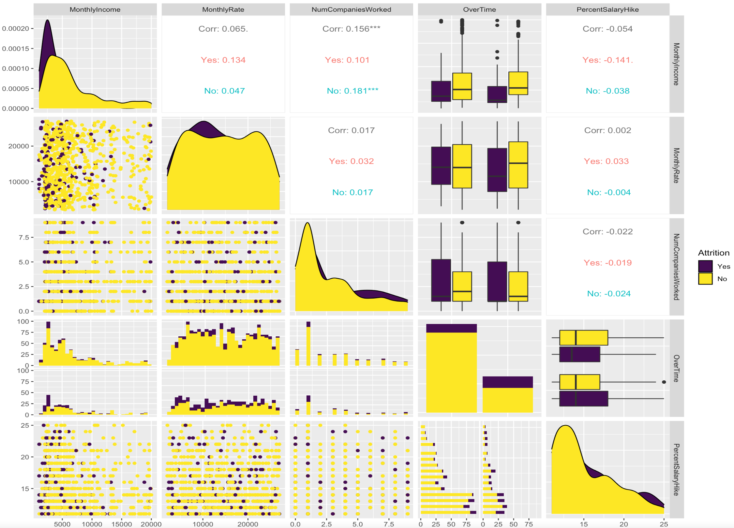
Data overview: colorized by Attrition

Slide 6
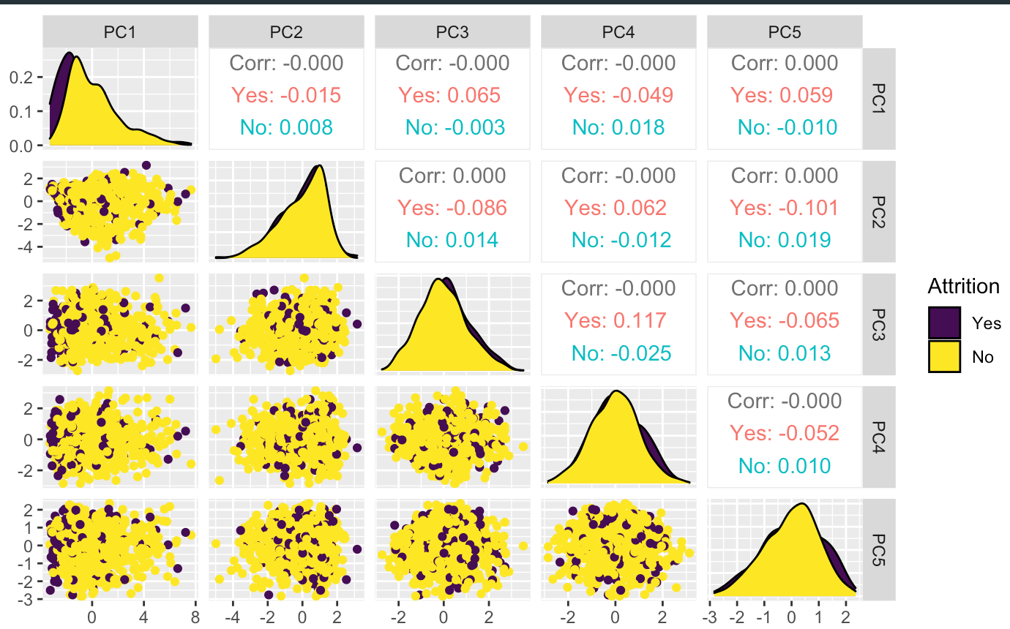
EDA: Principal Component Analysis:

Slide 7
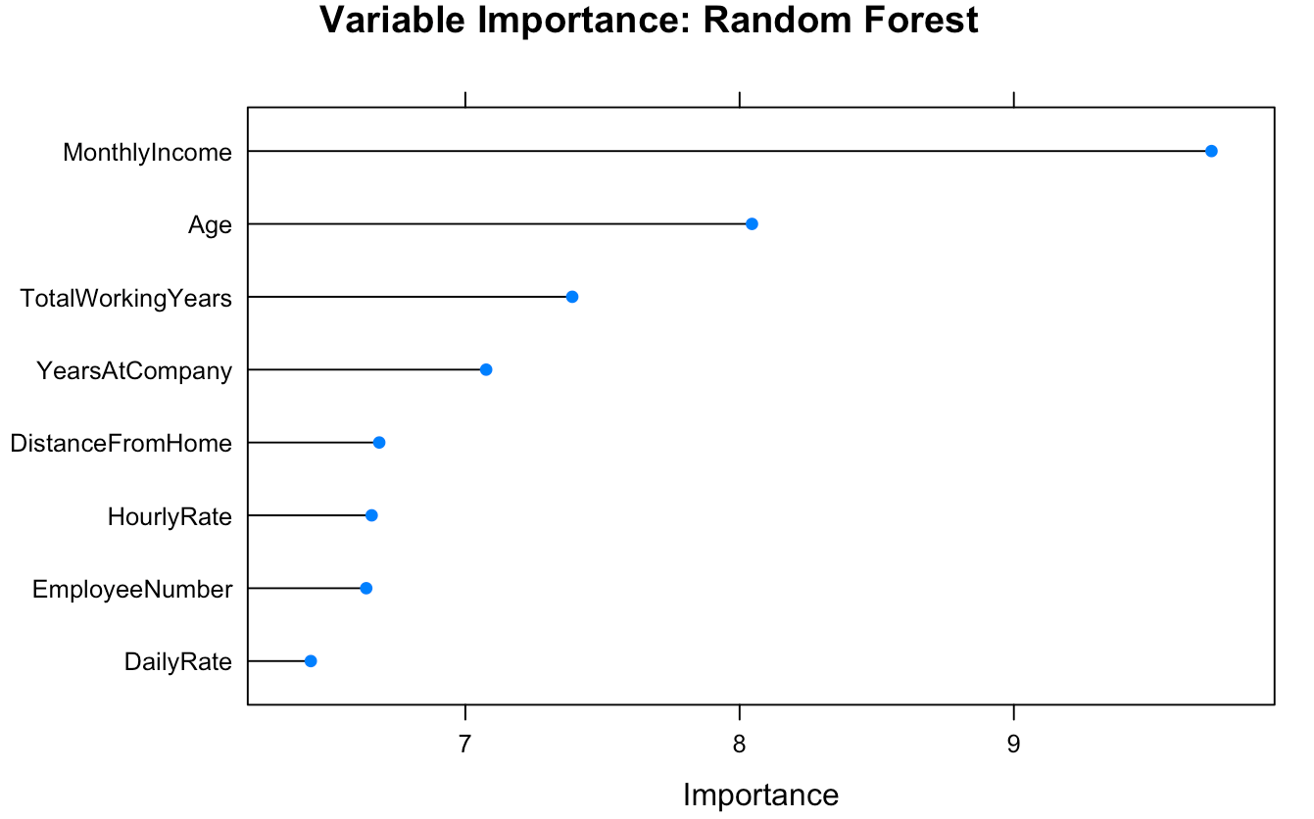
Which Top Factors Contribute to Attrition?
Correlated!
Correlated!
Note: These variables are Correlated!!
We must determine which are correlated
To accurately isolate the top 3.

Slide 8
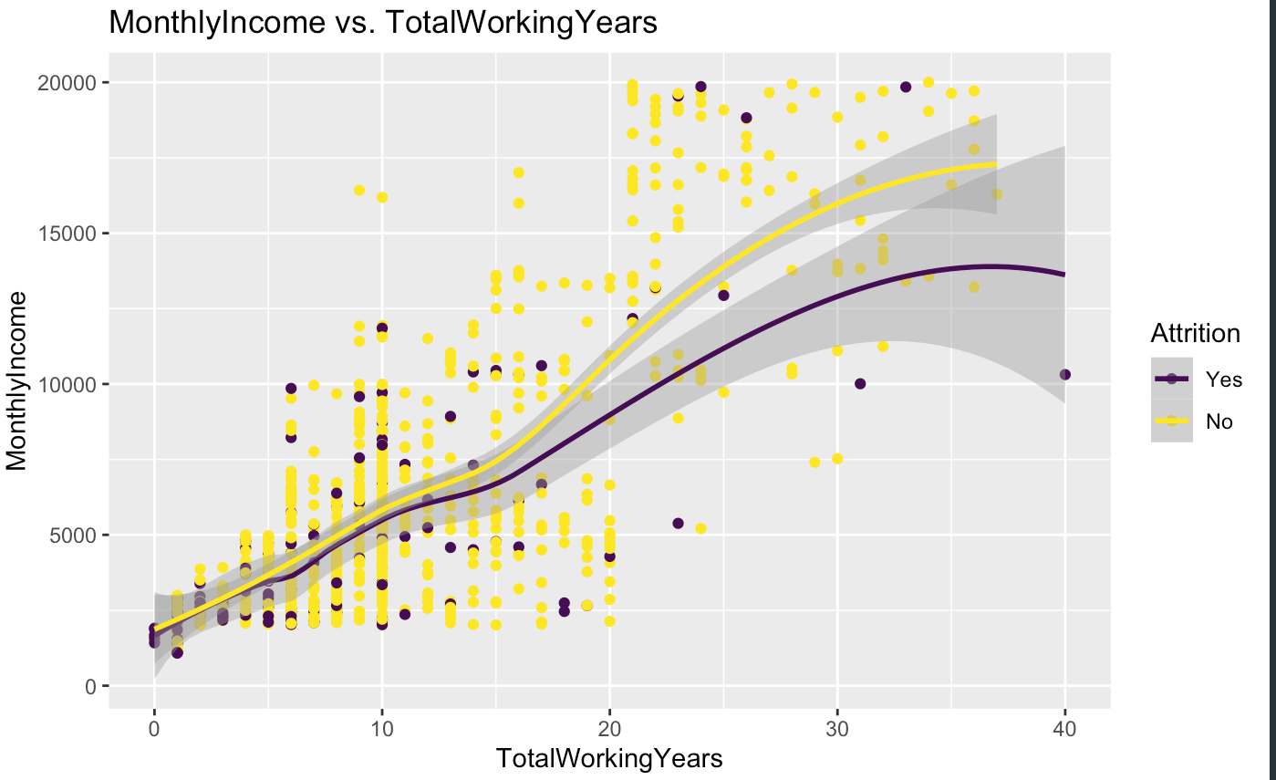

Slide 9
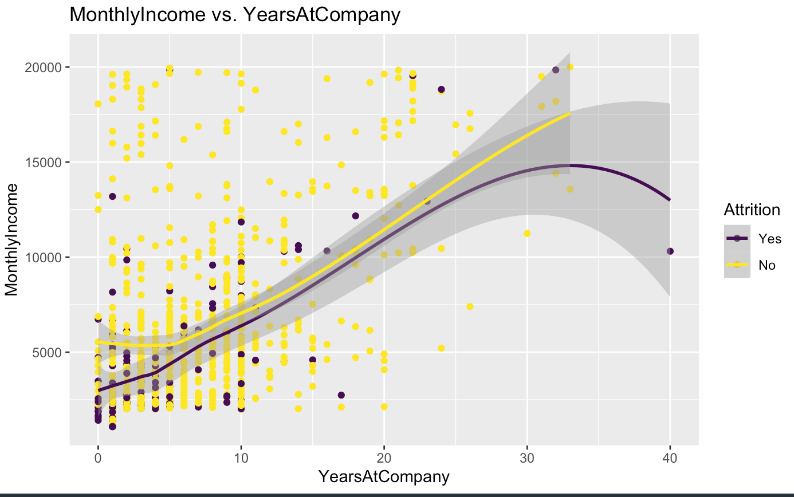

Slide 10
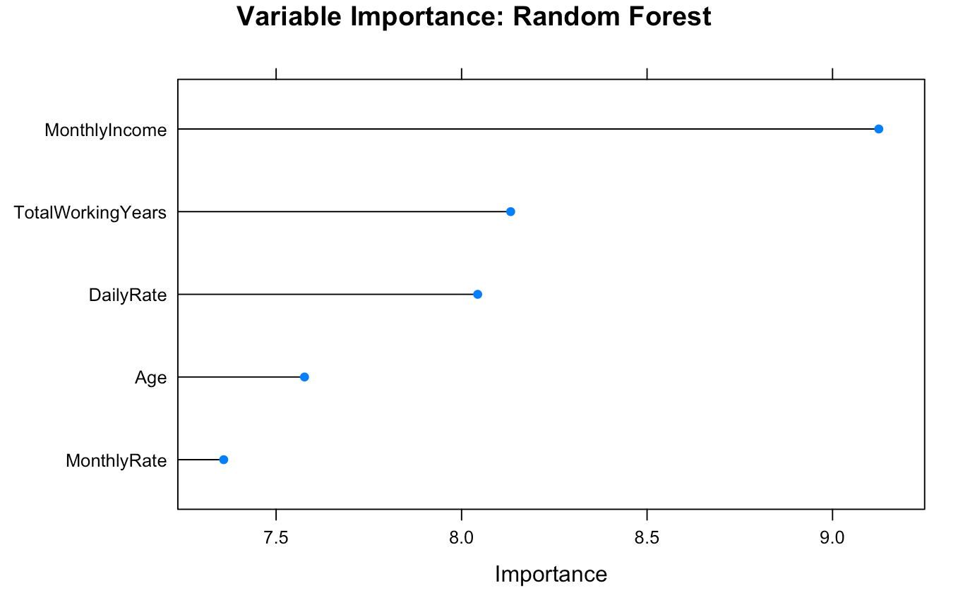
After removing Variables:
-TotalWorkingYears
- YearsAtCompany
And Re-running our model
Top factors are:

Slide 11
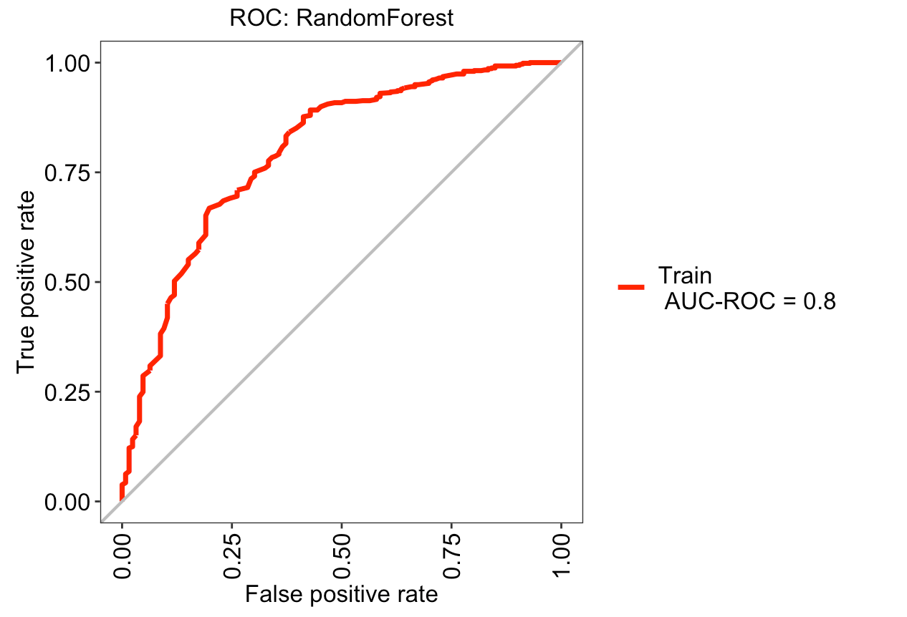
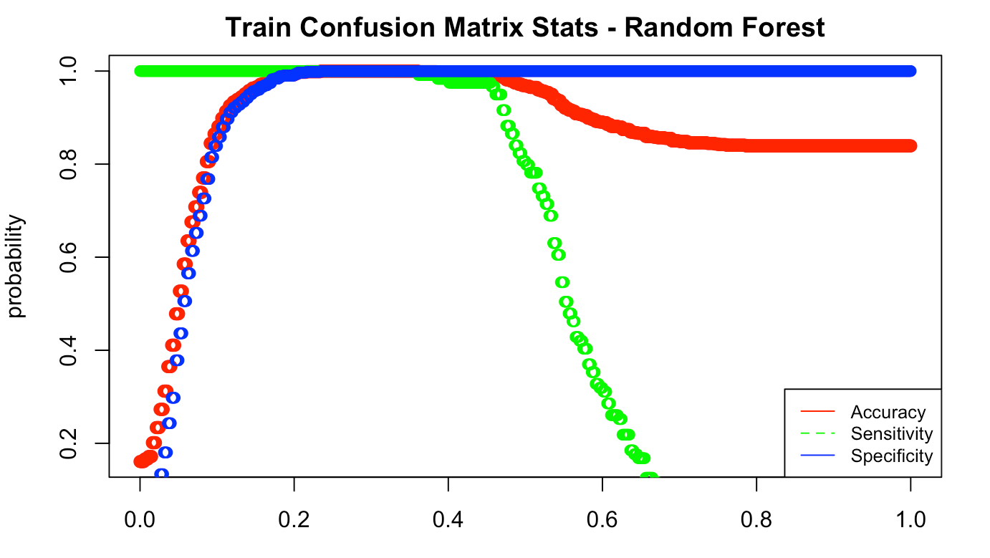
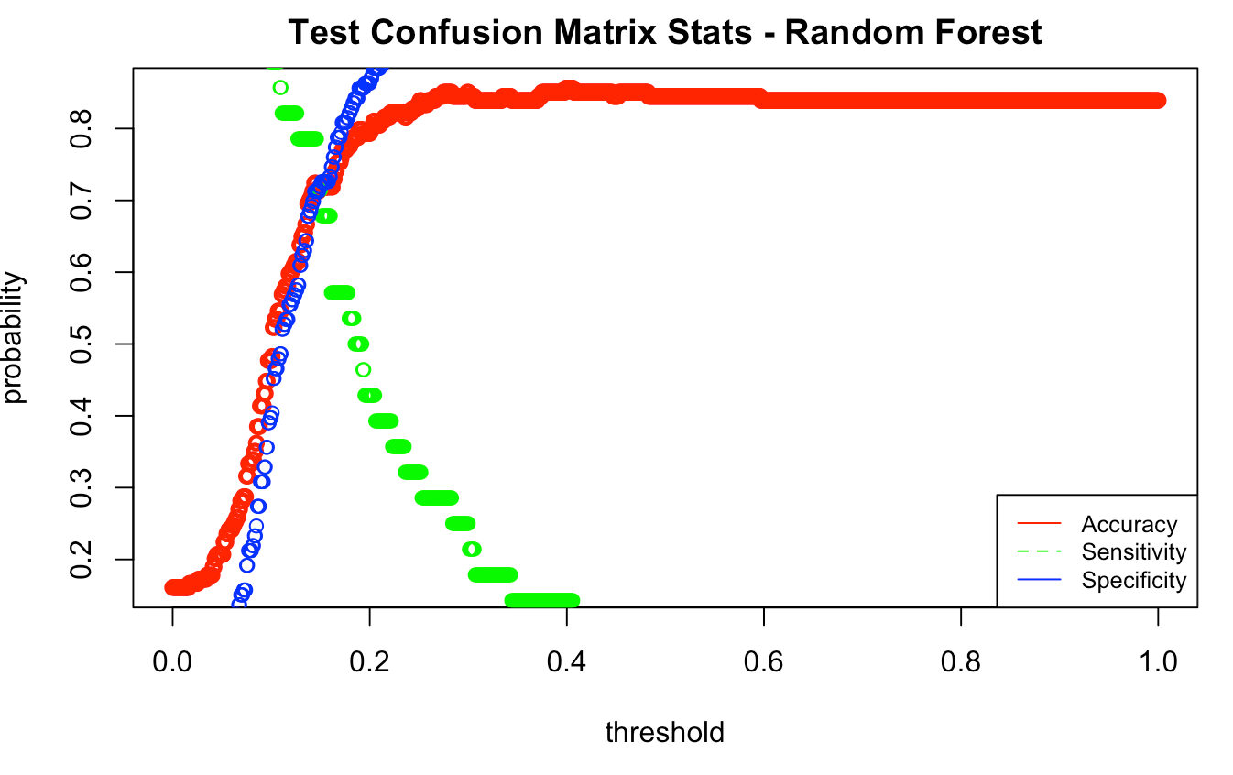
Predicting Attrition: Random Forest
Best CrossValidated Cutoff Probability used = .145
Test Accuracy = 0.7126
Test Sensitivity = 0.7143
Test Specificity = 0.7192
Test: Accuracy

Slide 12
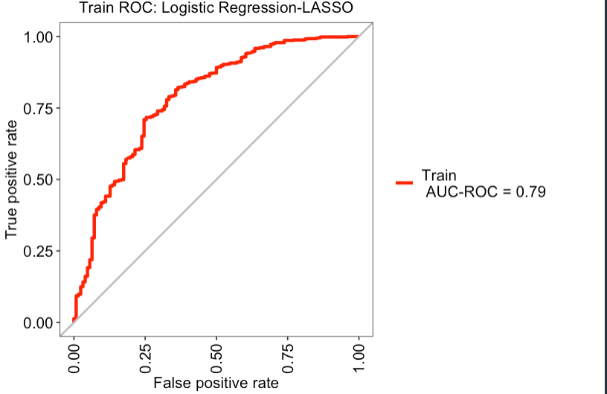
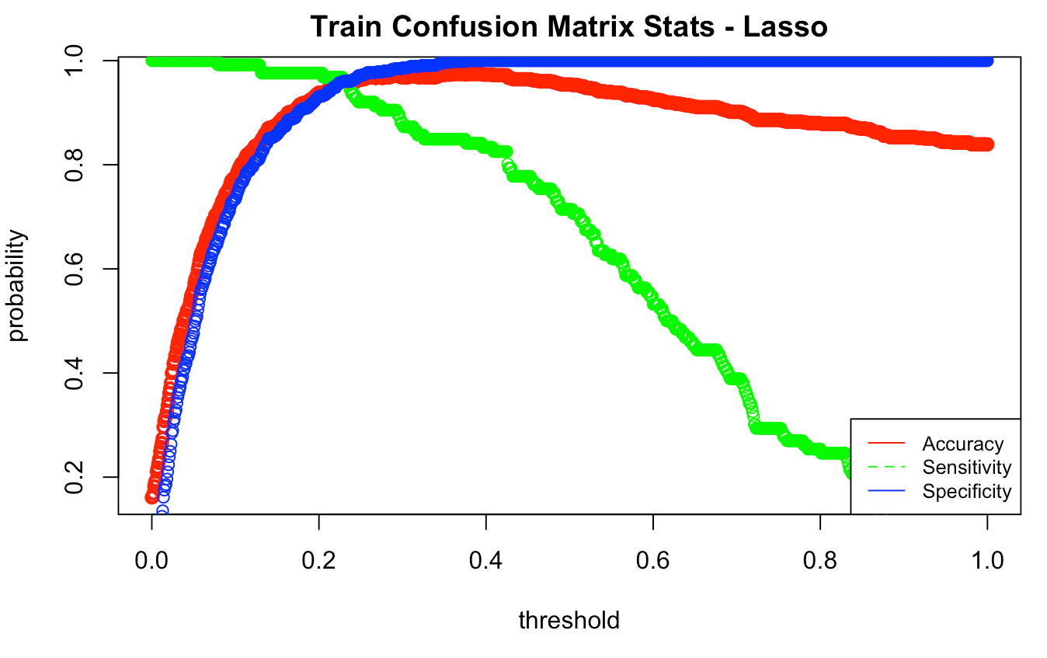
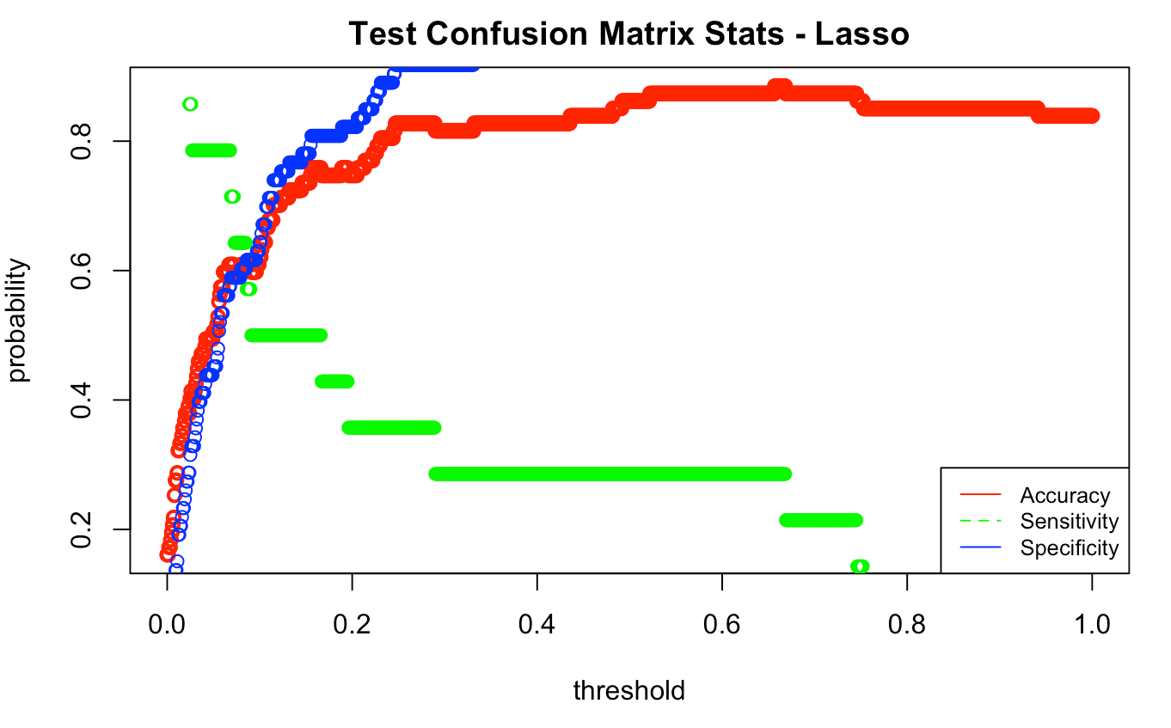
Predicting Attrition: Logistic Regression
Note: Although Accuracy is similar to Random Forest
When we tune thresholds to achieve the required
Specificity and sensitivity, performance is much worse
For Threshold .13 we get Accuracy = 0.56, Sensitivity=0.575 and
Specificity=0.53

Slide 13
Predicting Attrition: Choose Random Forest
Random Forest > Logistic Regression With Lasso!

Slide 14
Prediction: Monthly Income
MLR with LASSO:
"Train RSME"
490.9302
"Test RSME"
509.3047
KNN-5:
"Train RSME"
490.9302
"Test RSME"
509.3047
Choose MLR with LASSO!

