Slide 1
MLOps
Minh Quan Do

Slide 2
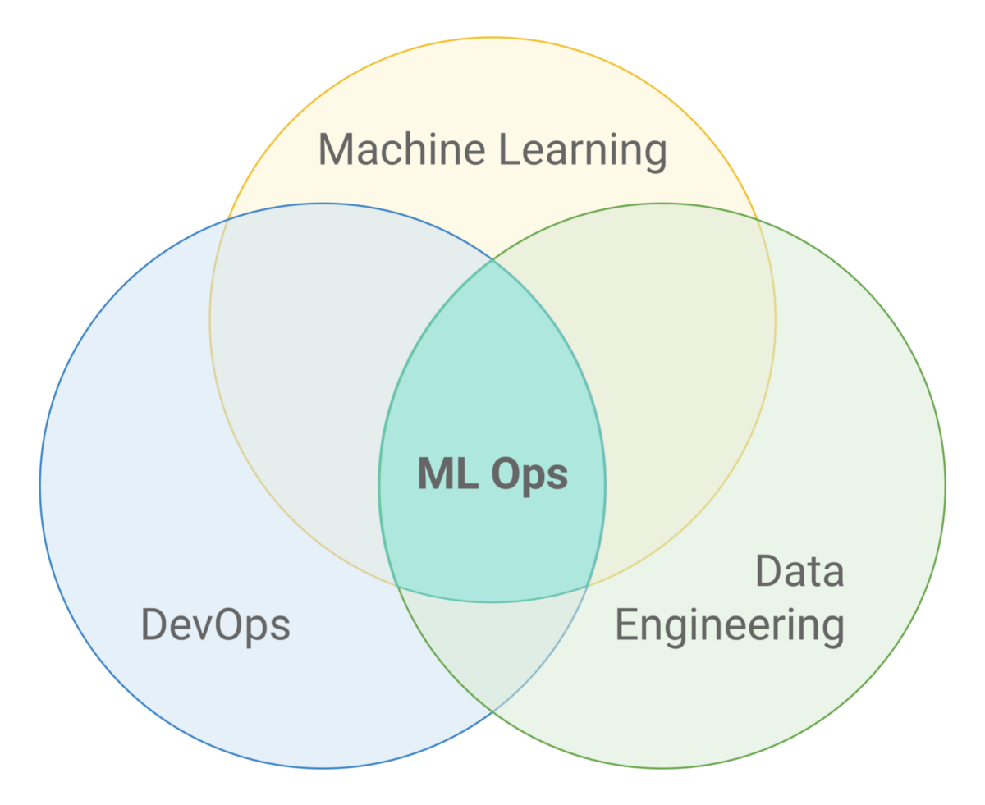
FAIRS MLOps : What is it?
MLOps combines practices from DevOps, Machine Learning, and Data Engineering
MLOps allows the ease of deploying, monitoring and updating models with new data in production
Leveraging FAIRS capabilities alongside MLOps practices will enable organizations to:
Reduce costs of using labelling services
Give models new capabilities to defend itself against adversarial attacks and account for new classes
Improves trust in the data used during the retraining process
Leidos Proprietary

Slide 3
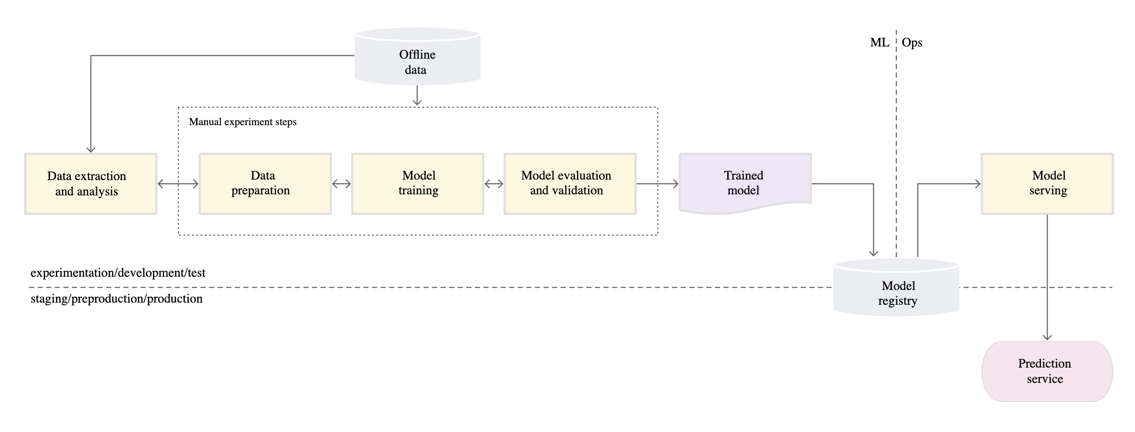
MLOPs Level 0
MLOPs Level 0: Manual ML Steps to serve model as production service
https://cloud.google.com/architecture/mlops-continuous-delivery-and-automation-pipelines-in-machine-learning#mlops_level_0_manual_process
https://www.youtube.com/watch?v=6gdrwFMaEZ0&list=PLK5gIELtOr1-ALboRLgMZsFybpFwq8m5f&index=2

Slide 4
Pros with MLOps Level 0
Simple workflow
Allows teams to focus more on the experimentation side
Fewer people needed to execute this workflow
Fewer tools needed

Slide 5
Cons with MLOps Level 0
Every step is manual
Data scientists write code to do exploratory data analysis, data preparation, model training, and model evaluation
Data scientists hand over trained model to software engineering team
Software engineering team deploys model as a prediction service

Slide 6
Cons with MLOps Level 0
Disconnect between data science teams and engineering teams
Engineering requirements are typically much stricter:
Low-latency (such as in the case of quantitative trading)
Memory/processing constraints (such as in the case of embedded IoT devices)
Engineering teams have to remove certain pieces of code to prepare model for deployment, examples include:
Removing steps in data preparation specific to only being used to train a model (ex. randomly flipping, rotating, and adding noise to images)
Disabling drop-out layers
Differences in the development process and the deployment process lead to training-serving skew
Training-serving skew: when there is a difference in the performance of the model between development and production
Lack of performance monitoring:
Performance of models more likely to degrade over time due to data drift
All of this results in:
Longer development time, infrequent release iterations
Performance of models are more likely to degrade over time due to lack of performance monitoring

Slide 7
Recommended Tools for MLOps Level 0
Deployment:
Used to deploy models into production as a microservice
Containerization: docker
Model version tracking:
Used to track different versions of models
Model registry: Mlflow, DVC
Data version tracking:
Used to track different versions of datasets
DVC
Source code version control: Git

Slide 8
Teams that should use MLOps Level 0
Small ML teams
Few people and resources
Likely do not have enough expertise to build a full MLOps pipeline
Early stage startups
Rapidly changing business requirements often means their model architecture is changing too fast to bother with managing an MLOps pipeline
These teams just need to develop a basic model architecture that suits their needs
Teams that have less money for cloud infrastructure to run MLOps tools
Teams that build models that see relatively low volumes of data in production
Small amounts of data means they can easily do manual retraining

Slide 9
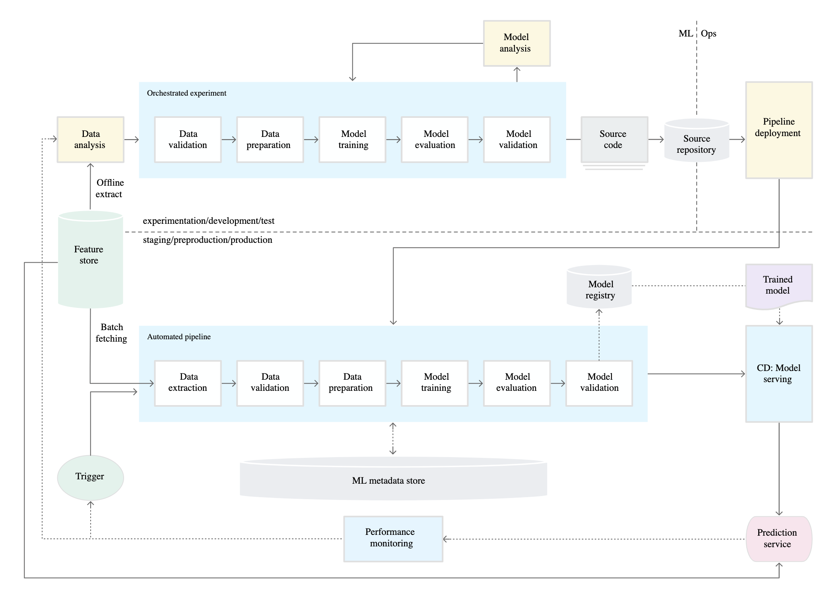
MLOps Level 1

Slide 10
MLOps Level 1
MLOPs Level 1: ML pipeline automation for continuous training (CT)
Pipeline implementation used in the development or experiment environment is also used in the preproduction and production environment.
This reduces chances of training-serving skew.
This is a key aspect of MLOps practice for unifying DevOps.

Slide 11
MLOps Level 1
Data validation:
Develop code to check the structure of the incoming data
Develop code to check. whether incoming data obeys a certain schema.

Slide 12
MLOps Level 1
Data preparation:
Removing outliers (data cleaning)
Split the data into training, validation, and test sets.
Apply data transformations and feature engineering
Output of this step are the data splits in the prepared format.

Slide 13
MLOps Level 1
Model training:
Implement different algorithms with the prepared data to train various ML models.
Subject the implemented algorithms to hyperparameter tuning to get the best performing ML model.
Output of this step is a trained model (and other model related artifacts like LoRA files).

Slide 14
MLOps Level 1
Model evaluation:
The model is evaluated on a holdout test set to evaluate the model quality.
The output of this step is a set of metrics to assess the quality of the model.

Slide 15
MLOps Level 1
Model validation:
The model is confirmed to be adequate for deployment – that its predictive performance is better than a certain baseline.

Slide 16
MLOps Level 1
Data extraction:
Fetch data from feature store or other sources

Slide 17
MLOps Level 1
Data validation:
Decide whether you should retrain the model or stop the execution of the pipeline.
Decision is automatically made if the following was identified by the pipeline:

Slide 18
MLOps Level 1
Data schema skews:
Anomalies in the input data like unexpected features, not receiving all the expected features, or receiving features with unexpected values.
Downstream pipeline steps cannot process anomalous data.
Stop the pipeline so the data science team can investigate.
Release a fix or an update to the pipeline to handle these changes in the schema.

Slide 19
MLOps Level 1
Data values skews:
Significant changes in the statistical properties of data.
Data patterns are changing.
Trigger a retraining of the model to capture these changes.

Slide 20
MLOps Level 1
Data preparation:
Removing outliers (data cleaning)
Split the data into training, validation, and test sets.
Apply data transformations and feature engineering
Output of this step are the data splits in the prepared format.
Same process as in development.

Slide 21
MLOps Level 1
Model training:
Conduct continuous training (CT) of the model in production. The model is automatically trained in production using fresh data based on live pipeline triggers.

Slide 22
MLOps Level 1
Model evaluation:
The model is evaluated on a holdout test set to evaluate the model quality.

Slide 23
MLOps Level 1
Model validation:
Compare the evaluation metric values produced by the newly trained model to the current model.
Make sure that the new model produces better performance than the current model before promoting it to production.

Slide 24
MLOps Level 1
Newly seen data is sent to a labelling service (like AWS SageMaker Ground Truth)
Labelled data is immediately fed into the pipeline; the data validation step is used to determine if retraining is needed.
If retraining is necessary, automatically retrain the model on new data

Slide 25
MLOps Level 1
Feature store:
A centralized repository where you standardize the definition, storage, and access of features for training and serving.
Provide an API for high-throughput batch serving and low-latency real-time serving for the feature values
Support both training and serving workloads.

Slide 26
MLOps Level 1
Metadata store:
Store information about each execution of the ML pipeline.

Slide 27
MLOps Level 1
Performance monitoring enables teams to catch model performance degradation faster.
Pipeline triggers trigger a new retraining of the pipeline

Slide 28
MLOps Level 1
ML pipeline in production continuously delivers prediction services to new models that are trained on new data.
In other words, the prediction service is automatically updated to the latest version of the model.

Slide 29
Pros of MLOps Level 1
Performance monitoring
Continuous retraining of the model happens automatically
Experimental-operational symmetry
The code that is used in the experimentation phase is also used in production, thus reducing the likelihood of training-serving skew

Slide 30
Cons of MLOps Level 1
More complex workflow than MLOps Level 0
Requires more expertise to set up MLOps Level 1 pipeline
Requires the use of more tools
Likely requires larger teams with some team members dedicated to maintaining the MLOps pipeline thus drawing manpower away from model creation and product development

Slide 31
Teams Who Should Use MLOps Level 1
Teams that already have working models
Larger teams that can dedicate more developers towards devops to maintain an MLOps Level 1 pipeline
Organizations that are willing to invest more into cloud infrastructure to run MLOps tools

Slide 32
Recommended Tools for MLOps Level 1
Performance monitoring tool: used to monitor performance of the model in production
Arize, Arthur, Fiddler
Pipeline trigger: used to trigger retraining
Arize
Feature store: used to standardize the storage and access of datasets
FEAST

Slide 33
Recommended Tools for MLOps Level 1 (cont.)
Metadata management: used to store metrics produced by continuous training
Databricks’ MLflow
Experiment tracking: used to ensure code, data, and model versioning
Databricks’ Mlflow, DVC, Weights & Biases (wandb)
ELT tool: Used for data extraction from feature store and other sources
Fivetran, DBT Labs
Deployment service: used to automatically containerize models and create prediction service
Triton, Seldon, KServe

Slide 34
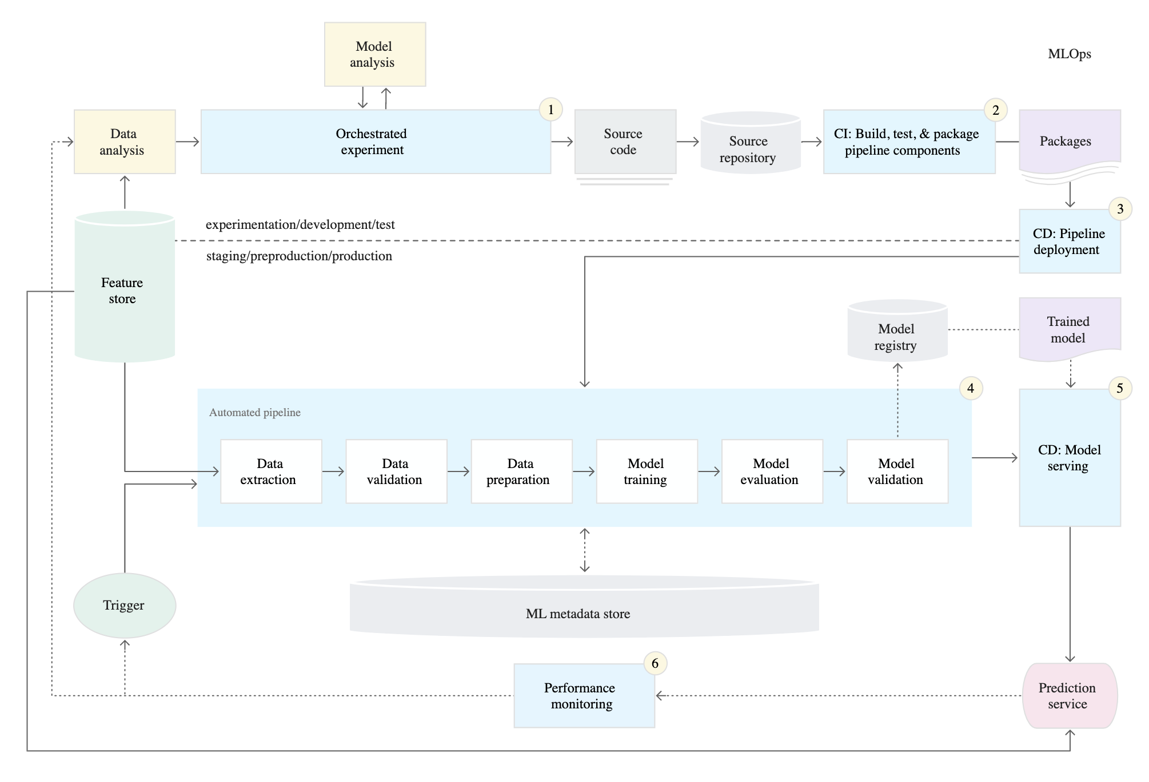
MLOps Level 2

Slide 35
MLOps Level 2
Development and experimentation: You iteratively try out new ML algorithms and new modeling where the experiment steps are orchestrated. The output of this stage is the source code of the ML pipeline steps that are then pushed to a source repository.

Slide 36
MLOps Level 2
Pipeline continuous integration: You build source code and run various tests. The outputs of this stage are pipeline components (packages, executables, and artifacts) to be deployed in a later stage.

Slide 37
MLOps Level 2
Pipeline continuous integration: You build source code and run various tests. The outputs of this stage are pipeline components (packages, executables, and artifacts) to be deployed in a later stage.

Slide 38
MLOps Level 2
Pipeline continuous delivery: You deploy the artifacts produced by the CI stage to the target environment. The output of this stage is a deployed pipeline with the new implementation of the model.

Slide 39
MLOps Level 2
Automated triggering: The pipeline is automatically executed in production based on a schedule or in response to a trigger. The output of this stage is a trained model that is pushed to the model registry.

Slide 40
MLOps Level 2
Model continuous delivery: You serve the trained model as a prediction service for the predictions. The output of this stage is a deployed model prediction service.

Slide 41
MLOps Level 2
Monitoring: You collect statistics on the model performance based on live data. The output of this stage is a trigger to execute the pipeline or to execute a new experiment cycle.

Slide 42
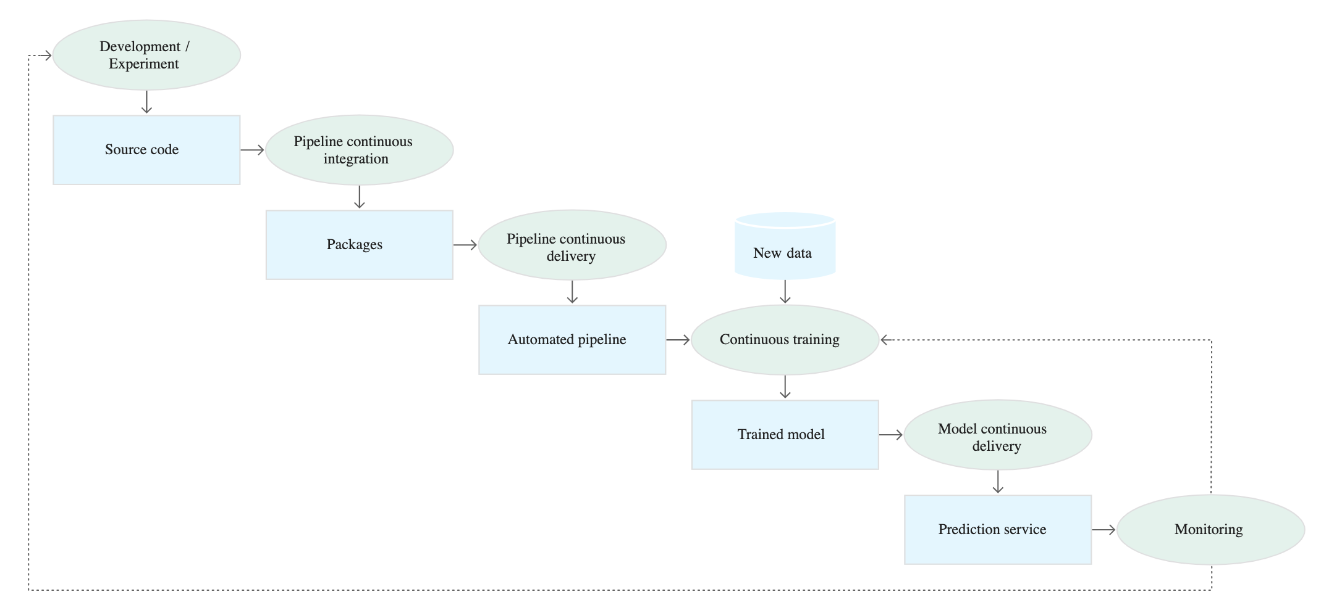
MLOps Level 2 in Summary

Slide 43
Pros of MLOps Level 2
CI/CD is used to ensure code used in experimentation step is automatically deployed as a continuous training pipeline; no need to do manual deployment of continuous pipeline
Teams that achieve MLOps Level 1 should not have very much trouble moving to MLOps Level 2 maturity
No need for additional tools
No need for additional expertise on the team as compared to MLOps Level 1

Slide 44
Cons of MLOps Level 2
Slightly more complex workflow than MLOps Level 1

Slide 45
Teams Who Should Use MLOps Level 2
Teams that already have already achieved MLOps Level 1 maturity

Slide 46
Recommended Tools for MLOps Level 2
Same tools as MLOps Level 1

Slide 47
What is MLOps Currently Missing?
There are two problems with MLOps:
MLOps operates with the assumption that all data seen during production are in the same classes as data in the training set
Lack of data annotation quality measurement (how do we make sure the training dataset is created and labelled properly?)

