Slide 1
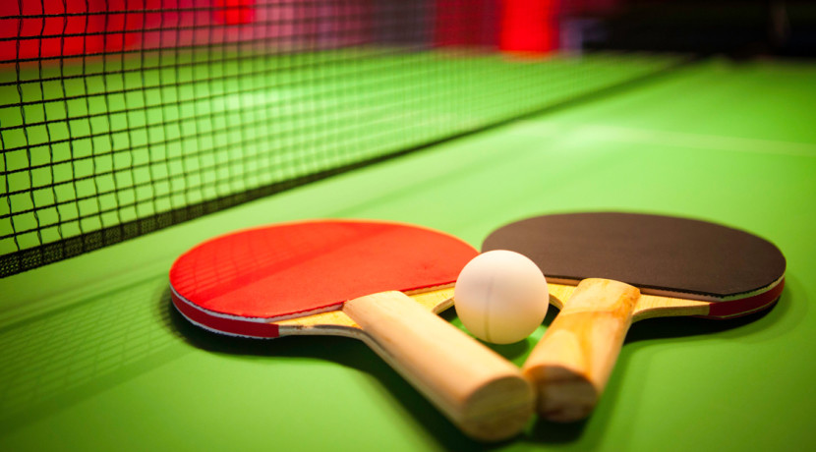
Ping Pong Game

