Slide 1
Intro to Web Scraping
Richard Mills

Slide 2
What will you (hopefully) get from this?
An appreciation of...
What is it?
Why is it useful?
What forms can it take?
What considerations are there?

Slide 3
What is it?
If asked for a one sentence description, I’d say...
It is the act of automating the retrieval of information from the internet and transforming it into something useful!

Slide 4
When might I need it?
Need to extract information that can’t (easily) be copied & pasted from a web browser.
Extracting information from large number of sites.
Data might not be embedded within a web-site but an alternative format (eg. XML/JSON)
A desire to automate/scale-up the above as part of a regular process.

Slide 5
Possible use cases?
Track the competition
Competitor prices
Product descriptions/reviews
Source inputs for work items
Stock quotes/financial metrics
Social/demographic data
Brand monitoring
Customer sentiment
Website testing

Slide 6
More generally…
The internet is a huge repository of information.
There is no reason why we shouldn’t be able to access that information as we do (say) local files on a business network.

Slide 7




How does “browsing the internet” work?
Scraping using
web-based APIs
“Conventional” web-scraping
Request submitted by browser
User enters URL into browser
(Hyper Text Transfer Protocol)
Content returned
HTML
_____
_____
_____
XML
_____
_____
_____
JSON
_____
_____
_____
TEXT
_____
_____
_____
....
_____
_____
_____
There are standards which specify what constitutes valid HTML, XML and JSON.
CSS
_____
_____
_____
JAVASCRIPT
_____
_____
_____
URL = Unique Resource Locator
HTML = Hyper Text Markup Language
XML = eXtendible Markup Language
JSON = JavaScript Object Notation
CSS = Cascading Style Sheet
API = Application Programming Interface
(Allows different applications to communicate)
Further details on what your browser does can be found here.

Slide 8
How does a browser load a web-page?
HTML Response
Submit a request to the web-server (via HTTP).
Interpret the HTML content received.
Request any additional assets referred to by the HTML.
Typically styling information, JavaScript code and media.
Run any JavaScript code marked for execution on page load.
Further changes can be made to the HTML code at this point and thereafter!
Render final HTML content as web-page to the user.
This is the bit we can automate using code rather than a browser.

Slide 9

Let’s try an example...
HTML Response
Turns out you’re a huge fan of
For a project you’re doing, you’d like to get the basic stats for each Pokémon:
Attack
Defence
Stamina
Turns out there’s already a website for this!

Slide 10
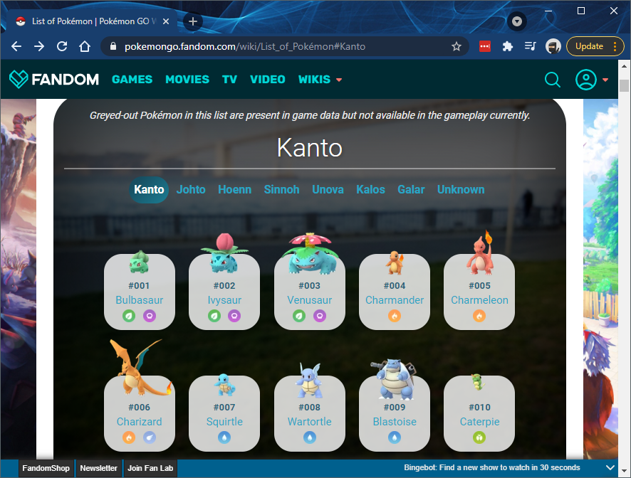
Pokémon-Go stats
HTML Response
(There looks to be ~700 of them.)

Slide 11
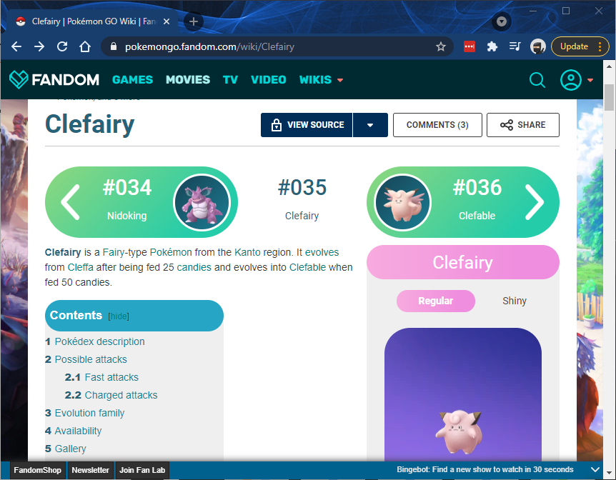
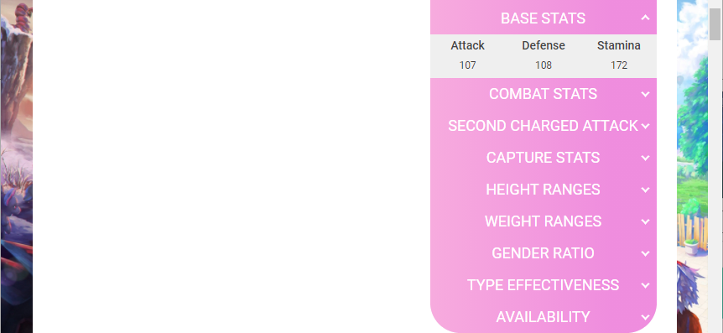

Pokémon-Go stats
HTML Response

Slide 12
Pokémon-Go stats
HTML Response
What do we need to do?
From that index page, extract a list of web-addresses for the Wiki-page of each Pokémon.
Download the HTML content of each page above, and extract the stats.

Slide 13
Pokémon-Go stats
HTML Response
Step 1 – Get a list of website addresses.
Taking the web-page that listed out all of the Pokémon...
What we want is the underlying web-address for each circled item.
This will be available in the underlying HTML.
On Chrome in Windows, we show this underlying HTML code with Ctrl-U.
Pressing this shows...

Slide 14
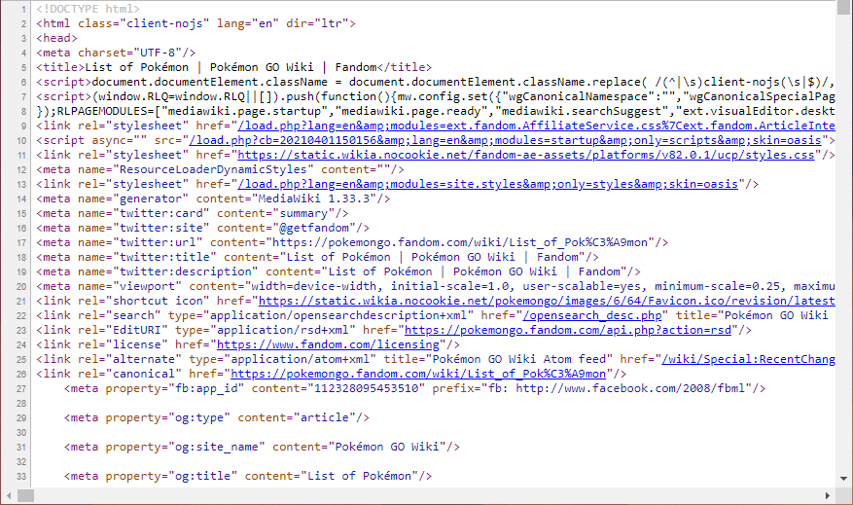
Pokémon-Go stats
HTML Response
Step 1 – Get a list of website addresses.
There’s a lot here with ~2,600 lines of HTML.
The HTML itself represents a collection of nodes.
Nodes can be children/siblings of other nodes giving the HTML a hierarchical/tree-like structure.
Some of these nodes correspond to things you can physically see on the web-page and can interact with.
Buried somewhere within this are the nodes corresponding to the hyperlinks for each Pokémon.

Slide 15
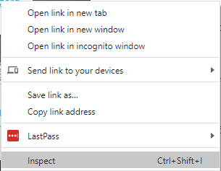
Pokémon-Go stats
HTML Response
Step 1 – Get a list of website addresses.
How can we track these elusive nodes?
If we right-click on one of the hyperlinks, we get the following options...
Clicking the Inspect option will open up the Chrome DevTools window and take us to the corresponding line in the HTML.

Slide 16
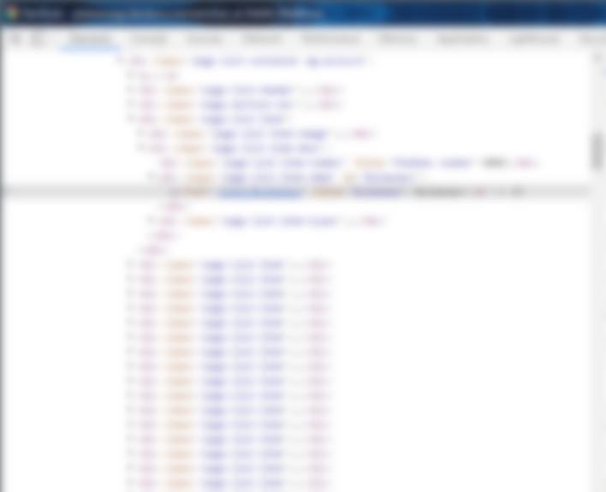
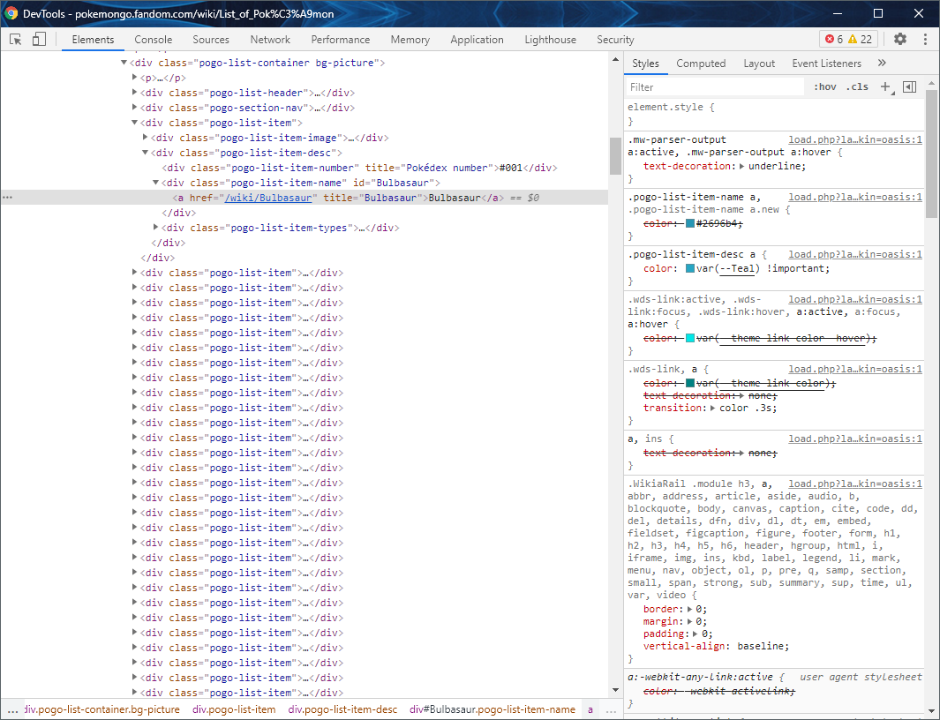
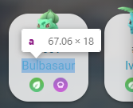
HTML Response
This is the element we’re currently inspecting
The relative path to the wiki-page for that Pokémon and its name are contained within that ‘a‘ node.
Going up a few levels, we can see that each Pokémon is represented by a div element of class “pogo-list-item”.
We can also see a number of other pogo-list-item nodes corresponding to the remaining Pokemon.
Can we automate this?
Yes!...
This is the page for this particular Pokemon.
It is relative to the base address of...
https://pokemongo.fandom.com/
Creature name

Slide 17
Pokémon-Go stats
HTML Response
There are (usually) two ways this can be approached via code:
Submit the request and work with the response as a plain block of text. This will more than likely require the use of regular expressions in order to extract the part(s) of the text that you need.

Slide 18
Pokémon-Go stats
HTML Response
Or...
Submit the request and convert the response into an “object” which allows you to more easily traverse the content. A VBA-based solution using this approach can be found here. Alternatively, I’ve done a step-by-step walkthrough of how I’d tackle this specific problem with R...

Slide 19
Pokémon-Go stats
HTML Response
Please check out...
Step 1 - Extract a list of web-addresses for the Wiki page of each Pokémon. (Workings here)
Step 2 - Download HTML content of each page above, and extract the stats. (Workings here)
You don’t need to be well versed in R to understand the code.
(The pages visited by the links above were created using only R!)

Slide 20
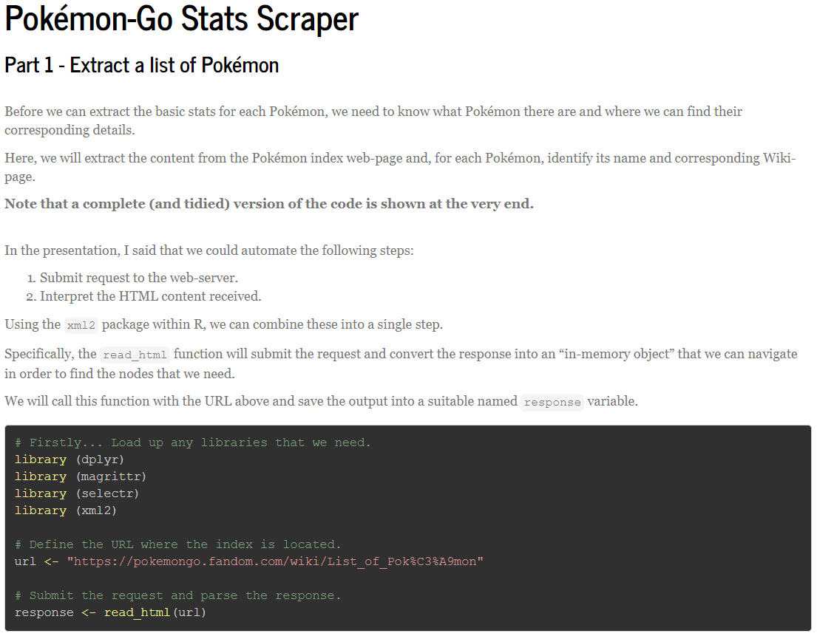
HTML Response

Slide 21
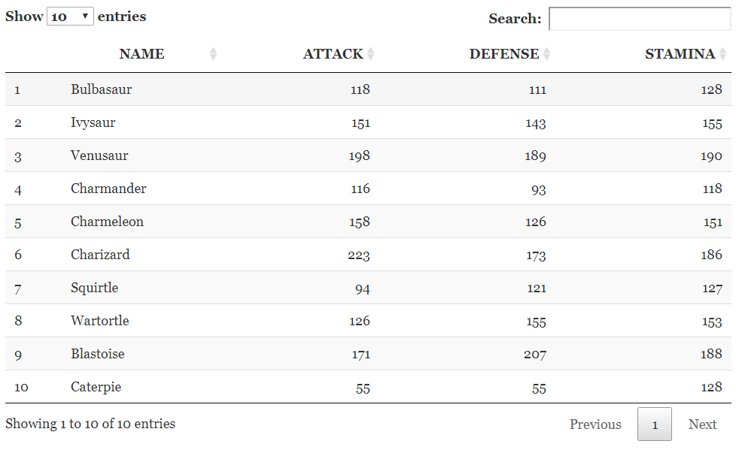
HTML Response

Slide 22
What have we seen so far?
HTML Response
A very (!) high-level explanation of how a browser deals with HTML content.
That HTML is a hierarchical format where nodes can be siblings/children to other nodes.
...and that some of these nodes represent things you can physically see on a web-page.
Showed how a browser (eg. Chrome) can be used to track down individual nodes on a web-page.
That there a couple of approaches to working with HTML content via code.
Links to VBA and R based solutions for the Pokémon stats project.

Slide 23
What didn’t we cover?
HTML Response
Cases where you would normally need to populate and submit information on a web-page before getting results.
Depending on the specific example, it could just be a simple extension of the techniques used for the Pokémon example.
More complex sites requiring “physical” interaction in order to get required content.
Includes the situation where required content is delivered after page-load.
Have mostly encountered this on price comparison websites.
Usually requires the controlling of a browser directly via code.

Slide 24
Back to this again...
Scraping using
web-based APIs
“Conventional” web-scraping
HTML
_____
_____
_____
XML
_____
_____
_____
JSON
_____
_____
_____
CSS
_____
_____
_____
JAVASCRIPT
_____
_____
_____
We are now looking at the situation where XML/JSON content is returned rather than HTML.

Slide 25
What is XML & JSON?
Stands for:
eXtendible Markup Language
JavaScript Object Notation
Both are globally standardised ways of expressing structured/hierarchical data in a “human readable” manner.
Generally used for transporting data over networks/internet.

Slide 26
An example...
Which one do you think is easier on the eyes?
{"employees":[ { "firstName":"John", "lastName":"Doe" }, { "firstName":"Anna", "lastName":"Smith" }, { "firstName":"Peter", "lastName":"Jones" } ]}
JSON
<employees> <employee> <firstName>John</firstName> <lastName>Doe</lastName> </employee> <employee> <firstName>Anna</firstName> <lastName>Smith</lastName> </employee> <employee> <firstName>Peter</firstName> <lastName>Jones</lastName> </employee> </employees>
XML

Slide 27
Requests resulting in XML response.
The only XML I usually have to deal with is PX related.
If you are comfortable working with HTML, then XML shouldn’t offer any surprises.
If you ever find yourself having to work with XML, I would encourage you to consider one of the following (in order):
R/Python – Very easy to use with plenty of online examples.
VBA – Doable. There are examples online.

Slide 28

Let’s try an example...
JSON Responses
The Cocktail Database was (surprisingly) a popular choice based on usage rankings^{(source)}
This website allows you to access various pieces of cocktail related info by sending requests to their web-based JSON API.

Slide 29
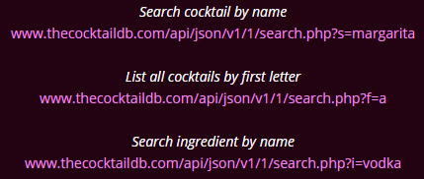
The Cocktail Database
JSON Responses
We need only replace this with the letter we’re interested in.
The documentation indicates that we can run some of the following requests (among a number of others):
URL
URL
URL
We are looking at part of the documentation for the website’s API.

Slide 30
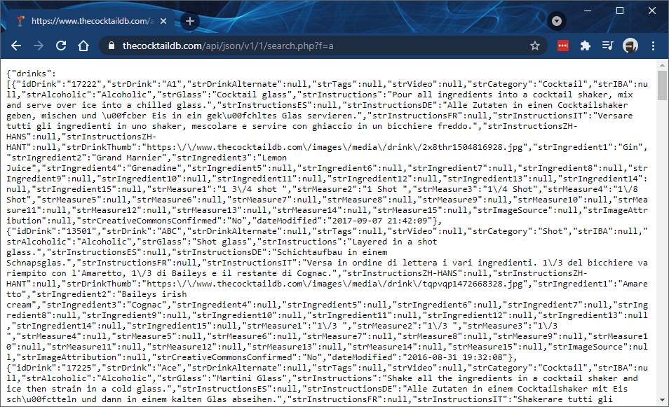
The Cocktail Database
JSON Response
If we wanted a list of all cocktails starting with ‘a’...
The documentation suggests we could use our browser to visit...
Not quite as “human readable” as I was hoping!

Slide 31
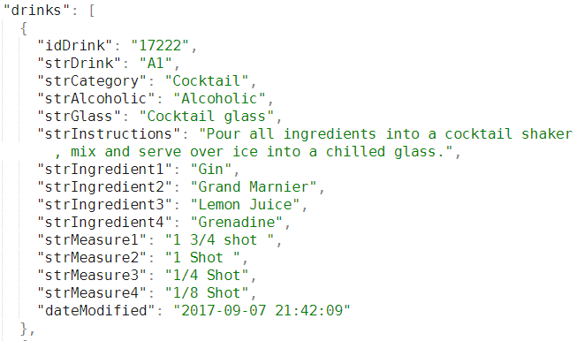
The Cocktail Database
Using an online JSON pretty-printer, and simplifying a little, we see:
Unique ID
Name
Instructions
Ingredients
Measures
Empty and less pertinent fields were removed. A number of other cocktails were returned but not shown above.

Slide 32
The Cocktail Database
Without needing to use a web browser...
...Could we get that data into a more usable format?
Of course!
Later versions of Excel allow you to import from XML/JSON directly.
In absence of that, we could use either of R/Python/VBA.

Slide 33
The Cocktail Database
In terms of requirements...
We want the user to be able to select the starting letter.
...and then be able to retrieve a list of corresponding cocktails and instructions.
What will the underlying code need to do?
Generate the request (based on the selected letter) for us to send to the web-API.
Receive the JSON response.
Scan the response to extract the desired fields*.
Output these to the user.
* Required the use of Regular Expressions which are incredibly powerful when it comes to searching for, extracting and manipulating text. Could be a separate talk in their own right!

Slide 34
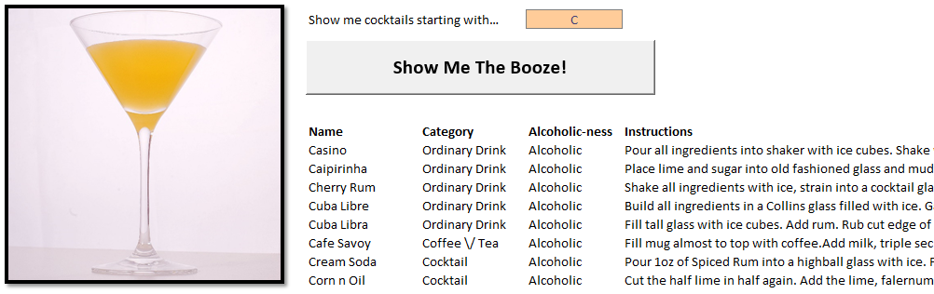
The Cocktail Database (VBA approach)
Sample output shown below.
Spreadsheet can be found here

Slide 35
The Cocktail Database (R approach)
Worked example with R code can be found here.
In case anyone was wondering...
The R approach was a lot easier to derive.
I challenge anyone to find a more elegant solution!

Slide 36
The Cocktail Database
The approaches shown here could be extended for the other options available as part of the API as desired.
Eg. Retrieve details for a particular drink.

Slide 37
A quick note on API Keys...
Websites may require you to include an “API key” in the URL when sending the request.
www.thecocktaildb.com/api/json/v1/970ae656-1346-42ca-8c5e-41c778f834ff/search.php?f=a
They are unique to you/team/business and should be protected like a password.
Obtaining a key will likely require registration and may have an associated cost.
The website will make this clear in the relevant documentation.
For example, a particular price plan may mean you can make up to (say) 100 requests per day using your API key.
Sample API key
Requested action
& parameter

Slide 38
What else I found...
Web-based APIs with JSON responses are also available for:
Current weather
Football Data
Near-Earth objects, Mars weather....
Chuck Norris jokes
{
"icon_url" : "https://assets.chucknorris.host/img/avatar/chuck-norris.png",
"id" : "IcL984nbQ0uWnkLEAMRMQA",
"url" : "",
"value" : "Palaeontologists think the velociraptor had feathers because Chuck Norris said so."
}

Slide 39
What have we seen so far?
HTML Response

Slide 40
What didn’t we cover?
HTML Response

Slide 41
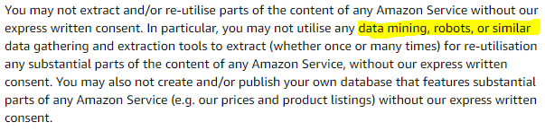
General considerations
Websites generally state within their Terms of Use whether they prohibit (automated) data retrieval.
The following was taken from the Amazon usage terms:

Slide 42
General considerations
If you place undue burden on their infrastructure, they may block your IP address or rescind any API keys issued to you.
If running batches, try and run them outside of core business hours.
...with suitable gaps in between each request!
(Please don’t make the news for having caused a “DDoS” attack)
DDoS = Directed Denial of Service

Slide 43
General considerations
Some of the approaches discussed will actually use less bandwidth as opposed to interacting the civilian way.
Some websites will check whether interactions are from a person as opposed to a script.
...which will lead to varying levels of headache for you.

Slide 44
General considerations
When scraping aggregators in the past, I used obviously fictional personal details so they could (hopefully) identify these and exclude them from their MI.
I can only imagine their surprise at Chuck Norris having requested ~50 life insurance quotes in succession!
There are companies whose speciality is scraping other companies websites.
They can deliver information in whatever format you require as often as you require it. (For a fee of course!)

Slide 45

Additional resources
Speak to me!
There are a lot of (free) tutorials on-line.
However, whether they are relevant really depends on your requirements.
I’d suggest discussing with me as a first step.
Mining Social Media: Finding Stories in Internet Data
Book by Lam Thuy Vo
Demonstrates the situations discussed here.
Targeted towards Python but underlying principles can be transferred to R (and possibly VBA)

Slide 46

Any questions?
Comments?

