Slide 1






Document AI – Ingestion, Extraction, Insight, Action
Customers
Generative AI
Customers
Customers
Human in the Loop
Review
Triggered by granular confidence threshold
Human in the Loop
Review
Triggered by granular confidence threshold
Agents
Human in the Loop
Review
Triggers -
Low confidence
Inconsistency
Agents
Agents
Document
Ingestion
Trigger Policy
Scheduled
Or
Realtime
Content Extraction
Structured Forms
Unstructured KV
Handwritten
Images, Videos
Language
Insight
&
Action
Post Processing
Data Validation
Anomaly Detection
Automated Reply
Email
Document
Input Channels (mail, chat, web)
Human in the Loop
Review
Triggered by granular confidence threshold
Human in the Loop
Review
Triggered by granular confidence threshold
Image
Video
Fraud Detection
Anomaly Detection
Form
Audio
New Insurance Quote
New Claim
Commercial Insurance
Worker Compensation
Data Store, Index, Search
Customers
Customers
Customers
New Insurance Quote
New Claim
Commercial Insurance
Worker Compensation
Agents
Agents
Agents

Slide 2
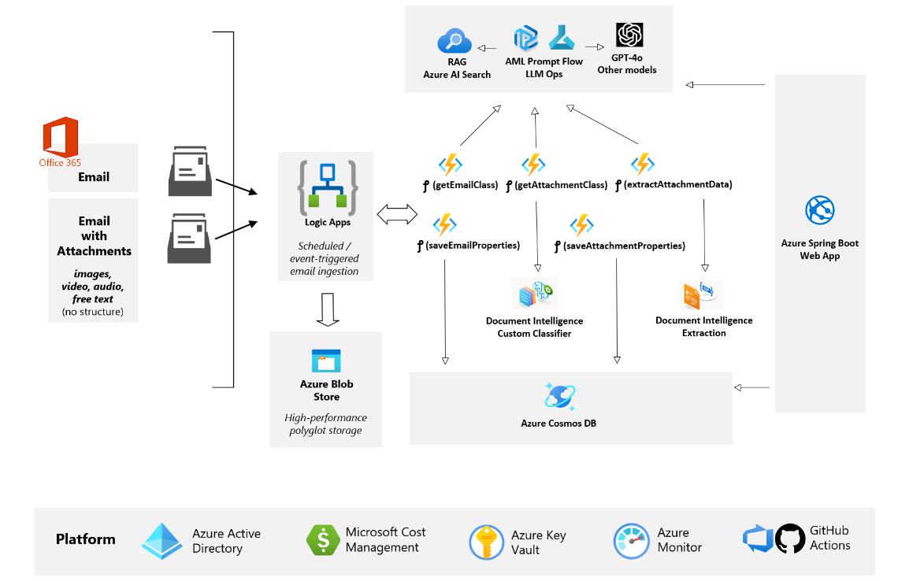
The Architecture
Notes:
Confidence - In ChatCompletion python API call if you set logProbs = true, OpenAI will return the probability of each token (prob of it selecting this token in the output out of all the alternatives).
https://community.openai.com/t/confidence-score-for-prompt-response/132278/2

Slide 3
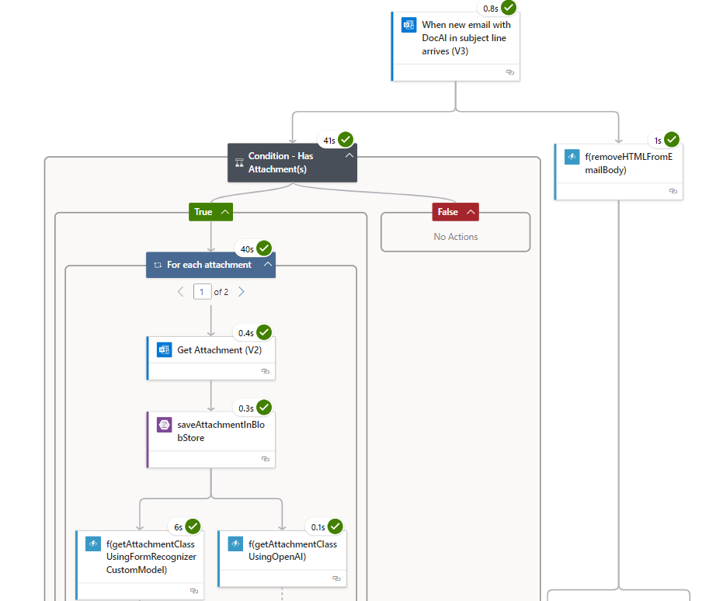
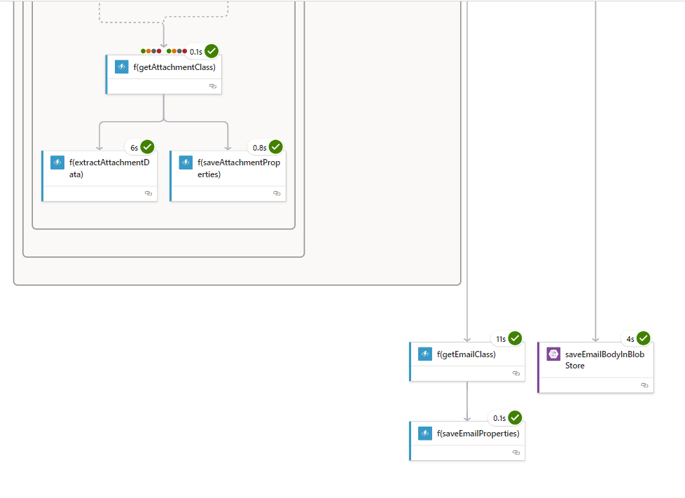

Slide 4
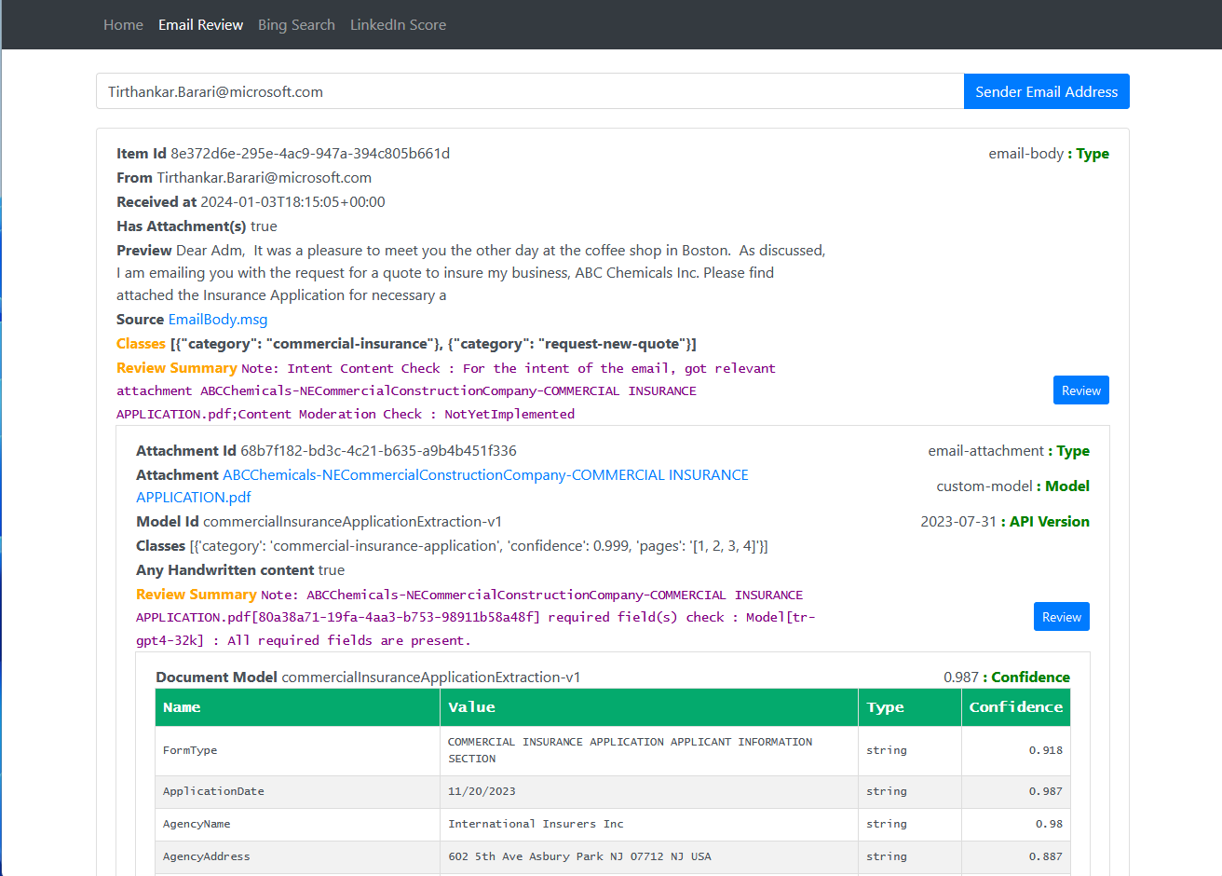
Detect & Fix
Data Insufficiencies
Data Inconsistencies

Slide 5
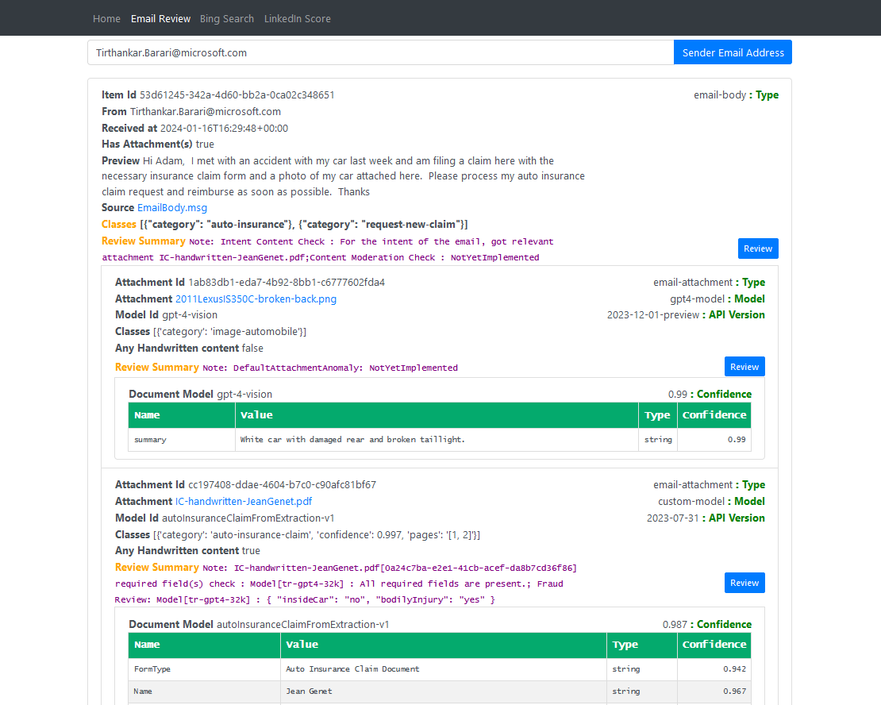
Fraud Detection
Anomaly Detection
Trigger HITL

