Slide 1






Document AI – Ingestion, Extraction, Insight, Action
Customers
Generative AI
Customers
Customers
Human in the Loop
Review
Triggered by granular confidence threshold
Human in the Loop
Review
Triggered by granular confidence threshold
Agents
Human in the Loop
Review
Triggers -
Low confidence
Inconsistency
Agents
Agents
Document
Ingestion
Trigger Policy
Scheduled
Or
Realtime
Content Extraction
Structured Forms
Unstructured KV
Handwritten
Images, Videos
Language
Insight
&
Action
Post Processing
Data Validation
Anomaly Detection
Automated Reply
Email
Document
Input Channels (mail, chat, web)
Human in the Loop
Review
Triggered by granular confidence threshold
Human in the Loop
Review
Triggered by granular confidence threshold
Image
Video
Fraud Detection
Anomaly Detection
Form
Audio
New Insurance Quote
New Claim
Commercial Insurance
Worker Compensation
Data Store, Index, Search
Customers
Customers
Customers
New Insurance Quote
New Claim
Commercial Insurance
Worker Compensation
Agents
Agents
Agents

Slide 2
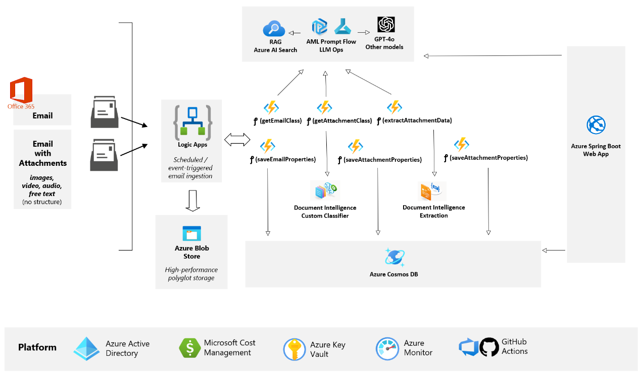
The Architecture
Notes:
Confidence - In ChatCompletion python API call if you set logProbs = true, OpenAI will return the probability of each token (prob of it selecting this token in the output out of all the alternatives).
https://community.openai.com/t/confidence-score-for-prompt-response/132278/2

Slide 3
Service Capacity and Limitations
Azure Open AI GPT 4 Turbo with Vision (Preview)
Supported Image file types – JPEG, GIF, PNG and WEBP
Max size of each image file – 20MB
Limit 10 images per chat call
Low Resolution option for faster response with lower token numbers instead of accuracy
Supported Video file types – MP4 and MOV (low resolution)
Max Video size of 3 minutes (for Playground)
No limitation of Video size for API
Selects 20 frames from the entire video
Supports English for grounding with transcripts
Transcripts are not accurate on lyrics in songs
Token calculation for image and video
GPT-4 (1106-preview)/Turbo max tokens per min (TPM) – 80k
Misc.
Azure Document Intelligence Service
Supported file types for custom models – JPEG, PNG, BMP, TIFF, HEIF, PDF
Transactions per second standard limit – 15 (adjustable)
Max doc size – 500MB
Max number of pages - 2000
Max number of custom classifier classes – 500 (default)
More details
Azure Cognitive Search Service
Supported file types for indexing – PDF, DOCX, DOC, XLSX, XLS, HTML, RTF, TXT, TSV
Different Data Sources for the Indexer to pull data in – full list
Number of documents per index – 24 billion
Max document size when calling an Index API – 16 MB
More details
Notes:
To read EXCEL files using python –
Use openpyxl to read/write .xlsx, .xlsm, .xltx and .xltm
Use XlsxWriter
Use pyxlsb (to parse the .xlsb binary file format)
pip install xlrd
Use pandas
Use Xlwings to read/write EXCEL cells
https://learnpython.com/blog/python-package-for-excel/

Slide 4
Service Capacity and Limitations
Azure Logic App
Workflows per region per Azure Subscription – unlimited (standard tier)
Max number of actions per workflow – 500
Actions nesting depth - 8
Max items in a loop – 100,000
Number of For each loops that can run in parallel – 20
Throughput and other limit details
Azure Arc enabled Logic App in AKS
Azure Functions
Function timeout duration – 30 min to unlimited (Premium & Dedicated Tier)
Hosting options details

Slide 5
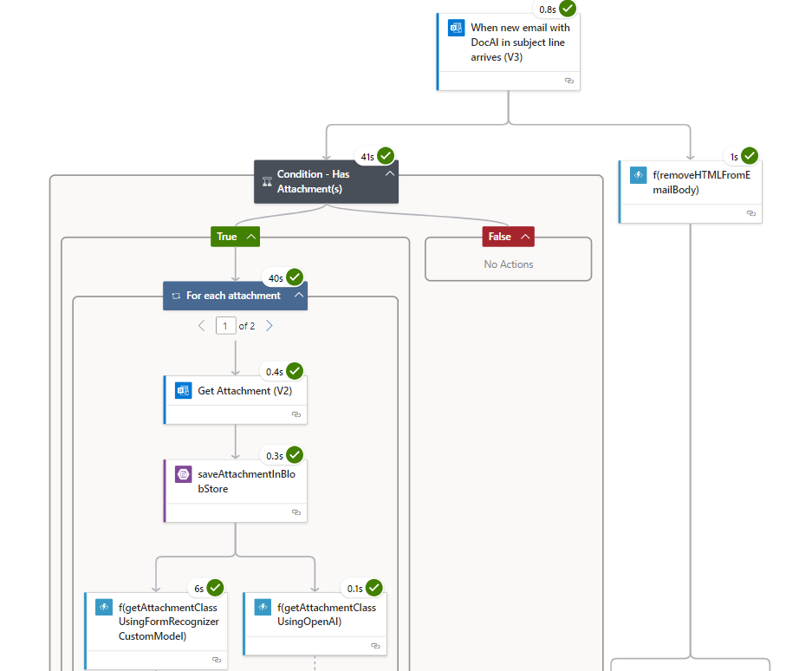
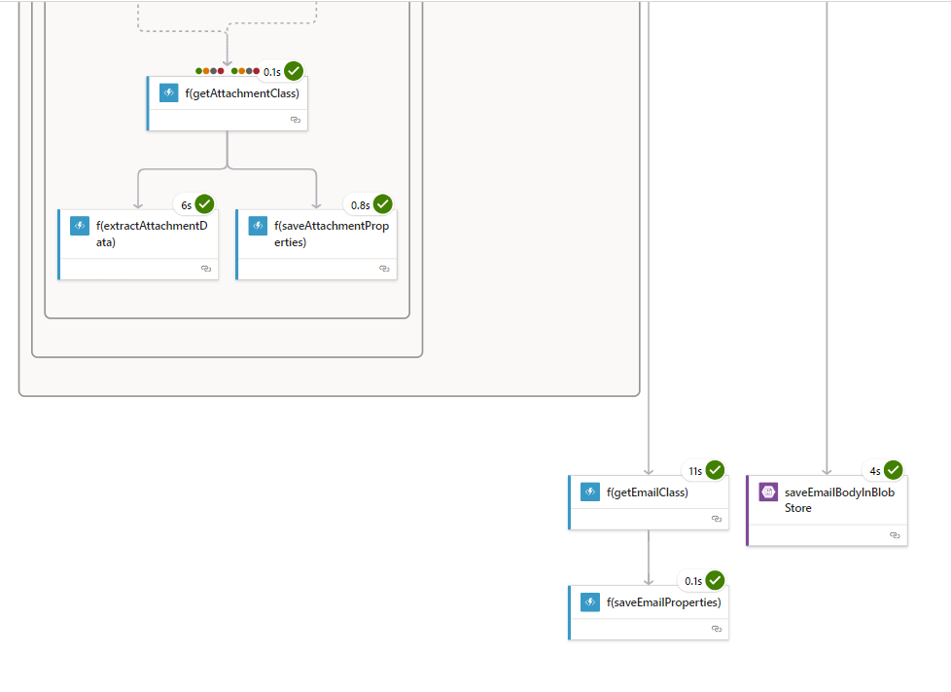

Slide 6
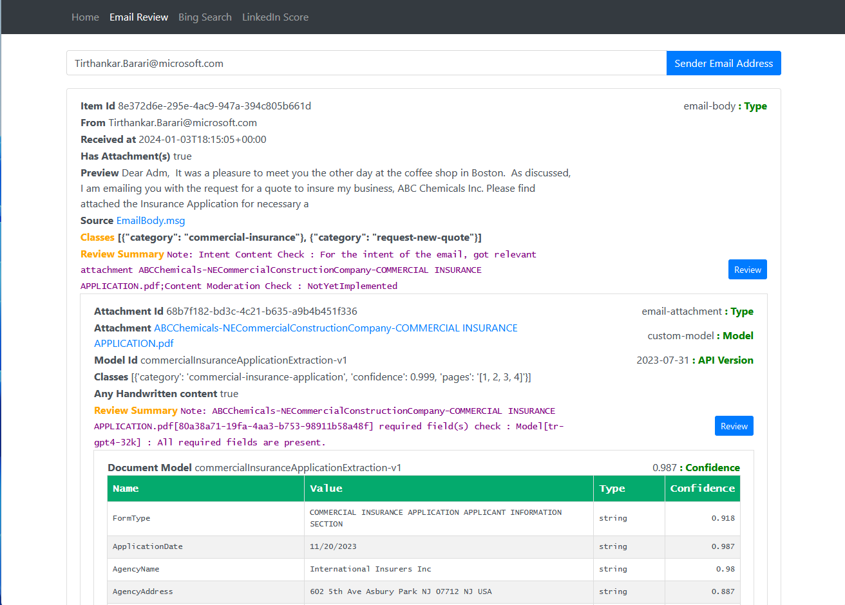
Detect & Fix
Data Insufficiencies
Data Inconsistencies

Slide 7
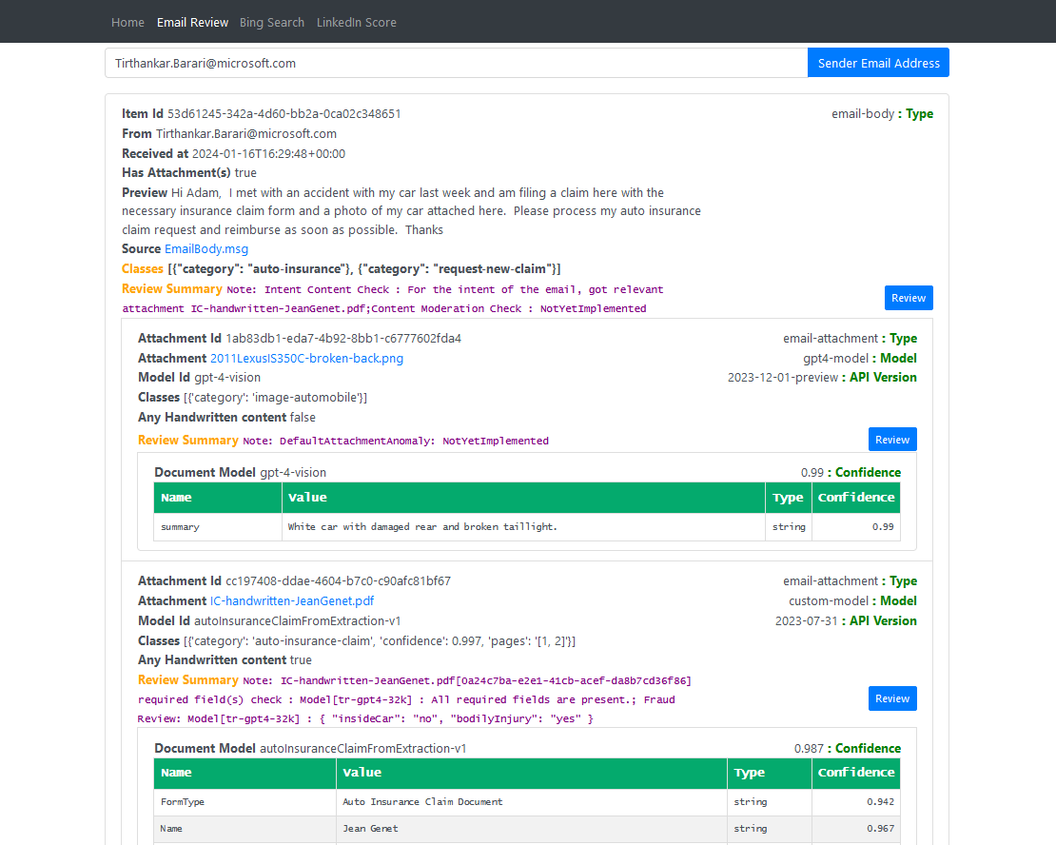
Fraud Detection
Anomaly Detection
Trigger HITL

Slide 9
References
What’s new in Document Intelligence Service
Query Fields
Key Value Pair
High Resolution Extraction
Barcode
Font Property Extraction
Formula Extraction (LaTeX representation as value)
AOAI with GPT-4 Vision API

