Slide 1
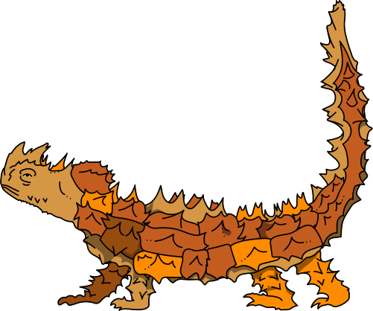


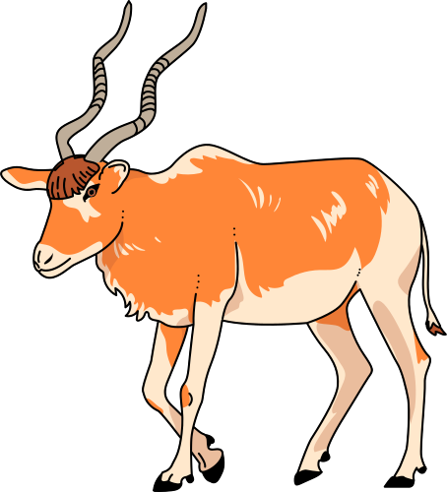
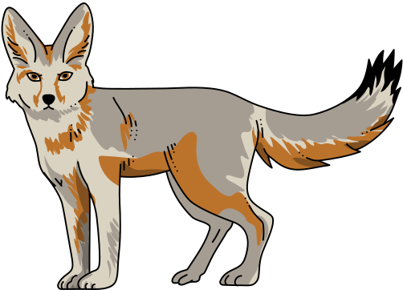

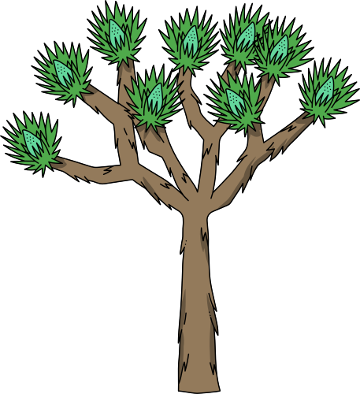
Biodiversity
Functional & Phylogenetic Diversity

Slide 2

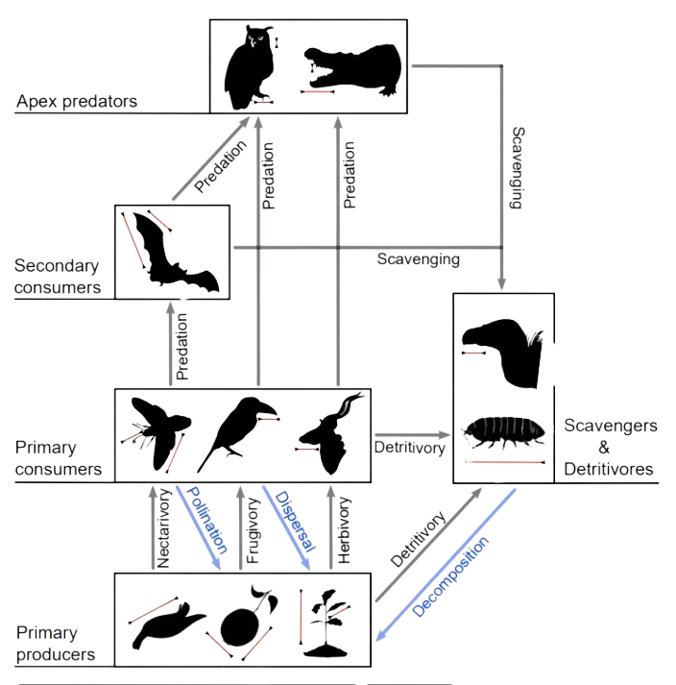


Functional Diversity
Decide on which functional traits are important.
Measure those traits on the species of interest.

Slide 3
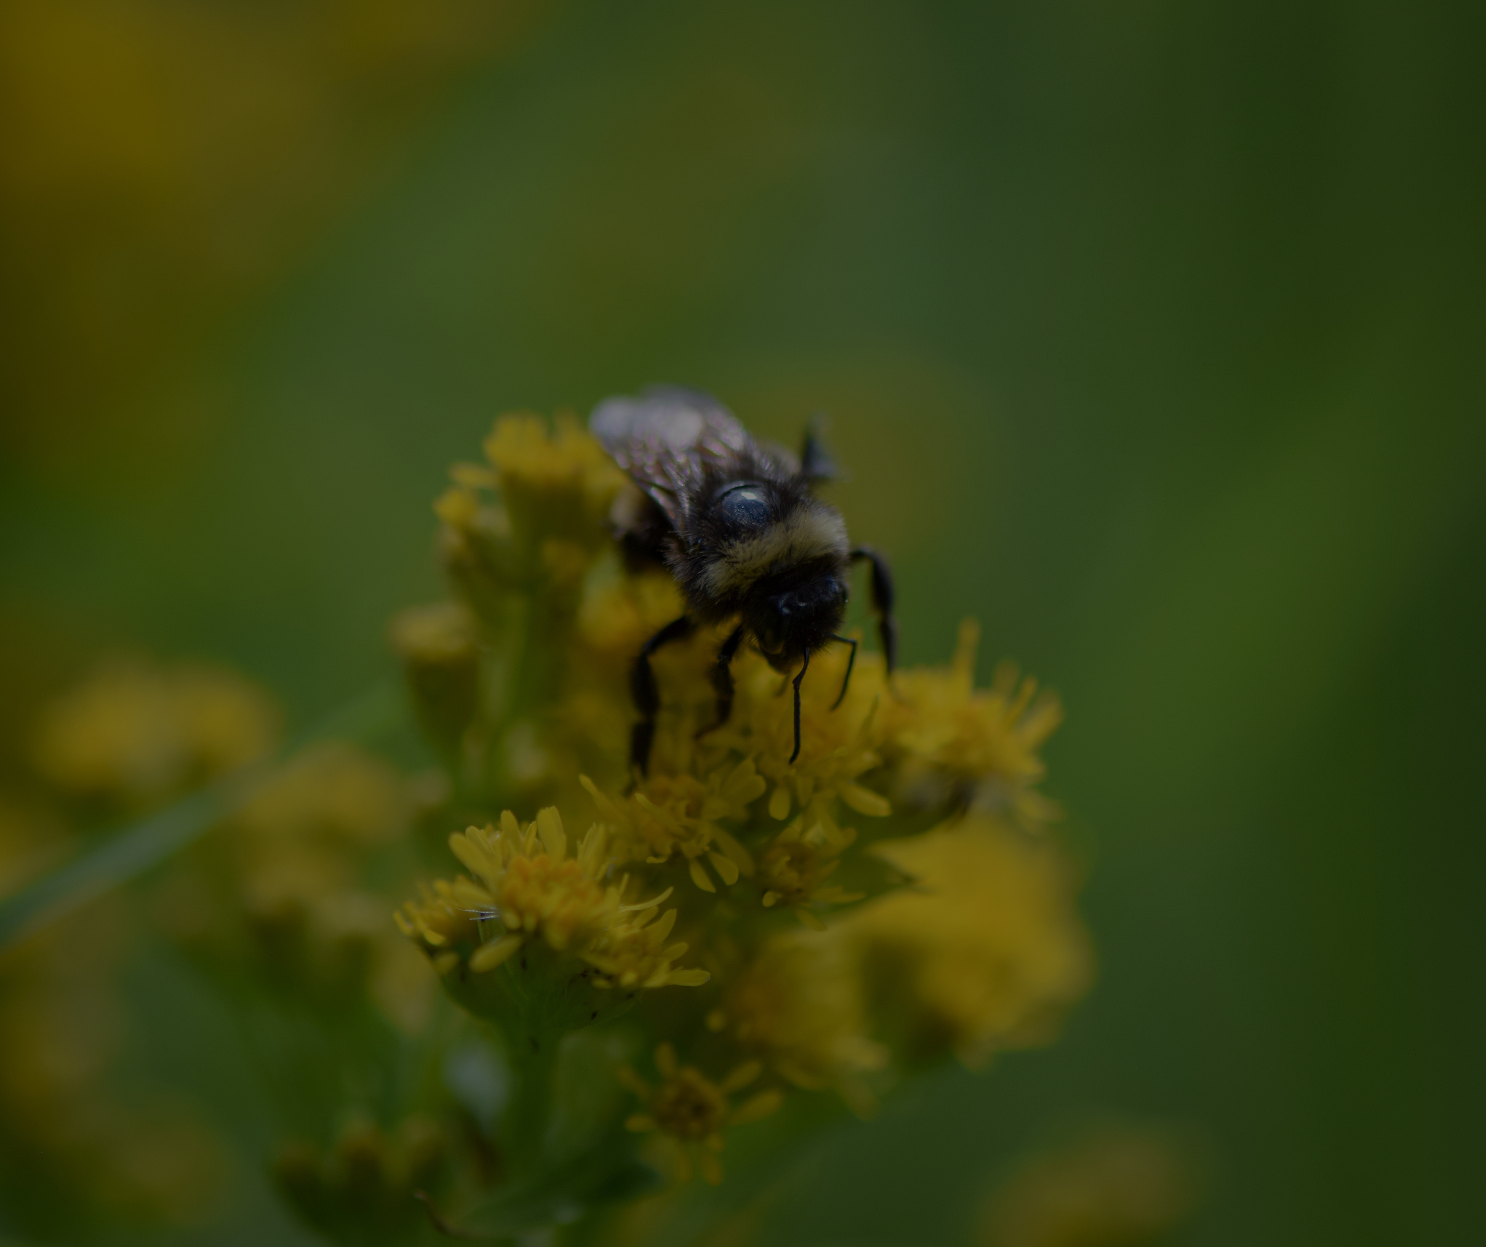
Functional Traits
Examples:
The different shapes and sizes of flowers that insects pollinate
The heights of trees in a canopy that influence their competitiveness for light
The gape sizes of predatory fishes that influence which types of prey species they eat.

Slide 4
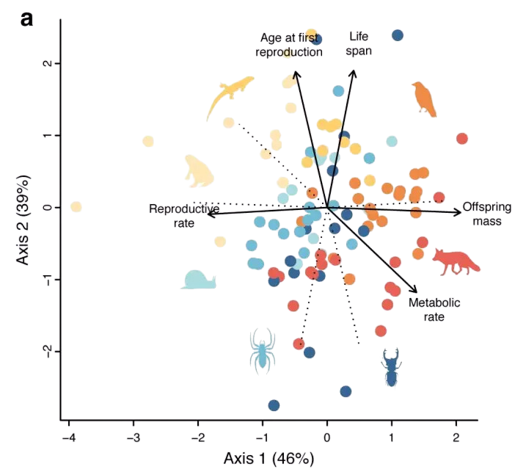

Functional Diversity
Once a researcher decides on which functional traits are important and collects measures of those traits on the species of interest, the next step is to quantify how similar or different species are in a “trait space.”
When many functional traits are measured, one usually calculates the Euclidean distance separating each pair of species in an n-dimensional matrix, where n is the number of traits measured.

Slide 5
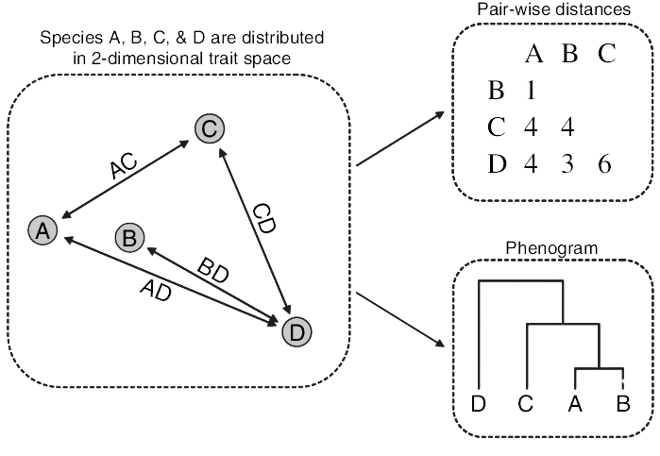
Functional Diversity
The trait distances that separate species can then be used to make a phenogram.
Diagram depicting relationships among species based on their overall similarity or dissimilarity in functional traits.

Slide 6
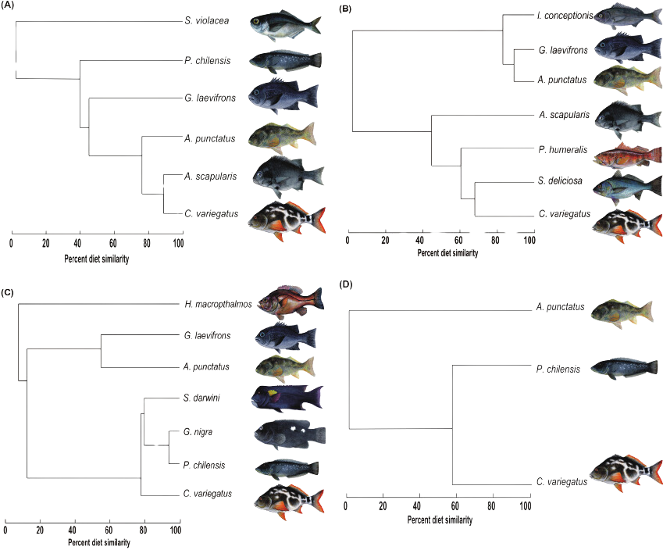
Functional Diversity
The trait distances that separate species can then be used to make a phenogram.
Diagram depicting relationships among species based on their overall similarity or dissimilarity in functional traits.

Slide 7
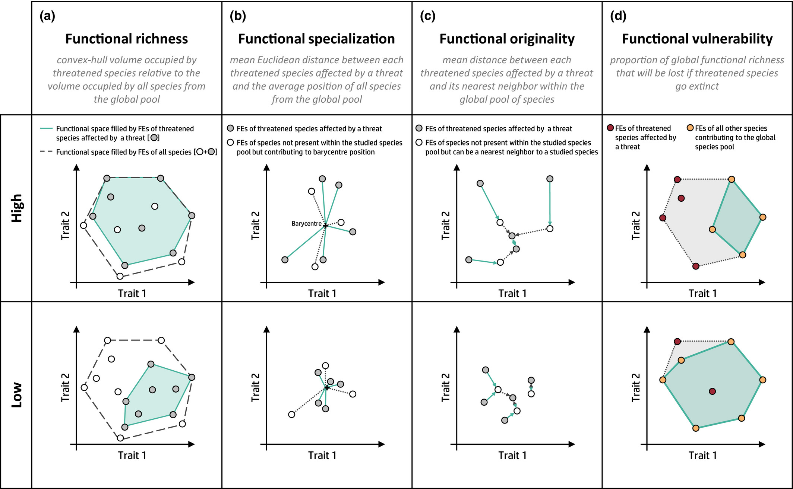
Functional Diversity
Once a phenogram is constructed, it is relatively simple to sum up the branch lengths among any species of interest to determine which sets of species have the largest or smallest functional diversity (FD).
Leclurc et al.,. 2020: Global changes threaten functional and taxonomic diversity of insular species worldwide. Diversity and Distributions.

Slide 8
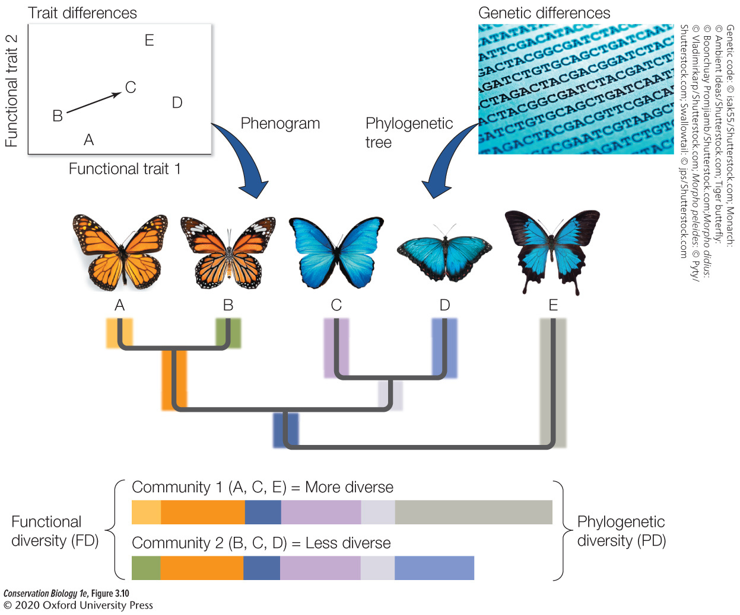
Phylogenetic Diversity
Summing the branch lengths of a phylogenetic tree that separate species gives a measure of phylogenetic diversity—the amount of genetic differentiation between any set of species that has resulted since their divergence from a common ancestor.

