Slide 1
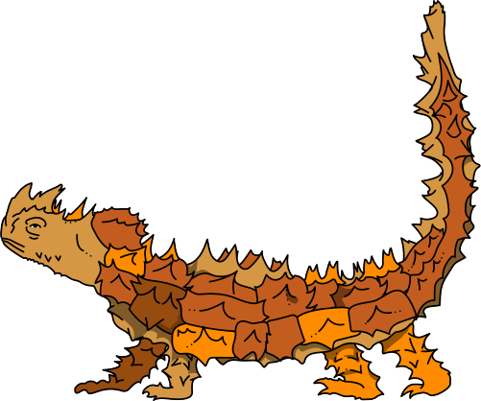
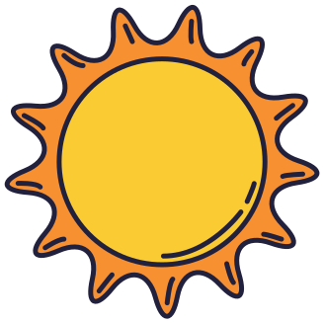
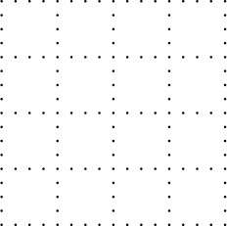
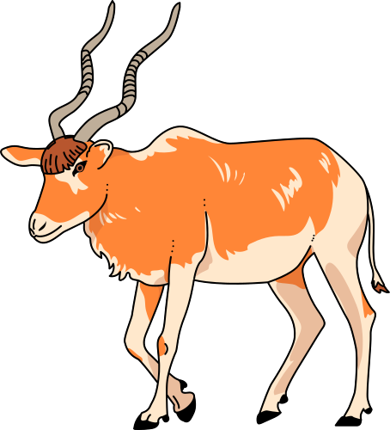
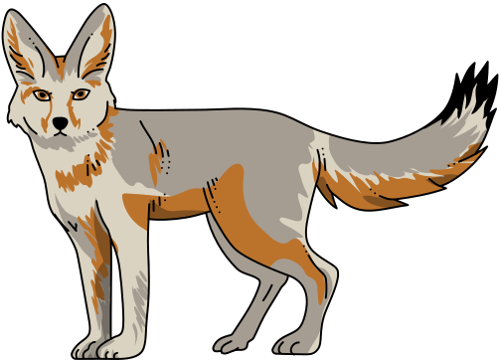

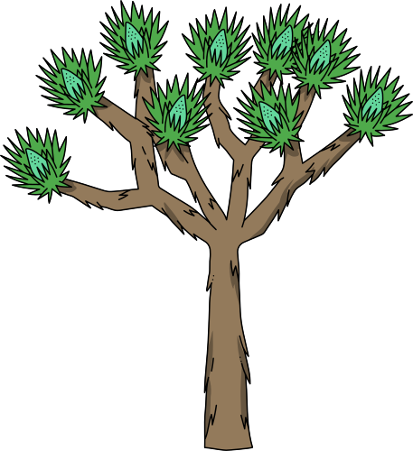
Biodiversity
Community & Ecosystem Diversity

Slide 2
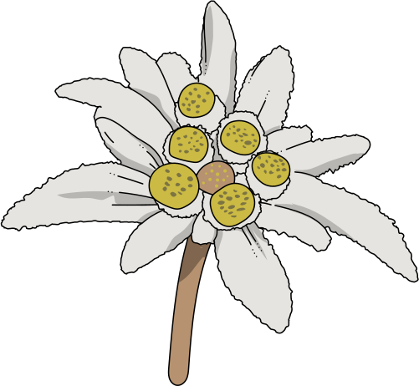
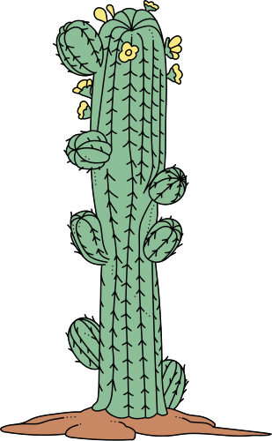
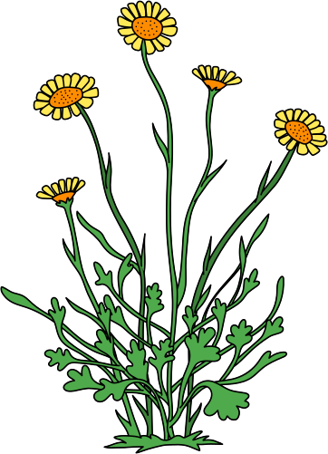
Community & Ecosystem Diversity
Biological Community
A biological community is a collection of species that occupy and interact in a particular location.
Joshua Tree
Ecosystem
Edelweiss Cactus
A biological community, together with its associated abiotic environment, is called an ecosystem.
Community Structure
The organization and complexity of a community is collectively referred to as community structure.
Saguaro
Desert Marigold

Slide 3
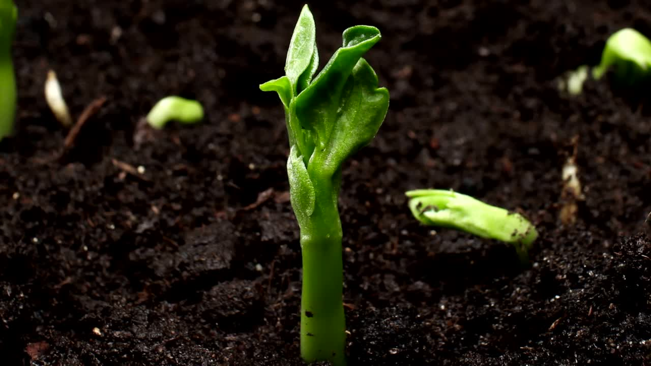
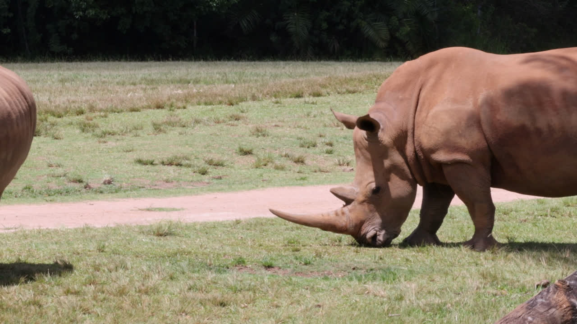
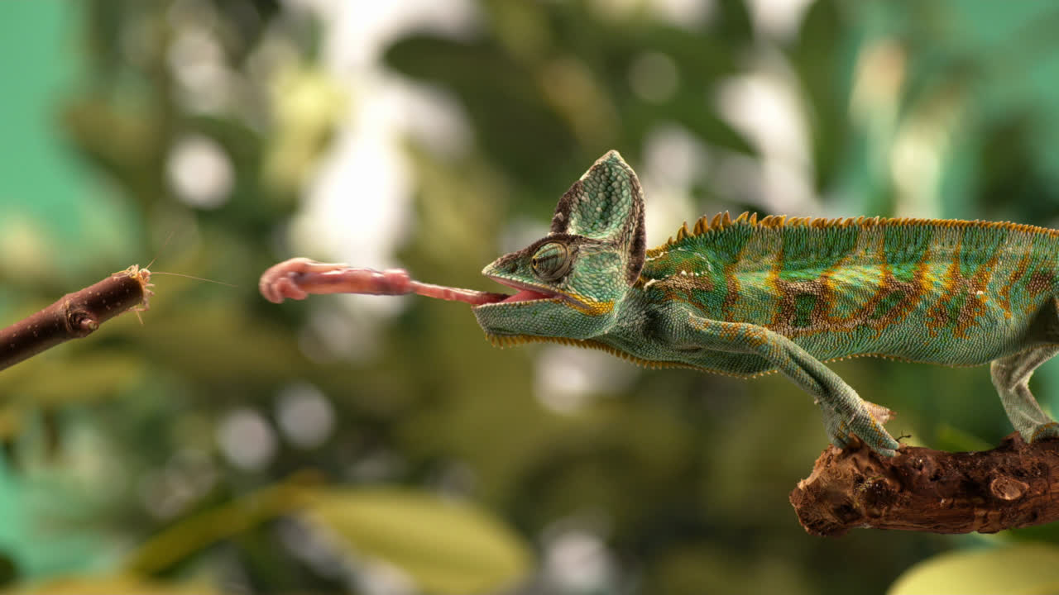
Trophic Structure
Primary (1°) producers
Primary (1°) consumers
Higher consumers
Obtain energy directly from the sun through the process of photosynthesis.
Also known as secondary (2°) and tertiary (3°) consumers, carnivores, or predators, they kill and eat other animals.
Also known as herbivores, eat photosynthetic species.

Slide 4
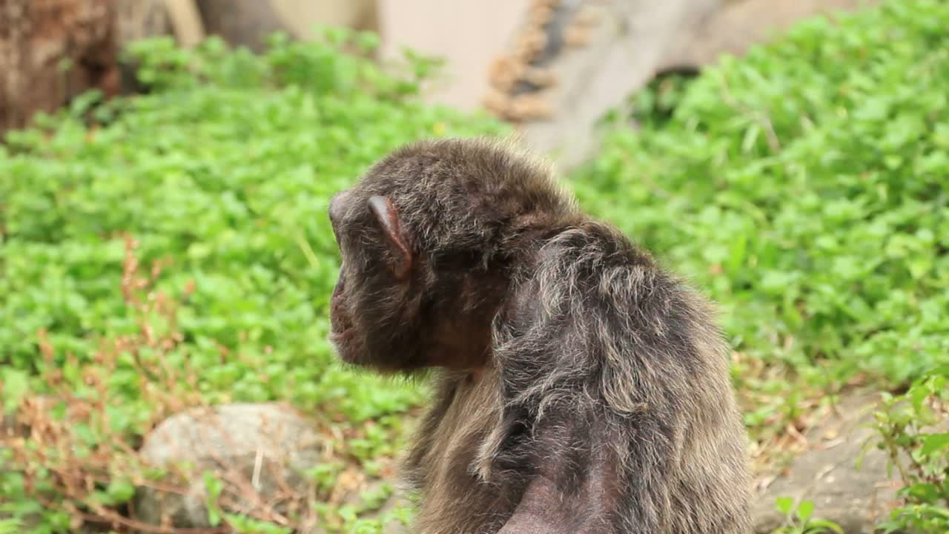
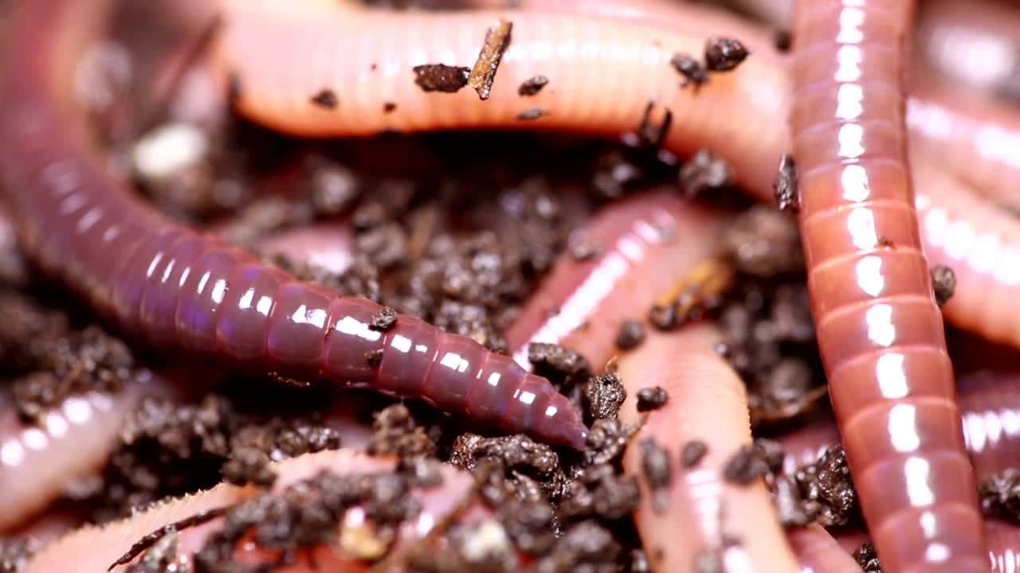
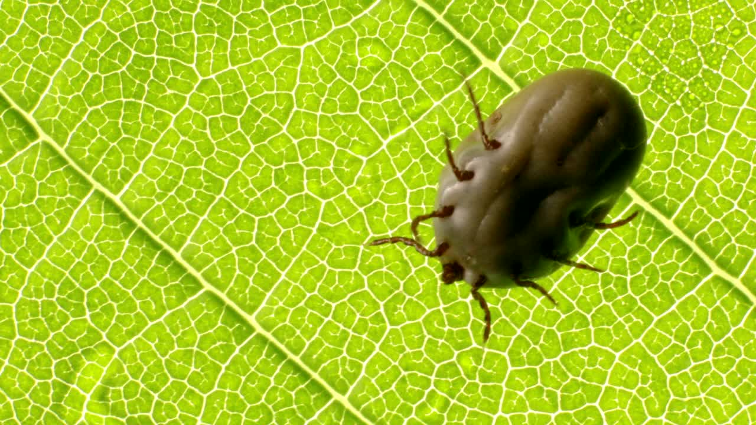
Trophic Structure
Omnivores
Detrivores
Parasites
Some species combine direct predation with scavenging behavior, and other species, known as omnivores, include a portion of plant foods in their diets.
Also known as decomposers, feed on dead plant and animal tissues and wastes (detritus), breaking down complex tissues and organic molecules.
Live on or within a host organism for all or part of their lives and may cause harm to the host or might just weaken it, while pathogens definitely cause harm to the cell.

Slide 5
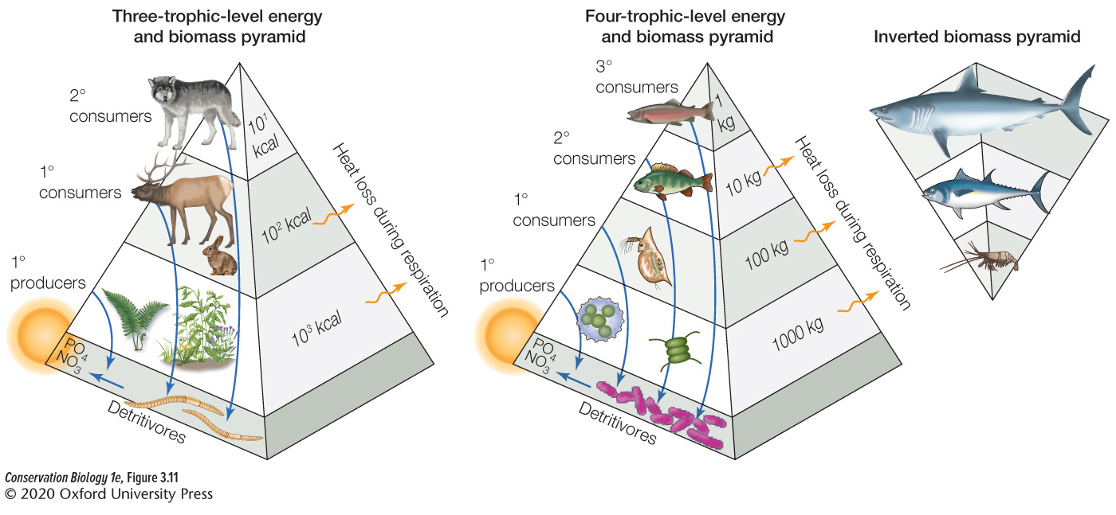
A trophic pyramid depicts the amount of biomass in, or energy available to, each trophic level in a community.
Energy—the number of kilocalories available for reproduction and growth—always declines at each successive trophic level.

Slide 6
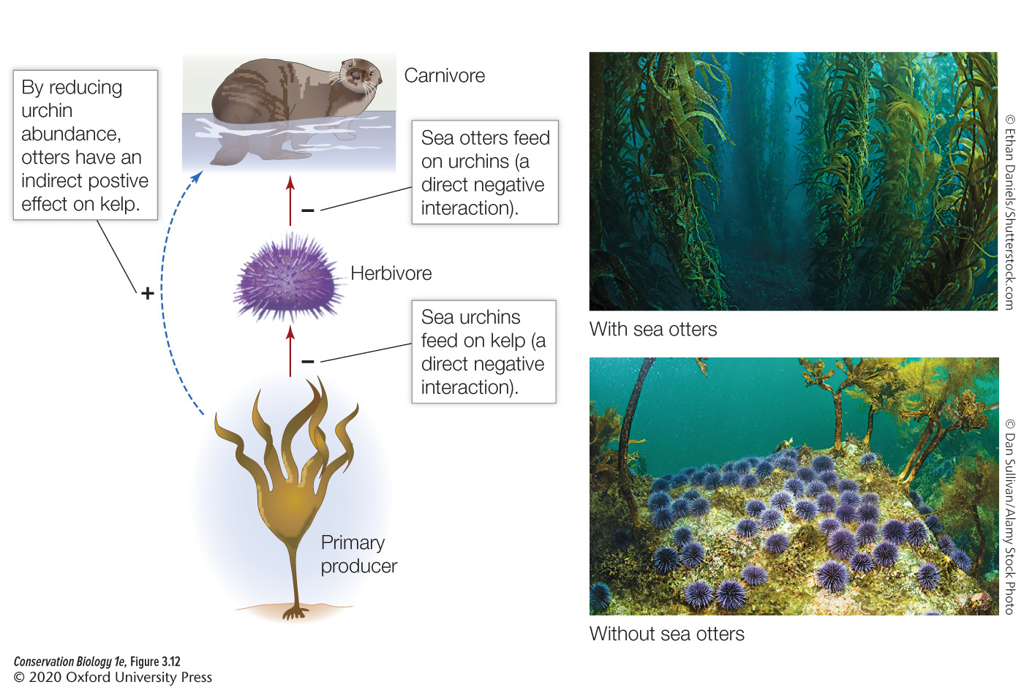
Trophic Cascade
An ecological phenomenon triggered by the addition or removal of top predators to a food pyramid, which then leads to reciprocal changes in the relative populations of predators and their prey. Trophic cascades can produce powerful indirect interactions that can alter the properties of entire ecosystems.

Slide 7


Slide 8
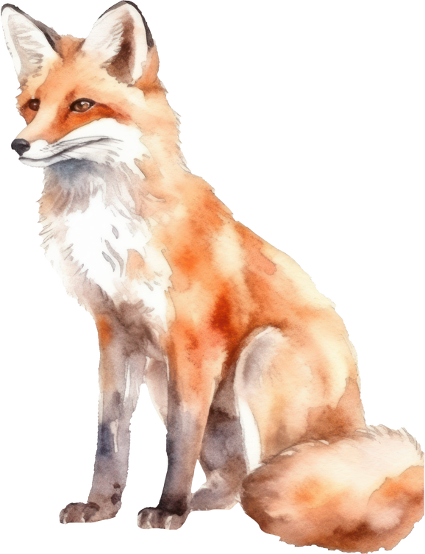
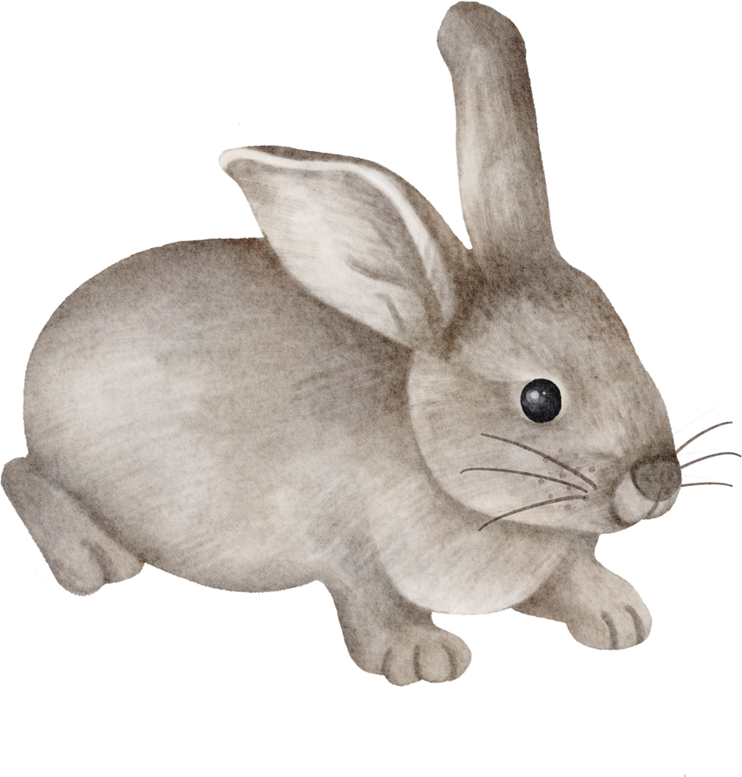
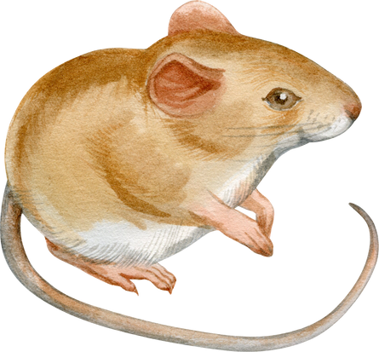
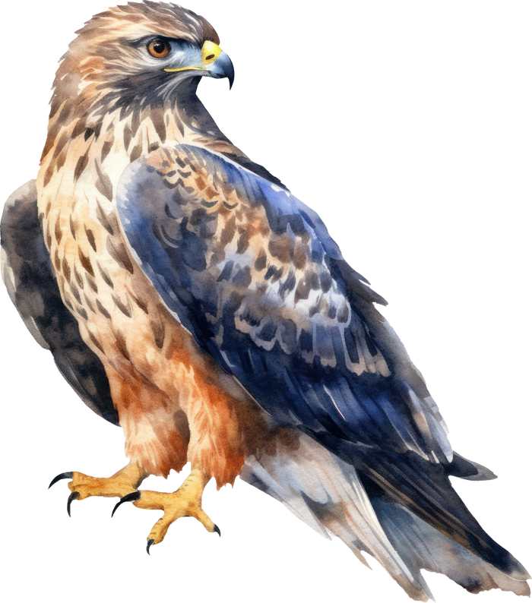
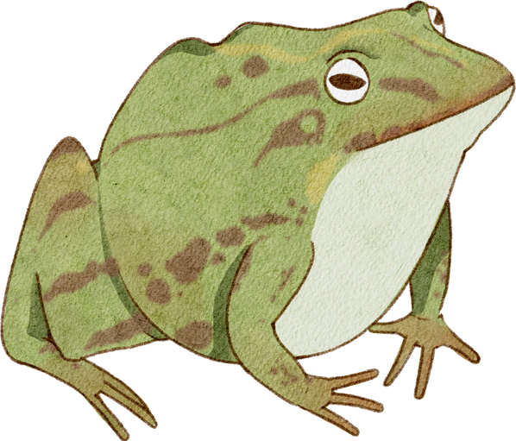
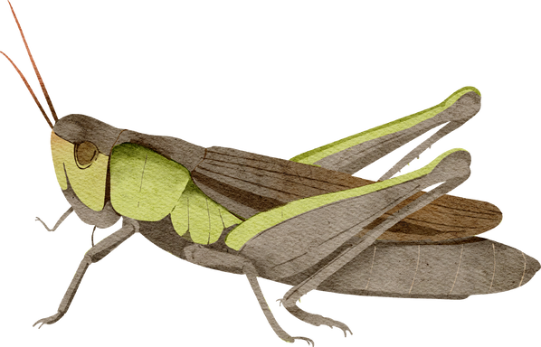
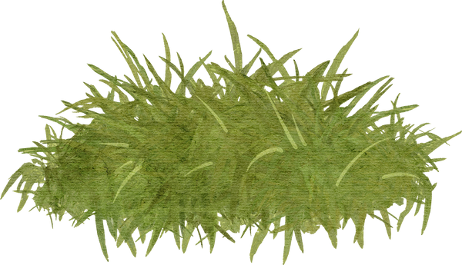
Food webs
Food webs depict feeding relationships between species that occupy different trophic levels in a community

Slide 9
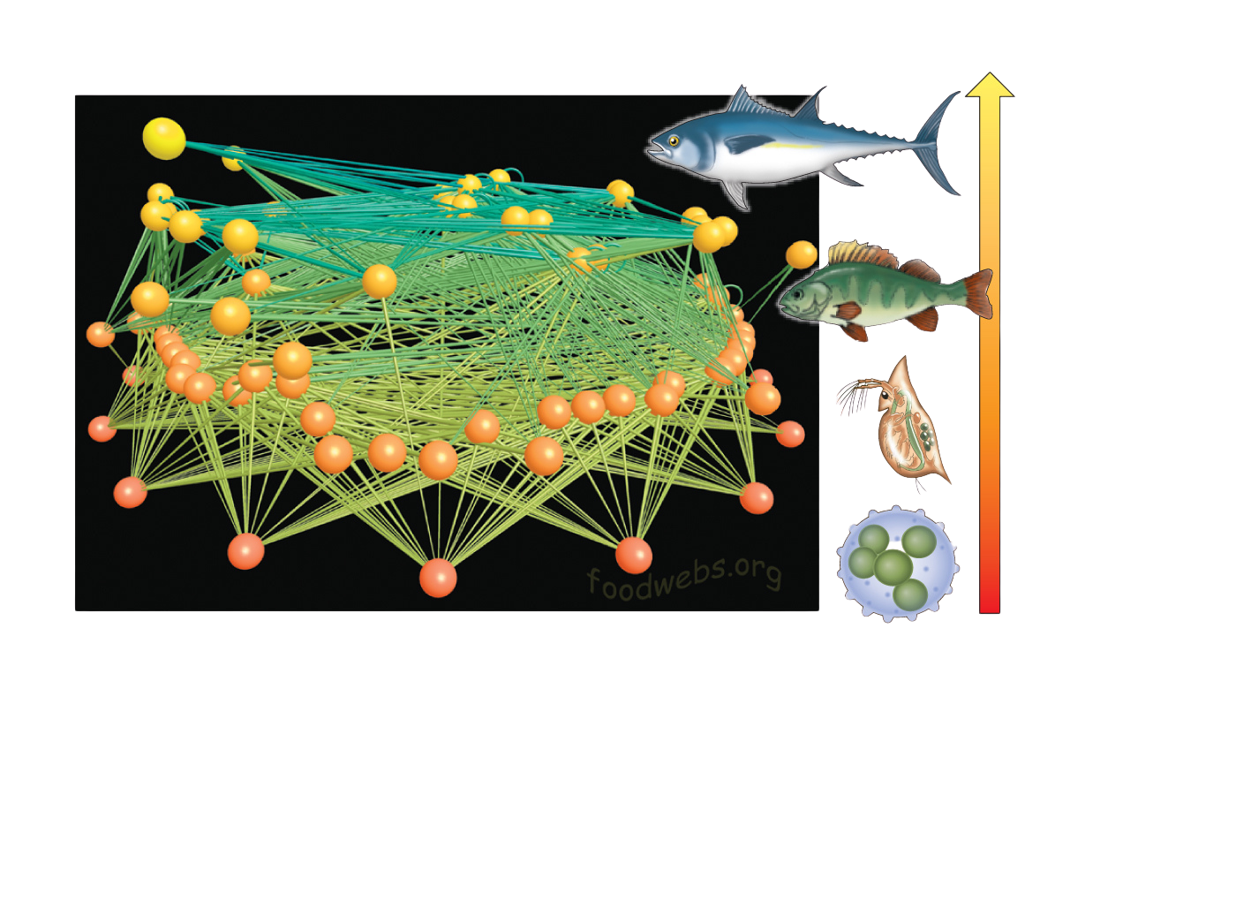
Food webs
Food webs depict feeding relationships between species that occupy different trophic levels in a community
Each dot in the matrix represents a link among species in the community.

Slide 10
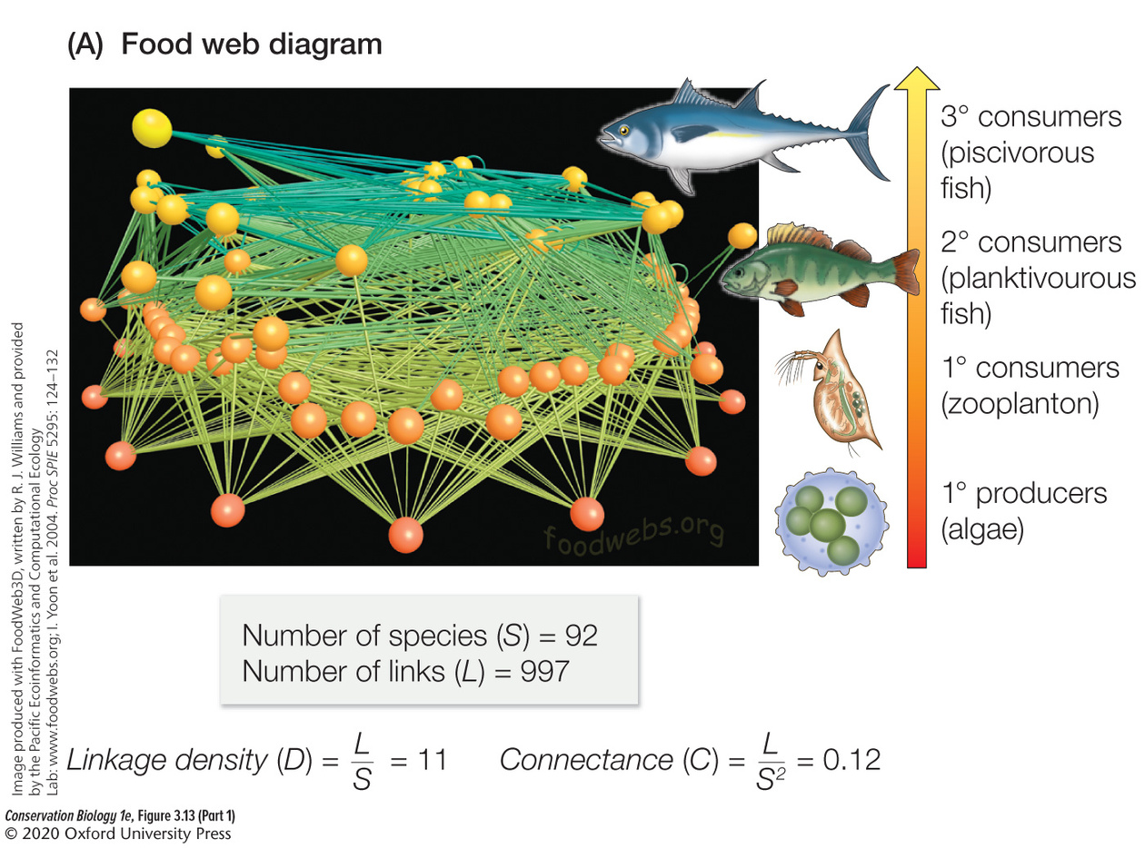
Food webs
Food webs depict feeding relationships between species that occupy different trophic levels in a community
They can be used to calculate the linkage density and connectance of species in the food web.

Slide 11
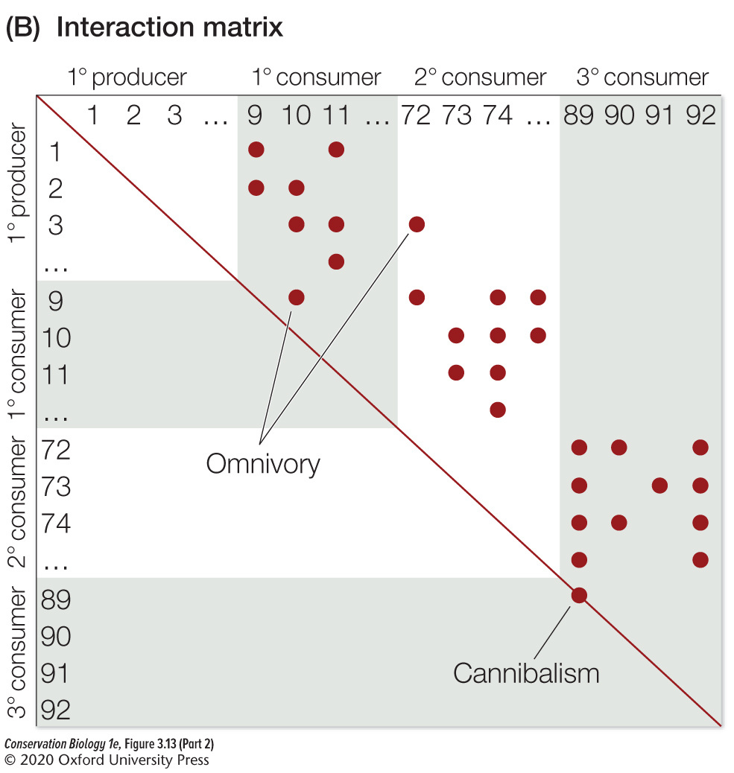
Interaction Matrix
The food web can also be described by an interaction matrix showing the presence of a link among species in the community.
The food web diagram and matrix can be used to identify species with a disproportionately large number of links.

Slide 12
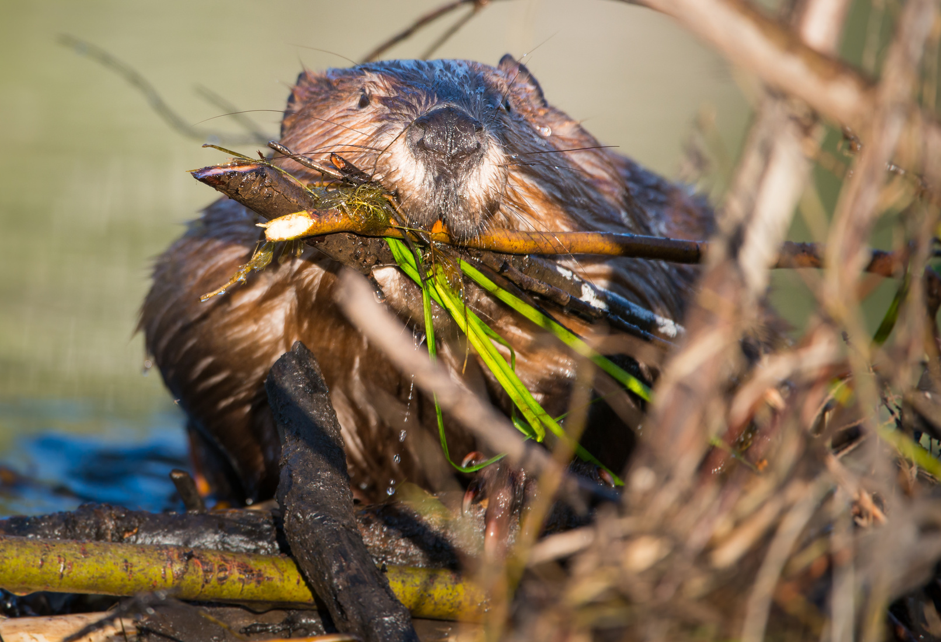
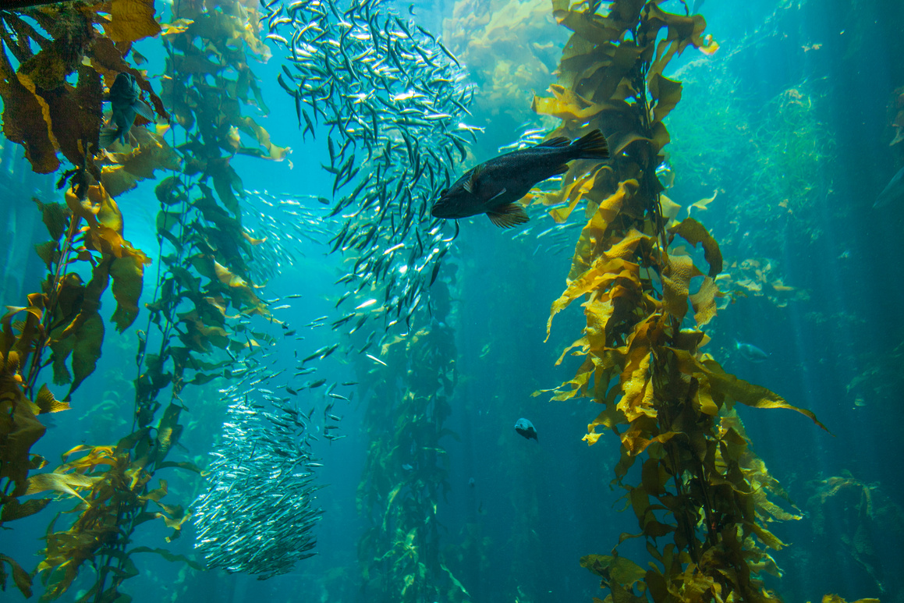
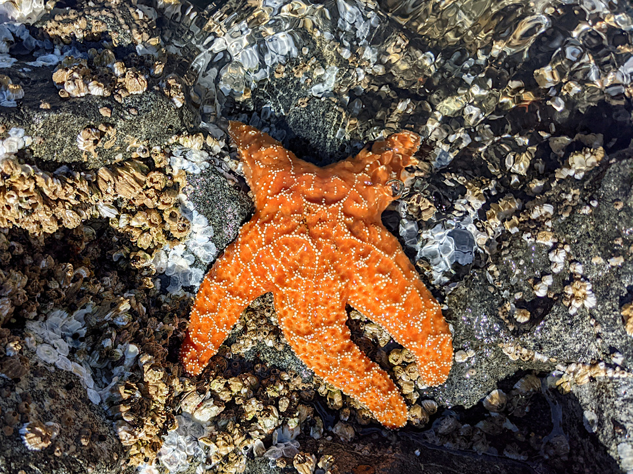
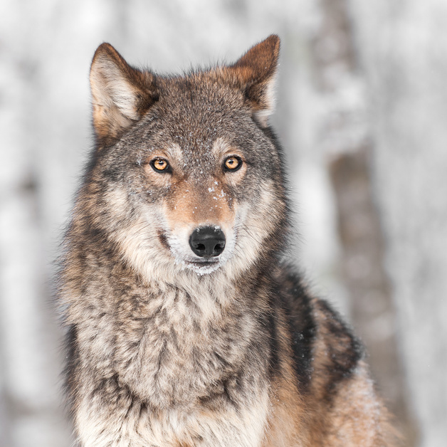
Species Composition - Special Cases
Ecosystem Engineers
Keystone Species

Slide 13
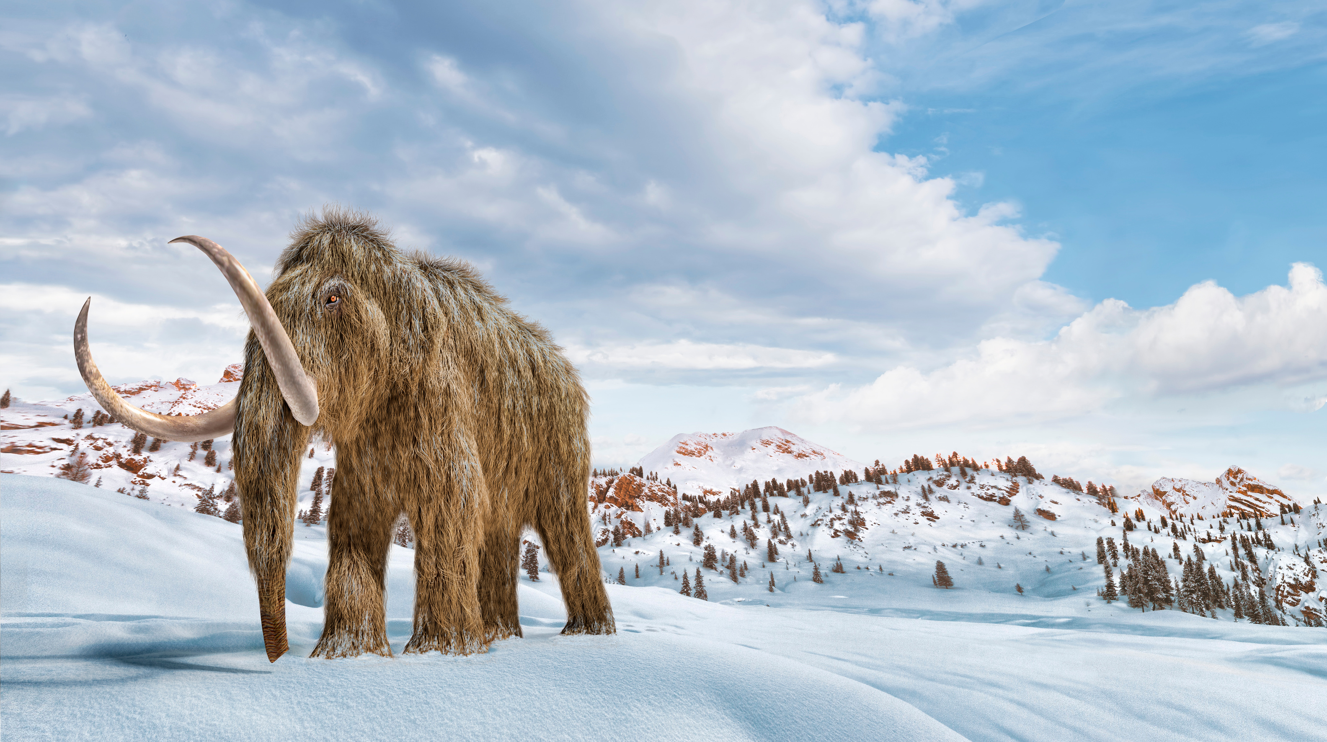
Ecosystem Engineers
Species that create new physical habitat or that extensively modify existing environments through their biological activities.

Slide 15
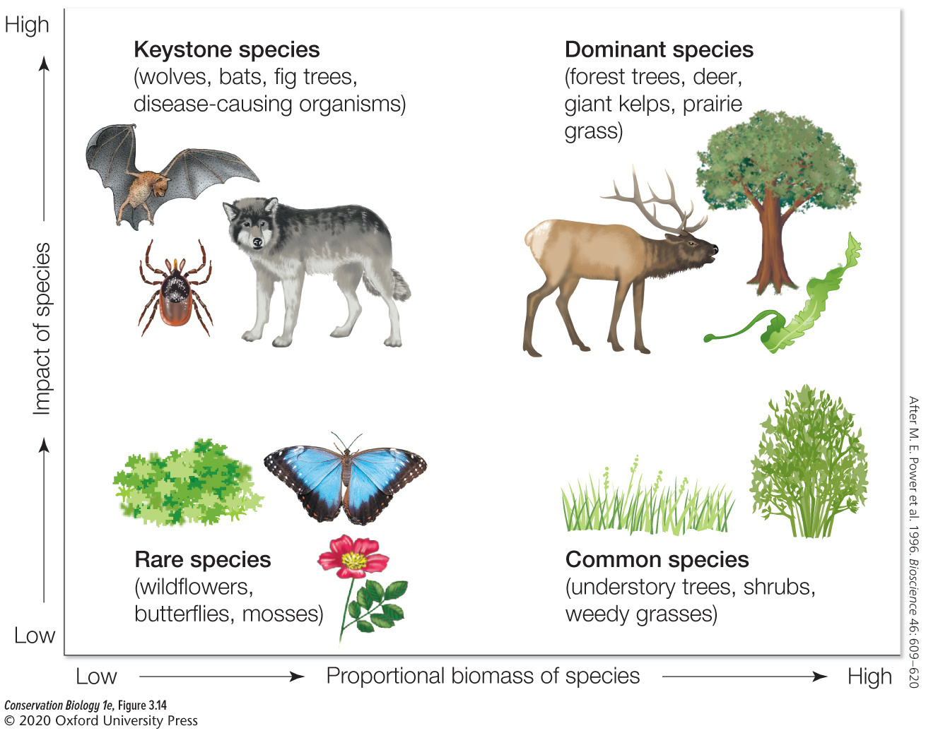
Keystone Species
A species that has a disproportionate impact (relative to its numbers or biomass) on the organization of a biological community. Loss of a keystone species can lead to a broader loss of biodiversity.

Slide 17
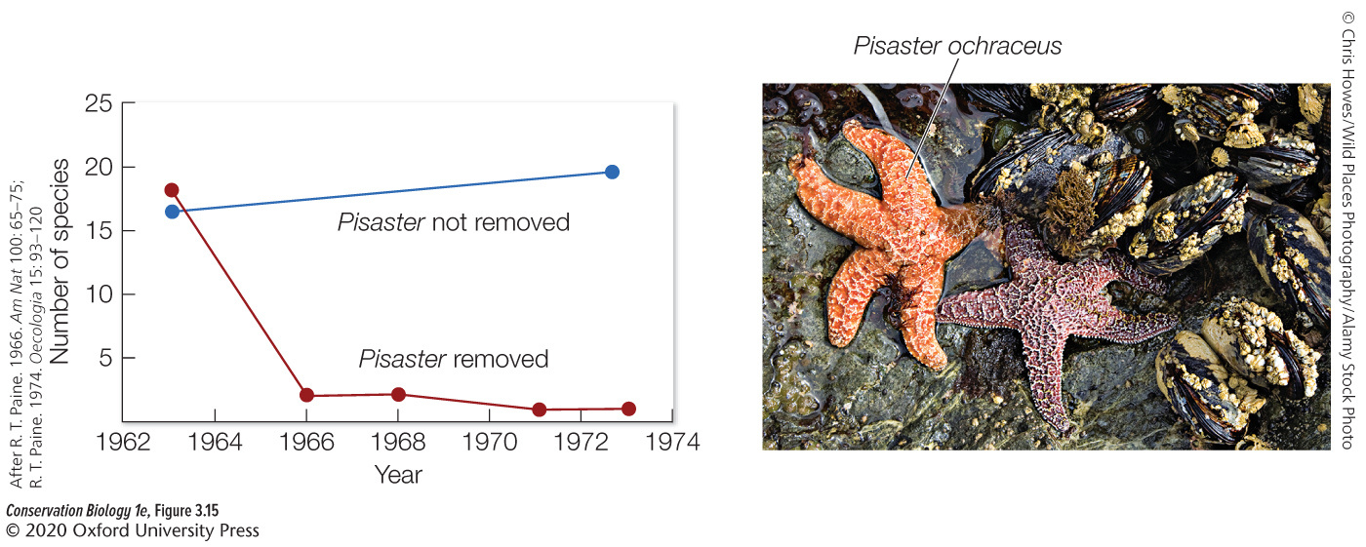
Selective predation by Pisaster on the competitively dominant mollusk species allows a wide variety of intertidal species to persist rather than be outcompeted. If Pisaster is removed, diversity of the intertidal community collapses

