Slide 1
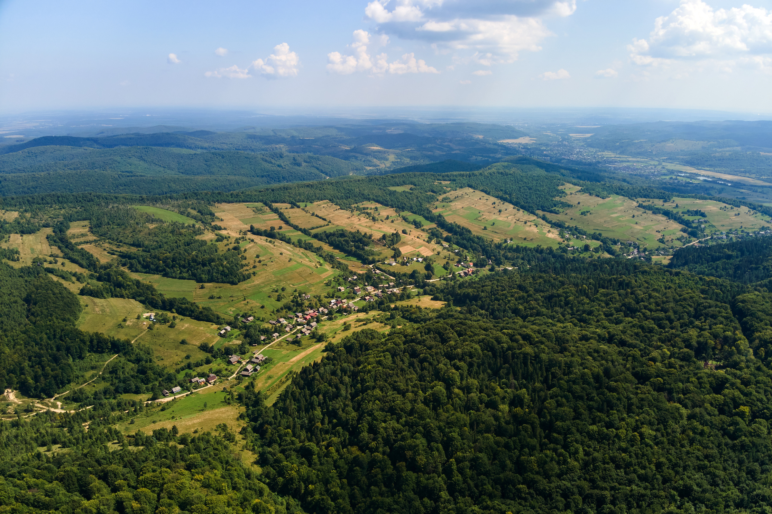
CONSERVATION BIO
Habitat Fragmentation
Chapter 9: Part 2

Slide 2


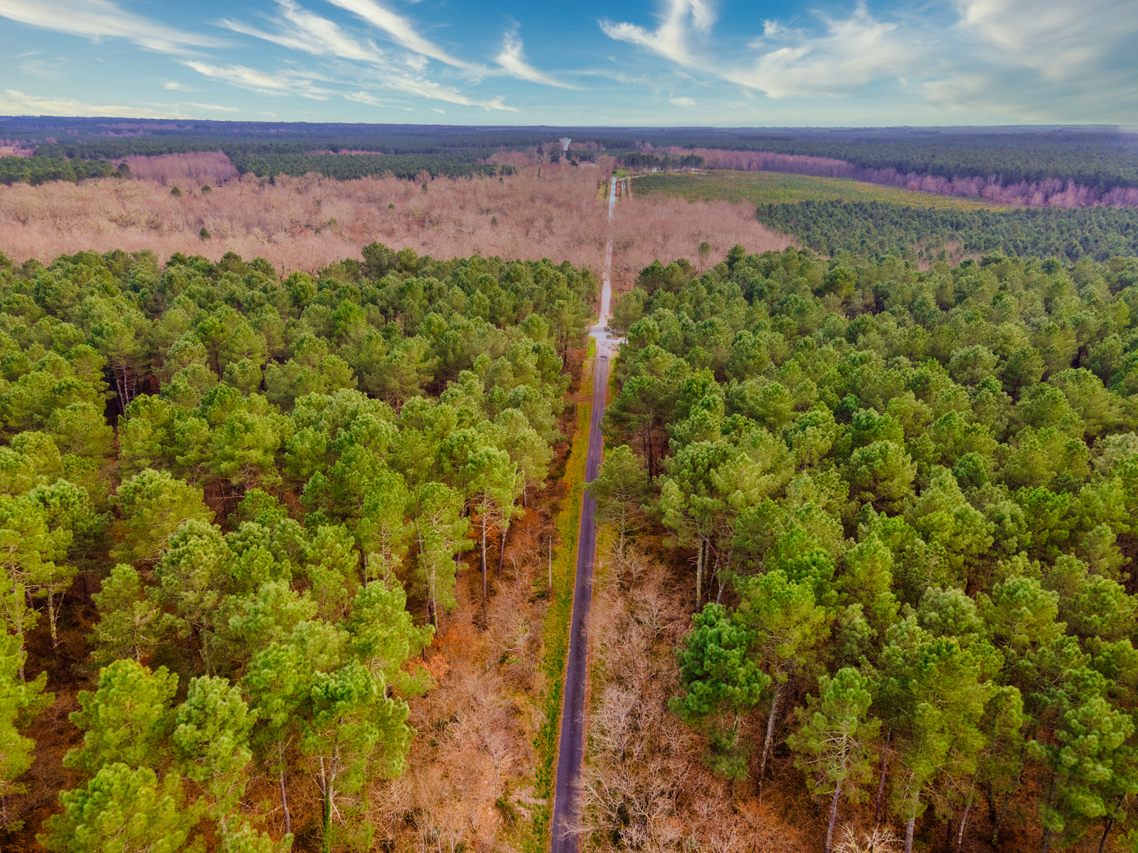


HABITAT FRAGMENTATION
The process by which a larger expanse of habitat is subdivided into smaller pieces, or patches, within a landscape.
Habitat Fragmentation and Habitat Loss almost always occur together.
One consequence of fragmentation is further loss of total habitat area.

Slide 3


Slide 4
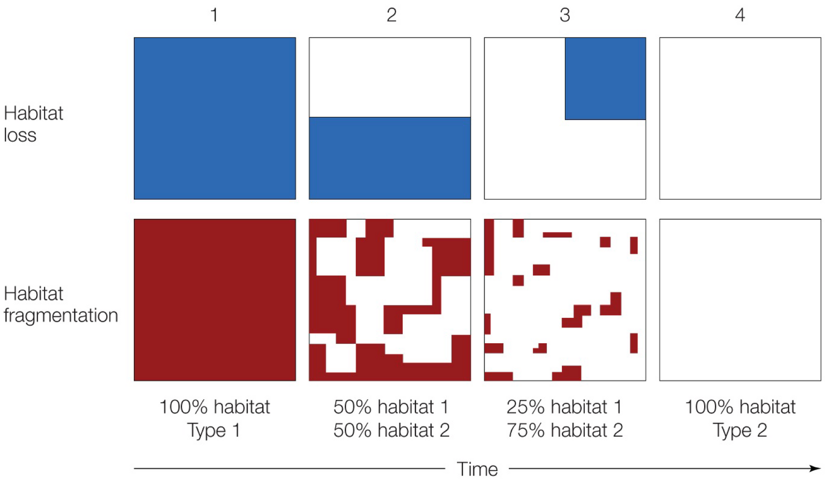

Loss and
FRAGMENTATION
Time series showing the loss and fragmentation of habitat from a natural landscape
habitat loss and fragmentation are both associated with a loss of area of habitat type 1
landscape conversion

Slide 5
Loss and
FRAGMENTATION
Habitat loss and fragmentation are both associated with a loss of area of habitat type 1

Slide 6
Loss and
FRAGMENTATION
Habitat loss and fragmentation are both associated with a loss of area of habitat type 1

Slide 7
Loss and
FRAGMENTATION
during time steps 2 and 3 fragmentation also changes the configuration of patches

Slide 8
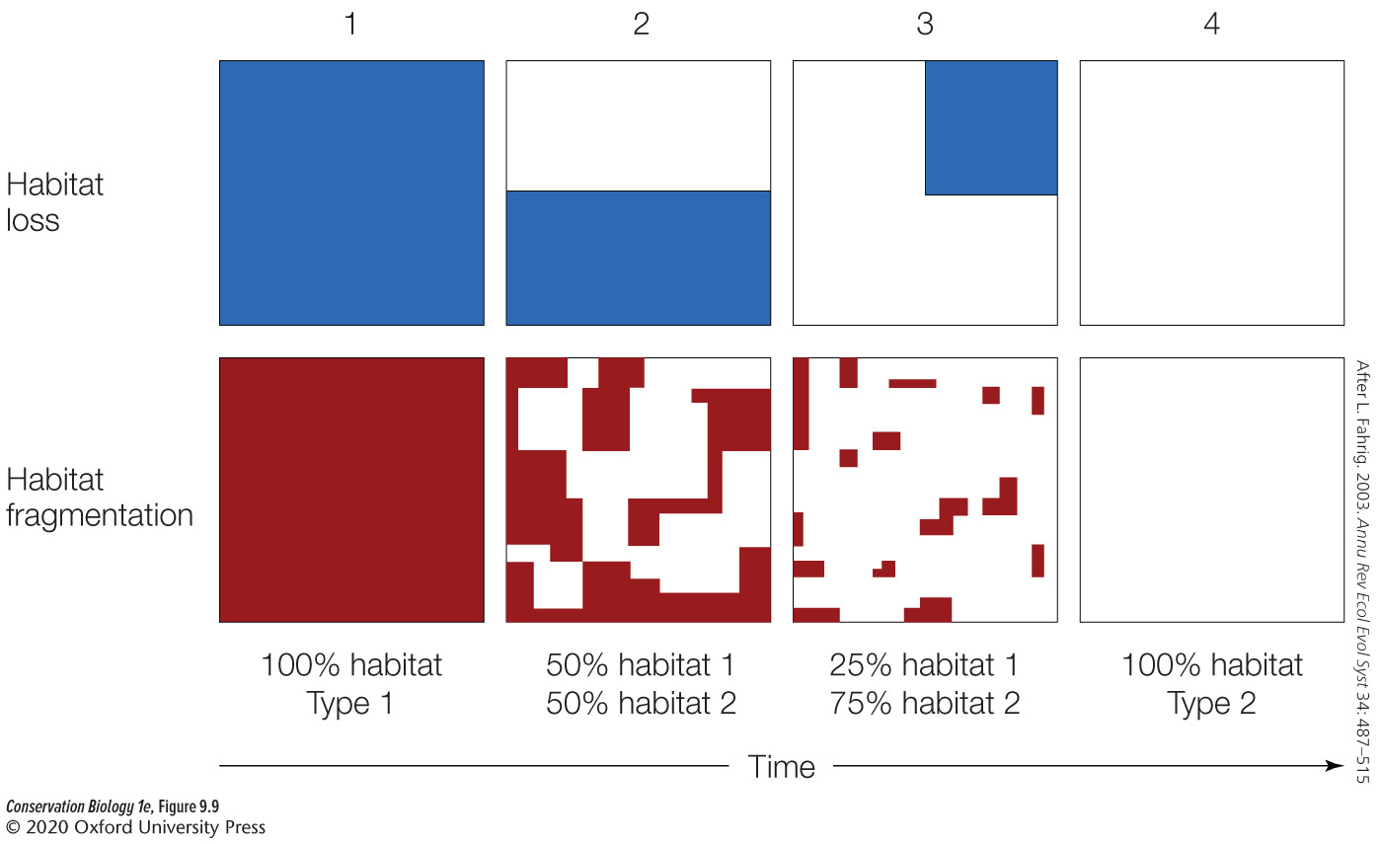

Slide 9



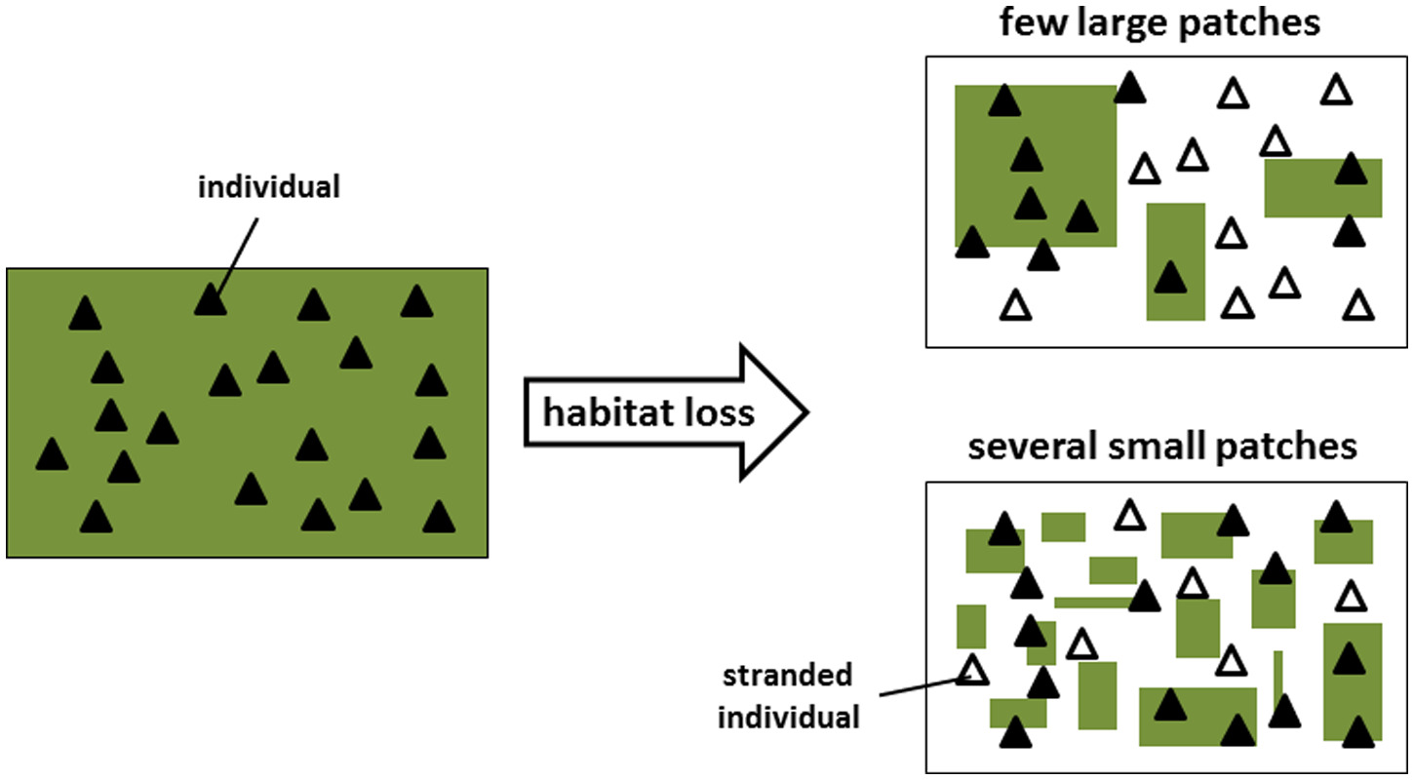
THE SLOSS DEBATE
Which of the other two scenarios is better for biodiversity—having a landscape composed of just one or a few large patches, or having a landscape composed of a greater number of smaller patches (assuming they are large enough for a species to persist)?

Slide 10
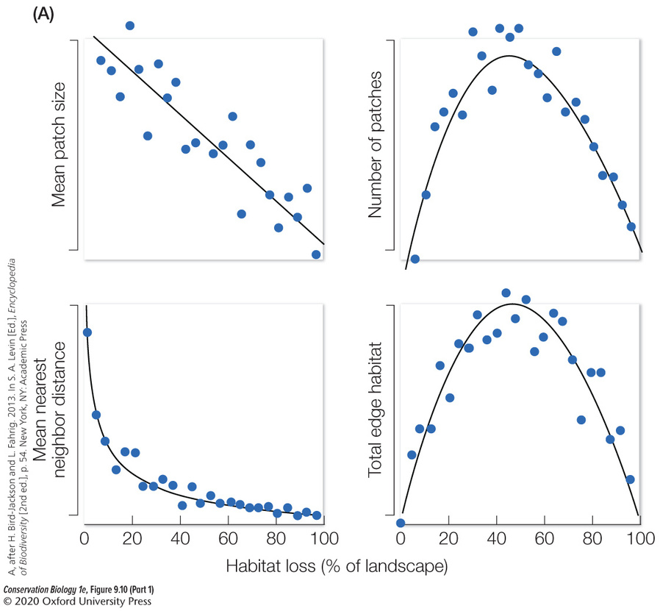
HABITAT FRAGMENTATION
01.
Increases the amount of edge habitat.
02.
03.
04.

Slide 11
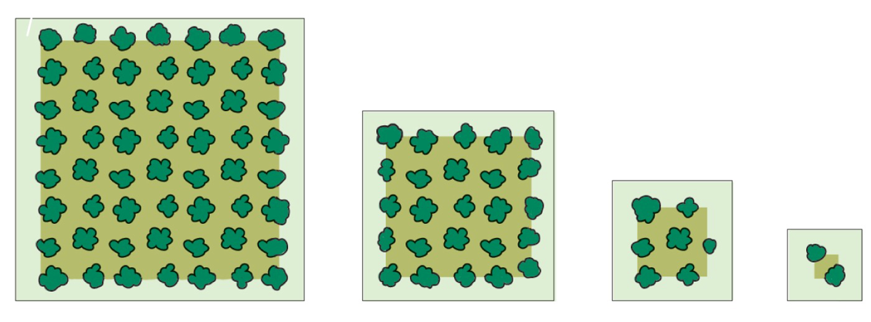
Edge effects and fragmentation
As patch sizes are reduced in a landscape, the proportion of core (interior) habitat declines, and the proportion of edge habitat increases

Slide 12
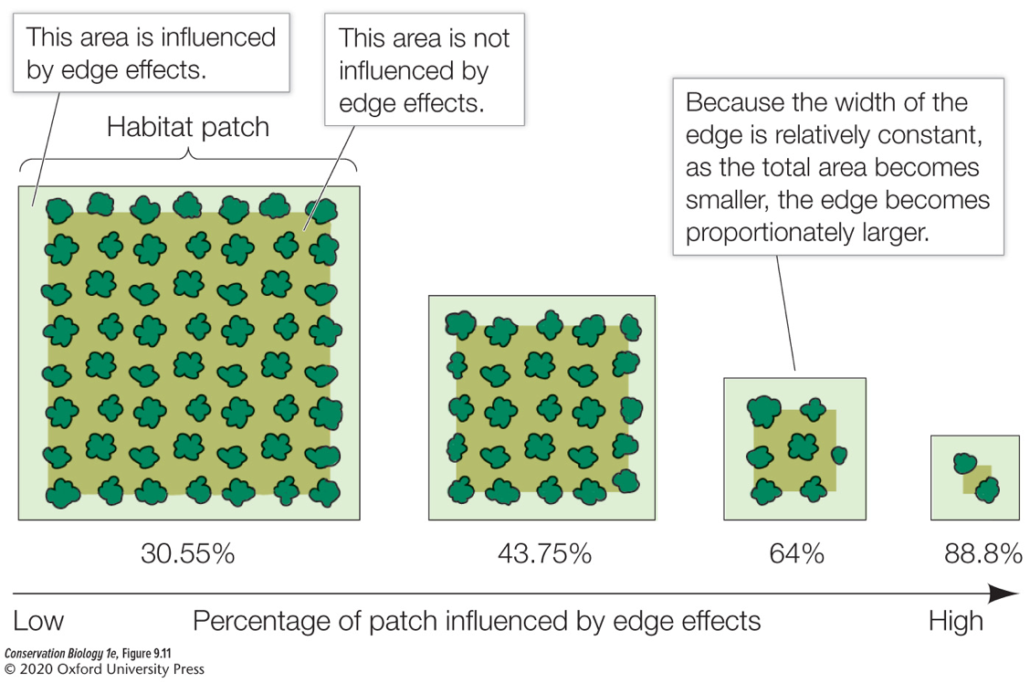
Edge effects and fragmentation
Edge effects have a greater influence on the dynamics of small patches.

Slide 13

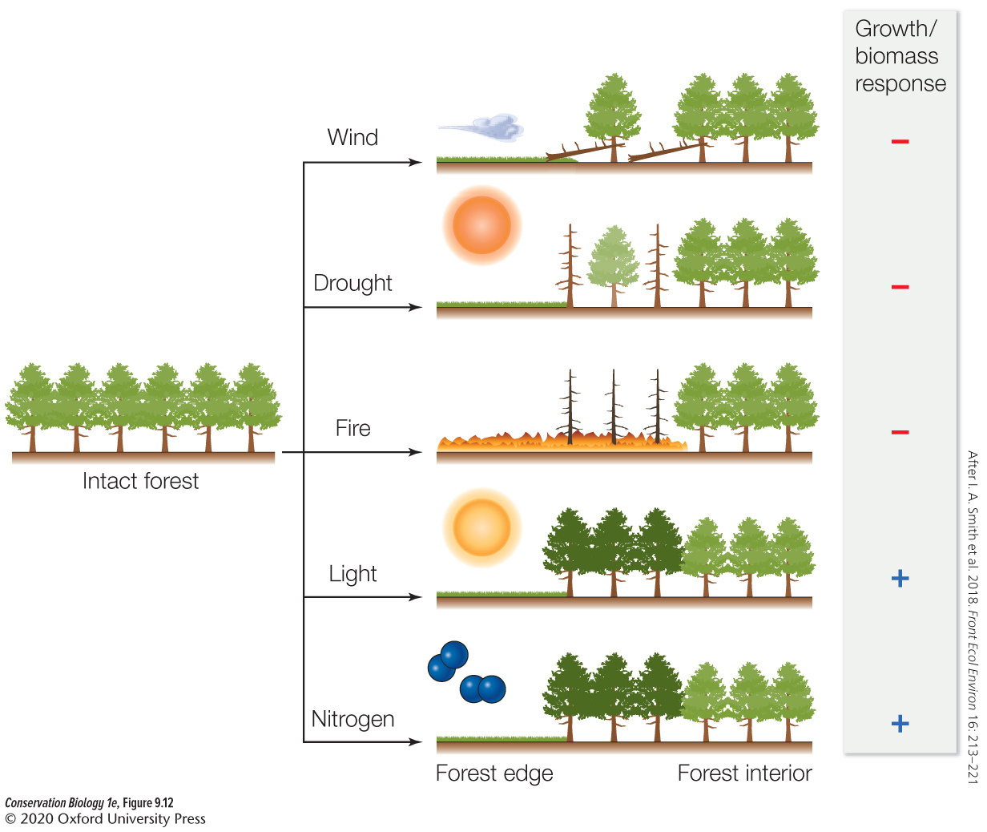

EDGE EFFECTS
Changes in the forest edge microenvironment include exposure to more wind, drought, fire, light, and nitrogen deposition.
The positive (+) sign and negative (–) signs indicate favorable and adverse conditions, respectively, for growth and biomass.

Slide 14
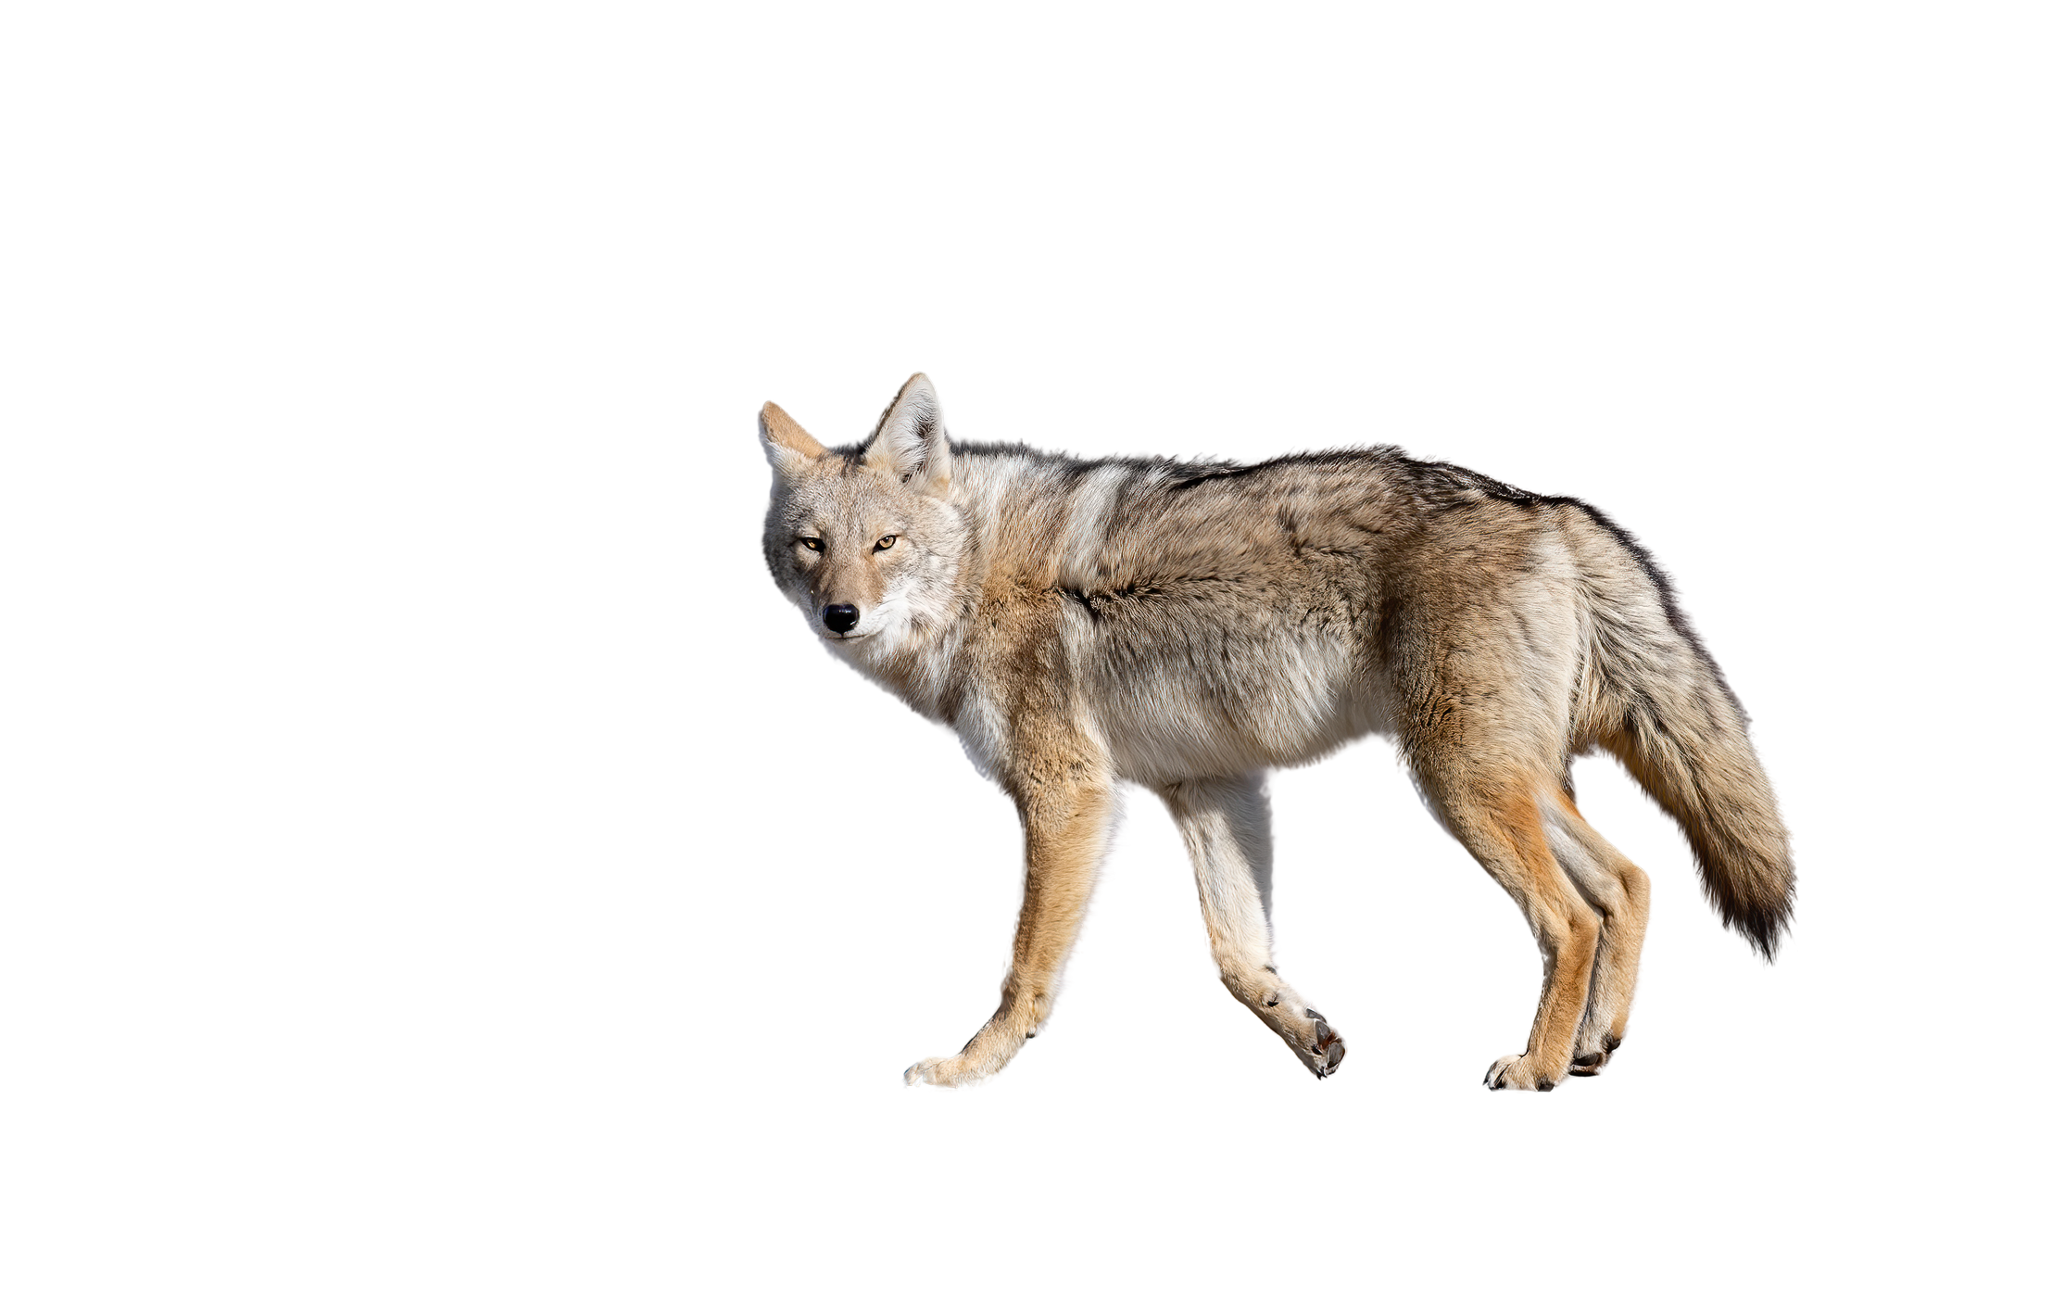
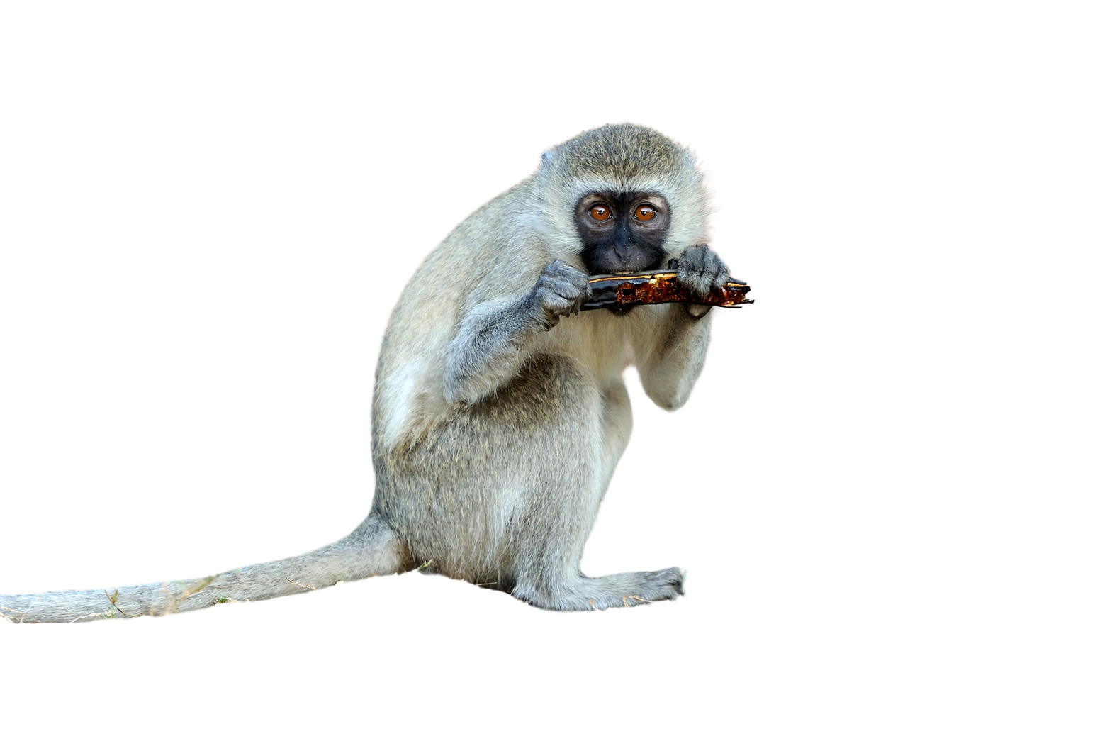
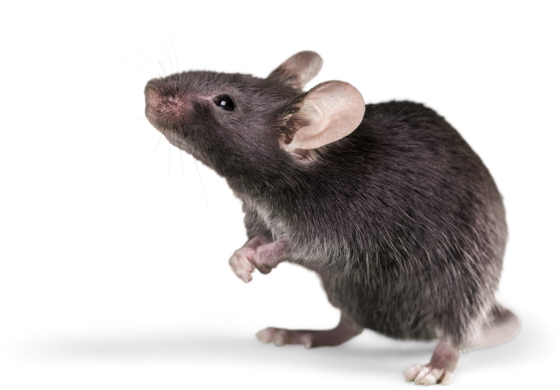
Species-Specific Responses
Some generalists thrive in edge habitats or human-dominated landscapes, while the same zones may be hostile to other species.

Slide 15
HABITAT FRAGMENTATION
01.
Increases the amount of edge habitat.
02.
Alters the size of habitat patches.
03.
Changes the number of patches.
04.

Slide 16
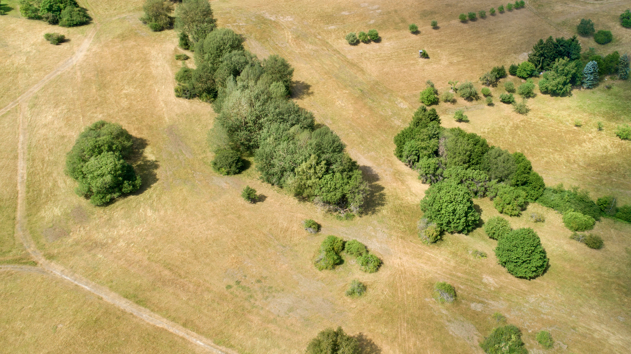
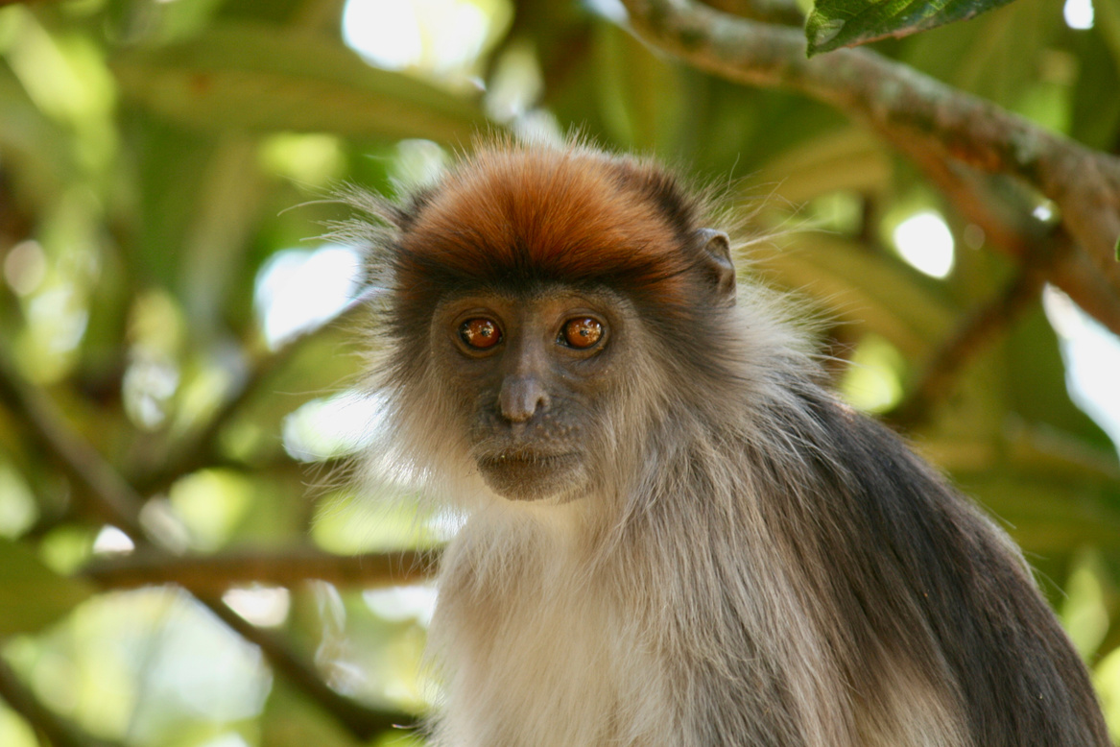
PATCH SIZE & NUMBER
Extinction Threshold
Thresholds of habitat size that are required for species to persist and complete their life cycles.
Large-bodied, mobile organisms require larger areas to complete their life cycles.
They reach their extinction threshold more easily.
Late stages of fragmentation = more species have reached their extinction threshold
This causes disproportionate biodiversity loss relative to early stages of habitat fragmentation.

Slide 17

THE ULTIMATE EFFECTS OF
PATCH SIZE AND NUMBER
DEPEND ON:
Whether species can disperse among the patches in a landscape, ultimately behaving like a set of populations that are linked by dispersal.
01
Whether patches in a landscape are sufficiently heterogeneous that they increase diversity across the landscape by adding new species.
02
such as when patches represent novel environments with new niche opportunities.

Slide 18
HABITAT FRAGMENTATION
01.
Increases the amount of edge habitat.
02.
Alters the size of habitat patches.
03.
Changes the number of patches.
04.
Increases the distance between habitat patches.

Slide 19
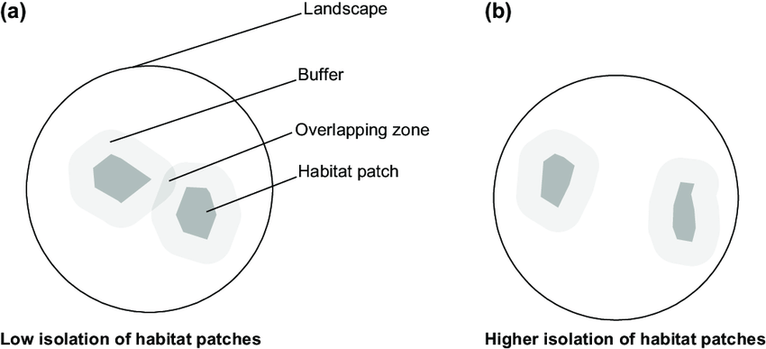
PATCH
ISOLATION
Isolation is a function of both the distance between habitat patches and the matrix that separates those habitat patches
As the matrix that separates habitat patches becomes increasingly hostile to dispersal, the successful emigration out of patches, and immigration into patches, becomes less likely.
Which built environments are disproportionately hostile to animals?

