Slide 1
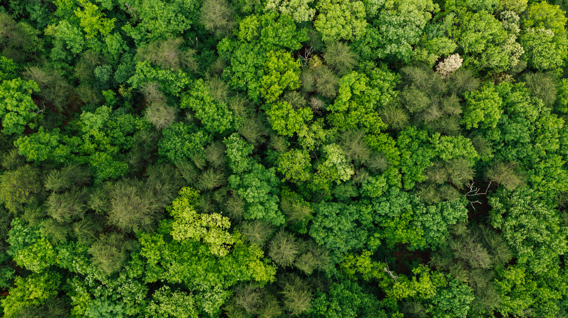




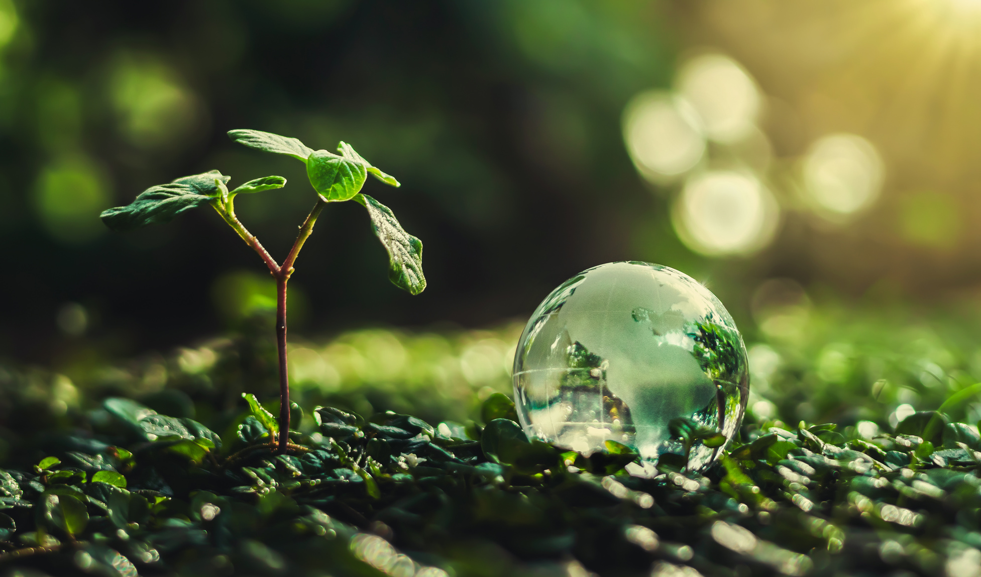
CONSERVATION BIO
METAPOPULATIONS & LANDSCAPE MOSAICS
CH 9 Part 3

Slide 2


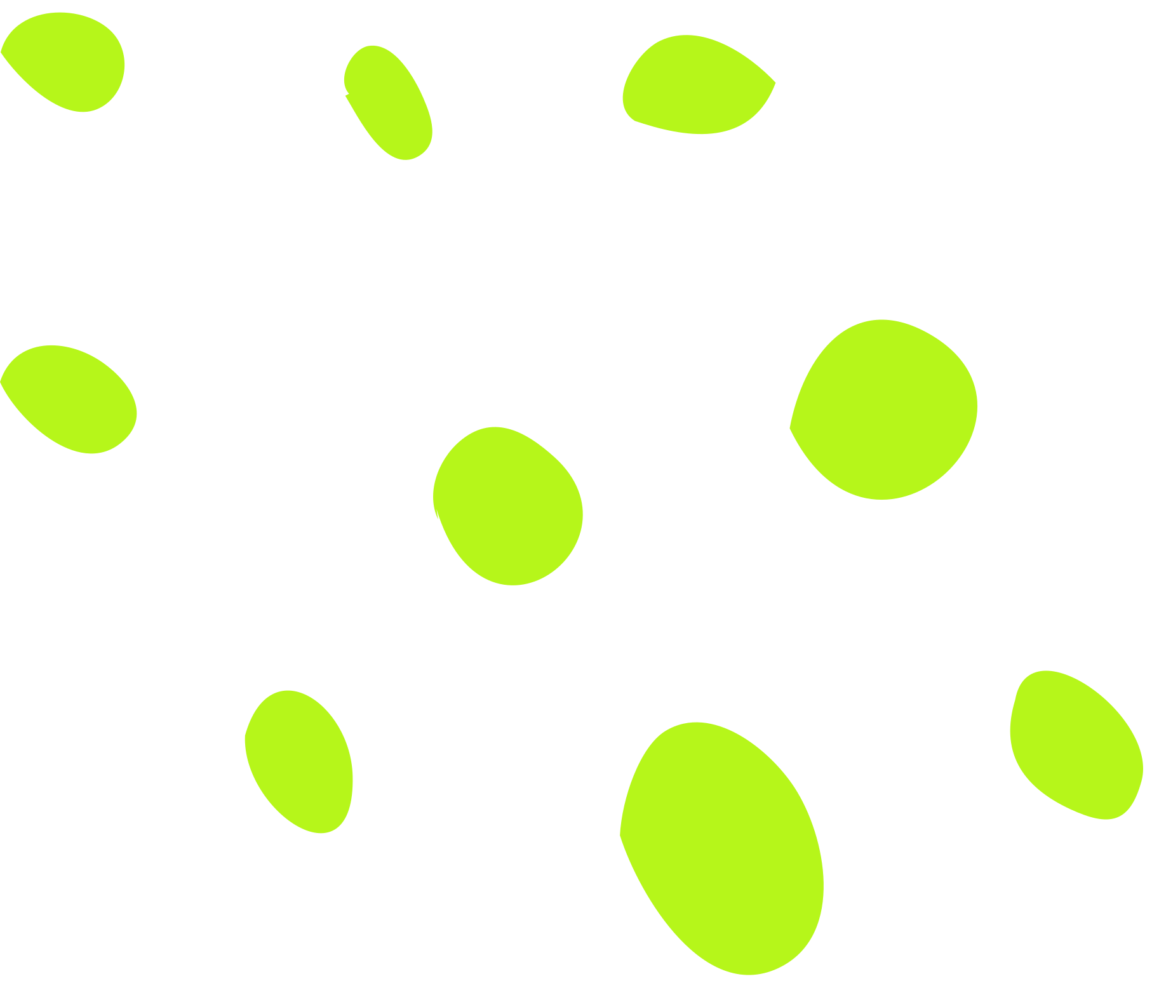

THE ULTIMATE EFFECTS OF
PATCH SIZE AND NUMBER
DEPEND ON:
Whether species can disperse among the patches in a landscape, ultimately behaving like a set of populations that are linked by dispersal.
01
Whether patches in a landscape are sufficiently heterogeneous that they increase diversity across the landscape by adding new species.
02
such as when patches represent novel environments with new niche opportunities.

Slide 3
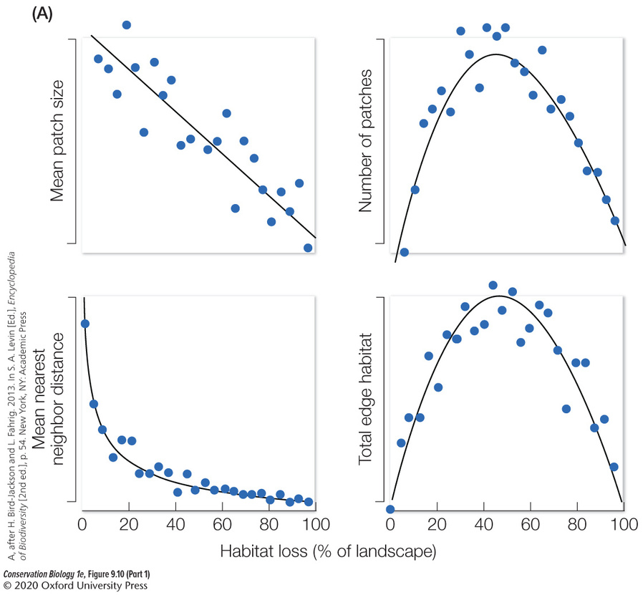
HABITAT FRAGMENTATION
01.
Increases the amount of edge habitat.
02.
Alters the size of habitat patches.
03.
Changes the number of patches.
04.
Increases the distance between habitat patches.

Slide 4
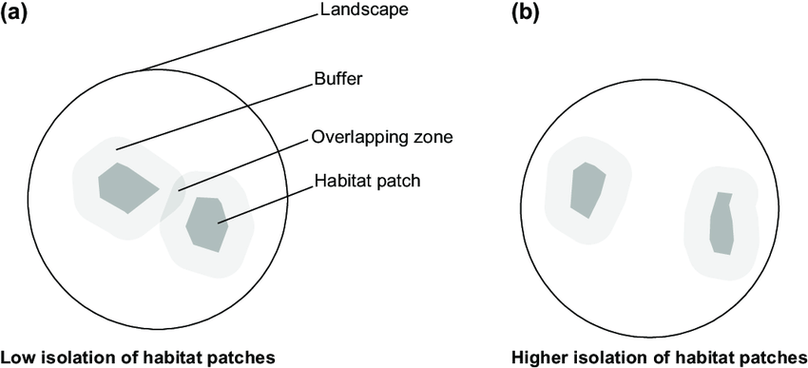
PATCH
ISOLATION
Isolation is a function of both the distance between habitat patches and the matrix that separates those habitat patches
As the matrix that separates habitat patches becomes increasingly hostile to dispersal, the successful emigration out of patches, and immigration into patches, becomes less likely.
Which built environments are disproportionately hostile to animals?

Slide 5
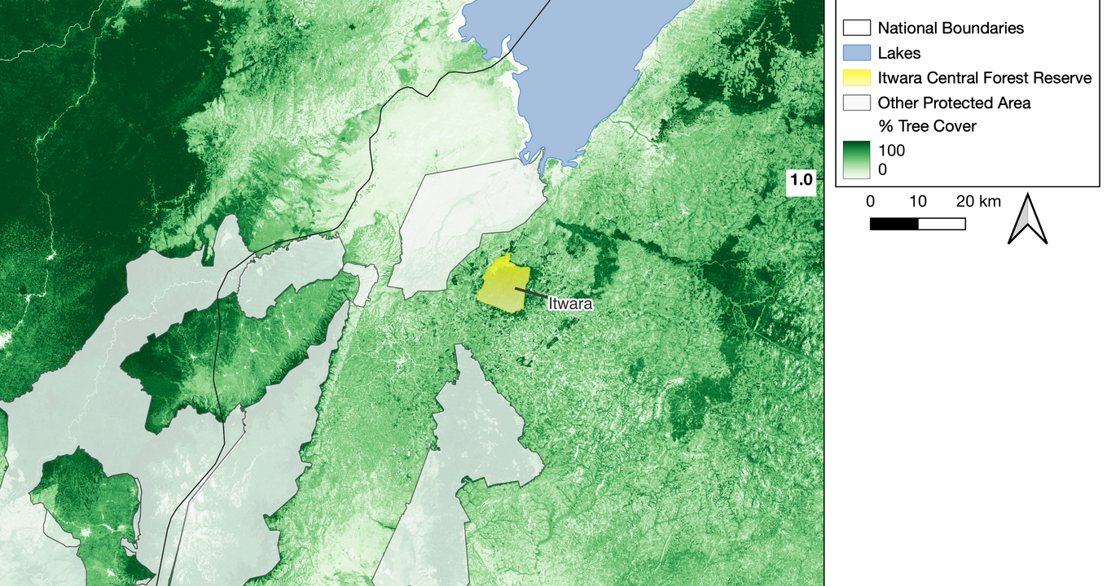
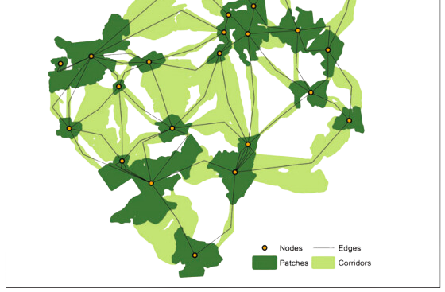
What is a
metapopulation
?
A metapopulation is basically a population of populations.
More specifically, it is collection of local populations that are spatially separated from each other in individual patches of a landscape but connected to each other by dispersal.

Slide 6
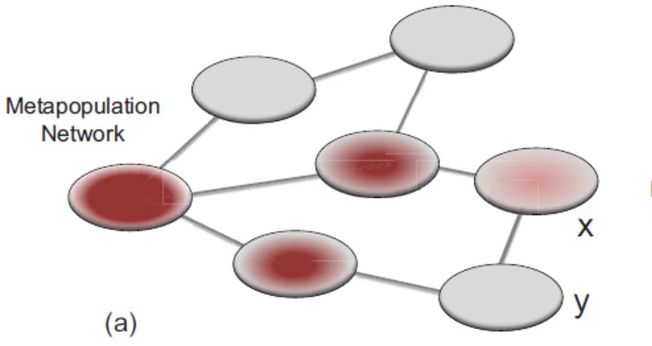
Principles of
metapopulations
Individual populations in single suitable habitat patches have finite life spans.
They blink in and out of the landscape as small local populations go extinct or are founded.

Slide 7
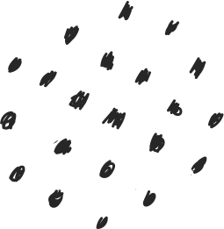





01
02
Levins’
OCCUPIED OR UNOCCUPIED
PATCH EXTINCTION
Each patch can be occupied (1) or unoccupied (0). This ignores any local population dynamics.
At each time step, occupied patches go extinct with probability .
Metapopulation Model
Richard Levins developed a simple model to describe patch occupancy in metapopulations.
03
04
COLONIZATION
OCCUPANCY FRACTION
Unoccupied patches can be colonized with probability .
The objective of the model is to estimate the fraction of patches occupied, .

Slide 8



Metapopulation
occupancy dynamics
f = I - E
Occupancy Fraction
Colonization Rate
Extirpation Rate
f
I
E
Fraction or proportion of patches that are occupied at time t.
Total fraction of patches that are colonized by immigrants per time period.
Total fraction of patches that are extirpated per time period.

Slide 9
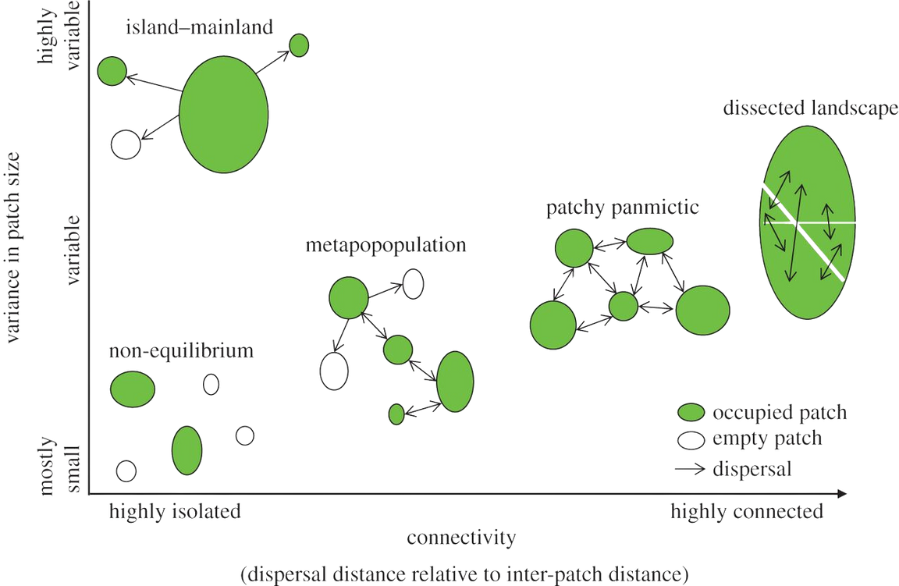

variants
metapopulation models
What happens when we alter individual assumptions?

Slide 10


Island
Key Elements
1. ISOLATION
Biogegraphy
The core idea of island biogeography is that isolated habitats (like islands) have unique ecological characteristics due to their separation from similar habitats.
2. SPECIES DIVERSITY
Island biogeography originally focused on studying the biodiversity patterns observed on isolated islands.
Island biogeography studies how species richness and composition change with island size and isolation.
The theory predicts that larger islands closer to the mainland will have higher species diversity due to larger habitats and easier colonization.
However, the concept has been extended to any habitat fragment that is isolated from similar habitats, regardless of whether it is a true island or not.
Implications
Island biogeography has practical implications for conservation biology, particularly in terms of managing and preserving biodiversity in fragmented landscapes.

Slide 11
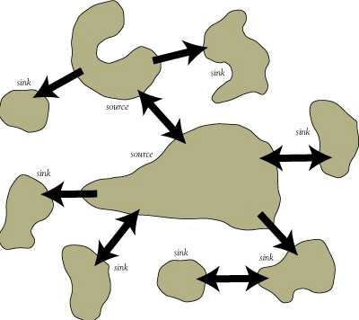
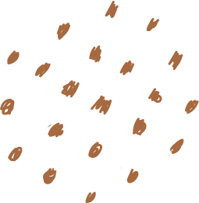
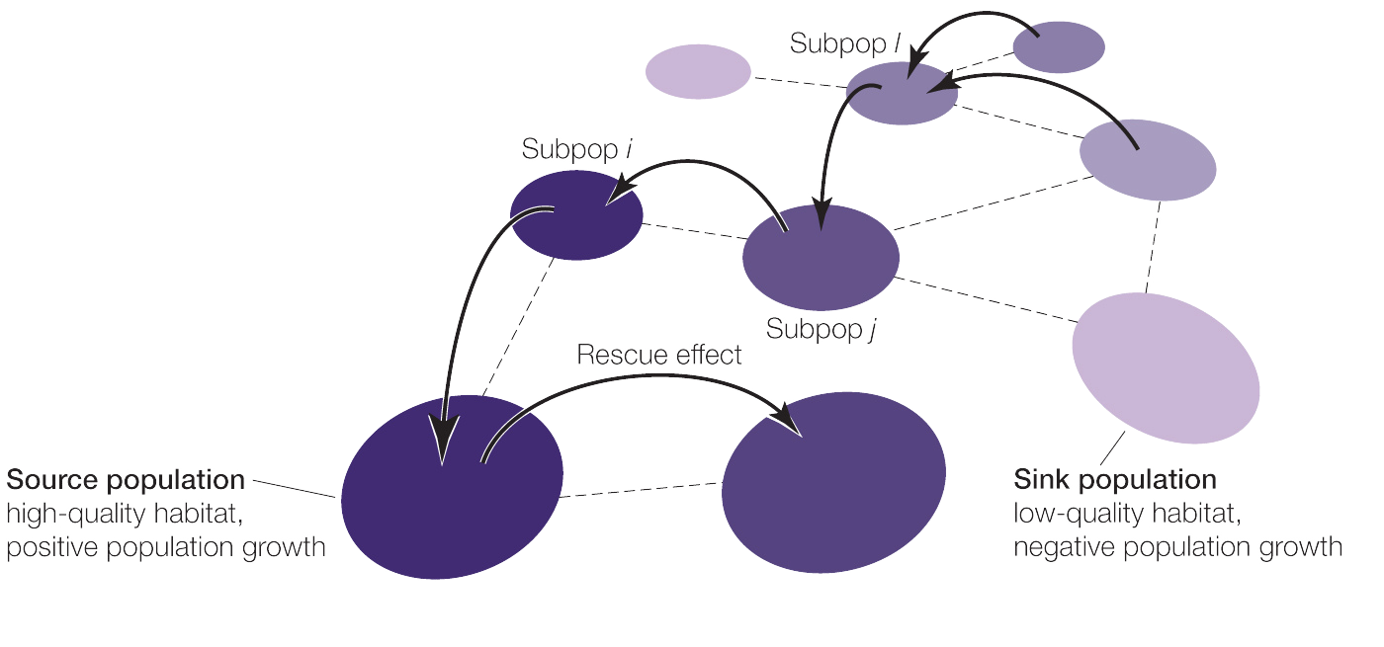
Sources &
sinks
The model assumes that the same species occupies two habitats, one of high quality and one of low quality.
A source population is defined as a patch with a positive intrinsic growth rate (r>0) that contributes more immigrants to nearby patches than it receives back from these neighboring patches.
A source population should persist indefinitely, even in isolation.

Slide 12
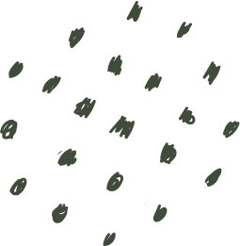

Sources &
sinks
The model assumes that the same species occupies two habitats, one of high quality and one of low quality.
A sink population is defined as a patch with a negative intrinsic growth rate (r<0). A sink population would go extinct if it were not for the constant input of immigrants from nearby source populations.
Sink populations cannot persist in isolation.

Slide 13
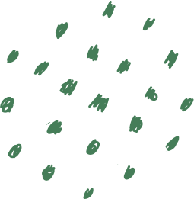
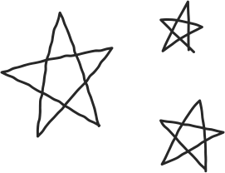
01
02
SPATIAL CONSERVATION PLANNING
CONSERVATION VALUE OF SELECTIVELY LOGGED FORESTS
Source-sink
Basic algorithms consider spatial connectivity, but assume that species density indicates metapopulation persistence.
The long-term robustness of protected area networks could be limited if some or all of the prioritized sites for a given species actually represent sinks.
Most studies of logging impacts have been patches adjacent to intact primary forest, and in most cases, impacts are assessed using relative measures of abundance, density or incidence
patterns
Issues encountered when conservationists ignore them...
03
SPECIES DISTRIBUTION MODELLING
In source-sink systems, species distribution models (SDMs) overestimate the bioclimatic niche of a species by including areas of low suitability for population growth (sinks), and consequently produce unreliable predictions of current and future distributions

Slide 14
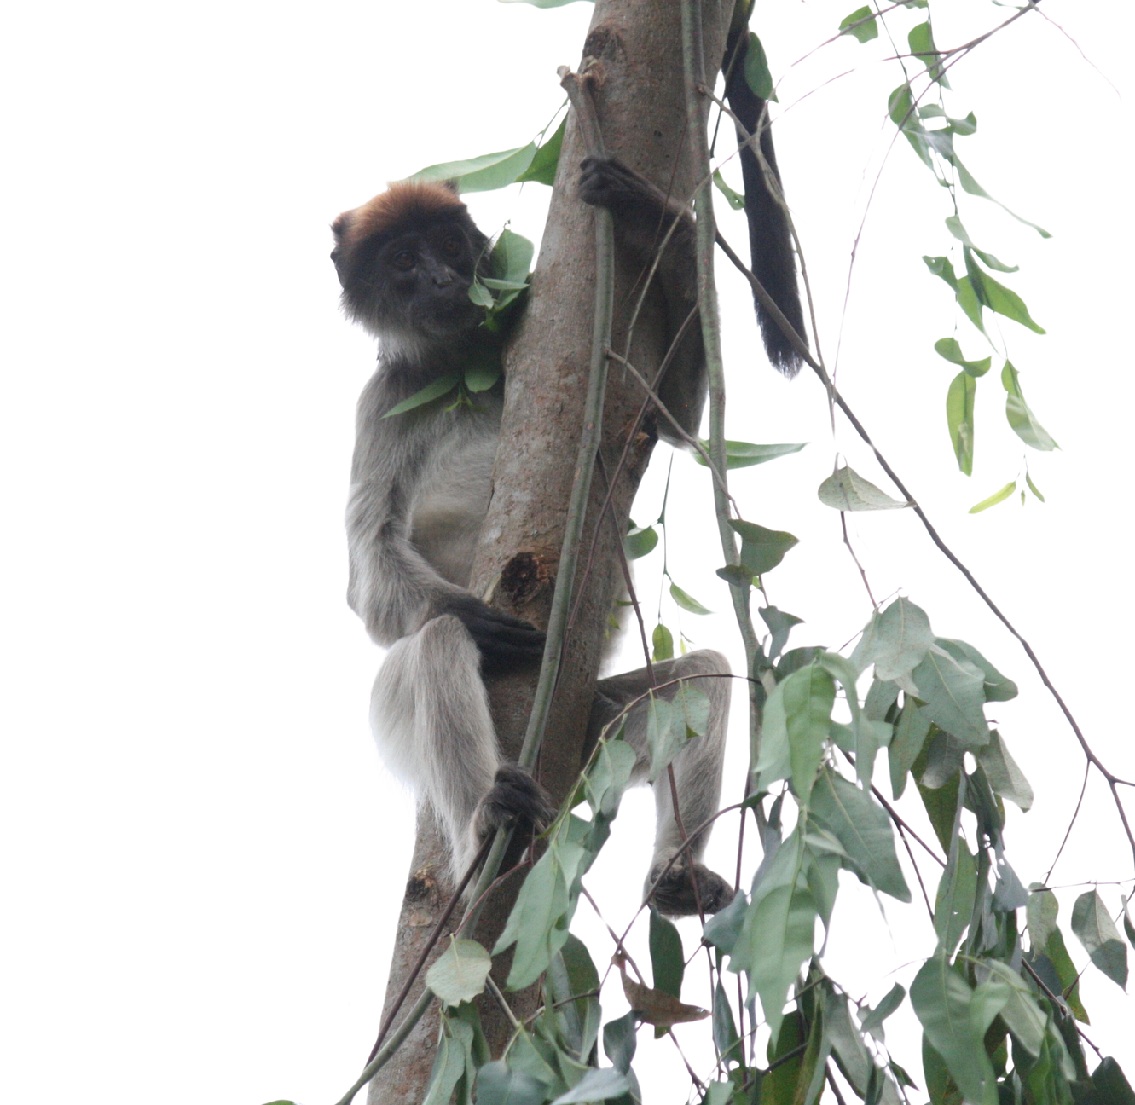
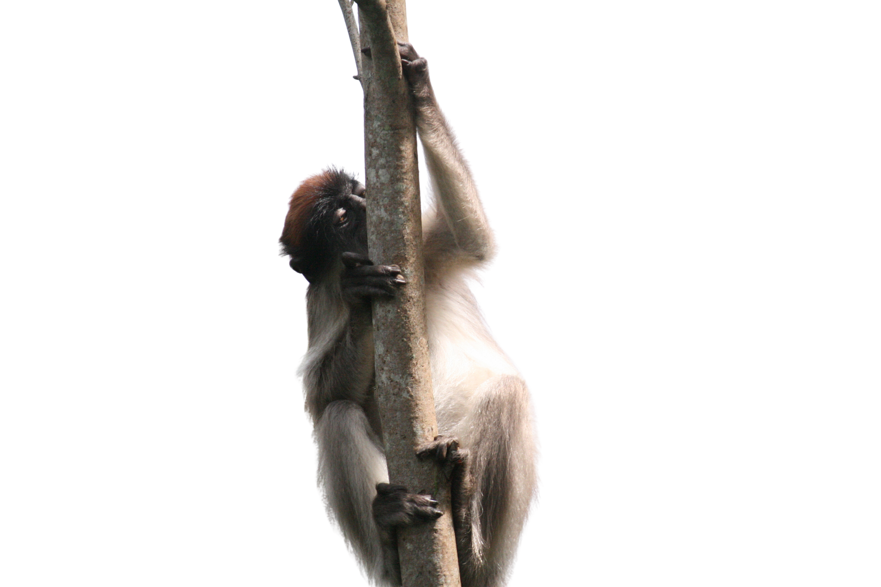
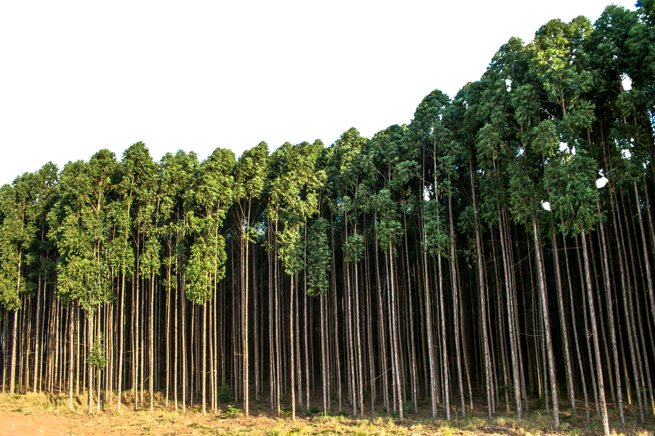
Ecological Traps
Areas of low-quality habitat that reduce survival and reproduction.

Slide 15
Key Elements
In Summary:
1. POPULATION DYNAMICS
Metapopulation theory considers the dynamics of interconnected populations inhabiting patches of suitable habitat.
Metapopulation
These populations may experience local extinctions and recolonizations over time
Theory
2. HABITAT QUALITY AND CONNECTIVITY
The theory emphasizes the importance of habitat quality and connectivity between patches for maintaining metapopulation persistence.
Metapopulation theory focuses on understanding how spatially structured populations persist in a landscape of habitat patches that may go through cycles of local extinction and recolonization.
3. SOURCE-SINK DYNAMICS
Metapopulations often involve a balance between source populations (sustainable and exporting individuals) and sink populations (dependent on immigration to persist).
Implications
Metapopulation theory is particularly relevant for understanding population viability in fragmented landscapes, conservation strategies (like creating corridors between habitat patches), and disease spread in human-altered landscapes.

