Slide 1
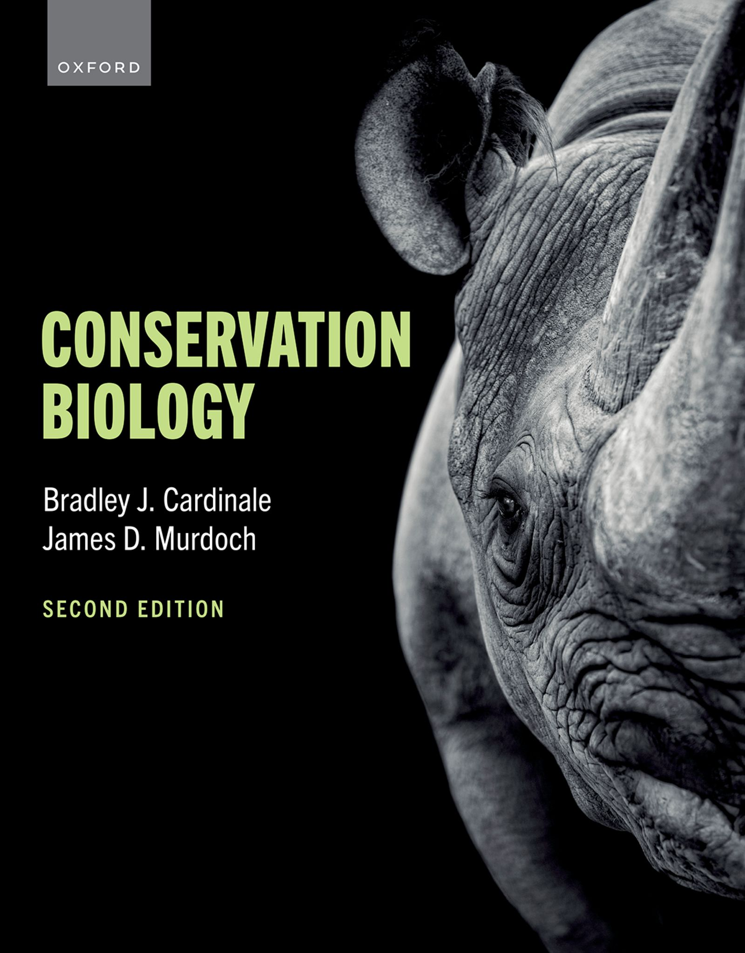
CONSERVATION BIOLOGY
By Bradley J. Cardinale and James D. Murdoch

Slide 2
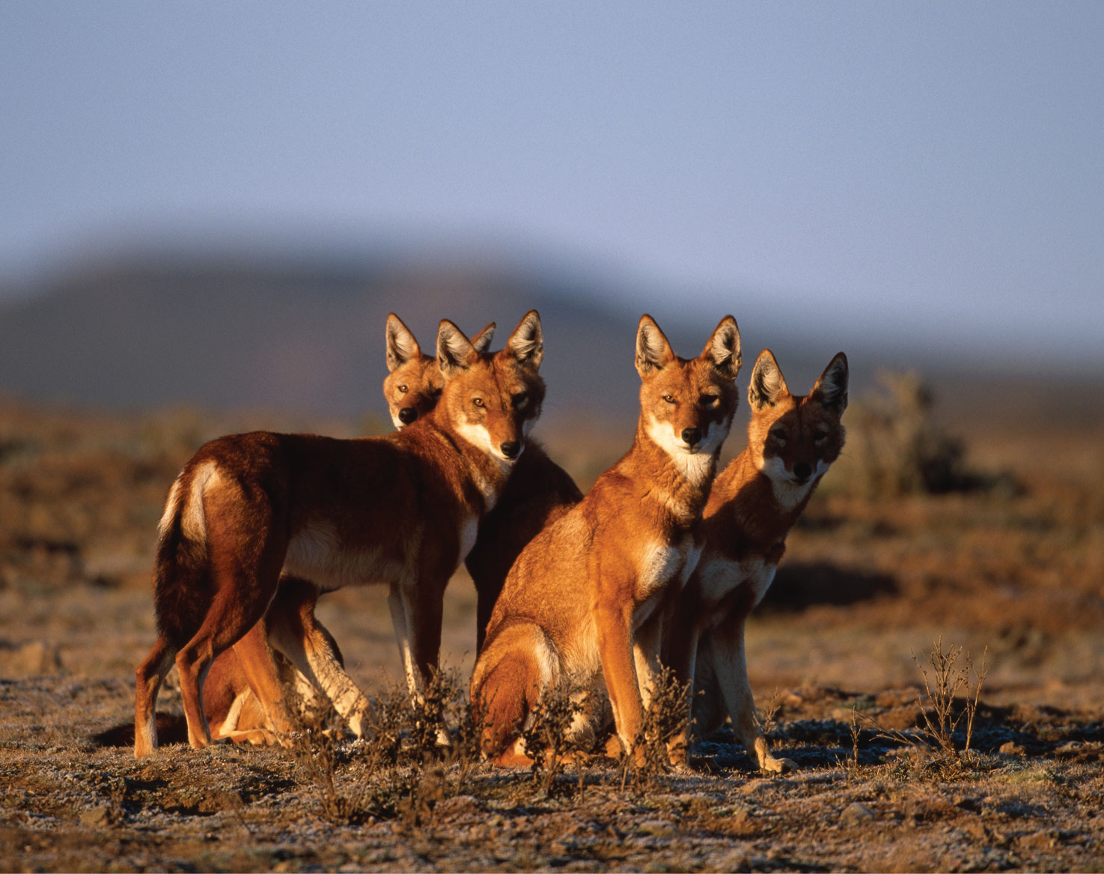
2
Notes:
The Ethiopian wolf (Canis simensis) is one of the rarest canids in the world and is confined to seven isolated mountain ranges in the Ethiopian highlands. It is listed as Endangered on the International Union for Conservation of Nature’s Red List of Threatened Species, with a global population of fewer than 500 individuals.

Slide 3
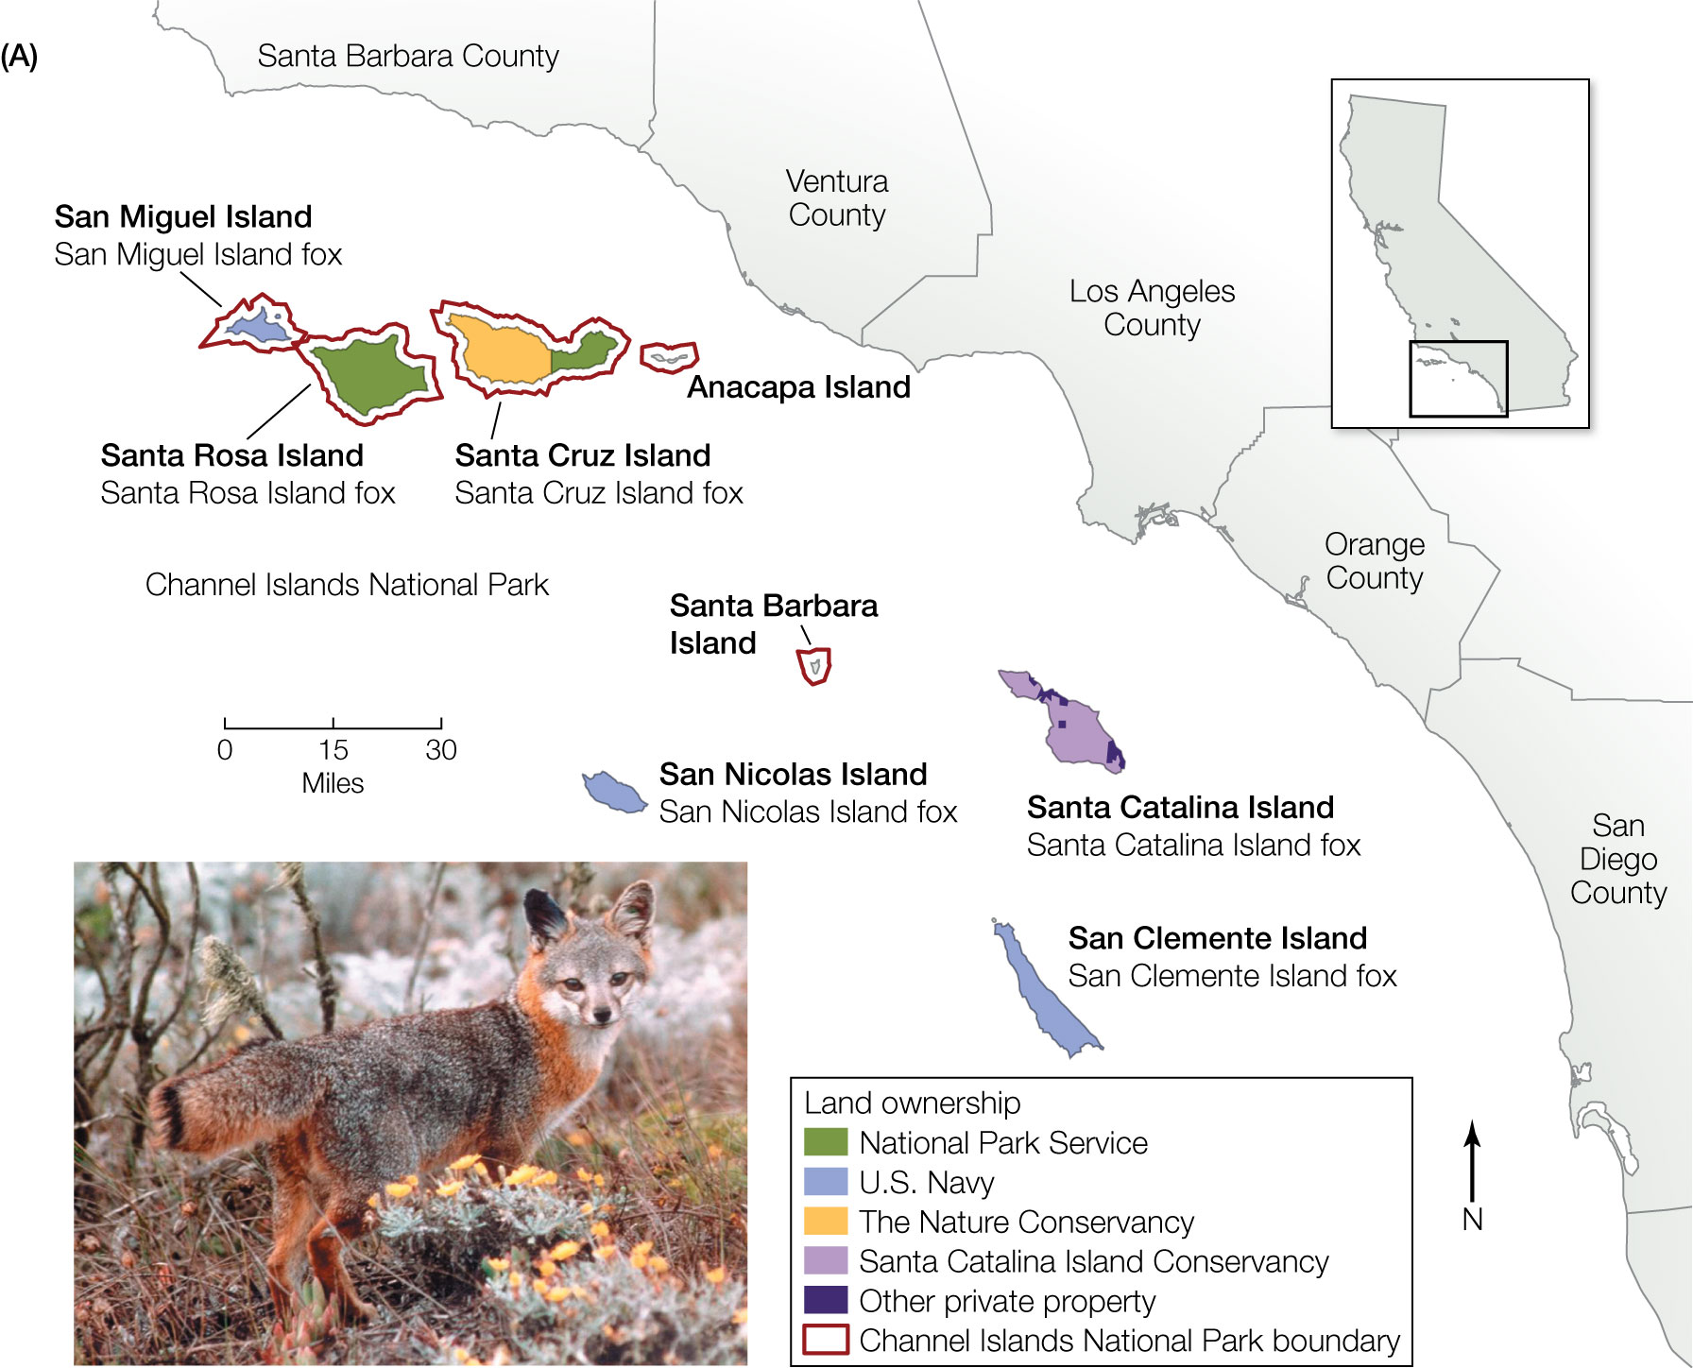
3
Notes:
The island fox (Urocyon littoralis) is a small canid endemic to the Channel Islands of Southern California. Island foxes occur on six of the eight Channel Islands, including San Miguel, Santa Rosa, and Santa Cruz in the north and Santa Catalina, San Nicolas, and San Clemente in the south.

Slide 4
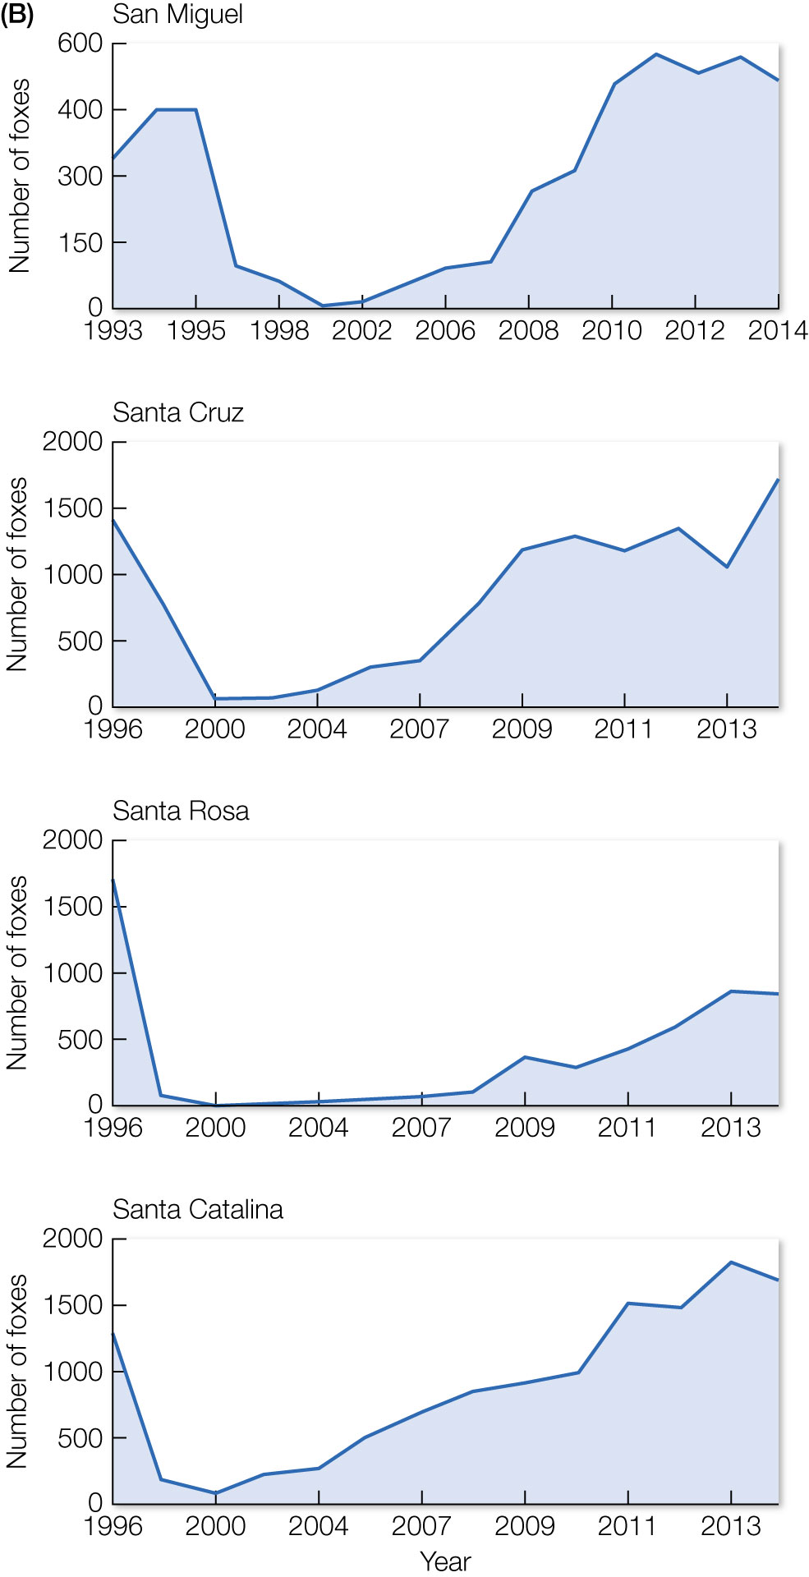
4
Notes:
Population estimates of island foxes on four of California’s Channel Islands. Each island has a unique subspecies, all four of which were listed as endangered under the U.S. Endangered Species Act in 2004 because of sharp population declines, mainly from golden eagle predation and disease. (Courtesy of Friends of the Island Fox [www.islandfox.org] from data presented at the June 16–17, 2015, Island Fox Conservation Working Group.)

Slide 5
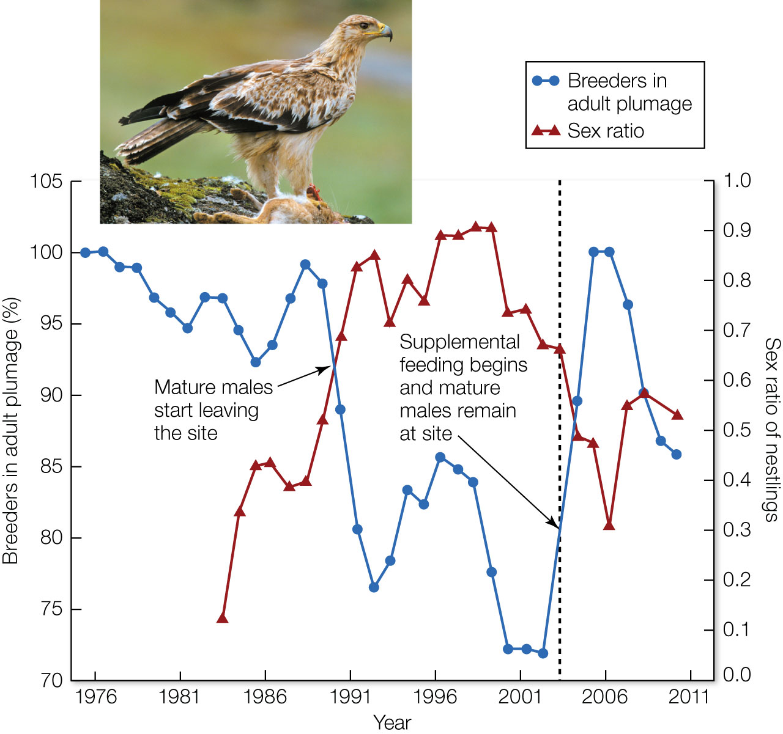
Figure 13.1 Population changes in Spanish imperial eagles (Aquila adalberti). Small population size resulted in changes in the sex ratio of eagles in the population partly due to demographic stochasticity.
Notes:
Figure 13.1 Population changes in Spanish imperial eagles (Aquila adalberti). Small population size resulted in changes in the sex ratio of eagles in the population partly due to demographic stochasticity. The population initially declined because of food scarcity, as mature birds left the population to find food elsewhere. Subsequent matings with immature males resulted in mainly male offspring, causing a change in sex ratio and population declines. Supplemental feeding led to mature males remaining at the site to breed and a return to the original sex ratio

Slide 6
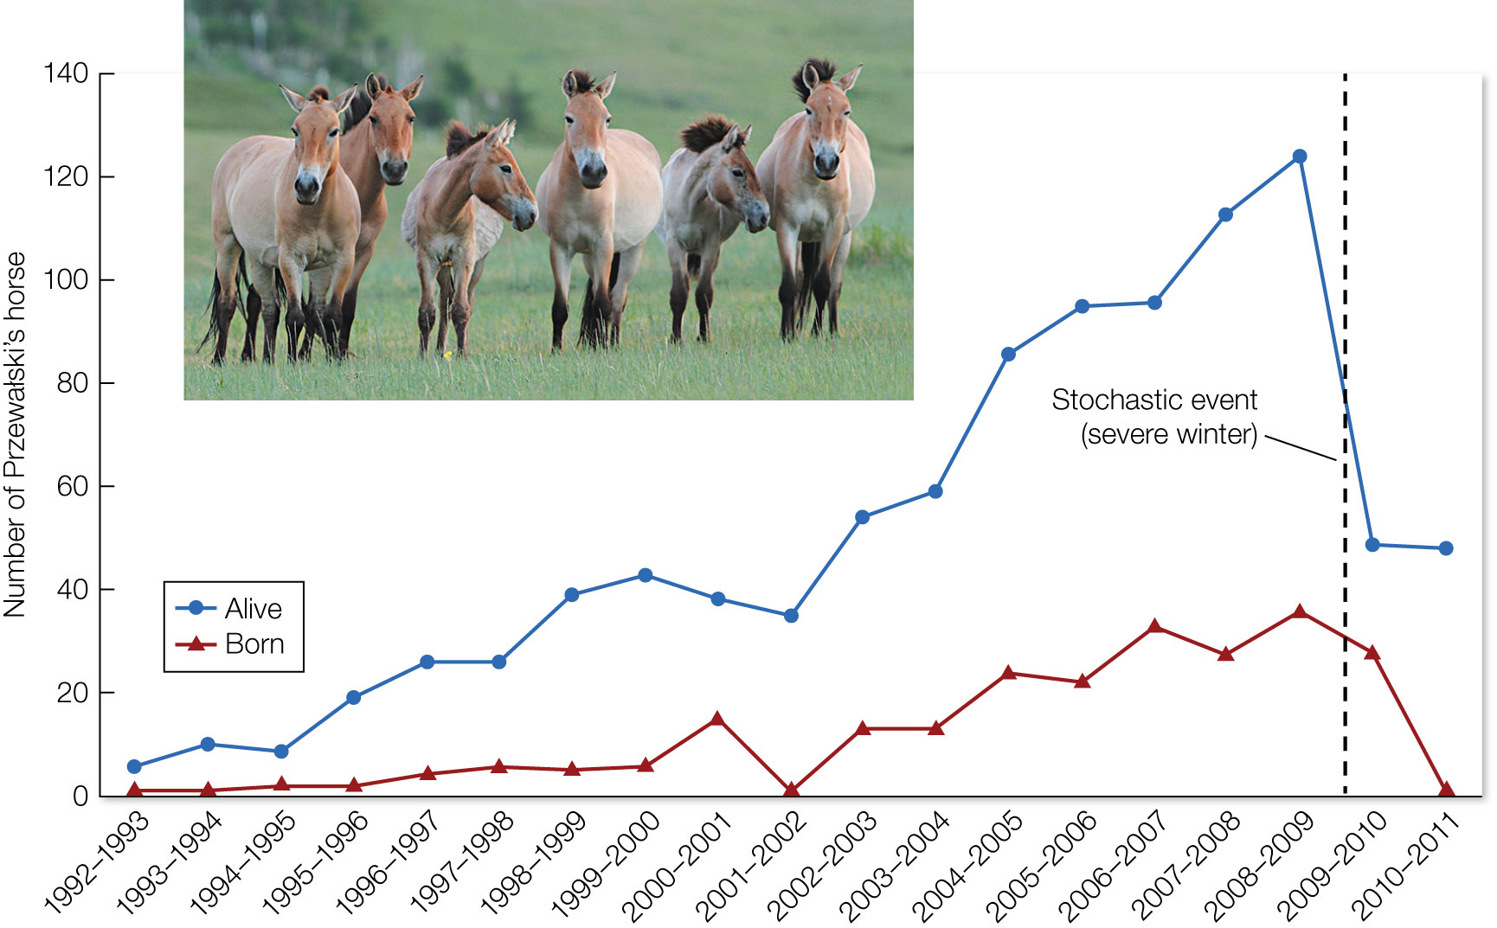
Figure 13.2 Population size and number of newborn Przewalski’s horse (Equus ferus przewalskii) in a reintroduced population in Mongolia.
Notes:
Figure 13.2 Population size and number of newborn Przewalski’s horse (Equus ferus przewalskii) in a reintroduced population in Mongolia. A stochastic event (the severe winter of 2009/2010) caused a 60% decline in the population, and only one newborn was recruited into the population.

Slide 7
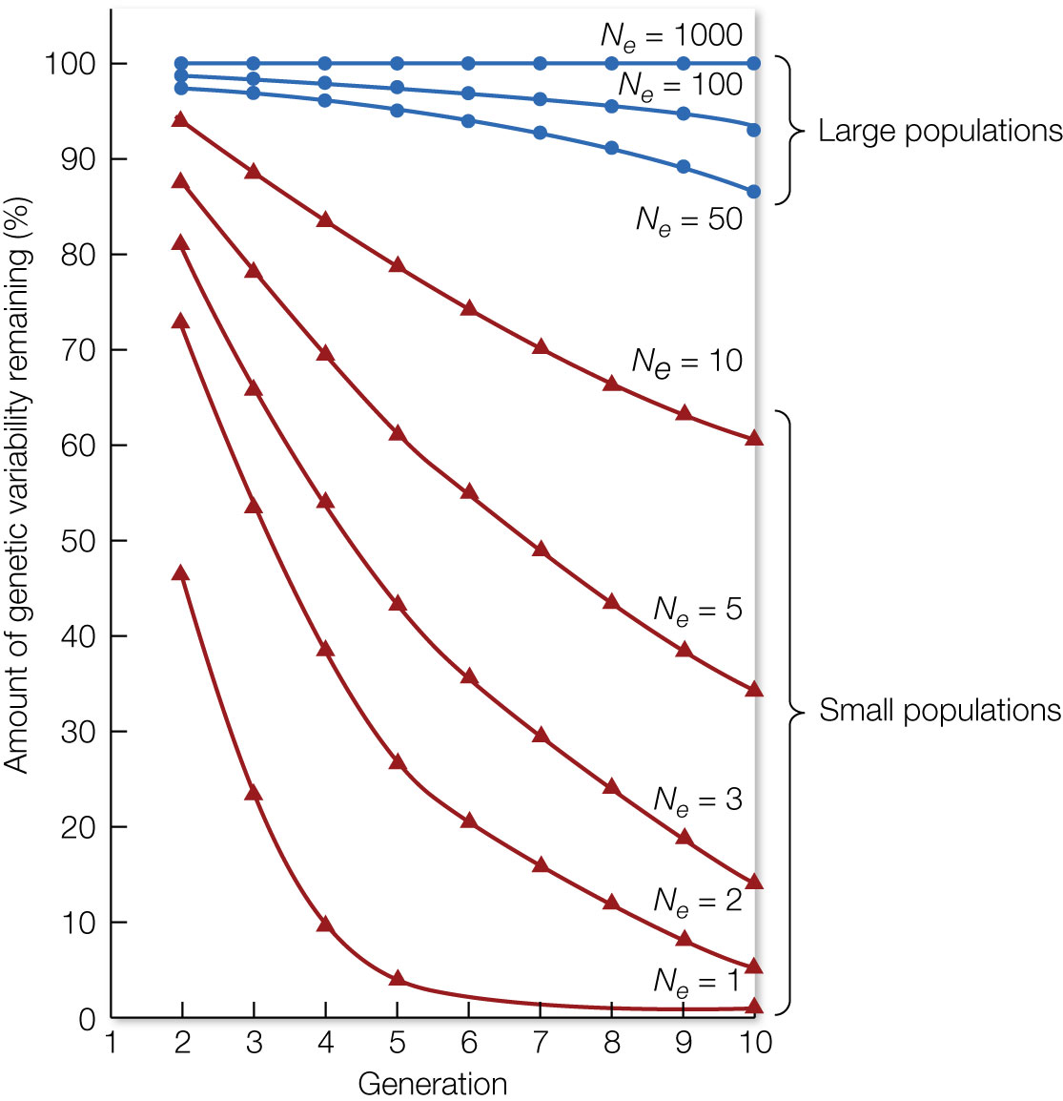
Figure 13.3 Genetic variability is lost randomly through genetic drift. This graph shows the average percentage of genetic variability remaining after 10 generations in theoretical populations of various effective population sizes (N_{e}).
Notes:
Figure 13.3 Genetic variability is lost randomly through genetic drift. This graph shows the average percentage of genetic variability remaining after 10 generations in theoretical populations of various effective population sizes (N_{e}).

Slide 8
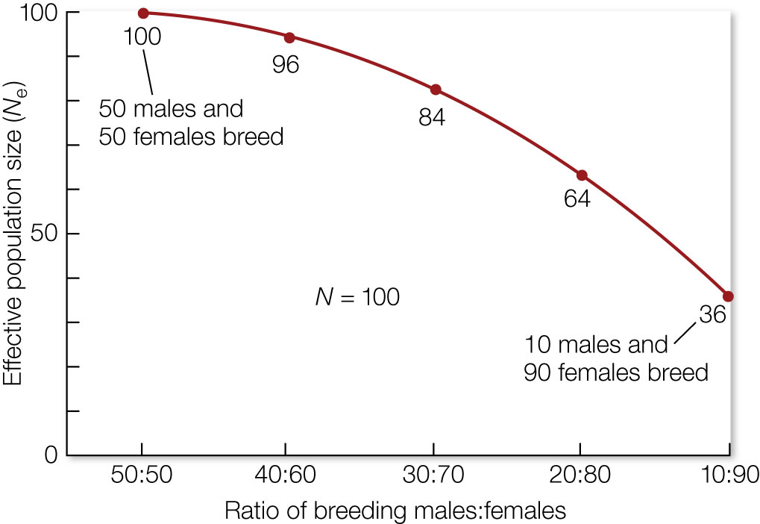
Figure 13.4 The effective population size (N_{e}) declines when the number of males and females in a breeding population (N) of 100 individuals is increasingly unequal.
Notes:
Figure 13.4 The effective population size (N_{e}) declines when the number of males and females in a breeding population (N) of 100 individuals is increasingly unequal.

Slide 9
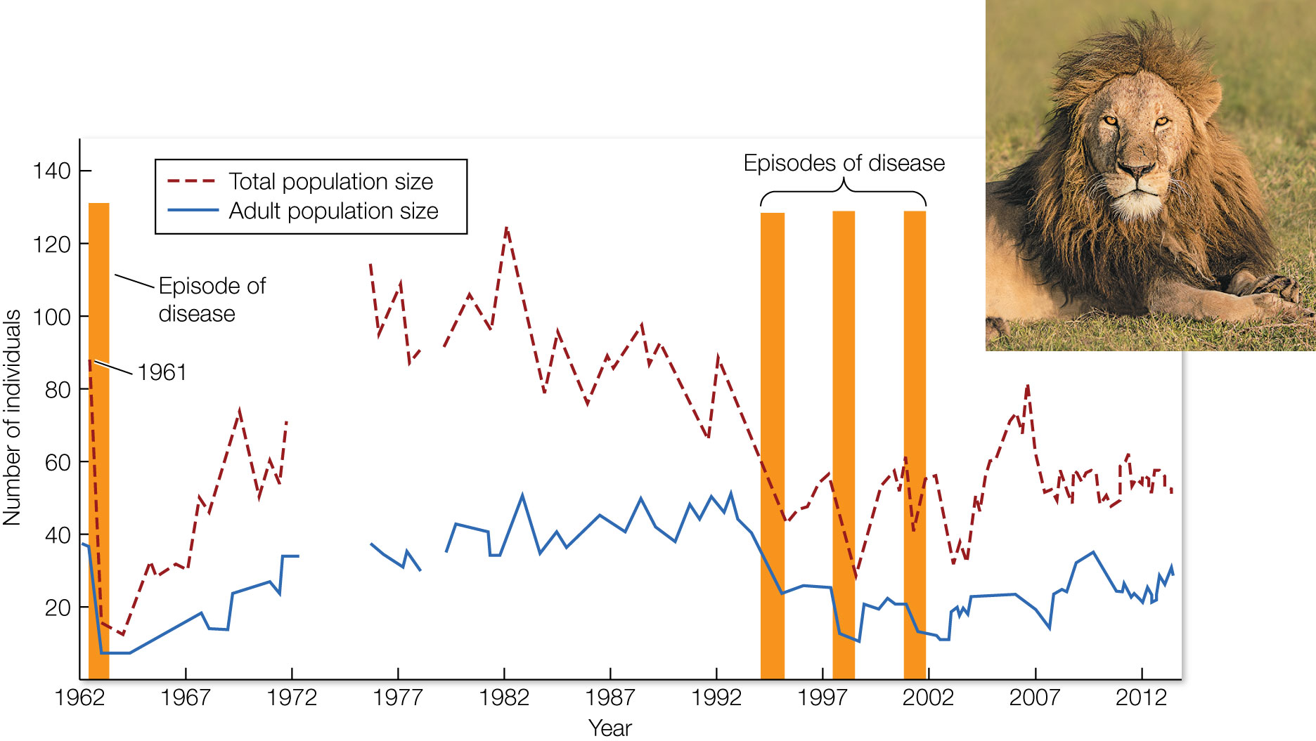
Figure 13.5 The Ngorongoro Crater lion population in Tanzania consisted of about 90 individuals in 1961 before it crashed in 1962.
Notes:
Figure 13.5 The Ngorongoro Crater lion population in Tanzania consisted of about 90 individuals in 1961 before it crashed in 1962. Since that time, the population reached a peak of 125 individuals in 1983 before collapsing to 34 individuals (fewer than 20 of which were adults). Small population size, an isolated location, lack of immigration since 1964, and disease have contributed to the loss of genetic variability caused by a population bottleneck. A lack of census data for certain years is the cause of gaps in the lines. The four vertical bars represent episodes of disease outbreak.

Slide 10
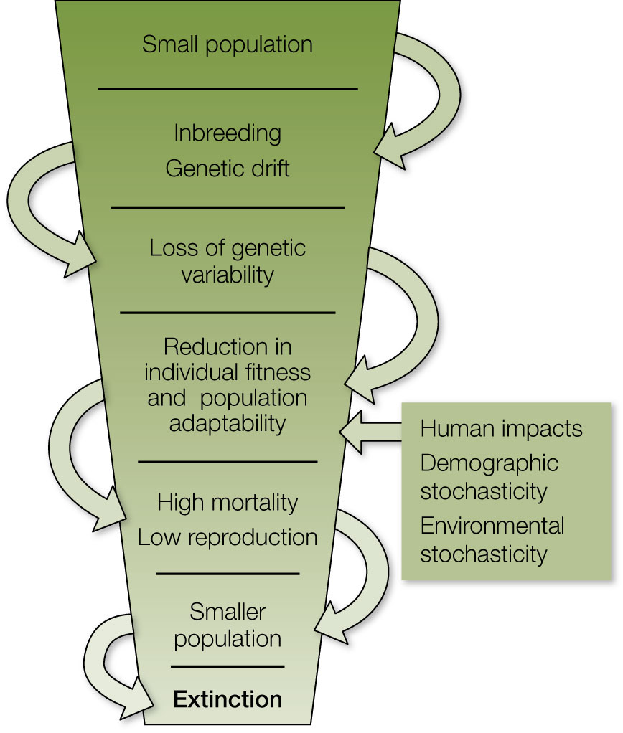
Figure 13.6 Once a population drops below a certain size, it can enter an extinction vortex in which the factors that affect small populations tend to drive its size progressively lower. This downward spiral can lead to local extinction of the species.
Notes:
Figure 13.6 Once a population drops below a certain size, it can enter an extinction vortex in which the factors that affect small populations tend to drive its size progressively lower. This downward spiral can lead to local extinction of the species.

Slide 11
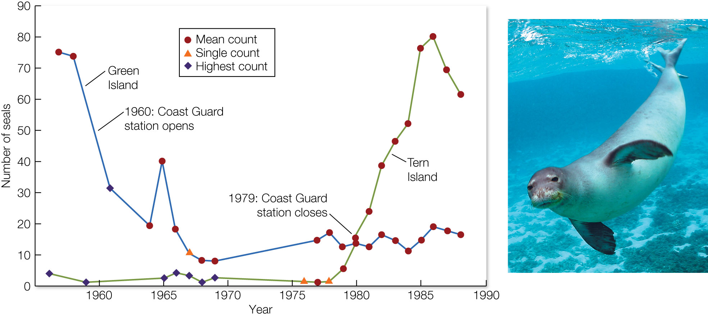
Figure 13.7 A census of the Hawaiian monk seal (Monachus schauinslandi) populations on Green Island, Kure Atoll; and Tern Island, French Frigate Shoals, revealed that this species was in danger of extinction.
Notes:
Figure 13.7 A census of the Hawaiian monk seal (Monachus schauinslandi) populations on Green Island, Kure Atoll; and Tern Island, French Frigate Shoals, revealed that this species was in danger of extinction. Population counts were plotted from a single count, the mean of several counts, or the maximum of several counts. Seal populations declined when a Coast Guard station was opened on Green Island in 1960 because of disturbance by people and dogs; the population increased on Tern Island after the closing of a Coast Guard station in 1979.

Slide 12
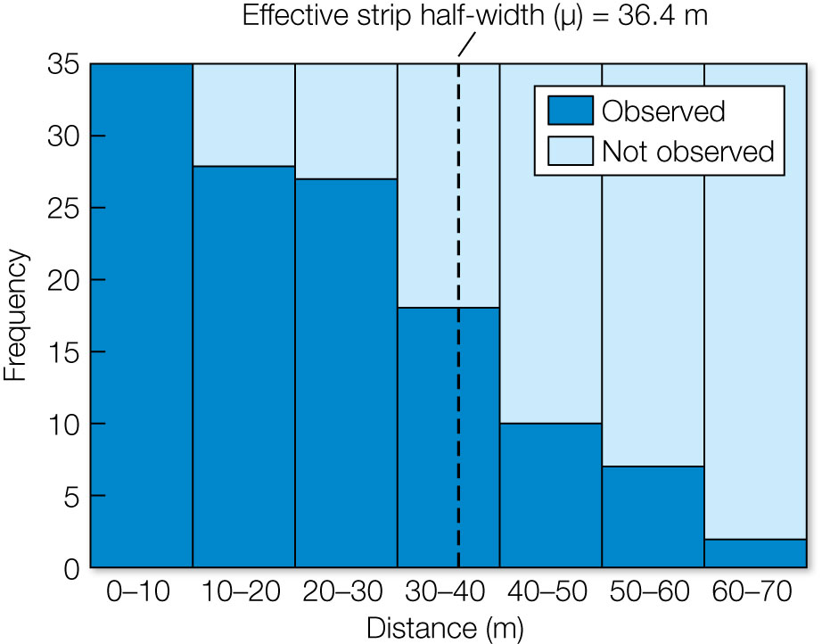
12
Notes:
A graph showing the number (or frequency) of animals detected in different distance “bins,” each 10 m from the centerline of a transect survey. For each animal detected during the survey, the perpendicular distance from the line was measured. These results are from a hypothetical example of a zebra survey but are typical for transect (or circular plot) surveys for many other species.

Slide 13
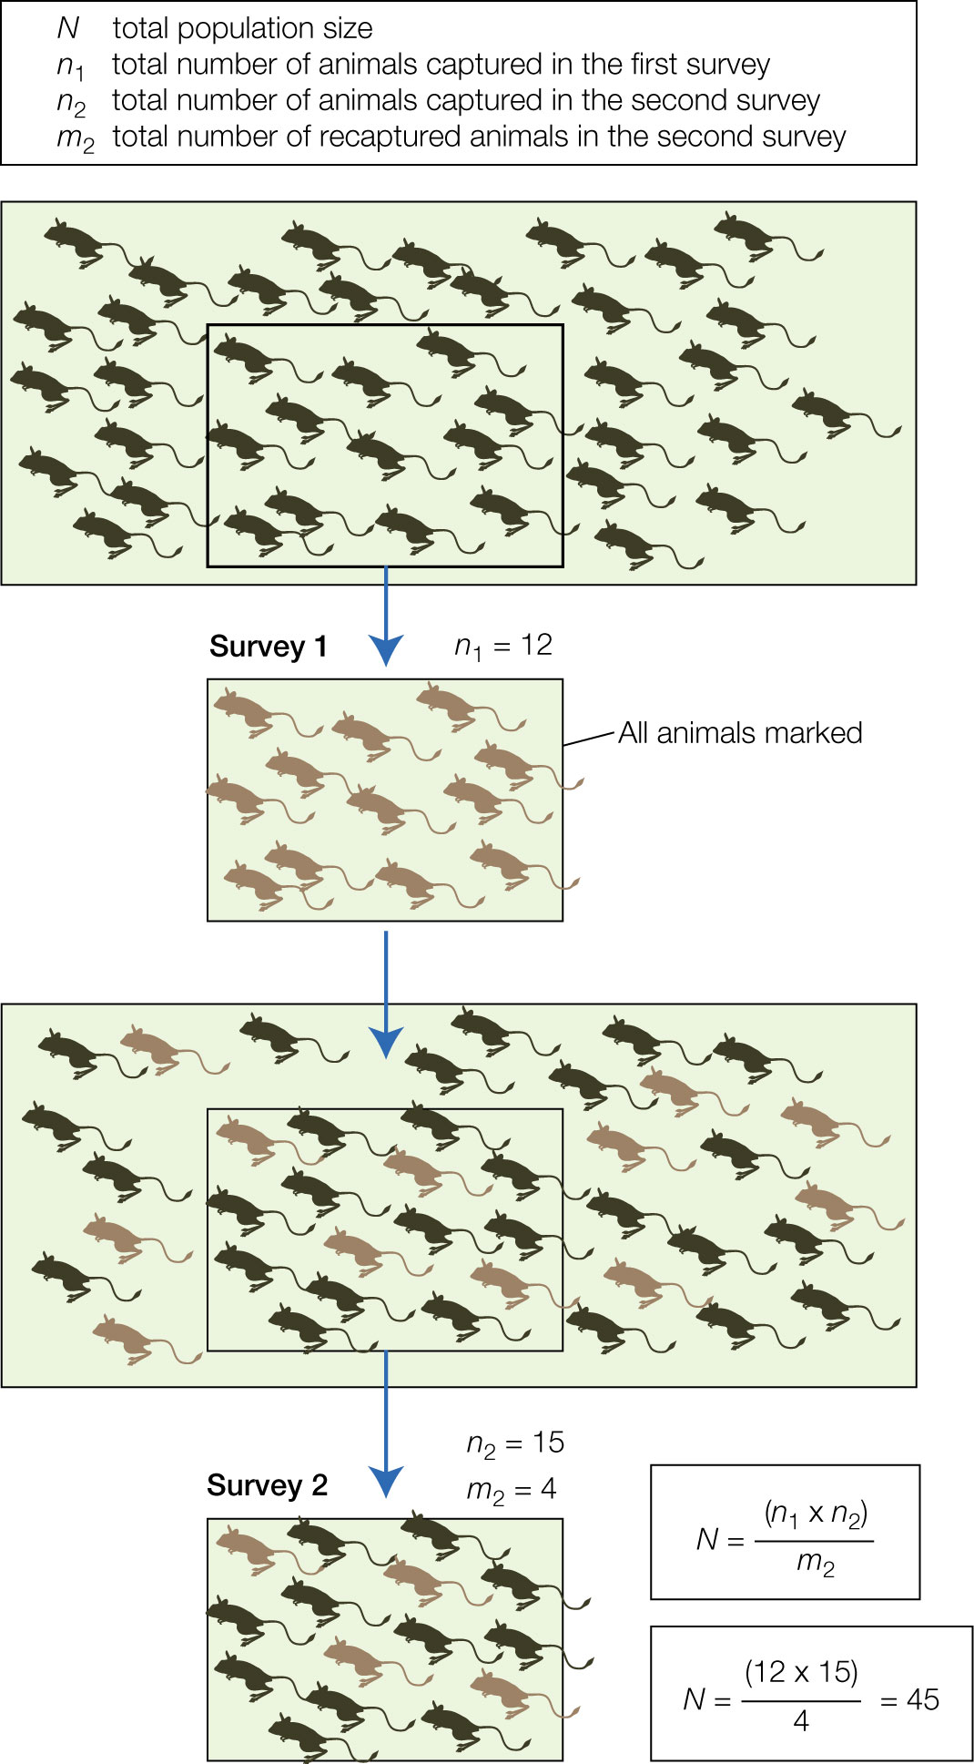
Figure 13.8 The capture–mark–recapture (CMR) approach to estimating population size. In this case, CMR is used to estimate the population of jerboas (N), which is unknown.
Notes:
Figure 13.8 The capture–mark–recapture (CMR) approach to estimating population size. In this case, CMR is used to estimate the population of jerboas (N), which is unknown. Survey 1 captures a proportion of the total (n₁) and those animals are marked and released back into the population. Survey 2 captures a new group of individuals (n₂), of which some number are marked (m₂). The ratio of m₂ to n₂ should be equivalent to the ratio of n1 to N. Note that the Lincoln–Peterson equation estimates a total population of 45, which is slightly more than the true total number of jerboas (40 in the top box).

Slide 14

14
Notes:
The photo depicts Tucker, the Center for Conservation Biology scat detection dog, locating whale scat from Southern Resident killer whales on the Salish Sea in Washington State. Scats are genotyped to determine the whale’s identity and sex. Reproductive, stress, and nutrition hormones extracted from the samples indicate physiological health as well as pregnancy occurrence and loss. Toxins extracted from these samples indicate how nutritional stress interacts with toxin loads, leading to spontaneous abortion of nutritionally compromised whales.

Slide 15
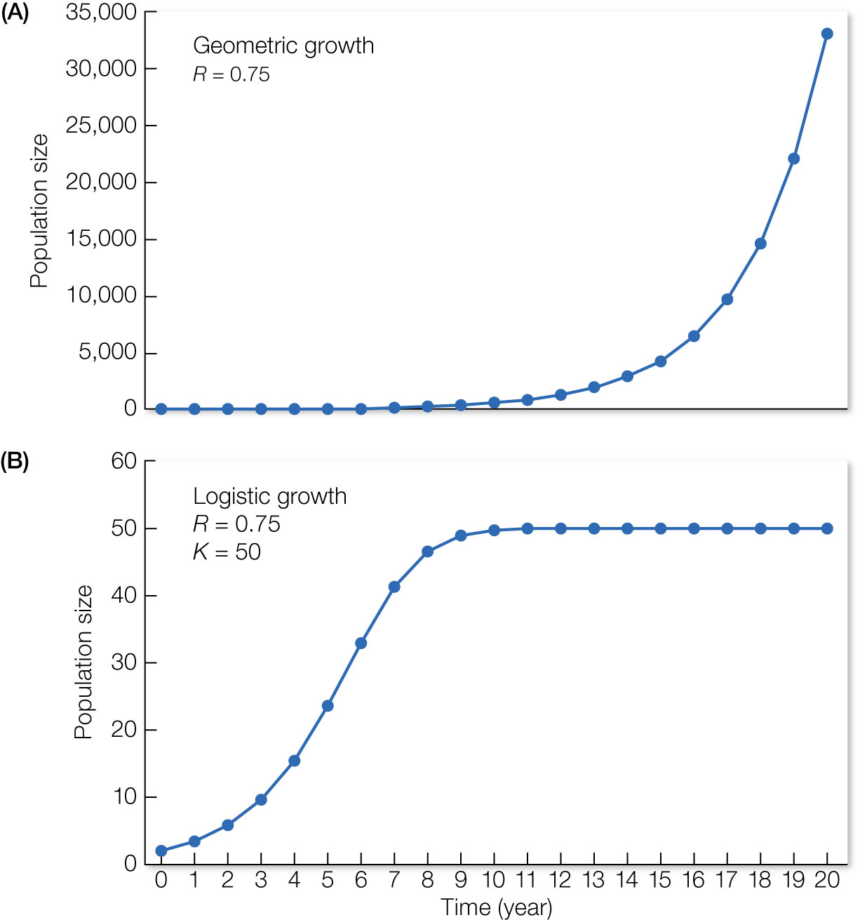
Figure 13.9 Population growth calculated using the geometric growth model (A) and logistic growth model (B).
Notes:
Figure 13.9 Population growth calculated using the geometric growth model (A) and logistic growth model (B). The geometric growth model shows a pattern of exponential growth that is unconstrained, because birth and death rates are constant. The logistic growth model introduces a carrying capacity (K, the maximum number of individuals an area can support) to account for the effect of intraspecific competition in the population. Both models are discrete-time models (with year as the time unit) and have the same growth rate (R).

Slide 16
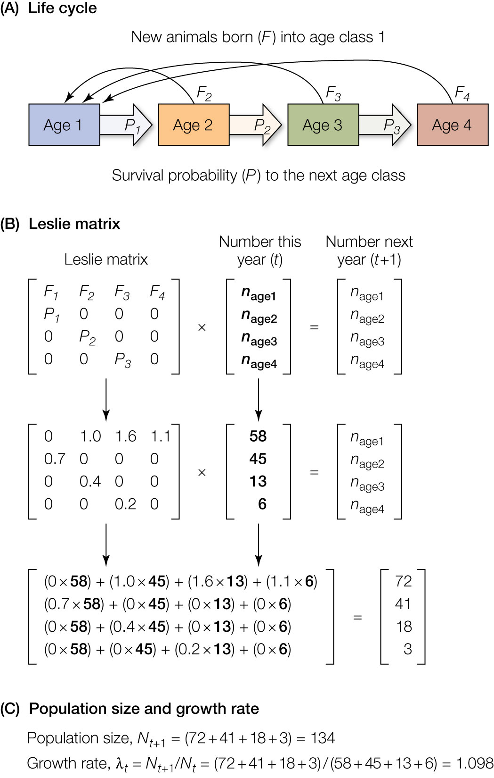
Figure 13.10 Using a Leslie matrix to estimate the size and growth rate of a population when there is age structure.
Notes:
Figure 13.10 Using a Leslie matrix to estimate the size and growth rate of a population when there is age structure. (A) In this example, the species lives for 4 years and ages are divided into classes (1 = 0–1 year; 2 = 1–2 years; 3 = 2–3 years; and 4 = 3–4 years). Animals in each class have a probability P of surviving to the next class. Animals in each age class except the first produce offspring at a rate F; these offspring then enter the first age class. (B, C) Because survival and fecundity differ by age class, there is age structure in this population. If we estimate these parameters and census the population in the current year, a Leslie matrix can be used to estimate the number of individuals in each class in the next time step. Total population size is then the sum of all animals in each age class. Population estimates can also be used to calculate the growth rate for the population.

Slide 17
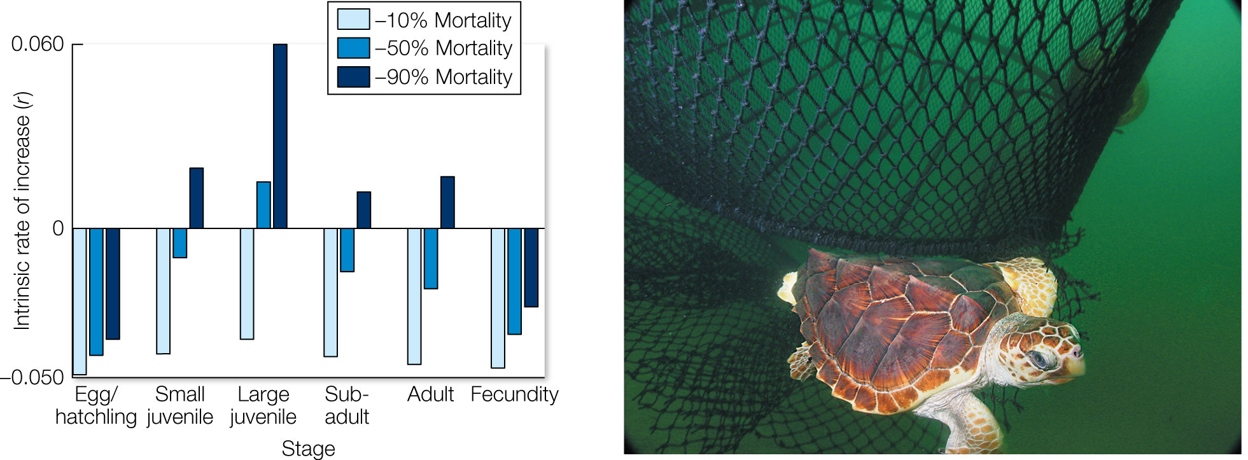
Figure 13.11 A stage-based model of loggerhead turtles (Caretta caretta) was used to simulate of the effects of 10%, 50%, and 90% reductions in mortality on the intrinsic population growth rate (r) of different life stages.
Notes:
Figure 13.11 A stage-based model of loggerhead turtles (Caretta caretta) was used to simulate of the effects of 10%, 50%, and 90% reductions in mortality on the intrinsic population growth rate (r) of different life stages. The results revealed that efforts to reduce mortality of large juveniles had the greatest effect on the population. A main source of mortality for turtles in this age class is entrapment in fishing nets. These results led to more widespread use of escape hatches in nets, known as turtle excluder devices.

Slide 18
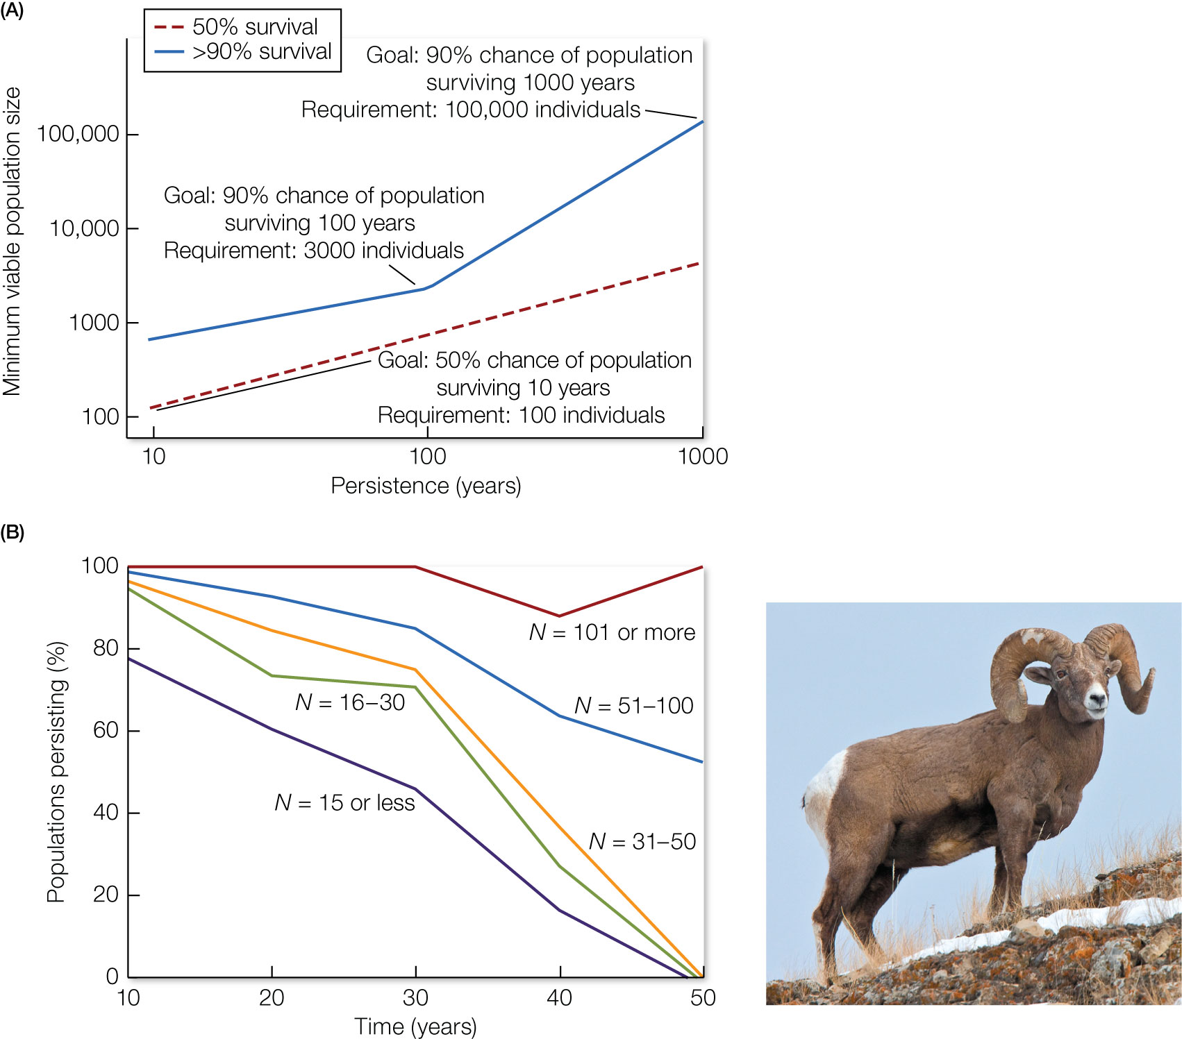
Figure 13.12 (A) If the goal is persistence for a greater number of years, then a larger minimum viable population size is needed.
Notes:
Figure 13.12 (A) If the goal is persistence for a greater number of years, then a larger minimum viable population size is needed. This point is illustrated by two lines: one showing the minimum viable population size (y axis) required to ensure a 50% chance of survival (dashed red line) and a second showing the size needed to ensure a 90% chance of survival (solid blue line). These log scale values were derived from data on changes in population size and persistence of 1,198 different species. (B) The relationship between the initial population size (N) of bighorn sheep and the percentage of populations that persisted over time. Almost all populations with more than 100 sheep persisted beyond 50 years, while populations with fewer than 50 individuals died out within 50 years. Not included are small populations that were actively managed and augmented by the release of additional animals.

Slide 19
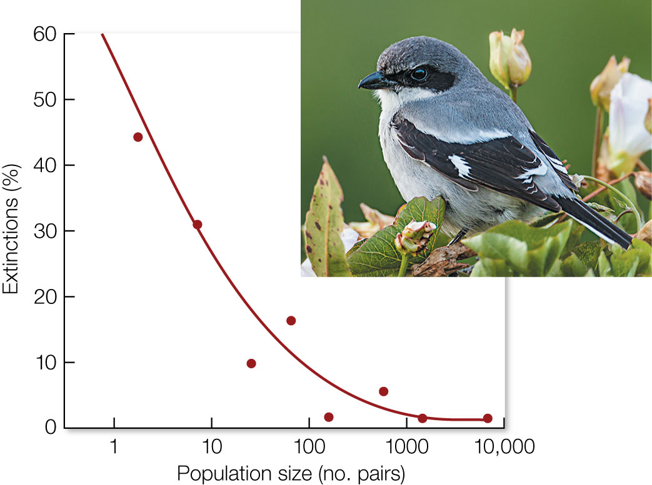
Figure 13.13 Extinction rates of bird species like the loggerhead shrike, Lanius ludovicianus anthonyi, on the Channel Islands of Southern California.
Notes:
Figure 13.13 Extinction rates of bird species like the loggerhead shrike, Lanius ludovicianus anthonyi, on the Channel Islands of Southern California. Each dot represents the extinction percentage of all the species in that population size class; extinction rate decreases as the size of the population increases. Populations with fewer than 10 breeding pairs had an overall 39% probability of extinction over 80 years. Populations of between 10 and 100 pairs averaged about 10% probability of extinction, and populations of over 100 pairs had a very low probability of extinction.

Slide 20
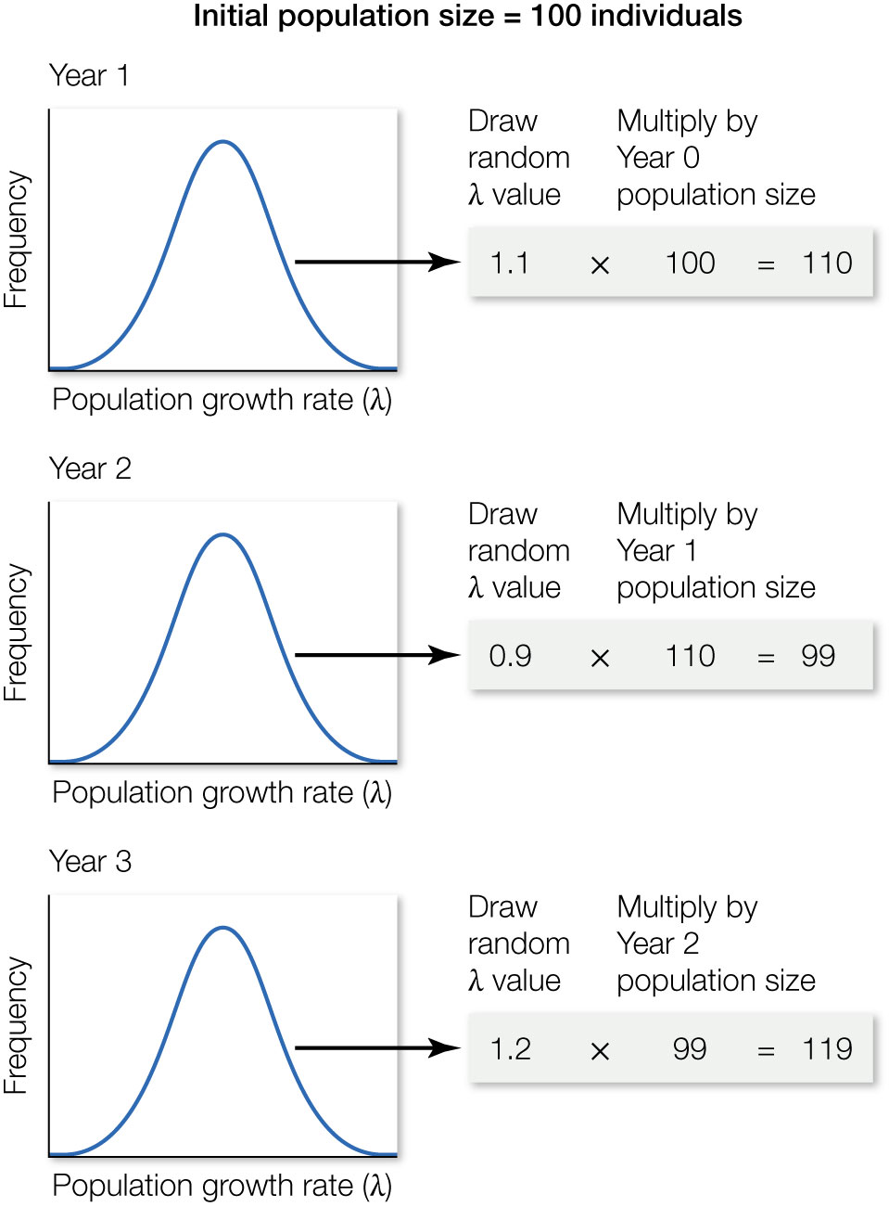
Figure 13.14 Projecting a population forward in a basic population viability analysis using a geometric growth model; each projection is referred to as a trial.
Notes:
Figure 13.14 Projecting a population forward in a basic population viability analysis using a geometric growth model; each projection is referred to as a trial. Starting with an initial population size, estimating the population size in the next step involves drawing a random population growth rate value (λ) from a distribution of values from past data and then multiplying this value by the initial population size. Estimating population size in the next year involves drawing a new λ value and multiplying it by the year 1 population size. This procedure is repeated year after year until the final period of the analysis is reached.

Slide 21
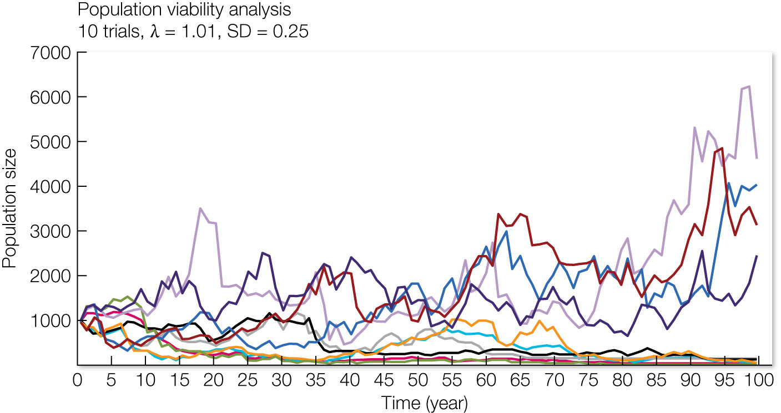
Figure 13.15 A population viability analysis based on 10 population projections, or trials.
Notes:
Figure 13.15 A population viability analysis based on 10 population projections, or trials. The probability of viability in this case is the number of trials that end with more than 2 individuals out of the total number of trials = 4/10, or 40%. Population viability analyses usually conduct more than just 10 trials, often hundreds or thousands.

Slide 22
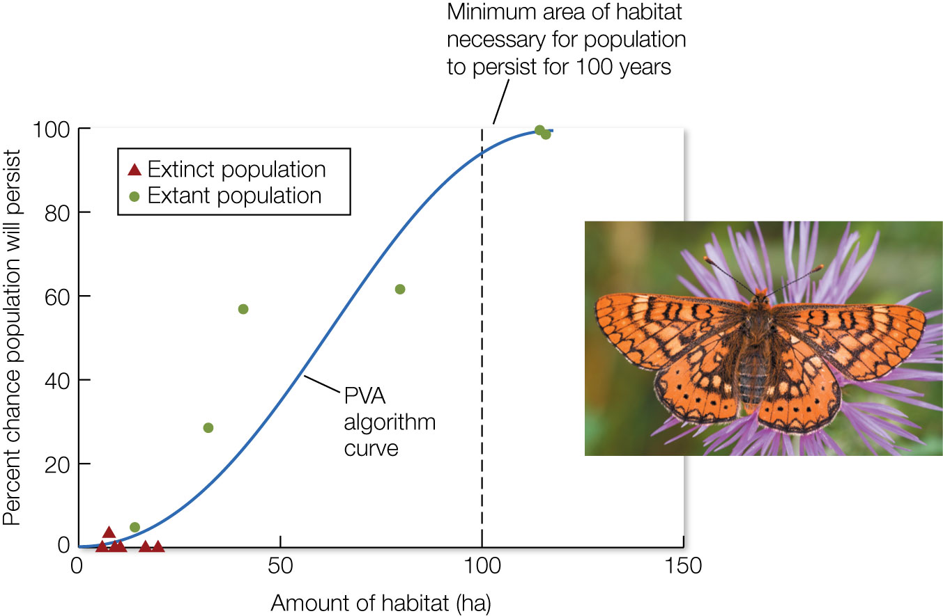
Figure 13.16 Population viability analyses predict that it takes 100 hectares of habitat to ensure (at 95% likelihood) the persistence of a marsh fritillary butterfly (Euphydryas aurinia) population for 100 years.
Notes:
Figure 13.16 Population viability analyses predict that it takes 100 hectares of habitat to ensure (at 95% likelihood) the persistence of a marsh fritillary butterfly (Euphydryas aurinia) population for 100 years. All the extinct populations occupied areas much smaller than 100 hectares. Four of the six extant populations occupy areas smaller than 100 hectares and are predicted to go extinct unless their habitat is increased.

Slide 23
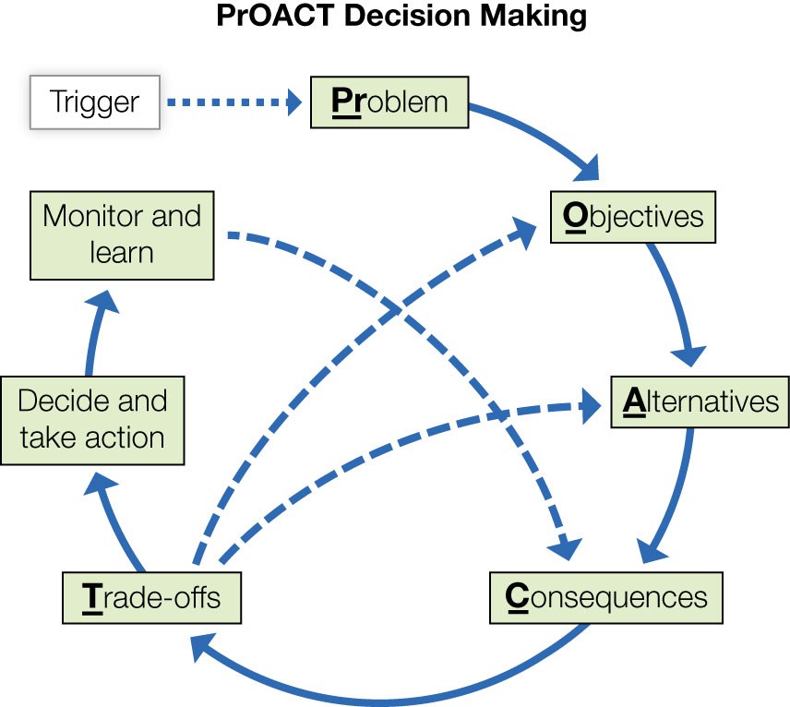
Figure 13.17 PrOACT is a transparent, data-driven approach to evaluate decisions. PrOACT stands for problem, objectives, alternatives, consequences, and trade-offs.
Notes:
Figure 13.17 PrOACT is a transparent, data-driven approach to evaluate decisions. PrOACT stands for problem, objectives, alternatives, consequences, and trade-offs. The PrOACT approach forms the basis of structured decision-making, which is often used to evaluate conservation decisions. Key steps include articulating the problem, identifying objectives important to addressing the problem, developing a set of alternative decisions that could be made, estimating the consequences of each alternative on each objective, and evaluating the trade-offs of each alternative given the consequences. A decision follows, and further monitoring information collected after the decision is implemented can be used to update the consequences, which then updates the trade-offs. This last step forms the foundation of what is referred to as adaptive management.

Slide 24
TABLE 13.1 Results of a decision-making analysis using a framework to evaluate and compare three management alternatives for reducing a potential outbreak of disease in a bighorn sheep populationª
 | Objective
Management alternative | Probability of persistence Goal: maximize Weight: 0.21 | Operating costs Goal: minimize Weight: 0.15 | Personnel costs Goal: minimize Weight: 0.14 | Crisis response costs Goal: minimize Weight: 0.19 | Viewing opportunity Goal: maximize Weight: 0.15 | Hunting opportunity Goal: maximize Weight: 0.18 | Final score^{b}
AGGRESSIVE
Expected outcome | 0.9 | 105 | 220 | 8 | 0.9 | 190
Normalized score | 1.00 | 0.00 | 0.00 | 1.00 | 1.00 | 1.00
Normalized score × wt. | 0.21 | 0.00 | 0.00 | 0.19 | 0.15 | 0.18 | 0.72
MODERATE
Expected outcome | 0.8 | 100 | 170 | 16 | 0.8 | 135
Normalized score | 0.80 | 0.05 | 0.23 | 0.80 | 0.80 | 0.35
Normalized score × wt. | 0.17 | 0.01 | 0.03 | 0.15 | 0.12 | 0.06 | 0.53
Notes:
TABLE 13.1 Results of a decision-making analysis using a framework to evaluate and compare three management alternatives for reducing a potential outbreak of disease in a bighorn sheep populationª

Slide 25
TABLE 13.1 (Continued)
 | Objective
Management alternative | Probability of persistence Goal: maximize Weight: 0.21 | Operating costs Goal: minimize Weight: 0.15 | Personnel costs Goal: minimize Weight: 0.14 | Crisis response costs Goal: minimize Weight: 0.19 | Viewing opportunity Goal: maximize Weight: 0.15 | Hunting opportunity Goal: maximize Weight: 0.18 | Final score^{b}
REACTIVE
Expected outcome | 0.4 | 0 | 0 | 48 | 0.4 | 105
Normalized score | 0.00 | 1.00 | 1.00 | 0.00 | 0.00 | 0.00
Normalized score × wt. | 0.00 | 0.15 | 0.14 | 0.00 | 0.00 | 0.00 | 0.28
Source: M. S. Mitchell et al. 2013. Wild Soc Bull 37: 107–114.
ªThe consequence of each alternative decision on each objective was estimated from models, data, and expert opinion. These values were normalized by objective (i.e., scaled from 0 to 1.0, with 0 being the worst and 1.0 being the best; if the goal for an objective is to maximize, then the lowest value among the alternatives becomes 0 and the highest value becomes 1.0; if the goal is to minimize, the lowest value is the best and becomes 1.0 and the highest value becomes 0). Finally, normalized scores were multiplied by weights and summed across objectives to result in a final score for each alternative management decision. The higher the score, the better the decision. ^{b}Equations for normalizing values in an objective: (1) if the goal is to maximize, then: (value – min)/(max – min); (2) if the goal is to minimize, then: (value – max)/(min – max). For ex- ample, the normalized value for the moderate alternative in the probability of persistence objective = (0.8 – 0.4)/(0.9 – 0.4) = 0.8.
Notes:
TABLE 13.1 Results of a decision-making analysis using a framework to evaluate and compare three management alternatives for reducing a potential outbreak of disease in a bighorn sheep populationª

Slide 26
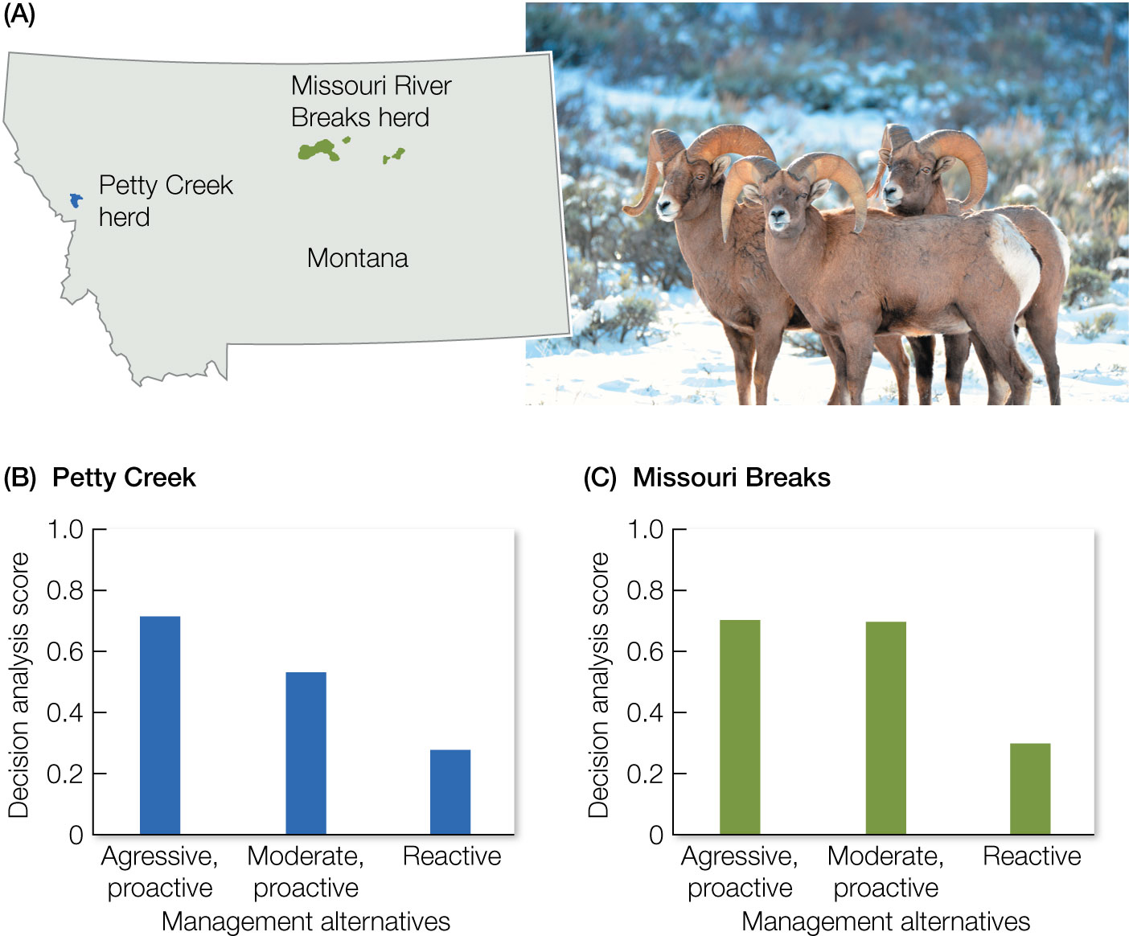
Figure 13.18 Scores for three management alternatives for two populations of bighorn sheep in Montana, calculated using a decision-making framework (see Table 13.1).
Notes:
Figure 13.18 Scores for three management alternatives for two populations of bighorn sheep in Montana, calculated using a decision-making framework (see Table 13.1).

