Slide 1
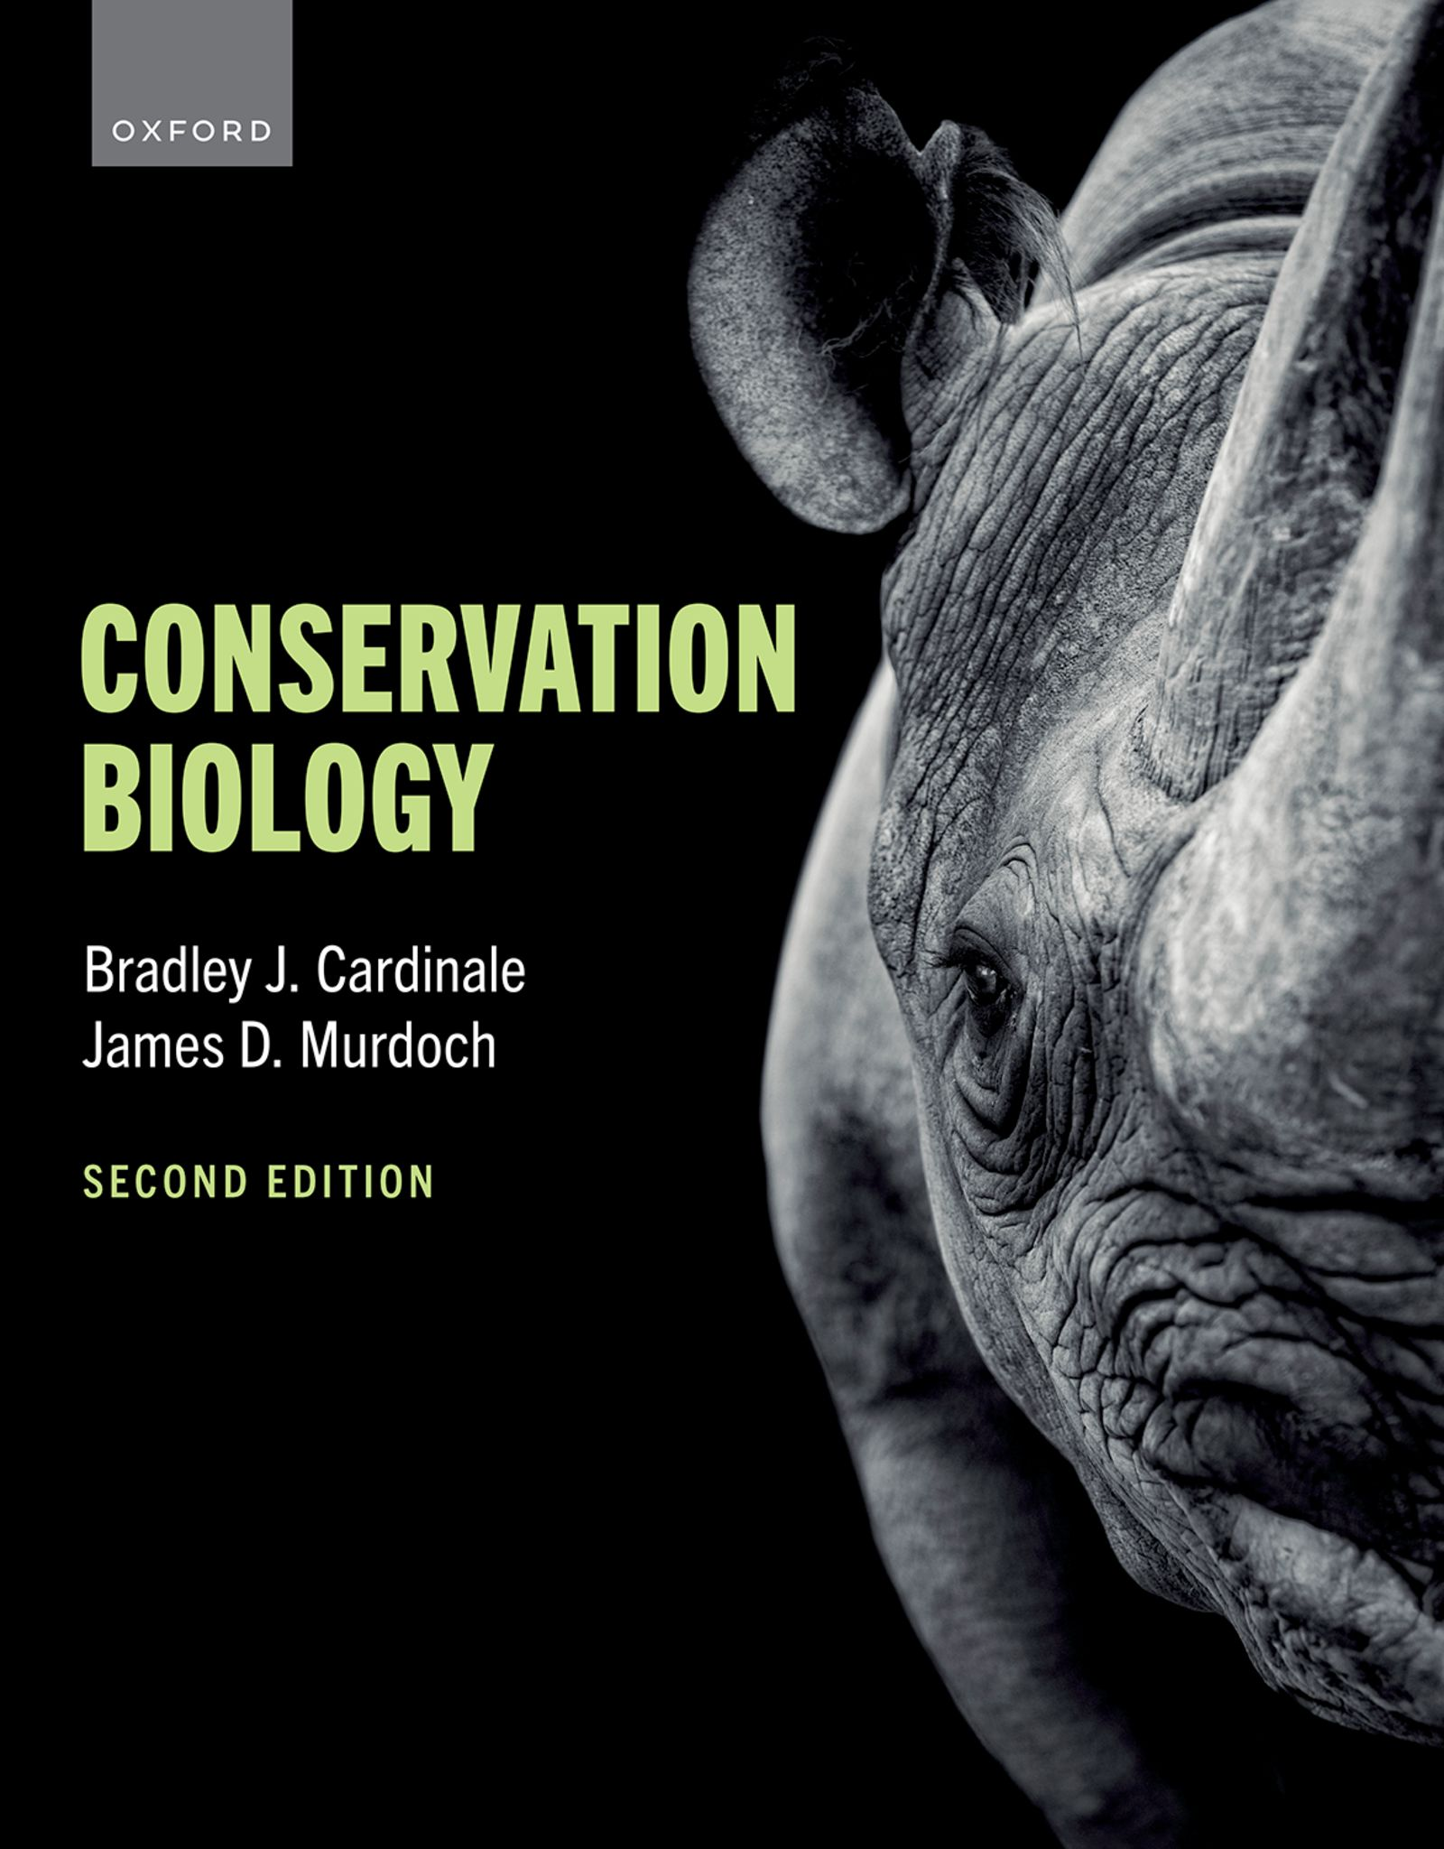
CONSERVATION BIOLOGY
By Bradley J. Cardinale and James D. Murdoch

Slide 2
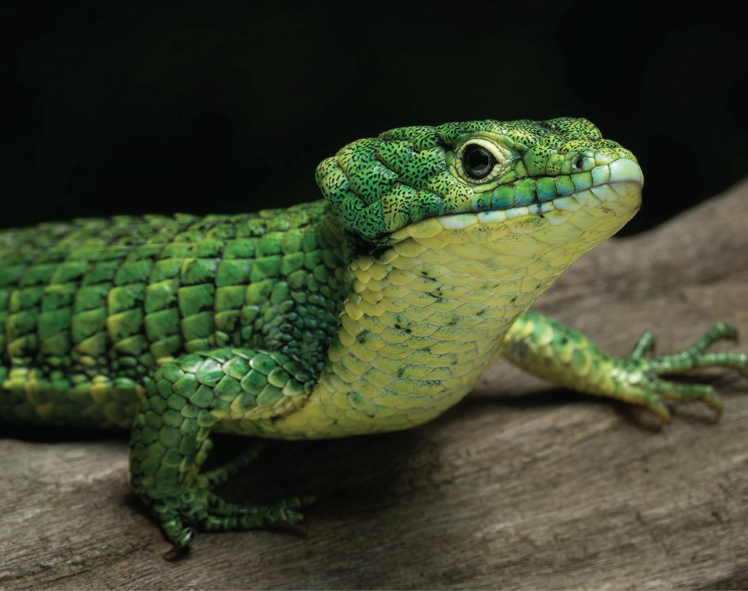
2
Notes:
The terrestrial arboreal alligator lizard (Abronia graminea), also known as the Mexican alligator lizard, is endemic to the highlands of Mexico, where it is commonly found inhabiting cloud and pin-oak forest canopies. The species is endangered by habitat loss and fragmentation.

Slide 3
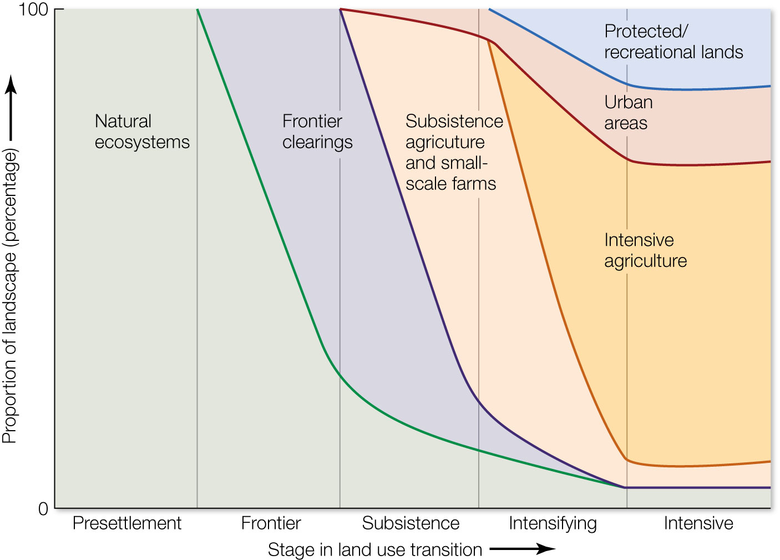
Figure 9.1 An idealized sequence of land-use transitions.
Notes:
Figure 9.1 An idealized sequence of land-use transitions. As societies progress through demographic and economic transitions, they tend to follow a predictable sequence of land-use change: natural ecosystems that are dominant during presettlement give way to frontier clearings, which then transition to subsistence agriculture and small-scale farms, which then give way to intensive urban development and protected or recreational lands. Various parts of the world are in different stages of these transitions depending on their history, socioeconomic conditions, and ecological histories. Furthermore, some places remain in one stage of landuse transition for a long time while others move rapidly between stages.

Slide 4
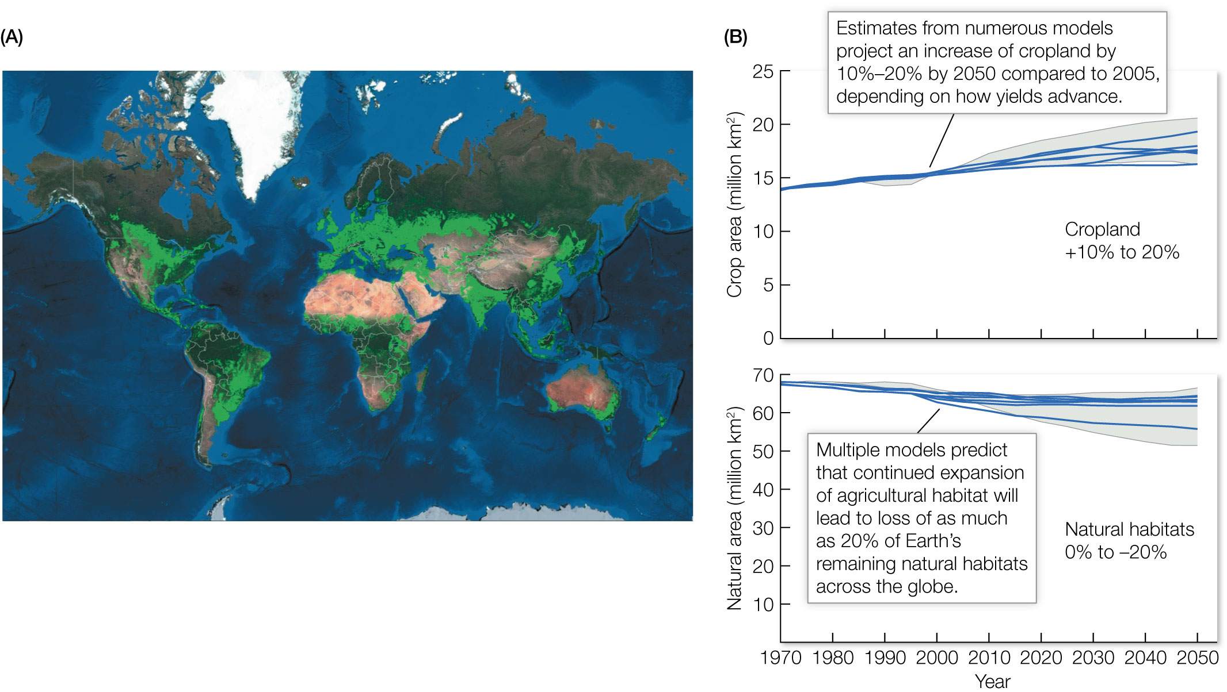
Figure 9.2 Global habitat loss due to expansion of agriculture.
Notes:
Figure 9.2 Global habitat loss due to expansion of agriculture. (A) As of 2017, the world has 18.7 million km2 of cropland and 33.8 million km2 of pasture lands. Altogether, agriculture occupies about 46% of Earth’s inhabitable land surface, representing the single largest use of land on the planet (green area in map). (B) Smith and colleagues18 summarized several integrated assessments of future land-use change (each assessment represents a different blue line; gray shading indicates 20th to 80th percentiles of literature estimates) and projected that the amount of agricultural land on Earth will need to increase 10% to 20% by 2050 (compared with 2005 levels) to feed the growing human population. This will correspond to a future loss of up to 20% of the natural habitats remaining on Earth.

Slide 5
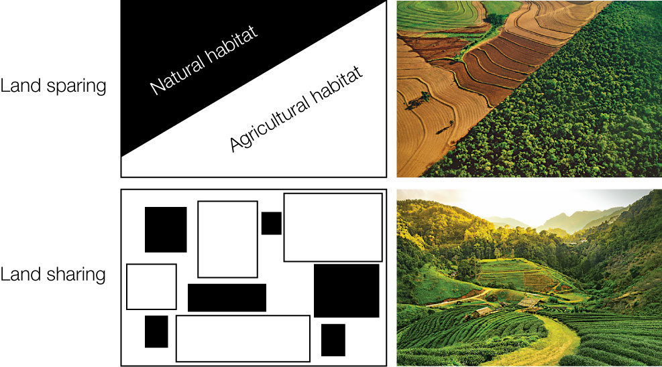
5
Notes:
The left side of this figure depicts the distribution of natural habitat (black) and agricultural habitat (white) for land sparing (top) and land sharing (bottom). The right side presents examples of what real landscapes might look like under these two alternative land uses.

Slide 6
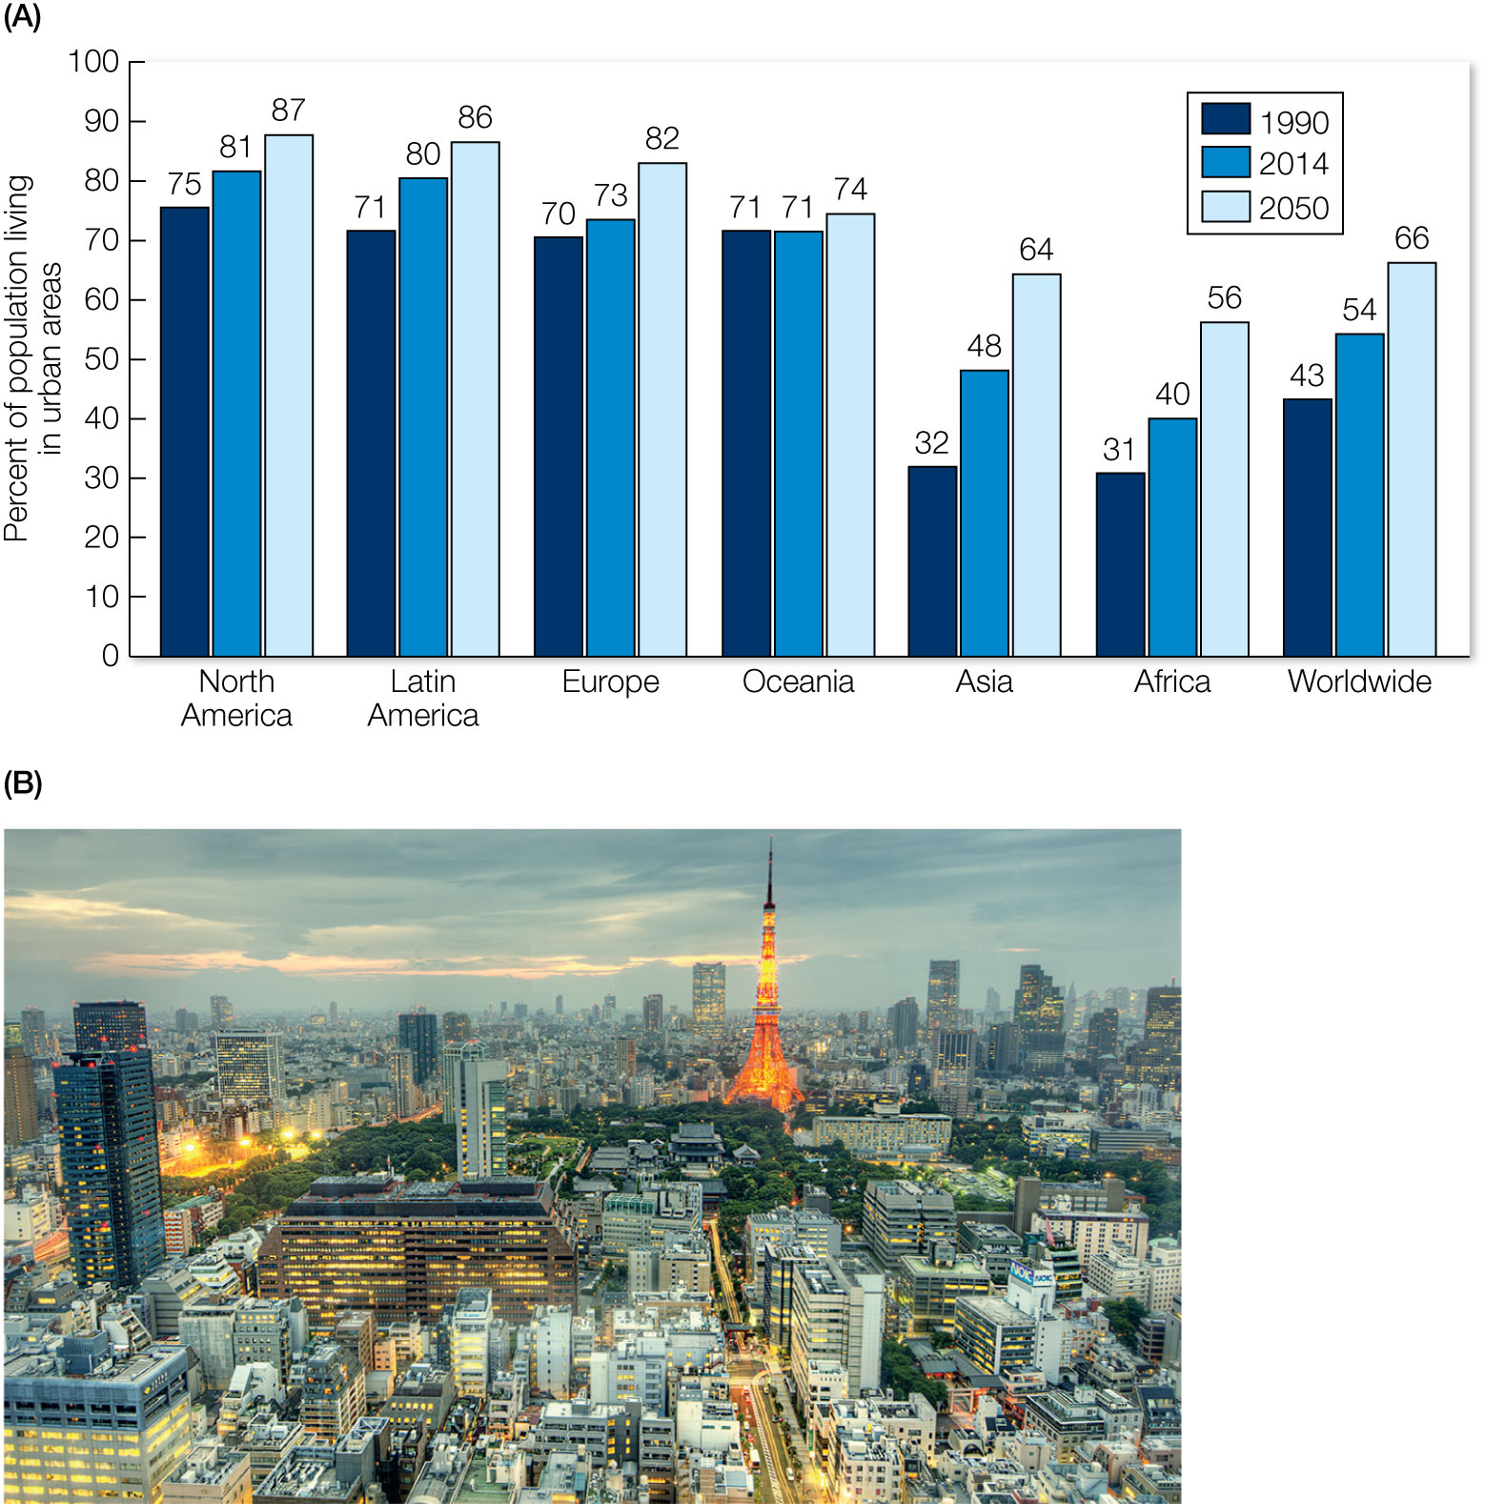
Figure 9.3 Urbanization.
Notes:
Figure 9.3 Urbanization. (A) The world is in the middle of a dramatic transition where the majority of the human population is moving into urban habitats. By 2050, almost 7 of every 10 people will live in a megacity. The large population shifts from rural to urban habitat are taking place in Asia and Africa. (B) Tokyo, Japan, is currently the world’s most populous city, with 38 million inhabitants.

Slide 7
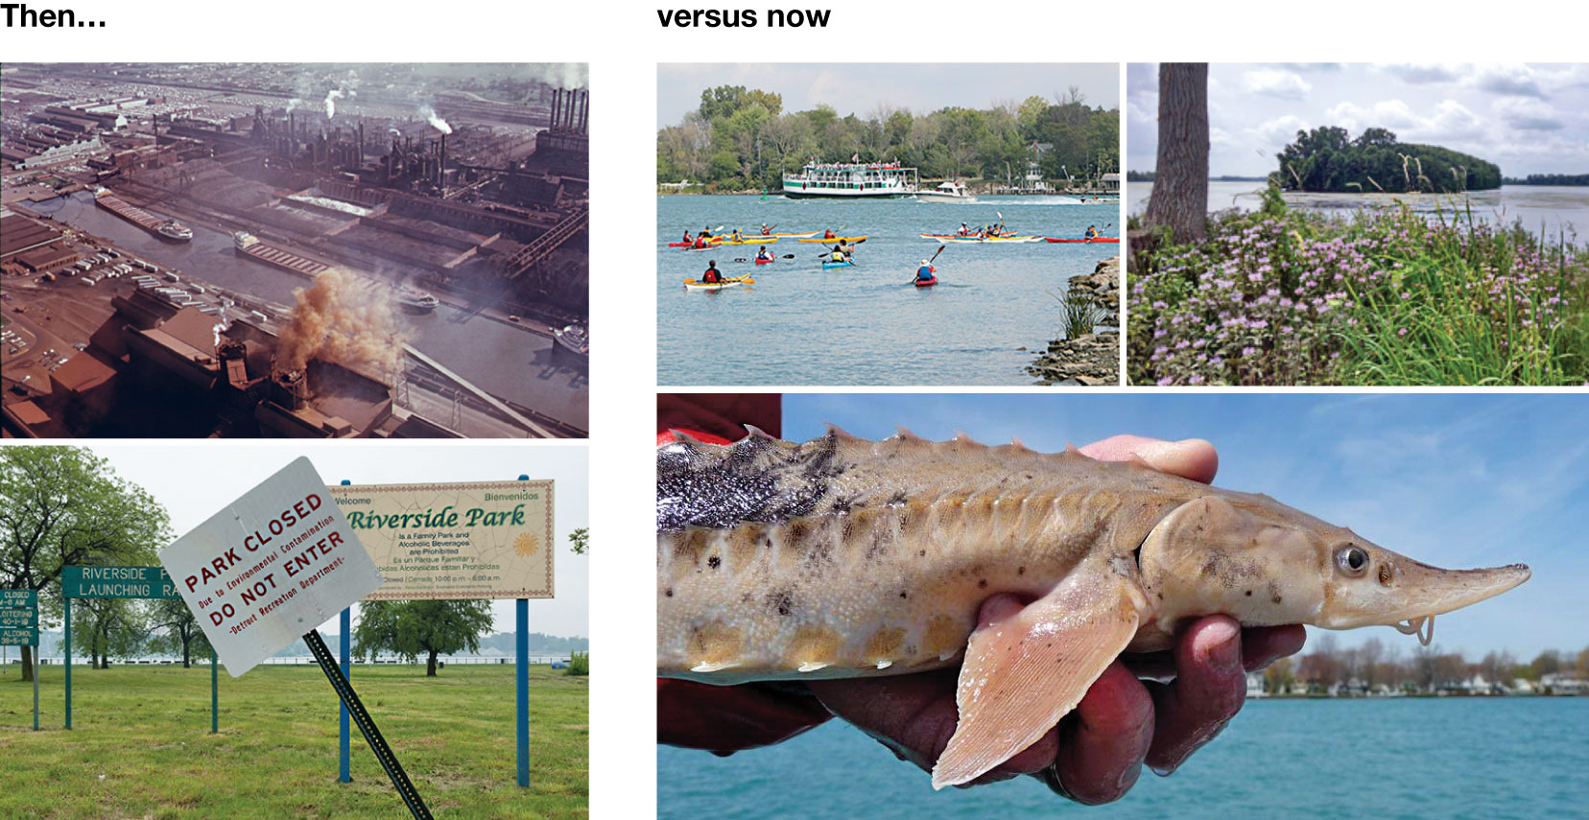
7
Notes:
In the 1950s–1970s, Detroit was heavily polluted by industry, and its waterways, like the Detroit River, were filled with oil, chemicals, and raw sewage (left). In the early twenty-first century, the urban environments of Detroit are being reinvented to be cleaner and greener. Much of the Detroit River waterfront has been renovated and revitalized and now supports hundreds of species of fish, birds, and mammals, as well as recreational activities that draw tourists and provide opportunities for residents of the city.

Slide 8
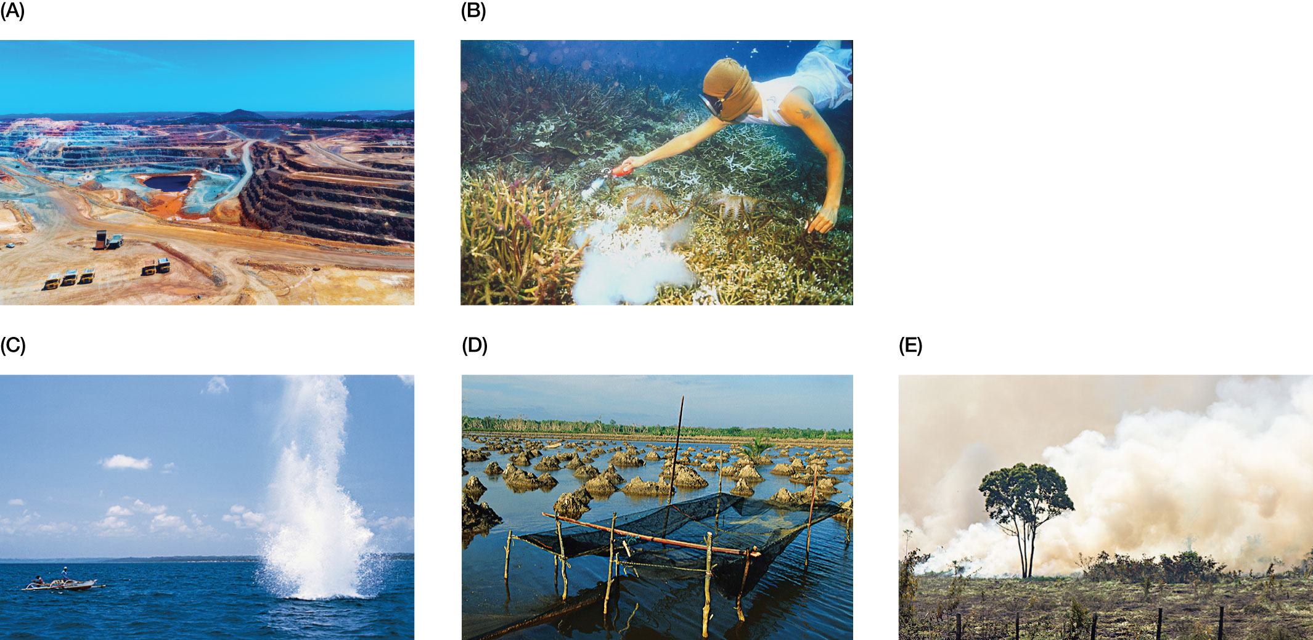
Figure 9.4 Habitat loss caused by extractive industries.
Notes:
Figure 9.4 Habitat loss caused by extractive industries. (A) A large surface copper mine destroys all local plant and animal life and leaves behind pollution in the form of acid mine drainage. (B, C) Fishermen use illegal methods of cyanide poisoning and dynamite blasting to collect fish from coral reefs. These methods simultaneously kill the coral habitat. (D) A coastal mangrove forest in Thailand is clear-cut to make way for shrimp farms. (E) A rain forest in the Amazon is slashed and burned to prepare for cattle ranching.

Slide 9
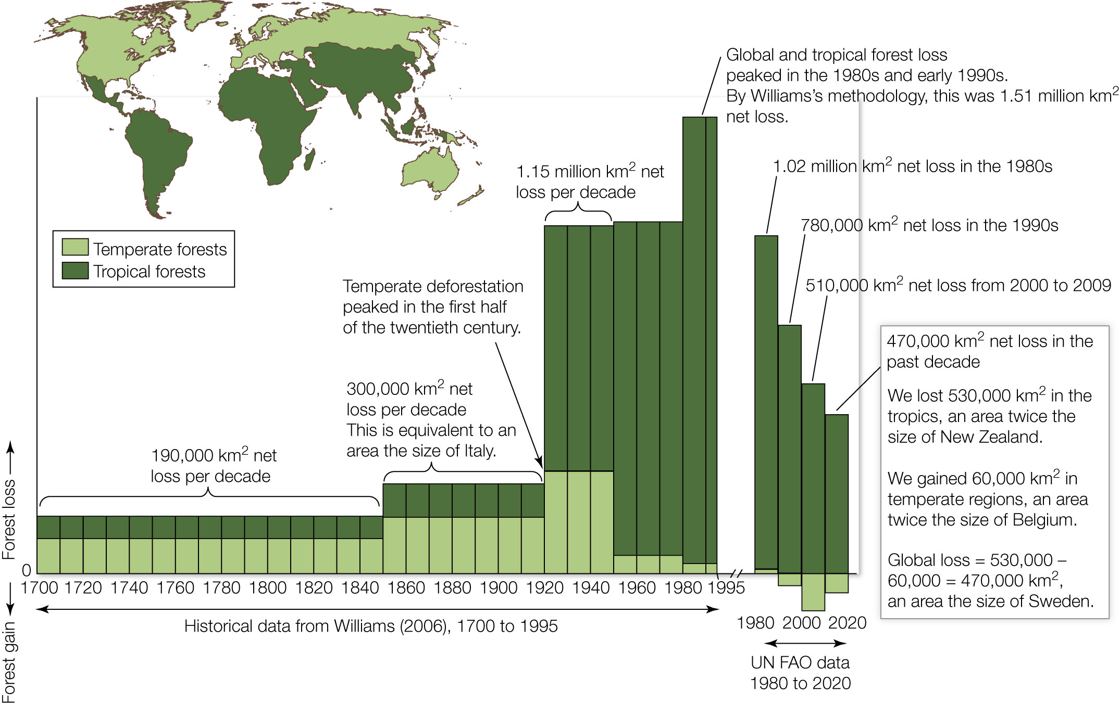
Figure 9.5 Decadal losses and gains in global forest cover over the past three centuries.
Notes:
Figure 9.5 Decadal losses and gains in global forest cover over the past three centuries. Decadal forest loss is measured as the average net loss every 10 years, in square kilometers. Bars above zero represent net deforestation, while bars below zero represent net afforestation (e.g., 1990–2020 in temperate forests).

Slide 10
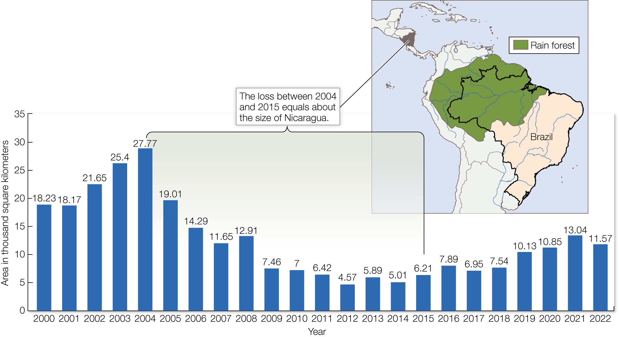
Figure 9.6 With 60% of the Amazon rain forest (green) lying within its borders, Brazil is home to a large fraction of the world’s rain forests.
Notes:
Figure 9.6 With 60% of the Amazon rain forest (green) lying within its borders, Brazil is home to a large fraction of the world’s rain forests. But Brazil is also responsible for a large fraction of the world’s loss of rain forest habitat. Although new policies have tried to slow deforestation in Brazil, the country has lost an average of 12,160 km2 per year since 2000, and rates of deforestation have been increasing since 2012.

Slide 11
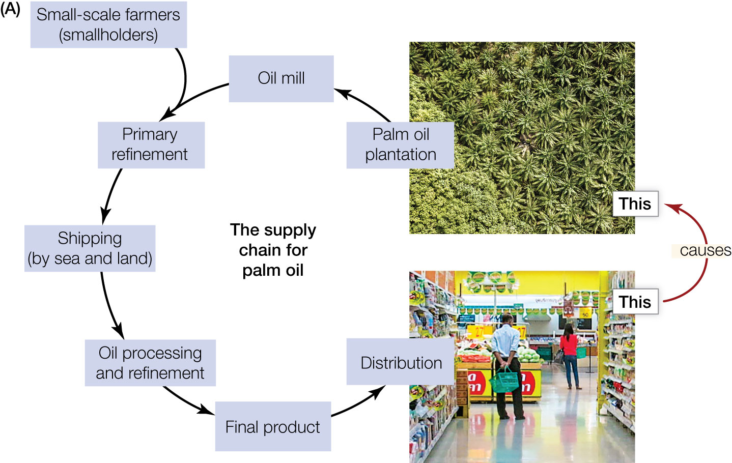
11
Notes:
The supply chain for palm oil, which shows how purchasing decisions in developed nations cause tropical deforestation in developing nations.

Slide 12
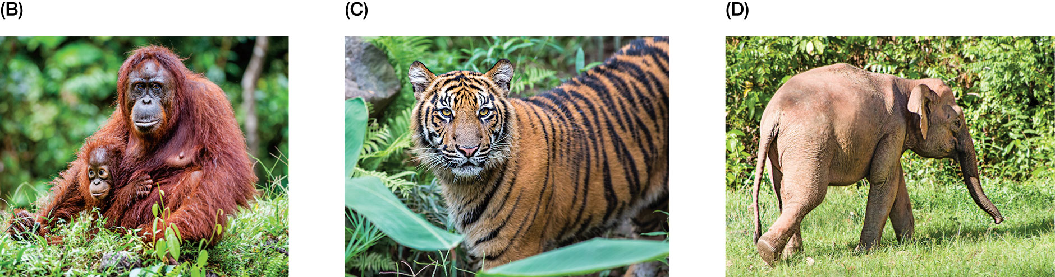
12
Notes:
Examples of species that are threatened with extinction by the rapid expansion of palm oil plantations in Southeast Asia: (B) the orangutan, (C) the Sumatran tiger, and (D) the Borneo elephant.

Slide 13
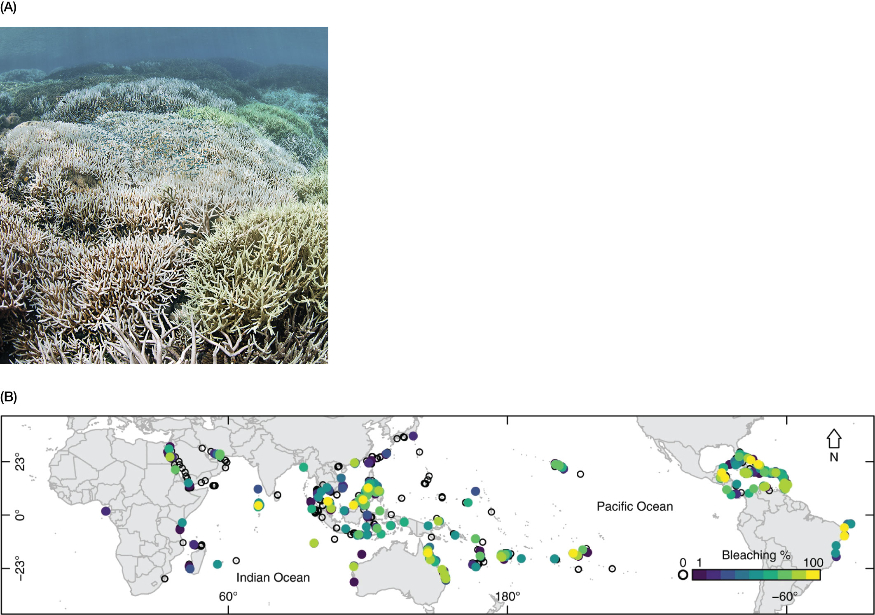
Figure 9.7 Impacts of global climate change on coral reefs.
Notes:
Figure 9.7 Impacts of global climate change on coral reefs. (A) In 2016, rising water temperatures led to heat stress that caused severe bleaching (the loss of symbiotic algae) in Australia’s Great Barrier Reef. One in every three corals died during the mass mortality event, and large portions of the reef were killed. (B) Prior
to 1998, few reefs had experienced severe bleaching. Since 1998, however, every reef region has experienced severe bleaching, with many areas suffering significant bleaching-induced mortality. In this figure, the prevalence of coral bleaching is presented as a percentage of the coral assemblage that has bleached, measured at 3,351 sites in 81 countries, from 1998 to 2017. White circles indicate no bleaching. Colored circles indicate 1% bleaching (blue) through 100% bleaching (yellow).

Slide 14
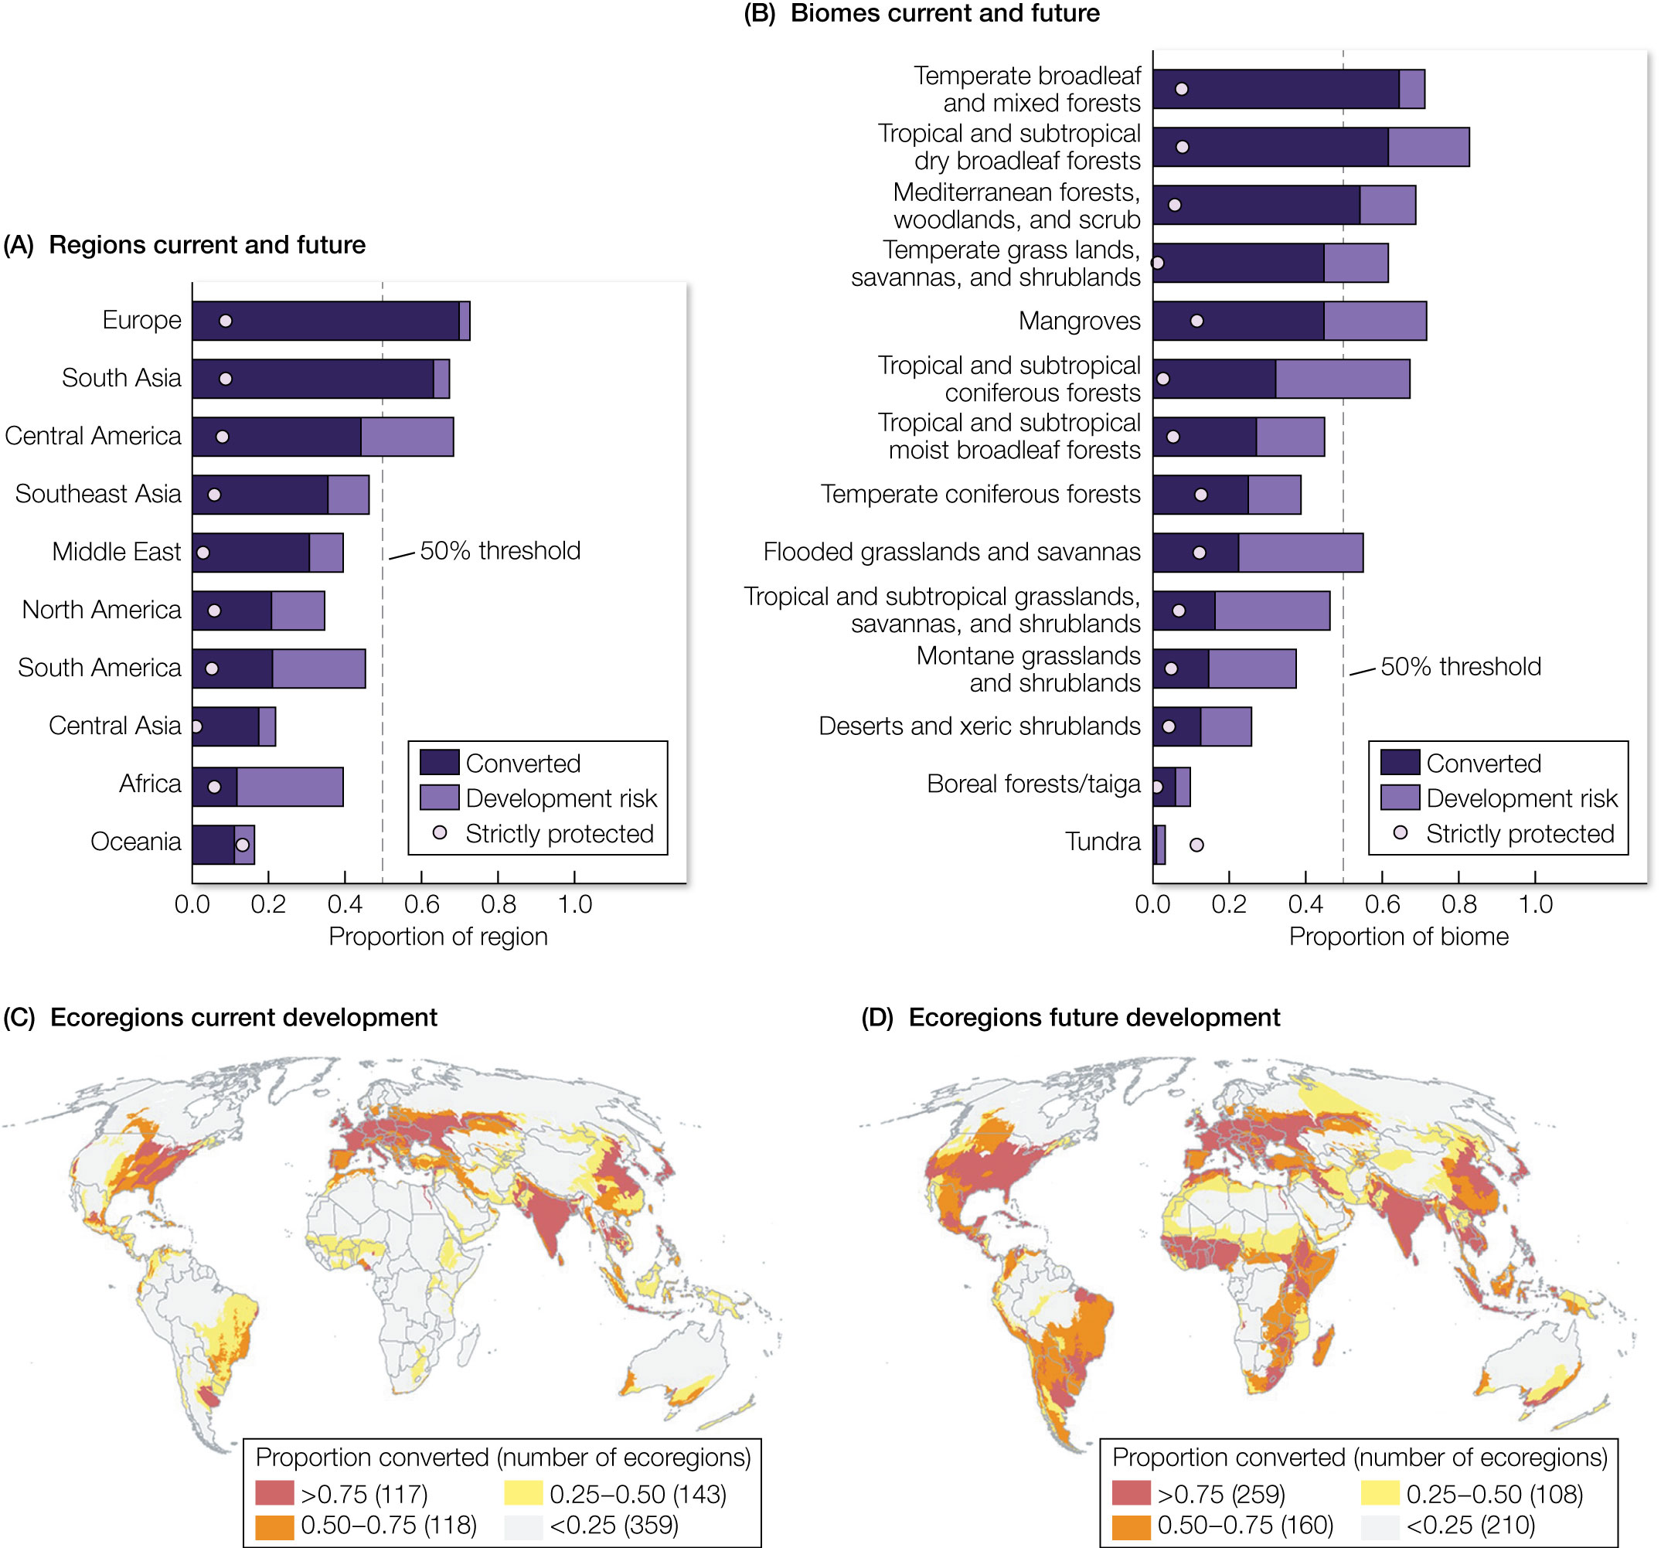
Figure 9.8 Land conversion at present and in the future.
Notes:
Figure 9.8 Land conversion at present and in the future. The proportion of land in each geopolitical region (A) and biome (B) that is currently converted (dark purple) and at high risk of future development (light purple). Vertical dashed lines show the 50% threshold for land conversion. The proportion of strictly protected natural lands (dots) is given for comparison. The maps on the bottom (C and D) show the distribution of terrestrial ecoregions that have 75%, 50%–75%, 25%–50%, and less than 25% of their lands currently converted (C) and potentially converted in the future (D) due to areas with high development risk.

Slide 15
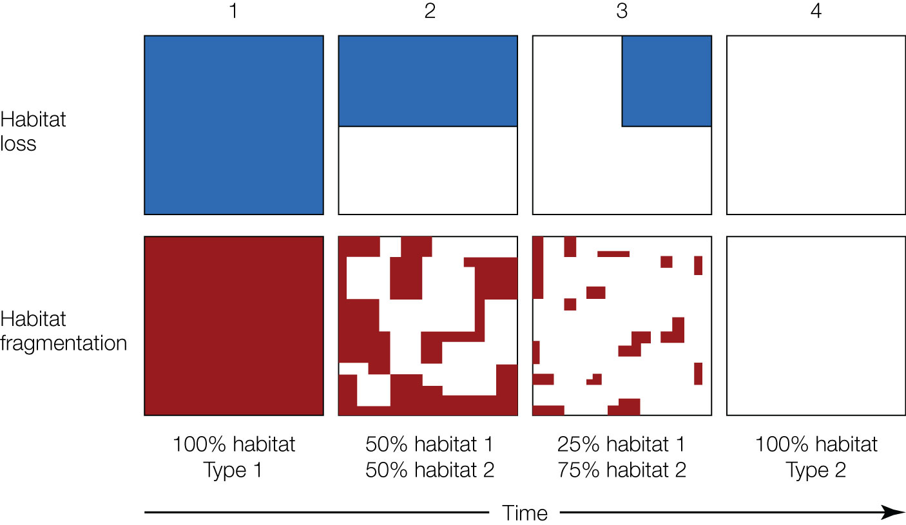
Figure 9.9 The relationship between habitat loss and habitat fragmentation. This diagram depicts a time series showing the loss and fragmentation of habitat from a natural landscape.
Notes:
Figure 9.9 The relationship between habitat loss and habitat fragmentation. This diagram depicts a time series showing the loss and fragmentation of habitat from a natural landscape. Between time steps 1 and 4, the landscape is altered from being composed entirely of habitat type 1 (blue or red) to being composed entirely of habitat type 2 (white). Note that while habitat loss and fragmentation are both associated with a loss of area of habitat type 1, fragmentation in time steps 2 and 3 also changes the configuration of patches, including the number of patches in the landscape, the mean size of patches, the distance between and isolation of patches, and the amount of edge habitat in the landscape.

Slide 16
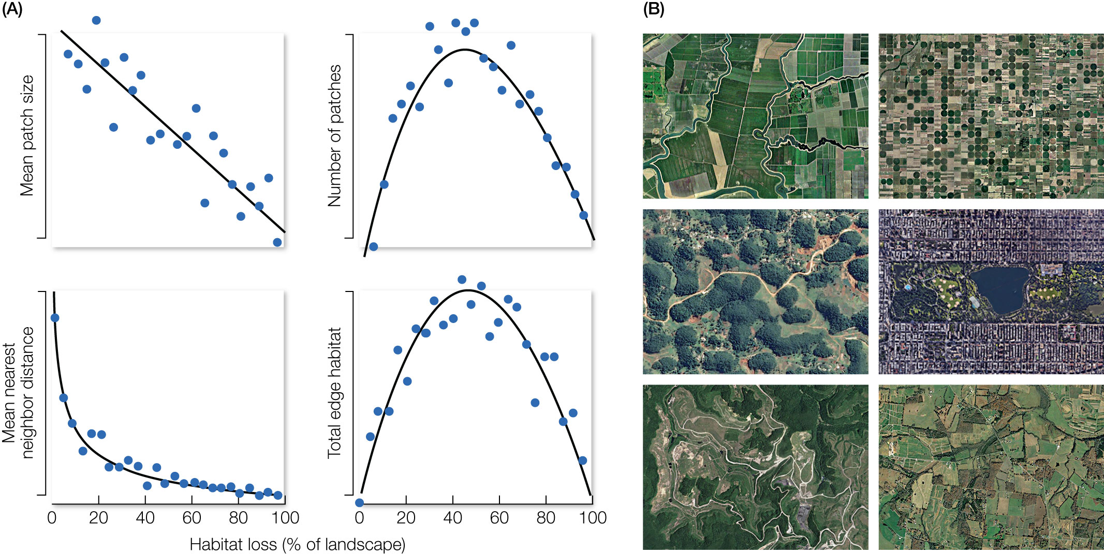
Figure 9.10 Habitat loss and patch configuration.
Notes:
Figure 9.10 Habitat loss and patch configuration. (A) Illustration of how four aspects of patch configuration relate to habitat loss in a landscape. Note that the four aspects of patch configuration change differently as the amount of habitat is reduced, and several change nonlinearly. This variety of effects allows fragmentation to produce a wide variety of patterns in a landscape. To illustrate, consider (B), which shows examples of real fragmented landscapes that have different patterns of patch configuration. Note that some landscapes have many small patches and others have only a few large patches. Some have patches close together; others are far apart. Some have elongated patches with high edge:interior ratios; others are round with low edge:interior ratios. Fragmentation will influence biodiversity very differently in these landscapes.

Slide 17
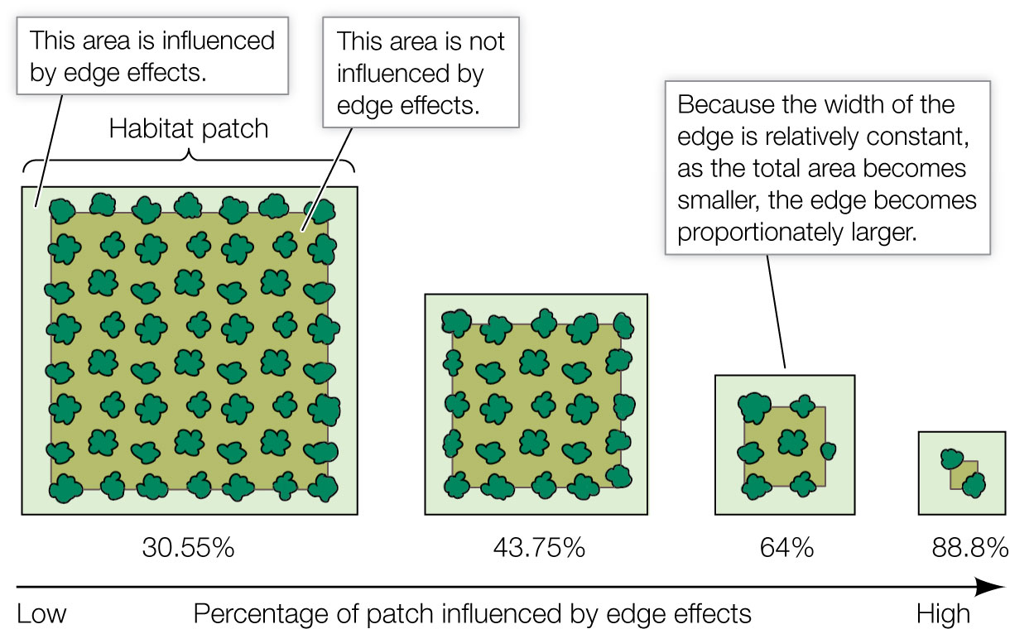
Figure 9.11 As patch sizes are reduced in a landscape, the proportion of core (interior) habitat declines and the proportion of edge habitat increases. As a result, edge effects have a greater influence on the dynamics of small patches.
Notes:
Figure 9.11 As patch sizes are reduced in a landscape, the proportion of core (interior) habitat declines and the proportion of edge habitat increases. As a result, edge effects have a greater influence on the dynamics of small patches.

Slide 18
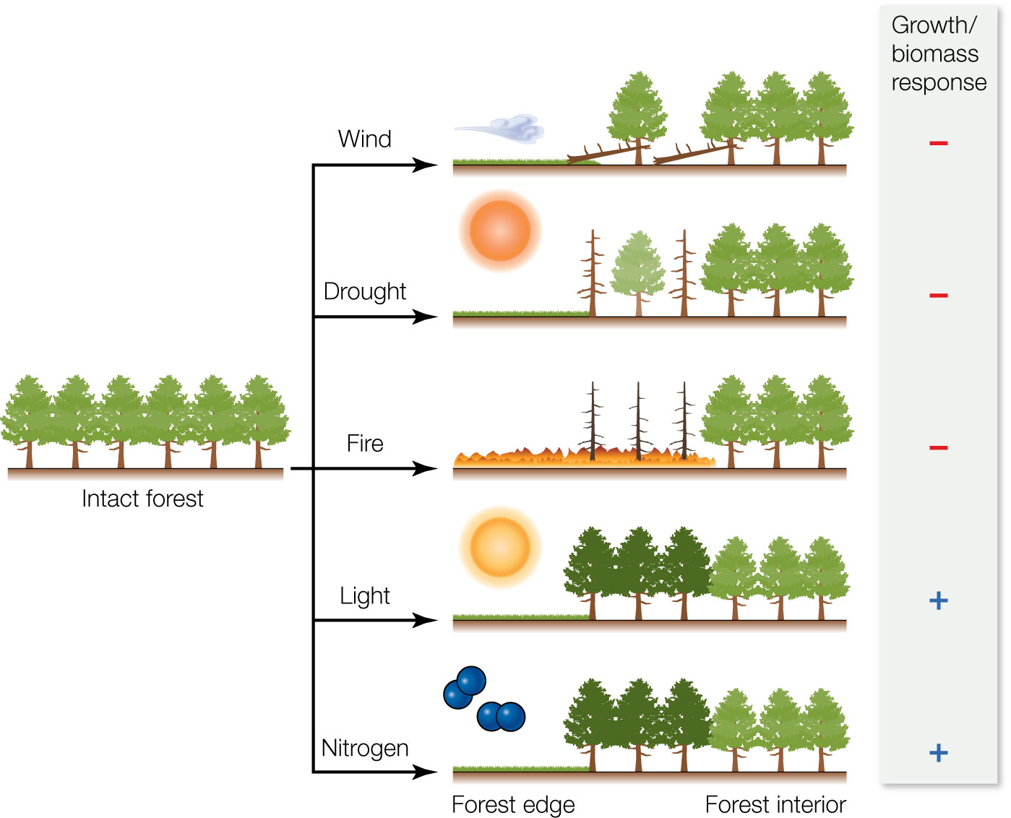
Figure 9.12 Changes in the forest edge microenvironment include exposure to more wind, drought, fire, light, and nitrogen deposition.
Notes:
Figure 9.12 Changes in the forest edge microenvironment include exposure to more wind, drought, fire, light, and nitrogen deposition. The positive (+) and negative (–) signs indicate favorable and adverse conditions, respectively, for growth and biomass.

Slide 19
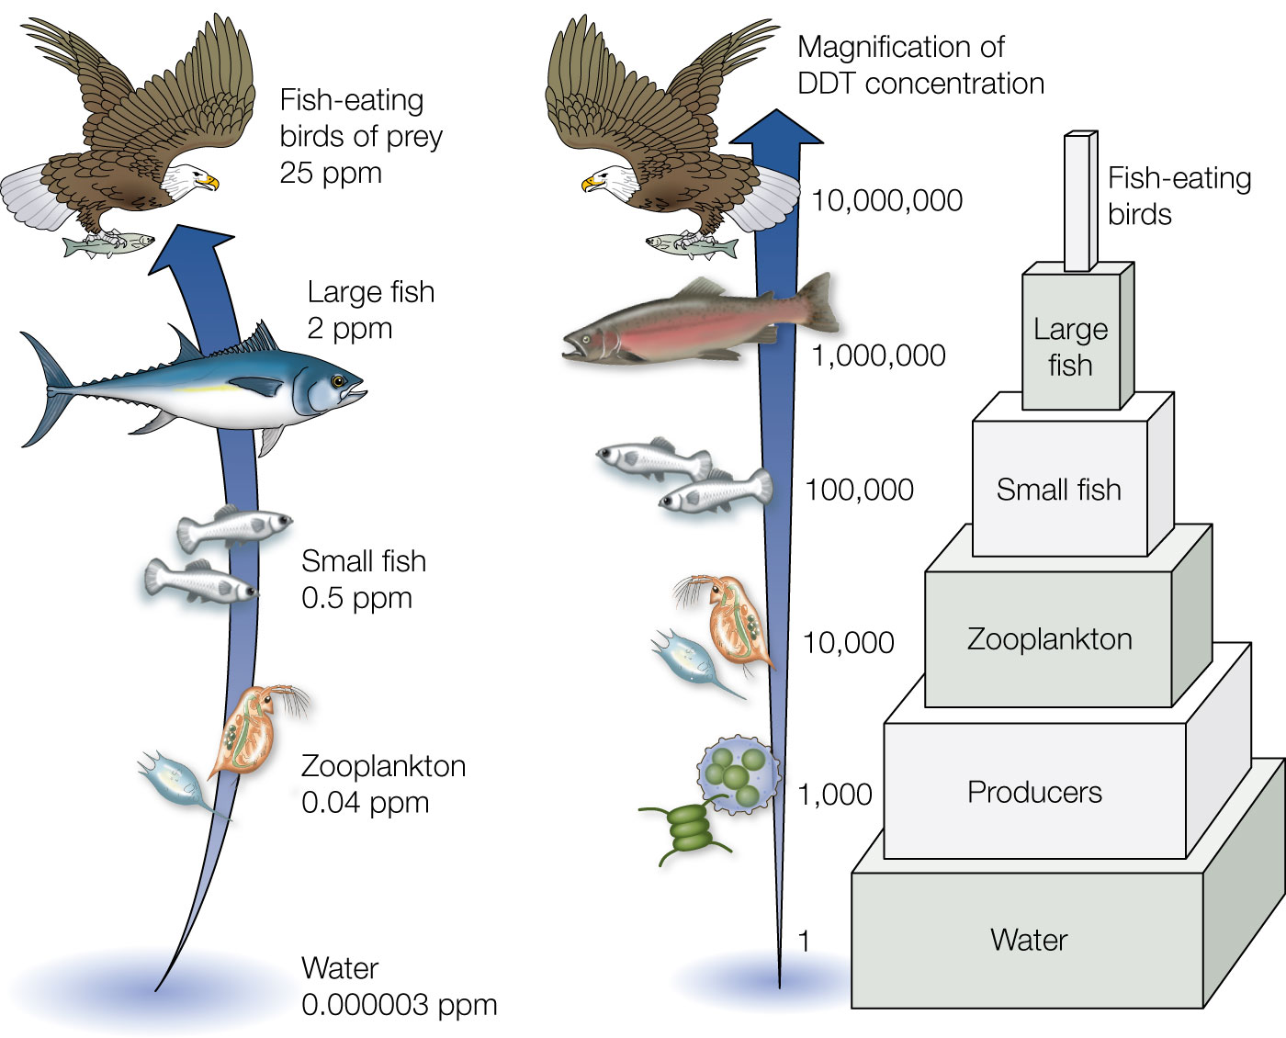
Figure 9.13 Biomagnification of dichlorodiphenyltrichloroethane (DDT). (Left) The actual concentration of DDT in various components of the food web in parts per million (ppm). (Right) The relative magnification of DDT at successive trophic levels of the food web.
Notes:
Figure 9.13 Biomagnification of dichlorodiphenyltrichloroethane (DDT). (Left) The actual concentration of DDT in various components of the food web in parts per million (ppm). (Right) The relative magnification of DDT at successive trophic levels of the food web.

Slide 20
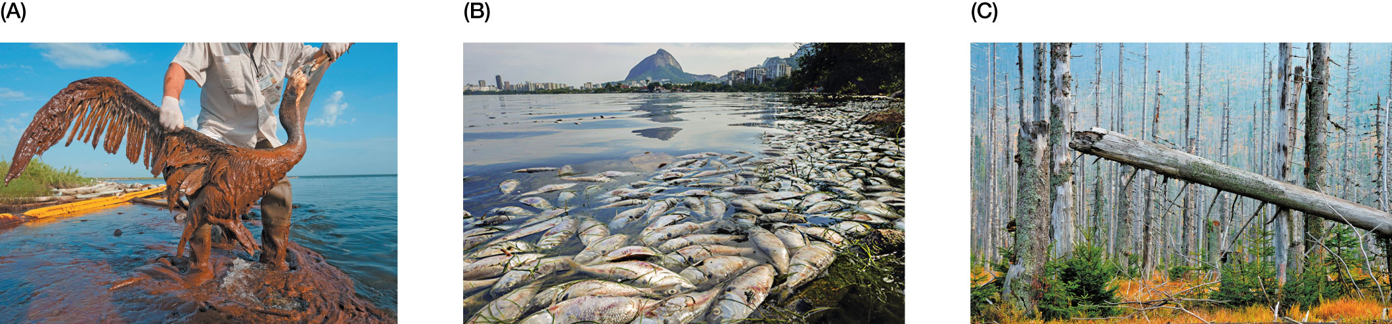
Figure 9.14 (A) Birds, marine mammals, and many other ocean animals sicken and die when they are covered by oil following spills.
Notes:
Figure 9.14 (A) Birds, marine mammals, and many other ocean animals sicken and die when they are covered by oil following spills. This brown pelican was found following the Deepwater Horizon oil spill in the Gulf of Mexico in 2010, which, at 4.9 million barrels, is the largest marine oil spill in history. (B) Coastal hypoxia. Fish in the Rodrigo de Freitas Lagoon in Rio de Janeiro died off because of pollution. High nitrogen and phosphorus levels from human activity resulted in excessive algal growth, followed by algal death and decay, leading to oxygen levels so low that fish could not survive. (C) Acid rain leads to the death of trees over large expanses of forest area in New England.

Slide 21
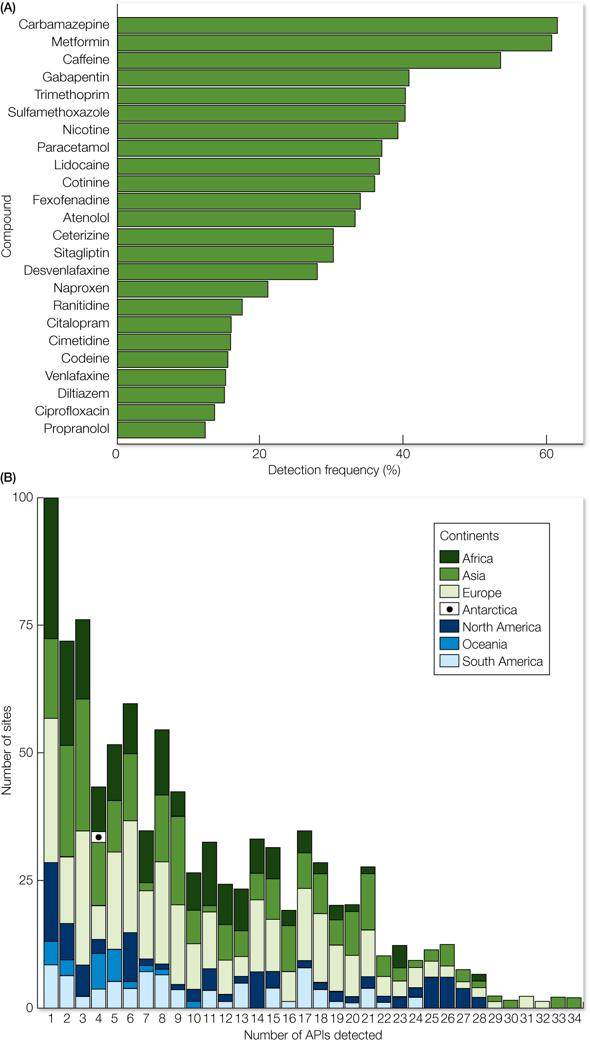
Figure 9.15 Pharmaceutical pollution was measured in 258 of the world’s rivers spanning 104 countries.
Notes:
Figure 9.15 Pharmaceutical pollution was measured in 258 of the world’s rivers spanning 104 countries. (A) The frequency of detections (x-axis) for each compound measured (y-axis). The frequency of detection is measured as the percentage of rivers in which the compound was detected. (B) The number of river sites (y axis) in which an increasing number of active pharmaceutical ingredients (APIs) were measured at detectable levels (x axis).

Slide 22
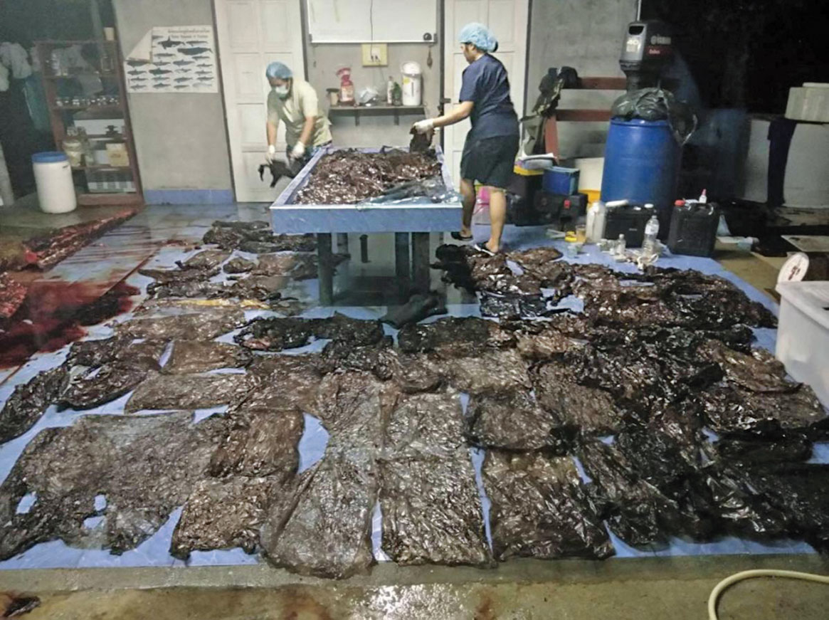
Figure 9.16 In 2018, a small male pilot whale was found near the Thai border with Malaysia, unable to swim or breathe and vomiting plastic bags.
Notes:
Figure 9.16 In 2018, a small male pilot whale was found near the Thai border with Malaysia, unable to swim or breathe and vomiting plastic bags. After the whale died, a necropsy revealed 80 plastic bags weighing 7.7 kg, which the whale likely mistook for food, clogging its stomach.

Slide 23
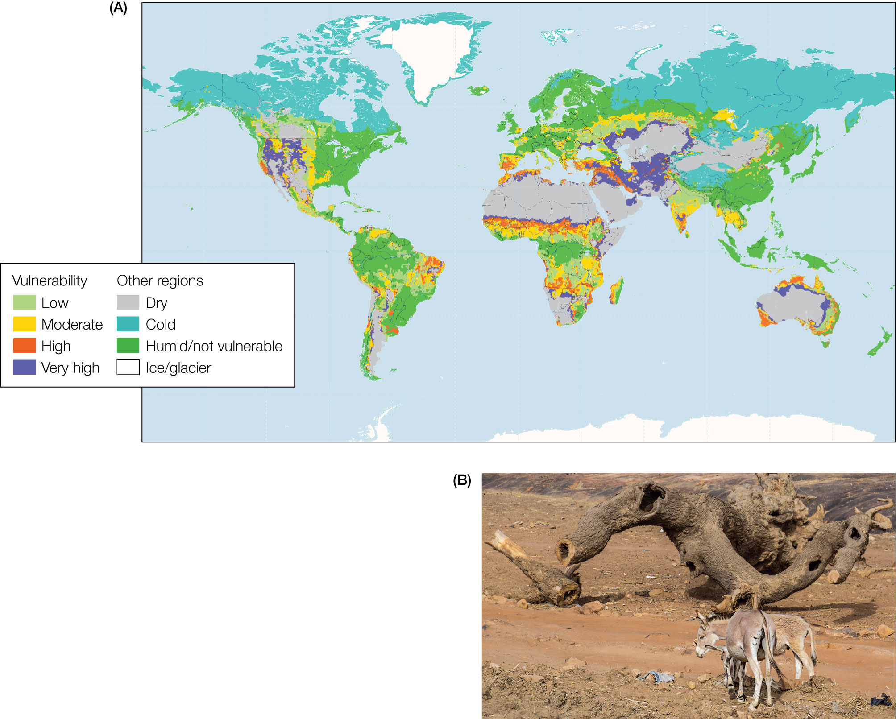
Figure 9.17 (A) Arid areas of the world are experiencing encroaching desertification, with increasing aridity and expanding deserts.
Notes:
Figure 9.17 (A) Arid areas of the world are experiencing encroaching desertification, with increasing aridity and expanding deserts. The regions shaded in red, orange, and yellow are vulnerable to desertification and are potentially at risk of becoming desert over the next several decades. (B) Deserts are expanding in the Sahel region south of the Sahara as human activities stress semiarid ecosystems.

Slide 24
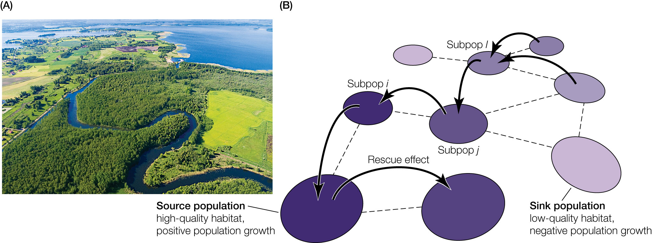
Figure 9.18 (A) Modern landscapes increasingly look like patchy mosaics where some habitats have been lost and converted to human uses,
Notes:
Figure 9.18 (A) Modern landscapes increasingly look like patchy mosaics where some habitats have been lost and converted to human uses, others have been degraded by human activities, and those that remain are small, fragmented, and disconnected from each other. (B) Species populations in landscape mosaics are
often subdivided and behave like a metapopulation where some populations are sources and others are sinks.

Slide 25
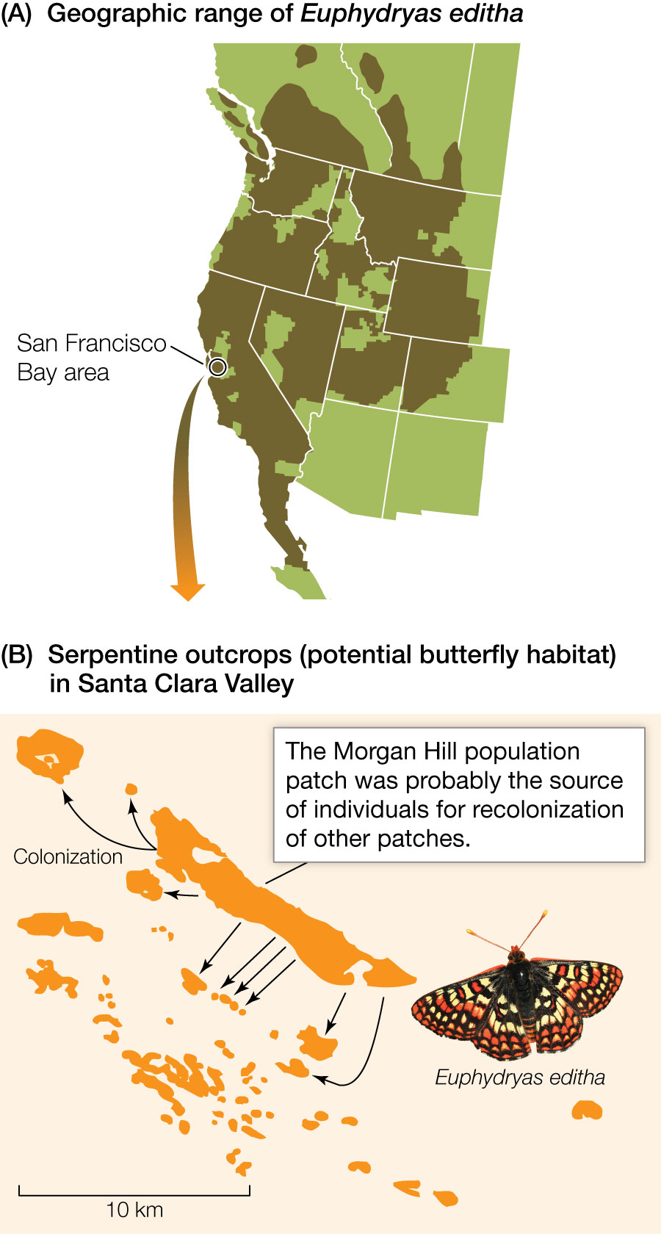
Figure 9.19 (A) The bay checkerspot butterfly (Euphydryas editha bayensis) was once distributed throughout the western United States.
Notes:
Figure 9.19 (A) The bay checkerspot butterfly (Euphydryas editha bayensis) was once distributed throughout the western United States. However, habitat loss, fragmentation, and degradation have severely reduced its population size and restricted its range to the San Francisco Bay region of California. (B) In its current habitat, the bay checkerspot butterfly exists as a metapopulation composed of many distinct subpopulations that inhabit shallow serpentine soils where its host plant (the dwarf plantain, Plantago erecta) is found. Biologists have used metapopulation models to estimate the probability of extinction of the species and the number of habitat patches required for the butterfly to persist in the landscape and to determine high-priority habitats for conservation.

Slide 26
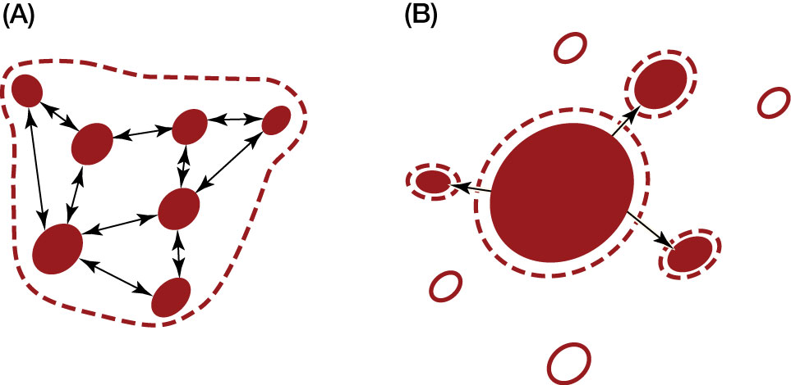
26
Notes:
Stylistic representation of two kinds of metapopulations. Ovals represent habitat patches: filled ovals represent occupied patches; open ovals represent vacant patches. Arrows indicate migration, and dashed lines indicate the boundaries of local populations. (A) Metapopulation model. (B) Mainland–island (or source–sink) metapopulation.

