Slide 1
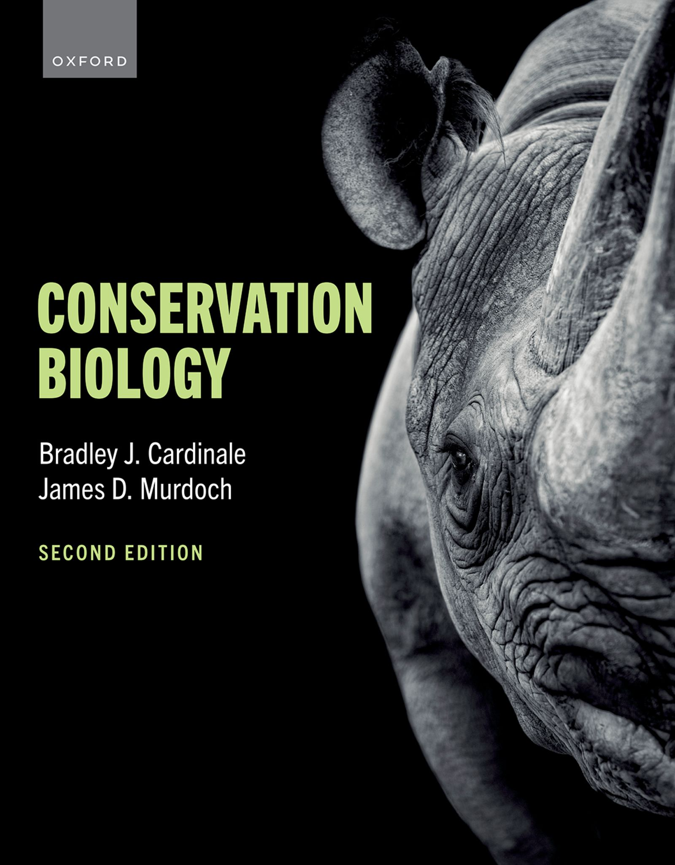
CONSERVATION BIOLOGY
By Bradley J. Cardinale and James D. Murdoch

Slide 2
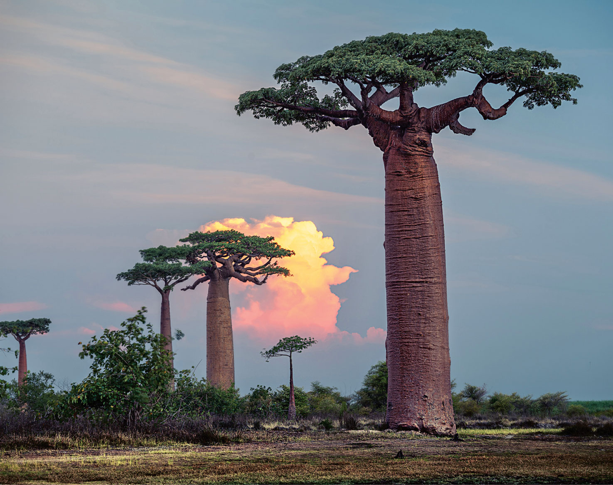
2
Notes:
The iconic baobab tree faces ever-increasing threats from climate change and habitat loss. The most threatened of the African baobabs is Adansonia perrieri, which is Critically Endangered, with fewer than 100 known trees remaining.

Slide 3
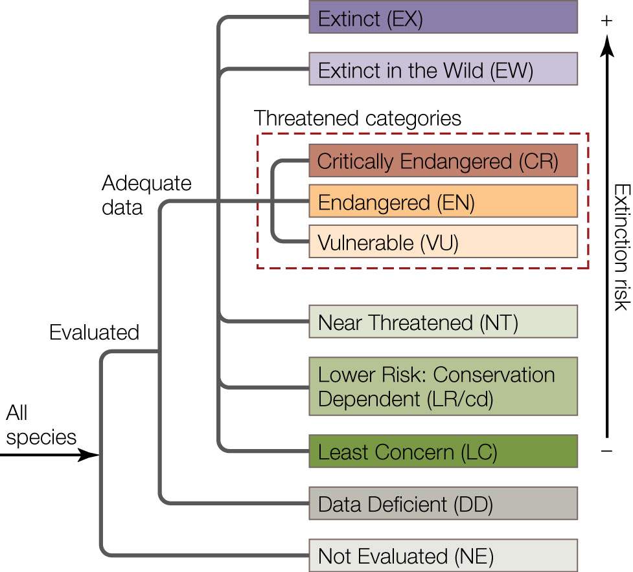
3

Slide 4
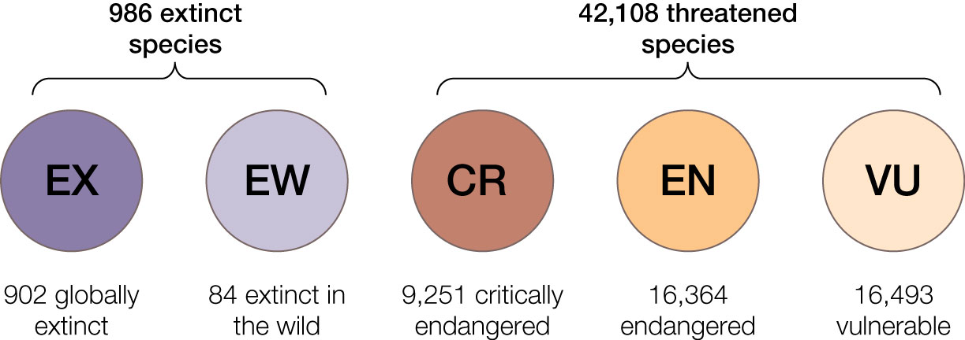
Figure 8.1 A summary of species that comprise the 2022 IUCN Red List of threatened species.
Notes:
Figure 8.1 A summary of species that comprise the 2022 IUCN Red List of threatened species. To date, a total of 150,388 species have been assessed. Of those, 986 species have been declared Extinct or Extinct in the Wild, while 42,108 are considered threatened with extinction.

Slide 5
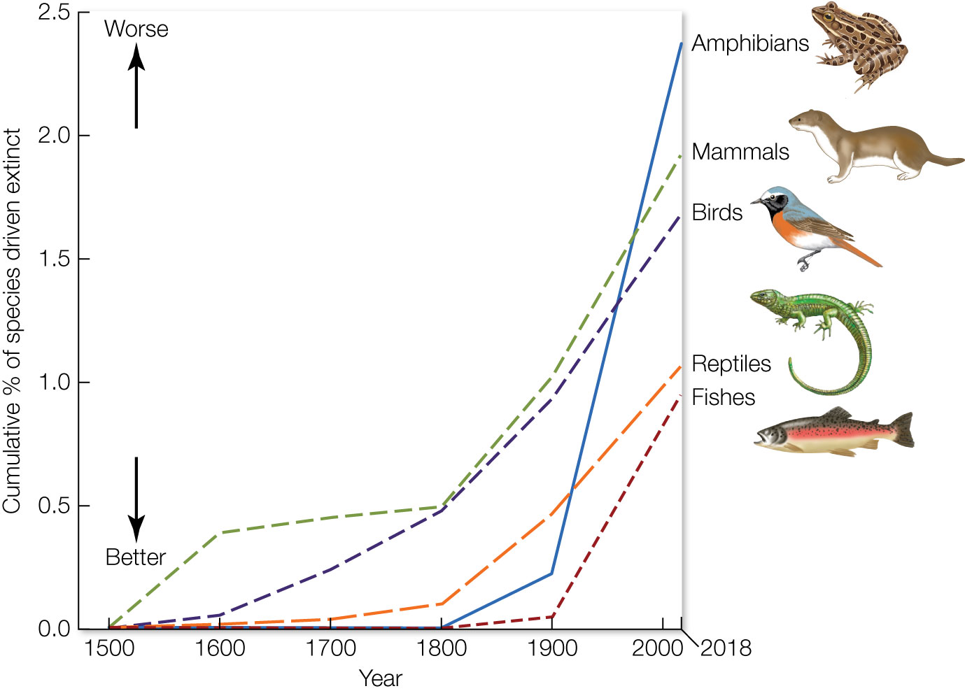
Figure 8.2 The cumulative percentage of vertebrate species that have been declared Extinct or Extinct in the Wild over the past 500 years.
Notes:
Figure 8.2 The cumulative percentage of vertebrate species that have been declared Extinct or Extinct in the Wild over the past 500 years.

Slide 6
TABLE 8.1 Numbers of threatened species by major groups of organisms (1996–2022)
 | Estimated number of described species | Number of species evaluated by IUCN | Percentage of described species assessed | Number of threatened species on 2022 IUCN Red List version 2022–2
VERTEBRATES
Mammals | 6,596 | 5,973 | 91 | 1,340
Birds | 11,188 | 11,188 | 100 | 1,400
Reptiles | 11,733 | 10,222 | 87 | 1,842
Amphibians | 8,536 | 7,486 | 88 | 2,606
Fishes | 36,367 | 25,351 | 70 | 3,551
Subtotal | 74,420 | 60,220 | 81 | 10,739
INVERTEBRATES
Insects | 1,053,578 | 12,441 | 1.2 | 2,345
Mollusks | 113,813 | 9,032 | 8 | 2,399
Crustaceans | 80,122 | 3,197 | 4 | 745
Corals | 5,574 | 831 | 15 | 253
Arachnids | 110,615 | 441 | 0.40 | 251
Velvet worms | 210 | 11 | 5 | 9
Horseshoe crabs | 4 | 4 | 100 | 2
Others | 157,543 | 905 | 0.57 | 157
Subtotal | 1,521,459 | 26,862 | 2 | 6,161
Notes:
TABLE 8.1 Numbers of threatened species by major groups of organisms (1996–2022)

Slide 7
TABLE 8.1 (Continued)
 | Estimated number of described species | Number of species evaluated by IUCN | Percentage of described species assessed | Number of threatened species on 2022 IUCN Red List version 2022–2
PLANTS
Mosses | 21,925 | 329 | 1.5 | 181
Ferns and allies | 11,800 | 747 | 6 | 288
Gymnosperms | 1,113 | 1,046 | 94 | 436
Flowering plants | 369,000 | 60,470 | 16 | 24,000
Green algae | 12,929 | 16 | 0.1 | 0
Red algae | 7,568 | 58 | 0.8 | 9
Subtotal | 424,335 | 62,666 | 15 | 24,914
FUNGI AND PROTISTS
Lichens | 17,000 | 86 | 0.5 | 62
Mushrooms | 120,000 | 539 | 0.4 | 226
Brown algae | 4,541 | 15 | 0.3 | 6
Subtotal | 141,541 | 640 | 0.5 | 294
TOTAL | 2,161,755 | 150,388 | 7 | 42,108
Source: Data from IUCN. 2022. The IUCN Red List of Threatened Species. Version 2022-2, updated as of December 9, 2022, at www.iucnredlist.org.
Note: The data available via this link change as new updates are issued. IUCN, International Union for Conservation of Na- ture.
Notes:
TABLE 8.1 Numbers of threatened species by major groups of organisms (1996–2022)

Slide 8
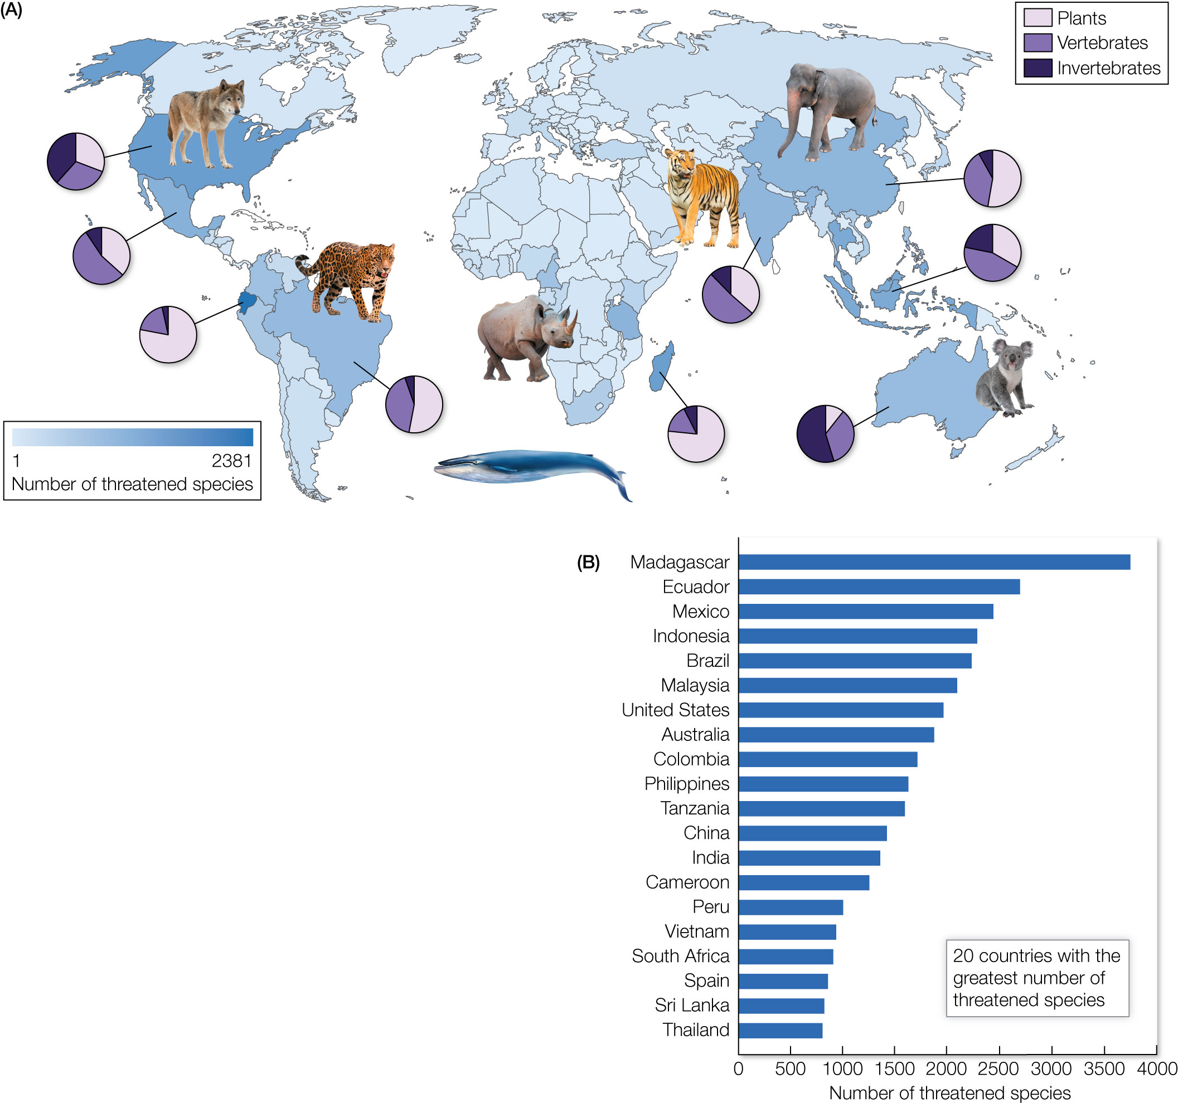
Figure 8.3 The global distribution of species threatened with extinction.
Notes:
Figure 8.3 The global distribution of species threatened with extinction. (A) World map of countries having the highest (darker blue) and lowest (lighter blue) numbers of threatened species on the International Union for Conservation of Nature’s Red List. Inset pie charts show the proportion of threatened species of plants, vertebrates, and invertebrates in several countries that rank among those with the highest number of threatened species. (B) Twenty-three countries have more than 800 threatened species on the Red List.

Slide 9
TABLE 8.2 Estimates of modern extinction rates (in extinctions per million species years) vary depending on the time frame used and the number of species included in the calculation
Time frame | Extinct (902) | +Extinct in wild (986) | +Threatened (43,094)
100 years | 4.2 (42×) | 4.6 (46×) | 199.3 (1,993×)
200 years | 2.1 (21×) | 2.3 (23×) | 99.7 (997×)
500 years | 0.8 (8×) | 0.9 (9×) | 39.9 (399×)
Note: Numbers in parentheses given the number of times than background rate of extinction in fossil record.
Notes:
TABLE 8.2 Estimates of modern extinction rates (in extinctions per million species years) vary depending on the time frame used and the number of species included in the calculation

Slide 10
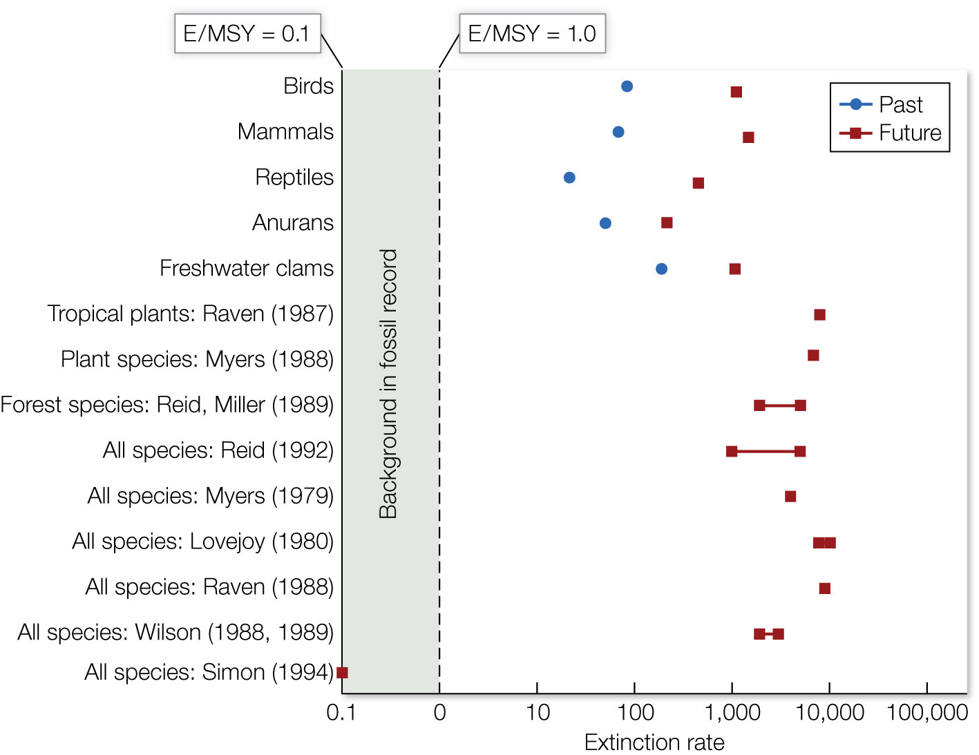
Figure 8.4 A summary of studies (y axis) that have published estimates of modern extinction rates (x axis) for various groups of organisms.
Notes:
Figure 8.4 A summary of studies (y axis) that have published estimates of modern extinction rates (x axis) for various groups of organisms. Extinction rates are reported in extinctions per million species years (E/MSY). Estimates are given for extinctions since 1900 (blue circles) and extinctions projected in the near future (red squares) assuming all threatened species go extinct in the next 100 years.

Slide 11
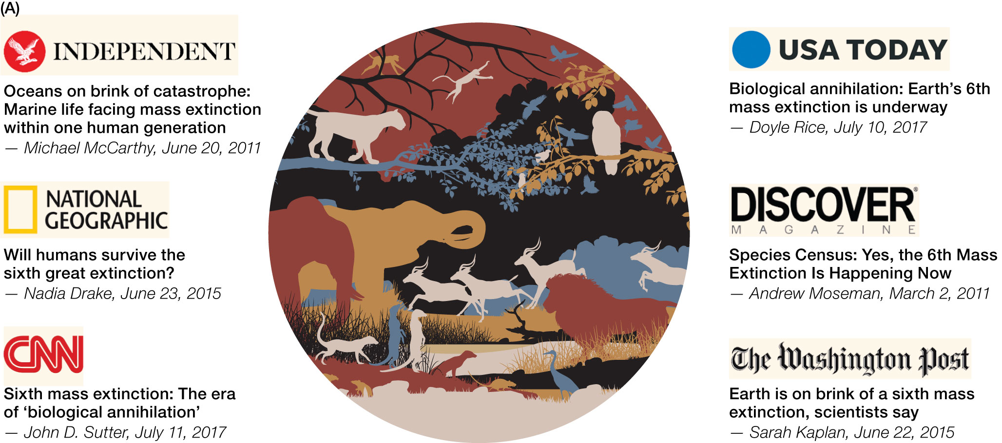
11
Notes:
Many biologists believe we are currently entering the sixth mass extinction in the history of life on Earth, and this view has been popularized in the public media. But until recently, the scientific evidence to support this view has been lacking.

Slide 12
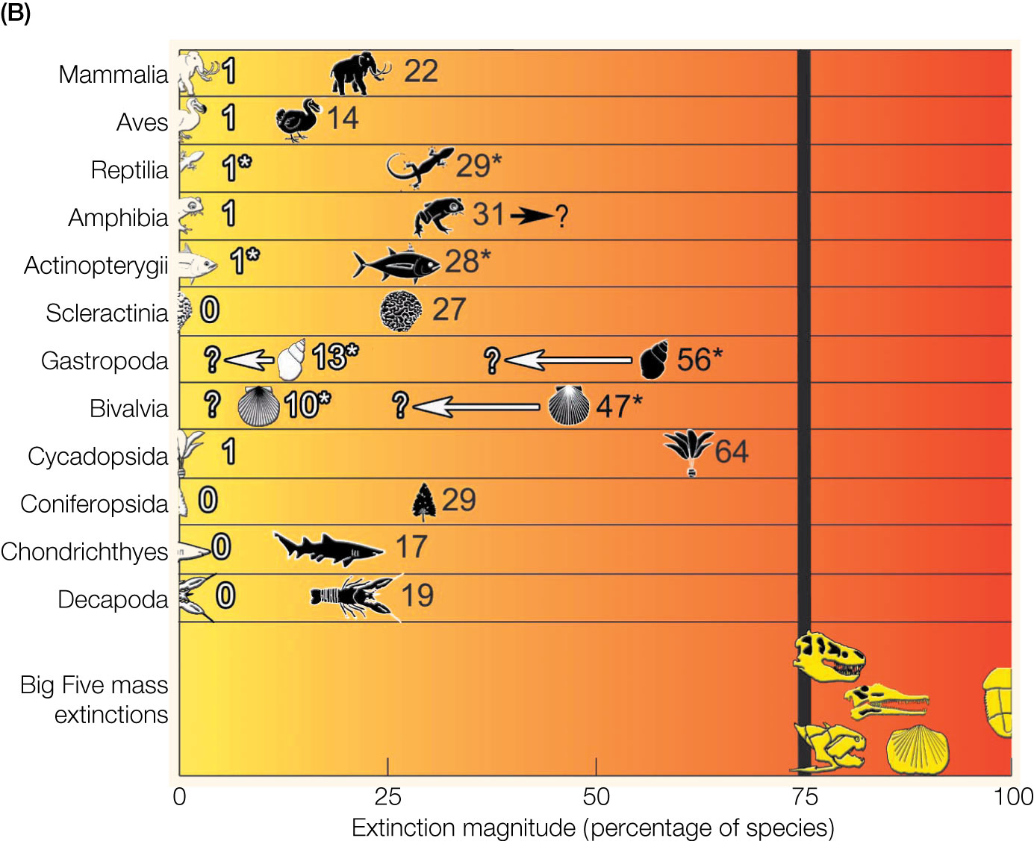
12
Notes:
Extinction magnitudes for well-studied taxonomic groups compared with the 75% benchmark used to classify prior mass extinction events. White icons and numbers indicate species extinctions that have occurred over the past 500 years. Black icons add currently threatened species to those that are already known to be extinct. Yellow icons indicate species lost in the Big Five extinctions: Cretaceous–Tertiary, Devonian, Triassic, Ordovician–Silurian, and Permian–Triassic (from left to right). Asterisks indicate taxa for which very few species (less than 3% for gastropods and bivalves) have been assessed; white arrows show where extinction magnitudes are probably inflated (because species perceived to be in peril are often assessed first).

Slide 13
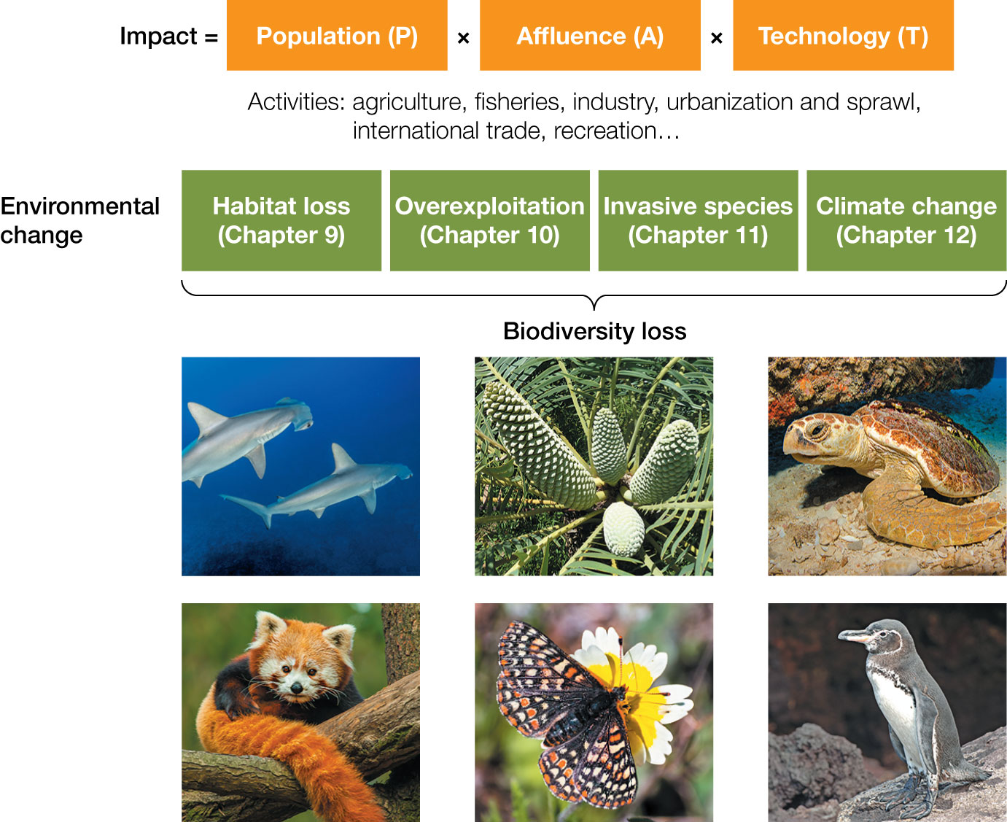
Figure 8.5 Drivers of biodiversity loss. The ultimate causes of biodiversity loss are given by the IPAT equation, which shows how human impacts on the environment are proportional to human population growth,
Notes:
Figure 8.5 Drivers of biodiversity loss. The ultimate causes of biodiversity loss are given by the IPAT equation, which shows how human impacts on the environment are proportional to human population growth, as well as increases in affluence and improvements in technology that underlie resource consumption. Population growth and consumption, in turn, drive a wide variety of human activities that lead to major forms of environmental change. It is these forms of environmental change that are the proximate causes of biodiversity loss on the planet.

Slide 14
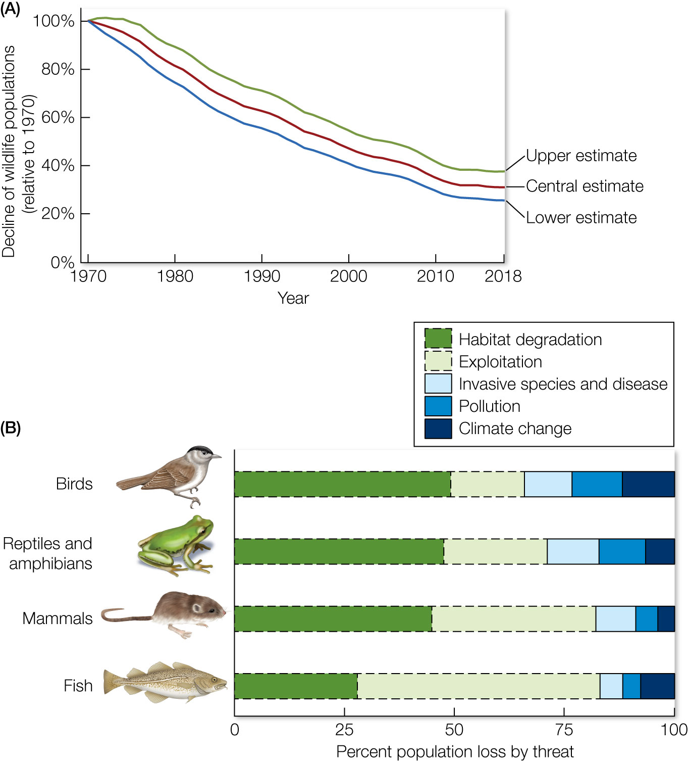
Figure 8.6 (A) The Living Planet Index (LPI), represented on the y axis, is an indicator of the state of global biodiversity, based on trends in more than 32,000 populations of 5,230 terrestrial, freshwater, and marine species.
Notes:
Figure 8.6 (A) The Living Planet Index (LPI), represented on the y axis, is an indicator of the state of global biodiversity, based on trends in more than 32,000 populations of 5,230 terrestrial, freshwater, and marine species. The most recent LPI shows that relative to 1970 levels, the average species population has declined by 69%. (B) The primary causes of these population declines are habitat loss and degradation, followed by overexploitation. Invasive species and disease are common threats to amphibians and reptiles.

Slide 15
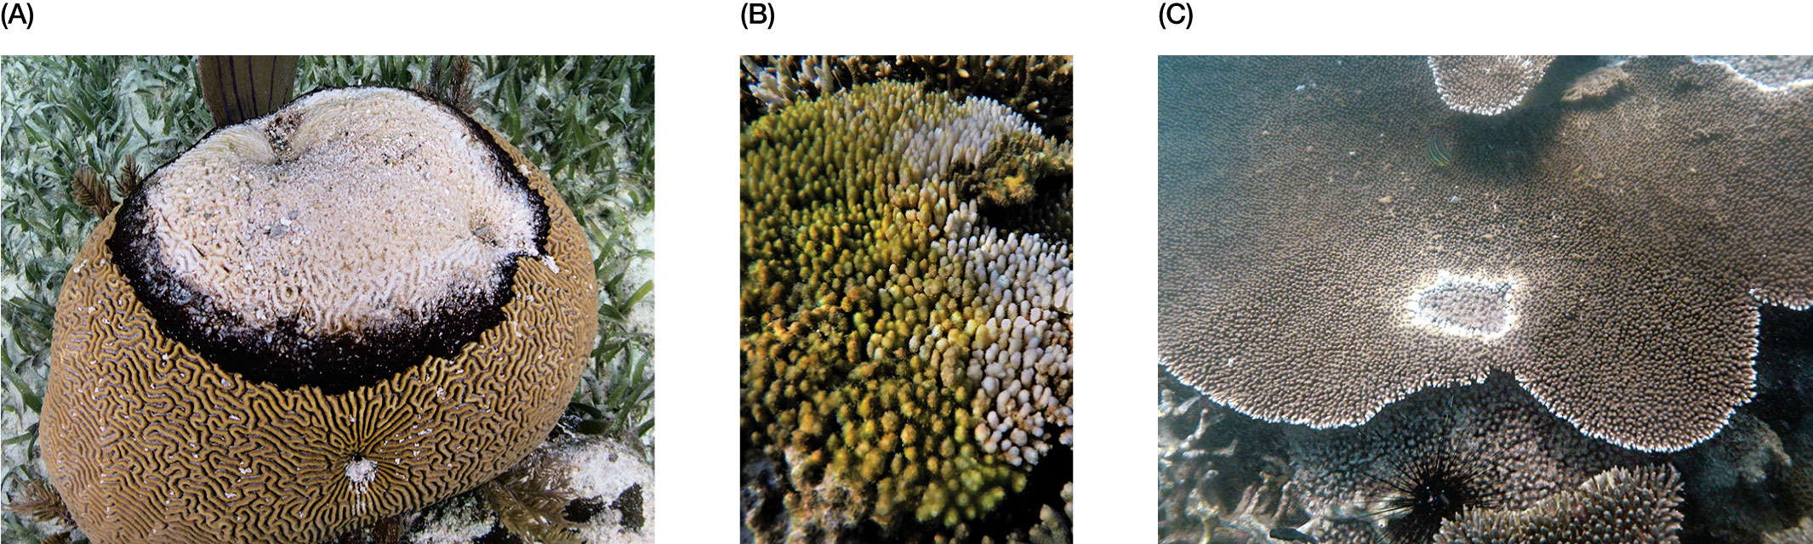
Figure 8.7 Corals are a good example of how multiple stressors can interact to cause population declines. As they respond to increasing water temperatures, many types of coral become physiologically stressed, which can subsequently make them more susceptible to disease due to viral, bacterial, and fungal pathogens.
Notes:
Figure 8.7 Corals are a good example of how multiple stressors can interact to cause population declines. As they respond to increasing water temperatures, many types of coral become physiologically stressed, which can subsequently make them more susceptible to disease due to viral, bacterial, and fungal pathogens. (A) Black band disease is present as dark pigmented areas of tissue on this coral in the Caribbean. (B) An acroporid coral is infected with white band disease, which is caused by a species of Vibrio bacteria that destroys the coral tissue. (C) White pox, characterized by circular lesions, is caused by the gram-negative enterobacterium Serratia marcescens.

Slide 16
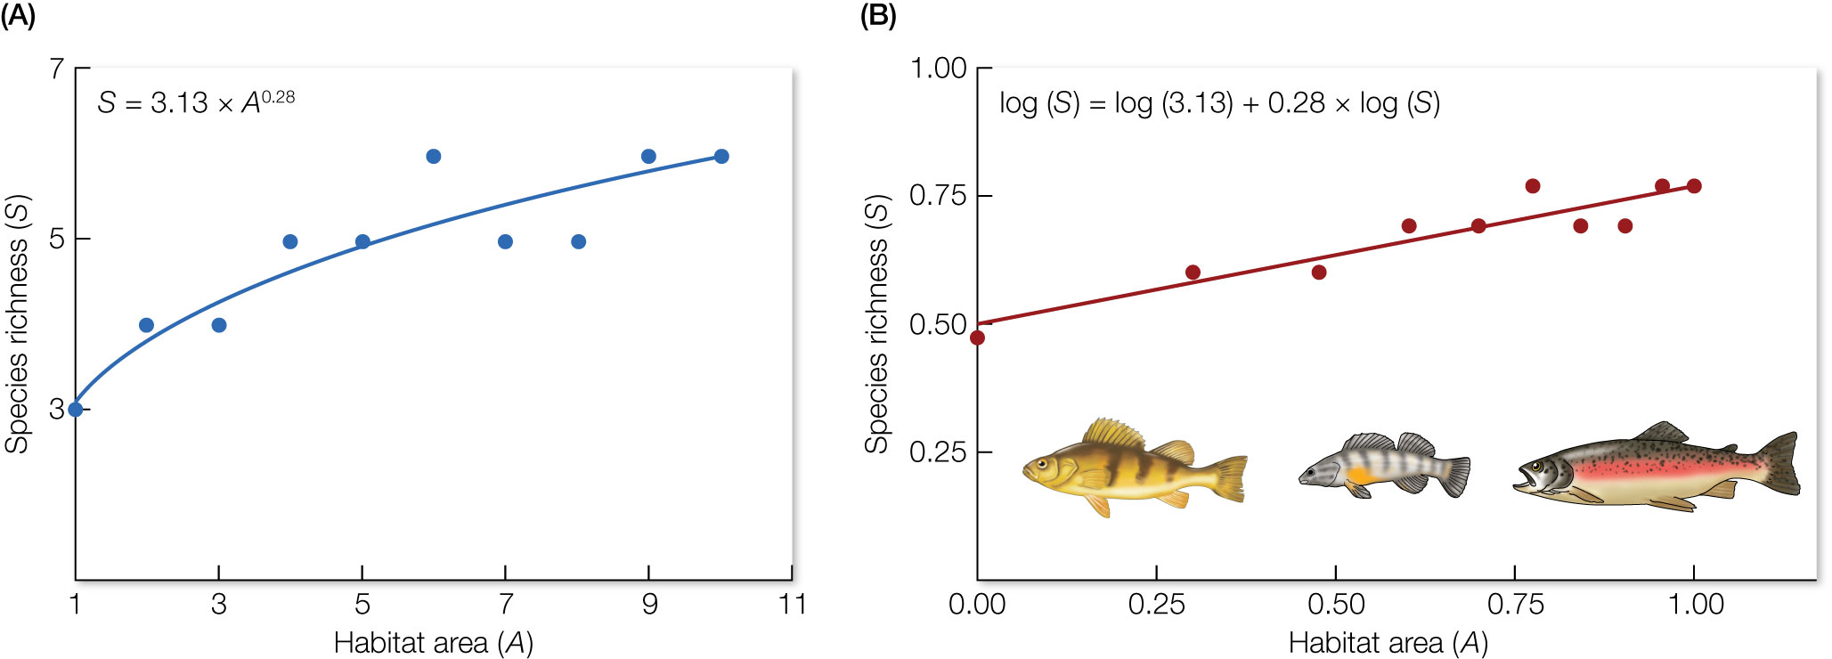
Figure 8.8 A hypothetical species–area relationship relating the species richness (S) of freshwater fish (y axis) to the surface area (A, in hectares) of lakes (x axis).
Notes:
Figure 8.8 A hypothetical species–area relationship relating the species richness (S) of freshwater fish (y axis) to the surface area (A, in hectares) of lakes (x axis). (A) The relationship is expressed as the nonlinear power function S = 3.13 × A^{0.28}. (B) The relationship is shown log transformed to the linear function.

Slide 17
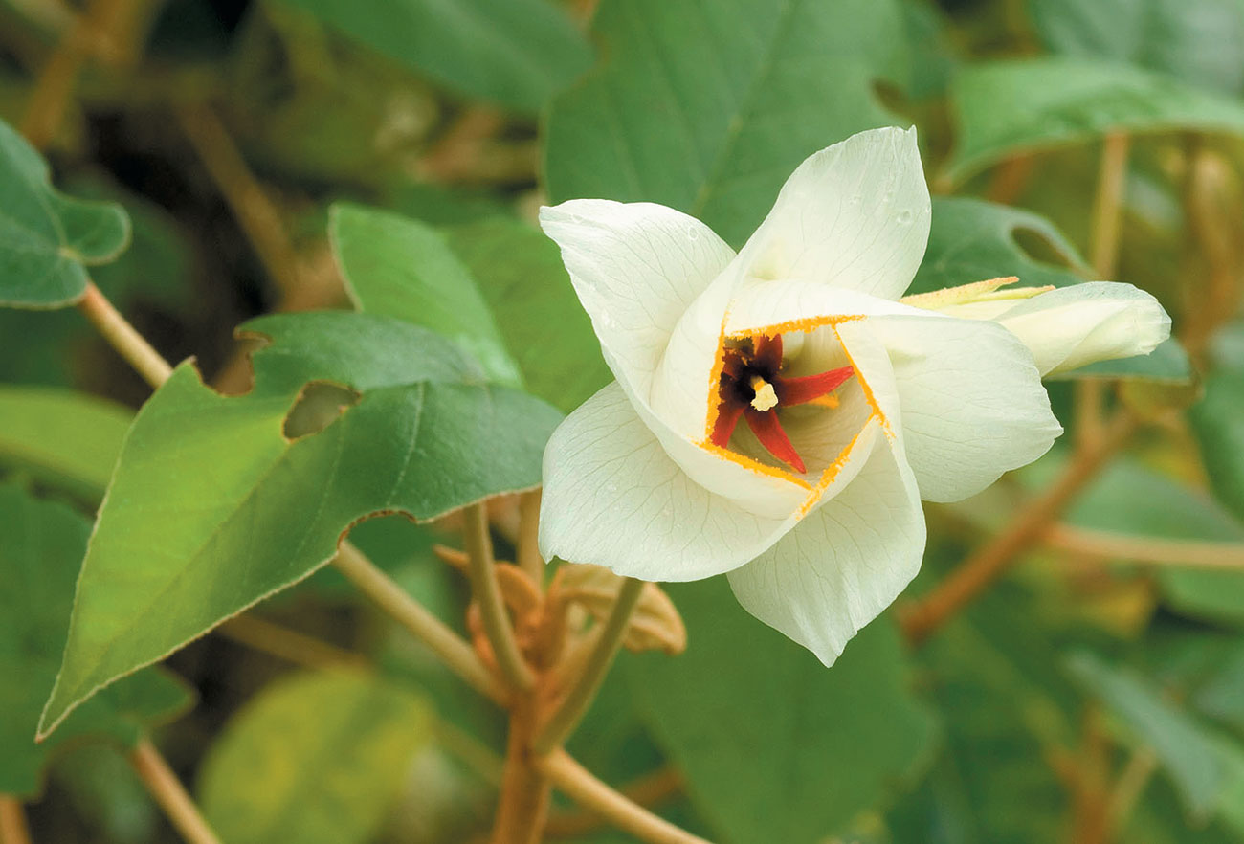
Figure 8.9 St. Helena ebony (Trochetiopsis ebenus) is endemic to the island of St. Helena in the southern Atlantic Ocean. The wild population has been reduced to just two individuals on the side of a cliff. Given such low numbers,
Notes:
Figure 8.9 St. Helena ebony (Trochetiopsis ebenus) is endemic to the island of St. Helena in the southern Atlantic Ocean. The wild population has been reduced to just two individuals on the side of a cliff. Given such low numbers, the species will almost certainly go extinct in the wild.

Slide 18
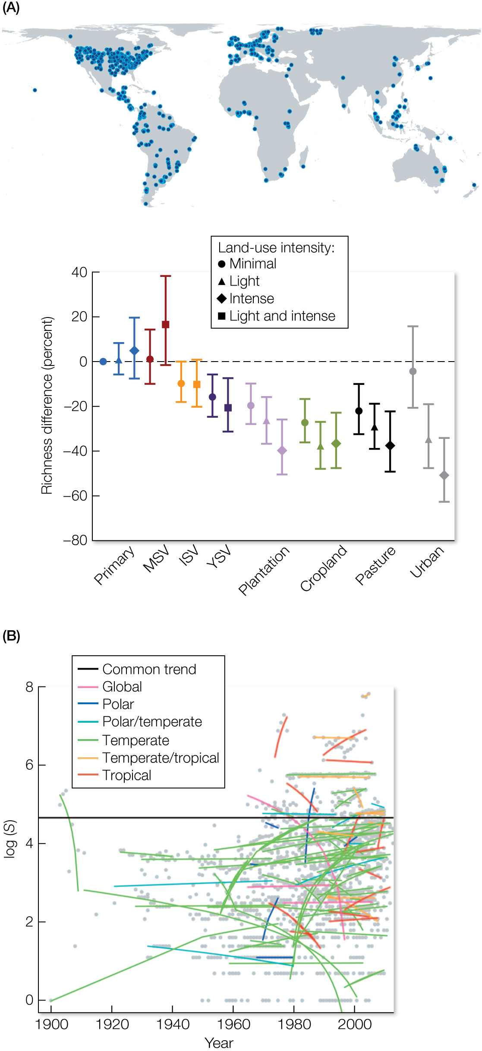
Figure 8.10 Empirically documented changes in local biodiversity.
Notes:
Figure 8.10 Empirically documented changes in local biodiversity. (A) Newbold and colleagues60 used spatial comparisons to quantify the difference in biodiversity between reference sites and paired sites (locations of paired sites are shown as dots on the map) that have experienced human disturbance. Results are shown for different habitat types: primary vegetation (primary); mature secondary vegetation (MSV); intermediate secondary vegetation (ISV); young secondary vegetation (YSV); plantations; croplands; pastures; and urban habitats. (B) Dornelas and colleagues65 collated results from 100 biological monitoring programs that have collected time-series data on biodiversity (lines of varying colors), most of which were in intact sites that have not been destroyed or converted by human activities. The black line shows the authors’ best statistical model, one that has a single slope, but which allows the time series to have differing intercepts. Note the line shows no net change over time.

Slide 19
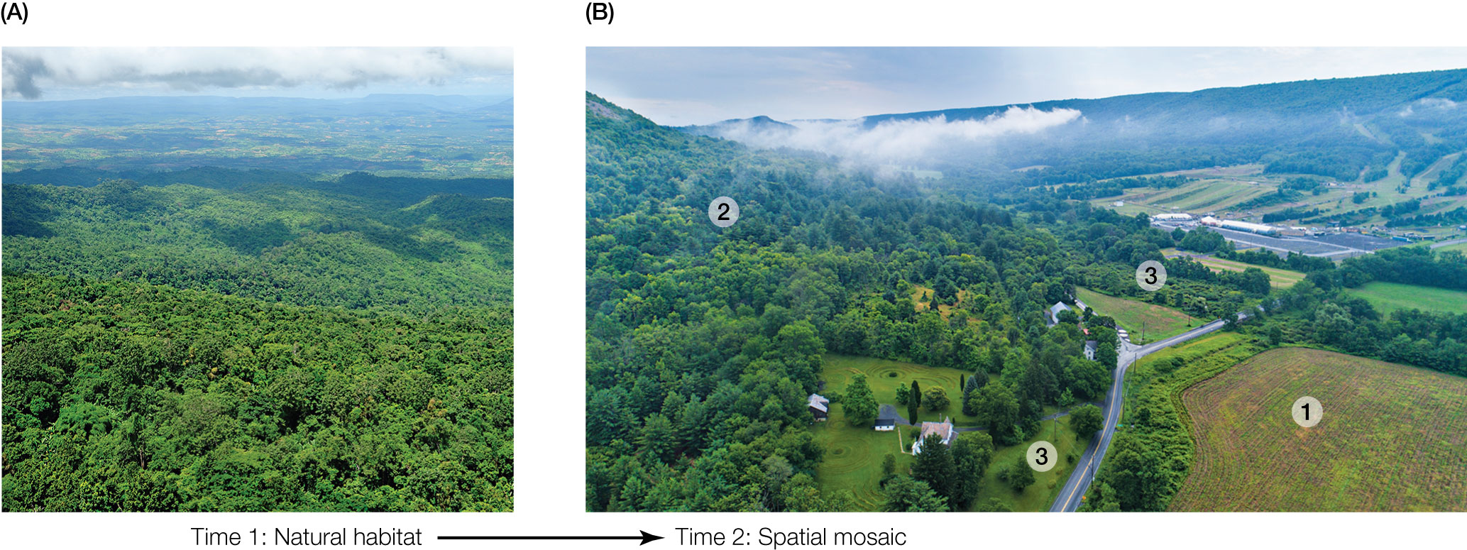
Figure 8.11 Natural or seminatural landscapes
Notes:
Figure 8.11 Natural or seminatural landscapes (A) that are transformed by human activities (B) are often a spatial mosaic of habitats, each with unique changes in biodiversity. Habitats that are destroyed or converted to other uses (point 1) tend to experience large declines in biodiversity. Habitat patches (point 2) may experience declines caused by fragmentation or increases in biodiversity due to colonization of novel species. Habitats that are recovering from disturbed conditions, such as the abandoned farm field at point 3, could return to historic conditions with no net loss of species.

Slide 20
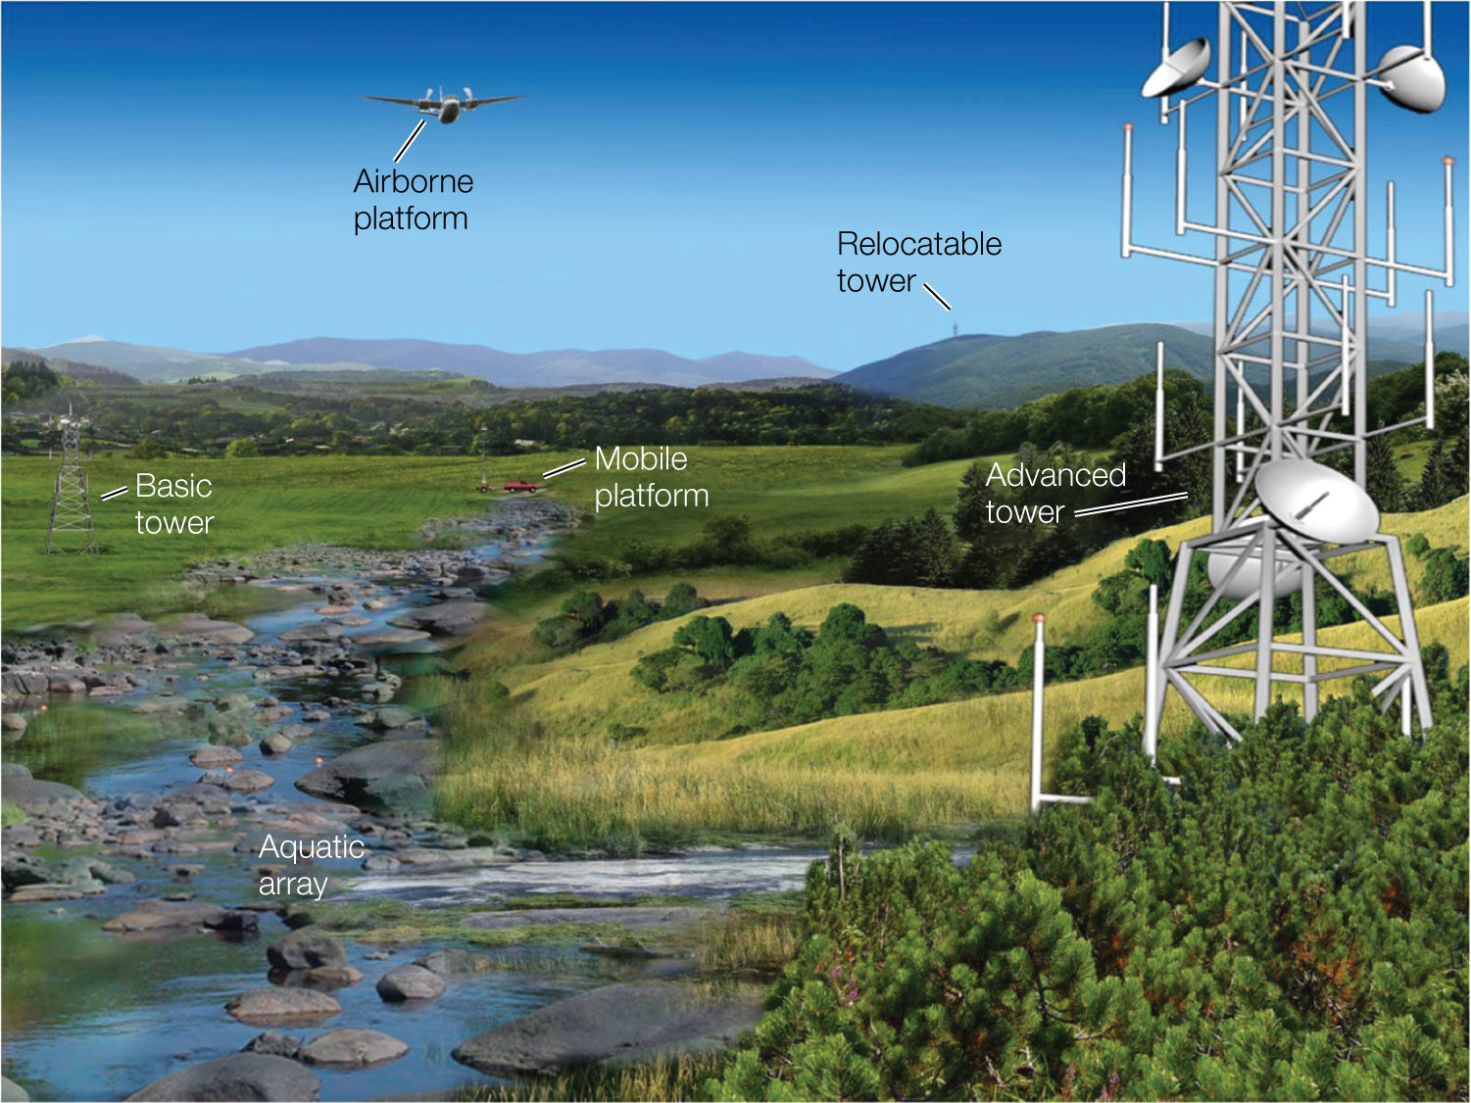
Figure 8.12 Regional observation and monitoring networks like the U.S.
Notes:
Figure 8.12 Regional observation and monitoring networks like the U.S. National Ecological Observatory Network (NEON) are designed with in situ sensor arrays, advanced instrumentation towers, and airborne platforms that monitor the health of natural ecosystems and the services they provide to society. The Global Earth Observation System of Systems is an effort by more than 100 national governments to connect the instrumentation from regional networks like NEON to enhance data sharing and promote common standards for monitoring Earth’s ecosystems.

Slide 21
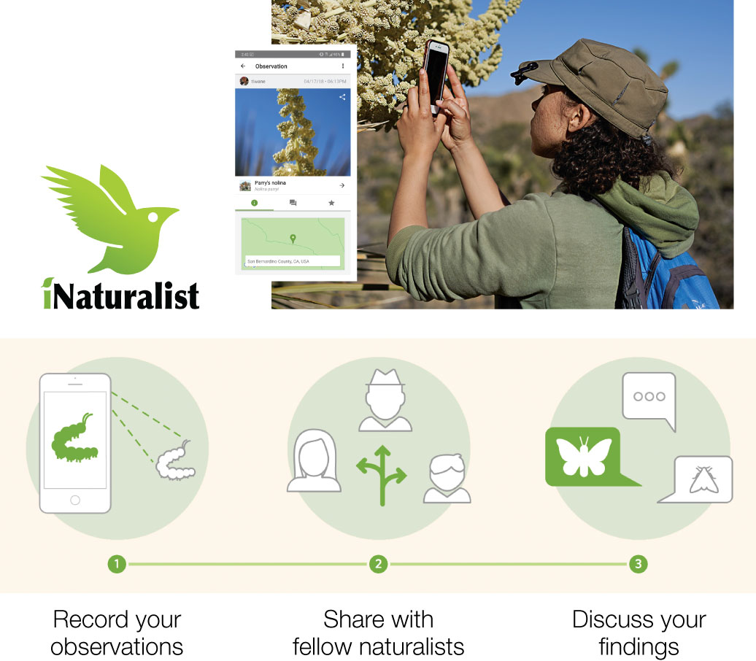
21
Notes:
Citizen science programs like iNaturalist, which use crowdsourcing to identify species and collect data on their distribution and population sizes, are helping to establish a much-needed global biodiversity monitoring network.

Slide 22
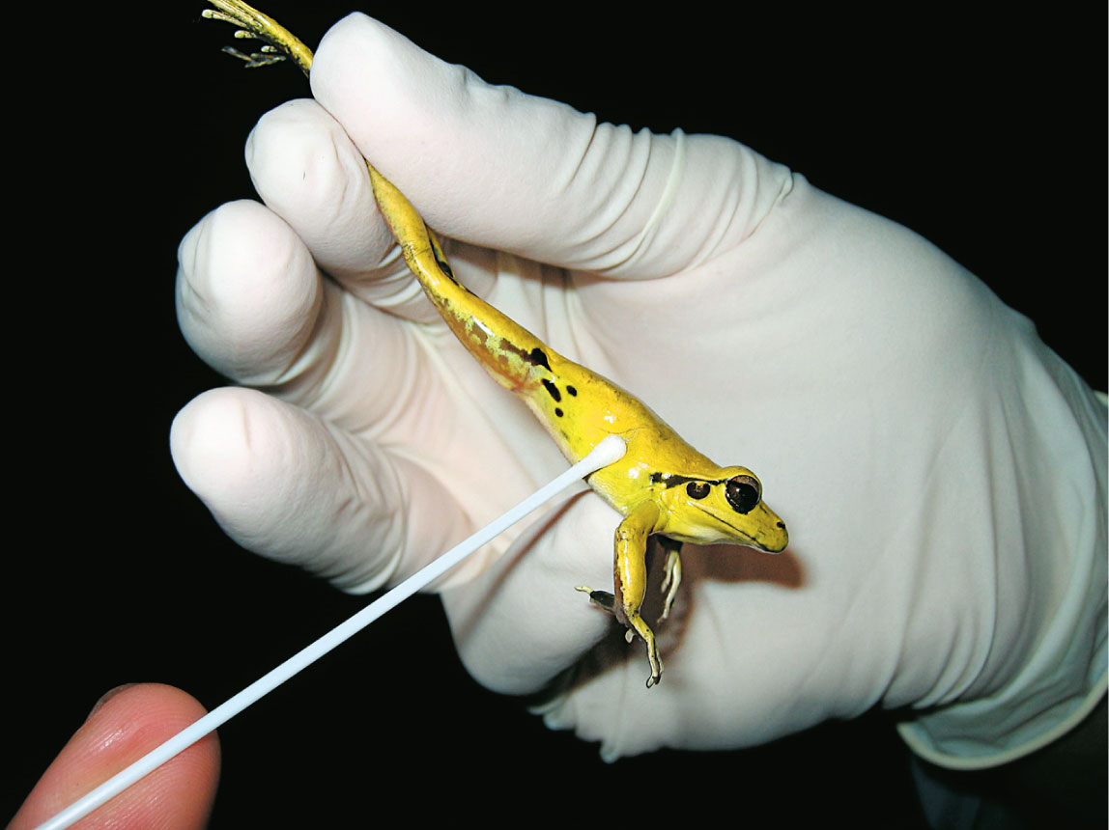
22
Notes:
Worldwide studies have shown that amphibians face multiple threats. Infection by a waterborne fungus is a major contributor to amphibian decline. Here, a researcher uses a cotton swab on an Australian frog, which will be tested for the presence of the disease-causing chytrid fungus.

Slide 23
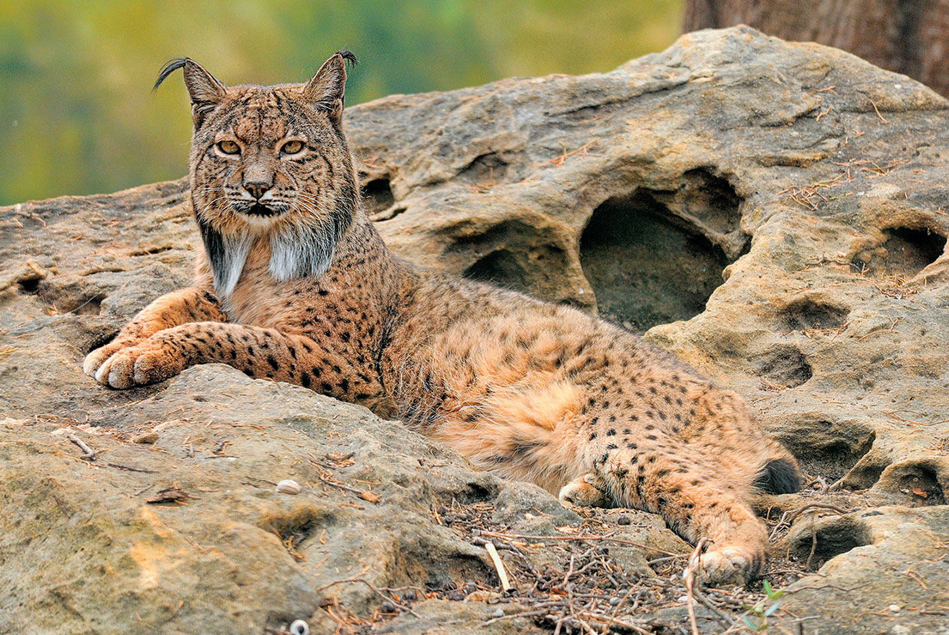
Figure 8.13 The Iberian lynx (Lynx pardinus) occupies a highly restricted geographic range, with only two breeding populations in Spain. As a result, the species is the world’s most endangered felid.
Notes:
Figure 8.13 The Iberian lynx (Lynx pardinus) occupies a highly restricted geographic range, with only two breeding populations in Spain. As a result, the species is the world’s most endangered felid.

Slide 24
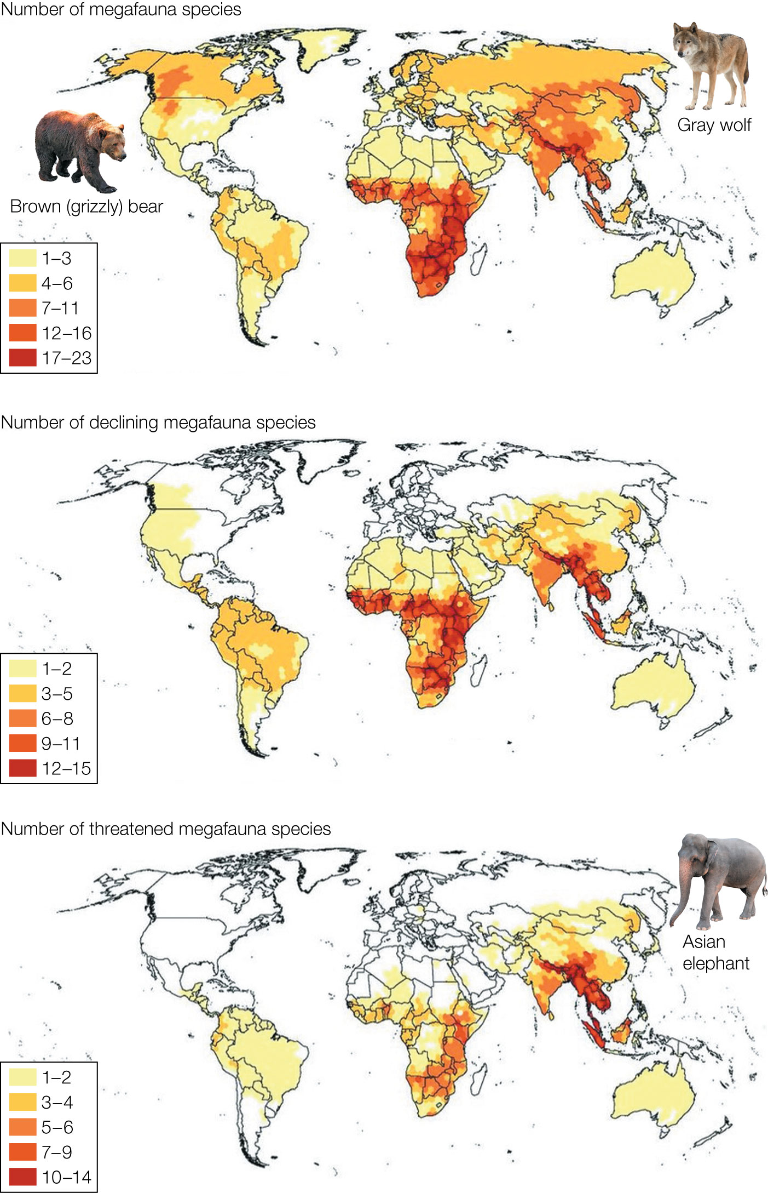
Figure 8.14 The world’s largest species at risk. Scientists examined the conservation status of 105 of the world’s largest land animals and found that 60% are threatened with extinction.
Notes:
Figure 8.14 The world’s largest species at risk. Scientists examined the conservation status of 105 of the world’s largest land animals and found that 60% are threatened with extinction. These megafauna (very large animals) are concentrated in sub-Saharan Africa and Southeast Asia and are often keystone species with profound impacts on their ecosystems.

Slide 25
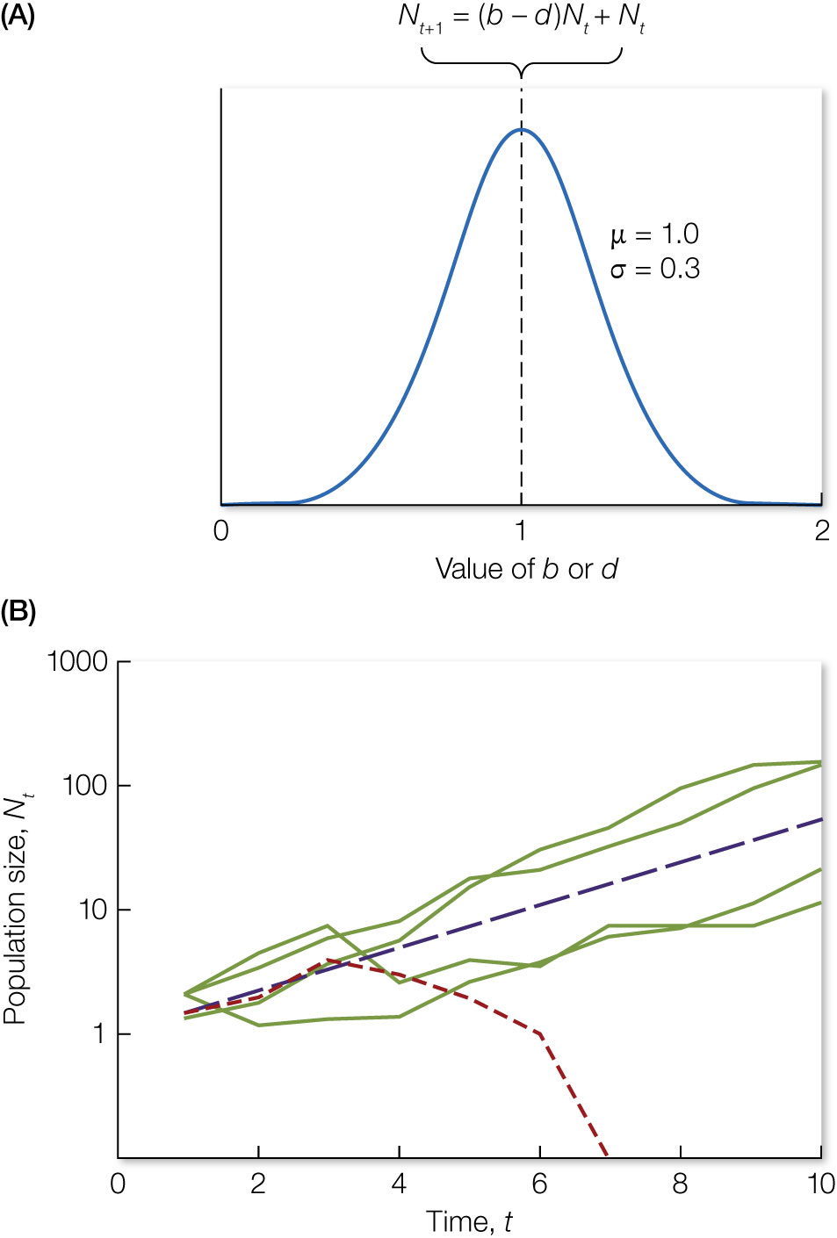
Figure 8.15 Simulations of a simple population model illustrate the impacts of stochasticity on population growth. With no variation in birth (b) or death (d) rates, populations grow deterministically (B, dashed purple line).
Notes:
Figure 8.15 Simulations of a simple population model illustrate the impacts of stochasticity on population growth. With no variation in birth (b) or death (d) rates, populations grow deterministically (B, dashed purple line). When b and d are selected at random from a normal probability distribution (A), populations may grow faster or slower (B, solid green lines) or even go extinct (B, dashed red line).

