Slide 1
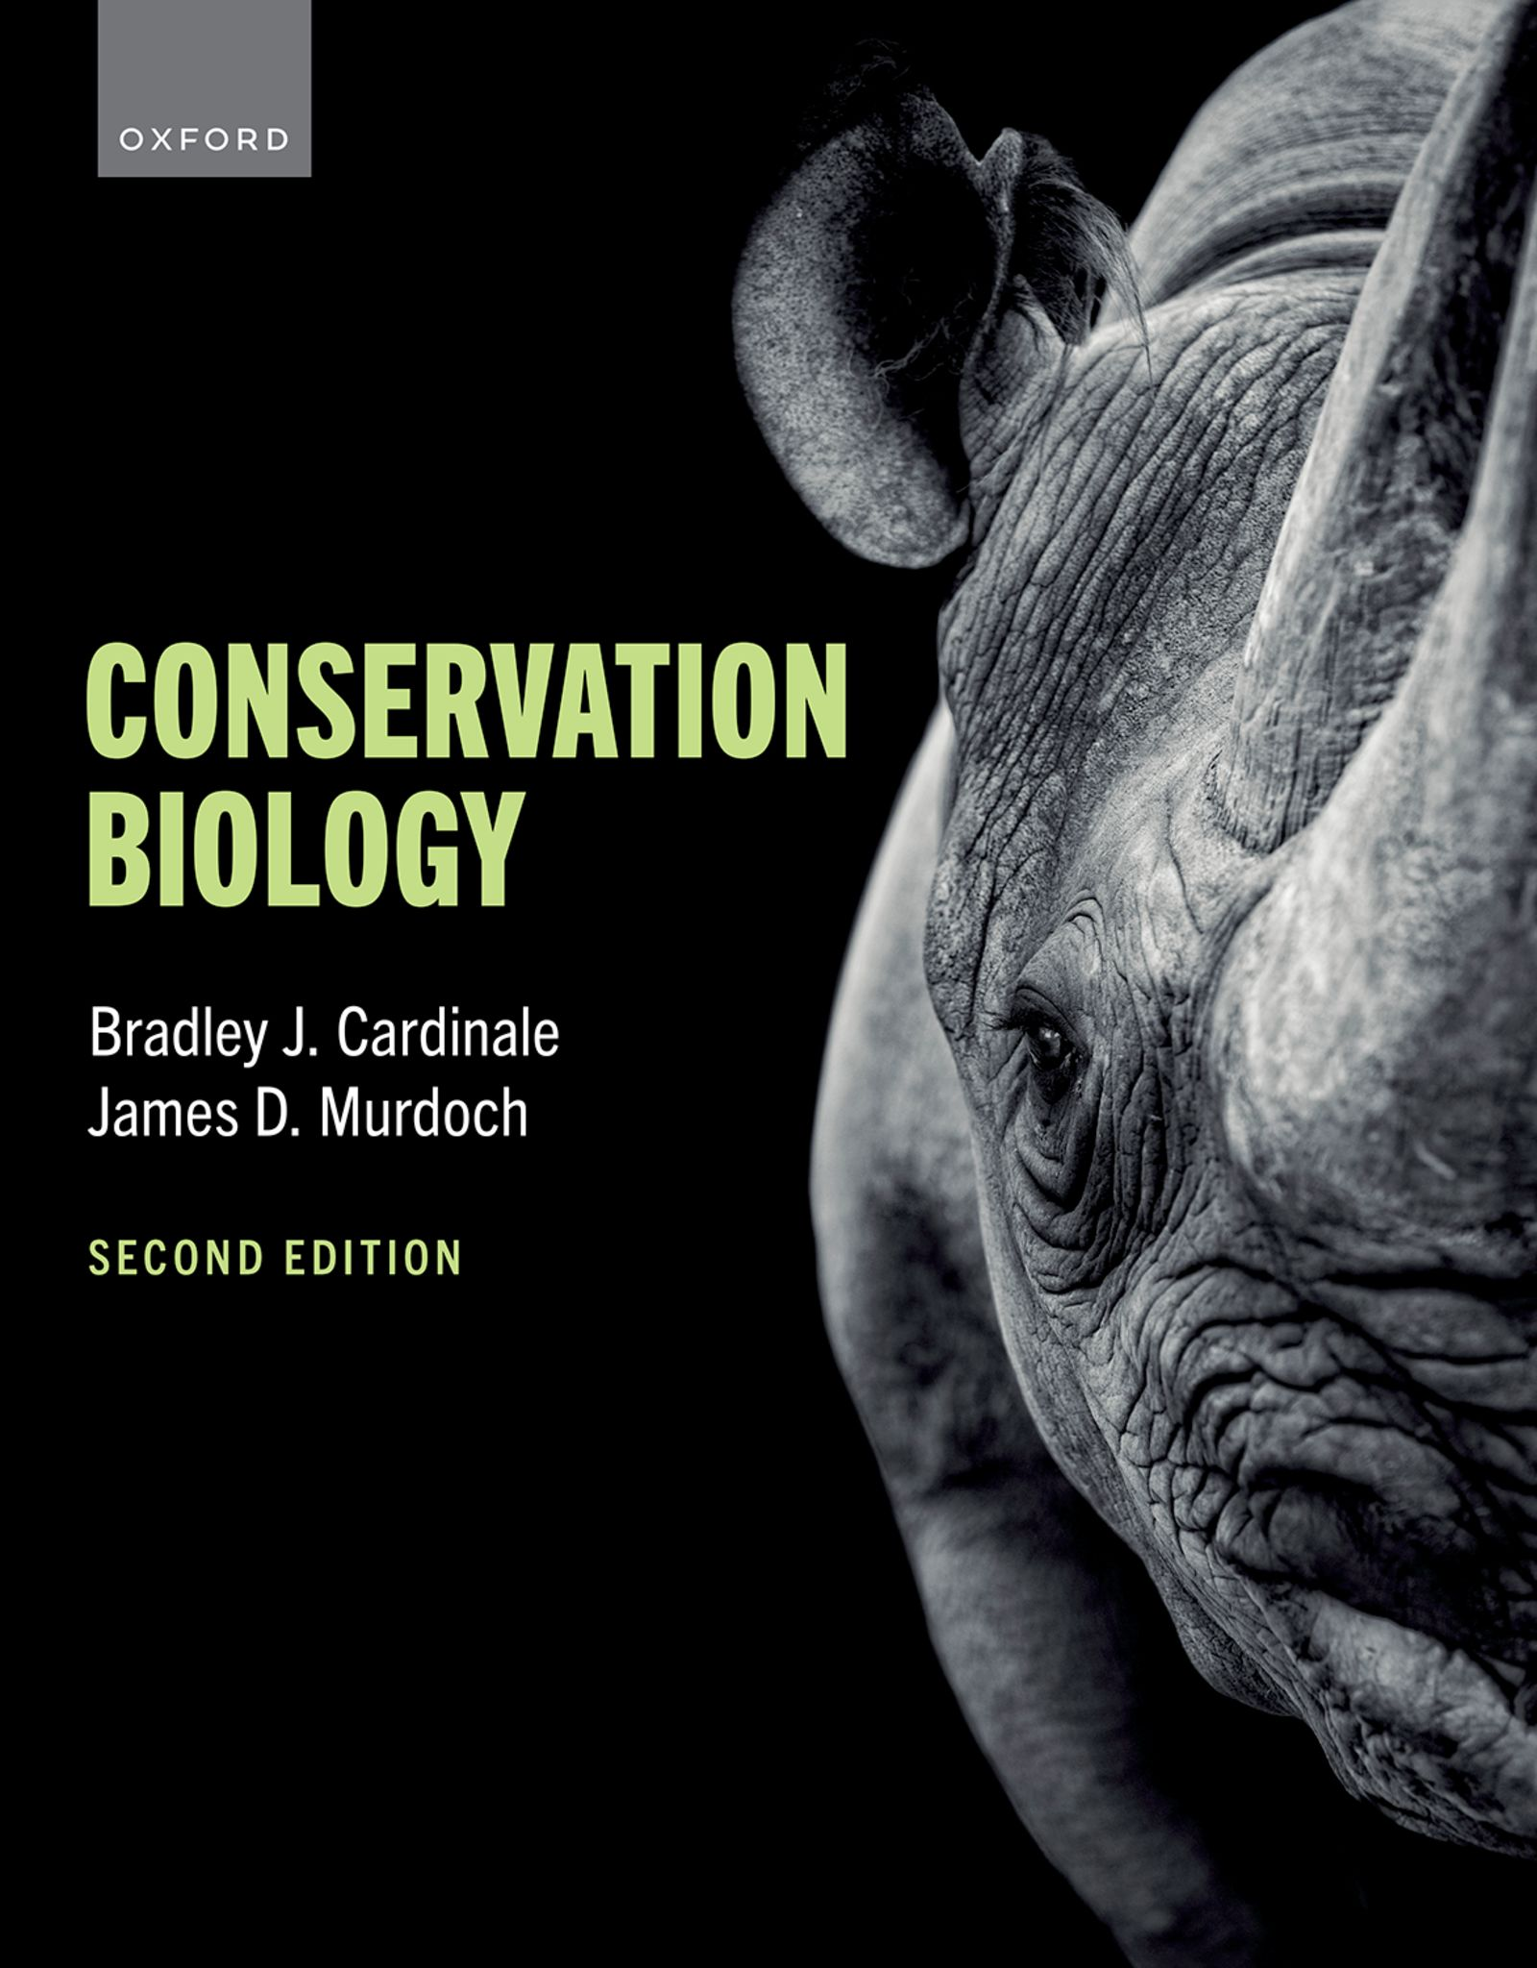
CONSERVATION BIOLOGY
By Bradley J. Cardinale and James D. Murdoch

Slide 2
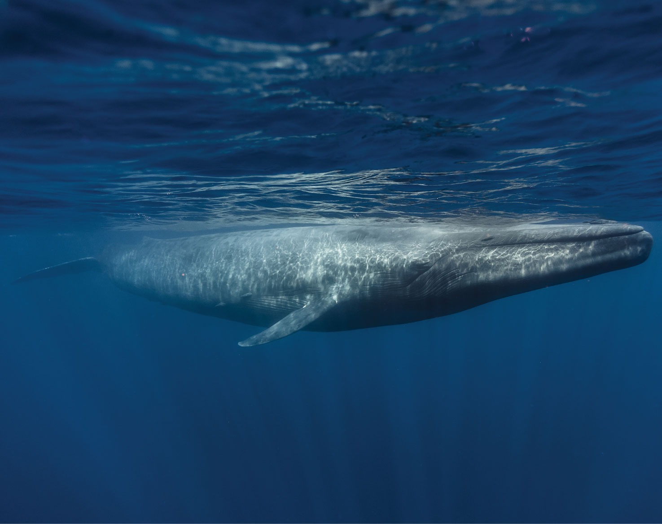
2
Notes:
The blue whale (Balaenoptera musculus) is the largest animal to ever exist on the planet. It is an endangered species as a result of whale hunting, but populations are now increasing because of global protections.

Slide 3
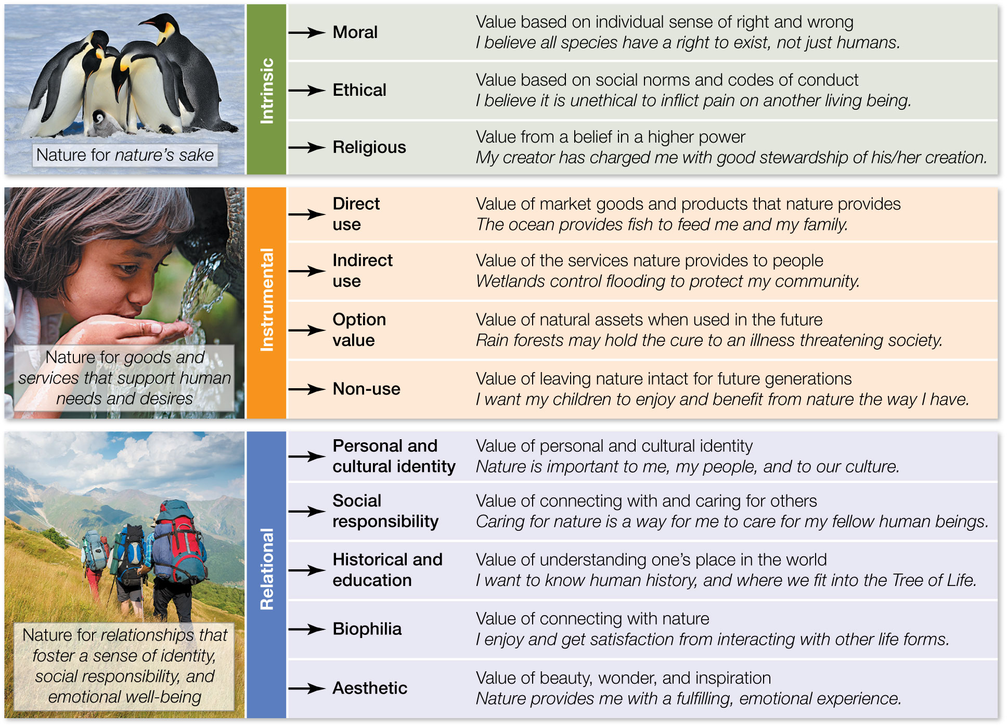
Figure 5.1 A classification of three types of value systems that are used to justify conservation of nature and its biodiversity.
Notes:
Figure 5.1 A classification of three types of value systems that are used to justify conservation of nature and its biodiversity.

Slide 4
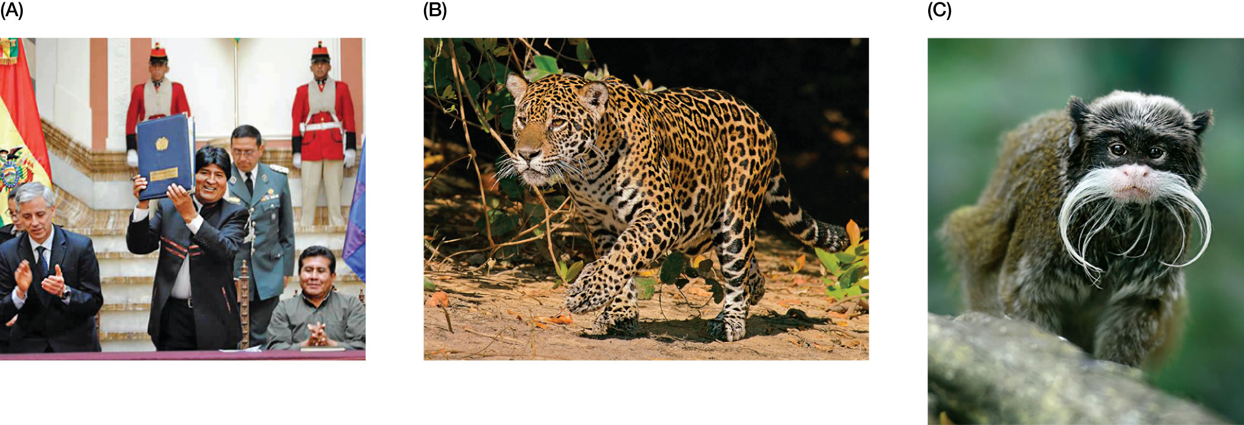
Figure 5.2 (A) President Evo Morales enacts Bolivia’s Law of the Rights of Mother Earth at a ceremony that recognized the intrinsic value of nature and guaranteed the right to exist for native Bolivian animals like the (B) jaguar (Panthera onca boliviensis)
Notes:
Figure 5.2 (A) President Evo Morales enacts Bolivia’s Law of the Rights of Mother Earth at a ceremony that recognized the intrinsic value of nature and guaranteed the right to exist for native Bolivian animals like the (B) jaguar (Panthera onca boliviensis) and (C) emperor tamarin (Saguinus imperator).

Slide 5
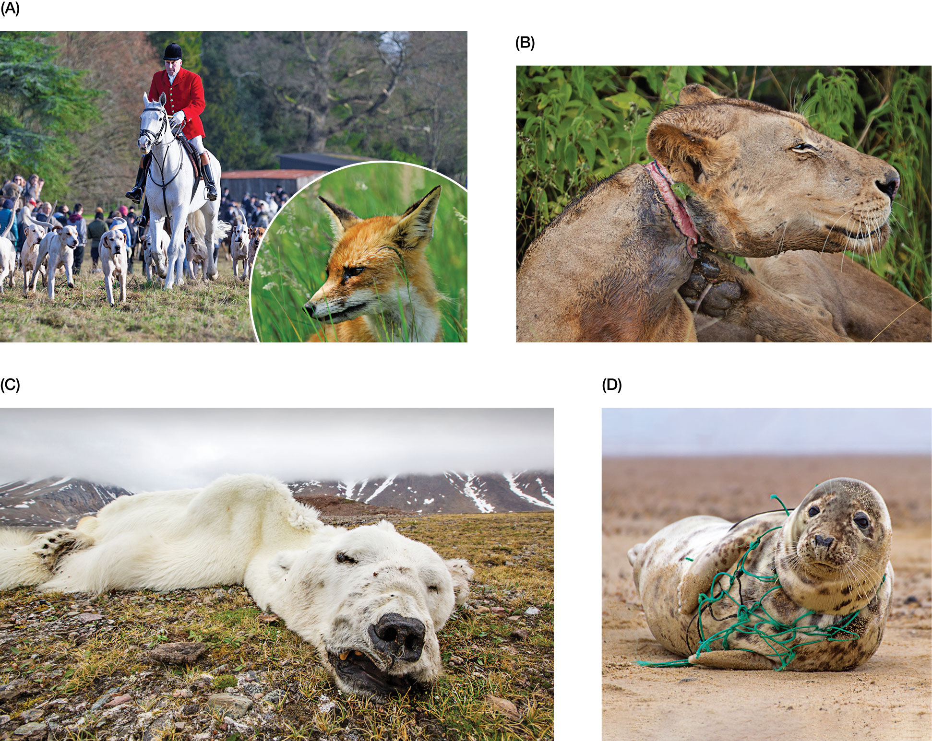
Figure 5.3 While most human societies consider it unethical for a person to knowingly inflict pain and suffering on another human being, some believe it is also unethical for humans to knowingly inflict pain and suffering on other nonhuman life-forms.
Notes:
Figure 5.3 While most human societies consider it unethical for a person to knowingly inflict pain and suffering on another human being, some believe it is also unethical for humans to knowingly inflict pain and suffering on other nonhuman life-forms. This includes not only the pain and suffering inflicted directly by human activities like hunting (A) and trapping (B), but also that inflicted indirectly through human impacts like climate change (C) and pollution (D).

Slide 6
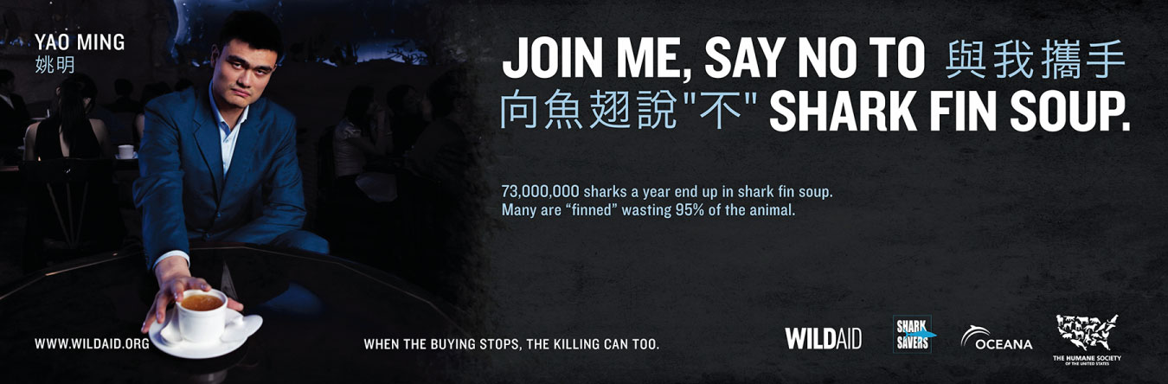
6
Notes:
Former National Basketball Association professional basketball star Yao Ming joined forces with WildAid in a public service campaign to educate the public about the plight of sharks and to reduce demand for shark fin soup in China.

Slide 7

7
Notes:
The Buddhist Declaration on Nature Venerable Lungrig Namgyal Rinpoche, Abbot, Gyuto Tantric University

Slide 8

8
Notes:
The Christian Declaration on Nature Father Lanfranco Serrini, Minister General, Order of Friars Minor (Franciscans)

Slide 9

9
Notes:
The Hindu Declaration on Nature Dr. Karan Singh, President, Virat Hindu Samaj

Slide 10

10
Notes:
The Muslim Declaration on Nature Dr. Abdullah Omar Nasseef, Secretary General, Muslim World League

Slide 11

11
Notes:
The Jewish Declaration on Nature Rabbi Arthur Hertzberg, Vice President, World Jewish Congress

Slide 12
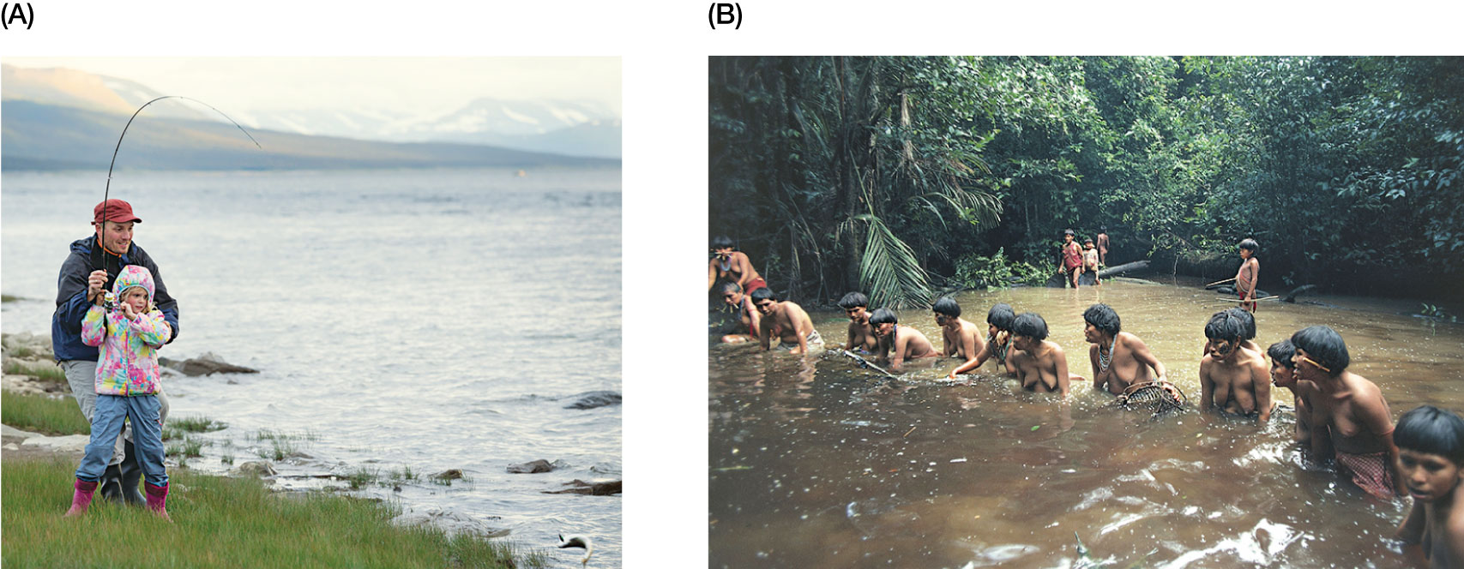
Figure 5.4 Examples of nature fostering relational values and desirable relationships that give one a sense of personal and cultural identity.
Notes:
Figure 5.4 Examples of nature fostering relational values and desirable relationships that give one a sense of personal and cultural identity. (A) A father enjoys time with his daughter as he teaches her how to fish, and (B) Yanomami tribesmen and women take part in communal fishing in the Venezuelan Amazon region.

Slide 13
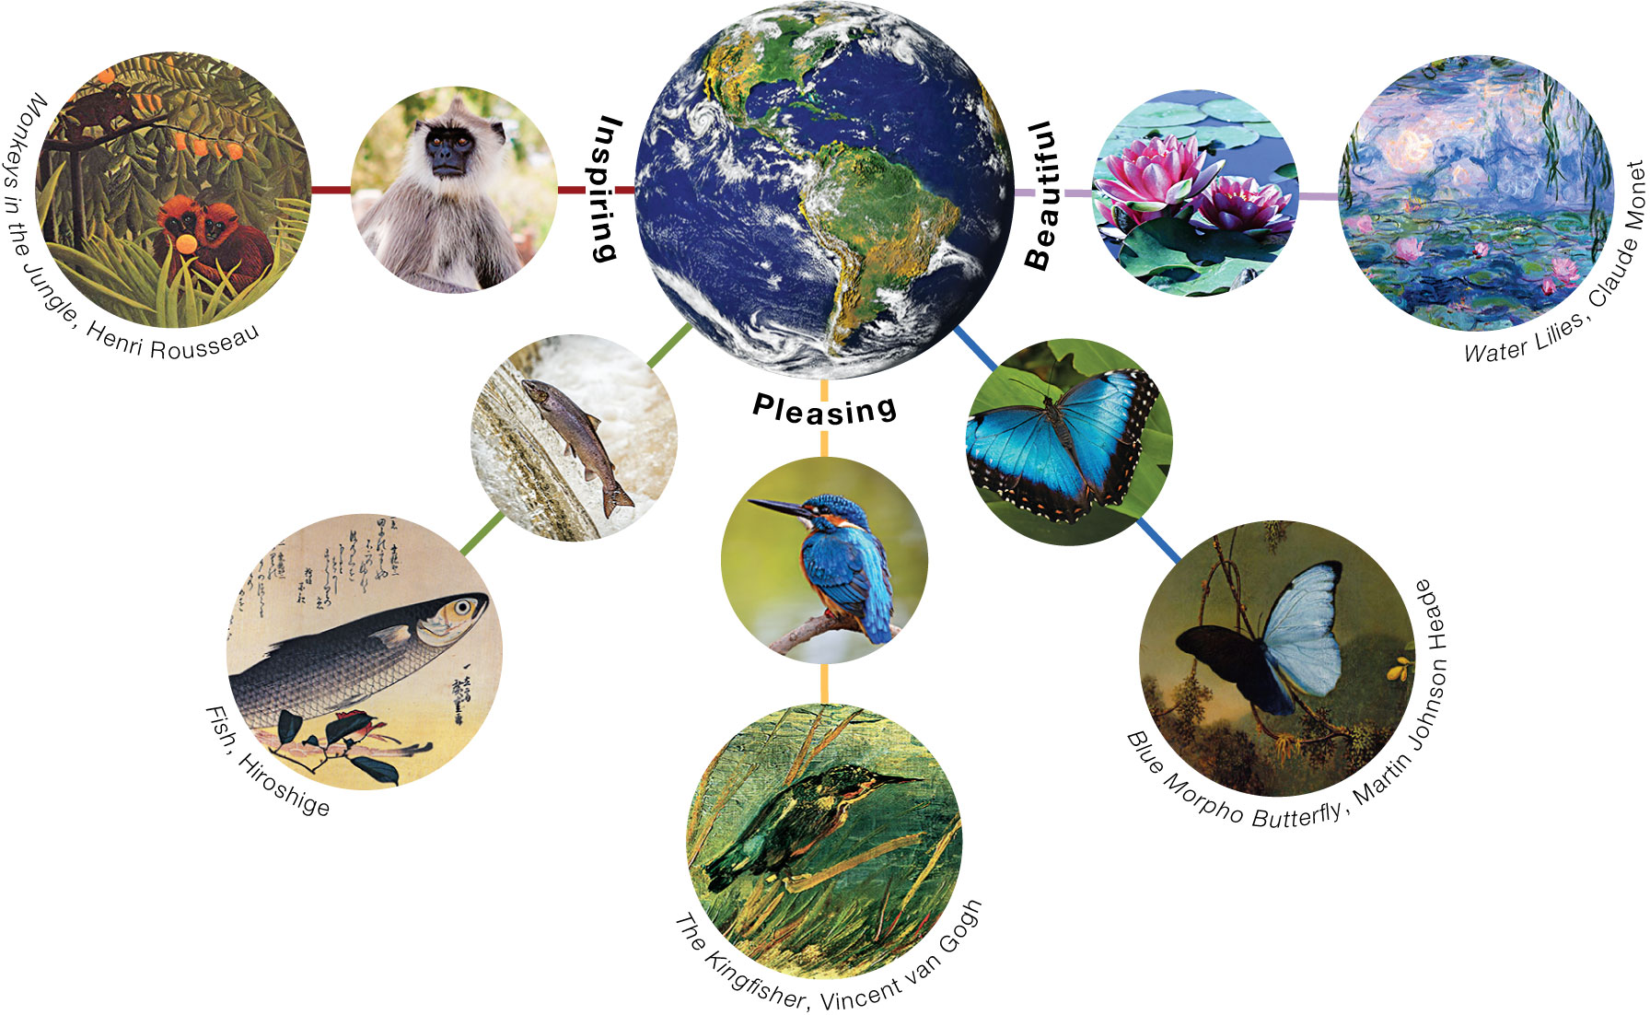
Figure 5.5 Nature is filled with the stunning beauty of flowering plants, trees, insects, birds, fish, and mammals. Such beauty has routinely inspired the greatest artists in history to produce some of the world’s most treasured masterpieces of art.
Notes:
Figure 5.5 Nature is filled with the stunning beauty of flowering plants, trees, insects, birds, fish, and mammals. Such beauty has routinely inspired the greatest artists in history to produce some of the world’s most treasured masterpieces of art.

Slide 14
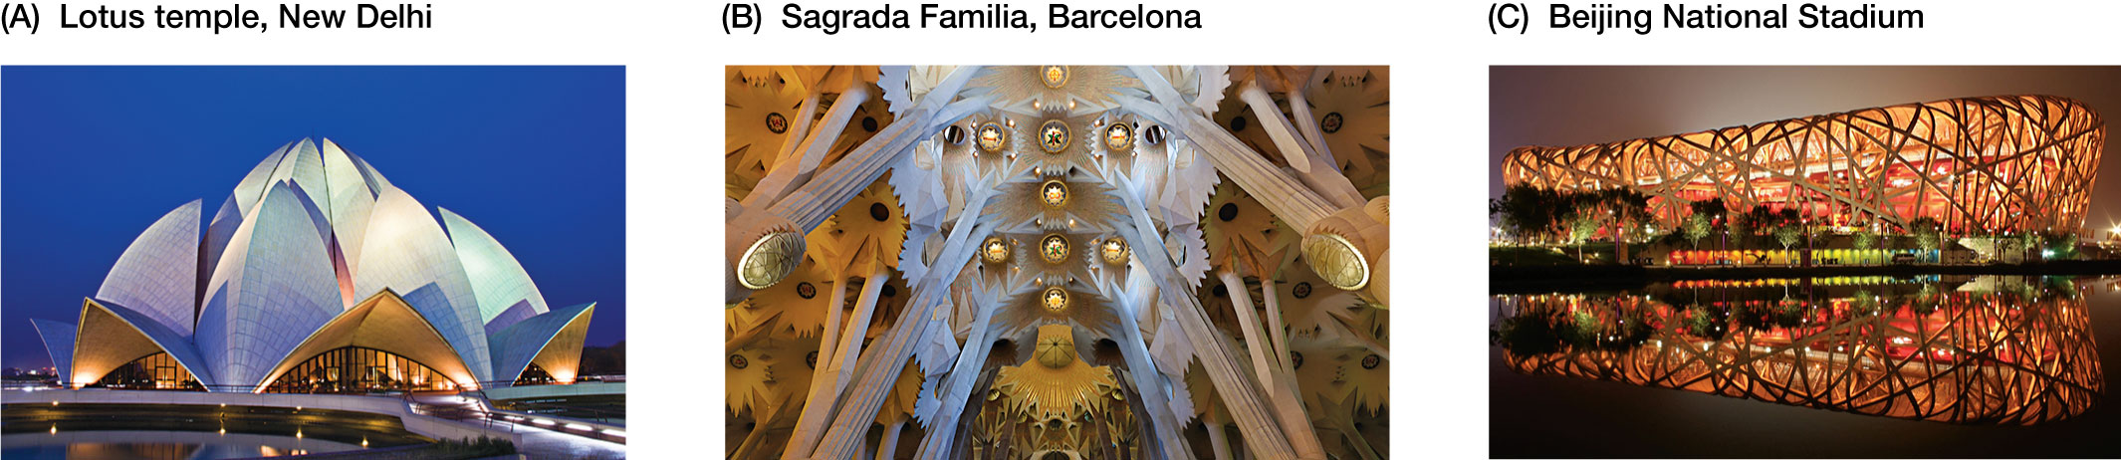
Figure 5.6 Many of the world’s architectural wonders have been inspired by nature.
Notes:
Figure 5.6 Many of the world’s architectural wonders have been inspired by nature. (A) The Lotus Temple in New Delhi was designed by architect Fariborz Sahba, who was inspired by the shape of the lotus flower. (B) The central nave of Barcelona’s spectacular La Sagrada Familia was modeled after tree trunks so that those who enter feel as though they’re walking into a forest—just as famed Catalan architect Antoni Gaudí intended. (C) Beijing National Stadium in China, nicknamed the Bird’s Nest, was designed by Swiss architecture firm Herzog & de Meuron for the 2008 Olympic Games.

Slide 15
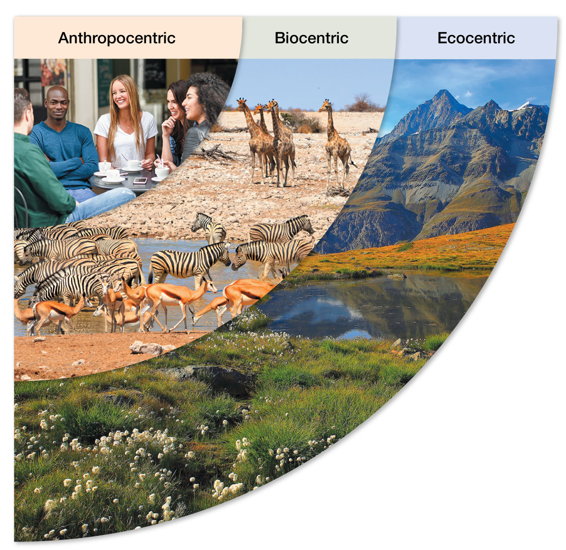
Figure 5.7 Three ethical worldviews that influence how people view nature and its biodiversity.
Notes:
Figure 5.7 Three ethical worldviews that influence how people view nature and its biodiversity.

