Slide 1
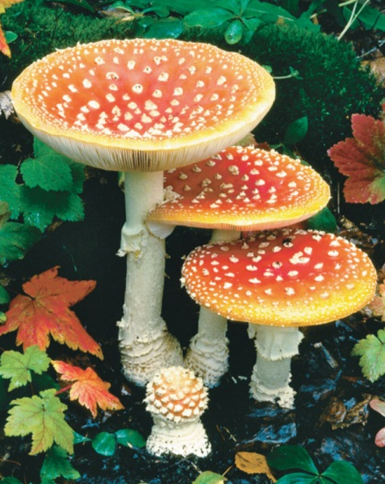
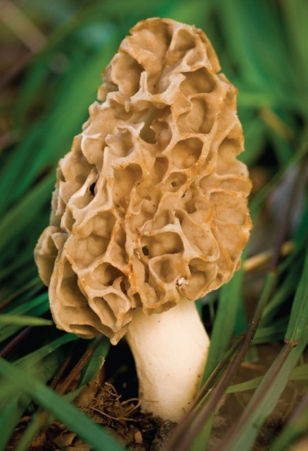
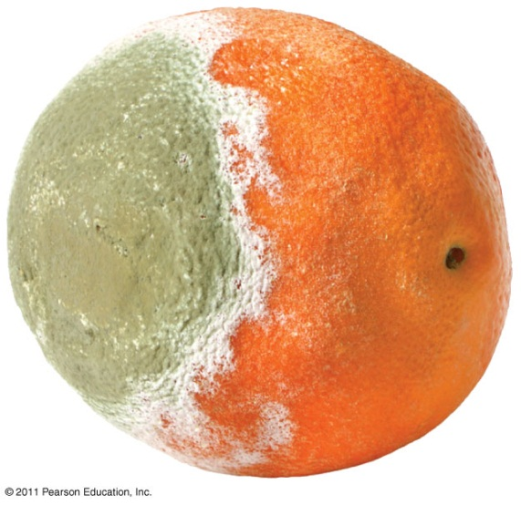
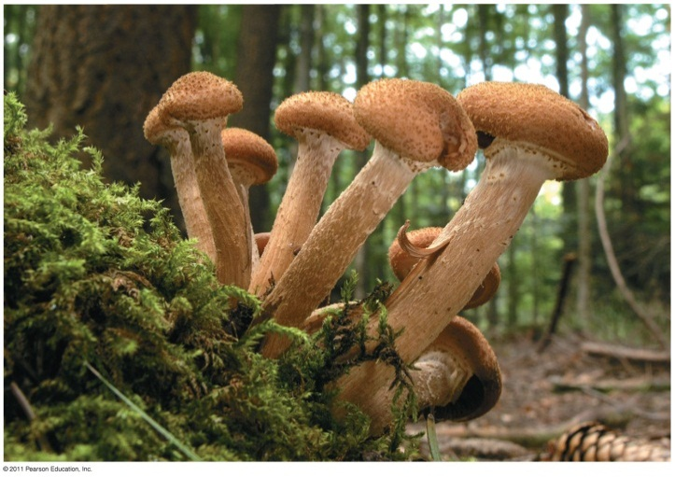
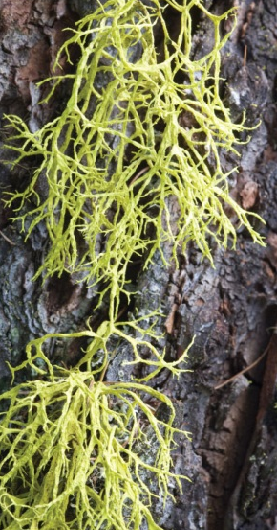
Fungi Diversity and Anatomy
BIOL 1750 – Biology II Lab
University of Nebraska at Omaha
AH 225

Slide 2

Reminders NO QUIZ THIS WEEK!
The Results writing assignment takes the place of the pre-lab quiz next week. Due at the beginning of lab next week.
Write a Results Section Comparing Biodiversity and Similarity of Two Different Habitats at Glacier Creek Preserve (4 pts)
On the back of this page, write your name, lab time/section, and a paragraph presenting the results of the data analyses we used to compare habitat biodiversity and species composition. Using your group data, make a small table presenting the species richness for each habitat type. Above the table itself, give your table a complete, descriptive caption. Be very specific (include time, measurements made etc.). Describe the legend in paragraph form. For example, “Values represent the mean height of Brassica rapa plants either treated with gibberellic acid (dark bar) or in the control treatment (white bar).”
Report the results by referring to Table 1. That means cite the Table in your text like: “The woodland habitat had greater overall diversity than the riparian habitat (Table 1).” Make sure you report the results of both the species richness and similarity index, but DO NOT be redundant in reporting the values. Because the Table will have species richness values you will not state the species richness values in paragraph form. Simply state which habitat had higher or lower diversity and cite the Table. Lastly, would you reject or fail to reject your null hypotheses based on your group’s data?

Slide 3
Today’s lab . . .
Today – Lab 4 (20-point activity)
Parts of a Microscope
Comparative Anatomy of True Fungi
Next Week – Lab 5
Plant Anatomy and Physiology

Slide 4
Fungi Diversity and Anatomy
Objectives: Students will be able to…
Use a microscope and label the parts
Name the Fungi phylum, given representative organisms
Describe the differences in reproduction between the three Fungi phyla (Zygomycota, Ascomycota, Basidiomycota) and label the major reproductive structures
Discuss ecological roles and economic importance of fungi
Describe a lichen, and identify the three lichen thallus types
Describe the relationship between mycorrhizal fungi and plants

Slide 5
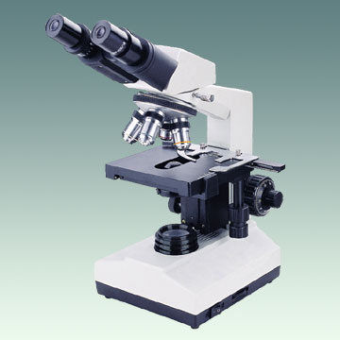
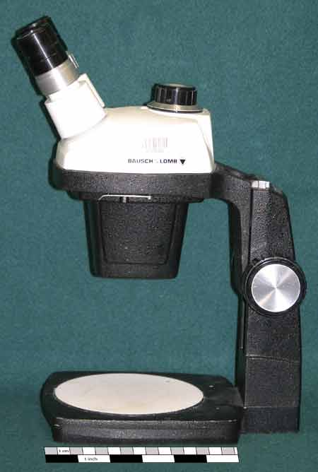
Microscopes are Awesome!
Compound microscope
Dissecting microscope
uses only transmitted light
greater magnification
for viewing slides
uses transmitted and reflected light
better resolution
for viewing 3D objects

Slide 6
Microscopes are Awesome!
How to use a compound microscope with Murray Gans (7:54)
For review you can watch the video above again,
or watch this shorter video covering only
the parts of the microscope (0:48).

Slide 7
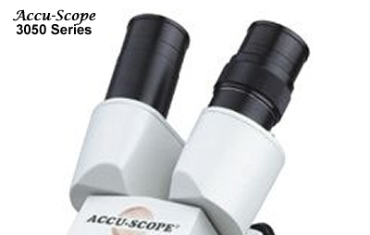
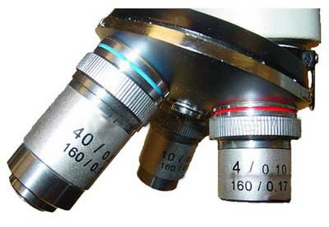
Magnification
Eyepiece (Ocular)
Objective
=
X
Remember the eyepiece has a 10x lens.

Slide 8
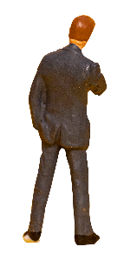
Using a Microscope
Only use lens paper to clean objectives.
Wash, dry, and reuse slides. When finished place slide on paper towel at front bench to dry.
Discard coverslips or broken glass in the sharps box NOT the trash can.
Let us know if a microscope is not working

Slide 9
Today’s lab . . .
Today – Lab 4 (20-point activity)
Parts of a Microscope
Comparative Anatomy of True Fungi
Next Week – Lab 5
Plant Anatomy and Physiology
The Fascinating Map of Fungi (23:09)

Slide 10
Protists General Characteristics
Any organism not classified as a plant, animal, fungus, or bacteria (prokaryote).
Protists are eukaryotic having a distinct nucleus and organelles.
Most protists are unicellular (one-celled) but some are multicellular.

Slide 11
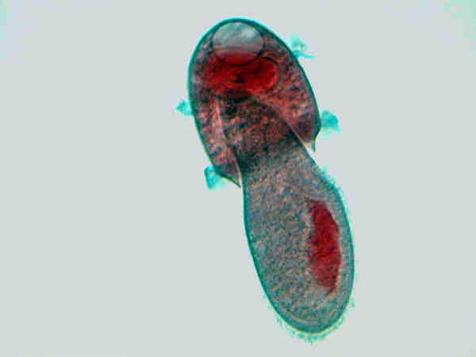
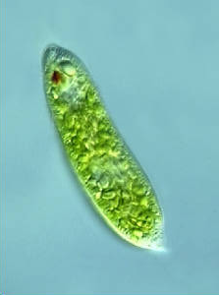
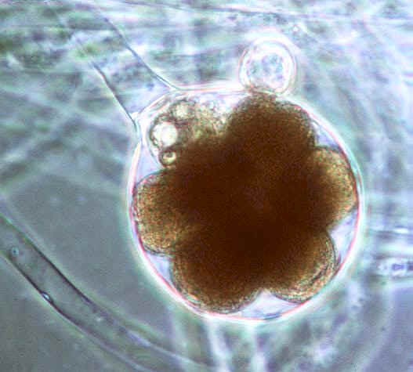
Protists are primarily classified according to how they obtain nutrition
Animal-like
heterotrophs (eat other organisms)
Plant-like
autotrophs that contain chloroplasts and make their own food (photosynthesis).
Fungus-like
decomposers and/or heterotrophs
Didinium
eating
Paramecium
Green like plants!
Water mold

Slide 12
Fungus-Like Protists No chitin!
Water molds, downy molds, and slime molds
Unicellular to colonial
Heterotrophic
Many are saprophytic (get energy from dead, decaying organisms)
Need moist environment
All exhibit movement at some point during life cycle

Slide 13
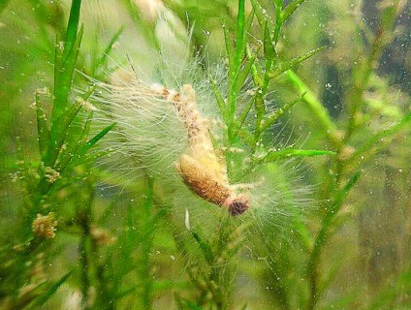
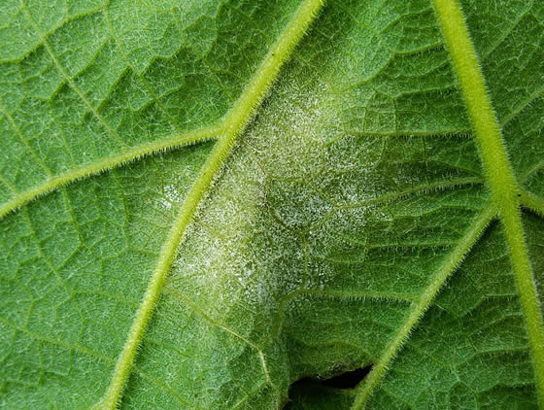
Fungus-Like Protists No chitin!
Oomycetes - Water molds and downy mildews
Have flagellated reproductive cells
Large and diverse group
https://owlcation.com/stem/Saprolegnia-and-Phytophthora-Oomycetes-or-Water-Molds
http://lifeofplant.blogspot.com/2011/03/oomycetes.html

Slide 14
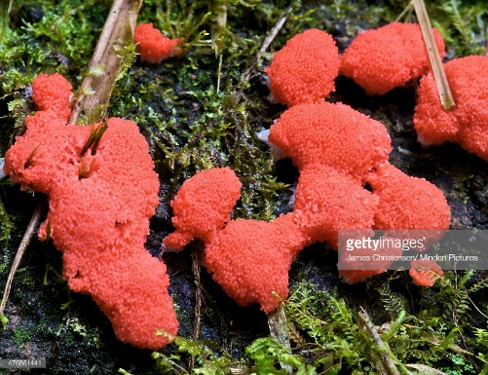
Fungus-Like Protists No chitin!
Plasmodial and cellular slime molds
Myxomycetes – Plasmodial slime molds
Cells merge together into large mass (3:13)
Amoeboid movement
Reproduce with spores in harsh environments (low food and/or moisture)
Dictyostelids – Cellular slime molds
Independent except to reproduce, again only when food is scarce Haploid during entire life cycle

Slide 15
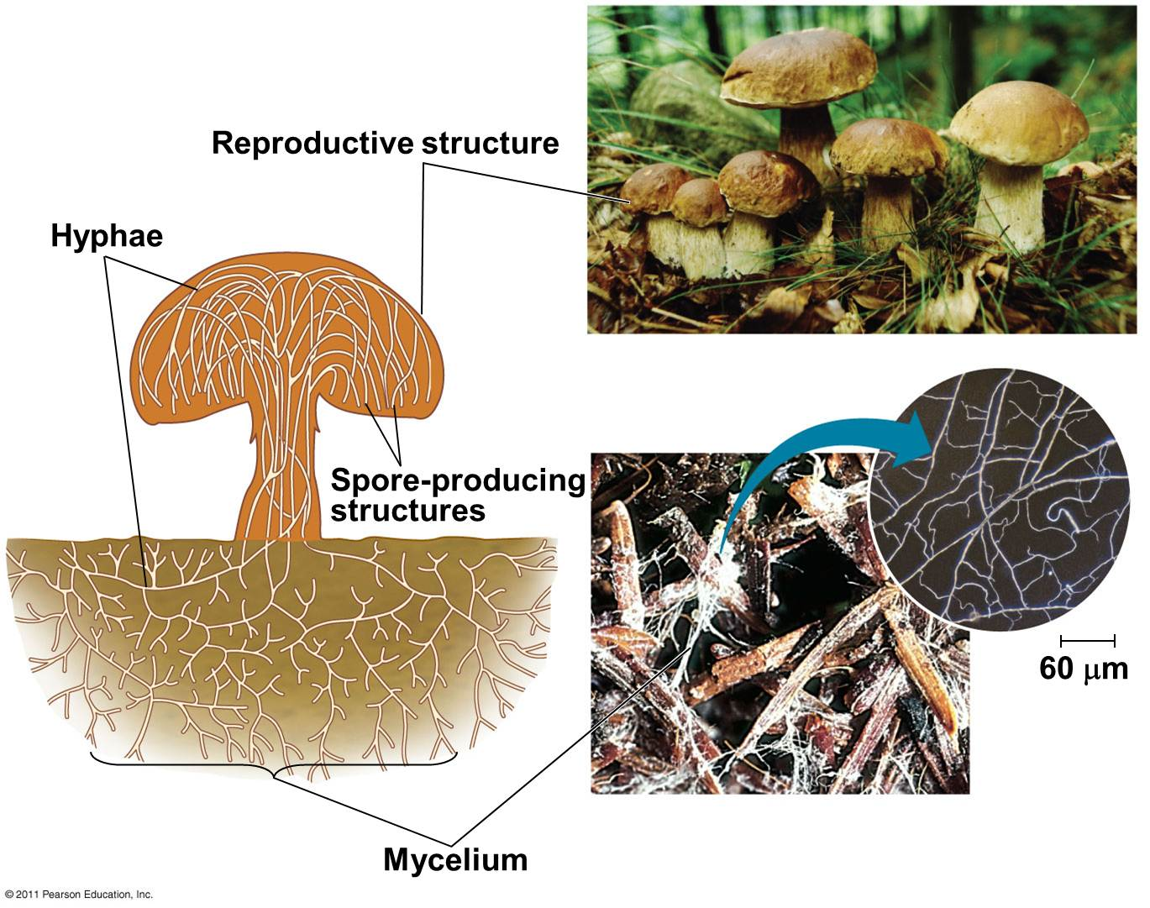
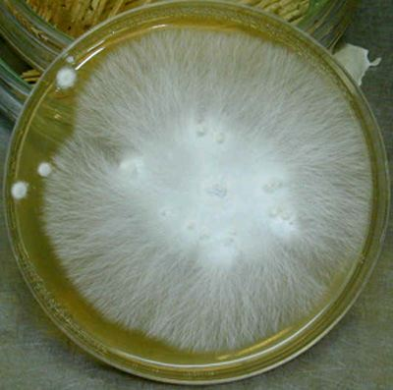
Fungi Anatomy
(basidiomycete)
Fungi are usually filamentous organisms composed of: hyphae (singular = hypha) that make up the mycelium (plural = mycelia)
mycelium on agar plate
Four main structures
Hyphae (together are mycelium, which is the body)
Fruiting body
Sporangia
Spores

Slide 16
Fungi Phyla
We are focusing on three groups that are distinguished by their reproductive structures:
Zygomycota (bread molds, etc.) (Now split into many phyla)
Ascomycota (sac fungi)
Basidiomycota (club fungi)
May reproduce sexually or asexually
png image from pngtree.com

Slide 17
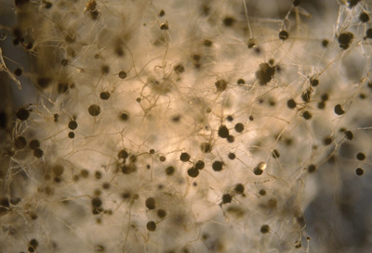
Zygomycota (zygote fungi) These species are now in Mucuromycota
Rhizopus stolonifer, see life cycle in lab manual
distinguish between sexual and asexual reproductive process
Identify hyphae, sporangia, and zygosporangia
Watch: The fastest living thing on the planet (4:59)
Pilobolus crystallinus, shotgun fungus
Rhizopus stolonifer, common bread mold

Slide 18
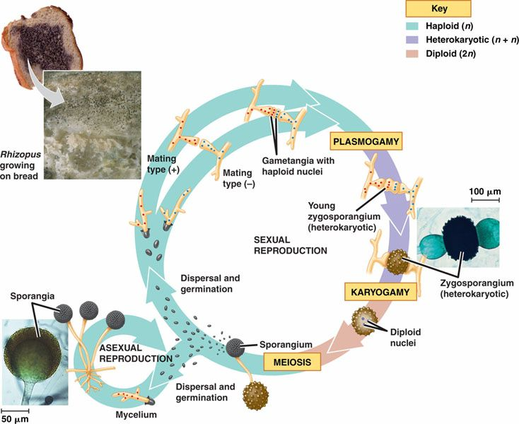
Zygomycota Life cycle
http://bio1151.nicerweb.com/Locked/media/ch31/31_12ZygomyceteLifCycle.jpg

Slide 19
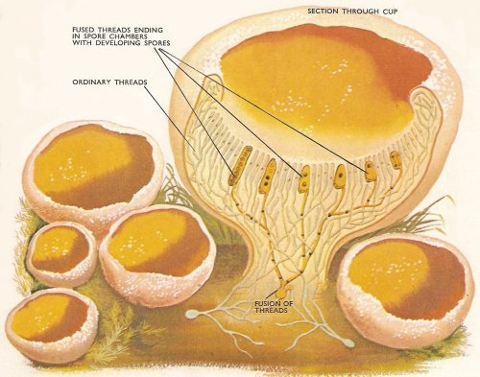
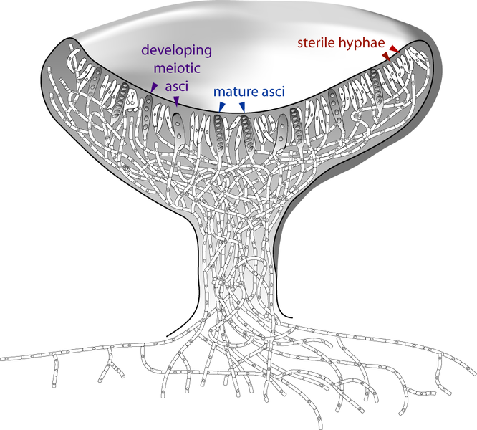
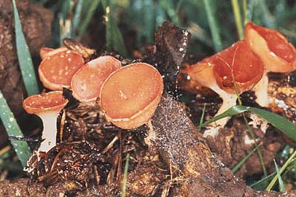
Ascomycota
asci (singular = ascus)
with ascospores
hyphae
ascocarp

Slide 20
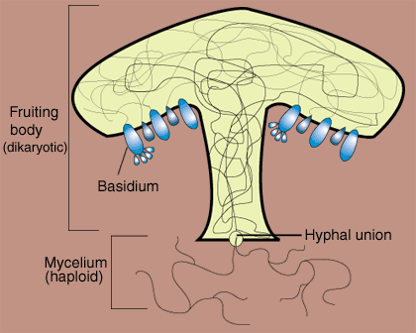
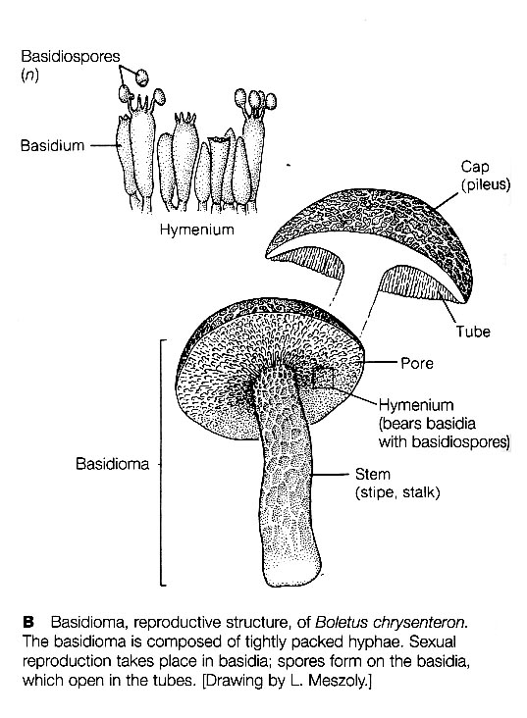
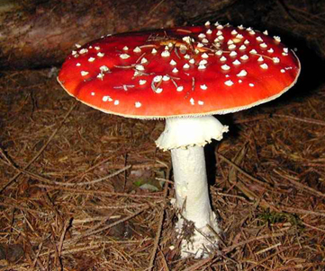
Basidiomycota
gills

Slide 21
Lab 4 – Fungi Diversity and Anatomy
Exercise 1: Microscope Anatomy
Label the parts of a microscope
Learn how to make a wet mount
Exercise 2: Comparative Anatomy of True Fungi
Zygomcetes
Rhyzopus – make tape mount
Pilobolus viewing on demo
Ascomycetes
Peziza prepared slide
Sordaria - make wet mount
Saccharomyces – make wet mount (yeast)
Basidiomycetes
Common mushroom – make dry mount
Coprinus prepared slide
Basidiocarp examples on demo
Exercise 3: Lichens and Mycorrhizae
Examine lichens on demo
View figures of mycorrhizae

Slide 22
Reminders
The Discussion writing assignment takes the place of the pre-lab quiz next week. Due at the beginning of lab next week.
Write a Discussion Section Explaining the Anatomical Structures of Fungi and the Main Differences among the Three Major Phyla (4 pts)
On the back of this page, write your name, lab time/section, and a paragraph discussing the results of our discovery-based scientific study exploring fungi anatomy and reproduction. Compare the structures of the three major fungi phyla, zygomycetes, ascomycetes, and basidiomycetes. Explain what potential benefits you think may be associated with the different structures and reproductive modes (sexual and asexual) among the phyla. Incorporate one article about fungi that you find on your own (through Criss Library, Web of Science, or Google Scholar). Paraphrase the information and cite your article correctly in the text (Author, Year). Lastly, describe an aspect of the comparative study that you would suggest be modified in the future to gain further insight into fungi anatomy and reproduction.

Slide 23
The End

Slide 24
Pre/Post-lab Questions
Lab 4 – Fungi Diversity and Anatomy (and proper use of microscopes) (pre-lab)
1. What are the three phyla (true fungi) we will focus on in today’s lab?
2. If you focus on a slide using the 4X magnification objective, what is the total magnification you will observe using a compound microscope?
3. Lichens are symbiotic associations between __________ and ___________
4. Give one important role that fungi play in ecosystems.
5. Are fungi autotrophic, heterotrophic, or both?
6. How is a saprophyte different from a parasite?
7. Are fungi generally sexual, asexual, or both?

Slide 25
Pre/Post-lab Questions
Lab 3 – Microbes and Ecosystem Ecology (post-lab)
1. Is there typically more soil organic carbon in soils near the equator or near the poles of the earth?
2. Soil contains more organic carbon than the atmosphere, true or false?
3. Why do we find more soil organic carbon at some latitudes than others?
4. What is the approximate level of CO2 in our Earth’s atmosphere?
5. What was the dependent variable in our soil respiration experiment?
6. Briefly explain why changes in temperature may affect soil respiration rates?
7. Briefly explain why changes in moisture may affect soil respiration rates?

Slide 26
Pre/Post-lab Quiz
1.
2.
3.
4.

Slide 27
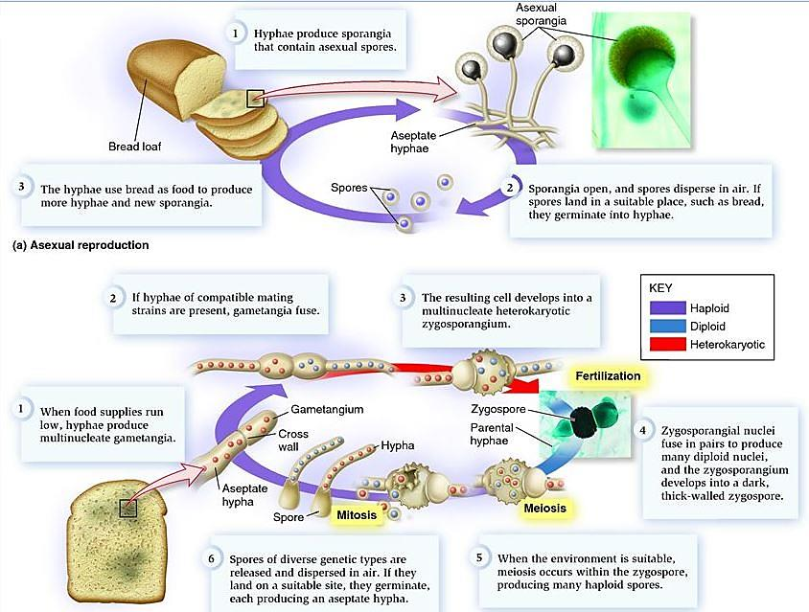
Zygomycota Life cycle (detailed)
(b) sexual reproduction

Slide 28
Research Lab Assistant – Biology Department (Work Study)
Duties may include - The research lab assistant will assist in research projects based on UNO research lab foci, which range from cellular and molecular biology, physiology, ecology, and evolution of plants, fungi, and animals. Duties may include care for study organisms, data collection both in the lab and field, data organization, general lab maintenance, identification of specimens, organization of specimens, dish-washing, data entry, preparing chemical solutions, and general laboratory work.
Inquiries can be made to Debbie Quaas at dquaas@unomaha.edu or in the Biology Office (AH 114). For more information on the particular UNO research labs, please visit the UNO Biology Faculty and Staff Page.

