Slide 1
Fully corrected 3D φ_h fits
BC + RC Bayesian · acc020 Zeroth Order · 26 October 2026
Refinement, native φ_h overlays, and a quantitative comparison with the July 2026 5D weights.
The next Monte Carlo iteration was not started.

Slide 2
What was refined
Input
Unfolded_Simple_3D_Final_Thesis_Bank_
rho0_new_acc020_Zeroth_Order_Full.root
Family
3D BC_RC_Bayesian only. Acceptance-only, RC-only, and 5D were not refit.
Coverage
All 452 Q²-y and z-pT bins that have a 3D BC+RC φ_h histogram.
Fit
A(1 + B cos φ_h + C cos 2φ_h), histogram uncertainties, spline initialization.
Passes
One full remake, then one Q²-y 9 remake after a tagged guide for bin (9, 32).
Preserved in the same ROOT file
452 Bayesian φ_h histograms
452 RC φ_h histograms
452 BC+RC φ_h histograms
Fit objects were written only for BC+RC (452). No extra working copy of the ROOT file.
Selective write. Unselected families were not refit.
3D BC+RC acc020

Slide 3
Where each correction is applied
Already in the stored histogram
Applied only to spline A
3D Bayesian unfolding
Radiative corrections
Bin-centering corrections
The fit uses this native histogram and its TH1 uncertainties. Luminosity, photon flux, and bin volume are not applied again during the fit.
A → A / (bin area × luminosity × Γ_γ)
Luminosity includes the Klimenko beam-blocker and tracking correction. B and C are not rescaled. A is stored in log space.
Bin (9, 32): area 0.00384, L = 4.58×10¹⁰ μb⁻¹, Γ_γ = 4.00×10⁻⁴. Beam-on / beam-off luminosity = 0.981.
The φ_h figures in this deck are these unnormalized distributions.
Each factor is applied once. Histogram fits stay unnormalized.
3D BC+RC acc020

Slide 4
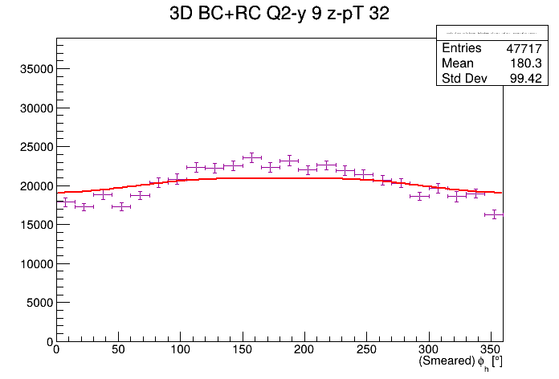
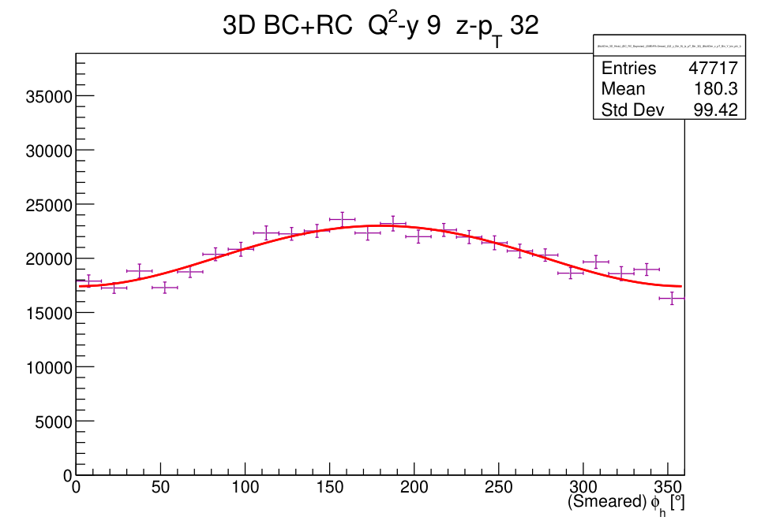
Fit quality after two passes
452
0
1.087
2.18
5
Bins fitted
Failed or empty
Median χ²/NDF
95th percentile
Bins above 3
Bin (9, 32) was the one poor fit. The untagged guide left B = −0.046 and χ²/NDF = 7.09. A tagged ("9", "32", "3D", "BC") guide and a Q²-y 9 remake give B = −0.137, C = −0.005, χ²/NDF = 1.554 (NDF 21). The right-hand figure is that refit. The left-hand figure is the fit before the guide change.
Left: before the (9, 32) guide. Right: final fit.
3D BC+RC acc020

Slide 5
Bins that still sit above χ²/NDF = 3
Q²-y | z-pT | χ²/NDF | χ² | NDF | B | C
1 | 32 | 3.85 | 80.84 | 21 | -0.137 | 0.002
3 | 29 | 3.73 | 70.91 | 19 | -0.167 | 0.007
12 | 24 | 3.73 | 55.87 | 15 | -0.103 | -0.007
10 | 17 | 3.52 | 73.92 | 21 | -0.133 | 0.005
1 | 26 | 3.07 | 64.46 | 21 | -0.165 | 0.039
These five were left in place. (1, 32) and (1, 26) are single high bins at the edge of φ_h. (3, 29), (12, 24), and (10, 17) are elevated but still describe the histogram. No bin has χ²/NDF above 5, and no fit was excluded from the spline.
The pull screen of all 452 histograms did not turn up another bin that needed a new guide.
Unresolved fits. None were dropped from the spline.
3D BC+RC acc020

Slide 6
Comparison sample
Nominal 5D file, left unchanged
Prepare_Next_Iteration/rho0_Subtracted_5D_V2_4D_xB_Fit_Pars_from_5D_BC_RC_Bayesian_Compute_SplineWeight.txt
Generated 29 July 2026. This is the file named by the reweighting and response-matrix defaults.
New 3D file
Prepare_Next_Iteration/acc020_3D_BC_RC_4D_xB_Fit_Pars_from_3D_BC_RC_Bayesian_Compute_SplineWeight.txt
Same C++ signature: ComputeSplineWeight(Q², xB, y, z, pT, φ_h) = A(1 + B cos φ + C cos 2φ), coordinates (xB, y, z, pT).
Matched kinematics
421 shared bin centers. 31 3D bins and 48 5D bins have no partner and are not in the differences. 3D and 5D are two reductions of related data, not independent measurements.
Differences below use the common 421 centers.
3D BC+RC acc020

Slide 7
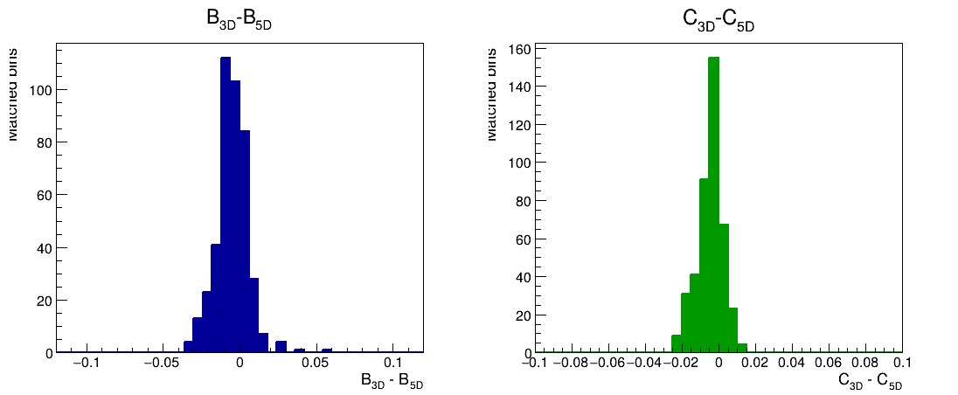
Modulation differences of the weight functions
Evaluated splines at the bin centers. Median |ΔB| = 0.0067 and median |ΔC| = 0.0048.
5D comparison
3D BC+RC acc020

Slide 8
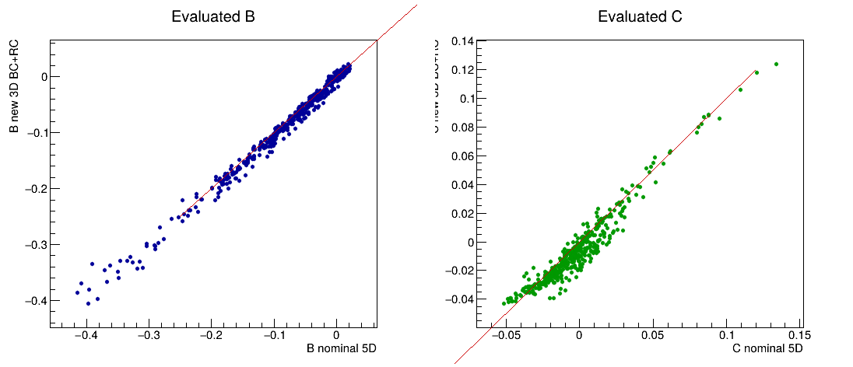
B and C stay on the same line
Each point is one matched bin. The line is equality. Color is not used; the spread is the whole matched sample.
5D comparison
3D BC+RC acc020

Slide 9
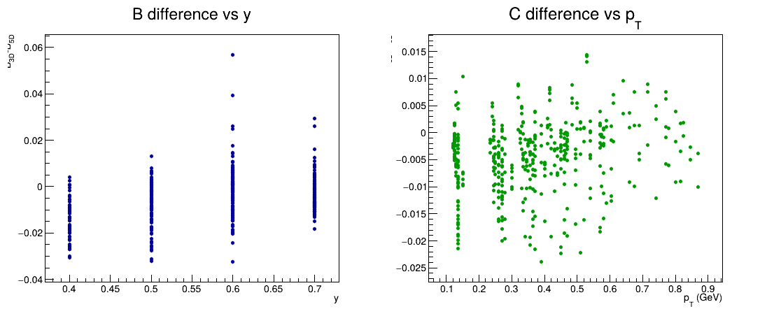
No single y or pT band carries the change
ΔB versus y and ΔC versus pT. The larger B shifts sit at a few high-pT points, not in one y bin.
5D comparison
3D BC+RC acc020

Slide 10
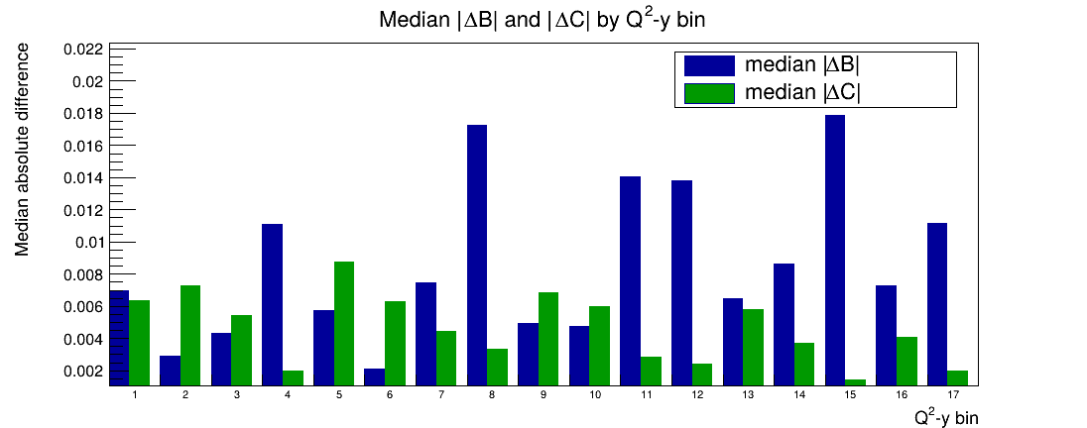
Median |ΔB| and |ΔC| by Q²-y bin
Smoothed weight functions. The larger medians are Q²-y 8, 11, 12, and 15, still below 0.02.
5D comparison
3D BC+RC acc020

Slide 11
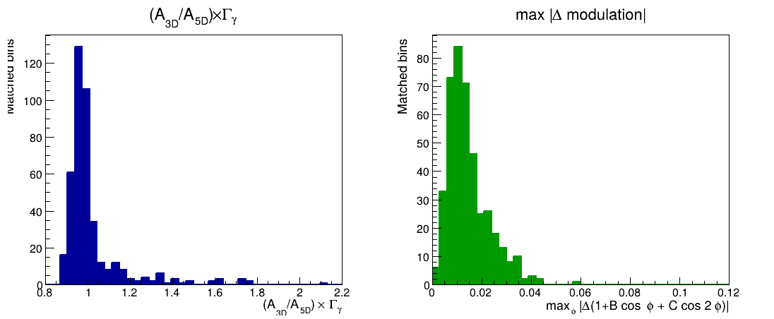
A after removing the photon-flux convention
Left: (A_3D/A_5D)×Γ_γ. Median 0.976. Right: largest |Δ(1+B cos φ+C cos 2φ)| over φ. Median 0.012.
5D comparison
3D BC+RC acc020

Slide 12
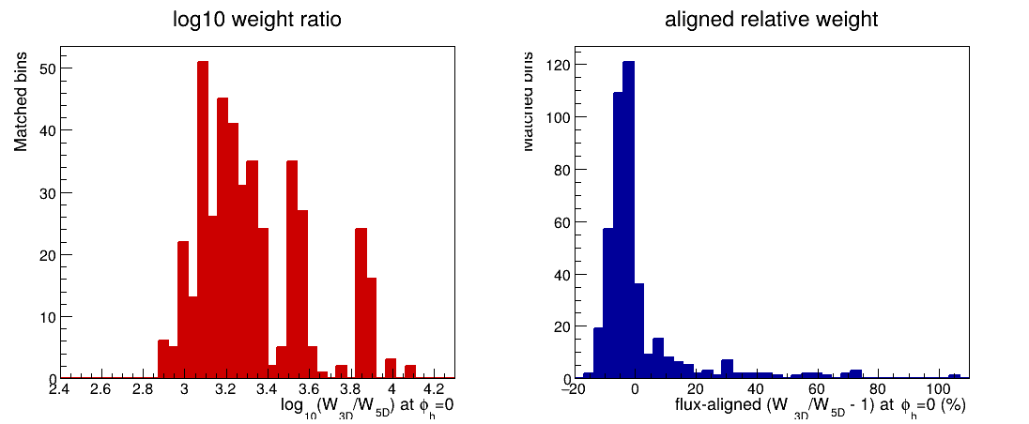
What a drop-in file swap would do to the event weight
Left: log10(W_3D/W_5D) at φ_h = 0. Median ratio 1804. Right: the same ratio after multiplying out Γ_γ, in percent.
5D comparison
3D BC+RC acc020

Slide 13
Largest fit-parameter differences
Training values, before spline smoothing. |ΔB| never exceeds 0.10. |ΔC| never exceeds 0.10.
B
C
Bin | y | z | pT | 3D | 5D | Δ
2, 6 | 0.60 | 0.63 | 0.80 | -0.319 | -0.407 | 0.088
10, 2 | 0.60 | 0.61 | 0.26 | -0.039 | -0.114 | 0.075
3, 24 | 0.50 | 0.30 | 0.68 | -0.162 | -0.236 | 0.074
8, 20 | 0.40 | 0.41 | 0.53 | -0.210 | -0.137 | -0.073
1, 1 | 0.70 | 0.56 | 0.14 | 0.021 | -0.040 | 0.061
Bin | y | z | pT | 3D | 5D | Δ
3, 24 | 0.50 | 0.30 | 0.68 | 0.014 | 0.082 | -0.068
9, 9 | 0.70 | 0.36 | 0.26 | -0.077 | -0.019 | -0.058
14, 15 | 0.60 | 0.35 | 0.35 | 0.019 | -0.033 | 0.051
1, 22 | 0.70 | 0.21 | 0.14 | -0.013 | 0.033 | -0.046
9, 2 | 0.70 | 0.56 | 0.26 | -0.033 | 0.008 | -0.041
Parameter |ΔB|: median 0.012, 95th percentile 0.039, maximum 0.088. 3.1% of matched bins exceed 0.05. Parameter |ΔC|: median 0.008, 95th percentile 0.033, maximum 0.068. The biggest B shifts are high-z or high-pT edges, especially (2, 6). They are spread across Q²-y rather than confined to one region.
Fit parameters. The smoothed weight functions move less than these training values.
3D BC+RC acc020

Slide 14
What the change means for the next iteration
The φ modulation is close.
Across 421 shared bins, B and C differ by about 0.01. The change is broad. Q²-y 8, 11, 12, and 15 move a little more. A few high-pT edges move by 0.05–0.09 in B.
The absolute weight is not a drop-in.
The new A is divided by Γ_γ. The July A is not. At φ_h = 0 the new weight is larger by a median factor 1804, and that factor changes with Q² and y (95th percentile 7451). Γ_γ itself is about 5×10⁻⁴.
Once that factor is removed, the remaining weight change is a few percent in the middle of the distribution and a few tens of percent in the tail. The July file also uses the pre-11 August 2026 target density, a flat 2.0% luminosity difference (0.07151 / 0.0701).
Practical step
Keep the Monte Carlo and response-matrix defaults on the July 5D file until a 3D weight is built with the same A convention, or the consumer is taught to expect the flux division. The new file is the right cross-section spline. It is not the right drop-in event weight.
Defaults were not switched. Production was not run.
3D BC+RC acc020

Slide 15
Where the products are
ROOT and JSON, updated in place
Unfolded_Simple_3D_Final_Thesis_Bank_
rho0_new_acc020_Zeroth_Order_Full.root
Fit_Pars_from_Simple_RooUnfold_SelfContained_using_
Unfolded_Simple_3D_Final_Thesis_Bank_
rho0_new_acc020_Zeroth_Order_Full.json
Spline, new names
Prepare_Next_Iteration/acc020_3D_BC_RC_4D_xB_Fit_Pars_from_3D_BC_RC_Bayesian_Compute_SplineWeight.txt
Matching Fit_Par_A/B/C .npz and .pkl files sit beside it. 452 training points. No failed fits removed.
Figures
phi_h_pdf/Q2y01 through Q2y17, 452 pages. Comparison tables and plots are in comparison/.
The slides after this one are those 452 fits, grouped by Q²-y.
Full-resolution PDFs remain in phi_h_pdf/.
3D BC+RC acc020

Slide 16
Q²-y bin 1
29 z-pT bins · native BC+RC histogram and fit

Slide 17
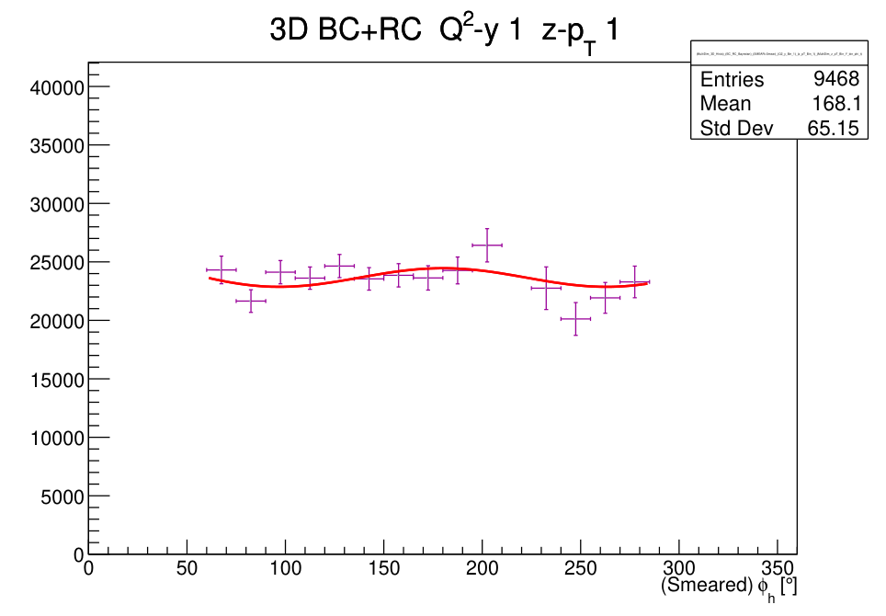
Q²-y 1 z-pT 1
Unnormalized

Slide 18
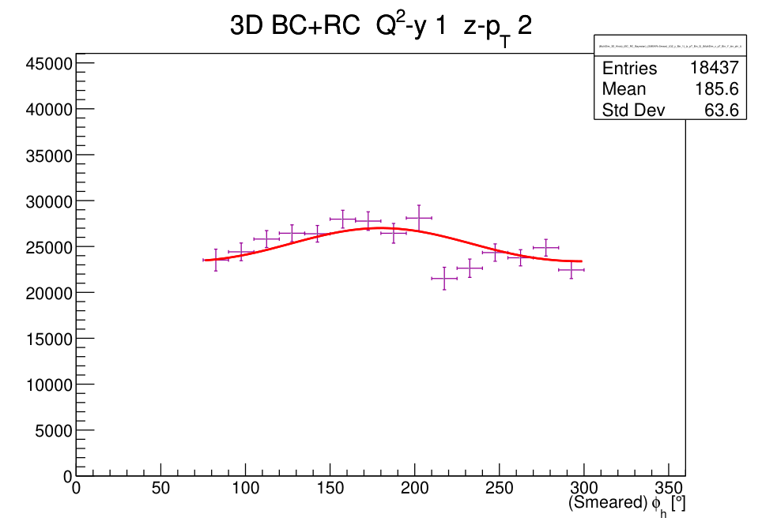
Q²-y 1 z-pT 2
Unnormalized

Slide 19
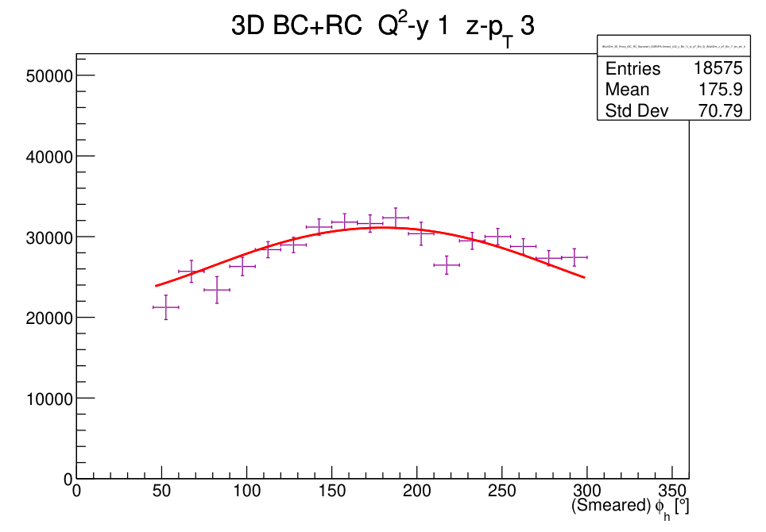
Q²-y 1 z-pT 3
Unnormalized

Slide 20
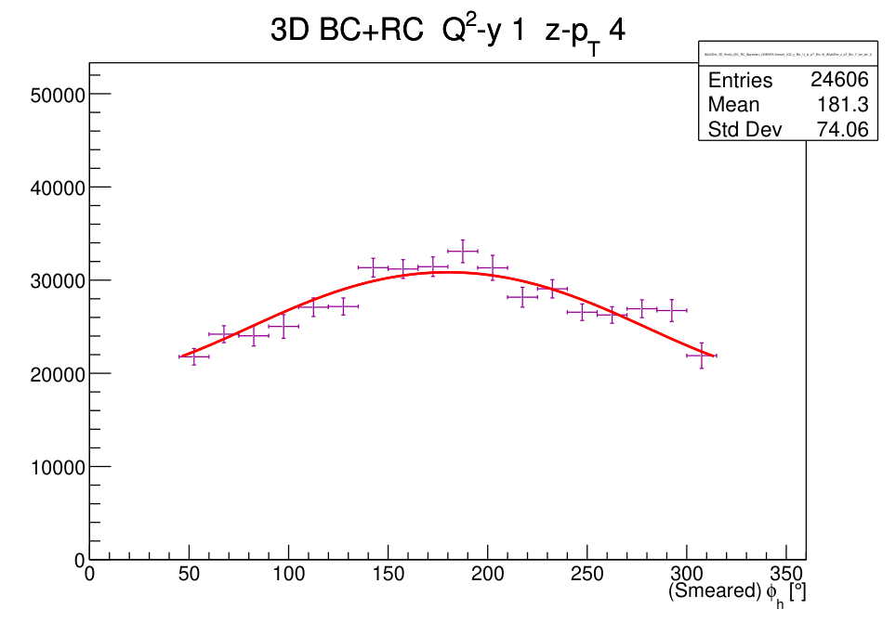
Q²-y 1 z-pT 4
Unnormalized

Slide 21
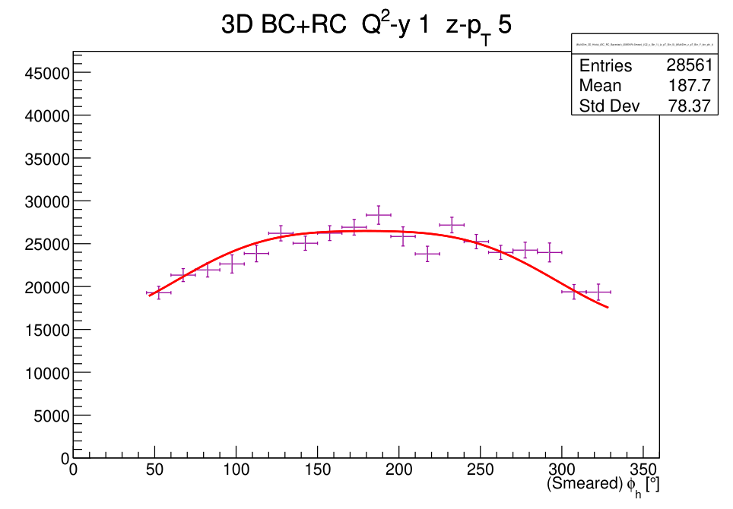
Q²-y 1 z-pT 5
Unnormalized

Slide 22
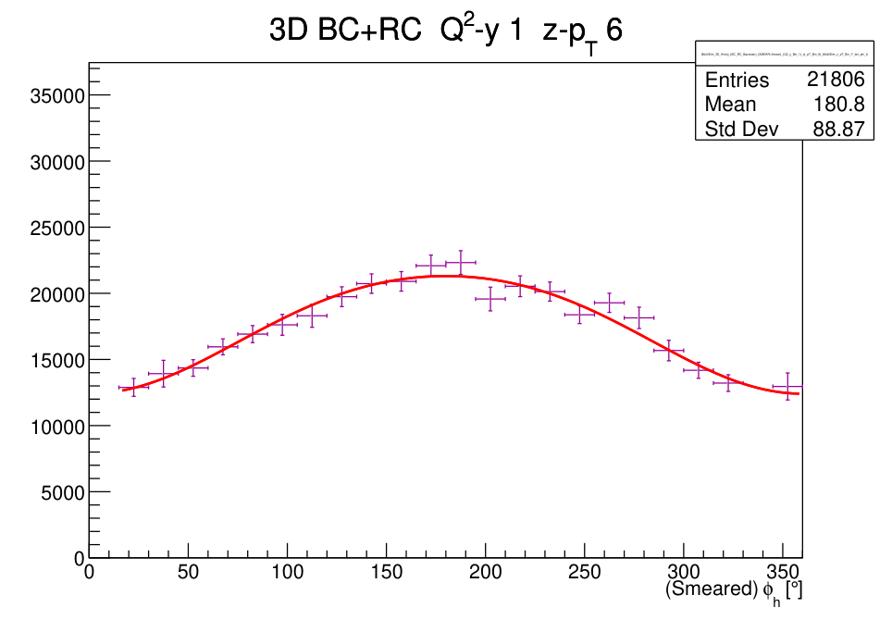
Q²-y 1 z-pT 6
Unnormalized

Slide 23
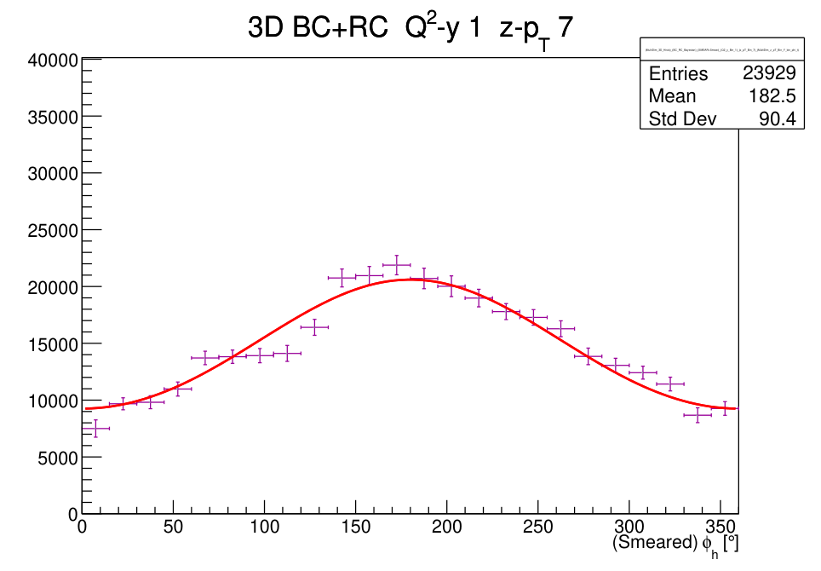
Q²-y 1 z-pT 7
Unnormalized

Slide 24
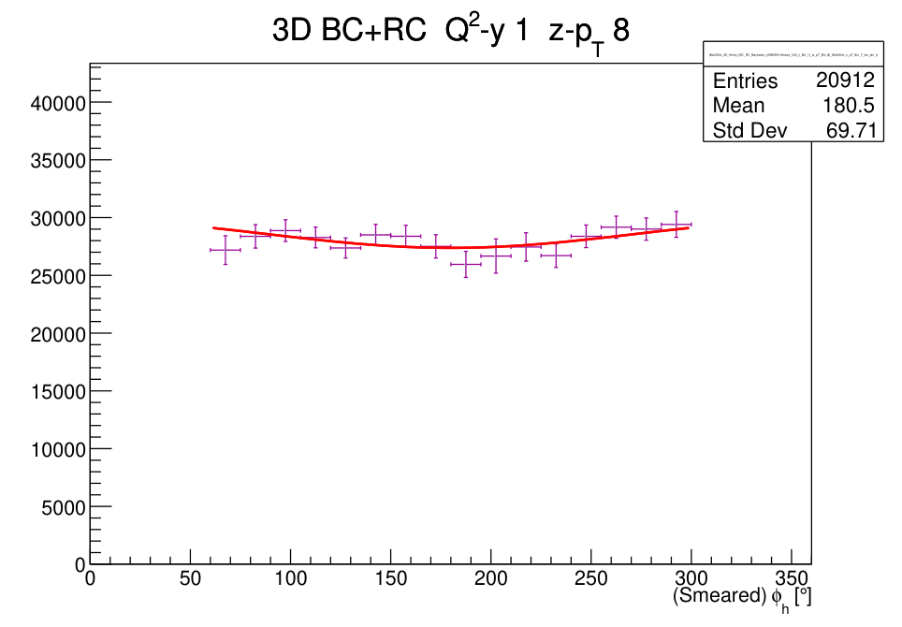
Q²-y 1 z-pT 8
Unnormalized

Slide 25
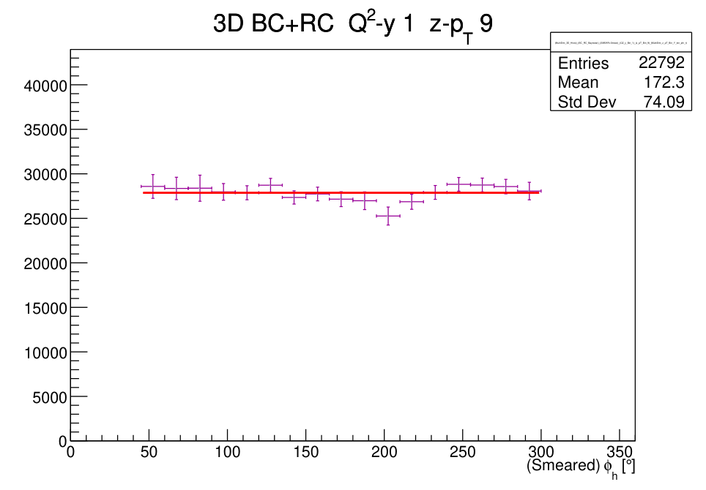
Q²-y 1 z-pT 9
Unnormalized

Slide 26
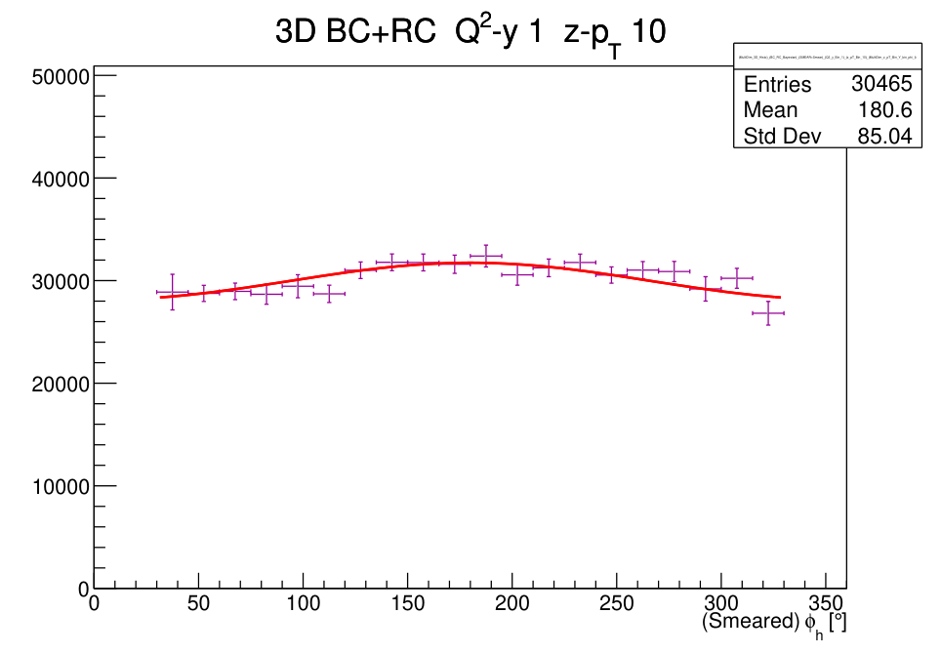
Q²-y 1 z-pT 10
Unnormalized

Slide 27
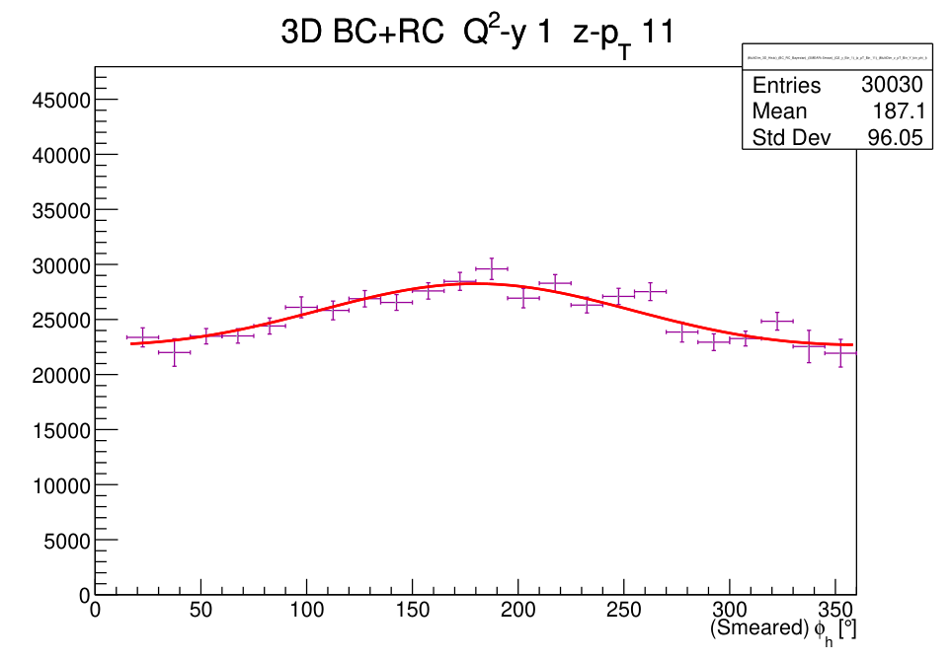
Q²-y 1 z-pT 11
Unnormalized

Slide 28
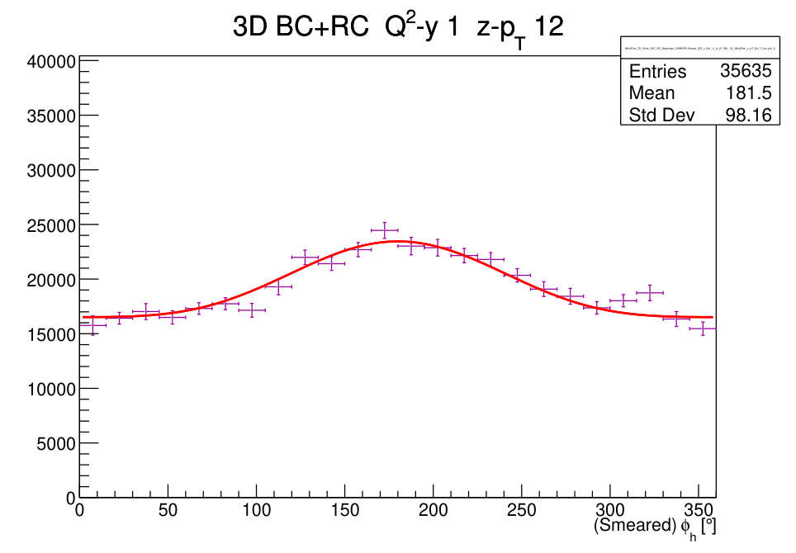
Q²-y 1 z-pT 12
Unnormalized

Slide 29
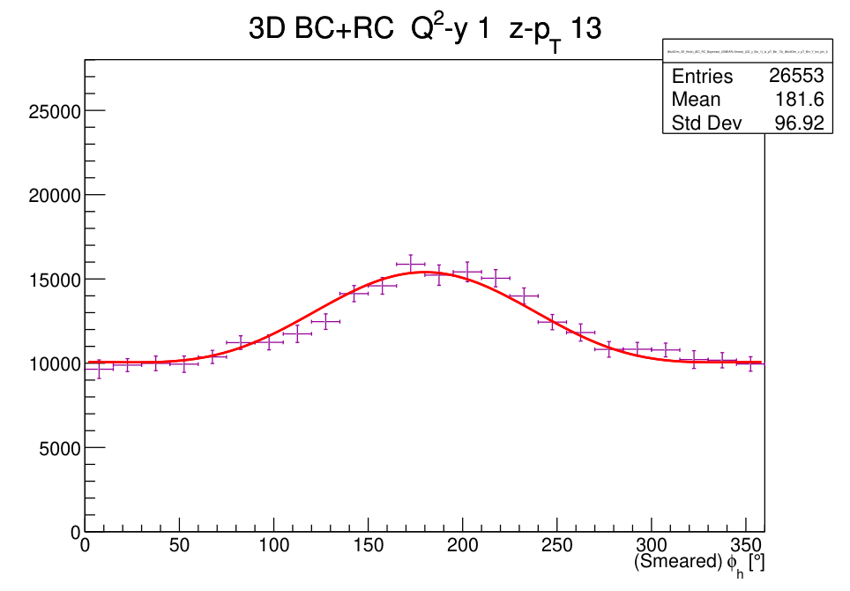
Q²-y 1 z-pT 13
Unnormalized

Slide 30
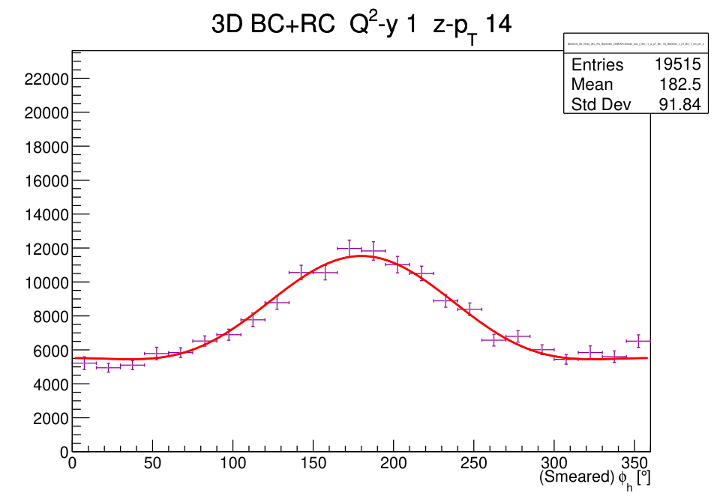
Q²-y 1 z-pT 14
Unnormalized

Slide 31
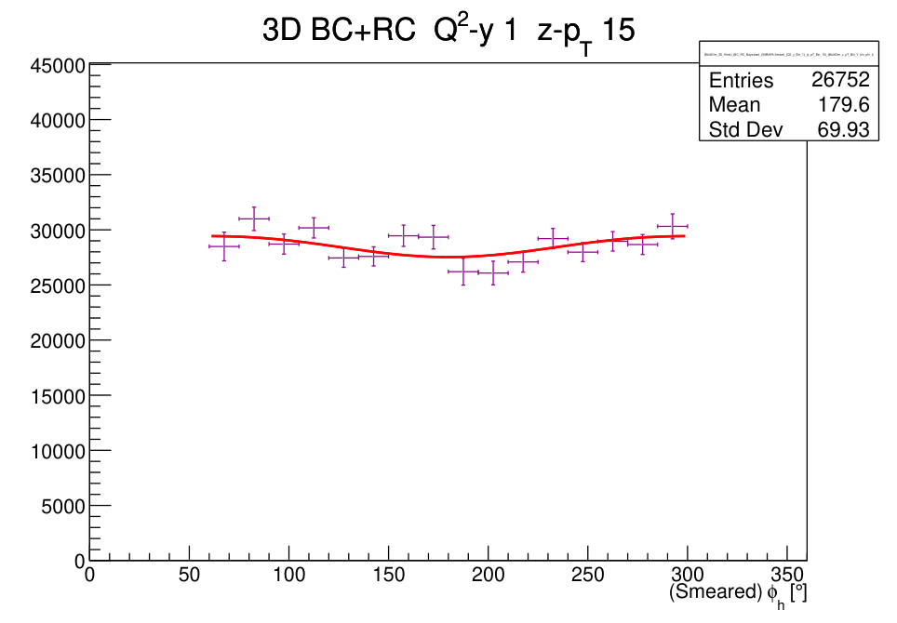
Q²-y 1 z-pT 15
Unnormalized

Slide 32
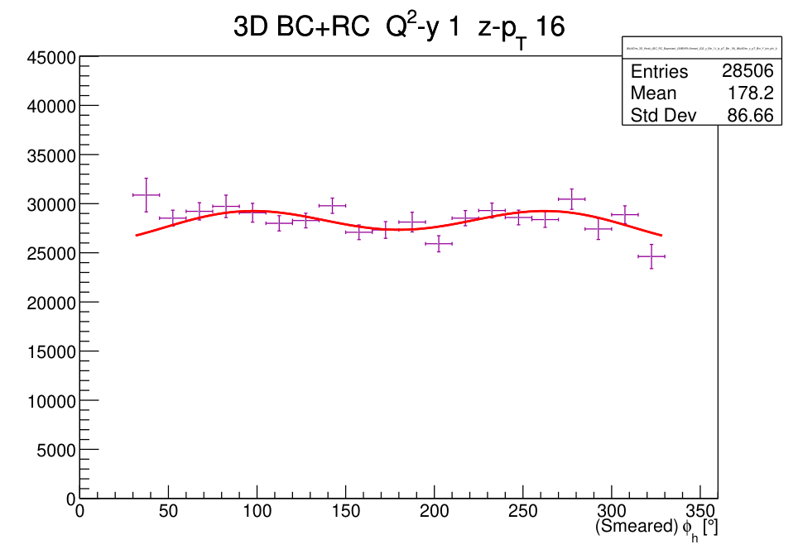
Q²-y 1 z-pT 16
Unnormalized

Slide 33
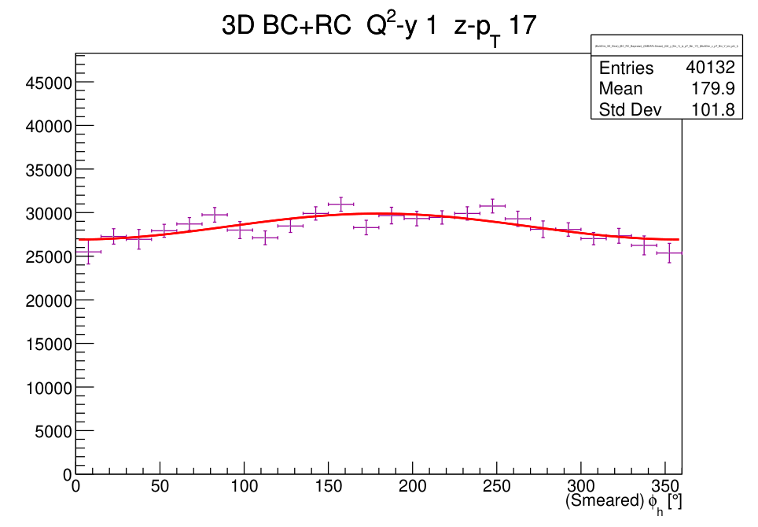
Q²-y 1 z-pT 17
Unnormalized

Slide 34
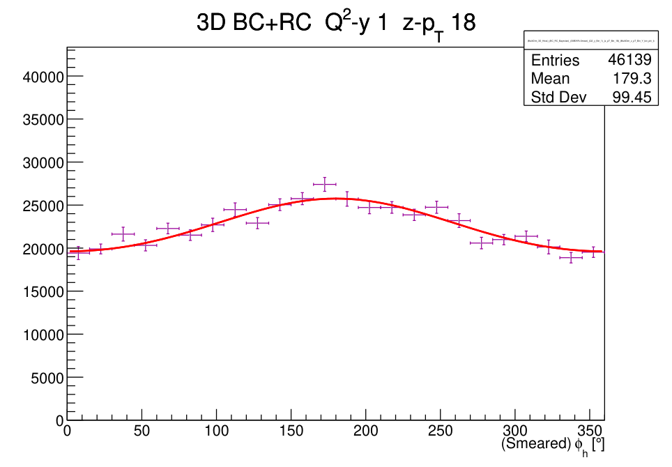
Q²-y 1 z-pT 18
Unnormalized

Slide 35
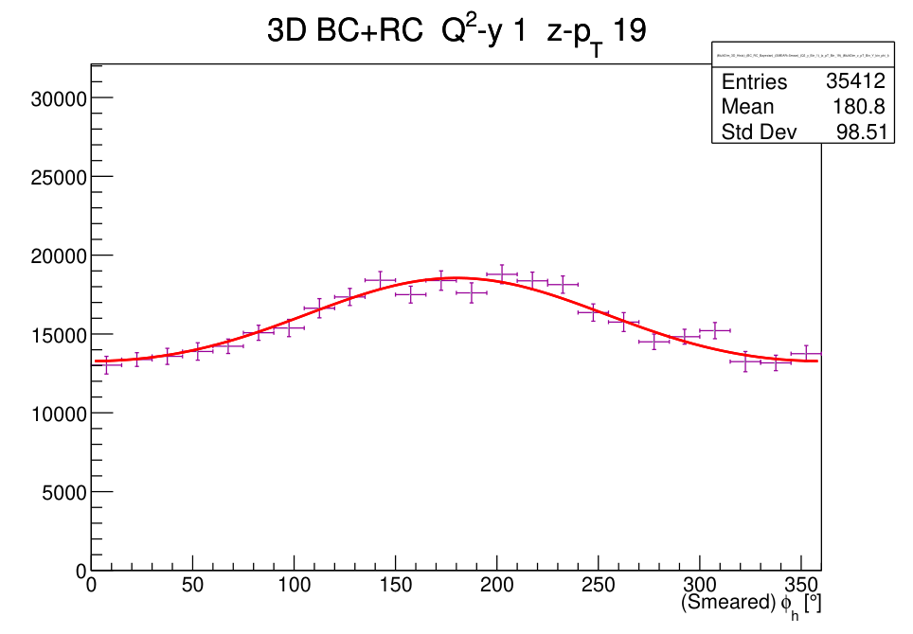
Q²-y 1 z-pT 19
Unnormalized

Slide 36
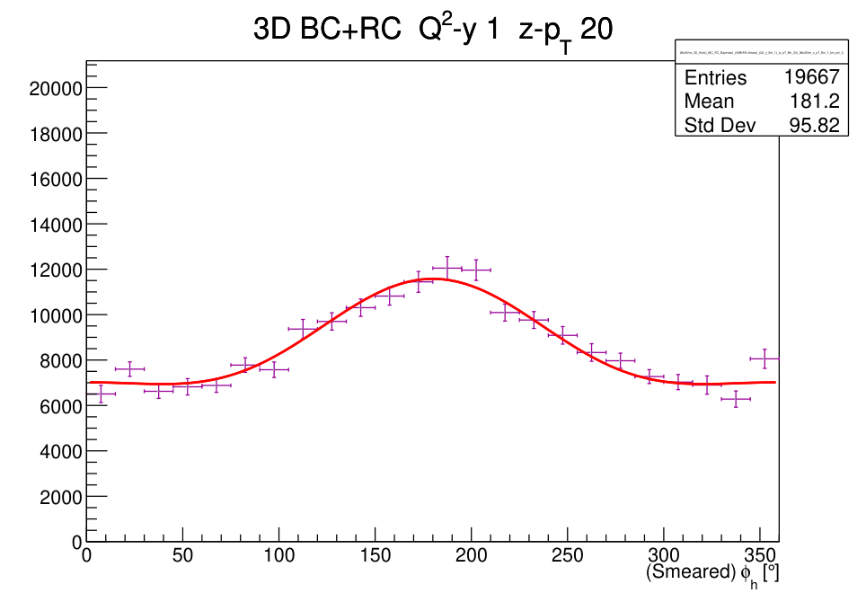
Q²-y 1 z-pT 20
Unnormalized

Slide 37
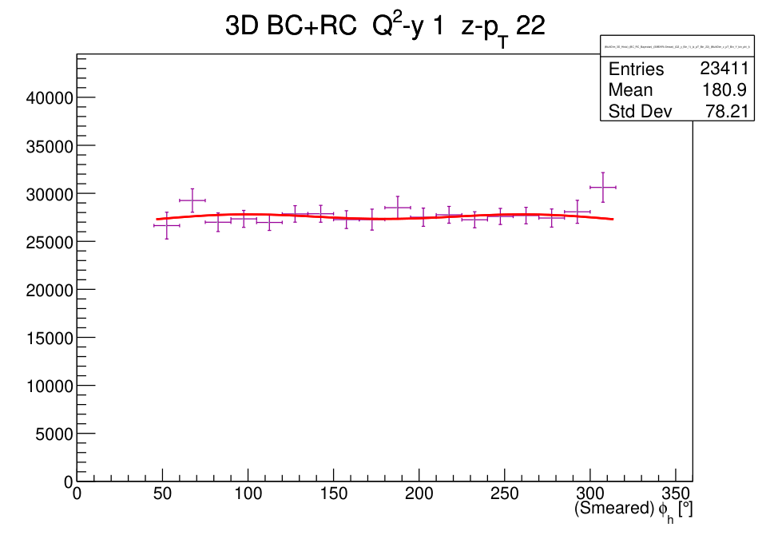
Q²-y 1 z-pT 22
Unnormalized

Slide 38
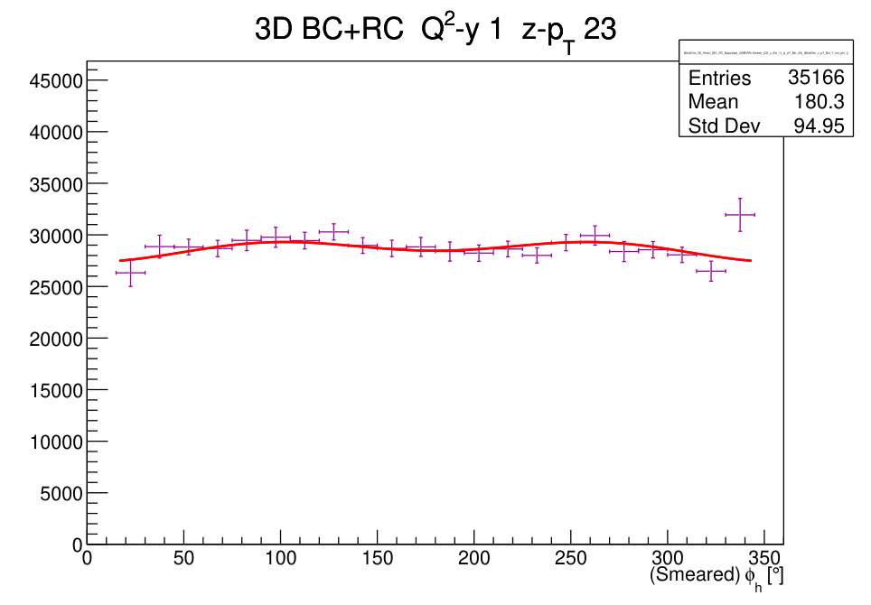
Q²-y 1 z-pT 23
Unnormalized

Slide 39
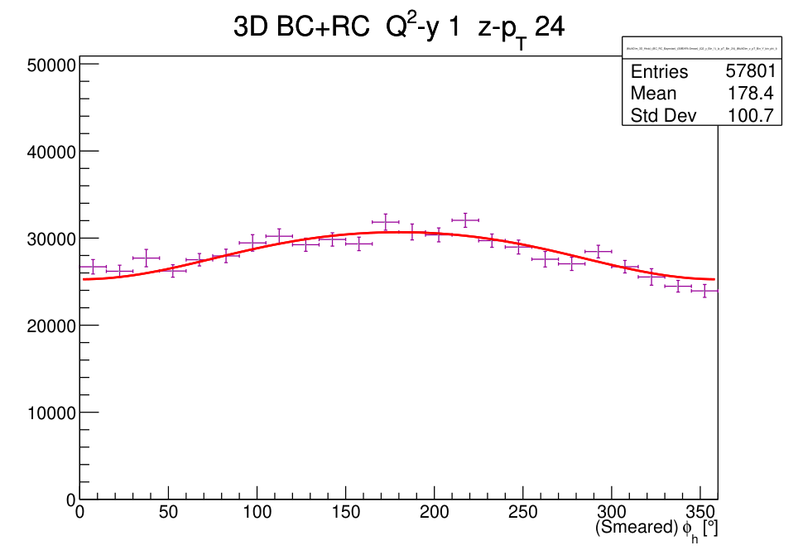
Q²-y 1 z-pT 24
Unnormalized

Slide 40
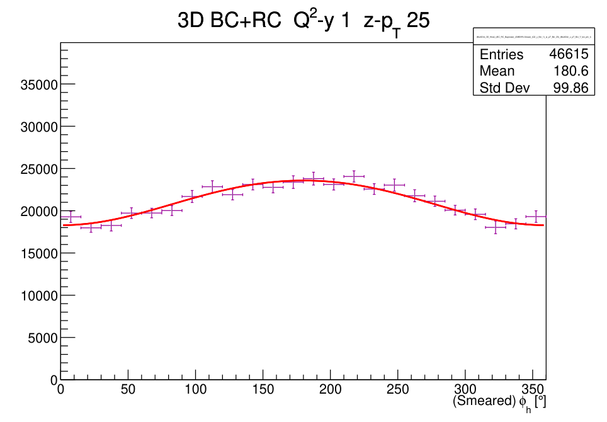
Q²-y 1 z-pT 25
Unnormalized

Slide 41
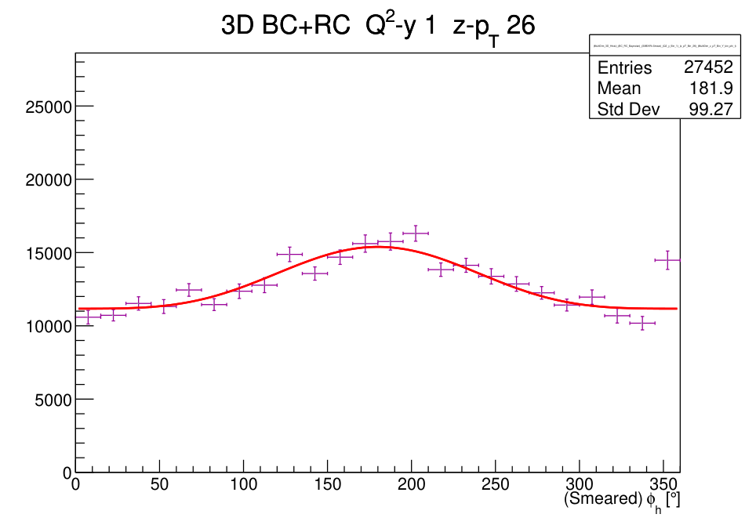
Q²-y 1 z-pT 26
Unnormalized

Slide 42
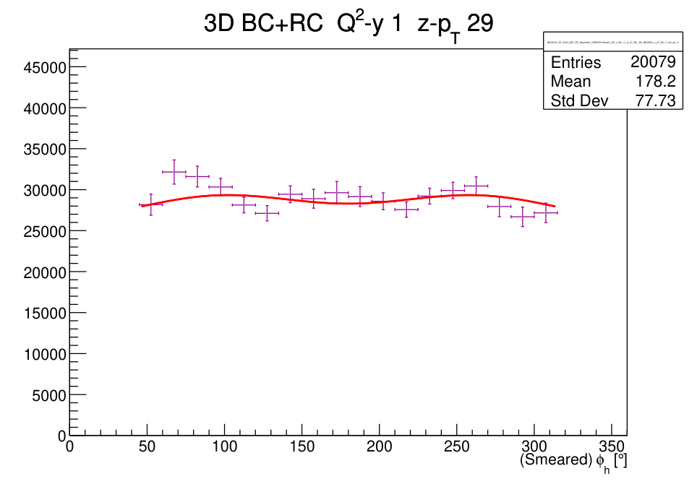
Q²-y 1 z-pT 29
Unnormalized

Slide 43
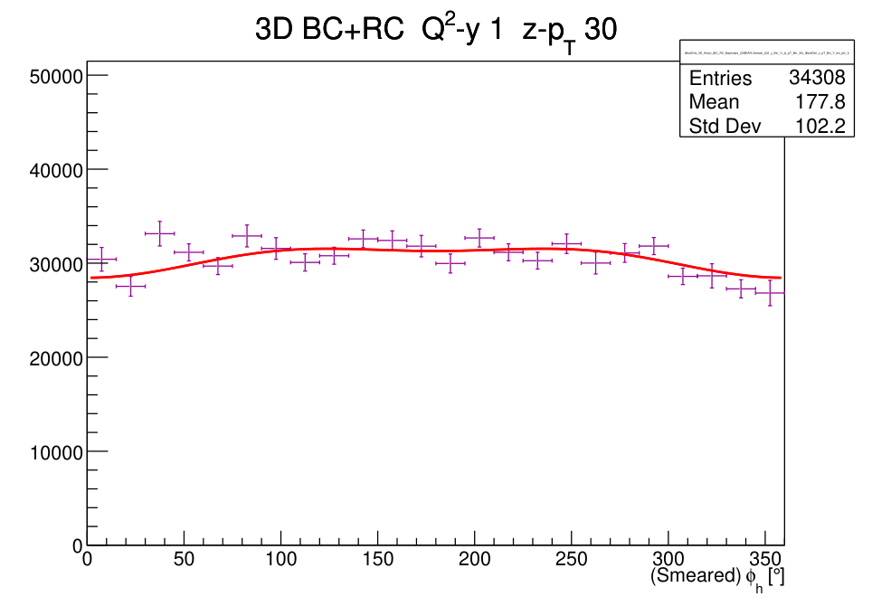
Q²-y 1 z-pT 30
Unnormalized

Slide 44
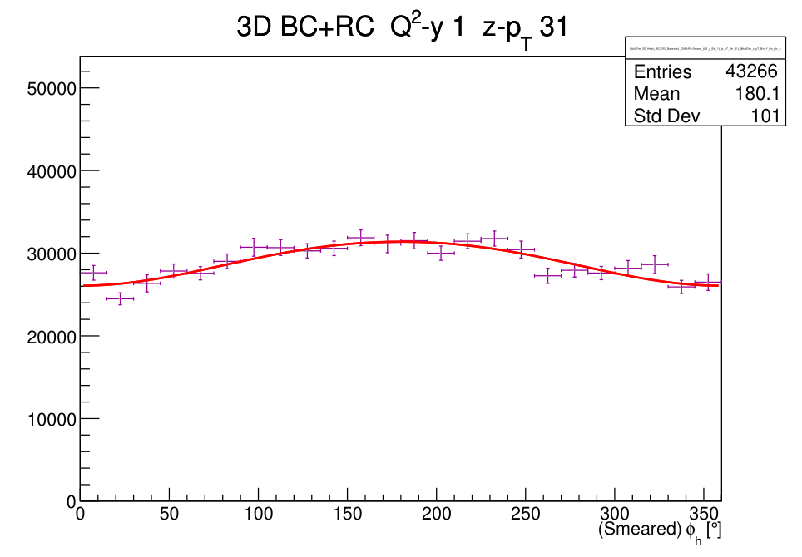
Q²-y 1 z-pT 31
Unnormalized

Slide 45
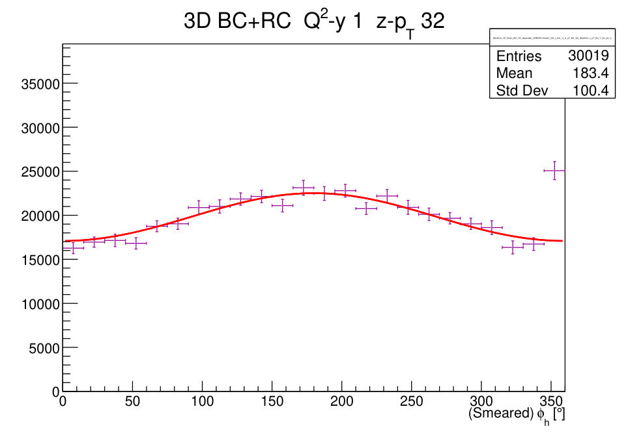
Q²-y 1 z-pT 32
Unnormalized

Slide 46
Q²-y bin 2
32 z-pT bins · native BC+RC histogram and fit

Slide 47
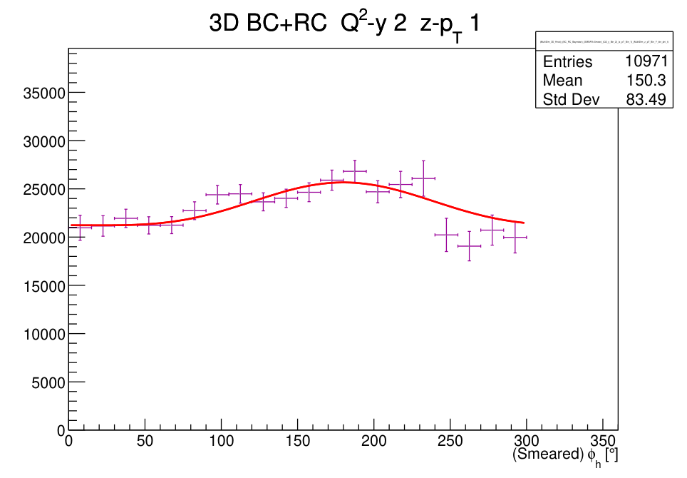
Q²-y 2 z-pT 1
Unnormalized

Slide 48
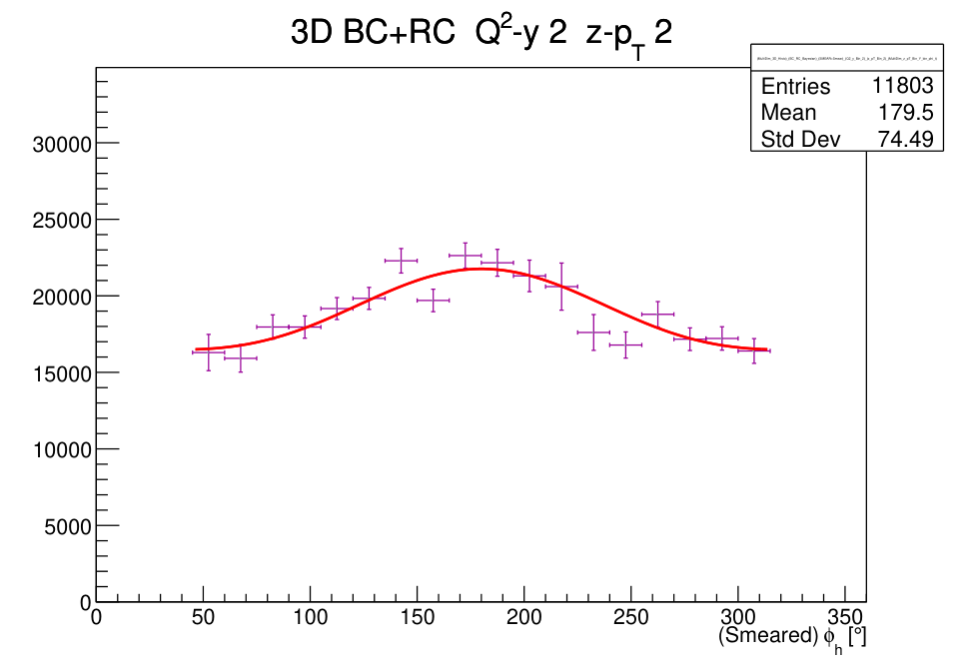
Q²-y 2 z-pT 2
Unnormalized

Slide 49
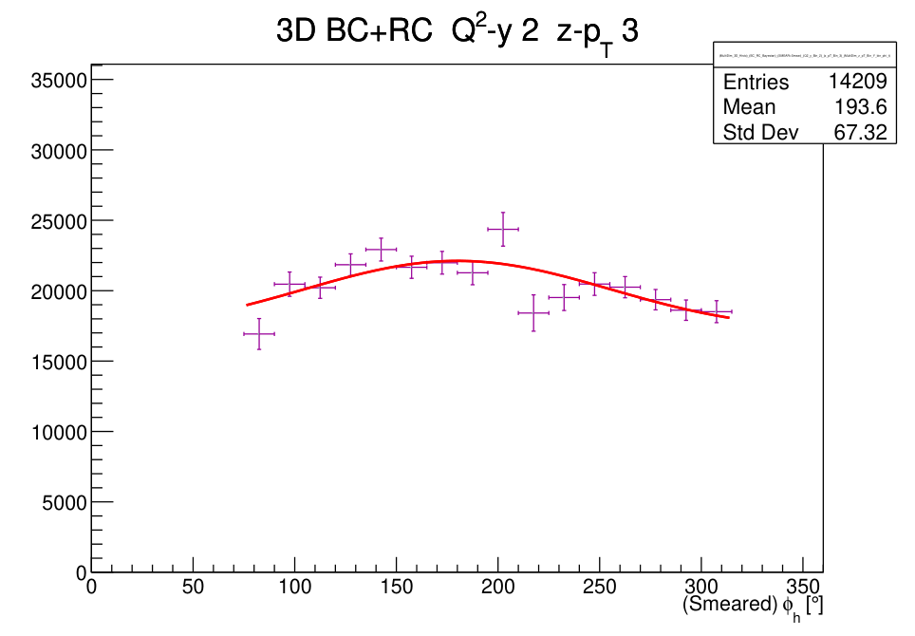
Q²-y 2 z-pT 3
Unnormalized

Slide 50
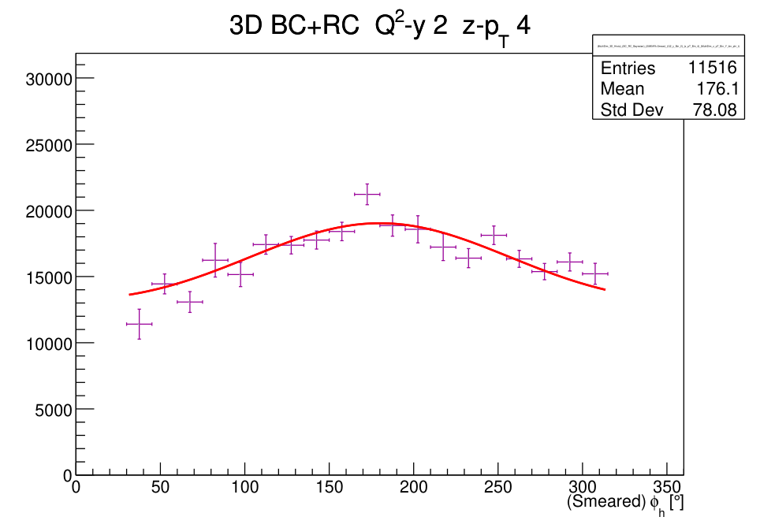
Q²-y 2 z-pT 4
Unnormalized

Slide 51
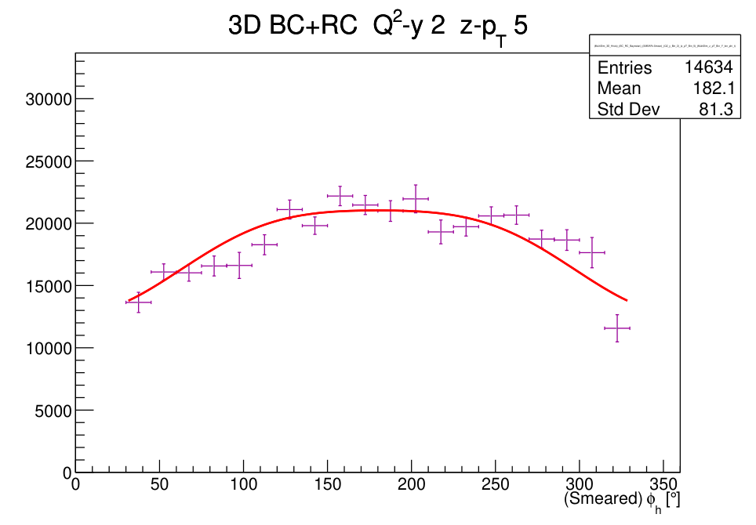
Q²-y 2 z-pT 5
Unnormalized

Slide 52
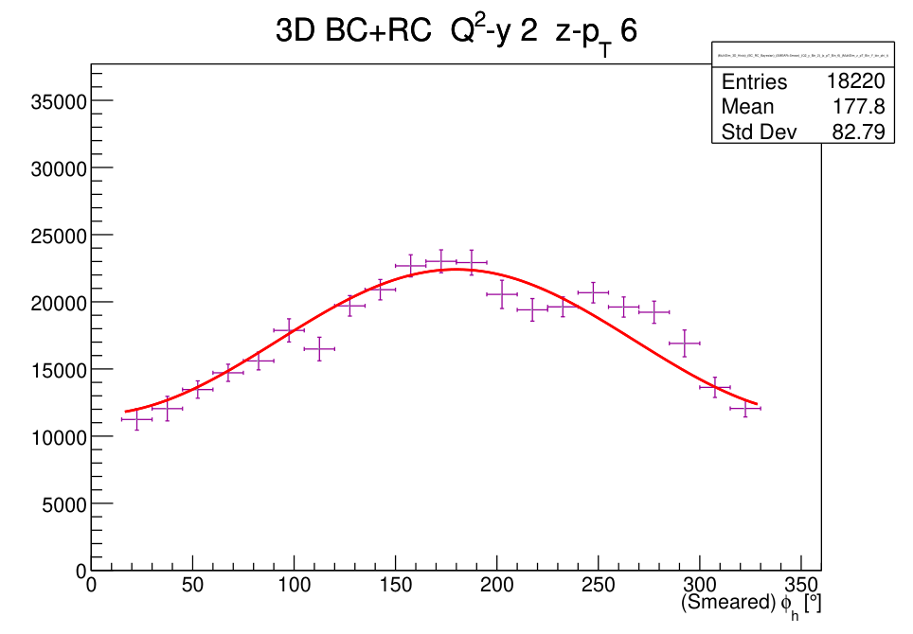
Q²-y 2 z-pT 6
Unnormalized

Slide 53
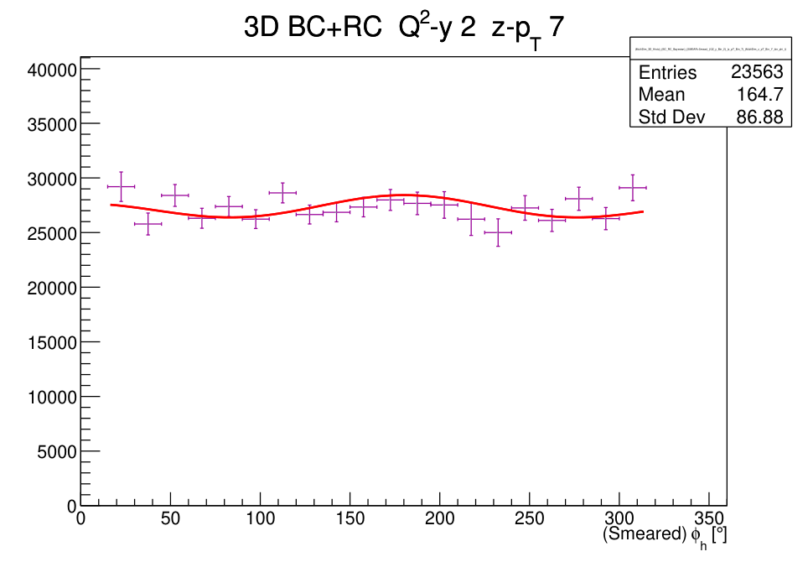
Q²-y 2 z-pT 7
Unnormalized

Slide 54
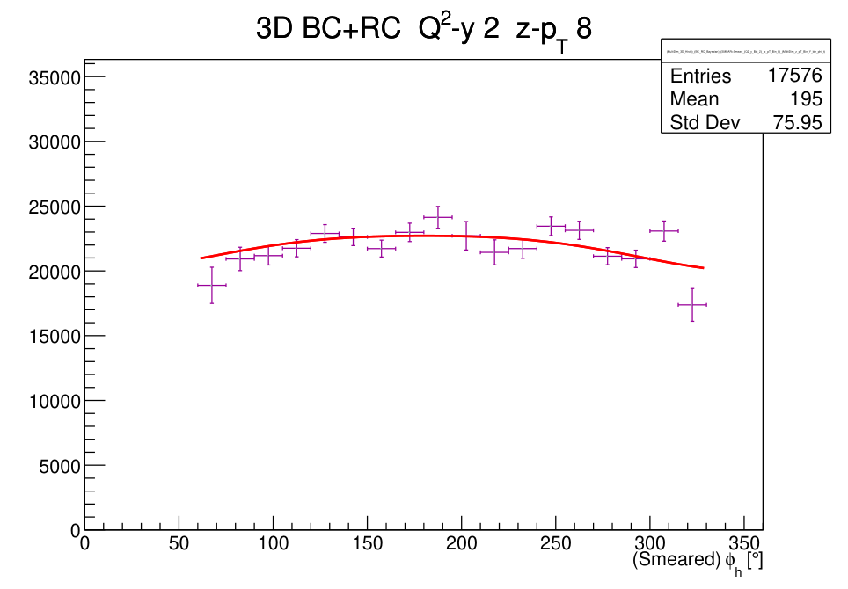
Q²-y 2 z-pT 8
Unnormalized

Slide 55
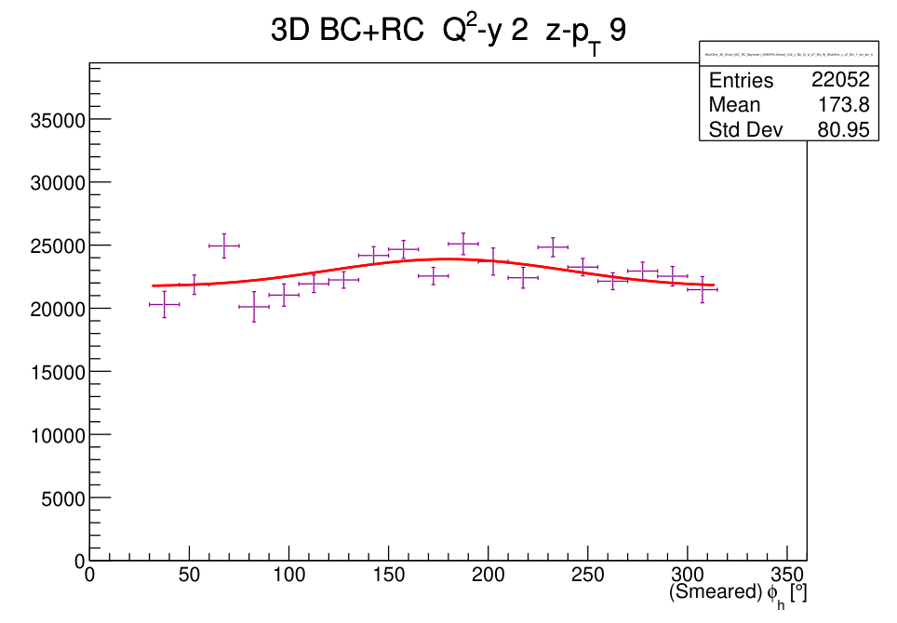
Q²-y 2 z-pT 9
Unnormalized

Slide 56
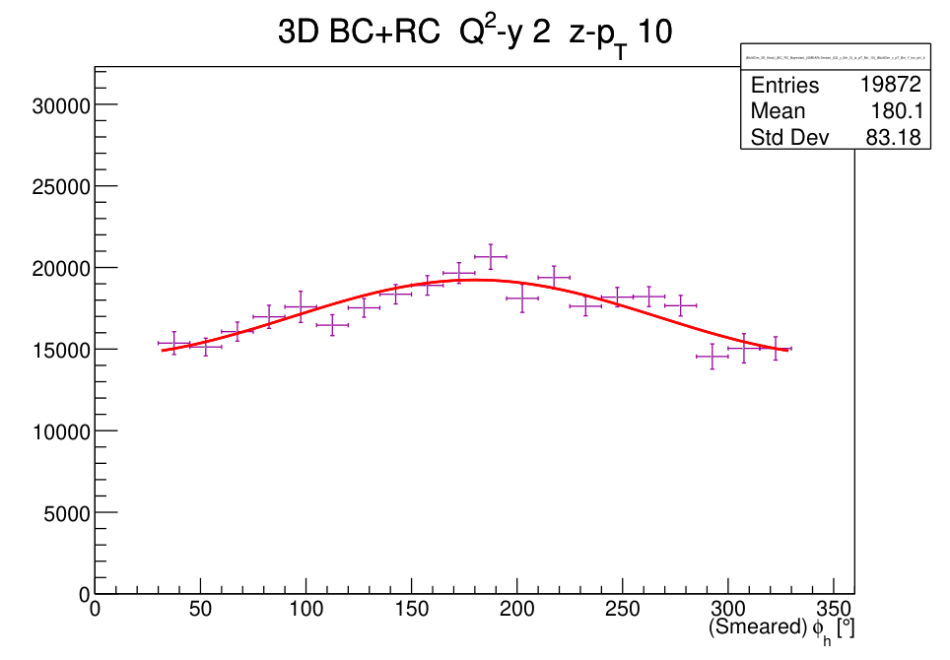
Q²-y 2 z-pT 10
Unnormalized

Slide 57
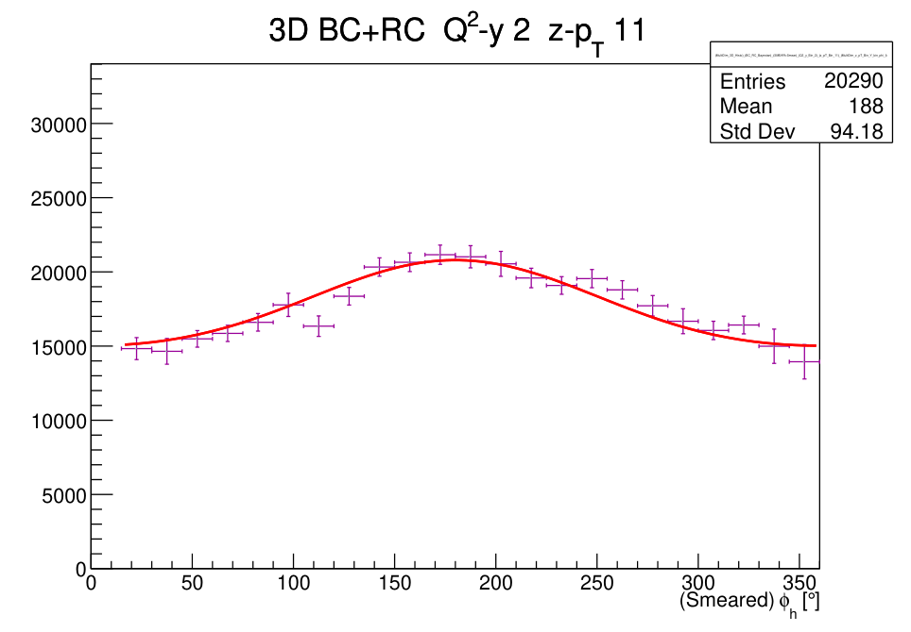
Q²-y 2 z-pT 11
Unnormalized

Slide 58
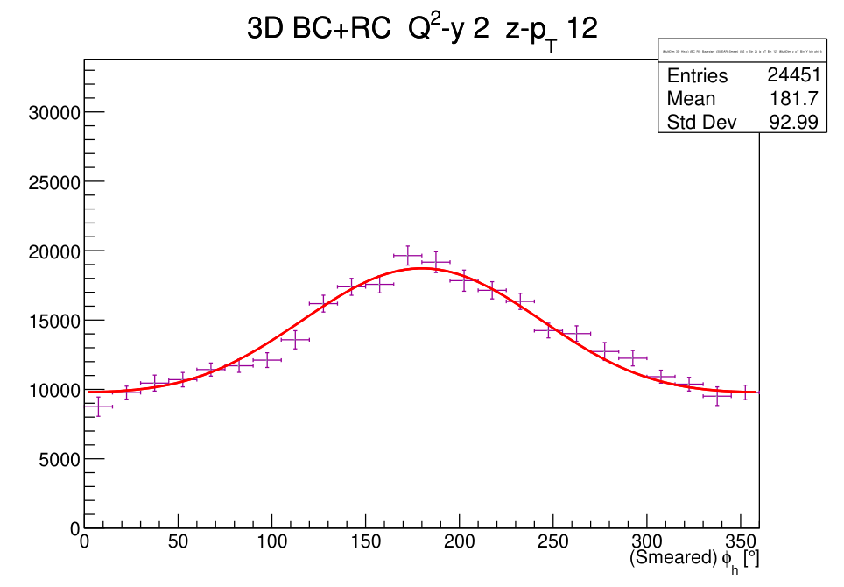
Q²-y 2 z-pT 12
Unnormalized

Slide 59
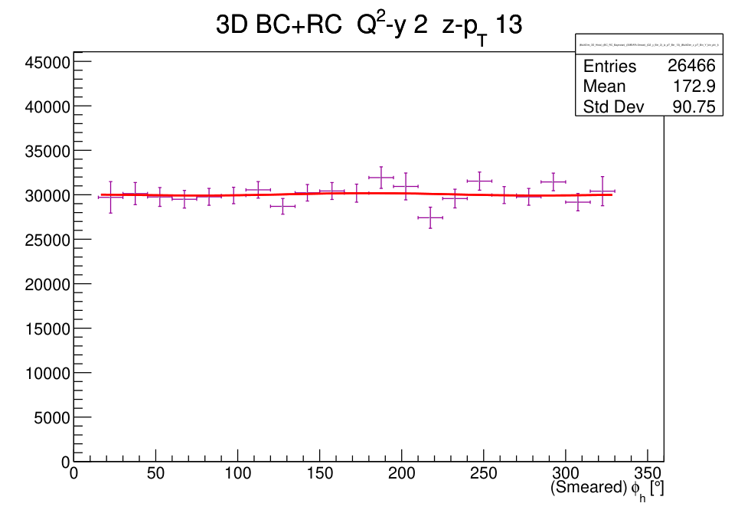
Q²-y 2 z-pT 13
Unnormalized

Slide 60

Q²-y 2 z-pT 14
Unnormalized

Slide 61

Q²-y 2 z-pT 15
Unnormalized

Slide 62

Q²-y 2 z-pT 16
Unnormalized

Slide 63

Q²-y 2 z-pT 17
Unnormalized

Slide 64

Q²-y 2 z-pT 18
Unnormalized

Slide 65

Q²-y 2 z-pT 19
Unnormalized

Slide 66

Q²-y 2 z-pT 20
Unnormalized

Slide 67

Q²-y 2 z-pT 21
Unnormalized

Slide 68

Q²-y 2 z-pT 22
Unnormalized

Slide 69

Q²-y 2 z-pT 23
Unnormalized

Slide 70

Q²-y 2 z-pT 25
Unnormalized

Slide 71

Q²-y 2 z-pT 26
Unnormalized

Slide 72

Q²-y 2 z-pT 27
Unnormalized

Slide 73

Q²-y 2 z-pT 28
Unnormalized

Slide 74

Q²-y 2 z-pT 29
Unnormalized

Slide 75

Q²-y 2 z-pT 31
Unnormalized

Slide 76

Q²-y 2 z-pT 32
Unnormalized

Slide 77

Q²-y 2 z-pT 33
Unnormalized

Slide 78

Q²-y 2 z-pT 34
Unnormalized

Slide 79
Q²-y bin 3
28 z-pT bins · native BC+RC histogram and fit

Slide 80

Q²-y 3 z-pT 1
Unnormalized

Slide 81

Q²-y 3 z-pT 2
Unnormalized

Slide 82

Q²-y 3 z-pT 3
Unnormalized

Slide 83

Q²-y 3 z-pT 4
Unnormalized

Slide 84

Q²-y 3 z-pT 5
Unnormalized

Slide 85

Q²-y 3 z-pT 7
Unnormalized

Slide 86

Q²-y 3 z-pT 8
Unnormalized

Slide 87

Q²-y 3 z-pT 9
Unnormalized

Slide 88

Q²-y 3 z-pT 10
Unnormalized

Slide 89

Q²-y 3 z-pT 11
Unnormalized

Slide 90

Q²-y 3 z-pT 12
Unnormalized

Slide 91

Q²-y 3 z-pT 13
Unnormalized

Slide 92

Q²-y 3 z-pT 14
Unnormalized

Slide 93

Q²-y 3 z-pT 15
Unnormalized

Slide 94

Q²-y 3 z-pT 16
Unnormalized

Slide 95

Q²-y 3 z-pT 17
Unnormalized

Slide 96

Q²-y 3 z-pT 18
Unnormalized

Slide 97

Q²-y 3 z-pT 19
Unnormalized

Slide 98

Q²-y 3 z-pT 20
Unnormalized

Slide 99

Q²-y 3 z-pT 21
Unnormalized

Slide 100

Q²-y 3 z-pT 22
Unnormalized

Slide 101

Q²-y 3 z-pT 23
Unnormalized

Slide 102

Q²-y 3 z-pT 24
Unnormalized

Slide 103

Q²-y 3 z-pT 25
Unnormalized

Slide 104

Q²-y 3 z-pT 26
Unnormalized

Slide 105

Q²-y 3 z-pT 27
Unnormalized

Slide 106

Q²-y 3 z-pT 28
Unnormalized

Slide 107

Q²-y 3 z-pT 29
Unnormalized

Slide 108
Q²-y bin 4
23 z-pT bins · native BC+RC histogram and fit

Slide 109

Q²-y 4 z-pT 7
Unnormalized

Slide 110

Q²-y 4 z-pT 8
Unnormalized

Slide 111

Q²-y 4 z-pT 9
Unnormalized

Slide 112

Q²-y 4 z-pT 10
Unnormalized

Slide 113

Q²-y 4 z-pT 13
Unnormalized

Slide 114

Q²-y 4 z-pT 14
Unnormalized

Slide 115

Q²-y 4 z-pT 15
Unnormalized

Slide 116

Q²-y 4 z-pT 16
Unnormalized

Slide 117

Q²-y 4 z-pT 17
Unnormalized

Slide 118

Q²-y 4 z-pT 19
Unnormalized

Slide 119

Q²-y 4 z-pT 20
Unnormalized

Slide 120

Q²-y 4 z-pT 21
Unnormalized

Slide 121

Q²-y 4 z-pT 22
Unnormalized

Slide 122

Q²-y 4 z-pT 23
Unnormalized

Slide 123

Q²-y 4 z-pT 25
Unnormalized

Slide 124

Q²-y 4 z-pT 26
Unnormalized

Slide 125

Q²-y 4 z-pT 27
Unnormalized

Slide 126

Q²-y 4 z-pT 28
Unnormalized

Slide 127

Q²-y 4 z-pT 29
Unnormalized

Slide 128

Q²-y 4 z-pT 31
Unnormalized

Slide 129

Q²-y 4 z-pT 32
Unnormalized

Slide 130

Q²-y 4 z-pT 33
Unnormalized

Slide 131

Q²-y 4 z-pT 34
Unnormalized

Slide 132
Q²-y bin 5
32 z-pT bins · native BC+RC histogram and fit

Slide 133

Q²-y 5 z-pT 1
Unnormalized

Slide 134

Q²-y 5 z-pT 2
Unnormalized

Slide 135

Q²-y 5 z-pT 3
Unnormalized

Slide 136

Q²-y 5 z-pT 4
Unnormalized

Slide 137

Q²-y 5 z-pT 5
Unnormalized

Slide 138

Q²-y 5 z-pT 6
Unnormalized

Slide 139

Q²-y 5 z-pT 7
Unnormalized

Slide 140

Q²-y 5 z-pT 8
Unnormalized

Slide 141

Q²-y 5 z-pT 9
Unnormalized

Slide 142

Q²-y 5 z-pT 10
Unnormalized

Slide 143

Q²-y 5 z-pT 11
Unnormalized

Slide 144

Q²-y 5 z-pT 12
Unnormalized

Slide 145

Q²-y 5 z-pT 13
Unnormalized

Slide 146

Q²-y 5 z-pT 14
Unnormalized

Slide 147

Q²-y 5 z-pT 15
Unnormalized

Slide 148

Q²-y 5 z-pT 16
Unnormalized

Slide 149

Q²-y 5 z-pT 17
Unnormalized

Slide 150

Q²-y 5 z-pT 18
Unnormalized

Slide 151

Q²-y 5 z-pT 19
Unnormalized

Slide 152

Q²-y 5 z-pT 20
Unnormalized

Slide 153

Q²-y 5 z-pT 21
Unnormalized

Slide 154

Q²-y 5 z-pT 22
Unnormalized

Slide 155

Q²-y 5 z-pT 23
Unnormalized

Slide 156

Q²-y 5 z-pT 25
Unnormalized

Slide 157

Q²-y 5 z-pT 26
Unnormalized

Slide 158

Q²-y 5 z-pT 27
Unnormalized

Slide 159

Q²-y 5 z-pT 28
Unnormalized

Slide 160

Q²-y 5 z-pT 29
Unnormalized

Slide 161

Q²-y 5 z-pT 31
Unnormalized

Slide 162

Q²-y 5 z-pT 32
Unnormalized

Slide 163

Q²-y 5 z-pT 33
Unnormalized

Slide 164

Q²-y 5 z-pT 34
Unnormalized

Slide 165
Q²-y bin 6
26 z-pT bins · native BC+RC histogram and fit

Slide 166

Q²-y 6 z-pT 1
Unnormalized

Slide 167

Q²-y 6 z-pT 2
Unnormalized

Slide 168

Q²-y 6 z-pT 3
Unnormalized

Slide 169

Q²-y 6 z-pT 4
Unnormalized

Slide 170

Q²-y 6 z-pT 5
Unnormalized

Slide 171

Q²-y 6 z-pT 6
Unnormalized

Slide 172

Q²-y 6 z-pT 7
Unnormalized

Slide 173

Q²-y 6 z-pT 8
Unnormalized

Slide 174

Q²-y 6 z-pT 9
Unnormalized

Slide 175

Q²-y 6 z-pT 10
Unnormalized

Slide 176

Q²-y 6 z-pT 11
Unnormalized

Slide 177

Q²-y 6 z-pT 12
Unnormalized

Slide 178

Q²-y 6 z-pT 13
Unnormalized

Slide 179

Q²-y 6 z-pT 14
Unnormalized

Slide 180

Q²-y 6 z-pT 15
Unnormalized

Slide 181

Q²-y 6 z-pT 16
Unnormalized

Slide 182

Q²-y 6 z-pT 17
Unnormalized

Slide 183

Q²-y 6 z-pT 19
Unnormalized

Slide 184

Q²-y 6 z-pT 20
Unnormalized

Slide 185

Q²-y 6 z-pT 21
Unnormalized

Slide 186

Q²-y 6 z-pT 22
Unnormalized

Slide 187

Q²-y 6 z-pT 23
Unnormalized

Slide 188

Q²-y 6 z-pT 25
Unnormalized

Slide 189

Q²-y 6 z-pT 26
Unnormalized

Slide 190

Q²-y 6 z-pT 27
Unnormalized

Slide 191

Q²-y 6 z-pT 28
Unnormalized

Slide 192
Q²-y bin 7
32 z-pT bins · native BC+RC histogram and fit

Slide 193

Q²-y 7 z-pT 1
Unnormalized

Slide 194

Q²-y 7 z-pT 2
Unnormalized

Slide 195

Q²-y 7 z-pT 3
Unnormalized

Slide 196

Q²-y 7 z-pT 4
Unnormalized

Slide 197

Q²-y 7 z-pT 7
Unnormalized

Slide 198

Q²-y 7 z-pT 8
Unnormalized

Slide 199

Q²-y 7 z-pT 9
Unnormalized

Slide 200

Q²-y 7 z-pT 10
Unnormalized

Slide 201

Q²-y 7 z-pT 11
Unnormalized

Slide 202

Q²-y 7 z-pT 12
Unnormalized

Slide 203

Q²-y 7 z-pT 13
Unnormalized

Slide 204

Q²-y 7 z-pT 14
Unnormalized

Slide 205

Q²-y 7 z-pT 15
Unnormalized

Slide 206

Q²-y 7 z-pT 16
Unnormalized

Slide 207

Q²-y 7 z-pT 17
Unnormalized

Slide 208

Q²-y 7 z-pT 18
Unnormalized

Slide 209

Q²-y 7 z-pT 19
Unnormalized

Slide 210

Q²-y 7 z-pT 20
Unnormalized

Slide 211

Q²-y 7 z-pT 21
Unnormalized

Slide 212

Q²-y 7 z-pT 22
Unnormalized

Slide 213

Q²-y 7 z-pT 23
Unnormalized

Slide 214

Q²-y 7 z-pT 24
Unnormalized

Slide 215

Q²-y 7 z-pT 25
Unnormalized

Slide 216

Q²-y 7 z-pT 26
Unnormalized

Slide 217

Q²-y 7 z-pT 27
Unnormalized

Slide 218

Q²-y 7 z-pT 28
Unnormalized

Slide 219

Q²-y 7 z-pT 29
Unnormalized

Slide 220

Q²-y 7 z-pT 31
Unnormalized

Slide 221

Q²-y 7 z-pT 32
Unnormalized

Slide 222

Q²-y 7 z-pT 33
Unnormalized

Slide 223

Q²-y 7 z-pT 34
Unnormalized

Slide 224

Q²-y 7 z-pT 35
Unnormalized

Slide 225
Q²-y bin 8
26 z-pT bins · native BC+RC histogram and fit

Slide 226

Q²-y 8 z-pT 6
Unnormalized

Slide 227

Q²-y 8 z-pT 7
Unnormalized

Slide 228

Q²-y 8 z-pT 8
Unnormalized

Slide 229

Q²-y 8 z-pT 11
Unnormalized

Slide 230

Q²-y 8 z-pT 12
Unnormalized

Slide 231

Q²-y 8 z-pT 13
Unnormalized

Slide 232

Q²-y 8 z-pT 14
Unnormalized

Slide 233

Q²-y 8 z-pT 16
Unnormalized

Slide 234

Q²-y 8 z-pT 17
Unnormalized

Slide 235

Q²-y 8 z-pT 18
Unnormalized

Slide 236

Q²-y 8 z-pT 19
Unnormalized

Slide 237

Q²-y 8 z-pT 20
Unnormalized

Slide 238

Q²-y 8 z-pT 21
Unnormalized

Slide 239

Q²-y 8 z-pT 22
Unnormalized

Slide 240

Q²-y 8 z-pT 23
Unnormalized

Slide 241

Q²-y 8 z-pT 24
Unnormalized

Slide 242

Q²-y 8 z-pT 25
Unnormalized

Slide 243

Q²-y 8 z-pT 26
Unnormalized

Slide 244

Q²-y 8 z-pT 27
Unnormalized

Slide 245

Q²-y 8 z-pT 28
Unnormalized

Slide 246

Q²-y 8 z-pT 29
Unnormalized

Slide 247

Q²-y 8 z-pT 30
Unnormalized

Slide 248

Q²-y 8 z-pT 31
Unnormalized

Slide 249

Q²-y 8 z-pT 32
Unnormalized

Slide 250

Q²-y 8 z-pT 33
Unnormalized

Slide 251

Q²-y 8 z-pT 34
Unnormalized

Slide 252
Q²-y bin 9
29 z-pT bins · native BC+RC histogram and fit

Slide 253

Q²-y 9 z-pT 1
Unnormalized

Slide 254

Q²-y 9 z-pT 2
Unnormalized

Slide 255

Q²-y 9 z-pT 3
Unnormalized

Slide 256

Q²-y 9 z-pT 4
Unnormalized

Slide 257

Q²-y 9 z-pT 5
Unnormalized

Slide 258

Q²-y 9 z-pT 6
Unnormalized

Slide 259

Q²-y 9 z-pT 7
Unnormalized

Slide 260

Q²-y 9 z-pT 8
Unnormalized

Slide 261

Q²-y 9 z-pT 9
Unnormalized

Slide 262

Q²-y 9 z-pT 10
Unnormalized

Slide 263

Q²-y 9 z-pT 11
Unnormalized

Slide 264

Q²-y 9 z-pT 12
Unnormalized

Slide 265

Q²-y 9 z-pT 13
Unnormalized

Slide 266

Q²-y 9 z-pT 14
Unnormalized

Slide 267

Q²-y 9 z-pT 15
Unnormalized

Slide 268

Q²-y 9 z-pT 16
Unnormalized

Slide 269

Q²-y 9 z-pT 17
Unnormalized

Slide 270

Q²-y 9 z-pT 18
Unnormalized

Slide 271

Q²-y 9 z-pT 19
Unnormalized

Slide 272

Q²-y 9 z-pT 20
Unnormalized

Slide 273

Q²-y 9 z-pT 22
Unnormalized

Slide 274

Q²-y 9 z-pT 23
Unnormalized

Slide 275

Q²-y 9 z-pT 24
Unnormalized

Slide 276

Q²-y 9 z-pT 25
Unnormalized

Slide 277

Q²-y 9 z-pT 26
Unnormalized

Slide 278

Q²-y 9 z-pT 29
Unnormalized

Slide 279

Q²-y 9 z-pT 30
Unnormalized

Slide 280

Q²-y 9 z-pT 31
Unnormalized

Slide 281
Q²-y 9 z-pT 32
Unnormalized

Slide 282
Q²-y bin 10
32 z-pT bins · native BC+RC histogram and fit

Slide 283

Q²-y 10 z-pT 1
Unnormalized

Slide 284

Q²-y 10 z-pT 2
Unnormalized

Slide 285

Q²-y 10 z-pT 3
Unnormalized

Slide 286

Q²-y 10 z-pT 4
Unnormalized

Slide 287

Q²-y 10 z-pT 5
Unnormalized

Slide 288

Q²-y 10 z-pT 6
Unnormalized

Slide 289

Q²-y 10 z-pT 7
Unnormalized

Slide 290

Q²-y 10 z-pT 8
Unnormalized

Slide 291

Q²-y 10 z-pT 9
Unnormalized

Slide 292

Q²-y 10 z-pT 10
Unnormalized

Slide 293

Q²-y 10 z-pT 11
Unnormalized

Slide 294

Q²-y 10 z-pT 12
Unnormalized

Slide 295

Q²-y 10 z-pT 13
Unnormalized

Slide 296

Q²-y 10 z-pT 14
Unnormalized

Slide 297

Q²-y 10 z-pT 15
Unnormalized

Slide 298

Q²-y 10 z-pT 16
Unnormalized

Slide 299

Q²-y 10 z-pT 17
Unnormalized

Slide 300

Q²-y 10 z-pT 18
Unnormalized

Slide 301

Q²-y 10 z-pT 19
Unnormalized

Slide 302

Q²-y 10 z-pT 20
Unnormalized

Slide 303

Q²-y 10 z-pT 21
Unnormalized

Slide 304

Q²-y 10 z-pT 22
Unnormalized

Slide 305

Q²-y 10 z-pT 23
Unnormalized

Slide 306

Q²-y 10 z-pT 25
Unnormalized

Slide 307

Q²-y 10 z-pT 26
Unnormalized

Slide 308

Q²-y 10 z-pT 27
Unnormalized

Slide 309

Q²-y 10 z-pT 28
Unnormalized

Slide 310

Q²-y 10 z-pT 29
Unnormalized

Slide 311

Q²-y 10 z-pT 31
Unnormalized

Slide 312

Q²-y 10 z-pT 32
Unnormalized

Slide 313

Q²-y 10 z-pT 33
Unnormalized

Slide 314

Q²-y 10 z-pT 34
Unnormalized

Slide 315
Q²-y bin 11
23 z-pT bins · native BC+RC histogram and fit

Slide 316

Q²-y 11 z-pT 1
Unnormalized

Slide 317

Q²-y 11 z-pT 2
Unnormalized

Slide 318

Q²-y 11 z-pT 3
Unnormalized

Slide 319

Q²-y 11 z-pT 4
Unnormalized

Slide 320

Q²-y 11 z-pT 6
Unnormalized

Slide 321

Q²-y 11 z-pT 7
Unnormalized

Slide 322

Q²-y 11 z-pT 8
Unnormalized

Slide 323

Q²-y 11 z-pT 9
Unnormalized

Slide 324

Q²-y 11 z-pT 10
Unnormalized

Slide 325

Q²-y 11 z-pT 11
Unnormalized

Slide 326

Q²-y 11 z-pT 12
Unnormalized

Slide 327

Q²-y 11 z-pT 13
Unnormalized

Slide 328

Q²-y 11 z-pT 14
Unnormalized

Slide 329

Q²-y 11 z-pT 15
Unnormalized

Slide 330

Q²-y 11 z-pT 16
Unnormalized

Slide 331

Q²-y 11 z-pT 17
Unnormalized

Slide 332

Q²-y 11 z-pT 18
Unnormalized

Slide 333

Q²-y 11 z-pT 19
Unnormalized

Slide 334

Q²-y 11 z-pT 20
Unnormalized

Slide 335

Q²-y 11 z-pT 21
Unnormalized

Slide 336

Q²-y 11 z-pT 22
Unnormalized

Slide 337

Q²-y 11 z-pT 23
Unnormalized

Slide 338

Q²-y 11 z-pT 24
Unnormalized

Slide 339
Q²-y bin 12
15 z-pT bins · native BC+RC histogram and fit

Slide 340

Q²-y 12 z-pT 6
Unnormalized

Slide 341

Q²-y 12 z-pT 7
Unnormalized

Slide 342

Q²-y 12 z-pT 8
Unnormalized

Slide 343

Q²-y 12 z-pT 11
Unnormalized

Slide 344

Q²-y 12 z-pT 12
Unnormalized

Slide 345

Q²-y 12 z-pT 13
Unnormalized

Slide 346

Q²-y 12 z-pT 14
Unnormalized

Slide 347

Q²-y 12 z-pT 16
Unnormalized

Slide 348

Q²-y 12 z-pT 17
Unnormalized

Slide 349

Q²-y 12 z-pT 18
Unnormalized

Slide 350

Q²-y 12 z-pT 19
Unnormalized

Slide 351

Q²-y 12 z-pT 21
Unnormalized

Slide 352

Q²-y 12 z-pT 22
Unnormalized

Slide 353

Q²-y 12 z-pT 23
Unnormalized

Slide 354

Q²-y 12 z-pT 24
Unnormalized

Slide 355
Q²-y bin 13
26 z-pT bins · native BC+RC histogram and fit

Slide 356

Q²-y 13 z-pT 1
Unnormalized

Slide 357

Q²-y 13 z-pT 2
Unnormalized

Slide 358

Q²-y 13 z-pT 3
Unnormalized

Slide 359

Q²-y 13 z-pT 4
Unnormalized

Slide 360

Q²-y 13 z-pT 5
Unnormalized

Slide 361

Q²-y 13 z-pT 6
Unnormalized

Slide 362

Q²-y 13 z-pT 7
Unnormalized

Slide 363

Q²-y 13 z-pT 8
Unnormalized

Slide 364

Q²-y 13 z-pT 9
Unnormalized

Slide 365

Q²-y 13 z-pT 10
Unnormalized

Slide 366

Q²-y 13 z-pT 11
Unnormalized

Slide 367

Q²-y 13 z-pT 12
Unnormalized

Slide 368

Q²-y 13 z-pT 13
Unnormalized

Slide 369

Q²-y 13 z-pT 14
Unnormalized

Slide 370
Q²-y 13 z-pT 15
Unnormalized

Slide 371
Q²-y 13 z-pT 16
Unnormalized

Slide 372
Q²-y 13 z-pT 17
Unnormalized

Slide 373
Q²-y 13 z-pT 18
Unnormalized

Slide 374
Q²-y 13 z-pT 19
Unnormalized

Slide 375
Q²-y 13 z-pT 21
Unnormalized

Slide 376
Q²-y 13 z-pT 22
Unnormalized

Slide 377
Q²-y 13 z-pT 23
Unnormalized

Slide 378
Q²-y 13 z-pT 24
Unnormalized

Slide 379
Q²-y 13 z-pT 26
Unnormalized

Slide 380
Q²-y 13 z-pT 27
Unnormalized

Slide 381
Q²-y 13 z-pT 28
Unnormalized

Slide 382
Q²-y bin 14
31 z-pT bins · native BC+RC histogram and fit

Slide 383
Q²-y 14 z-pT 1
Unnormalized

Slide 384
Q²-y 14 z-pT 2
Unnormalized

Slide 385
Q²-y 14 z-pT 3
Unnormalized

Slide 386
Q²-y 14 z-pT 4
Unnormalized

Slide 387
Q²-y 14 z-pT 5
Unnormalized

Slide 388
Q²-y 14 z-pT 7
Unnormalized

Slide 389
Q²-y 14 z-pT 8
Unnormalized

Slide 390
Q²-y 14 z-pT 9
Unnormalized

Slide 391
Q²-y 14 z-pT 10
Unnormalized

Slide 392
Q²-y 14 z-pT 11
Unnormalized

Slide 393
Q²-y 14 z-pT 12
Unnormalized

Slide 394
Q²-y 14 z-pT 13
Unnormalized

Slide 395
Q²-y 14 z-pT 14
Unnormalized

Slide 396
Q²-y 14 z-pT 15
Unnormalized

Slide 397
Q²-y 14 z-pT 16
Unnormalized

Slide 398
Q²-y 14 z-pT 17
Unnormalized

Slide 399
Q²-y 14 z-pT 18
Unnormalized

Slide 400
Q²-y 14 z-pT 19
Unnormalized

Slide 401
Q²-y 14 z-pT 20
Unnormalized

Slide 402
Q²-y 14 z-pT 21
Unnormalized

Slide 403
Q²-y 14 z-pT 22
Unnormalized

Slide 404
Q²-y 14 z-pT 23
Unnormalized

Slide 405
Q²-y 14 z-pT 25
Unnormalized

Slide 406
Q²-y 14 z-pT 26
Unnormalized

Slide 407
Q²-y 14 z-pT 27
Unnormalized

Slide 408
Q²-y 14 z-pT 28
Unnormalized

Slide 409
Q²-y 14 z-pT 29
Unnormalized

Slide 410
Q²-y 14 z-pT 31
Unnormalized

Slide 411
Q²-y 14 z-pT 32
Unnormalized

Slide 412
Q²-y 14 z-pT 33
Unnormalized

Slide 413
Q²-y 14 z-pT 34
Unnormalized

Slide 414
Q²-y bin 15
19 z-pT bins · native BC+RC histogram and fit

Slide 415
Q²-y 15 z-pT 1
Unnormalized

Slide 416
Q²-y 15 z-pT 2
Unnormalized

Slide 417
Q²-y 15 z-pT 6
Unnormalized

Slide 418
Q²-y 15 z-pT 7
Unnormalized

Slide 419
Q²-y 15 z-pT 8
Unnormalized

Slide 420
Q²-y 15 z-pT 9
Unnormalized

Slide 421
Q²-y 15 z-pT 11
Unnormalized

Slide 422
Q²-y 15 z-pT 12
Unnormalized

Slide 423
Q²-y 15 z-pT 13
Unnormalized

Slide 424
Q²-y 15 z-pT 14
Unnormalized

Slide 425
Q²-y 15 z-pT 15
Unnormalized

Slide 426
Q²-y 15 z-pT 16
Unnormalized

Slide 427
Q²-y 15 z-pT 17
Unnormalized

Slide 428
Q²-y 15 z-pT 18
Unnormalized

Slide 429
Q²-y 15 z-pT 19
Unnormalized

Slide 430
Q²-y 15 z-pT 21
Unnormalized

Slide 431
Q²-y 15 z-pT 22
Unnormalized

Slide 432
Q²-y 15 z-pT 23
Unnormalized

Slide 433
Q²-y 15 z-pT 24
Unnormalized

Slide 434
Q²-y bin 16
24 z-pT bins · native BC+RC histogram and fit

Slide 435
Q²-y 16 z-pT 1
Unnormalized

Slide 436
Q²-y 16 z-pT 2
Unnormalized

Slide 437
Q²-y 16 z-pT 3
Unnormalized

Slide 438
Q²-y 16 z-pT 4
Unnormalized

Slide 439
Q²-y 16 z-pT 5
Unnormalized

Slide 440
Q²-y 16 z-pT 6
Unnormalized

Slide 441
Q²-y 16 z-pT 7
Unnormalized

Slide 442
Q²-y 16 z-pT 8
Unnormalized

Slide 443
Q²-y 16 z-pT 9
Unnormalized

Slide 444
Q²-y 16 z-pT 10
Unnormalized

Slide 445
Q²-y 16 z-pT 11
Unnormalized

Slide 446
Q²-y 16 z-pT 12
Unnormalized

Slide 447
Q²-y 16 z-pT 13
Unnormalized

Slide 448
Q²-y 16 z-pT 14
Unnormalized

Slide 449
Q²-y 16 z-pT 15
Unnormalized

Slide 450
Q²-y 16 z-pT 16
Unnormalized

Slide 451
Q²-y 16 z-pT 17
Unnormalized

Slide 452
Q²-y 16 z-pT 19
Unnormalized

Slide 453
Q²-y 16 z-pT 20
Unnormalized

Slide 454
Q²-y 16 z-pT 21
Unnormalized

Slide 455
Q²-y 16 z-pT 22
Unnormalized

Slide 456
Q²-y 16 z-pT 25
Unnormalized

Slide 457
Q²-y 16 z-pT 26
Unnormalized

Slide 458
Q²-y 16 z-pT 27
Unnormalized

Slide 459
Q²-y bin 17
25 z-pT bins · native BC+RC histogram and fit

Slide 460
Q²-y 17 z-pT 1
Unnormalized

Slide 461
Q²-y 17 z-pT 2
Unnormalized

Slide 462
Q²-y 17 z-pT 3
Unnormalized

Slide 463
Q²-y 17 z-pT 4
Unnormalized

Slide 464
Q²-y 17 z-pT 7
Unnormalized

Slide 465
Q²-y 17 z-pT 8
Unnormalized

Slide 466
Q²-y 17 z-pT 9
Unnormalized

Slide 467
Q²-y 17 z-pT 10
Unnormalized

Slide 468
Q²-y 17 z-pT 11
Unnormalized

Slide 469
Q²-y 17 z-pT 12
Unnormalized

Slide 470
Q²-y 17 z-pT 13
Unnormalized

Slide 471
Q²-y 17 z-pT 14
Unnormalized

Slide 472
Q²-y 17 z-pT 15
Unnormalized

Slide 473
Q²-y 17 z-pT 16
Unnormalized

Slide 474
Q²-y 17 z-pT 17
Unnormalized

Slide 475
Q²-y 17 z-pT 18
Unnormalized

Slide 476
Q²-y 17 z-pT 19
Unnormalized

Slide 477
Q²-y 17 z-pT 20
Unnormalized

Slide 478
Q²-y 17 z-pT 21
Unnormalized

Slide 479
Q²-y 17 z-pT 22
Unnormalized

Slide 480
Q²-y 17 z-pT 23
Unnormalized

Slide 481
Q²-y 17 z-pT 25
Unnormalized

Slide 482
Q²-y 17 z-pT 26
Unnormalized

Slide 483
Q²-y 17 z-pT 27
Unnormalized

Slide 484
Q²-y 17 z-pT 28
Unnormalized

