Slide 1

rich.dabrowski@mgo.com
https://github.com/RichD/laruby-rubocop

Slide 2
Intro
https://github.com/bbatsov/rubocop
RuboCop is a code analyzer written by bbatsov (Bozhidar Batsov) in 2012.
Based on the rules and conventions including:
Lint (ruby syntax checks, etc)
https://github.com/bbatsov/ruby-style-guide
https://github.com/bbatsov/rails-style-guide
These style checks are called “cops”.

Slide 3
Basic Usage
Scan all of the ruby files in your project directory.
$ rubocop
Check individual files
$ rubocop file.rb
Include Rails checks
$ rubocop --rails
Specify output file
$ rubocop --format json --out rubocop_results.json
List all cops.
$ rubocop --show-cops
Let RuboCop fix some offenses (experimental, use with caution!)
$ rubocop --auto-correct

Slide 4
Sample Output
Inspecting 149 files
CCCCCCCCCCCCCCCWCCCWCCWCCCC.CCCC.CC.WC..CC.CWCCC.CCCCCCC.CCCCC......C...........................C....................................................
Offenses:
app/helpers/application_helper.rb:110:1: C: Extra blank line detected.
app/helpers/application_helper.rb:110:1: C: Extra empty line detected at class body end.
app/models/content.rb:1174:7: C: Prefer single-quoted strings when you don't need string interpolation or special symbols.
"tracking"
^^^^^^^^^^
149 files inspected, 1814 offenses detected

Slide 5
Lint Cop Examples
# Supports --auto-correct
Lint/BlockAlignment:
Description: Align block ends correctly.
Enabled: true
Lint/DuplicateMethods:
Description: Check for duplicate methods calls.
Enabled: true

Slide 6
Ruby Metrics Cop Examples
Metrics/BlockNesting:
Description: Avoid excessive block nesting
StyleGuide: https://github.com/bbatsov/ruby-style-guide#three-is-the-number-thou-shalt-count
Enabled: true
Max: 3
Metrics/ClassLength:
Description: Avoid classes longer than 100 lines of code.
Enabled: true
CountComments: false
Max: 100

Slide 7
Ruby Style Cop Example
# Supports --auto-correct
Style/PercentLiteralDelimiters:
Description: Use `%`-literal delimiters consistently
StyleGuide: https://github.com/bbatsov/ruby-style-guide#percent-literal-braces
Enabled: true
PreferredDelimiters:
'%': ()
'%i': ()
'%q': ()
'%Q': ()
'%r': '{}'
'%s': ()
'%w': ()
'%W': ()
'%x': ()

Slide 8
Rails Cop Example
Rails/Validation:
Description: Use validates :attribute, hash of validations.
Enabled: true
Include:
- app/models/**/*.rb

Slide 9
Configuring RuboCop
command-line filter options
--except, --only, --lint, etc
.rubocop.yml
setting Include, Exclude, Enabled
rubocop comments in code
# rubocop:disable Metrics/LineLength, Style/StringLiterals
custom cops
write your own extensions

Slide 10
Benefits of using RuboCop
Learn ruby conventions
Improved code readability
Encourages good habits
Measures code quality

Slide 11
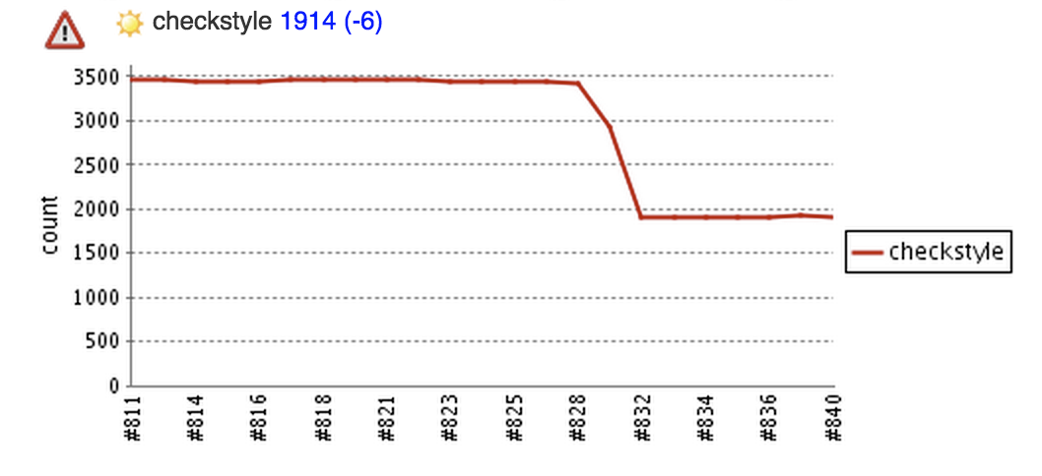
Jenkins checkstyle plugin

Slide 12
!!! Information Overload !!!
The older and larger the app the more offenses there tend to be.
You may need to ignore soon-to-be deprecated logic.
You may not have time to fix everything.

Slide 13
rubocop_changes.rb
$ ./rubocop_changes.rb -h
./rubocop_changes.rb: RuboCop Your Changes
This script checks git for local file changes to send to rubocop for
style validation.
Requires: git, rubocop
Options:
--help display help info
--branch check current branch vs master

Slide 14
Other Links
A similar rubocop wrapper:
https://gist.github.com/skanev/9d4bec97d5a6825eaaf6
vim plugin:
https://github.com/ngmy/vim-rubocop
RSpec extension to rubocop
https://github.com/nevir/rubocop-rspec
Other style guides
https://github.com/brigade/haml-lint
https://github.com/katgironpe/rails-erb-lint
https://github.com/brigade/scss-lint
https://github.com/geraud/jslint
https://github.com/zmbush/coffeelint-ruby

Slide 15

Questions?

