Slide 1

ECG Classification using Deep Learning
MIT-BIH Arrythmia Dataset
Lewis Richter
University West, Trollhättan, Sweden
GitHub: ECGClassification.git
Notes:
Exempelsidorna som följer visa hur layouten är tänkt med bilder och layoutflöde.
Under ”Ny bild”¹ finns fler layoutmallar² än de som ligger på exempelsidorna nedan.
1.
2.

Slide 2



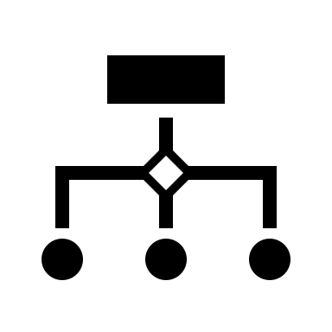


EU AI Regulations Impact
Why it matters: Healthcare AI is high-risk under EU law.
Implications:
Requires GDPR compliance
Mandatory risk assessment
Transparent design and human oversight
Outcome: Your model must be explainable and medically safe before deployment.

Slide 3
Requirements and Specifications
Main Goal: Classify ECG heartbeats into 5 categories
Requirements:
Dataset: MIT-BIH Arrhythmia Dataset
Accuracy ≥ 95%
Training Time ≤ 5 hours on M2 Mac Book Air
Generalization on unseen data
Evaluation with accuracy, precision, recall and F1-score

Slide 4
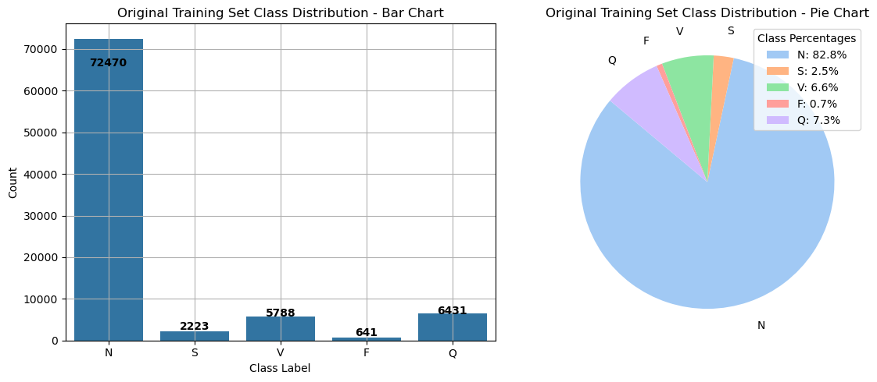

Dataset Overview
Dataset: MIT-BIH Arrhythmia (via Kaggle)
5 Classes: Normal, Supraventricular, Ventricular, Fusion, Unknown
Samples:
Training: 87,554 sample heartbeats
Test: 21,890 sample heartbeats

Slide 5
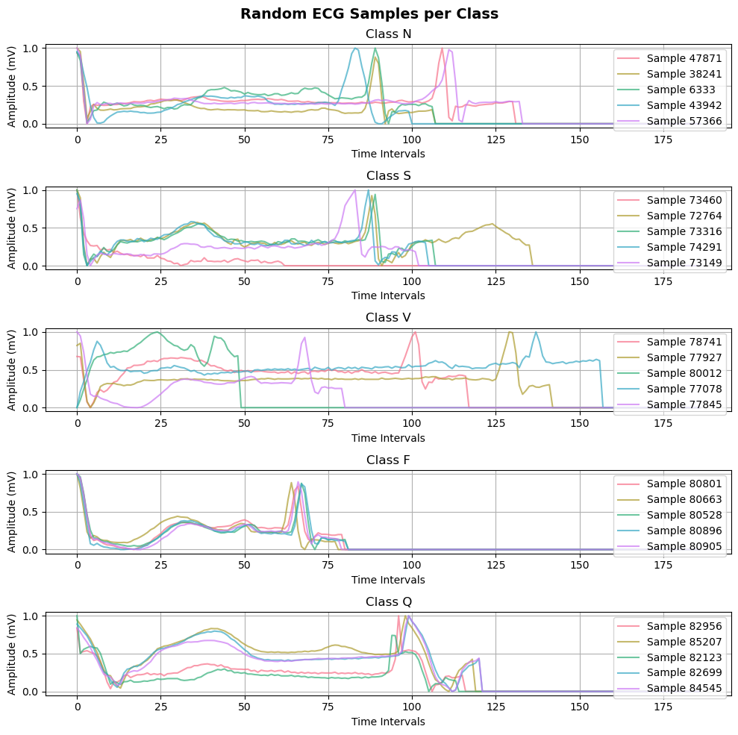
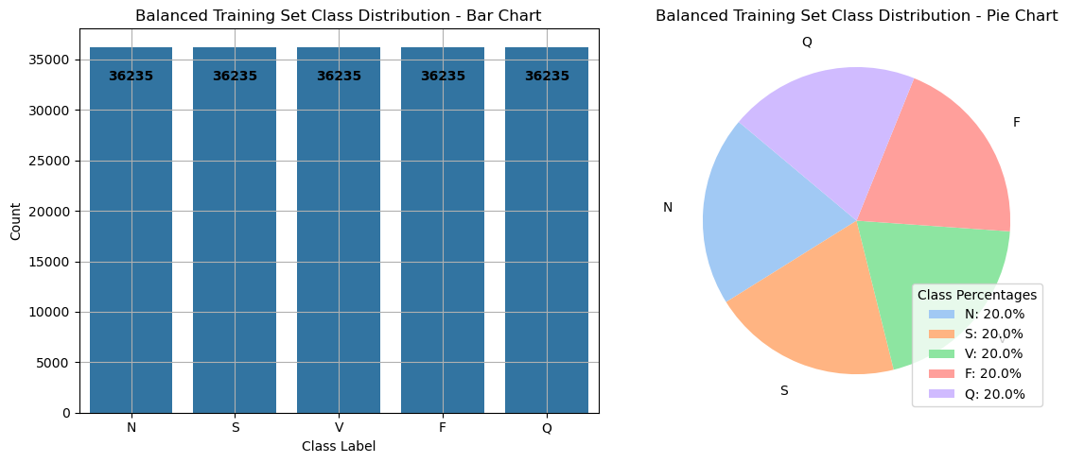
Dataset Overview
Dataset: MIT-BIH Arrhythmia (via Kaggle)
5 Classes: Normal, Supraventricular, Ventricular, Fusion, Unknown
Samples:
Training: 87,554 sample heartbeats
Test: 21,890 sample heartbeats

Slide 6
Dataset Overview
Imbalance handled using Random Under Sampling of the majority class (N) to 50% of the original heartbeats
Random Over Sampling of the minority classes to the same amount of samples

Slide 7
Dataset Overview
5 Classes:
Normal (N),
Supraventricular (S),
Ventricular (V),
Fusion (F),
Unknown (Q)
Individual Beats extracted from 24 hours ECG
Labelled independently by two experts

Slide 8
System Overview
Dataset: MIT-BIH Arrhythmia (via Kaggle)
Preprocessing:
Normalizing using StandardScaler:
Remove Mean
Scale to Unit Variance
Balancing using ImbLearn Library:
Random Under Sampling of Majority Class (N) to 50% (36,235 Heartbeats)
Random Over Sampling of Minority Classes to the same number of Heartbeats
Notes:
StandardScaler by sklearn
RandomOverSampler & RandomUnderSampler by imblearn

Slide 9
System Overview
Model Creation & Training:
CNN Model:
Input
3x Convolutional Layer & MaxPooling
Flatten
Dense & Dropout
Output
CNN-RNN Model:
LSTM (Long Short-Term Memory):
LSTM (64 Units)
GRU (Gated Recurrent Units):
GRU(64 Units)
RELU Activation Function
ADAM Optimizer
Categorical Crossentropy
Reduce Learning Rate on Plateau
Notes:
StandardScaler by sklearn
RandomOverSampler & RandomUnderSampler by imblearn

Slide 10
System Overview
Evaluation:
Training Duration
Predict Class Labels for Test Set
Accuracy Score
Precision Score
Recall Score
F1 Score
Classification Report
Confusion Matrix
Required Accuracy greater or equal to 95%
Repeat, if necessary, otherwise satisfied
Notes:
StandardScaler by sklearn
RandomOverSampler & RandomUnderSampler by imblearn

Slide 11
Algorithm Design
Iterative Process for Model Refinement
Based on Academic Literature and Course Concepts
Create Deep Learning Models using CNN and CNN-RNN Hybrids
RNNs: Long Short-Term Memory and Grated Rectified Unit Models

Slide 12
Algorithm Design (Iteration 1)
Model Comparison: Accuracy:
CNN: 8 min 4.4 sec 98.36%
LSTM: 94 min 4.9 sec 98.20%
GRU 74 min 33.7 sec 98.36%
Confusion Matrices in %
CNN | N | S | V | F | U
N | 99.12 | 0.45 | 0.35 | 0.09 | 0.09
S | 17.09 | 81.47 | 1.26 | 0.00 | 0.18
V | 2.49 | 0.07 | 96.13 | 1.24 | 0.07
F | 8.02 | 0.00 | 7.41 | 84.57 | 0.00
U | 0.75 | 0.06 | 0.06 | 0.00 | 99.13
LSTM | N | S | V | F | U
N | 98.87 | 0.75 | 0.18 | 0.07 | 0.13
S | 13.31 | 85.25 | 0.72 | 0.54 | 0.18
V | 2.28 | 0.35 | 95.51 | 1.59 | 0.28
F | 9.26 | 0.00 | 7.41 | 83.33 | 0.00
U | 0.81 | 0.12 | 0.06 | 0.00 | 99.00
GRU | N | S | V | F | U
N | 99.07 | 0.45 | 0.22 | 0.10 | 0.16
S | 13.85 | 83.81 | 1.98 | 0.00 | 0.36
V | 1.93 | 0.41 | 95.93 | 1.31 | 0.41
F | 9.26 | 0.62 | 10.49 | 79.63 | 0.00
U | 0.44 | 0.00 | 0.12 | 0.00 | 99.44

Slide 13
Algorithm Design (Iteration 2)
Incorporated Residual Blocks (Main Path and Shortcut using Skip Connection)
Model Comparison: Accuracy: Improvement
CNN: 120 min 41.4 sec 98.15% No
LSTM: 259 min 55.6 sec 98.57% Yes
GRU 113 min 9.3 sec 97.88% No
Confusion Matrices in %
CNN | N | S | V | F | U
N | 98.80 | 0.55 | 0.41 | 0.12 | 0.11
S | 14.75 | 83.09 | 1.98 | 0.18 | 0.00
V | 1.66 | 0.07 | 96.34 | 1.66 | 0.28
F | 5.56 | 1.23 | 8.64 | 84.57 | 0.00
U | 0.81 | 0.06 | 0.12 | 0.06 | 98.94
LSTM | N | S | V | F | U
N | 99.35 | 0.28 | 0.20 | 0.09 | 0.08
S | 16.01 | 81.83 | 1.62 | 0.36 | 0.18
V | 2.07 | 0.28 | 96.20 | 1.38 | 0.07
F | 7.41 | 0.62 | 7.41 | 84.57 | 0.00
U | 0.87 | 0.00 | 0.06 | 0.00 | 99.07
GRU | N | S | V | F | U
N | 98.69 | 0.63 | 0.46 | 0.09 | 0.13
S | 18.53 | 79.86 | 1.26 | 0.36 | 0.00
V | 1.59 | 0.69 | 95.86 | 1.38 | 0.48
F | 8.02 | 0.62 | 10.49 | 80.86 | 0.00
U | 0.81 | 0.19 | 0.44 | 0.00 | 98.57

Slide 14
Algorithm Design (Iteration 3)
Incorporated Batch Normalization,
Extend RNNs by introducing bidirectional layers
Global Average Pooling instead of Flattening
Model Comparison: Accuracy: Improved:
CNN: 34 min 33.9 sec 97.88% No
LSTM: 28 min 20.7 sec 98.20% No
GRU 30 min 50.9 sec 98.04% No
Confusion Matrices in %
CNN | N | S | V | F | U
N | 98.60 | 0.81 | 0.38 | 0.06 | 0.15
S | 15.65 | 82.55 | 1.44 | 0.36 | 0.00
V | 1.80 | 0.41 | 95.99 | 1.31 | 0.48
F | 9.88 | 0.00 | 12.35 | 77.78 | 0.00
U | 0.81 | 0.31 | 1.87 | 0.00 | 98.69
LSTM | N | S | V | F | U
N | 98.88 | 0.64 | 0.24 | 0.11 | 0.13
S | 15.29 | 82.37 | 1.80 | 0.54 | 0.00
V | 2.28 | 0.21 | 96.13 | 1.24 | 0.14
F | 9.26 | 0.00 | 8.02 | 82.72 | 0.00
U | 0.37 | 0.62 | 0.12 | 0.62 | 99.38
GRU | N | S | V | F | U
N | 98.65 | 0.67 | 0.36 | 0.19 | 0.13
S | 13.67 | 83.81 | 1.80 | 0.36 | 0.36
V | 1.86 | 0.41 | 95.86 | 1.59 | 0.28
F | 3.70 | 0.62 | 8.64 | 87.04 | 0.00
U | 0.56 | 0.00 | 0.12 | 0.19 | 99.13

Slide 15
Future Work & Conclusion
Iteration 1 Models have already been promising classifiers.
The Requirements have been met generally, a working classifier has been trained using multiple approaches.
Nevertheless per-class performance needs improvement.
The most efficient classifier was the CNN in Iteration 1, and the overall best classifier the CNN-LSTM in Iteration 2 using Residual Connections.
Suggestion:
Perform synthetic over sampling techniques such as SMOTE or ADASYN for better class balancing
Focus on per-class precision and recall to meet EU AI Regulations on healthcare requirements

Slide 16
Thank You!
Contact: lewis.richter@student.hv.se
University West, Trollhättan, Sweden
GitHub: ECGClassification.git
Notes:
Exempelsidorna som följer visa hur layouten är tänkt med bilder och layoutflöde.
Under ”Ny bild”¹ finns fler layoutmallar² än de som ligger på exempelsidorna nedan.
1.
2.

