Slide 1
NASA INTERNATIONAL SPACE APPS CHALLENEGE
CHALLENGE: BUILD A SPACE BIOLOGY KNOWLEDGE ENGINE
TEAM NAME: PHEONIX
MEMBER: RICHA NAYAK(LEAD)
INSTITUTE: SHRI SHANKARACHARAYA TECHNICAL CAMPUS, bhilai

Slide 2
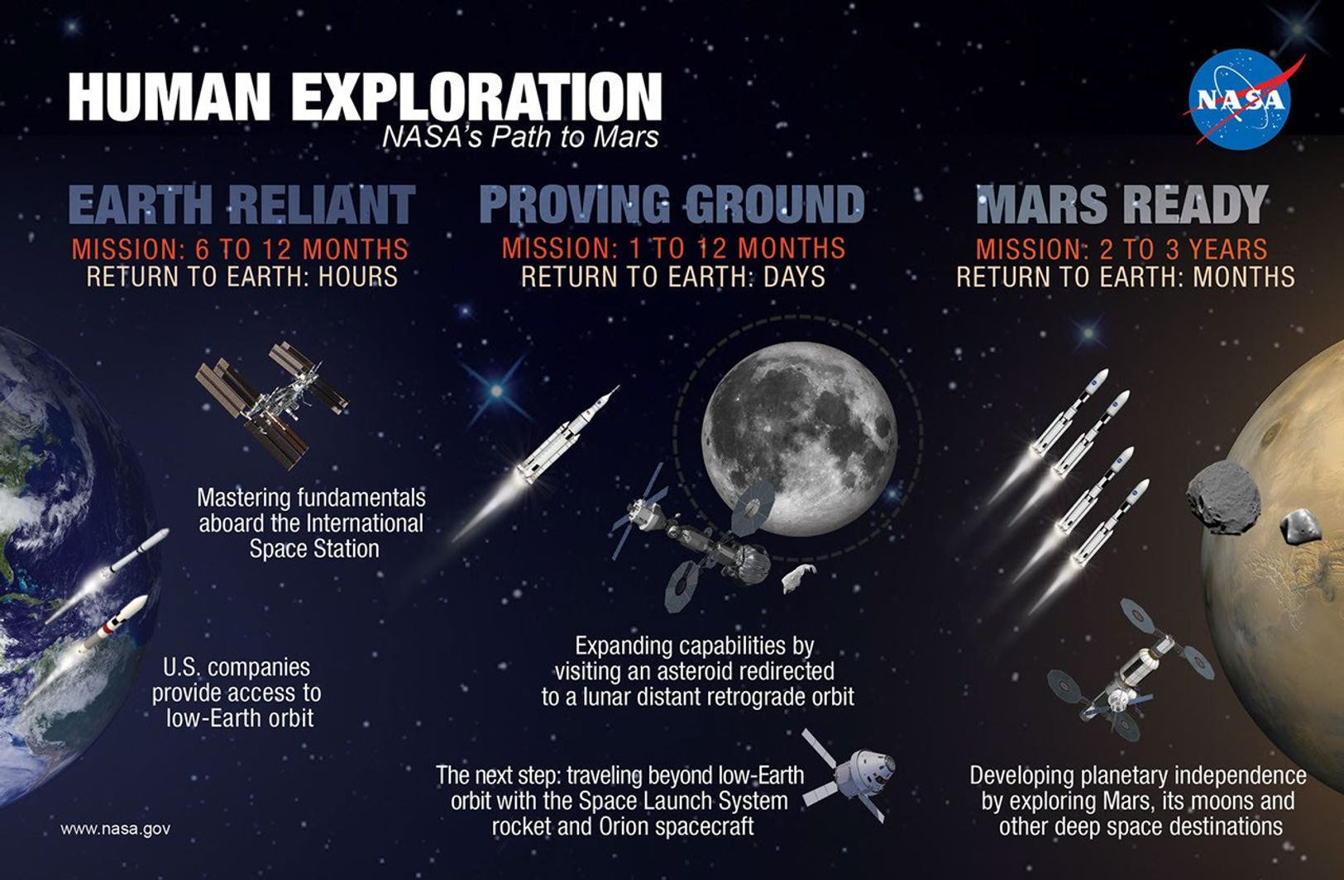
PROJECT NAME: KNOWLEDGE INFERENCER
MODLE ARCHITECTURE
MODULE DESCRIPTON
USER INTERFACE
CREDIT: NASA WEBSITE

Slide 3
Model architecture: KNOWLEDGE INFERENCER
STEP 1
STEP 2
STEP 3
INPUT MODULE
QUESTION AND ANSWER MODULE
FEATURE EXTRACTOR MODULE
STRUCTURED RESPONSE MODULE
TEXT SUMMARIZER MODULE
STEP 5
STEP 4

Slide 4
MODULE DESCRIPTION
STEP 1
THE SYSTEM RECEIVES THE DATA IN THE PDF FORMAT.
STEP 2
THE SYSTEM WILL RETREIVE BASIC INFORMATION SUCH AS PROJECT TITLE, PROJECT INITIATION DATE, PROJECT TERMINATION DATE AND THE FUNDING AGENCY.
STEP 3
THE SYSTEM WILL EXTRACT TOPIC WISE TEXT SEPARATELY FROM THE DOCUMENTS SUCH AS ABSTRACT, INTRODUCTION, METHODS, RESULTS, CONCLUSIONS, TABLES AND IMAGES.
STEP 4
STEP 5
THE SYSTEM WILL EXTRACT THE TEXTS TOPIC WISE AND CONVERT A LARGE PARAGRAPH INTO CONCISED GIST WITH THE HELP OF A SUMMARIZER.
THE SYSTEM WILL GENERATE STRUCTURED RESPONES FOR SCIENTIST, INVESTORS AND MISSION MANAGERS FOR DECISION MAKING, IDENTIFICATION OF KNOWLEDGE GAPS, RESEARCH PROGRESS AND INVESTING AGENCY.

Slide 5
USER INTERFACE MODULE
UPLOAD DOCUMENT
SELECTED AUDIENCE: SCIENTIST
SECTION 1: SUMMARIZED TEXT
SECTION 2: SUMMERIZED TEXT
SECTION 3: TABLES AND FIGURES
.
.
.
SECTION N: SUMMERIZED TEXT

Slide 6
USER INTERFACE MODULE
UPLOAD DOCUMENT
SELECTED AUDIENCE: INVESTORS
SUMMARIZATION OF ACHIEVED RESULTS

Slide 7
USER INTERFACE MODULE
UPLOAD DOCUMENT
SELECTED AUDIENCE: MISSION ARCHITECTS
RESEARCH PROGRESS
KNOWLEDGE GAPS

