Slide 1
CAPSTONE PROJECT
SALES ANALYTICS

Slide 2
SALES ANALYTICS
Power BI Desktop
Valuable Insights: The Power BI dashboard using the Sales Analytics Database provides valuable insights into the Northwind Trader's sales performance and operations. It presents data-driven analytics on sales of different category of eatables. Stakeholders can gain a deeper understanding of customer preferences, bestselling items, and effective marketing strategies.
Improvement Focus: The dashboard helps the company focus on areas that require improvement. By analyzing sales trends, product requirements, and discount effectiveness, the dashboard identifies opportunities to optimize sales and increase revenue. It enables the company to refine its marketing and selling strategies to better cater to customer demands.
Evaluation of Effectiveness: The dashboards facilitate the evaluation of various aspects of the this business. It assesses the effectiveness of discounts on sales, the impact of different category of products on revenue, and their success in different countries. With this evaluation, the company can make data-driven decisions to enhance its overall effectiveness and profitability.
Trend Identification: Using historical sales data, the dashboard identifies trends in sales over time. It helps identify seasonal patterns, bestselling products in specific quarters or months during the year, and the success of certain category overall. This trend identification empowers the company to plan for future demands and marketing efforts more effectively.
Comprehensive Understanding: The Power BI dashboard offers a comprehensive understanding of the company's operations. By presenting data on sales, customer, employee, order, product, customer and supplier analysis, stakeholders can have a holistic view of the business.
This comprehensive understanding enables better decision-making and a more cohesive strategy across all aspects of the selling process.
Customer Analysis
Order Analysis
Employee Analysis
Sales Analysis
Product Analysis
Supplier Analysis

Slide 3
OBJECTIVE: The objective of this project is to create comprehensive Power BI dashboard utilizing the Sales Analytics Database. The dashboard aims to provide valuable insights into the Northwind Traders company's sales performance, customer demand, and product success, enabling data-driven decision-making and strategic planning.
ANALYSIS SCOPE: The analysis will focus on various aspects of the selling process, including supplying, sales, customer location, shipping and the impact of discounts. It will encompass historical sales data, and we could make predictive analysis.
GOAL: The primary goal of this Power BI dashboard is to offer a holistic view of the company's operations. It will provide actionable insights to optimize sales, enhance product quality, improve selling strategies, and identify opportunities for growth and efficiency.

Slide 4
INSIGHTS & RECOMMENDATIONS: The Power BI dashboard will generate valuable insights into the top-selling product categories, top sales location, and sales trends over time. It will analyze the performance of different categories, identify bestselling products. Additionally, it will recommend effective discount strategies to boost sales and customer acquisition.
REPORT & PRESENTATION: The final deliverable will consist of a detailed report describing the data sources, data modeling methodologies, and data cleansing processes used in creating the Power BI dashboard. The. report will also include a step-by-step guide on how to interpret the insights and use the dashboard for decision-making. The presentation will showcase the key findings, visualizations, and actionable recommendations derived from the dashboard's analysis. .
The Power BI dashboard, along with the report and presentation, will serve as a powerful tool for the company's stakeholders. It will empower them to make informed decisions, optimize sales strategies, foster favourable products, and enhance the overall business performance in the competitive landscape.

Slide 5
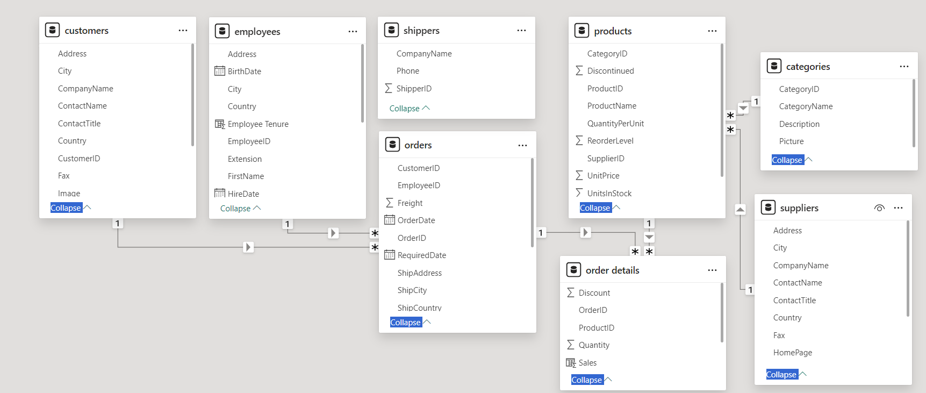
ER DIAGRAM

Slide 6
EDA Problem Statements

Slide 7
Q1. What are the key factors influencing customer retention or loyalty based on the dataset? Discount and Shipping Days influence customer retention.

Slide 8
Q2. How do customer preferences vary based on their location or demographics? Can we explore this through interactive visualizations?
We conclude that beverages and dairy products are the most popular and produce is the least popular among customers around the world.

Slide 9
Q3. Are there any interesting patterns or clusters in customer behavior that can be visualized to identify potential market segments? USA has the most number of customers and Seafood is bought by most customers. Conversely, Poland and Ireland have the lowest amount of customers and Produce is bought by least number of customers.

Slide 10
Q4. Are there any specific product categories or SKUs that contribute significantly to order revenue? Can we identify them through visualizations? Beverages contribute the most to the revenue whereas Grains/Cereals contribute the least.

Slide 11
Q5. Are there any correlations between order size and customer demographics or product categories? Can we explore this visually using scatter plots or heatmaps? On an average, Dairy Products have the highest order size and Produce have the lowest.
Category Name | Avg Order Size
Dairy Products | 24.9973
Condiments | 24.5278
Meat/Poultry | 24.2717
Confections | 23.6707
Beverages | 23.5941
Seafood | 23.2758
Grains/Cereals | 23.2755
Produce | 21.9853

Slide 12
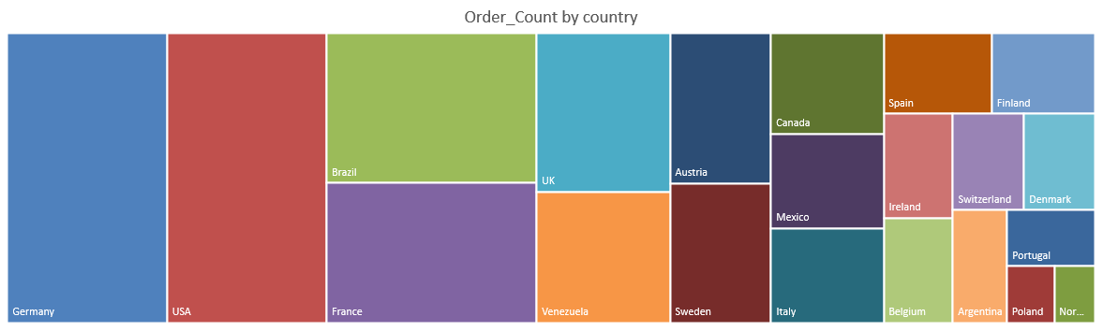
Q6. How does order frequency vary across different customer segments? Can we visualize this using bar charts or treemaps? Germany and USA get orders most frequently. Norway and Poland do not get frequent orders.

Slide 13
Q7. Are there any correlations between employee satisfaction levels and key performance indicators? Can we explore this visually through scatter plots or line charts? Employees will only stay with a Company if they are satisfied with the overall perks and tenure and the more tenure an employee has the more products they are likely to sell.

Slide 14
Q8. How does employee turnover vary across different departments or job roles? Can we visualize this using bar charts or heatmaps? -> By comparing the order counts for all Job Roles, we can identify whose activity has decreased significantly, potentially indicating turnover. Here Sales Manager indicates turnover.

Slide 15
Q9. Can we identify any patterns or clusters in employee skill sets or qualifications through visualizations? How can this information be used for talent management? -> Talent management can give suitable work to employees according to their skillset or qualifications.

Slide 16
Q10. Are there any correlations between product attributes (e.g., size, color, features) and sales performance? Sales of different products by their categories. Beverages have the highest sales but confections have the most amount of products. Produce have the lowest sales and the least amount of products.

Slide 17
Q11.How does product demand fluctuate over different seasons or months? Can we visualize this through line charts or area charts? We used order count to determine the fluctuation of product demands over months.

Slide 18
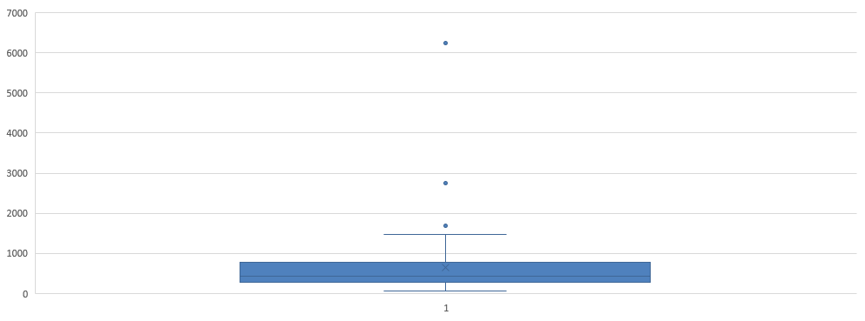
Q12. Can we identify any outliers or anomalies in product performance or sales using visualizations? How can this information be used for product optimization? -> To determine outliers, I used average sales. By identifying outliers, businesses can investigate the underlying reasons for these anomalies and take corrective actions if necessary.

Slide 19
Q13. Are there any correlations between supplier attributes (e.g., location, size, industry) and performance metrics (e.g., on-time delivery, product quality)? Can we explore this visually through scatter plots or heatmaps? Used heatmap and scatter plot to determine the performance of country reorder level. Finland is at the top and Brazil at the bottom.
SupplierCountry | AvgReorderLevel
Finland | 21.6667
Sweden | 20
Italy | 19
Germany | 16.1111
Spain | 15
Canada | 13.75
Singapore | 13.3333
Netherlands | 12.5
UK | 12.1429
Norway | 11.6667
USA | 11.25
Australia | 10
France | 8
Denmark | 7.5
Japan | 2.5
Brazil | 0

Slide 20
Q14. How does supplier performance vary across different product categories or departments? Can we visualize this using stacked bar charts or grouped column charts? We determine supplier performance by reorder level taken across different categories of products. It indicates that the products a supplier is supplying is of good quality and its sales are decent.

Slide 21
Q15. Can we identify any trends or patterns in supplier costs or pricing structures through visualizations? How can this information be used for procurement optimization? Pricing varies for suppliers of different products between range of 4-282. Aux Joyeux ecdes iastiques has the highest pricing whereas Rrefrescos Americanas LTDA has the lowest.
Insights from supplier costs and pricing structures help in negotiating better deals, selecting competitive suppliers, reducing costs, optimizing the supply chain, and managing risks, leading to procurement optimization.

Slide 22
Power BI Problem Statements

Slide 23
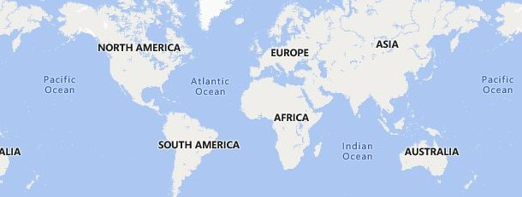



CUSTOMER ANALYSIS
Power BI Desktop
How does customer distribution vary across different regions or customer segments? Can we visualize it on a map or bar chart?
Can we visualize the distribution of customer demographics such as age, gender, or income using histograms or pie charts?
-> As we do not have any customer demographic like age, gender or income, we are using customer location to aggregate customers from different countries.
Country Germany
USA
Brazil France UK
Venezuela Austria Sweden Canada Italy Mexico Spain Finland Belgium Ireland Denmark Switzerland
2.17%
2.29%
2.29%
2.65%
2.77%
3.37%
1.57%
14.7%
What is the trend in customer acquisition over time? Can we create a line chart or area chart to display it?
14.7%
3.37%
3.61%
80
71
69
4.46%
10%
60
57
57
4.82%
46
50
5.54%
54
6.75%
9.28%
40
34
Jul 1994
Oct 1994
Jan 1995
Apr 1995
Jul 1995
Oct 1995
Jan 1996
Apr 1996

Slide 24
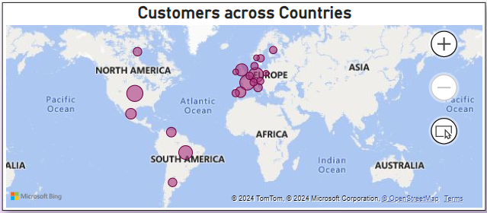
Q1. How does customer distribution vary across different regions or customer segments? Can we visualize it on a map or bar chart?
Gleaning from the report, it seems like USA, France and Germany has the highest number of customers, whereas countries like Ireland and Norway has the least amount of customers.

Slide 25
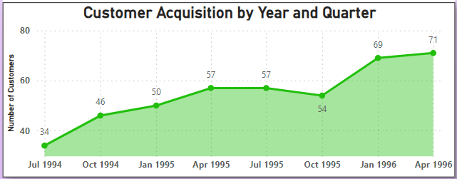
Q2. What is the trend in customer acquisition over time? Can we create a line chart or area chart to display it?
Customer acquisition was at it’s peak during the first & second quarter of the year 1996 and was at the lowest during the third & fourth quarter of year 1994.

Slide 26
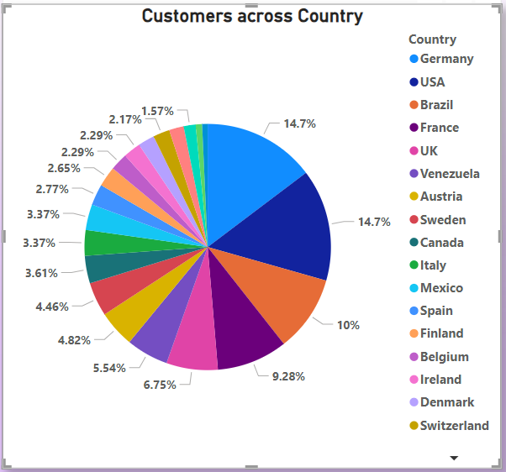
Q3 Can we visualize the distribution of customer demographics such as age, gender, or income using histograms or pie charts?
As we do not have any customer demographic like age, gender or income, we are using customer location to aggregate customers from different countries.
From the pie char, we understand that Germany, USA & Brazil has the highest percentage of customers, whereas Mexico & Finland have the least.

Slide 27

ORDER ANALYSIS
Power BI Desktop
How does order volume change over time? Can we create a time series chart or stacked bar chart to visualize it?
How does employee productivity vary across different departments or job roles? Can we create a stacked bar chart or grouped column chart to
visualize it?
-> We can determine the employee productivity across different job roles by the number of orders placed through them.
1996
1,500
1995
1994
0
500
1,000
1,000
Can we visualize the average order processing time or shipping duration using a bar chart or box plot?
500
8.49
0
Sales Inside Sales Represent… Coordinator
Vice President, Sales
Sales Manager
0
2
4
6
8

Slide 28
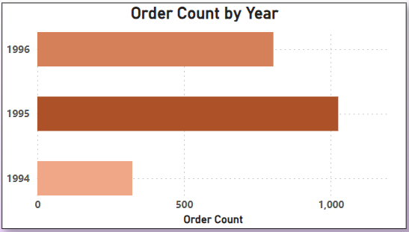
Q4. How does order volume change over time? Can we create a time series chart or stacked bar chart to visualize it?
We understand that1995 had the highest volume of orders and 1994 had the lowest volume.

Slide 29
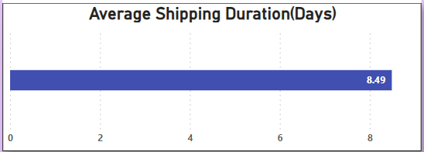
Q6. Can we visualize the average order processing time or shipping duration using a bar chart or box plot?
On an average, the shipping of orders takes about 8-9 days.

Slide 30
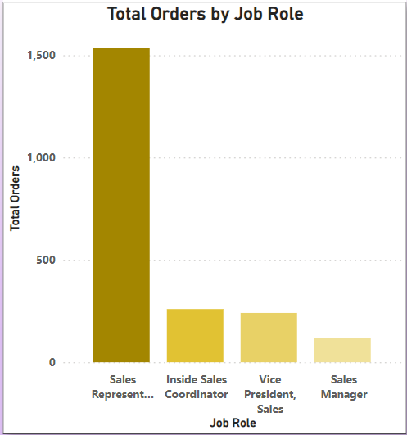
Q7. How does employee productivity vary across different departments or job roles? Can we create a stacked bar chart or grouped column chart to visualize it?
We can determine the employee productivity across different job roles by the number of orders placed through them.
Sales Representatives have gotten the most business to the company in comparision to any other job role.

Slide 31

EMPLOYEE ANALYSIS
Power BI Desktop
What is the distribution of employee tenure? Can we create a histogram or box plot to display it?
Can we visualize employee performance ratings or KPIs using a radar chart or bullet graph?
-> We take count of orders sold by each employee as employee performance indicator using line chart, as bullet or radar is not available for personal use in
35
power bi.
32
32
32
31
31
31
30
30
30
30
450
420
400
25
350
345
321
20
300
260
15
250
241
10
200
176
168
150
5
117
107
100
0
Margaret
Nancy
Janet
Laura
Andrew
Robert
Michael
Steven
Anne
1
2
3
4
5
6
7
8
9

Slide 32
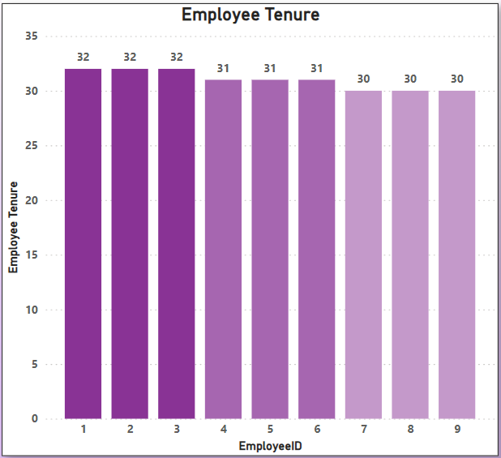
Q8. What is the distribution of employee tenure? Can we create a histogram or box plot to display it?
Almost all the employees have been with the company for 30-32 years. This depicts that the employees at the company are satisfied working at the Northwind Traders.

Slide 33
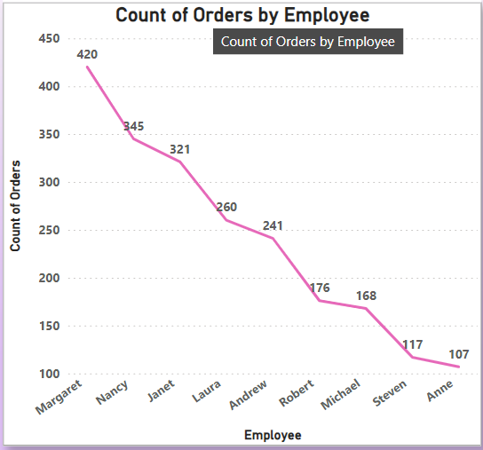
Q9. Can we visualize employee performance ratings or KPIs using a radar chart or bullet graph?
We take count of orders sold by each employee as employee performance indicator using line chart, as bullet or radar is not available for personal use in power bi.
Gleaning from the chart, it becomes apparent that Margaret has gotten the most amount of orders and Anne has the the lowest order count

Slide 34


SALES ANALYSIS
Power BI Desktop
What is the distribution of order values? Can we create a histogram or box plot to display it?
How does the sales volume vary across different product categories? Can we create a bar chart or treemap to display
it?
CategoryName
Beverages
Condiments
Confections
Dairy Products
Grains/Cere…
Meat/Poultry
Produce
Seafood
100%
Beverages
Dairy Products
80%
60%
286.53K
251.33K
Meat/Poultry
Seafood
Condiments
40%
20%
178.19K
Confections
141.62K
113.69K
Produce
0%
105.27K
USA
Austria
Brazil
France
UK
Ireland
Canada
Mexico
Finland
Spain
Italy
Poland
Grains/Cereals
Germany
Sweden
Belgium
Portugal
Norway
Venezuela
Denmark
Argentina
Switzerland
177.10K
100.73K

Slide 35
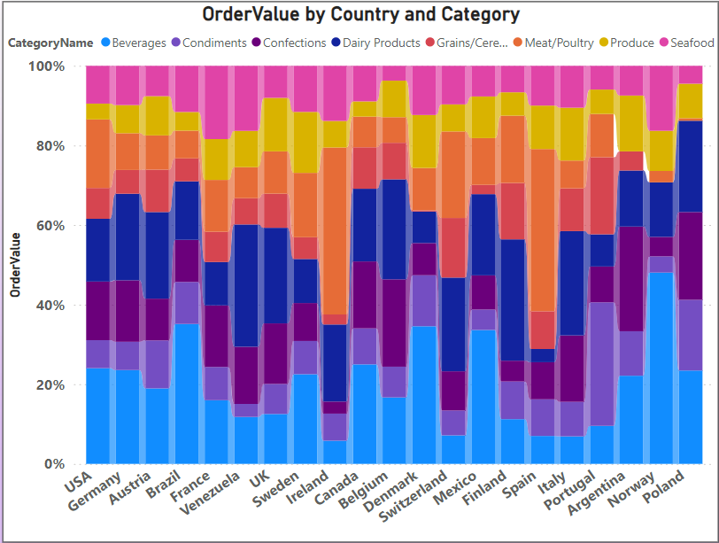
Q5. What is the distribution of order values?
From this chart, we can assume that Beverages and Dairy Products have the highest Order Value. Grains/Cereals and Produce have the least Order Value

Slide 36
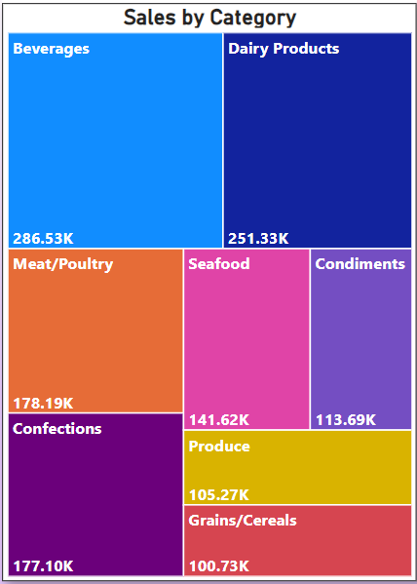
Q11. How does the sales volume vary across different product categories? Can we create a bar chart or treemap to display it?
It is clear from the Treemap that Beverages have the highest sales and Grains/Cereals have the lowest sales.

Slide 37
PRODUCT ANALYSIS
Power BI Desktop
What is the distribution of product ratings or reviews? Can we create a histogram or stacked bar chart to visualize it?
-> In a way ReorderLevel depicts the product review or rating, if the product quality is good
Can we visualize the pricing distribution of products using a box plot or violin plot?
->Pricing distribution of products of different categories using stacked column chart as box plot or violin plot is unavailable to use publicly.
and it is selling out then reorder would be necessary and higher reorder would mean better product review. Therefore we have used it and distributed between different categories of products.
Meat/Poultry
20.23% | 50.31% | 12.45% | 17.01%
100%
20.00%
25.00%
30.00%
25.00%
8.33%
13.89%
16.67%
5.56%
11.11%
13.89%
13.89%
5.56%
8.33%
12.00%
24.00%
8.00%
24.00%
12.00%
20.00%
10.34%
10.34%
6.90%
13.79%
17.24%
13.79%
20.69%
14.29%
19.05%
14.29%
23.81%
4.76%
23.81%
27.27%
22.73%
13.64%
18.18%
18.18%
100.00%
66.67%
Beverages
60.19% |  |  |  | 10.51%
80%
9.21%
48.80%
41.99%
Produce
60%
Dairy Products
11.83% |  |  | 12.53% | 11.14% | 12.11% |  | 13.23% | 19.14%
Confections
8.40% | 20.57% | 13.17% | 9.22% | 11.49% | 28.91% | 8.23%
40%
33.33%
Condiments
 | 10.77% | 10.45% |  | 12.23% | 9.52% | 10.30% | 8.32% | 19.57%
20%
Seafood
 | 26.46% |  | 11.01% | 13.13% | 8.04% |  |  | 10.96%
0%
Grains/Cereals
8.19% | 44.44% | 24.56% | 22.81%
Grains/Cereals
Beverages
Confections
Seafood
Condiments
Dairy Products
Meat/Poultry
Produce
0%
50%
100%

Slide 38
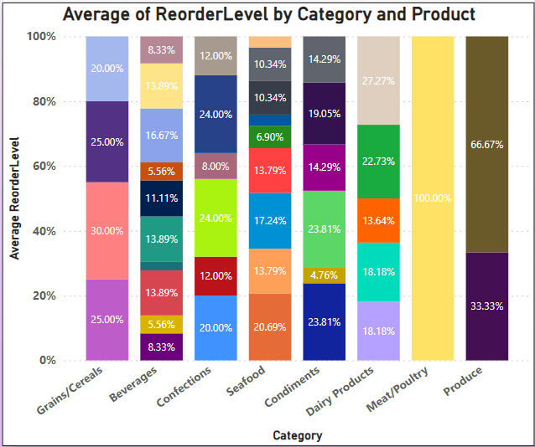
Q10. What is the distribution of product ratings or reviews? Can we create a histogram or stacked bar chart to visualize it?
In a way ReorderLevel depicts the product review or rating, if the product quality is good and it is selling out then reorder would be necessary and higher reorder would mean better product review. Therefore we have used it and distributed between different categories of products.
Pactao chinois is the most reordered product, following Manjimup dried apples and Longlife Tofu. Genen Shouyu, Laughing Lumberjack Lager and Chai are the least reordered products.

Slide 39
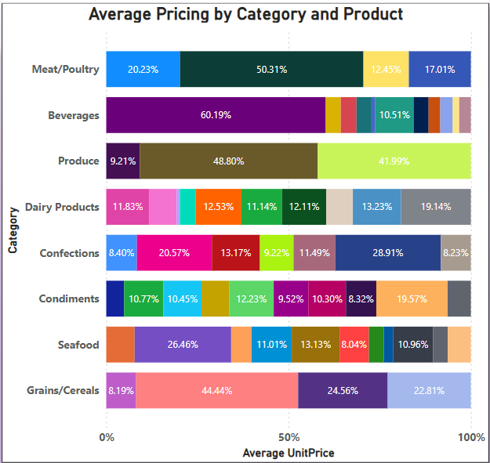
Q12. Can we visualize the pricing distribution of products using a box plot or violin plot?
Pricing distribution of products of different categories using stacked column chart as box plot or violin plot is unavailable to use publicly.
Analysing the chart, Rh Klosterbier and Konbu come out as the cheapest products. CA te de Blaye and Mishi Kobe Niku are the most expensive products among all the products.

Slide 40
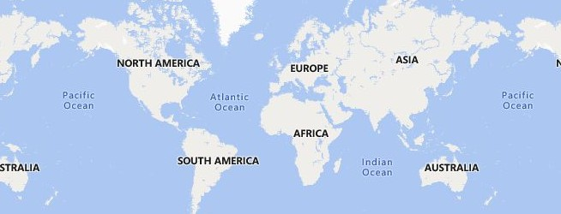


SUPPLIER ANALYSIS
Power BI Desktop
What is the distribution of supplier ratings or performance metrics? Can we create a bar chart or radar chart to visualize it?
-> Supplier performance can be determined with the average ReorderLevel, as the quality of goods supplied increases the chance of reorder.
How does the cost or pricing structure vary across different suppliers? Can we create a box plot or stacked bar chart to display it?
25.00
25.00
29
28
27
26
25
24
23
22
21
20
19
18
17
16
15
14
13
12
11
10 5
9
8
7
39
20.00
20.00
20.00
21.67
20.00
45
20
15.00
14
15.00
16.67
15.00
13
11.67
.00
11.67
13.33
12.50
11.67
12.50
29
10
9.00
15
.00
1
3.33
10.00
7.50
16
5.00
3.33
6.25
31
1.67
0.00
0.00
18
0
1 2 3 4 5 6 7 8 9 10 11 12 13 14 15 16 17 18 19 20 21 22 23 24 25 26 27 28 29
11
11
26
Can we visualize the geographical distribution of suppliers using a map or bubble chart?
14
141
20
15
20
26
26
45
30
15
28
36
0
50
100
150
200
© 2024 TomTom,, © 2024 Miiccrrossofftt Corrporrattiion,, © OpenSttrreettMap

Slide 41
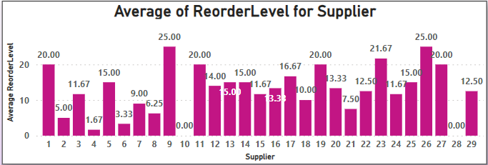
Q13. What is the distribution of supplier ratings or performance metrics? Can we create a bar chart or radar chart to visualize it?
Supplier performance can be determined with the average ReorderLevel, as the quality of goods supplied increases the chance of reorder.
As the average highest Reorder Level is of Supplier 9 and 26, they have the best supply of products. Supplier 10 and 28 have 0 average Reorder Level so their products might not have been as good as the others.

Slide 42
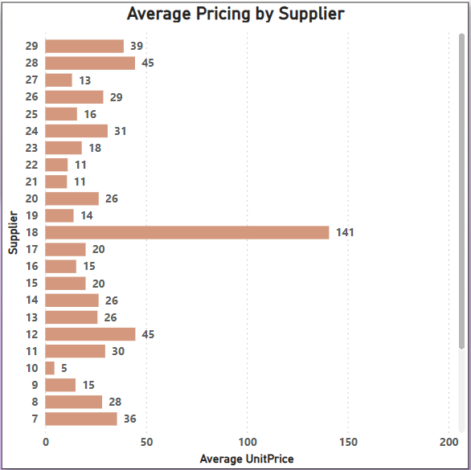
Q14. How does the cost or pricing structure vary across different suppliers? Can we create a box plot or stacked bar chart to display it?
We can clearly see that Supplier 18 has the highest pricing structure and supplier 10 has the lowest pricing structure.

Slide 43
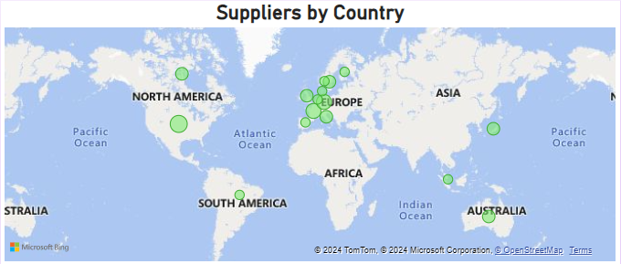
Q15. Can we visualize the geographical distribution of suppliers using a map or bubble chart?
We understand that USA has the most suppliers and most other countries like Norway, Denmark, Finland Spain, Brazil etc. have the least amount of suppliers.

