Slide 1
ProfileBook Capstone Project
Full-Stack Web Application (Angular + ASP.NET Core)
Submitted By: Richa Kumari
Batch: WIPRO-NGA-FSDA-FY26-C1
Instructor : Parth Shukla

Slide 2
Problem Definition and Objectives
Centralized platform for managing user profiles.
Secure login and registration with JWT.
Role-based access (User/Admin).
Database optimization for queries.
Admin management tasks (view, update, delete users).
API-driven design for scalability.

Slide 3
User Stories
Register and create profile
Secure login
Edit/update profile information
View profile
Change password

Slide 4
Admin Stories
View all registered users
Update or delete user profiles
Monitor login activities
Reset user credentials

Slide 5
Architecture
Frontend: Angular
Backend: ASP.NET Core Web API
Database: SQL Server
Authentication: JWT
UI: Bootstrap, Swagger for API Docs
System flow: User → Frontend → API → Database

Slide 6
Component Breakdown
Frontend: Login, Registration, Profile, Admin Dashboard
Backend: Controllers, Services, Repositories
API Endpoints: Register, Login, CRUD users, Admin management

Slide 7
Database Design & Entity Relationships
Users table with Role column (User/Admin)
Users → Posts (One-to-Many)
Users → Messages (One-to-Many)
Users → Reports (One-to-Many)
Admins manage posts, users, reports, groups

Slide 8
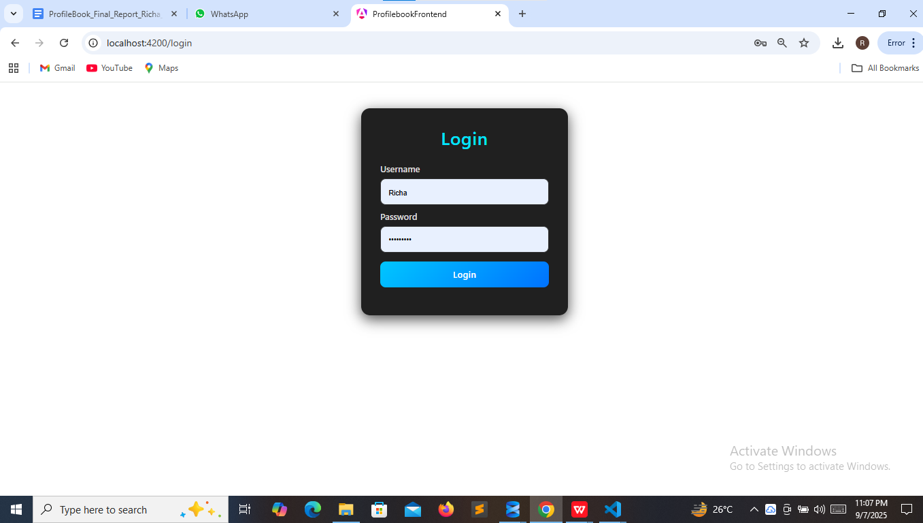
Login Page

Slide 9
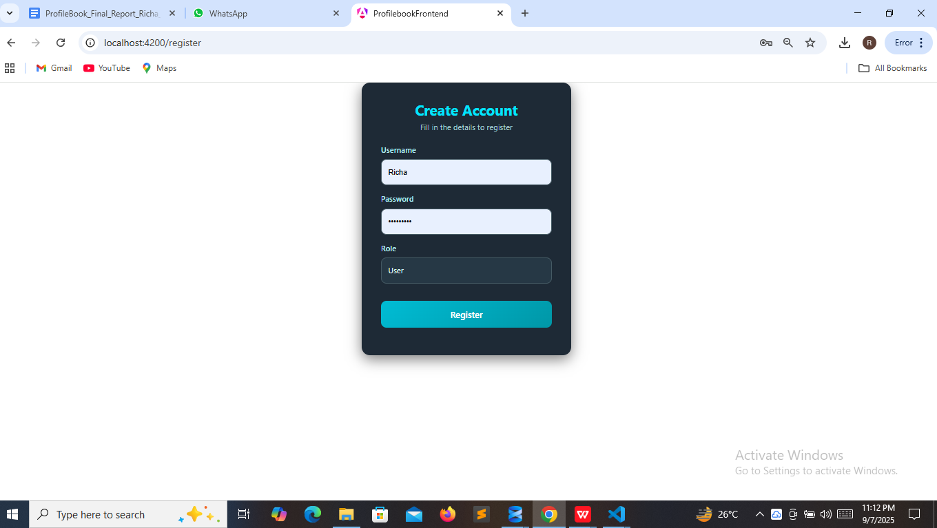
Register Page

Slide 10
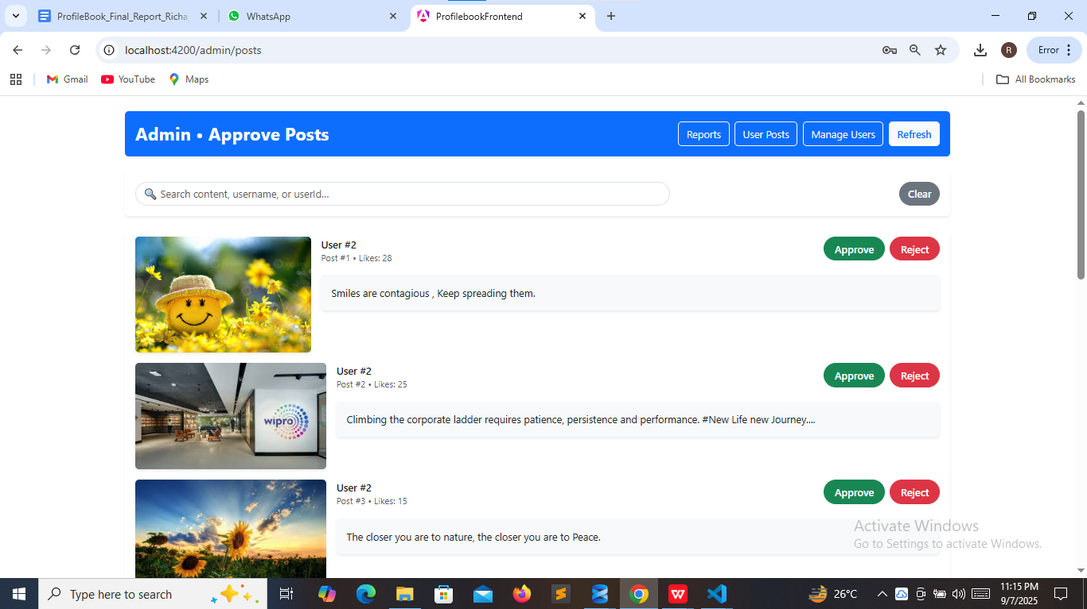
Admin Approve/Reject Posts

Slide 11
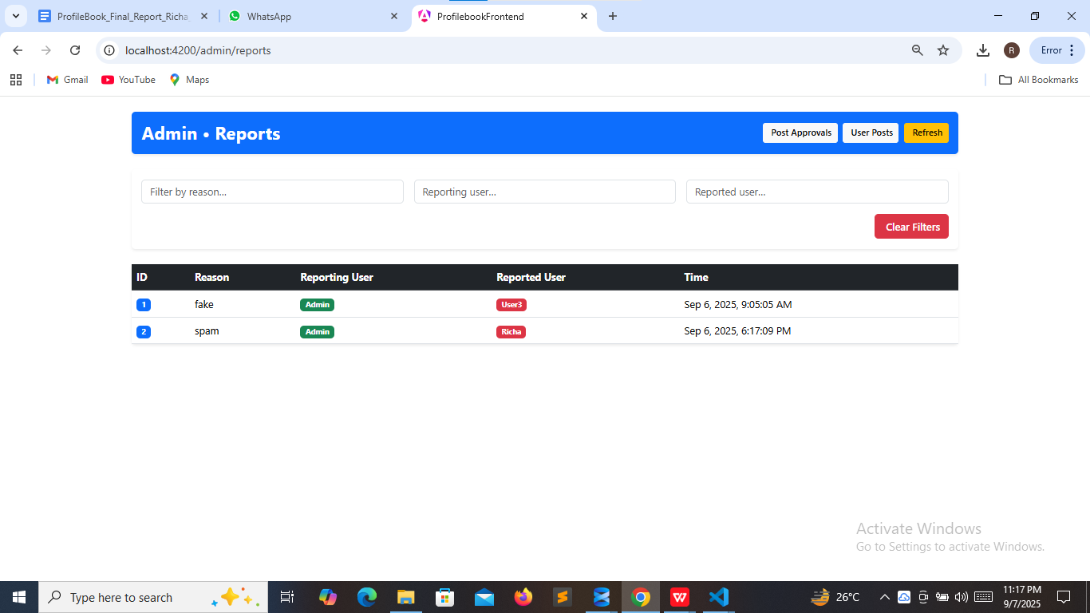
Admin Report Users

Slide 12
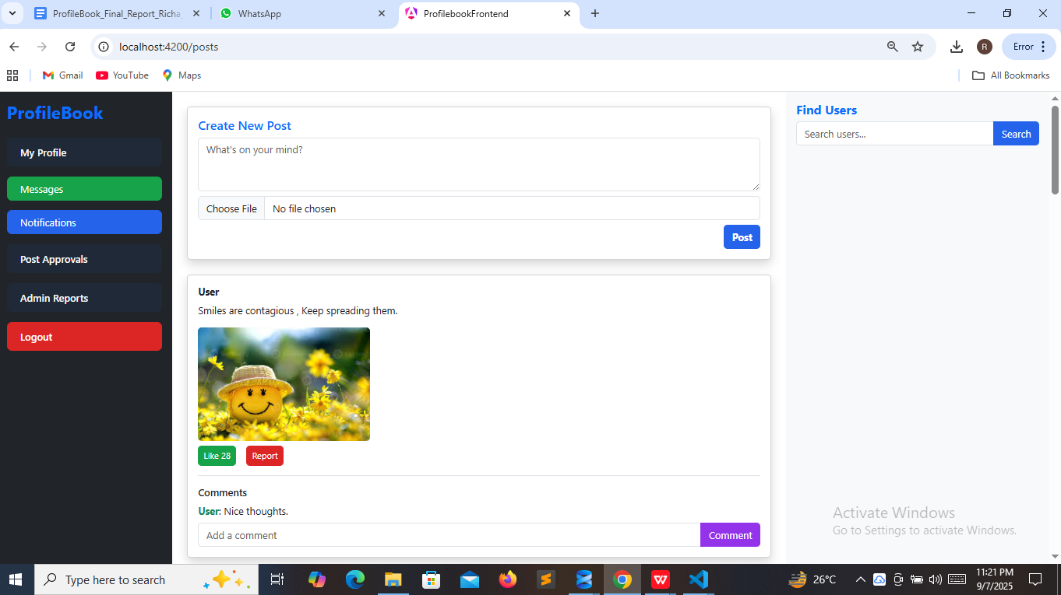
Home Page

Slide 13
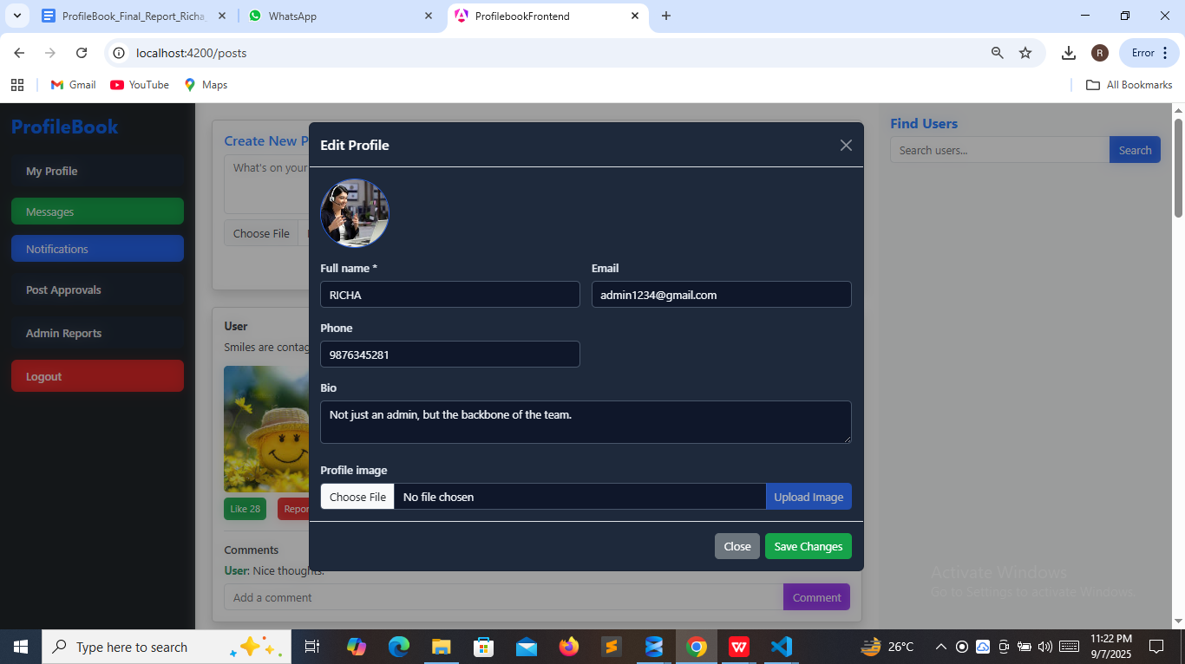
My Profile

Slide 14
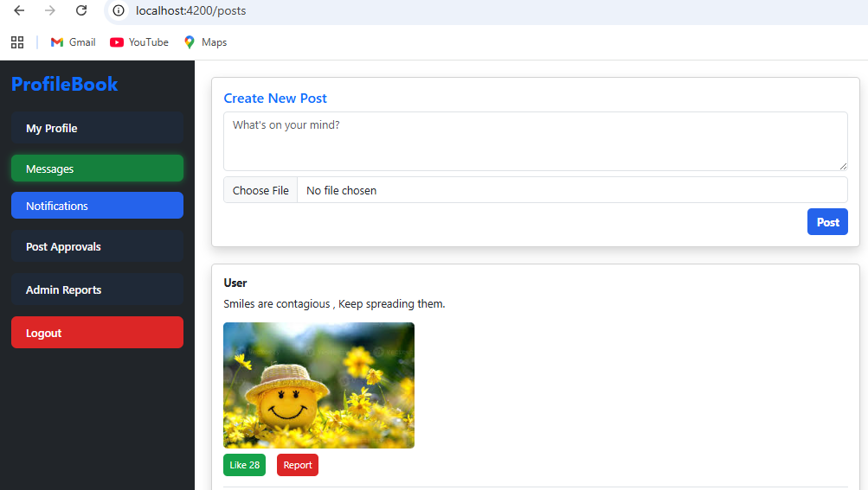
Create New Post

Slide 15
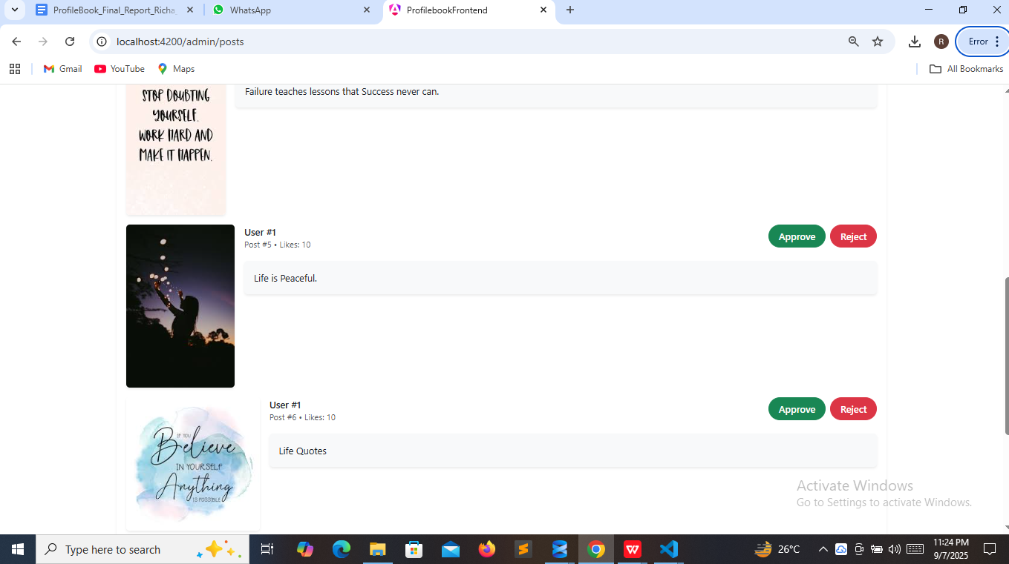
Post Approval Dashboard

Slide 16
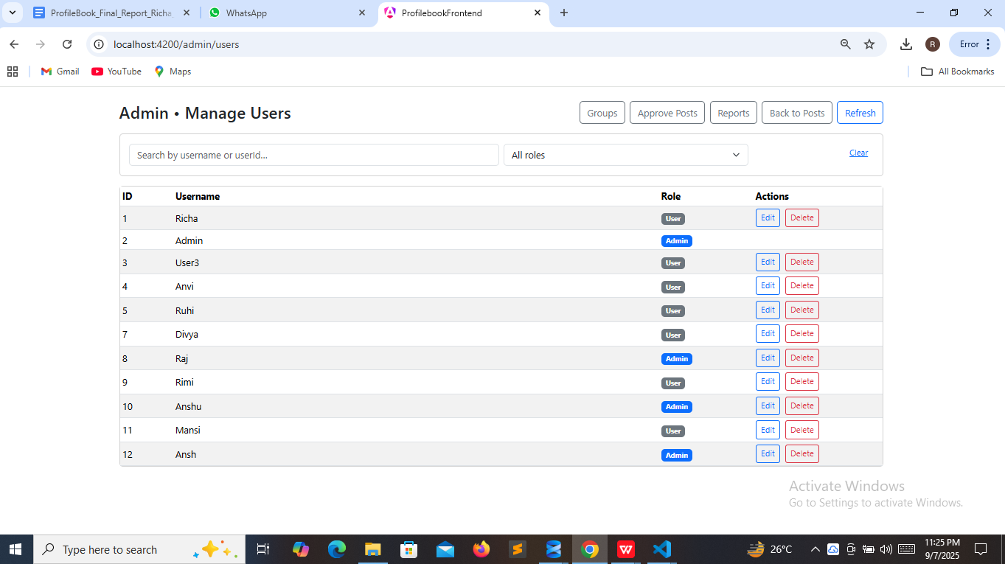
Admin Manage Users

Slide 17
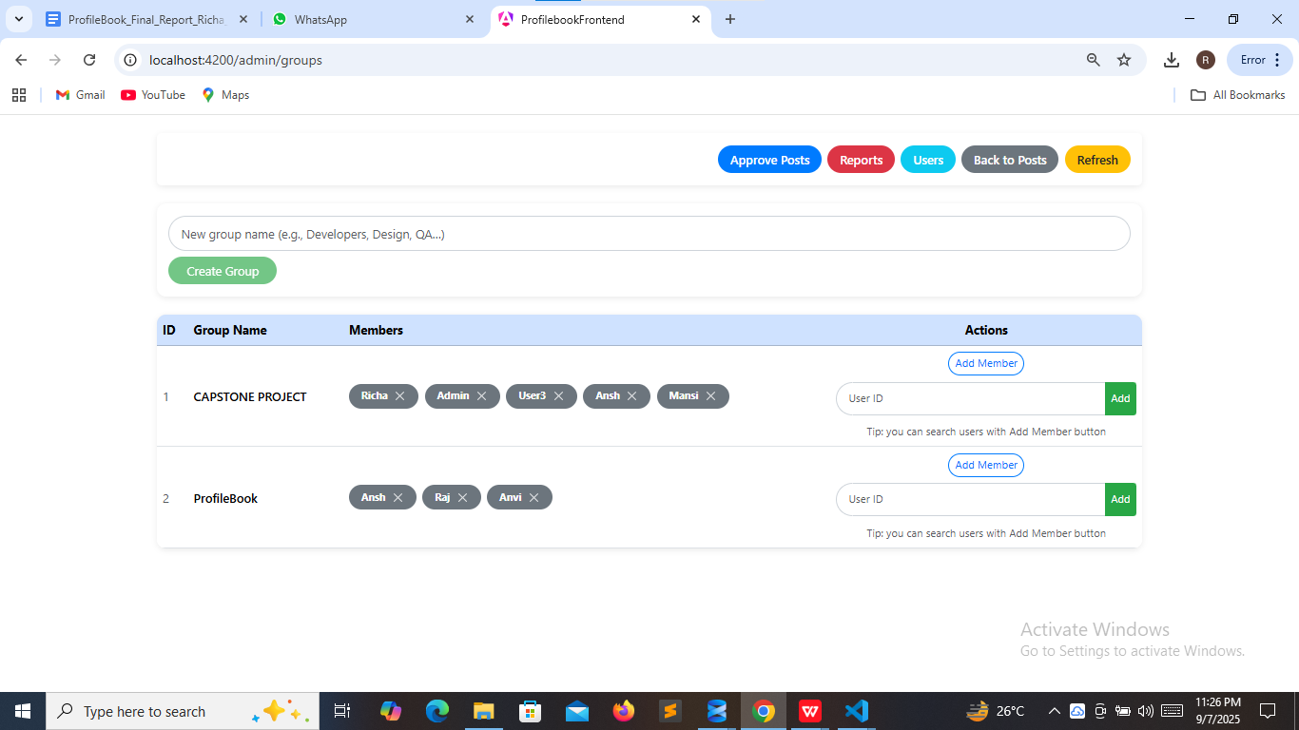
Create Groups

Slide 18
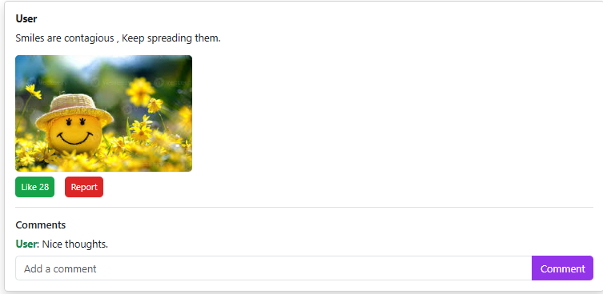
Like, Comment & Report

Slide 19
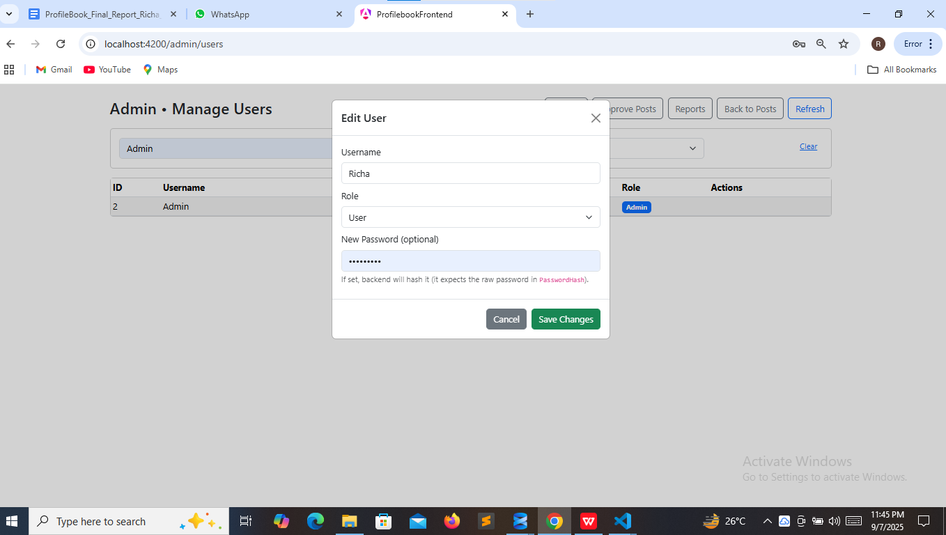
User Management Interface

Slide 20
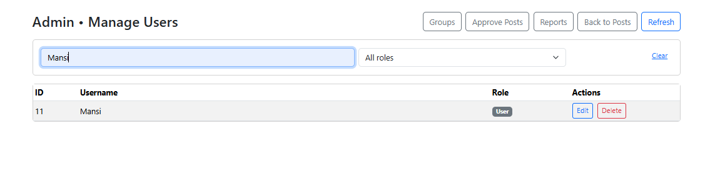
Search by Username/Role

Slide 21
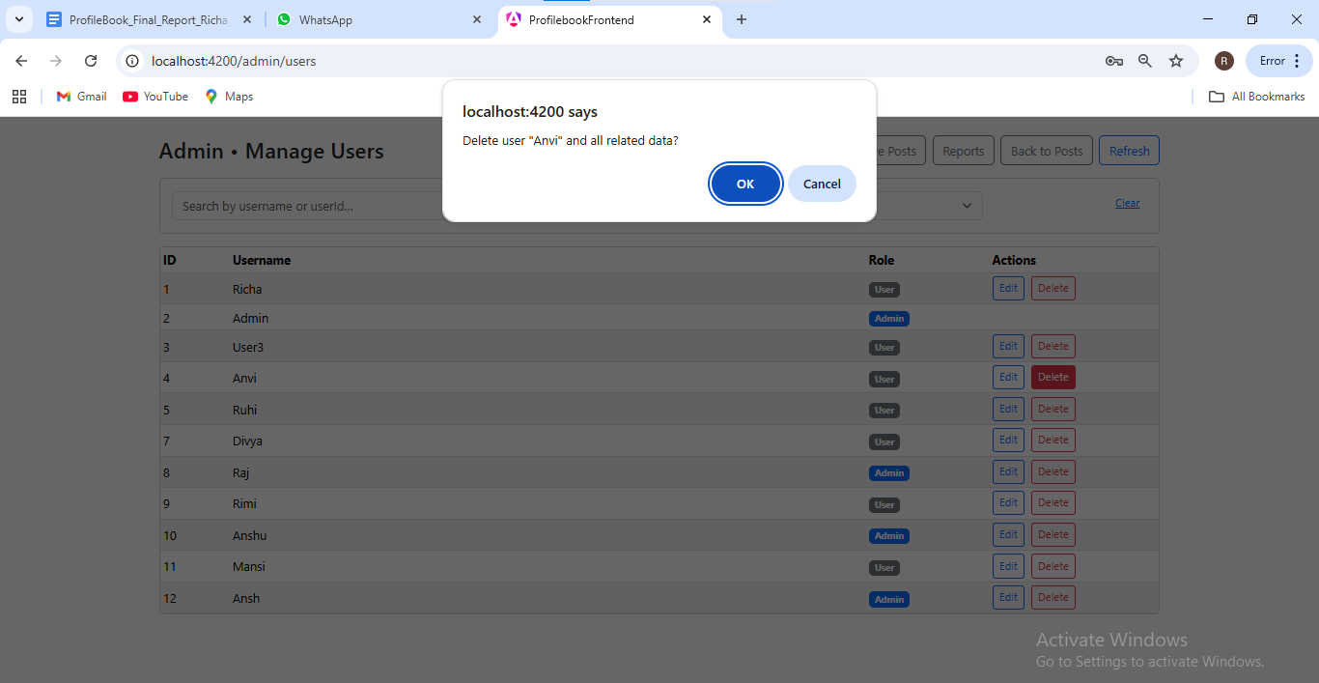
Admin Delete User

Slide 22
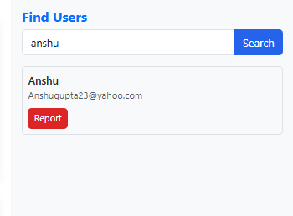
Search Users

Slide 23
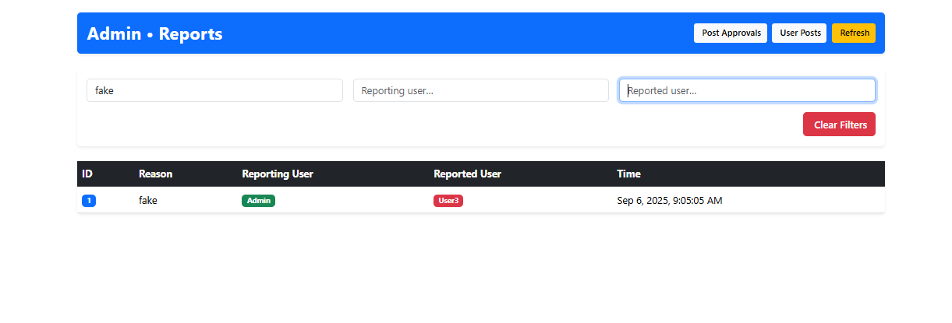
Search Reported Users

Slide 24
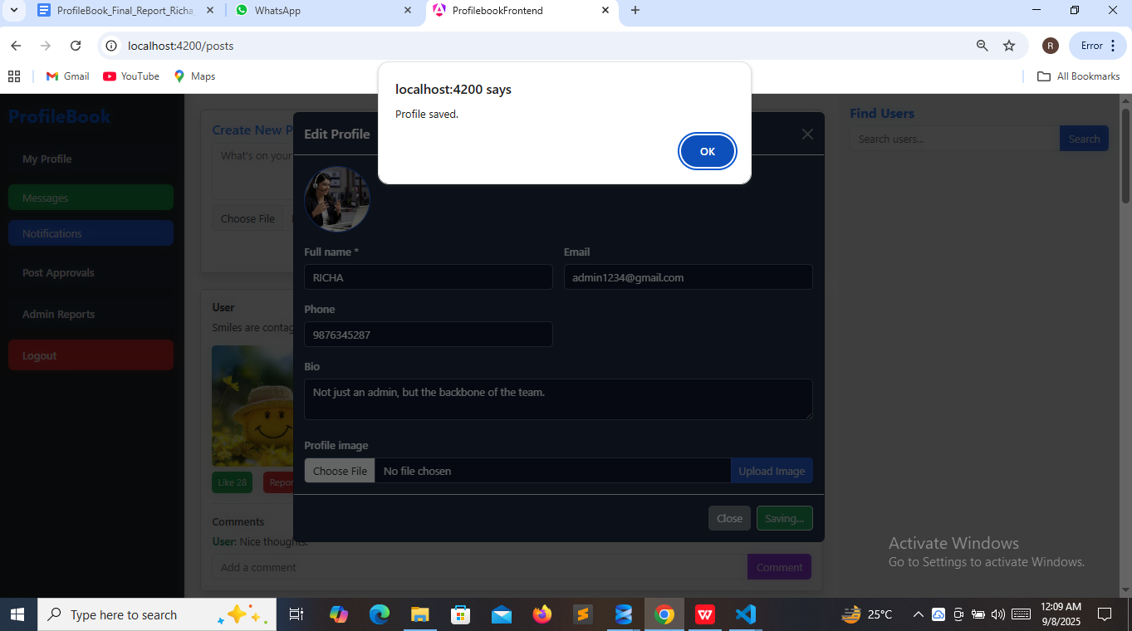
Profile Saved

Slide 25
Conclusion
Full-stack solution using Angular, ASP.NET Core, SQL Server.
Responsive UI with Angular.
Secure backend with REST APIs.
Efficient storage with SQL Server + EF Core.
Supports User and Admin role-based access.
Practical demonstration of full-stack development skills.

Slide 26
Special Thanks to Great Learning, Wipro, and my Trainer, Mentor Sir Parth Shukla for the guidance and Support.
THANK YOU

