Slide 1
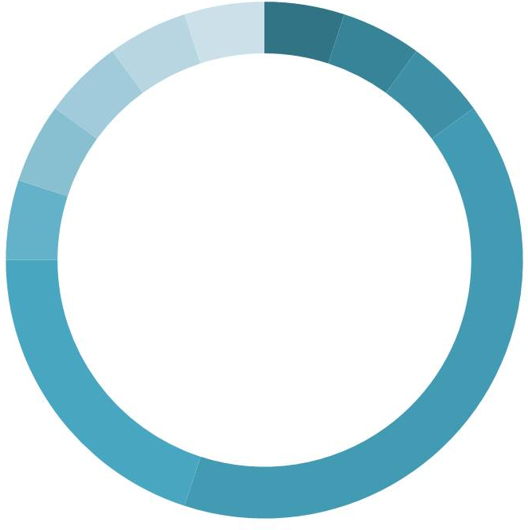


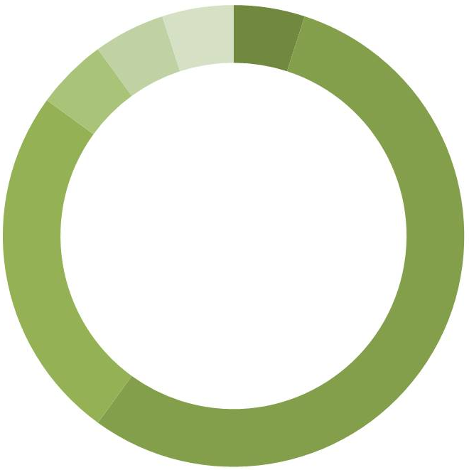
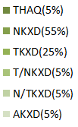
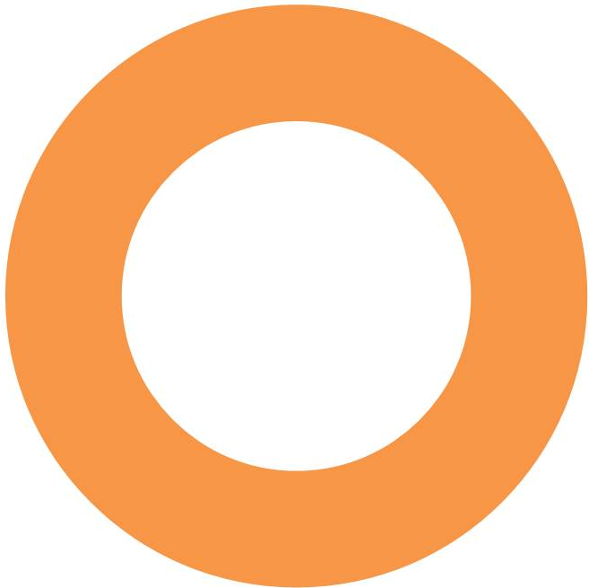

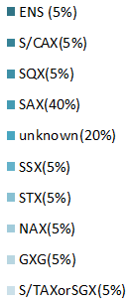

Slide 2
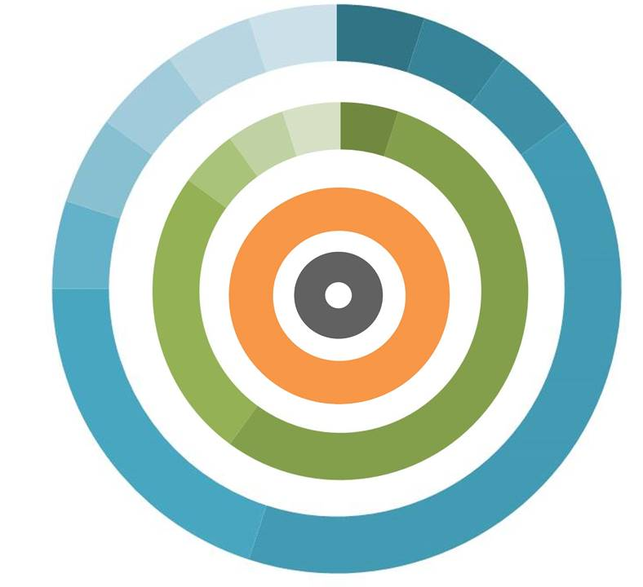

Sequences
spacing unknown
G1
G3
G5 Box
Consensus spacing 40-80 amino acids
G4
G4 Box
G3 Box
Consensus spacing 40-80 amino acids
G1 Box
G5

