Slide 1
Enhancing Security in Chat Applications: Integrating modified versions of AES, RSA, and ElGamal Encryption Techniques
19CSE311 Computer Security
Team_No: 2
Project Advisor:
Ms. Kavitha C.R.
Asst. Prof.(Sr.Gr.) CSE Dept.
S.No | Reg.No | Name of the Student | Section
1 | BL.EN.U4CSE21176 | S Navin Sunder | CSE C
2 | BL.EN.U4CSE21171 | Richa Vivek Savant | CSE C
3 | BL.EN.U4CSE21193 | Spoorthi M | CSE C

Slide 2
Problem Definition
To Design an End-to-End Chat Based Application using AES, RSA and ElGamal

Slide 3
Literature Survey
S.No | Author Name(s) | Full title of the paper with year | Inference from the paper (based on methodology, technology) | Open problem (for your proposed work)
4. | Xin Zhou & Xiaofei Tang | Research and implementation of RSA algorithm for encryption and decryption. (2011) | Emphasizes the critical role of RSA in ensuring information security by providing robust encryption and decryption solutions. It highlights the algorithm's effectiveness in maintaining confidentiality, integrity, and authenticity. | The paper suggests future research to improve the efficiency and security of the RSA algorithm.
5. | Eiichiro Fujisaki, Tatsuaki Okamoto, David Pointcheval & Jacques Stern | RSA-OAEP Is Secure under the RSA Assumption.(2010) | Reinforces the robustness of RSA–OAEP and suggests that it remains a reliable choice for secure encryption in cryptographic applications, despite the complexities involved in the security proof. | Suggests the need for further research to optimize the efficiency of security reductions for OAEP under various cryptographic assumptions.
6. | Yutong Zhong | An overview of rsa and oaep padding.(2022) | RSA-OAEP protects RSA against semantical insecurity. | No analysis into the encryption time, decryption time and resource utilization.

Slide 4
Literature Survey
S.No | Author Name(s) | Full title of the paper with year | Inference from the paper (based on methodology, technology) | Open problem (for your proposed work)
1. | Kannan et al. | Private Messaging Service using AES Encryption and Toxicity Detection. (2022) | The problem statement addresses the need for securing data and protecting users, especially minors, from harmful content in virtual spaces, while the methodology involves creating a private chat service using AES encryption and a Text Toxicity Prediction Model, with Express JS for server-side logic, locally stored keys using IndexedDB.6. | Future enhancements of this paper include integrating multi-factor authentication, improving the Text Toxicity Prediction Model for better security and performance.
2. | Bardis, N.G., Ntaikos, K. | Design of a secure chat application based on AES cryptographic algorithm and key management. (2008) | Designing and implementing a secure chat application using AES encryption and key management systems for authenticated users to send secure messages over a local network, with testing conducted to identify weaknesses before wider internet deployment . | The future work of Bardis et al.'s paper involves allowing the sending of encrypted data files, improving key storage facilities, enhancing communication security measures for larger user groups, and strengthening authentication control.
3. | Hidear Talirongan , Ariel M. Sison, Ruji P. Medina | Modified Advanced Encryption Standard using Butterfly Effect (2018) | The integration of the Butterfly Effect into the AES algorithm's round function resulted in significant improvements in security metrics, demonstrating enhanced encryption and decryption performance. | Future work involves further refining the modified AES algorithm, exploring additional security measures, and conducting more extensive testing to validate the effectiveness of the modifications.

Slide 5
Literature Survey
S.No | Author Name(s) | Full title of the paper with year | Inference from the paper (based on methodology, technology) | Open problem (for your proposed work)
7. | Zhu Yihong, Sun Lihong,Tang Zhuoliang and Zhang Fujun | The Application of ElGamal Encryption Technology to the Information Security of Digital Library. (2013) | The paper enhances digital library security by implementing ElGamal encryption, focusing on key pair generation, digital signatures, and secure data transmission to protect against unauthorized access and data manipulation. | The future work of this paper could involve further research and experimentation to explore the scalability and efficiency of the ElGamal encryption technology in larger digital library systems.
8. | Pratima Deshpande, S Santhanalakshmi, Lakshmi P | Experimental Study of Diffie-Hellman Key Exchange Algorithm on Embedded Devices. (2017) | The paper secures Raspberry Pi and Arduino communication using Diffie-Hellman, focusing on fast modular exponentiation and achieving 1ms (Arduino) and 0.4-0.6ms (Raspberry Pi) execution times. | Future work would be for exploring the scalability and performance implications of implementing the Diffie-Hellman key exchange algorithm on a larger network of interconnected embedded systems.
9. | J. Guruprakash and Srinivas Koppu | EC-ElGamal and Genetic Algorithm-Based Enhancement for Lightweight Scalable Blockchain in IoT Domain. (2019) | The paper enhances blockchain-based IoT security and performance using EC-ElGamal encryption, SHA-384 hashing, and Genetic Algorithms, evaluating metrics like processing time, validation, hash rate, and storage cost. | Future work is ensuring system scalability and efficiency with numerous IoT devices and high transaction volumes, while maintaining encryption and hashing security and addressing vulnerabilities.

Slide 6
Software/Tools Requirements
Front End Software:
JavaScript
CSS
HTML
Back End Software:
PHP
Xampp
MySQL
Hardware Requirements:
RAM: 4GB
Storage: 512GB
Operating System: Windows

Slide 7
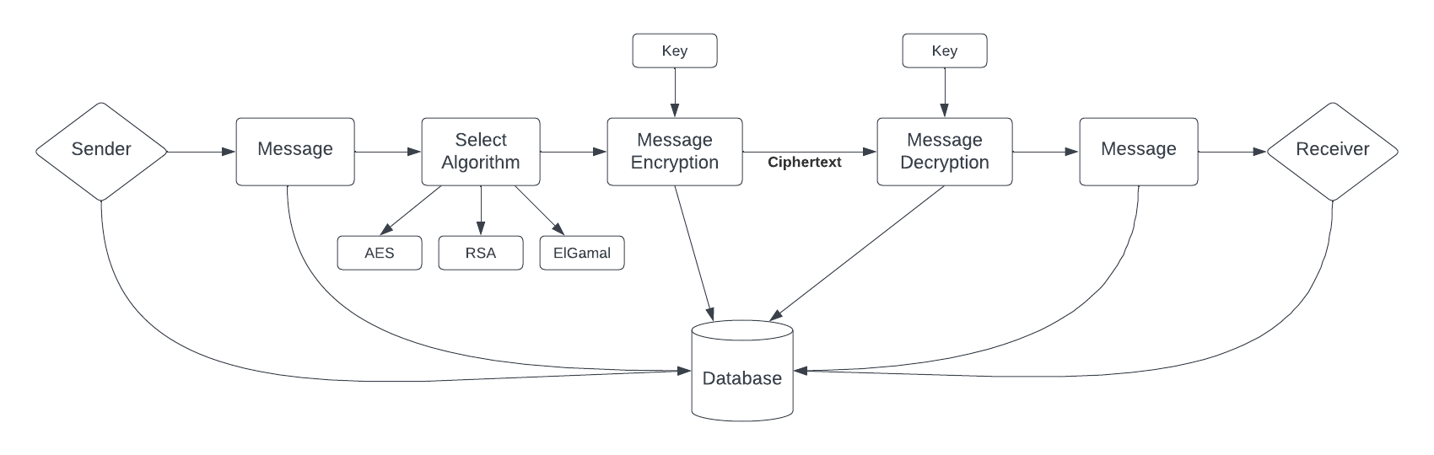
Architecture / Design

Slide 8
Implementation - AES
A symmetric encryption algorithm standardized by NIST.
Block Cipher: Encrypts data in fixed-size blocks (128 bits).
Key Sizes: 128, 192, or 256 bits.
Rounds: 10 rounds for 128-bit keys, 12 for 192-bit keys, and 14 for 256-bit keys.

Slide 9
Implementation - AES
Key Expansion: Generate round keys from the cipher key using the Key Expansion algorithm.
Initial Round: AddRoundKey: Each byte of the state is combined with a block of the round key using bitwise XOR.
Main Rounds (9, 11, or 13 rounds depending on the key size):
SubBytes: Each byte in the state is replaced with its corresponding byte in the S-box (substitution box).
ShiftRows: Rows of the state are shifted cyclically to the left by different offsets.
MixColumns: Columns of the state are mixed by multiplying them with a fixed polynomial.
AddRoundKey: Each byte of the state is combined with the round key.
Final Round (Same as Main Rounds, but without the MixColumns step):

Slide 10
Implementation - AES
SubBytes:
Replace each byte in the state with a byte from the S-box.
S-box: Non-linear substitution table for byte substitution.
ShiftRows:
First row remains unchanged.
Second row shifts left by one byte.
Third row shifts left by two bytes.
Fourth row shifts left by three bytes.
MixColumns:
Transform each column using matrix multiplication in a finite field.
Provides diffusion by mixing the bytes in each column.
AddRoundKey: XOR the state with the round key derived from Key Expansion.

Slide 11
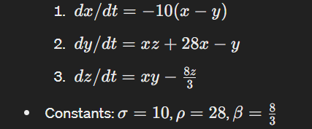
Implementation - AES
AES algorithm with the butterfly effect AND bit inversion:
Butterfly Effect: Concept from chaos theory implying "little causes can have bigger effects."
Lorenz Attractor: Algorithm by Edward Norton Lorenz to solve chaotic systems.
Formulas:

Slide 12
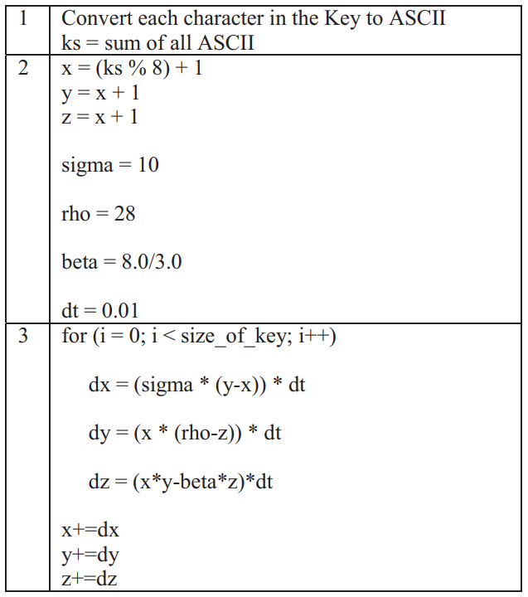
Implementation - AES
The butterfly effect algorithm for key updation:
for (i=0; i < 4; i++)
for(j=0; j<size_of_plaintext; j++)
{
temp=Butterfly_Effect[round*size_of_plaintext + j] >> (3-i) )*8
temp%=256
temp=(temp<0 ? (256+temp) : temp)
Cipher_Text[$i][$j] ^= temp }
end for loop
end for loop

Slide 13
Implementation - AES
Encryption Process modification with butterfly effect AND bit inversion:
Invert odd bits
AddRoundKey
Main Rounds (Nr-1):
SubBytes
ShiftRows
MixColumns
AddButterflyEffect: Introduce non-linearity and chaos.
AddRoundKey
Final Round:
SubBytes
ShiftRows
AddButterflyEffect
AddRoundKey

Slide 14
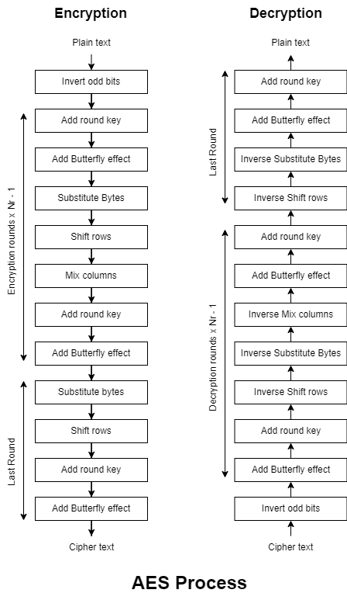
Implementation - AES
AES modified architecture for encryption and decryption process

Slide 15
Implementation - AES
Benefits of using AES with butterfly effect:
Enhanced Security:
Increased diffusion
Improved confusion
Better integrity check
Non-linear differential equations make reverse engineering the encryption process difficult
More resilient to known cryptographic attacks, such as brute-force, side-channel, and statistical attacks.
Benefits of inverting the odd position bits in AES initial round:
Flipping one bit in the plaintext will affect 32 bits after the MixColumn round operation.
Increases diffusion property after the MixColumn round.

Slide 16
Implementation - RSA-OAEP
RSA’s security is based on the difficulty of factoring large integers.
The standard algorithm is prone to various attacks.
One of these categories is ‘Plaintext Attacks’, which has a subcategory of ‘Short Message Attacks’.
Solution: Padding with bogus data.
Advantage: Confuses attackers (actual / padded bits).

Slide 17
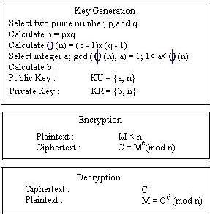
Implementation - RSA-OAEP

Slide 18
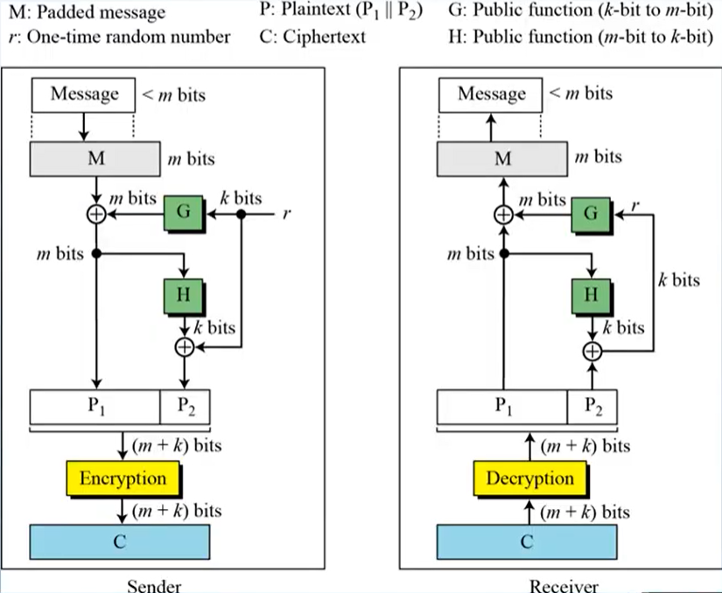

Implementation - RSA-OAEP
Padding
MGF/Obfuscation
G → k bits to m bits
H → m bits to k bits
P = P1 || P2

Slide 19
Implementation - El Gamal
The standard algorithm performing well for the real world scenarios. Its performance decreases on selecting the prime numbers for encryption and decryption
Computation cost for the algorithm is high using the standard algorithm.
Using Miller-Rabin Primality test.
Handle larger values of prime number and checks if they are prime or not by doing minimum number of iterations.
Using the equation p = 2*q + 1 which ensures that for a selected p if prime then q also is prime.

Slide 20
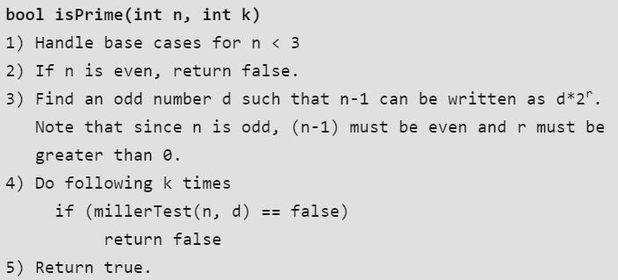
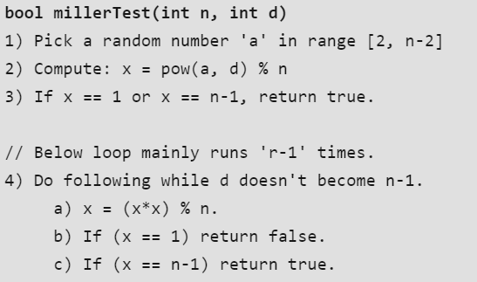
Implementation - El Gamal
Working of the algorithm:

Slide 21
Implementation - Chat Website
The application is implemented using the Xampp apache as a back-end server.
The algorithms are built using the programming languages PHP and JavaScript along with CSS for Styling.
The DataBase is built using MySQL which is integrated with phpmyadmin to view the movement of entire data in the application.

Slide 22
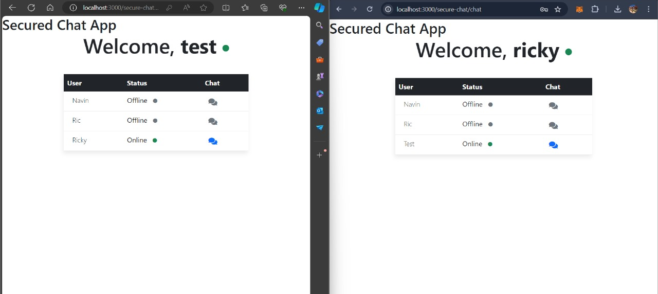
Implementation - Chat Website

Slide 23
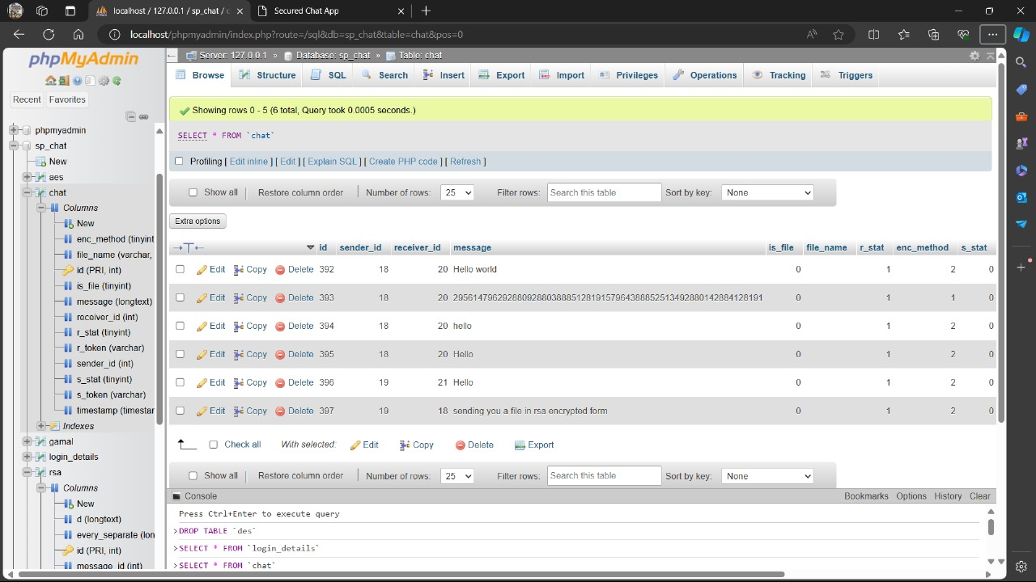
Implementation - Chat Website

Slide 24
Testing

Slide 25
Result and Analysis
Faster primality testing with better accuracy in determining the prime numbers.
Reduction in the time complexity of the algorithm.
Faster computation speed implies the better resource utilization.
Overall, making the chat application more secure.

Slide 26
Demonstration
Demo need to be presented

Slide 27
Timeline
Abstract Submission
17th April 2024
Literature Survey
24th April 2024
Design [Front End, Back End]
25th April- 6th May, 2024
Implementation
16th May, 2024
Testing
19th May 2024
Document Submission
26th May 2024

Slide 28
Conclusion and Future Enhancements
The AES standard algorithm updated using butterfly effect introduced to the key generation step at every stage of the round key generation has enhanced the overall security: confusion, diffusion, in addition to the bit inversion feature added at initial step
Robust Security: OAEP adds probabilistic encryption to RSA, preventing pattern recognition attacks.
Enhanced Resistance: OAEP's padding and masking techniques guard against chosen plaintext and ciphertext attacks.
Semantic Security: OAEP ensures ciphertext reveals no plaintext information, protecting against data breaches.
Performance Trade-offs: Minimal delays and resource use are justified by OAEP's significant security benefits.

Slide 29
Conclusion and Future Enhancements
ELGamal standard algorithm updated using Miller-Rabin primality test for faster derivation of the prime numbers used for the computation.
Overall reduces the computational cost and increases the improves the computation speed of the algorithm.
FUTURE WORK:
The updations in all the three algorithms, AES, RSA and ElGamal, have enhanced the security of the algorithms for a secure chat application, but the SPEED of the encryption and decryption remains a lagging factor.
Improvement of the computational speed can be worked upon in further study

Slide 30
Status of the project work Publication Yes / No
YES

Slide 31
References
Tharunraj, M. and Kannan, S., 2022, April. Private Messaging Service using AES Encryption and Toxicity Detection. In 2022 International Conference on Electronic Systems and Intelligent Computing (ICESIC) (pp. 173-178). IEEE.
Kumar, S. and Vashistha, A., 2013. Using El Gamal Cryptosystem in Message Feedback Mode for Computing Cost Reduction. International Journal of Computer Applications, 975, p.8887.
Bardis, N.G. and Ntaikos, K., 2008, October. Design of a secure chat application based on AES cryptographic algorithm and key management. In WSEAS International Conference. Proceedings. Mathematics and Computers in Science and Engineering (No. 10). WSEAS.
Bhaskar, R., Hegde, G. and Vaya, P.R., 2012. An efficient hardware model for RSA Encryption system using Vedic mathematics. Procedia Engineering, 30, pp.124-128.
Deshpande, P., Santhanalakshmi, S., Lakshmi, P. and Vishwa, A., 2017, August. Experimental study of Diffie-Hellman key exchange algorithm on embedded devices. In 2017 International Conference on Energy, Communication, Data Analytics and Soft Computing (ICECDS) (pp. 2042-2047). IEEE.
Starikovskiy, A., Zhgilev, A. and Shevchenko, N., 2018. Text Messages Protection System. Procedia computer science, 123, pp.457-466.

Slide 32
References
7. Bardis, N.G. and Ntaikos, K., 2008, October. Design of a secure chat application based on AES cryptographic algorithm and key management. In WSEAS International Conference. Proceedings. Mathematics and Computers in Science and Engineering (No. 10). WSEAS.
8. Nayak, S., Das, S., Das, S., Sarker, S., Sarker, P., Dey, A., Sinha, A., Saha, J., Banerjee, A., Saha, N. and Chowdhury, S., 2017, October. An application for end to end secure messaging service on Android supported device. In 2017 8th IEEE Annual Information Technology, Electronics and Mobile Communication Conference (IEMCON) (pp. 290-294). IEEE.
9. Tharunraj, M. and Kannan, S., 2022, April. Private Messaging Service using AES Encryption and Toxicity Detection. In 2022 International Conference on Electronic Systems and Intelligent Computing (ICESIC) (pp. 173-178). IEEE.
10. }Bodur, H. and Kara, R., 2015. Secure SMS Encryption Using RSA Encryption Algorithm on Android Message Application. In 3rd International Symposium On Innovative Technologies In Engineering And Science.
11. Sönmez, F. and Abbas, M.K., 2017. Development of a Client/Server Cryptography-Based Secure Messaging System Using RSA Algorithm. J. Manag. Eng. Inf. Technol, 4(6)

Slide 33
References
12. Harshitha, Y., Seema, S. and Apoorva, P., 2017, June. Comparative study on RSA algorithm of multi-keyword search scheme over encrypted cloud data. In 2017 International Conference on Intelligent Computing and Control (I2C2) (pp. 1-6). IEEE.
13. Akhil, K.M., Kumar, M.P. and Pushpa, B.R., 2017, June. Enhanced cloud data security using AES algorithm. In 2017 International Conference on Intelligent Computing and Control (I2C2) (pp. 1-5). Ieee.
14. Aparna, V.S., Rajan, A., Jairaj, I., Nandita, B., Madhusoodanan, P. and Remya, A.A., 2019, April. Implementation of AES algorithm on text and image using MATLAB. In 2019 3rd International Conference on Trends in Electronics and Informatics (ICOEI) (pp. 1279-1283). IEEE.
15. Guruprakash, J. and Koppu, S., 2020. EC-ElGamal and Genetic algorithm-based enhancement for lightweight scalable blockchain in IoT domain. IEEE Access, 8, pp.141269-141281.

Slide 34
Contribution of the Team Members
Sl. No. | Reg. No. | Name | Contribution description
1 | BL.EN.U4CSE21176 | S Navin Sunder | ELGamal algorithm modified using Miller-Rabin primality test for better performance
2 | BL.EN.U4CSE21171 | Richa Vivek Savant | RSA algorithm modified using OAEP to improve the security of the algorithm
3 | BL.EN.U4CSE21193 | Spoorthi M | AES encryption algorithm modified to improve security by adding features of the butterfly effect and bit inversion

Slide 35
THANK YOU

