Slide 1

Market Trends & Customer Insights Analysis of Zudio
Leveraging Power BI to uncover actionable retail intelligence across categories, cities, and customer segments — 2023 to 2026
POWER BI ANALYTICS
2023–2026
Name: Richal Kandulna
Roll No.: 2401247017
Course: PGDM (2024-26)

Slide 2
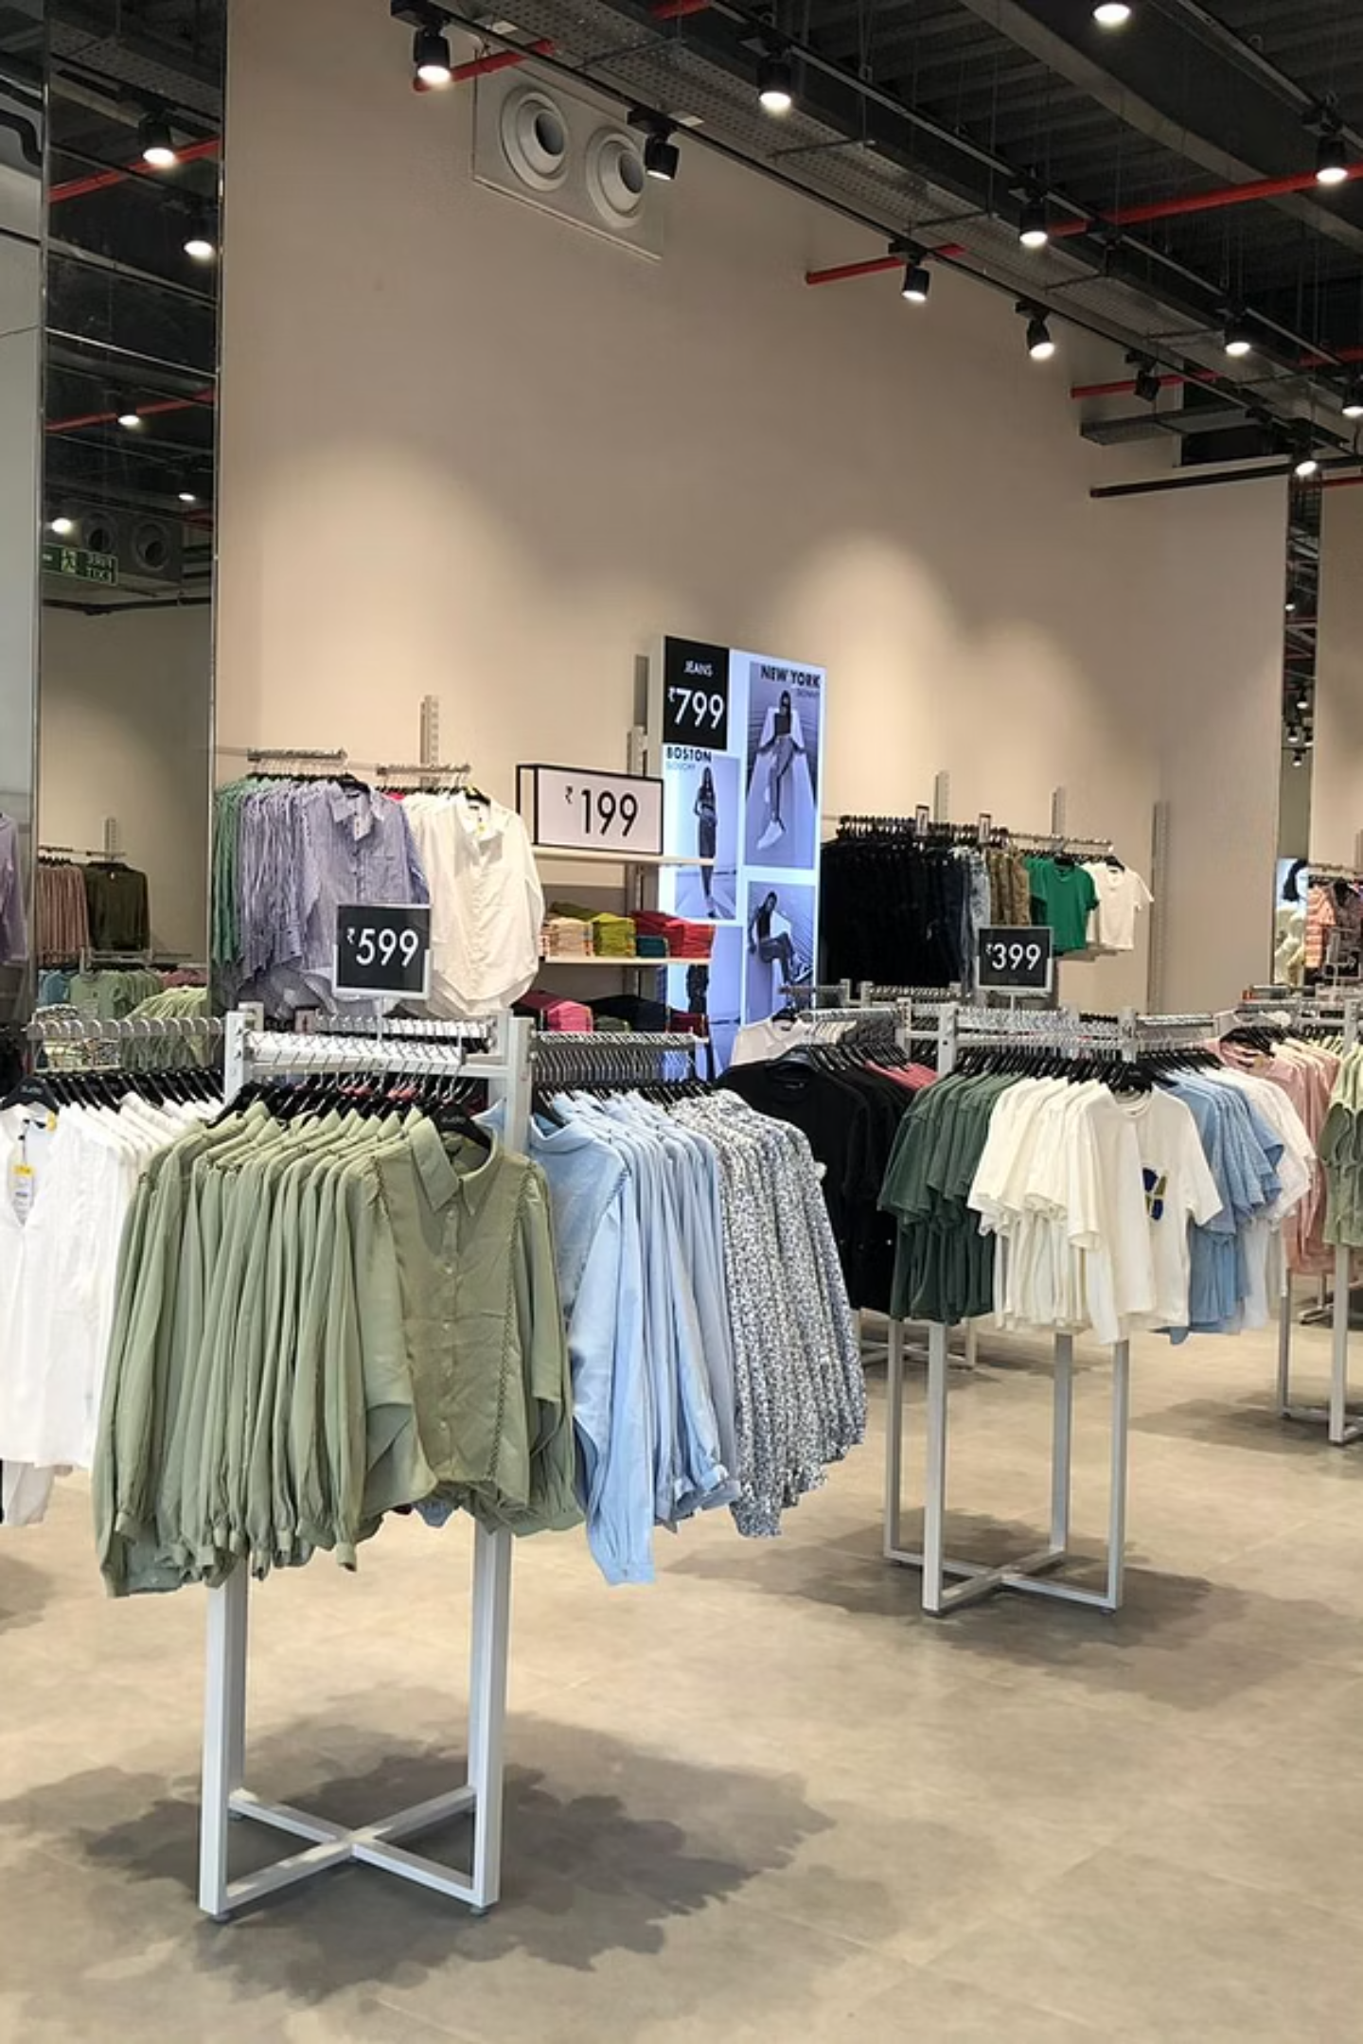
Company Overview
Brand Identity
Parent Company
Zudio is a value fashion brand offering trendy, affordable apparel for the everyday Indian consumer.
Wholly owned by Trent Ltd., the retail arm of the Tata Group — one of India's most trusted conglomerates.
Rapid Expansion
Aggressive store rollout across Tier 1 and Tier 2 Indian cities, making fashion accessible to a wide demographic.

Slide 3
Problem Statement
Despite strong growth, Zudio faces critical operational and analytical gaps that limit its ability to scale efficiently and serve customers effectively.
Demand Prediction Challenges
Inventory Inefficiencies
Inconsistent forecasting leads to stockouts during peak seasons and overstock during slow periods.
Poor visibility into real-time stock levels results in wasted capital and missed revenue opportunities.
Lack of Customer Insights
Regional Variations
Limited data on purchasing behavior prevents personalized marketing and effective category planning.
Sales patterns differ significantly across cities, yet strategies remain largely uniform and centralized.

Slide 4

Project Objectives
Identify Categories
Analyze Trends
Track sales performance across 2023–2026.
Prioritize Men, Women, Kids by revenue.
Understand Customers
Improve Decisions
Assess discount sensitivity and purchase patterns.
Enable data-driven retail strategy and action.
This analysis is designed to translate raw retail data into strategic intelligence — enabling Zudio's merchandising and leadership teams to act with confidence and precision.

Slide 5
Dataset Overview
Scope of Data
A comprehensive four-year dataset capturing Zudio's retail performance across multiple dimensions:
⏱ Time Period
🏙 Cities
👕 Categories
📊 Metrics
2023 – 2026
5 Key Markets
Men · Women · Kids
Revenue · Quantity · Discount

Slide 6
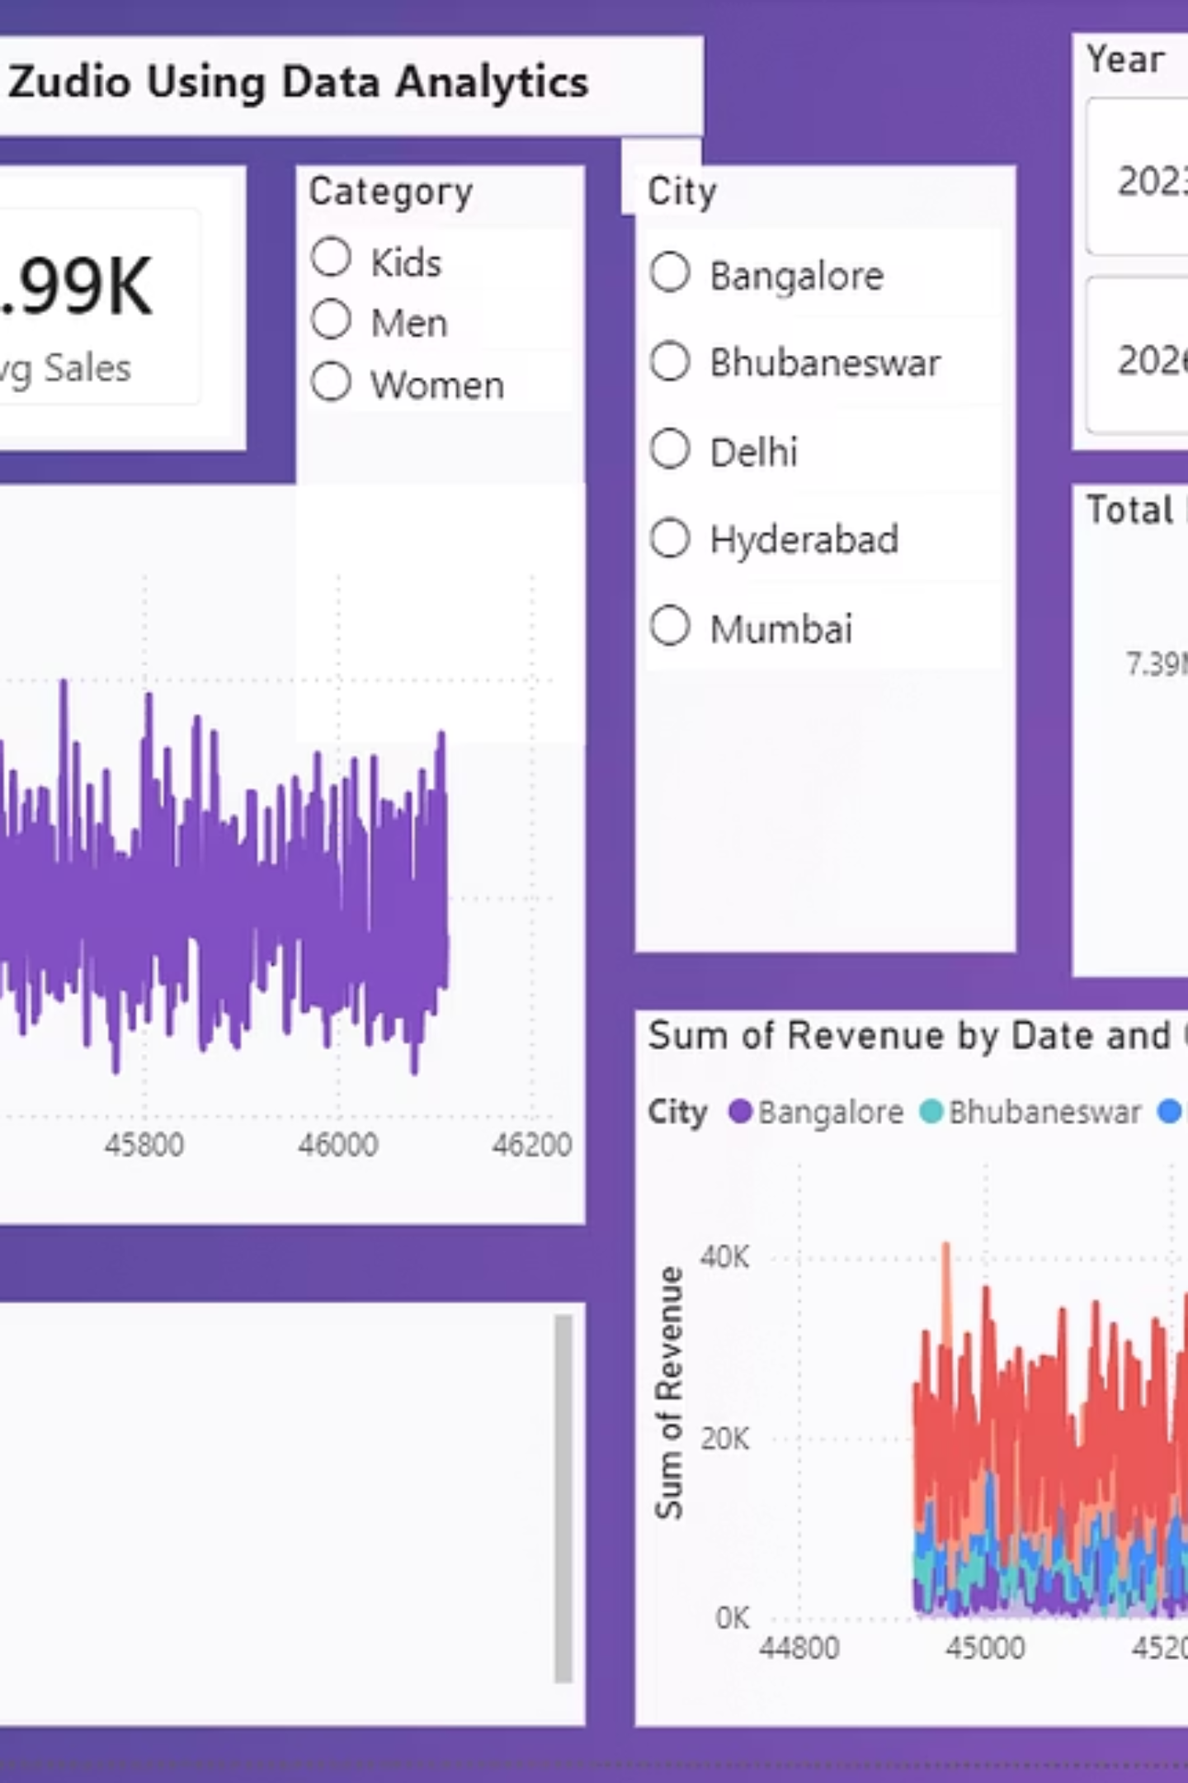
Power BI Dashboard
A multi-page interactive dashboard was built in Power BI to centralize Zudio's retail intelligence — enabling drill-through analysis and dynamic filtering across all key dimensions.
Overview Page
1
High-level KPIs, revenue trends, and total performance snapshot
Category Page
2
Breakdown of sales by Men, Women, and Kids segments
City Page
3
Geographic performance comparison across 5 metro markets
Discount Page
4
Discount depth vs. volume analysis and margin impact

Slide 7

Key Visuals in the Dashboard
KPI Cards
Sales Trend Line Chart
At-a-glance metrics for Total Revenue, Total Orders, and Average Sales Value — updated dynamically with every filter selection.
Monthly and yearly revenue trajectory highlighting seasonality, growth spurts, and dips across the 2023–2026 period.
Category Bar Chart
City Performance Chart
Side-by-side revenue and quantity comparison across Men, Women, and Kids categories for quick merchandising decisions.
Visual ranking of sales performance across 5 cities — enabling regional strategy and resource allocation.

Slide 8
Key Findings
What the Data Revealed
Women's category generates the highest revenue across all years and cities — a consistent top performer.
Metro cities dominate total sales volume, accounting for the majority of Zudio's revenue base.
Discount campaigns significantly boost purchase volume, though margin sensitivity must be managed carefully.
Year-over-year sales show a clear upward trajectory, validating Zudio's expansion strategy.
#1
5
4
Women's Category
Cities Analyzed
Years of Data
Highest revenue contributor across all regions
Metro markets driving majority of sales
Consistent YoY growth confirmed

Slide 9

Recommendations
Double Down on High-Performing Categories
Prioritize Women's and fast-growing Kids segments in inventory allocation and marketing spend.
Optimize Discount Strategy
Use targeted, time-bound discounts to drive volume without eroding margins — avoid blanket promotions.
Improve Inventory Planning
Leverage Power BI forecasts to align stock levels with demand signals, reducing both overstock and stockouts.
Embed Data-Driven Culture
Scale the dashboard to store managers and regional leads so decisions at every level are grounded in evidence.

Slide 10
Conclusion
This project demonstrates how Power BI can transform raw retail data into a strategic asset for Zudio — enabling smarter merchandising, better inventory control, and stronger business outcomes.
Data-Driven Insights
Business Performance
Strategic Enablement
Power BI unlocks patterns invisible to traditional reporting
Analytics directly improves revenue, efficiency, and margins
Leaders gain confidence to act on real-time intelligence
Thank You — Questions & Discussion Welcome

