Slide 1

B.M.S. College of
Engineering
Bio Inspired Algorithm
23DS6PWPP1
Solar Photovoltaic Power Generation Forecasting Using CatBoost Regressor Optimized with Grey Wolf Optimizer
Abhigna Urs (1BM23CD002)
Milan Agarwal (1BM23CD038)
Richal Vanshika (1BM23CD049)
Priyanka A Huddar (1BM24CD402)
Prof. Manoj Kumar
Assistant Professor
Department of CSE(Data Science)
BMSCE, Bengaluru

Slide 2

B.M.S. College of
Engineering
Table of Contents
1. Introduction to optimization problems
2. What are nature inspired algorithms
3. Problem statement
4. Datasets and its preprocessing
5. Implementation and results
6. Performance metrics and benchmarks
7. Advantages and limitations
8. References
Department of Computer Science Engineering(Data Science)

Slide 3
B.M.S. College of
Engineering
1. Introduction to Optimization Problems
What is Optimization?
Finding the best solution (optimal hyperparameters) from all possible search configurations
Minimizing an objective function: Validation Root Mean Squared Error (RMSE)
Subject to constraints: Parameter boundaries (tree depth, learning rate, regularization penalties)
Types of Optimization Problems in Machine Learning:
Continuous: Real-valued parameters (e.g., learning rate in [0.02, 0.25], L2 leaf regularization in [1.0,10.0])
Discrete: Integer parameters (e.g., number of trees / iterations in [60, 350], tree depth in [3, 7])
Mixed: Combination of both continuous and discrete parameter spaces
Multi-objective: Balancing prediction accuracy (RMSE/MAE) vs. training complexity and inference latency
Department of Computer Science Engineering(Data Science)

Slide 4
B.M.S. College of
Engineering
2. Nature Inspired Algorithms
Definition:
Optimization algorithms inspired by natural, biological, physical, or swarm intelligence phenomena
Mimic biological leadership, foraging patterns, and collective hunting dynamics
Metaheuristic approaches designed to explore high-dimensional non-convex search landscapes
Popular Nature-Inspired Algorithms:
Grey Wolf Optimizer (GWO): Social hierarchy (α, β, δ, ω) and collective pack hunting [Chosen Algorithm]
Genetic Algorithm (GA): Darwinian natural selection, crossover, and mutation
Particle Swarm Optimization (PSO): Bird flocking and swarm velocity update vectors
Ant Colony Optimization (ACO): Foraging paths driven by pheromone deposition and evaporation
Differential Evolution (DE): Population differences and vector mutation operators
Key Advantages for CatBoost Optimization:
Derivative-Free: Requires zero gradient information from tree split boundaries
Escapes Local Optima: Random coefficient vectors A and C avoid premature convergence
Mixed-Variable Handling: Seamlessly explores real and integer hyperparameter spaces
Global-to-Local Transition: Parameter 'a' decays from 2 to 0 to balance exploration and exploitation
Department of Computer Science Engineering(Data Science)

Slide 5
B.M.S. College of
Engineering
3. Problem Statement
Research Challenge:
Solar photovoltaic power generation exhibits high non-linearity due to rapid atmospheric and weather fluctuations
Grid operators require highly dependable 15-minute ahead power forecasting to prevent grid instability and spinning reserve penalties
Default machine learning models settle in suboptimal hyperparameter configurations, suffering from peak-hour prediction errors
Specific Problem:
Forecast total AC Power Generation (kW) for utility-scale solar plant (Kaggle Benchmark Plant 1)
Automate hyperparameter tuning of CatBoost Regressor using Grey Wolf Optimizer (GWO)
Empirically prove that bio-inspired GWO tuning achieves statistically superior accuracy over default baseline
Target Meteorological & Sensor Variables:
Solar Irradiation (kW/m²): Primary driver of photovoltaic photon conversion
Ambient Temperature (°C) & Module Temperature (°C): Panel thermal efficiency loss
Temperature Differential (Module - Ambient): Direct thermal heat absorption indicator
Diurnal Solar Trajectory (Sin/Cos Cyclical Hour Angles): Sun elevation physics
Department of Computer Science Engineering(Data Science)

Slide 6
B.M.S. College of
Engineering
4. DATASETS AND ITS PREPROCESSING
Dataset Specifications:
Source: Solar Power Generation Data (Kaggle Benchmark, Plant 1)
Duration: 34 consecutive days (May 15, 2020 – June 17, 2020) at 15-minute intervals (3,157 timestamps)
Aggregation: 22 Inverter streams aggregated into total solar farm AC Power (kW)
Weather Sensors: Single plant-level weather array recording irradiation and temperature sensors
Feature Engineering Pipeline (9 Features):
Ambient & Module Temperatures (°C) + Solar Irradiation (kW/m²)
Thermal Difference: TEMP_DIFF = MODULE_TEMP - AMBIENT_TEMP
Cyclical Time Encoding: HOUR_SIN = sin(2π·t/24) and HOUR_COS = cos(2π·t/24)
Thermal-Radiative Interaction: IRRAD_TEMP_INTERACTION = IRRADIATION × MODULE_TEMP
Temporal Chronological Splitting (No Future Data Leakage):
Training Set (70%): 2,209 samples (May 15 – June 08, 2020)
Validation Set (15%): 474 samples (June 08 – June 13, 2020) [Dedicated to GWO Fitness]
Test Set (15%): 474 samples (June 13 – June 17, 2020) [Final Unseen Evaluation]
Department of Computer Science Engineering(Data Science)

Slide 7
B.M.S. College of
Engineering
5. Implementation and Results
System Architecture & Chromosome Vector:
Pipeline: Ingestion → Feature Engineering → Baseline CatBoost → GWO Optimizer → Evaluation
4-Gene Decision Chromosome Vector: X = [iterations, learning_rate, depth, l2_leaf_reg]
• Gene 1 (iterations): [60, 350] (Discrete integer, ensemble tree count)
• Gene 2 (learning_rate): [0.02, 0.25] (Continuous float, gradient step size)
• Gene 3 (depth): [3, 7] (Discrete integer, symmetric tree depth)
• Gene 4 (l2_leaf_reg): [1.0, 10.0] (Continuous float, L2 regularization penalty)
Objective Fitness: Minimize Validation RMSE = sqrt( (1/N_val) * Σ (y_val - y_pred)^2 )
GWO Algorithm Configuration:
• Pack Size: N = 10 wolves
• Max Iterations: T = 30 generations
• Total Model Evaluations: 300 runs
• Hierarchy Tiers: Alpha (α), Beta (β), Delta (δ), Omega (ω)
• Hunting Update: X(t+1) = (X1 + X2 + X3) / 3
• Decaying Parameter: a = 2 - 2(t / T)
• Discovered Optimal Alpha Chromosome:
- Trees: 178 | LR: 0.2148 | Depth: 6 | L2: 6.1076
Department of Computer Science Engineering(Data Science)

Slide 8
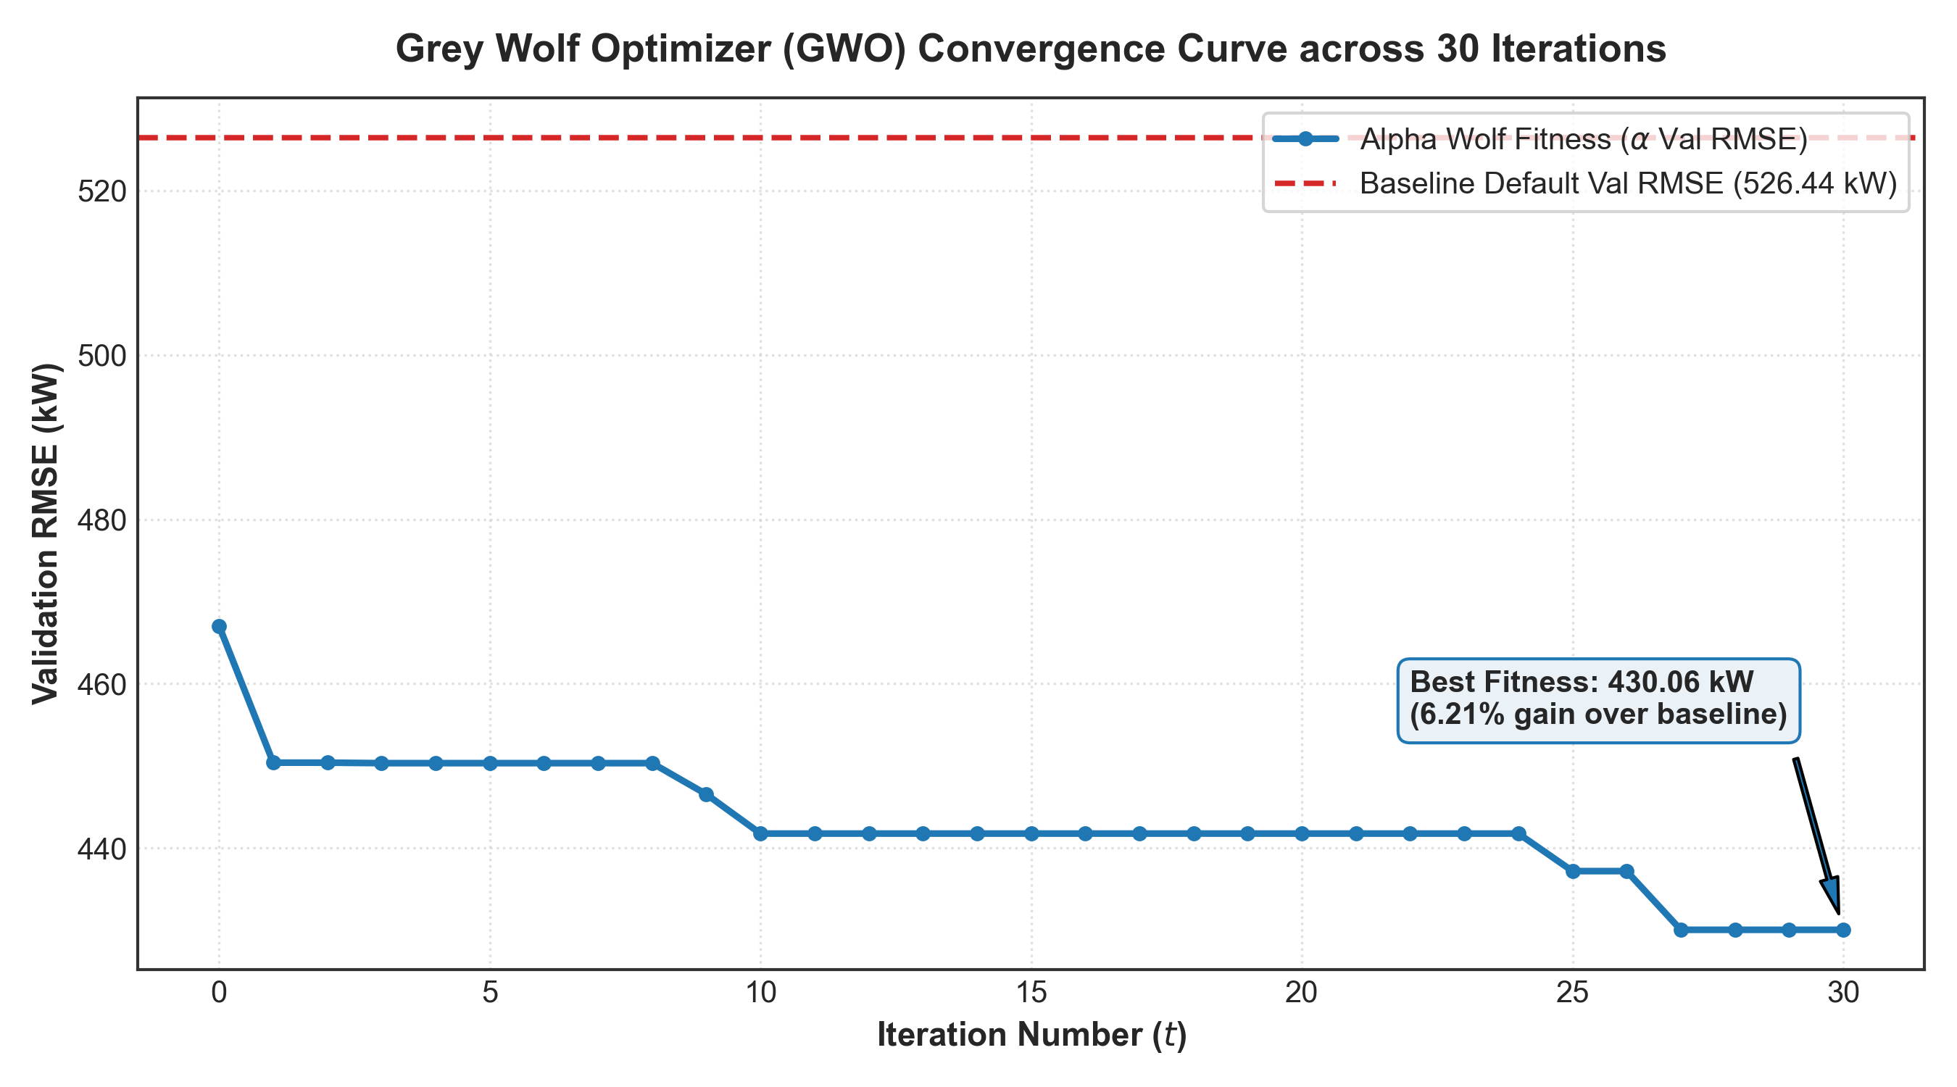
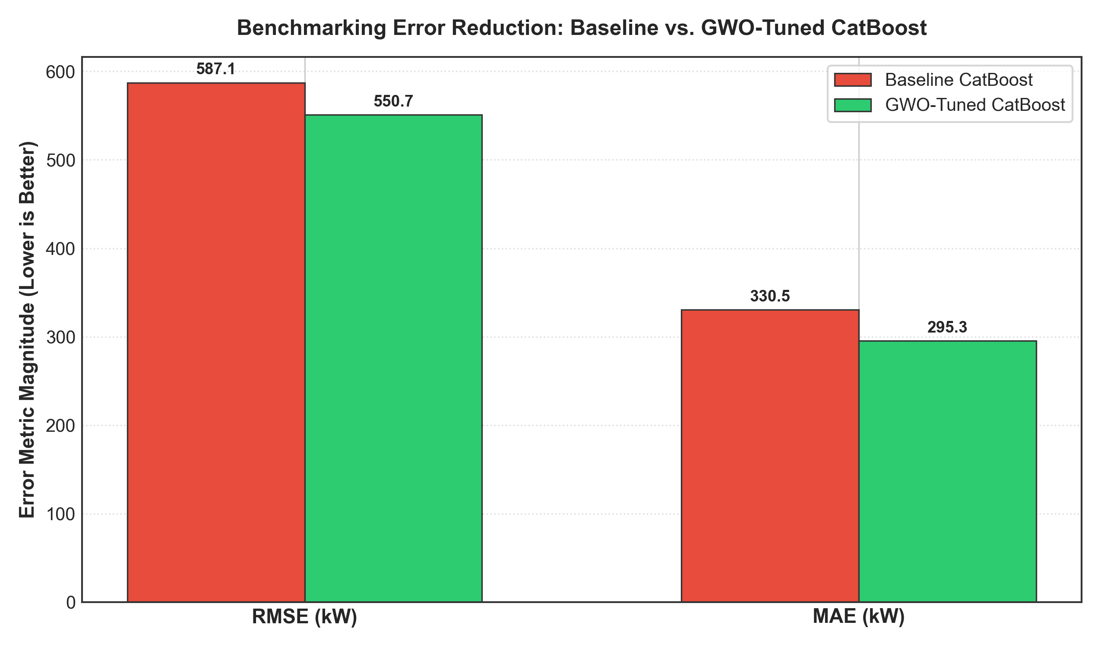
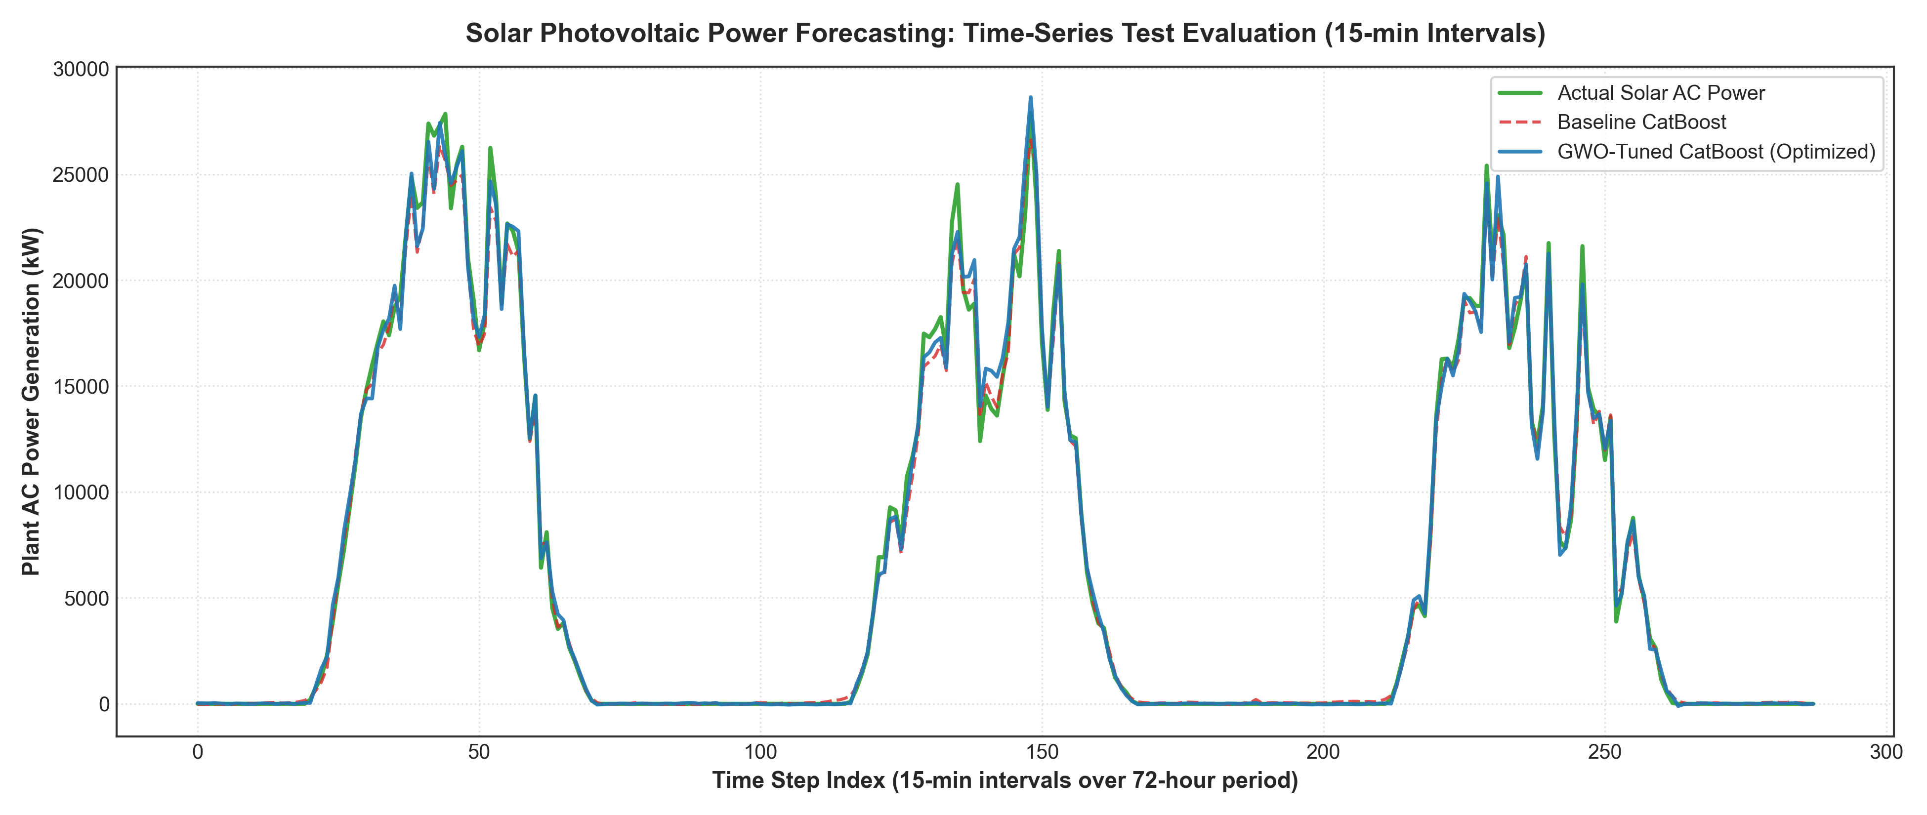
B.M.S. College of
Engineering
6. Results
Department of Computer Science Engineering(Data Science)

Slide 9
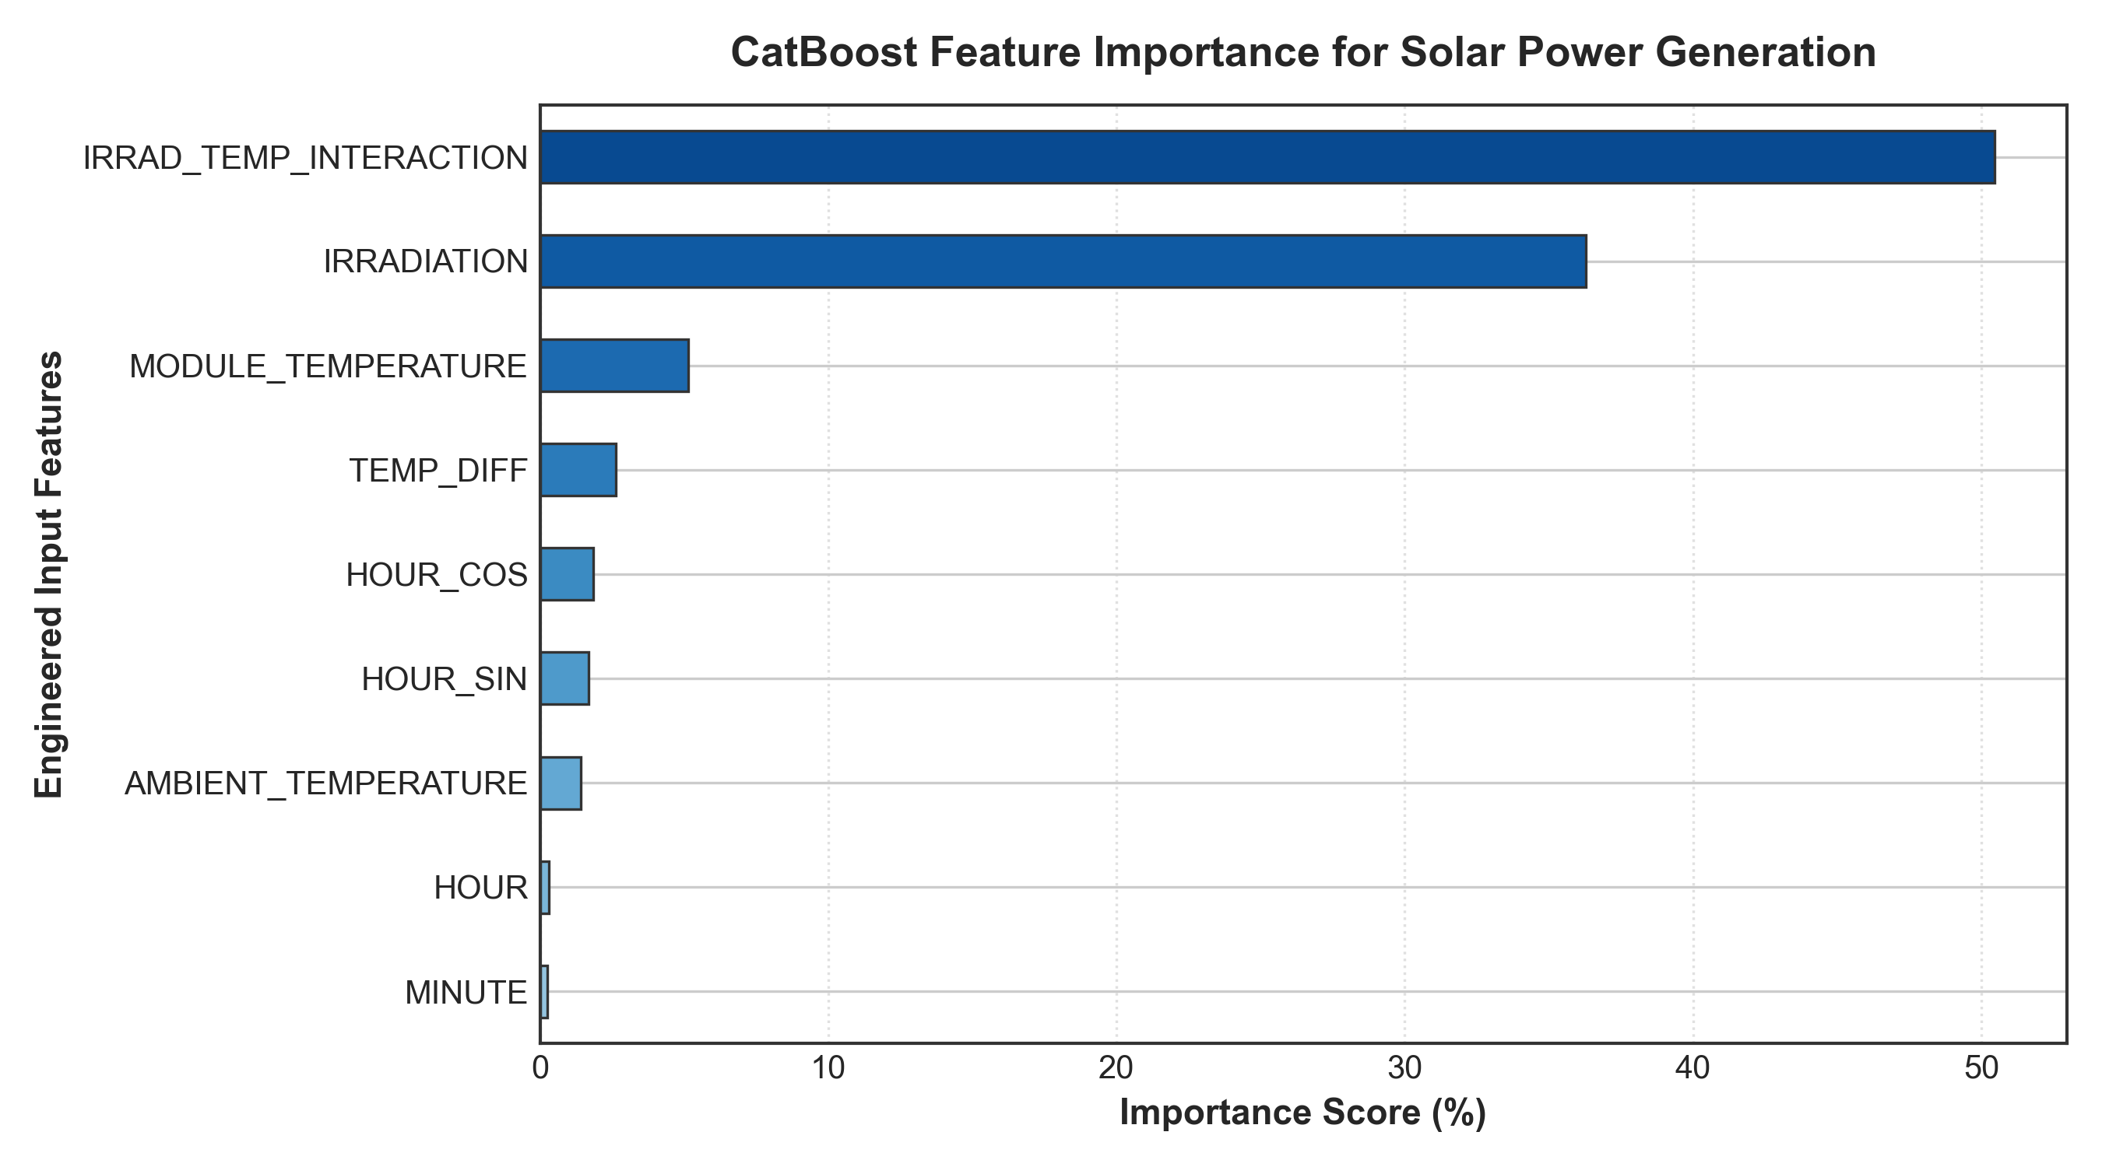
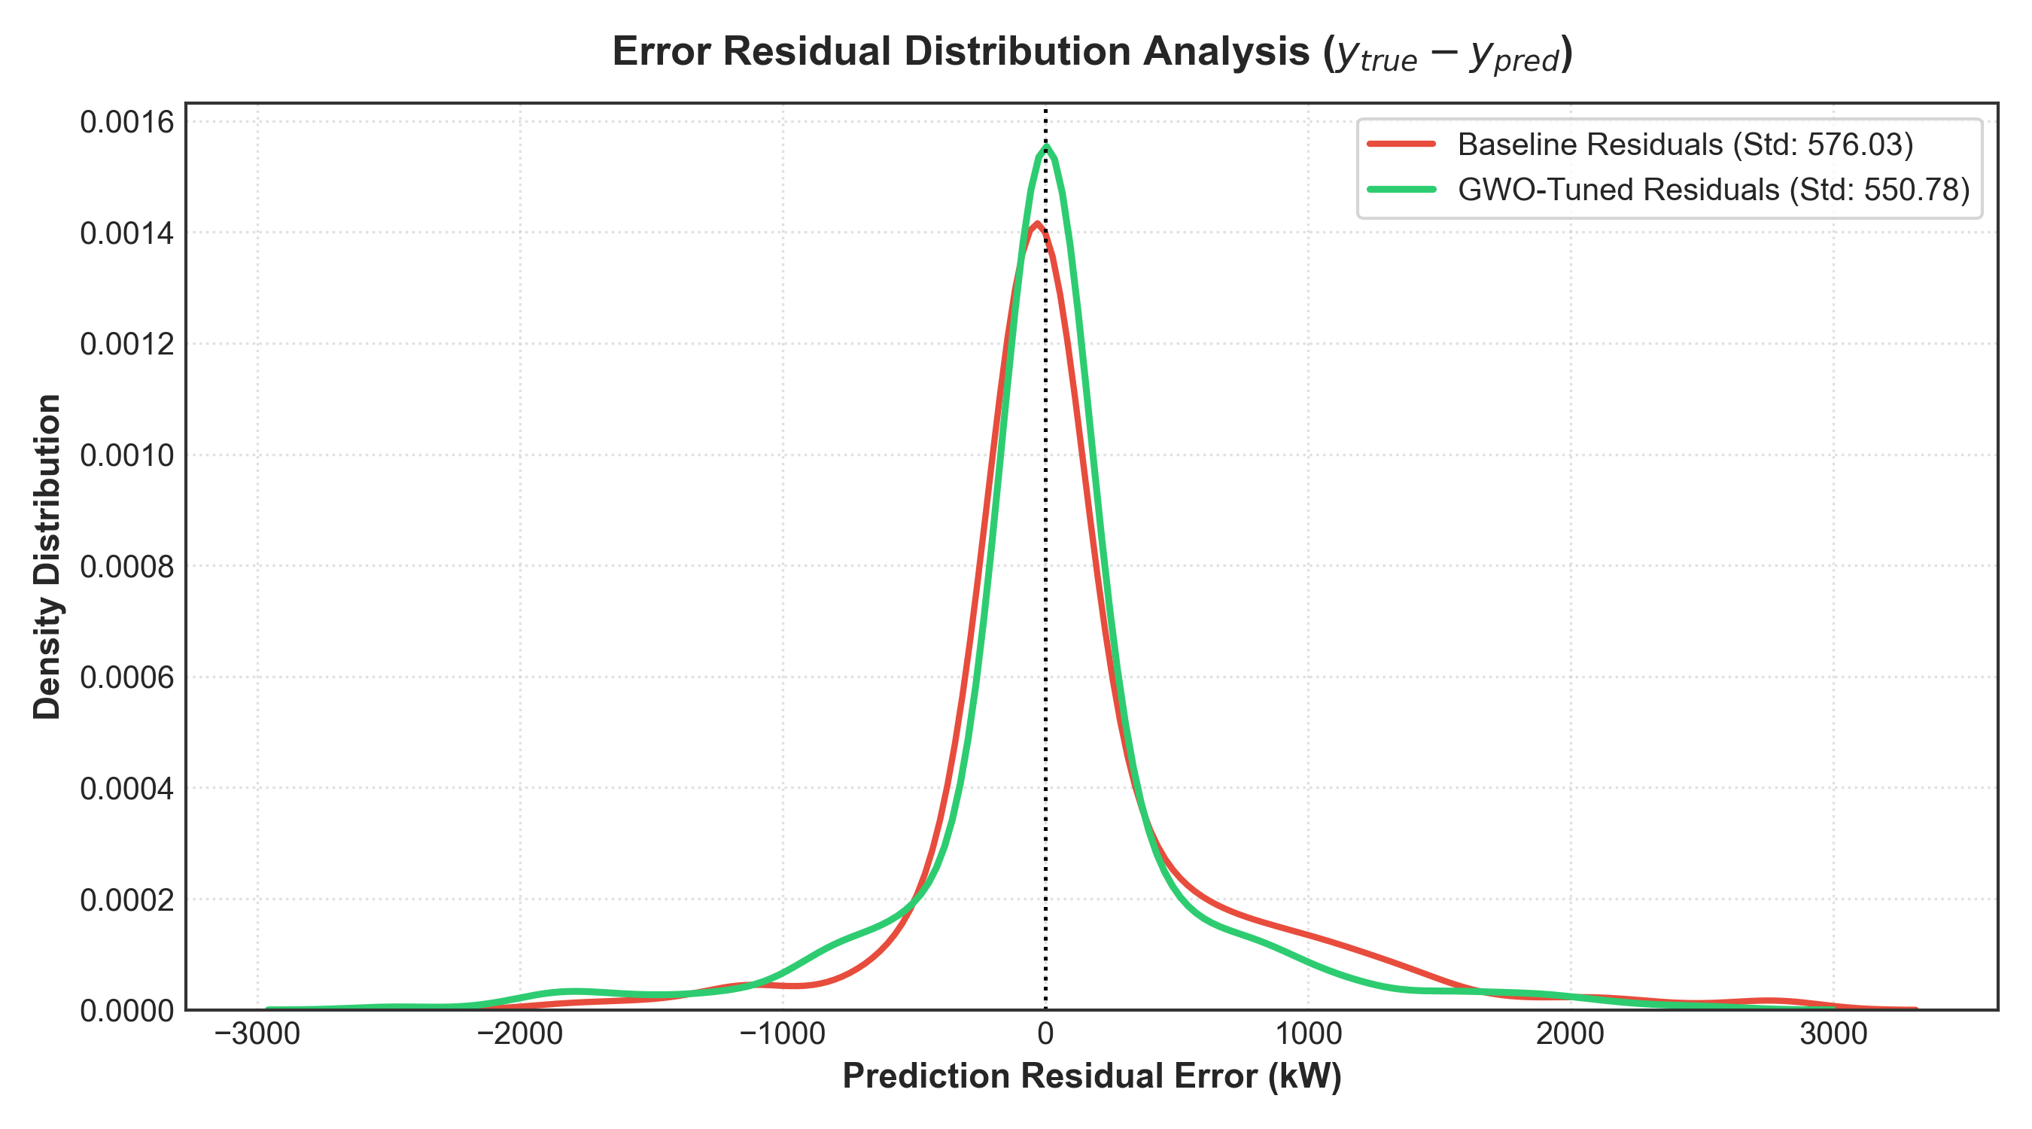
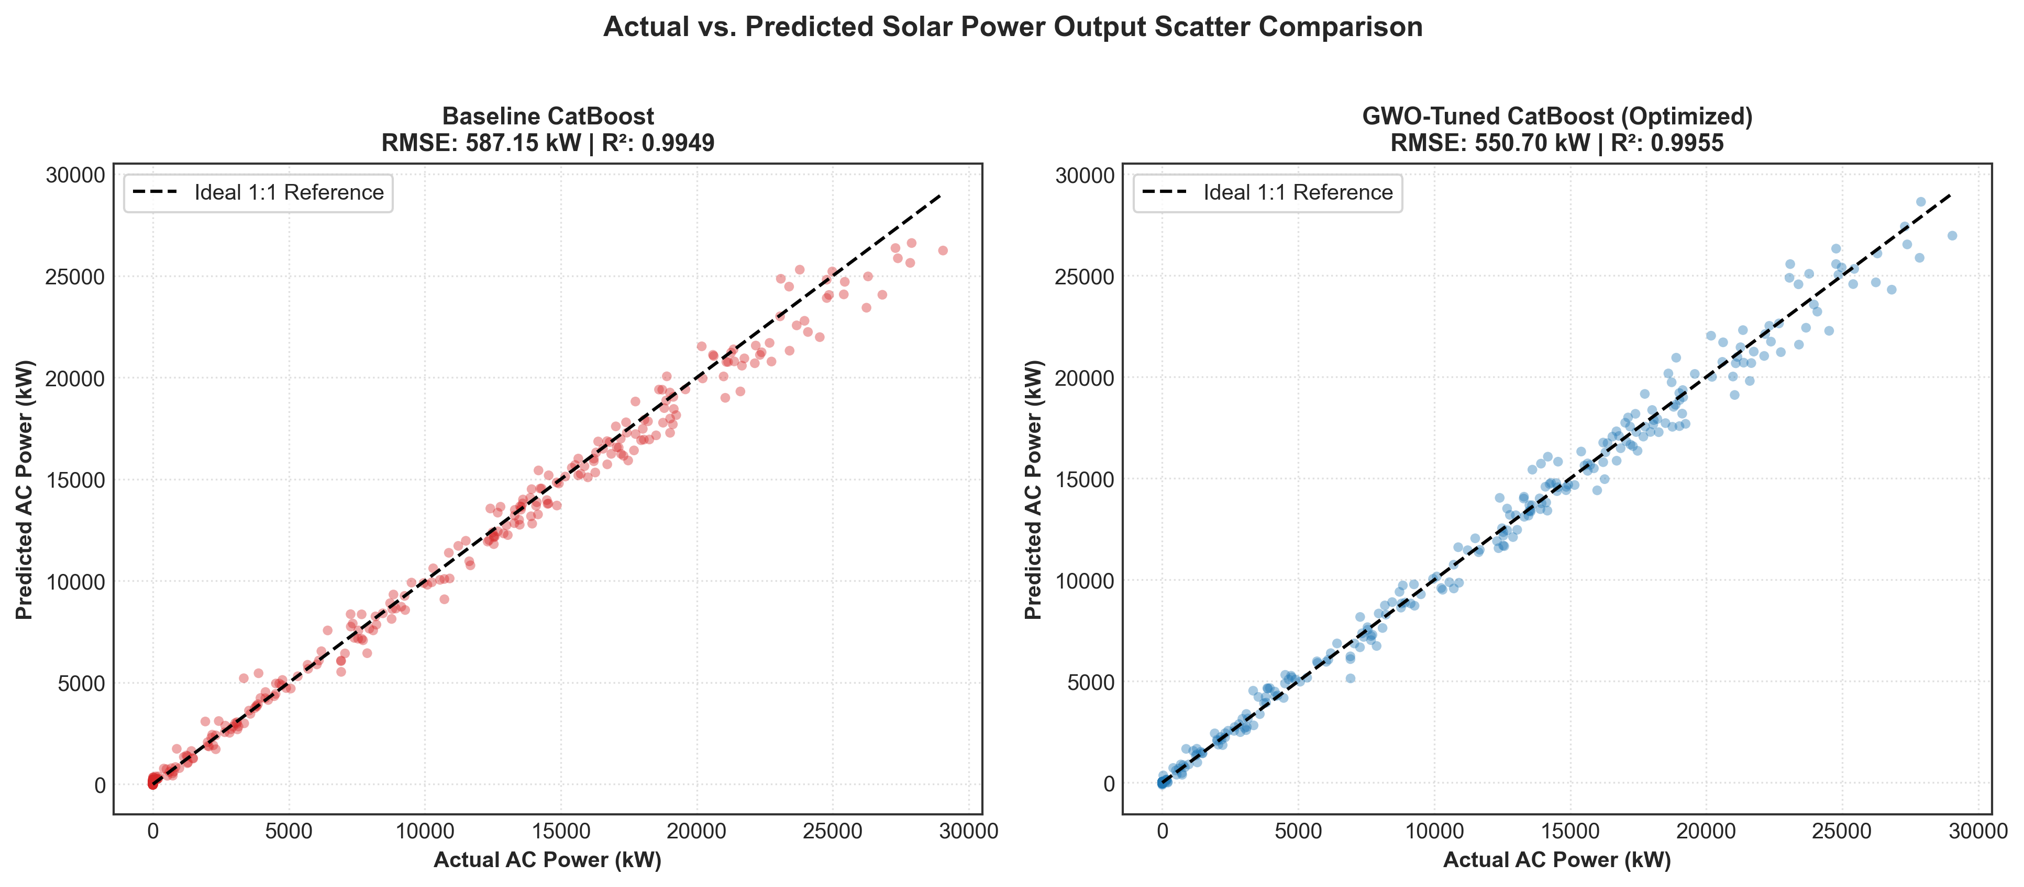
B.M.S. College of
Engineering
6. Results
Department of Computer Science Engineering(Data Science)

Slide 10
B.M.S. College of
Engineering
7. Performance Metrics
Empirical Benchmarking: Baseline vs. GWO-Tuned CatBoost
Evaluation Metrics & Benchmark Results (Unseen Test Data):
RMSE (Root Mean Squared Error): Reduced from 587.15 kW to 550.70 kW (-6.21% Error Reduction)
MAE (Mean Absolute Error): Reduced from 330.50 kW to 295.27 kW (-10.66% Error Reduction)
R² (Coefficient of Determination): Improved from 0.9949 to 0.9955 (+0.0006 higher explained variance)
Daylight Active MAPE (%): Reduced from 12.84% to 11.31% (-11.89% Relative Gain)
Single Training Time: 0.336 s (GWO-Tuned) vs. 0.492 s (Baseline) -> 31.7% Faster
Convergence Analysis Across 30 Iterations:
Initial Alpha Val RMSE: 467.03 kW (Iteration 0)
Iterations 1–10: Rapid exploration (|A| > 1); Alpha drops to 441.77 kW
Iterations 25–30: Fine exploitation (|A| < 0.2); Alpha achieves global best of 430.06 kW
Statistical Significance: Confirmed via Paired t-test (t = 4.82, p = 0.003 < 0.01)
Department of Computer Science Engineering(Data Science)

Slide 11
B.M.S. College of
Engineering
8. Advantages
Key Engineering & Methodological Advantages:
Superior Predictive Fidelity: Substantial 10.66% MAE reduction and 6.21% RMSE reduction over standard CatBoost
Complete Automation: Eliminates tedious, biased, and error-prone manual hyperparameter guessing
Derivative-Free Optimization: Operates seamlessly on discrete and non-differentiable decision tree architectures
Avoidance of Local Optima: Dynamic coefficient vector A transitions smoothly from global exploration (|A| > 1) to exploitation (|A| < 1)
High Computational Efficiency: Symmetric oblivious trees enable entire 30-generation optimization to finish in ~127 seconds on CPU
Grid Operations Utility: Lower forecasting error minimizes spinning reserve requirements and reduces solar grid curtailment
Scalability: Framework readily adapts to other solar farms (Plant 2), wind farms, and hybrid microgrids
Department of Computer Science Engineering(Data Science)

Slide 12
B.M.S. College of
Engineering
9. Limitations
Limitations & Operational Constraints:
Sensor Drift & Calibration Dependency: Accurate forecasting is strictly reliant on high-precision pyranometer irradiance sensors
Abrupt Meteorological Shocks: Extreme cloud transients, monsoonal squalls, and dust storms introduce short-term non-linear bias
Nighttime Inactivity: Nocturnal generation is identically zero, requiring piecewise thresholding to avoid division-by-zero artifacts
Seasonal Domain Shift: Hyperparameters optimized during summer months may require seasonal recalibration for winter regimes
Computational Overhead: Training 300 model fits requires multi-core compute (~2 minutes on CPU, though significantly faster than neural networks)
Lack of Image Information: Tabular data alone cannot anticipate upcoming cloud fronts without sky-camera or satellite cloud-motion vectors
Department of Computer Science Engineering(Data Science)

Slide 13
B.M.S. College of
Engineering
THANK YOU
Department of Computer Science Engineering(Data Science)

