Slide 1

MediSimplify
Converting Medical Reports into Patient-Friendly Summaries Using Prompt Engineering and Retrieval-Augmented Generation
Richan Abraham J R
URK23CS1086
Sourav Ghosh
URK23CS1084
Mini Project · October 2026
Notes:
Introduce both team members. One line: MediSimplify reads a PDF lab report, keeps every value exactly as printed, and explains each result in plain language using trusted, cited references, with safety checks before anything is shown.

Slide 2
Lab reports are written for doctors, not patients
Problem
Glucose, Fasting 128 H mg/dL 70 - 99
Is 128 bad? What does H mean? What is this test for?
Medical jargon
Flags and ranges
Unsafe shortcuts
Test names and abbreviations mean little to most patients
Ranges differ by lab, age and layout; flags are easy to misread
Generic chatbots can change values, diagnose or falsely reassure
Goal: explain each result in plain language, keep every value exactly as printed, cite trusted sources and never diagnose.
Notes:
A report line like this is clear to a doctor but not to a patient. The words are technical, the ranges vary by lab and age, and asking a generic chatbot is risky because it can change numbers, suggest a diagnosis or say everything is fine. Our goal is plain-language explanations that stay faithful to the report and to trusted sources.

Slide 3
Objectives
Objectives and scope
01
Extract test results from PDFs exactly as printed
02
Retrieve trusted background from a curated MedlinePlus library
03
Compare zero-shot, few-shot and RAG-enhanced prompting
04
Return structured, cited summaries as JSON
05
Check every summary for changed values and unsafe wording
06
Evaluate reproducibly on synthetic reports
Scope educational prototype · digitally generated PDFs · synthetic test data · not medical advice
Notes:
Six objectives that map onto the pipeline: faithful extraction, trusted retrieval, three prompting strategies, structured output, safety validation and a reproducible evaluation. The scope is deliberately limited: an educational prototype tested on synthetic reports, not a diagnostic tool.

Slide 4
Why existing approaches fall short
Existing approaches
Search engines
Generic pages; the patient must match each result alone
Generic AI chatbots
Can alter values, invent facts, diagnose or falsely reassure
Patient portals
Show numbers and flags with little explanation
Rule-based explainers
Fixed text per test, no link to the actual report
Fine-tuned medical models
Need large labelled datasets and heavy compute
Notes:
Five common ways people try to understand a report, and the main gap in each. Search and portals leave the patient to connect the dots. General chatbots are fluent but can change values or make unsafe claims. Rule-based text ignores the actual report, and fine-tuned models need data and compute a student project does not have. MediSimplify combines a general model with retrieval and strict checks.

Slide 5
How MediSimplify works
Proposed methodology
01
02
03
04
Extract
Retrieve
Explain
Check
Read the PDF; copy each test, value, unit and range exactly as printed
Find matching MedlinePlus passages with local embeddings and ChromaDB
Gemini writes a structured, cited summary from the facts and passages
Validate values, citations and wording before showing the summary
Next.js web app · FastAPI backend · PyMuPDF · Sentence Transformers + ChromaDB · Gemini 3.5 Flash-Lite
Notes:
Four stages. Extraction copies values verbatim and flags missing or conflicting data. Retrieval searches 20 public-domain MedlinePlus pages using test names only. Gemini returns JSON in a fixed schema with citation IDs. The validator checks the output against the report and the retrieved passages before the user sees it. Only structured test results are sent to the model, never names or report text.

Slide 6
Three prompting strategies, compared fairly
Prompt engineering
Zero-shot
Few-shot
RAG-enhanced
Instructions only
Rules: copy values, cite sources, never diagnose
Instructions
+ two reviewed example answers
Instructions and examples
+ retrieved MedlinePlus passages to cite
Same report facts, JSON schema, model and settings (temperature 0.2, seed 42), so only the prompt changes.
Notes:
All three strategies share the same system instructions, report facts, output schema and generation settings, so differences come from the prompt alone. Few-shot adds two reviewed examples written from synthetic values. RAG adds the retrieved passages, which the model must cite by ID. Report text is wrapped in delimiters and treated as data, so instructions hidden in a report are ignored.

Slide 7
Every summary is checked before it is shown
Safety validation
Values
Value, unit and range copied exactly; no invented tests
57 / 60
Citations
Every cited passage was actually retrieved
reworded unsafe sentences caught on a held-out set (was 3)
Abnormal results
Listed only if flagged or outside the printed range
1 / 30
Language
No diagnosis, treatment advice or false reassurance
safe sentences wrongly flagged
Privacy
Only test results reach the model, never report text
Hidden
a summary that fails is not shown as-is
Notes:
The validator compares the summary with the extracted facts and the retrieved passages. A changed value, an invented test or a citation to a passage that was not retrieved fails the summary, and so does diagnostic, treatment or falsely reassuring language. We measured the language check on a held-out set of 90 sentences written before the rules were tuned: it now catches 57 of 60 unsafe sentences, up from 3, and flags 1 of 30 safe ones. Both sets were written by the same author, so this is likely optimistic.

Slide 8
Live results with Gemini
Evaluation · 9 synthetic reports × 3 strategies
100%
values, units and ranges copied exactly by every strategy
1.0 → 0
unsourced background sentences per test, zero-shot vs RAG
95%
of RAG citations point to the right reference page
Notes:
Live run with gemini-3.5-flash-lite on 9 synthetic reports. No strategy changed a value or used unsafe language. Zero-shot added unsourced background to almost every test, so all its summaries carry warnings. Few-shot passed every check, but mainly because it explains very little. RAG is the only strategy that explains what each test measures with cited MedlinePlus sources; its warnings come from citing a passage retrieved for a neighbouring test. One run, nine reports, so the differences are descriptive only.

Slide 9
Zero-shot vs few-shot vs RAG
Evaluation · strategy comparison
 | Zero-shot | Few-shot | RAG-enhanced
Checks: passed / warnings / failed | 0 / 9 / 0 | 9 / 0 / 0 | 4 / 5 / 0
Values, units and ranges kept exact | 100% | 100% | 100%
Abnormal results found | 19 of 19 | 19 of 19 | 18 of 19
Explains what each test measures | 34 of 34, no source | 0 of 34 | 30 of 34, cited
Citations valid / on the right page | – | – | 100% / 95%
Unsafe wording (diagnosis, advice) | 0 | 0 | 0
Reading grade level | 9.1 | 3.5 | 6.9
Average time · prompt tokens | 12.6 s · 925 | 9.0 s · 2,428 | 12.6 s · 4,702
9 synthetic reports · 34 test explanations per strategy · gemini-3.5-flash-lite, temperature 0.2, seed 42 · one run
Notes:
Same nine synthetic reports, same model and settings, only the prompt changes. All three kept every value, unit and range exact and used no unsafe wording. They differ in how much they explain and whether it is sourced: zero-shot added background to all 34 explanations without any source, few-shot added none, and RAG explained 30 of 34 with MedlinePlus citations, 95 percent of them on the right page. RAG missed one abnormal result, the low duplicate hemoglobin in the conflicting-values report. Reading grade is the Flesch-Kincaid level of the summary and explanations; few-shot is low mainly because its text is very short.

Slide 10
What the comparison shows
Evaluation · findings
Zero-shot: unsourced
Few-shot: safe but thin
RAG: most useful
Added background to all 34 explanations despite being told not to
None of it cited; hardest to read (grade 9.1)
Passed every check by copying the examples' style
Restates values; explains no test
Explained 30 of 34 tests with MedlinePlus citations
95% on the right page; missed 1 of 19 abnormal results
Conclusion RAG gives the most informative summaries with verifiable sources, at about 5× the prompt tokens of zero-shot. One run on nine reports: descriptive, not significant.
Notes:
Zero-shot ignored the instruction to leave out unsourced background, so every summary carries warnings. Few-shot looks best on the checks, but only because it copies the examples and explains almost nothing, so passing checks is not the same as being useful. RAG is the only strategy that explains what each test measures with sources a reader can verify. The cost is a longer prompt, about five times zero-shot, with similar response time. Human ratings are the next step to confirm which summaries readers find clearest.

Slide 11
Built and tested
Implementation
Frontend
Next.js, TypeScript, Tailwind CSS
236
Backend
FastAPI, Pydantic, PyMuPDF
backend tests passing
Retrieval
Sentence Transformers, ChromaDB, 20 MedlinePlus pages
16
Language model
Gemini 3.5 Flash-Lite with a JSON schema
browser end-to-end tests
29 / 30
Evaluation
Synthetic dataset, fault injection, replayable runs
tests matched to the right reference page
Notes:
The full pipeline is implemented and public on GitHub. 236 backend tests cover extraction, retrieval, prompts, the validator, the Gemini error handling and the evaluation pipeline; 16 Playwright tests drive the web app in a real browser. On the evaluation set, extraction matched all 34 gold results exactly and retrieval picked the right MedlinePlus page for 29 of 30 covered tests.

Slide 12
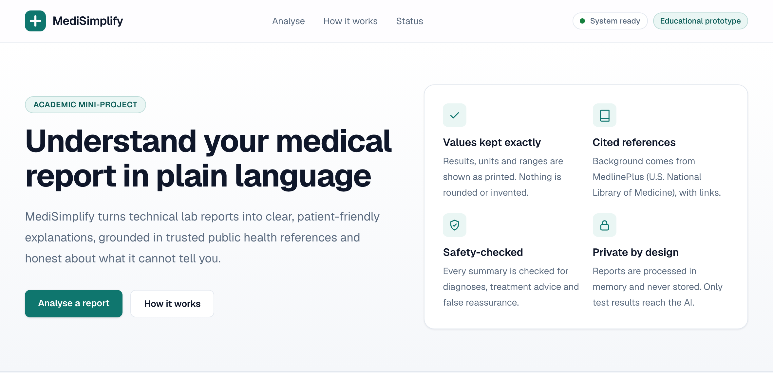
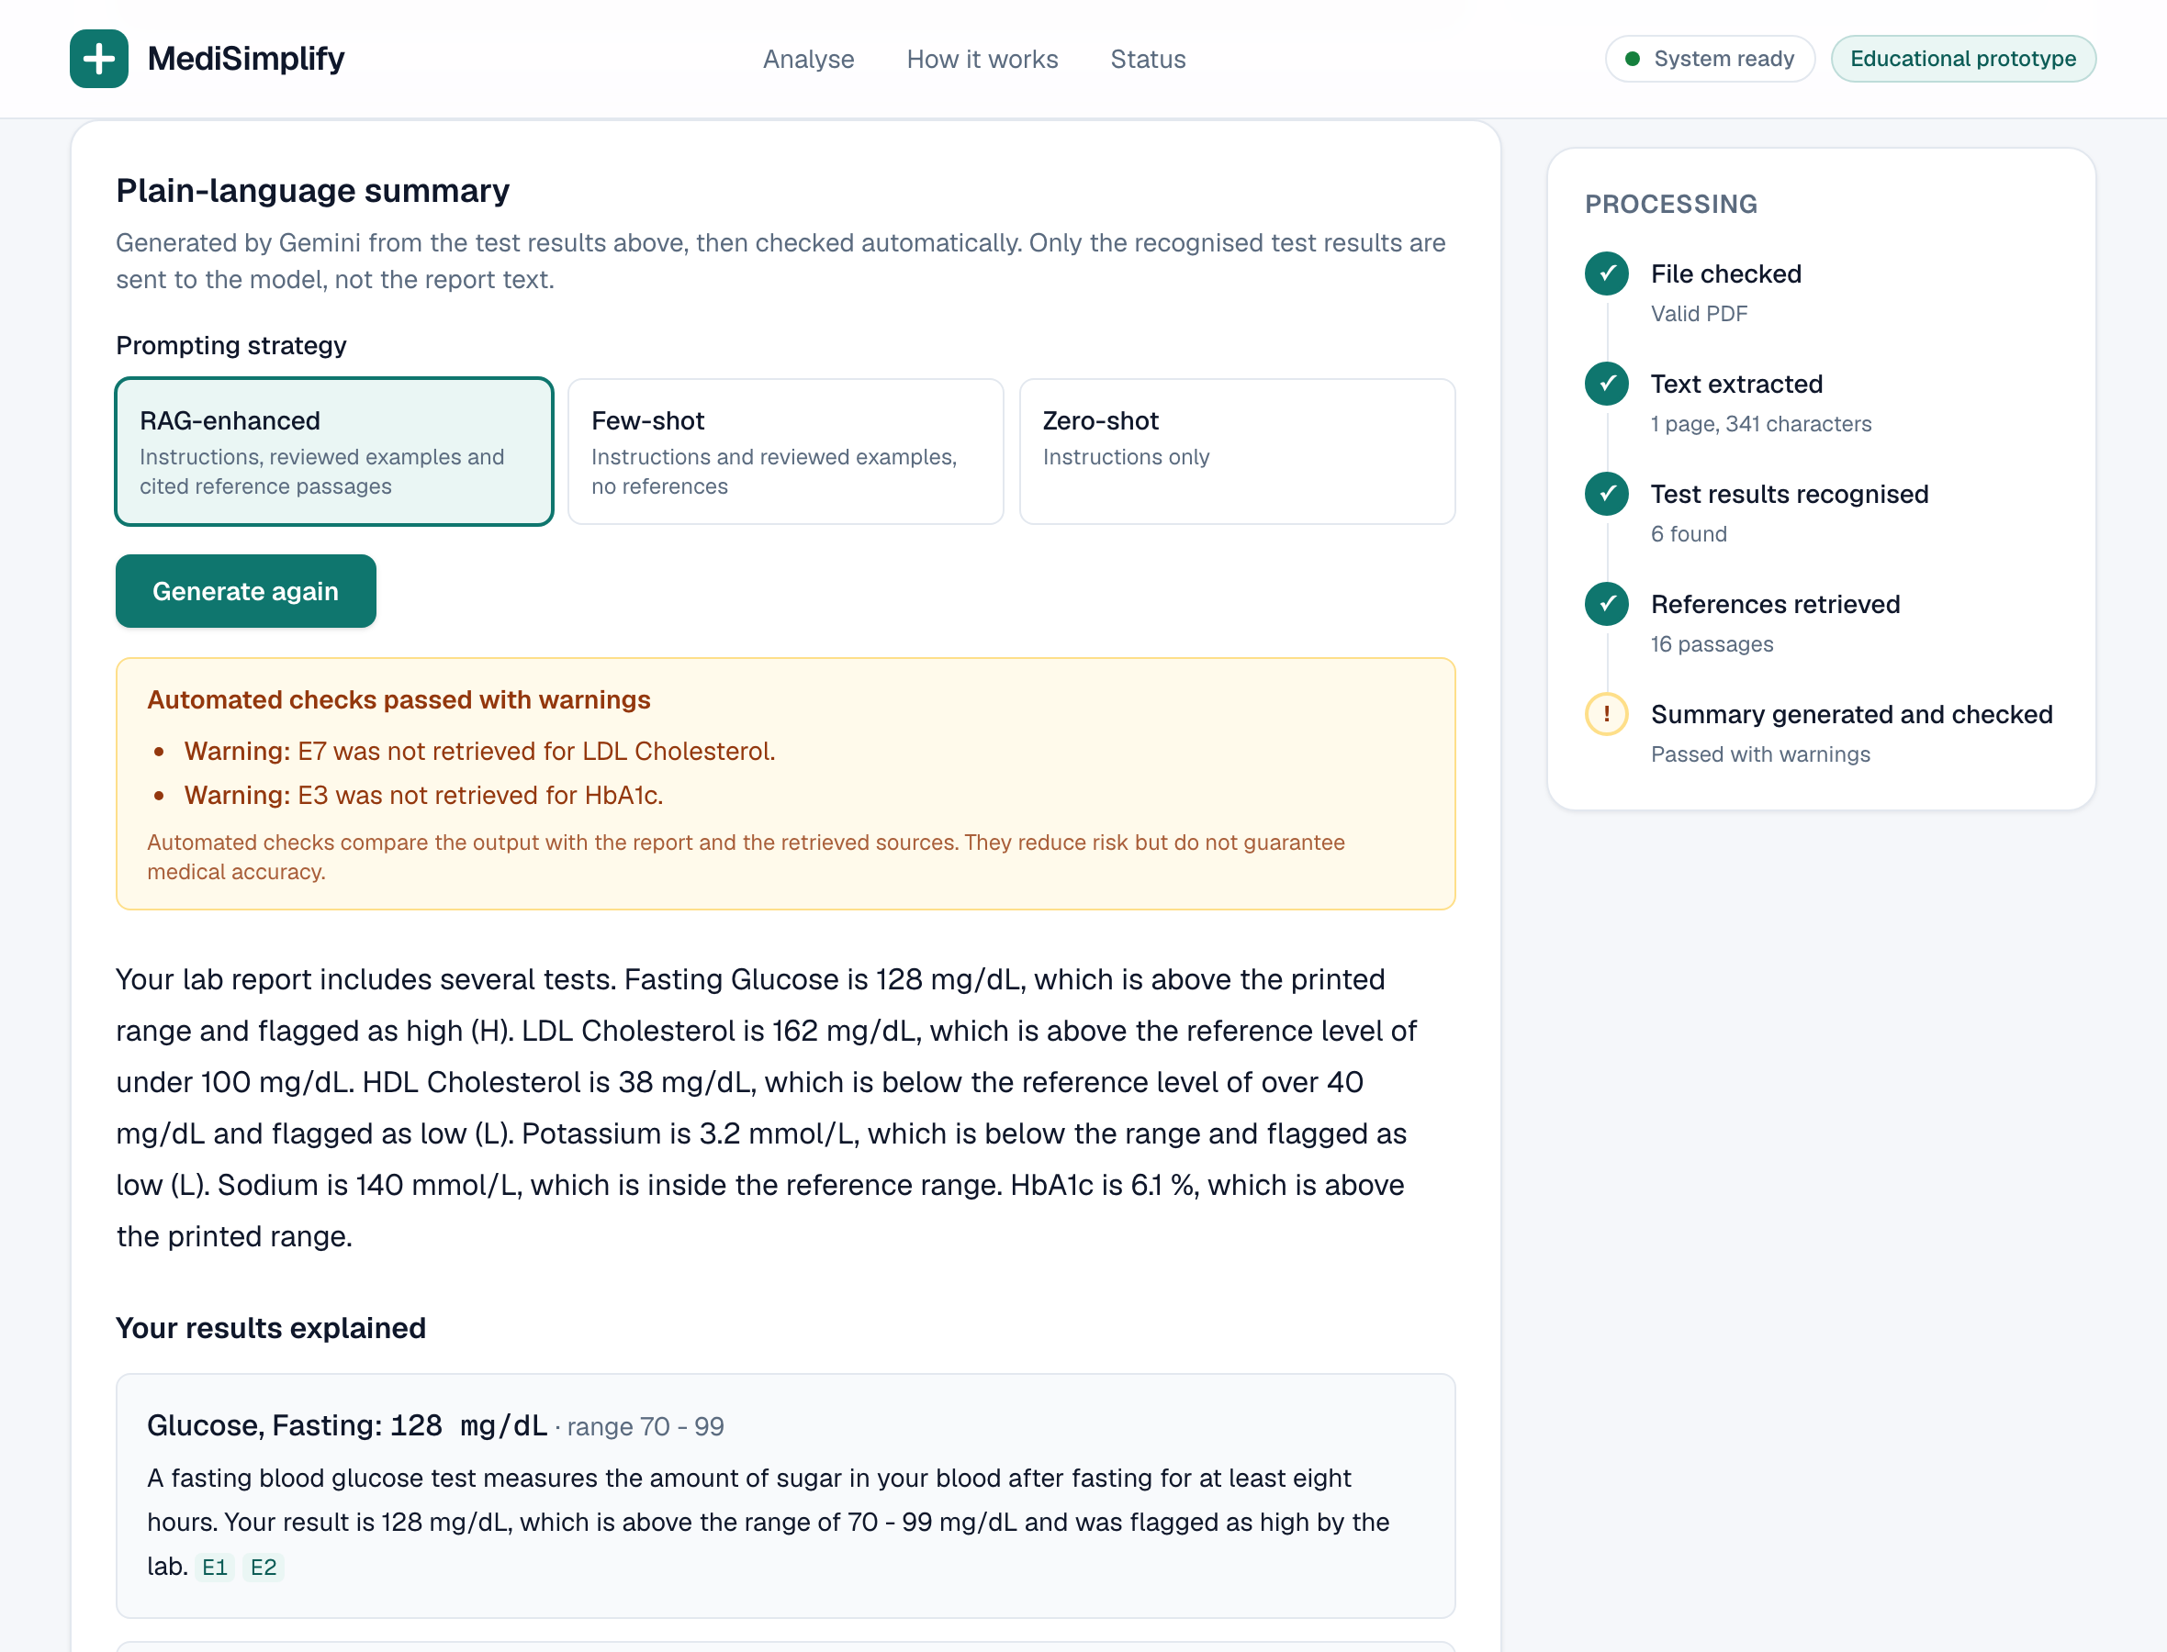
The app
Web application
Upload a PDF or try a synthetic sample
Processed in memory and never stored
Notes:
Left: the home page, where you upload a PDF or load a synthetic sample. Right: the results view. The sidebar tracks each processing stage; the summary panel shows the chosen strategy, the validation result and each test explained with citation tags linking to MedlinePlus.

Slide 13
Next steps
Done
Limitations
Next
Web app with live summaries
RAG library and citations
Safety validator and evaluation
Public GitHub repository
No OCR for scanned reports
Age-based ranges not compared
Rule-based safety checks
No human ratings yet
Human ratings of summaries
Independent held-out safety set
OCR and more report layouts
Wider reference library
Thank you. Questions?
Notes:
Summarize what is done, the honest limitations and what comes next, then invite questions.

