Slide 1
Brief OO Review

Slide 2
What is an Object?
Definition
  Any entity with identity, state, and behavior
  Can represent physical entities or entities created for modeling convenience
Example: A Circle - Very simple
  Attributes: Radius, Position, Display Mode
  Operations: Display, Grow, Shrink
Example: A Radar Track
  Attributes: Track Number, State vector, IFF, Classification
  Operations: Propagate, Evaluate, Update
Example: Cruise Controller
Cruise Controller
state: active, standby etc.
==> different behavior for
different states
state
attributes
currentSpeed
targetSpeed
set()
operations
resume()
accelerate()
cancel()

Slide 3
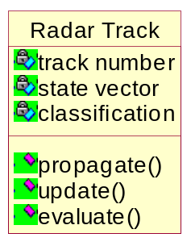
What is a Class?
Class definition
  Templates for objects
    Create a specific Radar Track from the Radar Track Class
Classes are design and analysis entities, objects are implementation entities.
In C++, an object is an instance of a class
An object has:
  attributes - state
  behavior - operations
  identity - each instance of the class is unique
Radar Track
Class definition
Radar Track:missile
track number = 102
state vector = position
classification = friendly
propagate()
update()
evaluate()
Radar Track Object
(each attribute has a
value)

Slide 4
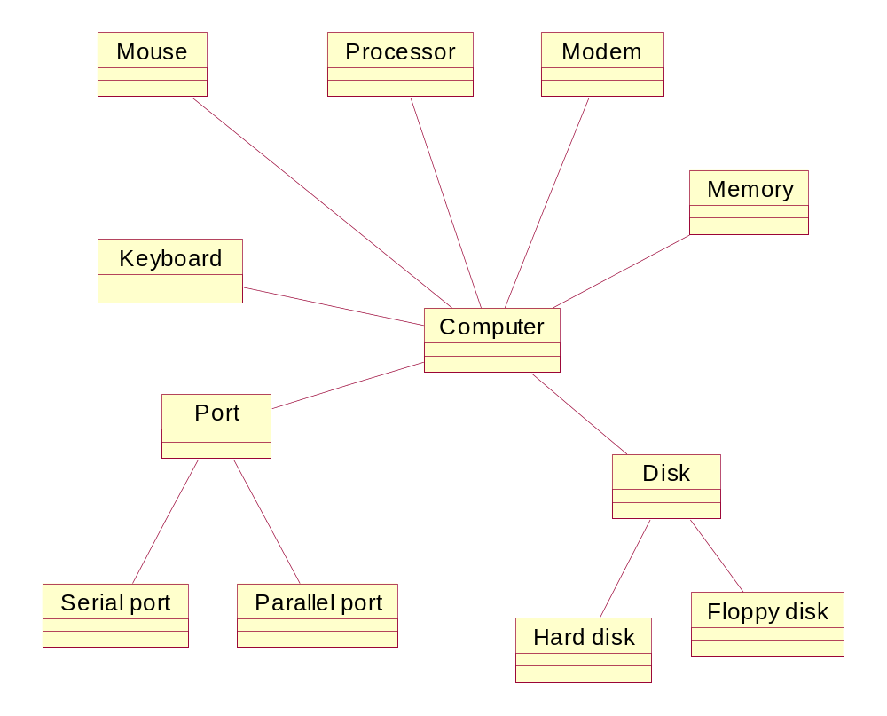
Class Diagram
In C++, an object does not
exist until program execution.
At design/code only the architecture
or template for the object can
be defined. This is called a
class definition and is a “type”
definition.
int main (void)
{
Computer myComputer;
//myComputer is an object
//when the program is executed
.
.
struct Computer
{
int numberModems;
int portSelection;
char processorType[];
etc.
.

Slide 5
Fundamental Properties of Objects
Identity - Distinguishes individual objects
  Classification - Scholar, Student, Professor
Attributes - Data associated with the object
Operations - Services provided by the object
State - Models how the object behaves
Purist view of state
  An object’s state is defined by the value of its attributes
We think of state differently
  A state represents certain behavior patterns of interest
  An enemy aircraft radar track may have two states - engaged/ not engaged
Depending upon its state, the object behaves differently
  A system may have two states, with different behavior in each state - i.e. Normal/Degraded

Slide 6
Modeling objects
How do you model an object? Decide what objects you need.
  Objects encapsulate related data and procedures that operate on the data and remember what happened!
  An object represents some significant entity with independent existence and behavior.
    A bunch of pure data is not an object.
      1995- Census- Data
    A collection of procedures is not an object.
      Threat evaluation algorithms
Naming Convention - Single Nouns/ Phrases
  Tracks - better Track
  Employees - better Employee
  Controlled Aircraft- good
  Track Manager - OK, but generally avoid Manager/controller

Slide 7
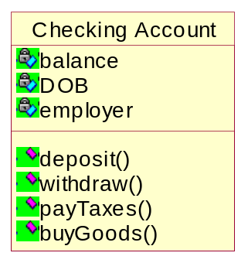
Checking Objects
Check for state, identity, behavior
Reality Checks - Objects
  Does the object represent a concept in the problem domain?
  Are the attributes and service descriptive of the concept?
  Are the operations and attributes functionally cohesive?
???

Slide 8
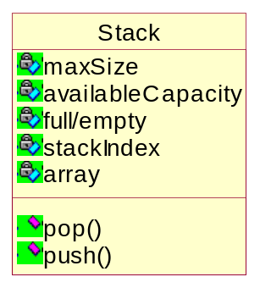
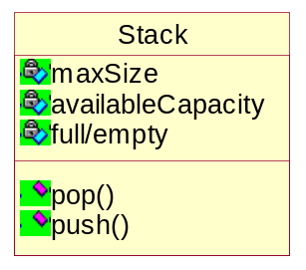
Attributes and Operations
Data associated with the object, can be public or private. Attributes are read - only by definition. Only the object itself can change its attribute values.
Use abstraction in modeling public attributes, they are data needed to express the behavior of the object.
Avoid private attributes in analysis/preliminary design, unless needed to express a requirement.
  e.g. Stack Pointer and Stack Array are not design attributes.
Operations model an object’s capabilities, they are the means by which the attributes can change.
Analysis/design
(OK, at implementation.)

Slide 9
Class relationships
Association
Composition/Aggregation
Inheritance

Slide 10
Simple Association
Objects are related e.g. call one another’s operations or reference objects of each others type
Employee
1
*
Assignment
Employee gets many assignments
An assignment is allocated to a single employee

Slide 11
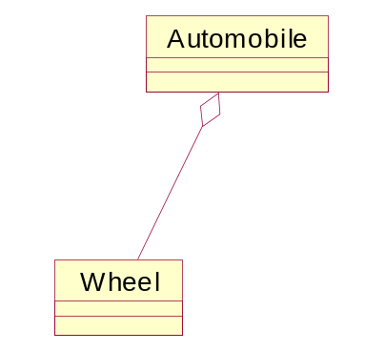
Composition/Aggregation
A whole-part relationship
Composition is a “has-a” relationship
The wheel is a part of the automobile or the automobile “has-a” wheel
Implies a special relationship between the whole and its parts. e. g. deleting whole also deletes all its parts
If a part can exist without the whole the relationship is called an aggregation

Slide 12
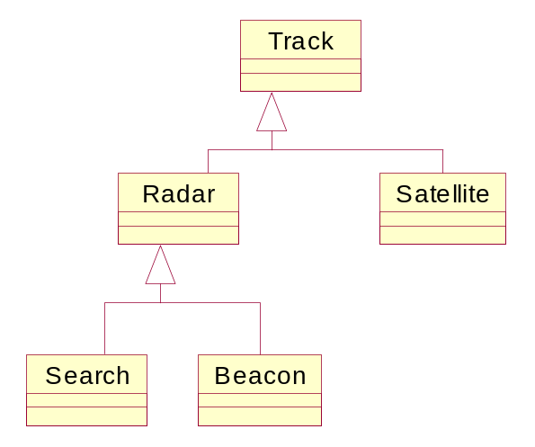
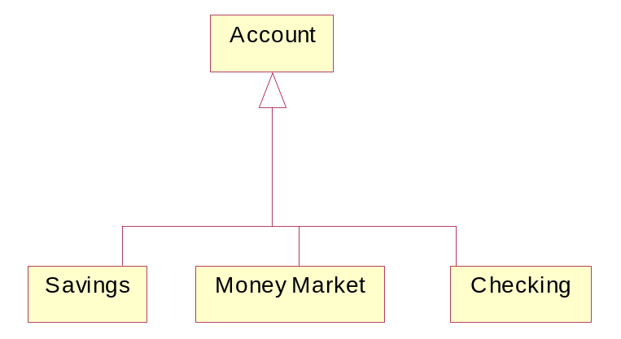
Reuse/Simple Inheritance
Often we need to create new classes that are only slightly different from an existing class
  We can cut and paste, but this increases volume and therefore complexity
  Better - build new classes from old--leave the common elements in a Super class, and build Sub classes with the additional behavior
  Sub classes have an “is-a” relationship with the Super class e.g. Savings is an Account

Slide 13
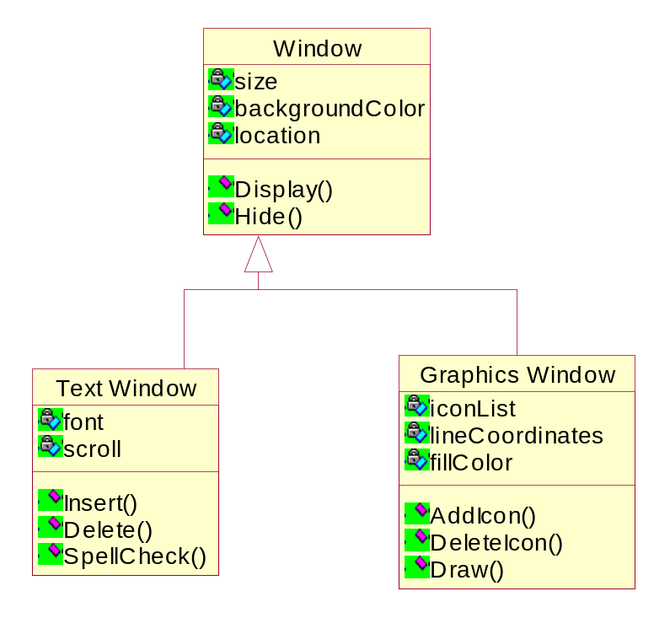
Inheritance
Creates subclasses from super or base classes.
Subclasses or derived classes inherit operations and attributes from their respective base classes.
Window myWindow;
myWindow.size = //OK
myWindow.location = //OK
myWindow.font = //not OK
GraphicsWindow myGW;
myGW.size = //OK
myGW.fillColor = //OK
myGW.backgroundColor = //OK
myGW.font = //not OK
myGW.Display(); //OK
myGW.Draw(); //OK

Slide 14
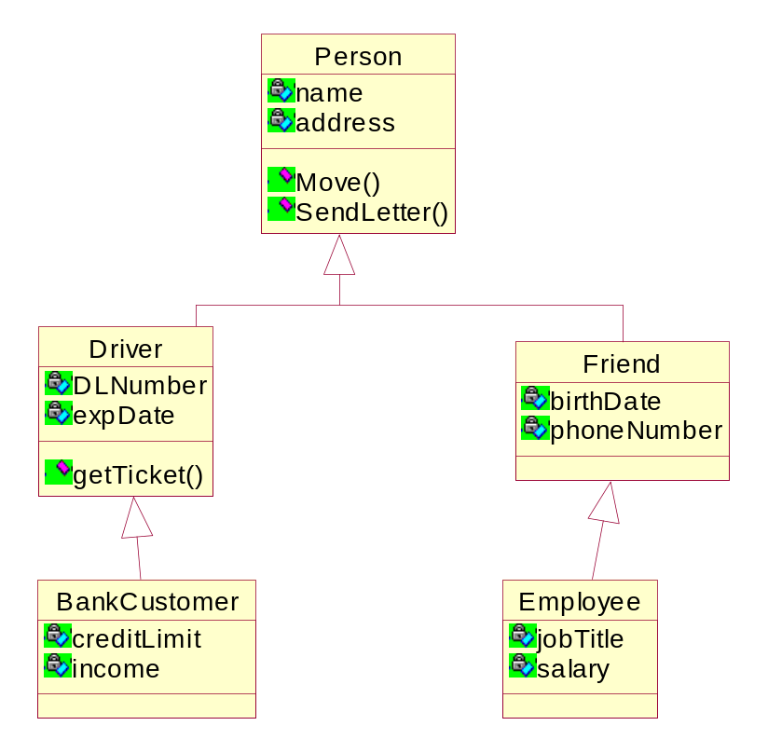
Inheritance
Be careful with inheritance
  Derived class should automatically inherit everything from the base class
  Having to “turn off” inherited attributes .. a warning signal
  Avoid placing non - cohesive attributes and services in a class just because some derived classes needs them
  Avoid creating derived classes that do not really belong
  Avoid inheritance of convenience
Example of BAD inheritance!!!

Slide 15
Object Oriented Software Model
What is Special about Object-Oriented (OO) Model?
  OO model is based on real-world entities
    Encapsulation and Information hiding are important
What do we express in an OO model (first cut)
  Who uses it & how?
  What are the architectural level objects?
  What are the components objects?
  What are the relationships between the objects?
  What can we reuse?
  How do we implement the objects?
  How do we organize the code modules?
  How do we organize the software modules on hardware platforms?
Notes:
2
2

Slide 16
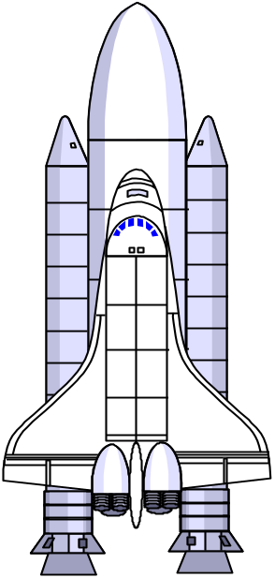
OO Advantages
Why is Object-Oriented Modeling So Popular?
  Evolutionary, not revolutionary
  Experience has shown that this is the superior way to
  manage and decompose an inherently complex system.
  Quality and Productivity gains
    Lower defect density
    Better maintainability
    Reuse potential
    Complexity reduction
  Newest ideas- Component
  based development
ENTERPRISE
ORBITER 1
CONTROLS
SPACEFRAME
POWER PLANT
NAV
ENGINE

Slide 17

Discover High-Level Object Model
Problem statement analysis
Domain Engineering
Technology Considerations
Sixth sense!!
Data
Recording
Air Safety
Automatic Identifier
Voice

and Classififier
Access
Radar
Air
Controller
Picture

Slide 18
Model Interactions
How?
  Each use case relates to one or more transactions
  Draw sequence diagrams for each transaction
  Transaction : A library member checks out a book
Member
Scanner
Account Monitor
Circulation
Receipt
Focus of
attention
Time
? A sequence diagram models?

Slide 19
Evolve
How? Divide and Conquer Divide and Simplify
  Decompose higher-level objects into lower-level objects
    Determine responsibilities
  Find relationships - dependencies, collaborations
  Model inheritance and aggregations
    Write specifications
      Write down each objects responsibilities
      Describe operations and attributes
Object Model

Slide 20
Exercise
Exercise
Assume that you are designing the software control system for a automotive cruise controller. Use your domain knowledge of cruise control systems for deciding what functions will be provided by your cruise control. List/draw what software objects should be included in the cruise control system.

Slide 21
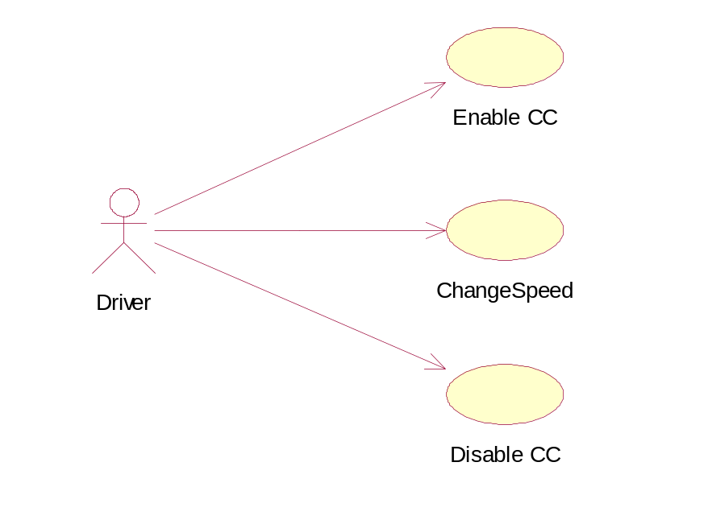
Use Cases
Activate CC
Set the CC speed
Maintain the speed (do nothing)
Activate "accel” switch to go faster
Activate "decel” switch to go slower
Activate "reset” switch to return to original speed
Braking disables cruise speed
Using the gas pedal disables cruise speed
Deactivate CC

Slide 22
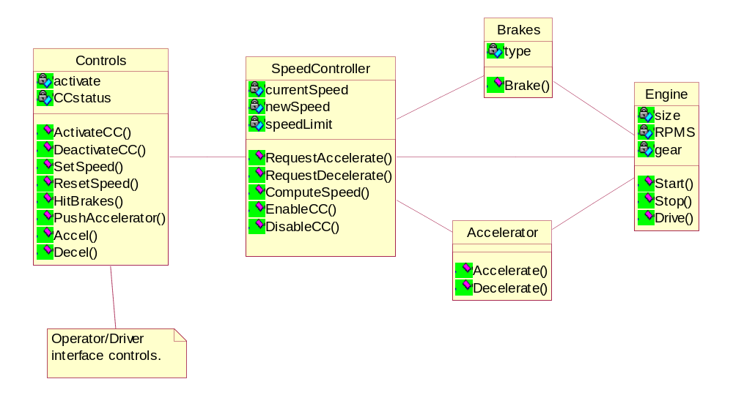
Logical View (Objects)

Slide 23
Sequence Diagram
Controls
SpeedController
Brakes
Accelerator
Engine
HitBrakes()
DisableCC()
Brake Applied
DisableCC()
Brake()
ComputeSpeed()
Drive()
Road Speed exceeds
target speed
RequestDecelerate()
Decelerate()
Brake()

