Slide 1
C/C++ Functional and Object Oriented Programming
Pat Dousette

Slide 2
C++ Class Outline
1. Overview of C Language - review
functions, arrays, pointers, structures, typedef, libraries, DMA
2. Transition to C++
Constants
Accessing data
Intro to the class structure
Function overloading
Intro to Stream I/O Class library - exercise for student
3. Object Oriented Design - review
Definition of an object
Characteristics
Relationships
4. Classes and functions
Data members
Member functions - constructors/destructors
Inline functions
Operator overloading
F
riend functions
Standard C++ class libraries
5. Dynamic Memory Management
New and Delete operators
Custom memory management

Slide 3
6. Inheritance
Basic
Types of
inheritnace
Object construction/destruction
Dominance
Multiple Inheritance
7. Polymorphism
Virtual functions/dynamic binding
Abstract classes - design hierarchies
Dynamic casting
8. Error Detection and Recovery
C
apturing
Detection and reporting
Recovery
Standard exception library
9. Templates
Functions
Classes
Standard Template Library
10. Miscellaneous
Namespace

Slide 4
Homework (Overview)
Assignments:
1. Write a file copy program - user inputs filenames, check for errors etc. Use IOSTREAM or STDIO. (optional use the command line for input of filenames)
2. Write a program to overload the [] operator to retrieve an integer array from a disk file in segments/pages. A disk array that is initialized and then accessed (read/write) as a normal array. Define the class and member functions (use constructors/destructors). Write a test program to use the class.
3. Design and implement a text_file class that does file_copy, file_compare, file_output etc.
4. Design and implement a binary_file class that does file_copy, file_compare, file_output etc.
5. Design a class hierarchy for a file system - class file, text_file, binary_file – implement the class definitions and code a test program.
Optional:
6. Design and implement a class template for a virtual array i.e. a dynamic array that behaves like a normal array – test it. Hint: this will include exception handling!
Due 2nd /3rd week of class
Due 5th week of class
Due 7th week of class
Due 8th week of class
Due 11th week of class
Due 12th week of class

Slide 5
Guidelines:
C++ coding standard – see the Syllabus
Assignments - brief requirements, brief design, source code, executable (no warnings allowed)
Text and Reference Books – pick a couple
C++ Primer Plus – Stephen Prata
Object Oriented Programming using C++ - Ira Pohl
C++ The Complete Reference - Herbert Schildt
The C++ Programming Language - Bjarne Stroustrup
Practical C++ Programming – Steve Oualline
C++ How to Program – Deitel & Deitel

Slide 6
C Language Review
Board Work

Slide 7
Write a simple C Program

Slide 8
//File
square.h
//
function prototypes
float
compute_square_area(float length);
float
get_square_length(void);
//File
main.c
#
include <
stdio.h>
#include “
square.h”
int main (
int
argc, char * argv[])
{
//declare data
float length, area;
len
gth = get_square_length();
area = compute_square_area(length);
printf(“\n\t Area: %f”, area);
return(0);
}
//File square.c
#include <stdio.h>
#include “square.h”
float get_square_length(void)
{
float length;
// formatted print and read
printf(“
\n\t Input length of the square:”);
scanf(“%f”, &length);
//read user input from keyboard
return(length);
}
float compute_square_area(float length)
{
float area;
area = length * length;
// compute area
return (area);
}

Slide 9
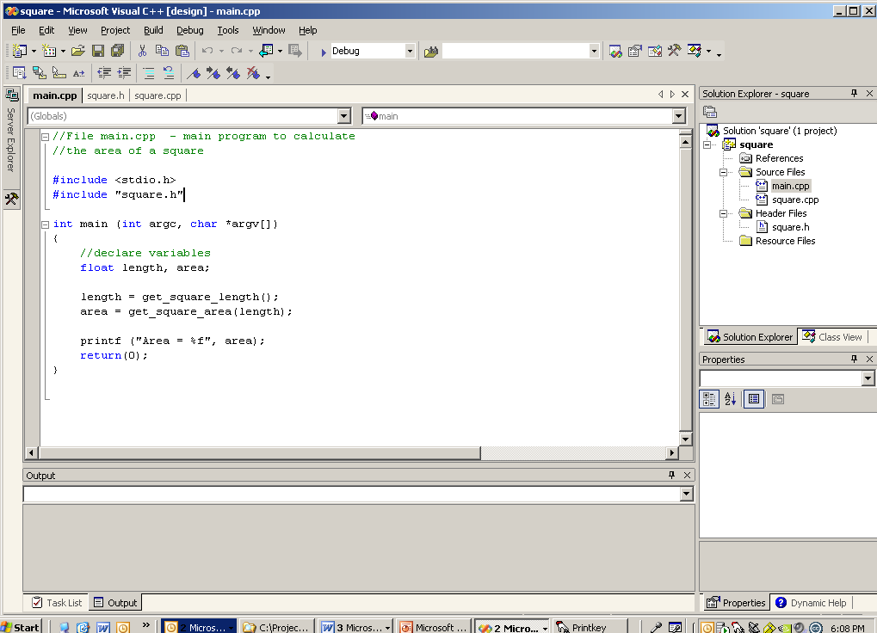

Slide 10
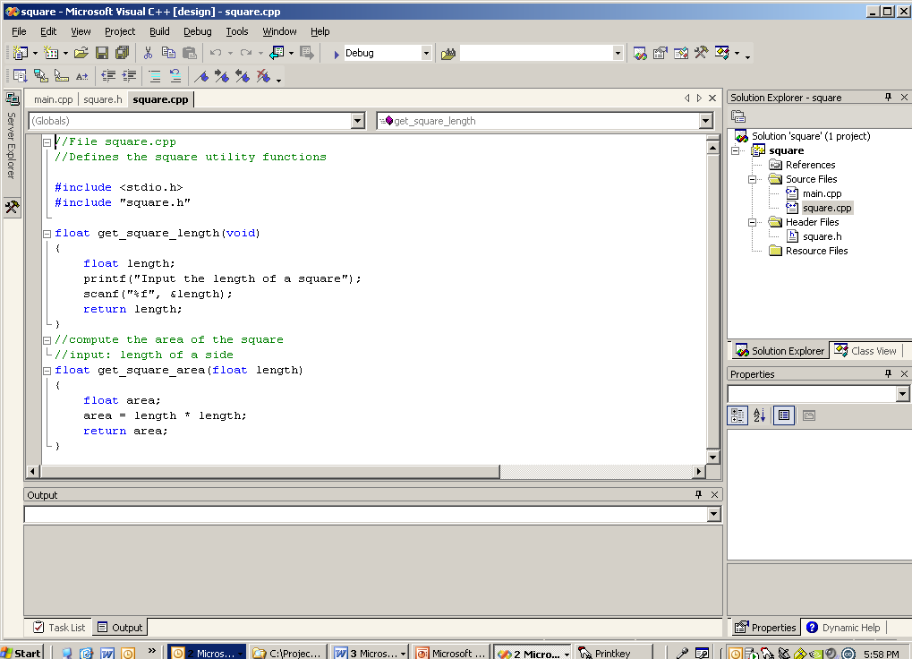

Slide 11
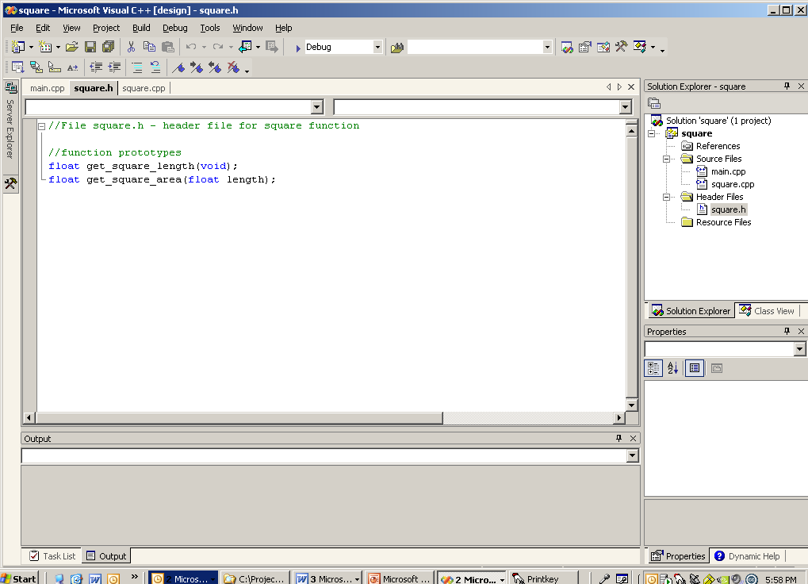

Slide 12
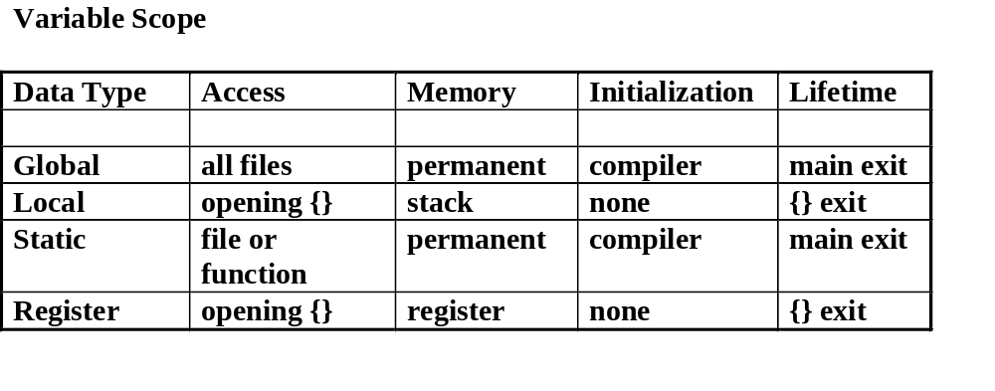

Slide 13
Arrays
myArray[10]
//Arrays in C (grouping data of the same type)
#include <stdio.c>
int main (int argc, char * argv[])
{
//Declaration
int myArray[10]; //all 10 elements of the array are of type integer
int myValue;
//Initialization
for (i=0; i < 10; i++) //indexing starts at 0
{
myArray[i] = 0; //all 10 elements are initialized to 0
}
//Random access of the data
myArray[5] = 10;
myValue = myArray[6];
myArray[4] = myArray[5];
printf(“Element = %d”, myArray[4];
return 0;
}
index | value
0 | 0
1 | 0
2 | 0
3 | 0
4 | 10
5 | 10
6 | 0
7 | 0
8 | 0
9 | 0
10 | ???
Caution: There is no boundary checking in C/C++

Slide 14
Pointers: a pointer is always an address
Declaring a pointer:
data type * pointer_name; //type of data being pointed to
int *ptr;
Initializing a pointer:
pointer_name = &variable; //address of variable
int var1;
ptr = &var1; //address operator
Using a pointer:
a_variable = *pointer_name;
int var2;
var1 = 7; //initialize the variable pointed to
var2 = *ptr; //de-reference operator

Slide 15
// Swap - Call-by-Value
#
include <
stdio.h>
void swap(float data1, float data2); //prototype
int main(void)
{
float a = 3.0, b = 4.0:
swap(
a,b);
// Will this work?
printf("a = %d\n", a);
printf("b = %d", b);
return 0;
}
//function definition
void swap (float data1, float data2)
{
float temp;
temp = data1;
data1 = data2;
data2 = temp;
return;
}

Slide 16
// Revised
version - Call-by-Reference
#
include <
stdio.h>
void swap (float *data1, float *data2);
// prototype
void main()
{
float a = 3.0, b = 4.0;
swap(&a, &b);
printf("a = %f\n", a);
printf("b = %f”, b);
}
void swap(float *data1, float *data2)
{
f
loat temp;
// store the content of data pointed to by data1
temp = *data1;
//swap the data pointed to by data1 and data2
*data1 = *data2;
*data2 = temp;
return;
}

Slide 17
When the
de-reference (*) operator is not used, the
pointer itself is operated on:
float *marker, a;
marker = &a;
//operate on marker by storing the
address of a
marker++; //increment the pointer
Initialize using a null pointer. Why?
char *marker = (char*) 0;
What about?
int main(void)
{
char *marker;
*marker = 'B';
/*The programs behavior is unpredictable since marker was
never initialized. The current content of marker (?) is
used as an address and character 'B' is written to it. The
program may crash or worse, it won't.
*/
char
*marker = (char*) 0;
/*results will be that the program will crash, but you will
know what happened and why.
*/

Slide 18
// Variable Access - array notation
//string copy function
#define NULL_CHAR '\0'
//standard last character of strings
char *
str_copy(char target[], char source[])
{
int
i;
/* while the null terminator is not found in the
source buffer */
for(i=0; source[i] != NULL_CHAR; i++)
{
// copy the content of source to target
target[i] = source[i];
}
//store the null terminator in target buffer
target[i] = NULL_CHAR;
return(&target[i]);
}

Slide 19
Arrays as Pointers
int array[10]; //”array” is a constant pointer
//The [] operator works as a dereference operator
array[0] = 10;
*array = 10; //equivalent to the above statement
array++; //not legal
*(array+1) = 10; //OK. Value of array is not changed

Slide 20
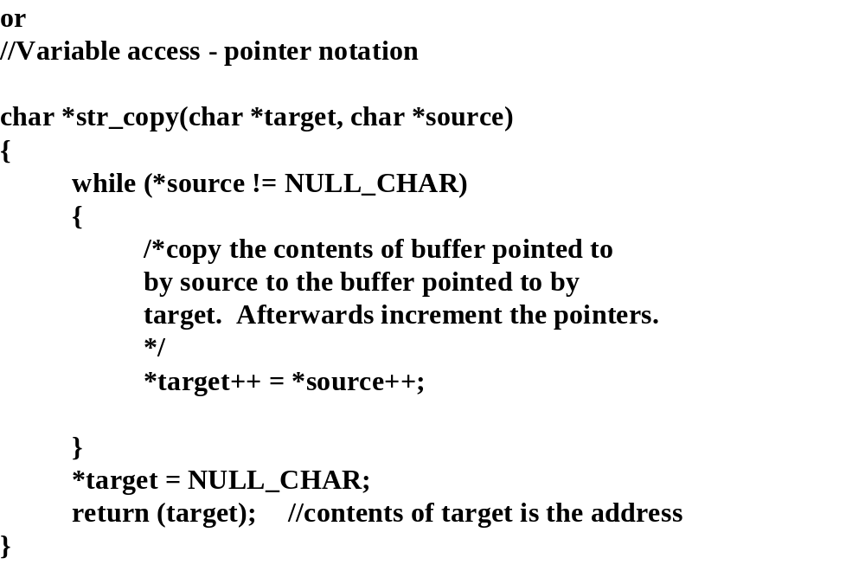

Slide 21
Structures and access to data

Slide 22
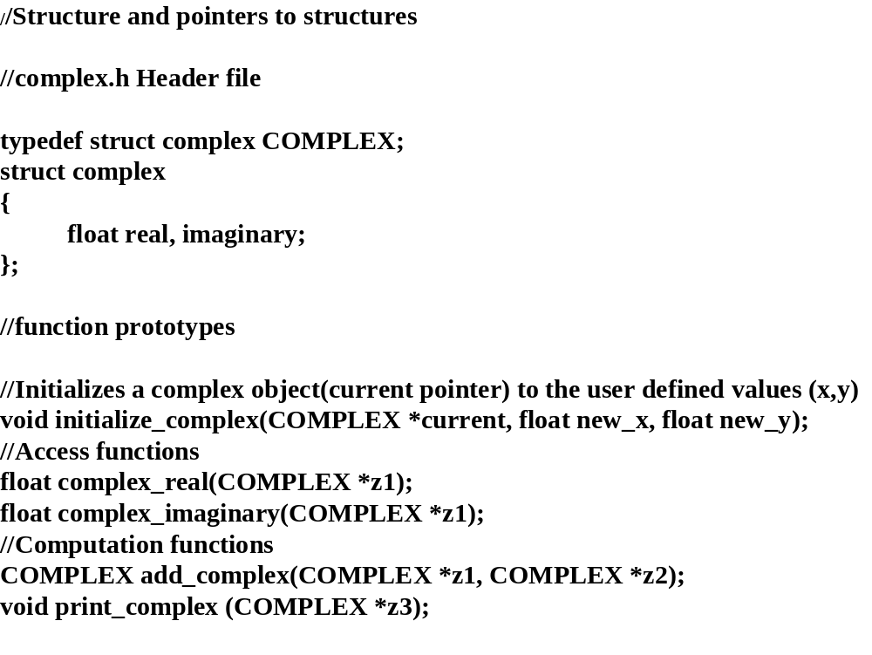
First a Quiz

Slide 23
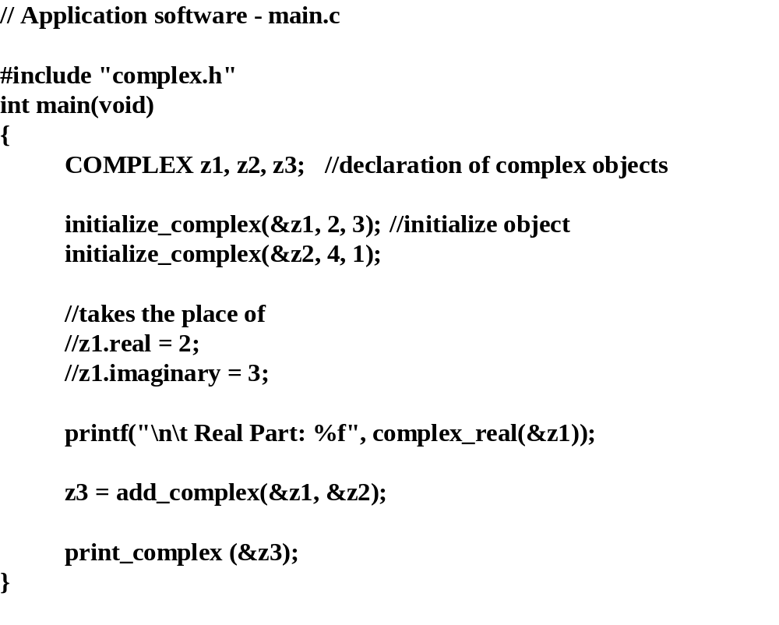

Slide 24
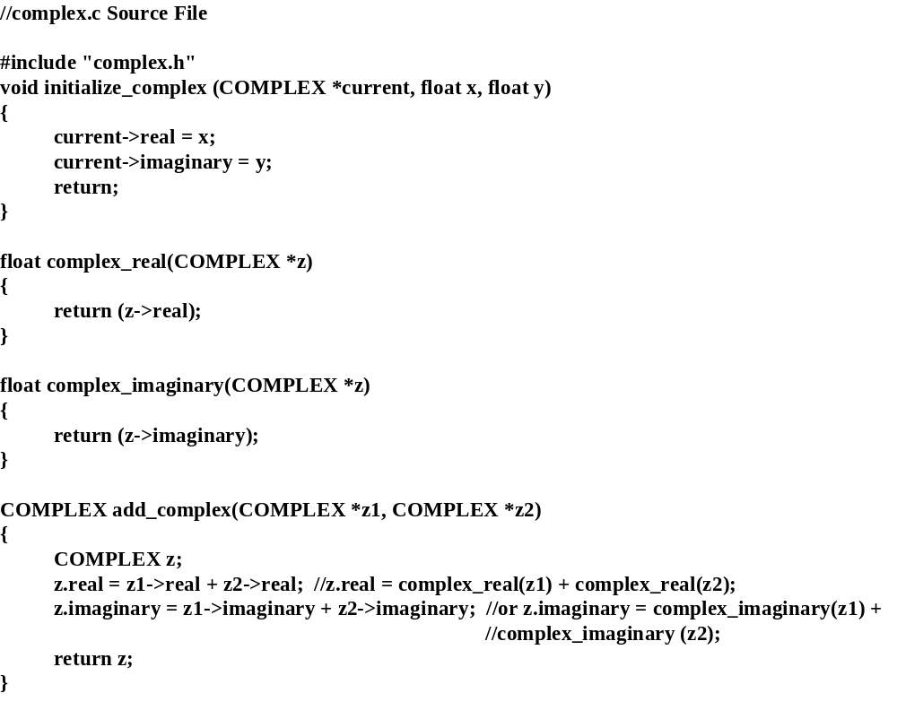

Slide 25
Dynamic Memory Allocation
Used when you do not know at compile time the size of memory to allocate for an array
Use when the size of the array can be variable
Use when the size of the array is large
#include <malloc.h>
Memory
Store
Application
DMA
Library
allocate
memory
request space (size)
memory
mocation

Slide 26
Dynamic Memory Allocation in C
//void *
malloc
(
size_t length);
//function prototype
#
include <
malloc.h>
char *
get_page(unsigned short
page_size)
{
char *page = (char*)
malloc (
page_size *
sizeof(char));
//allocate a char string buffer of length
page_size
return(page);
}
// void *
realloc(void *begin,
size_t length)
//function prototype
char *
resize_page(char *page, unsigned short
new_page_size)
{
//if current page exists and page size is valid
if(page && new_page_size >0)
{
char *temp;
// real
locate the existing buffer by using the new
//page_size
temp = (char*) realloc (page, new_page_size * sizeof(char));
if(temp)
{
//buffer successfully resized
page = temp;
// point to new block
}
else
{
printf(
"\n\t**Unable to resize buffer **");
}
}
return(page);
// return current address of the page
}

Slide 27
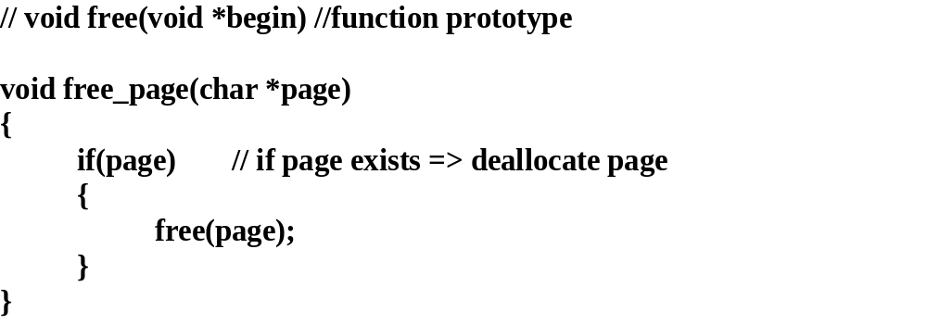

Slide 28
Basic File I/O
Use the stdio.h library for file input and output
#include <stdio.h>
To open a file:
Declare a pointer of type FILE and use fopen()
FILE *fptr:
FILE * fopen(char* filename, char* mode);
To read a line from a file:
char * fgets (char* buffer, int size, FILE* fptr);
To write a line from a file:
fputs (FILE* fptr, char* buffer);
To check for the end of file or a read/write error:
feop (FILE* fptr);
ferror (FILE* fptr);
After all I/O is complete close the file:
fclose (FILE* fptr);
There are many other functions in stdio.h for accessing data and managing files.

Slide 29
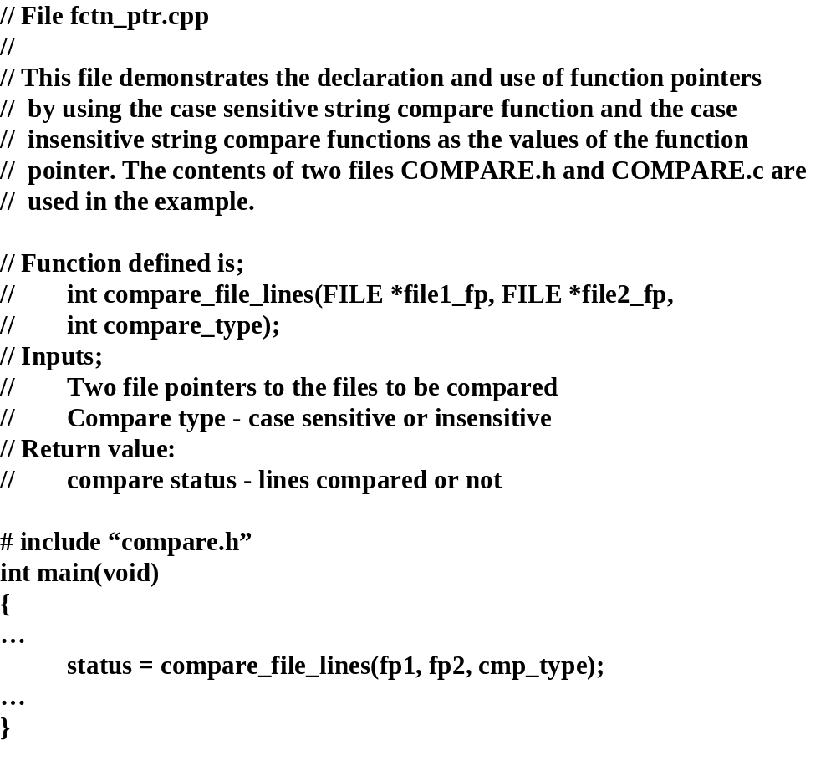

Slide 30
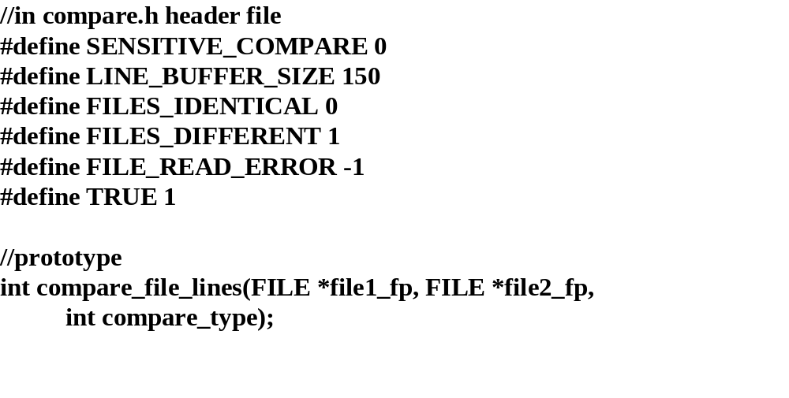

Slide 31
//
compare.c Source File
#
include <
stdio.h>
#
include <
iostream.h>
#
include <
string.h>
int
compare_file_lines(FILE *file1_fp, FILE *file2_fp,
int
compare_type)
{
char file1_buffer[LINE_BUFFER_SIZE];
char file2_buffer[LINE_BUFFER_SIZE];
char *buffer1_ma
rker, *buffer2_marker;
int
file_status = FILES_IDENTICAL;
int
line_ctr = 1;
// declare function pointer
int (*
compare_handler) (
const
char*,
const char*);
//based on comparison request ==>
//
use the applicable compare function
if(
compare_type == SENSITIVE_COMPARE)
{
int strcmp(char * string1, char * string2);
//initialize pointer for string compare
compare_handler = strcmp;
}
else
{
//initialize pointer for string compare(insensitive)
compare_handler = stricmp;
}

Slide 32
while (TRUE)
// loop will break on error or eof
{
//read a line from each file
buffer1_marker =
fgets(file1_buffer,
LINE_BUFFER_SIZE, file1_fp);
buffer2_marker =
fgets(file2_buffer,
LINE_BUFFER_SIZE, file2_fp);
//if read ok then compa
re
if (buffer1_marker && buffer2_marker)
{
line_ctr ++;
//use compare handler to compare lines
if((*compare_handler)(file1_buffer, file2_buffer))
{
cout <<"\n\t Files different at line = " <<line_ctr;
file_status = FILES_DIFFEREN
T;
}
}
else
//abort on file read error or EOF
{
break;
}
}

Slide 33
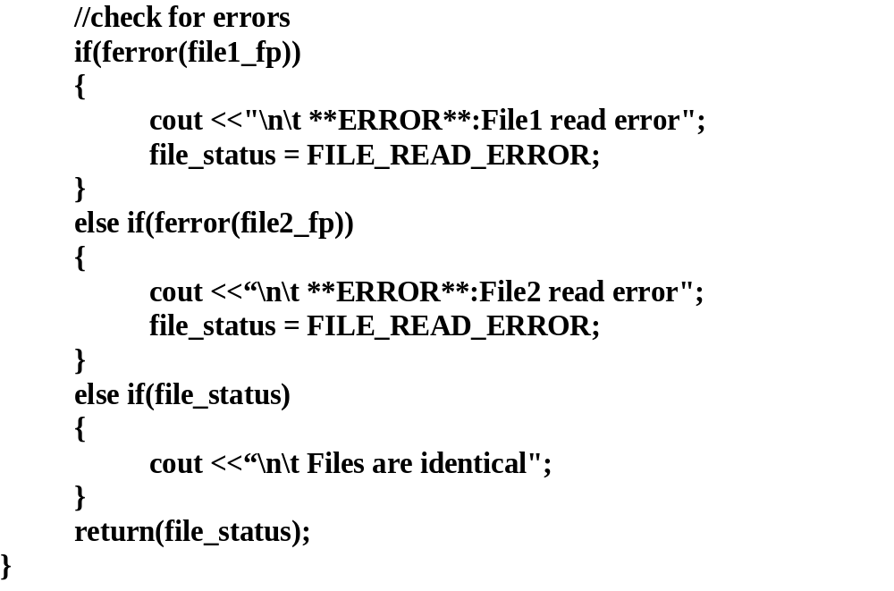

Slide 34
//
arrays of pointers - system interface
//
At operating system prompt
>
test 10
//
Test.cpp source file
#define INPUT_ERROR -1
#define ARG_ERROR 0
#define OK 1
#include <
stdlib.h>
//standard library:
int atoi(char * )
#include <
stdio.h>
//function prototypes
void
functional_test(
int
num_test_repetition);
int main(
int argc, char *argv[] )
{
int num_test_repetition, program_status = OK;
if(argc == 2)
{
/*convert test repetition from ASCII text
to a number */
num_test_repetition = atoi(argv[1]);
if(num_t
est_repetition > 0)
{
functional_test(num_test_repetition);
}
else
{
program_status = INPUT_ERROR;
}
else
{
program_status = ARG_ERROR;
printf("Usage: test <# of repetitions>\n");
}
return(program_status);
}

Slide 35
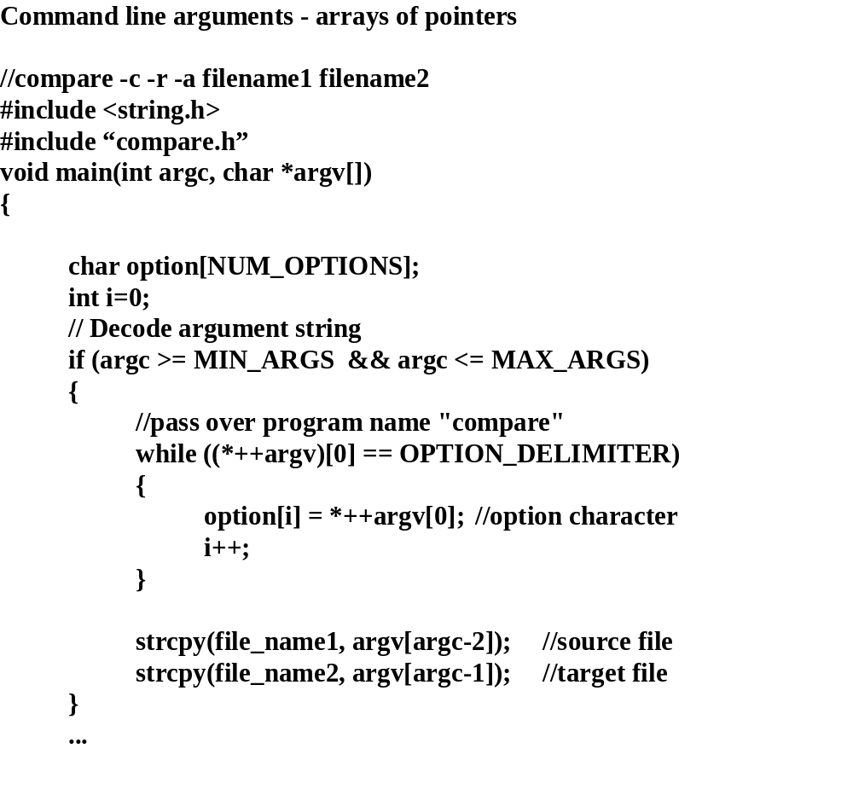
//increments argv to point to 2nd argument
//and gets 1st character in that argument
//increments argv[0] pointer to look at
//2nd character in argument

Slide 36
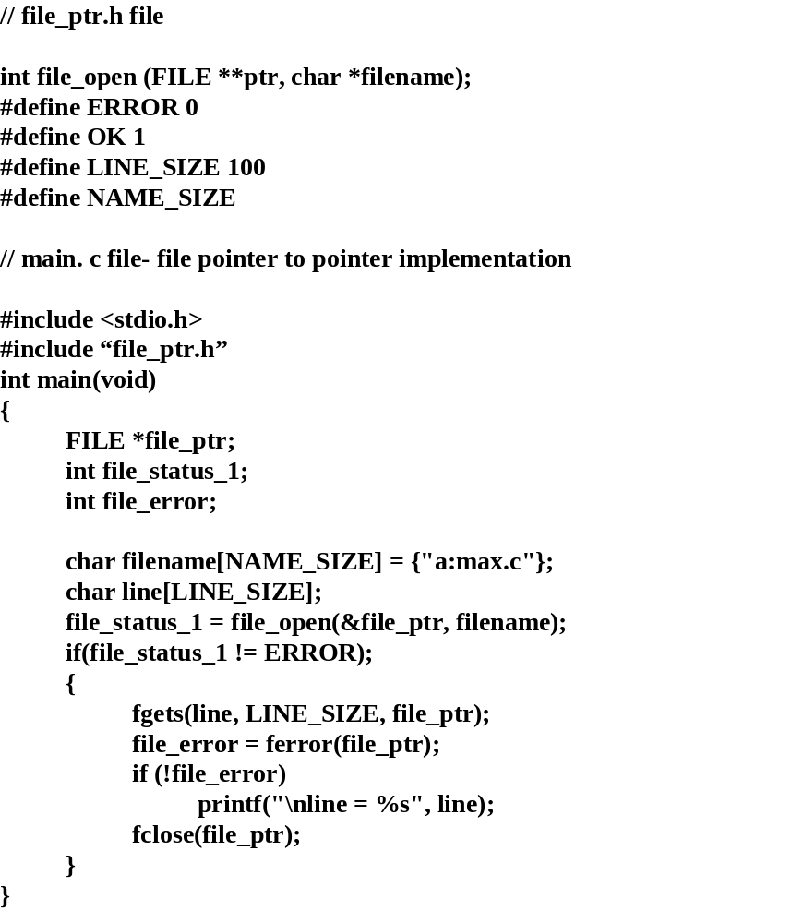
main
file_open
&file_ptr
file_ptr
file

Slide 37
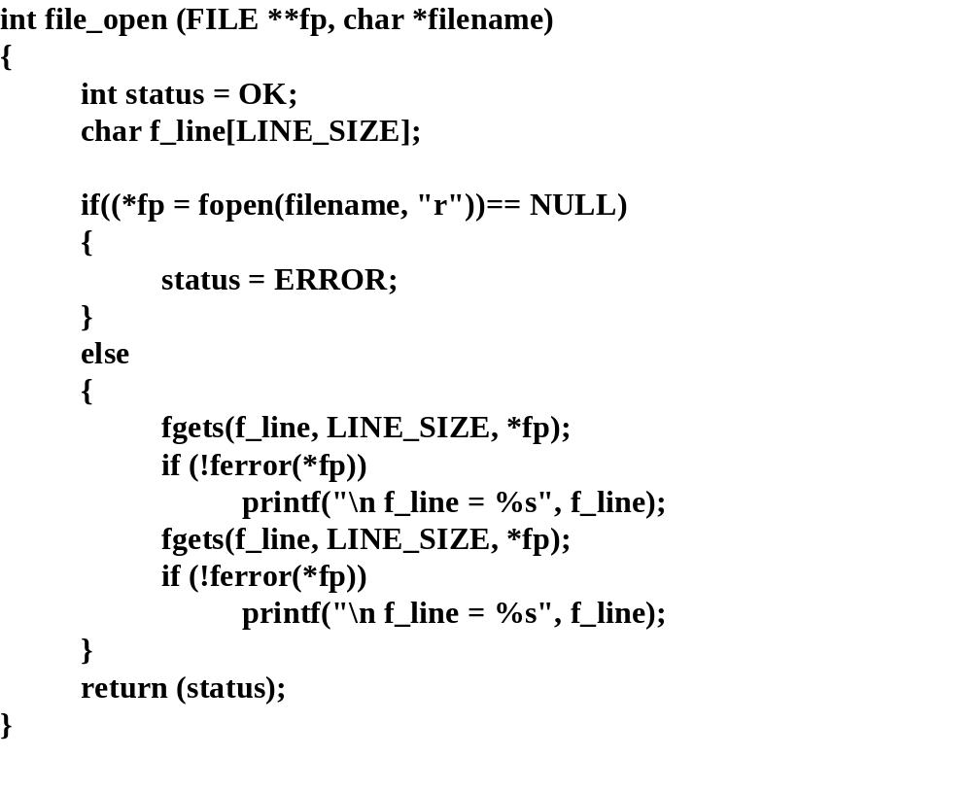
file_ptr
**fp
0010
0050
0010
.
.
*fp
0050
0050
*file_ptr
FILE struct

Slide 38
main Memory Space
Before call to file_open:
file_open Memory Space
fp
file_ptr
10000
0010
0010
.
.
*fp (after call to fopen(…))
0010
10050
**fp
After call to file_open:
10050
File Block
file_ptr
0010
10050
10050
FILE block

Slide 39
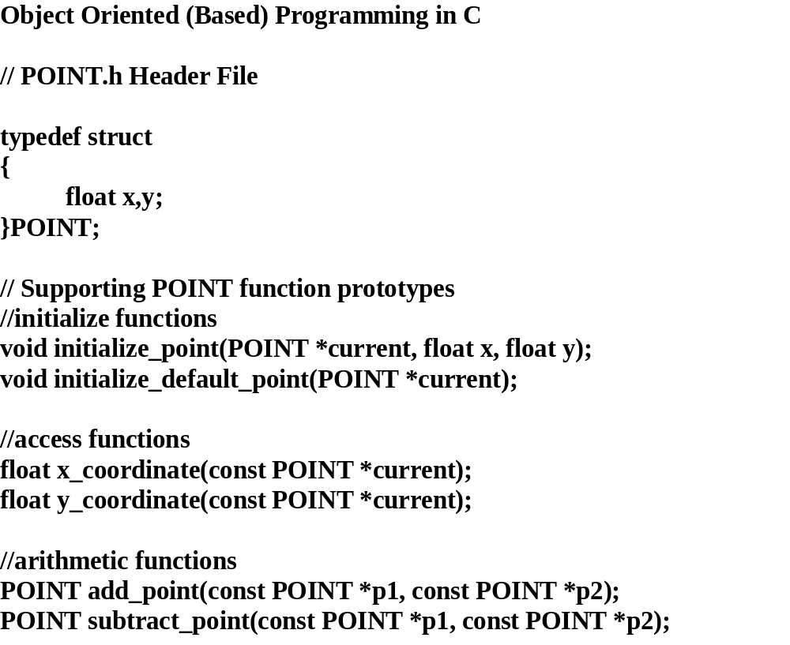
y
(x,y)
x

Slide 40
//
POINT.c Source File
#
include
“point.h”
void
initialize_point(POINT *current, float x, float y)
{
current->x = x;
//initialize to user defined values
current->y = y;
}
void
initialize_default_point(POINT *current)
{
current->x = 0;
//initialize to d
efault value
current->y = 0;
}
float x_coordinate(const POINT *current)
{
return(current->x);
// return x coordinate of the point
}
float y_coordinate(const POINT *current)
{
return(current->y);
// return y coordinate of the point
}
POINT add_point(const POINT *p1, const POINT *p2)
{
POINT result;
//declare a local point object
float x, y;
//add x and y components of p1 and p2
x = x_coordinate(p1) + x_coordinate(p2);
y = y_coordinate(p1) + y_coordinate(p2);
//store the point in result
initiali
ze_point (&result, x, y);
return(result);
}

Slide 41
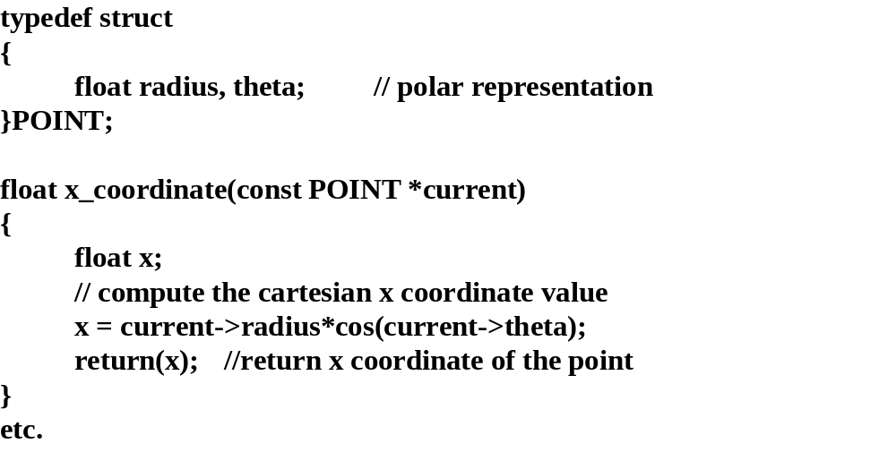
radius
theta

Slide 42
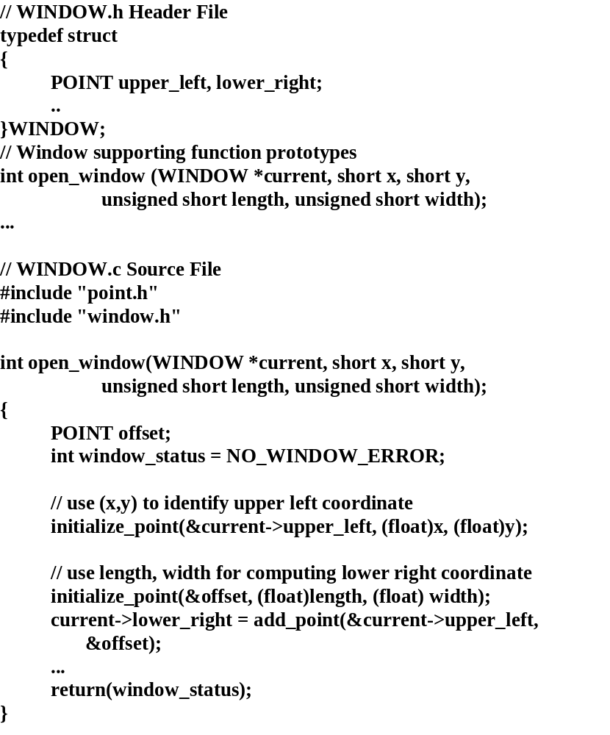

Slide 43
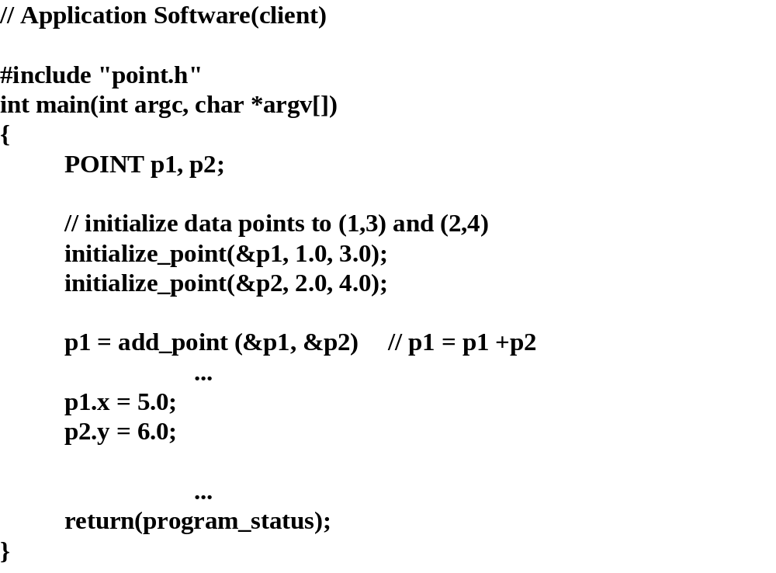

Slide 44
Object Oriented Design

