Slide 1
C++ Class

Slide 2
Class is a template definition of an object. An object is an instantiation of a class.
Data member - attribute of the class, of built-in type or another class(aggregation/ composition), a
new set of data members is built as each object is declared/constructed - provide state
Static data members - attribute of the class, of built-in types or another class, value of a static
attribute is the same for all instantiations of the class
Access Levels:
1. public - clients have full access to public data and use of public functions --> changes to
public members will probably effect the client program
2. protected - used in conjunction with inheritance, derived classes have access to protected
members, all other clients do not. Distinguishes between types of clients
3. private - data and functions not accessible by the client. Only class member functions may
operate on private data or call private functions

Slide 3
Class member functions:
Constructors: called automatically when an object is declared
reserve memory space - based on the class definition
initialize data members ==> placed in a predictable state, provides a safety net
initialization list - optio
nal except for composition, references, inheritance
Note: always a member function, cannot have a return value
Example: Savings and Name classes
Destructors: counterpart of constructor, called when object goes out of scope
clean-up
memory deall
ocation - delete (destructor is called first)
Note: used for classes that contain pointers, references to external data or streams, no parameters
or return value
Regular member functions
Example: Name and Savings
Static member functions -
Example:
Savings class

Slide 4
Savings
name
…
…
accountNumber
balance
Class Savings - regular data members
//
savings.h file
class Savings
{
private:
char name[NAME_SIZE];
//or Name
customerName;
int
accountNumber;
float balance;
public:
….
};
//internal containment – attributes are maintained within the class

Slide 5
*name
accountNumber
balance
name
//or external containment:
//
savings.h
class Savings
{
private:
char *name;
//or Name *
customerName;
int
accountNumber;
float balance;
public:
…
};
//which is best?
private access level – provides encapsulation – also applies to Name
(Savings is a client of Name - Savings uses Name)

Slide 6
Static data members:
//
savings.h
class Savings
{
private:
char *name;
//or Name *
customerName;
int
accountNumber;
float balance;
What is a static
members lifetime?
static
float
interestRate;
public:
…
};
//static members must be explicitly initialized in a source (.
.cpp) file
//
savings.cpp
#include
“savings.h”
Savings::SetInterestRate (
defaultRate);
or
Savings::Savings()
//default constructor
{
interestRate = DEFAULT_RATE;
//not a good idea—no need to
//set for each instantiati
on of
//Savings
}

Slide 7
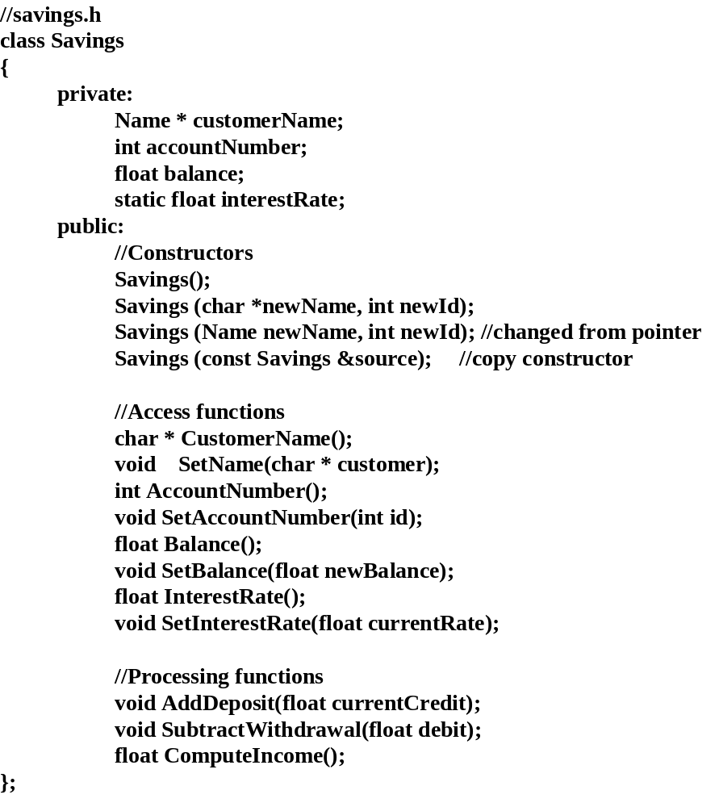
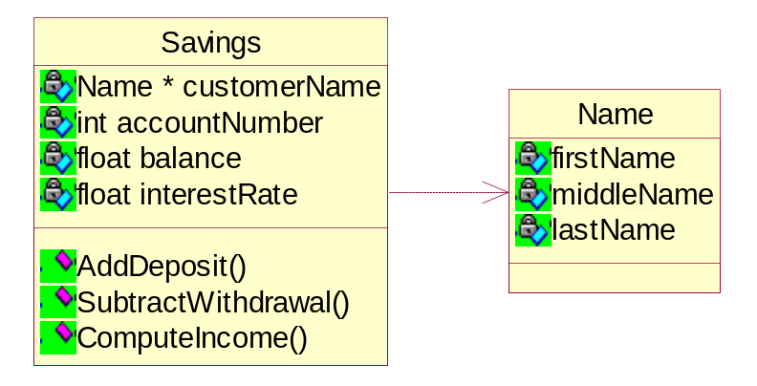

Slide 8
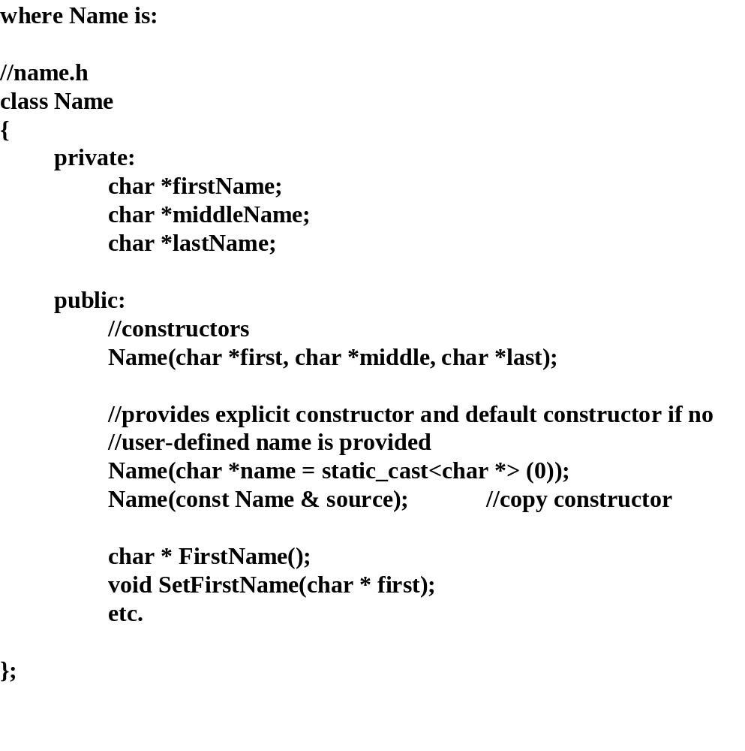
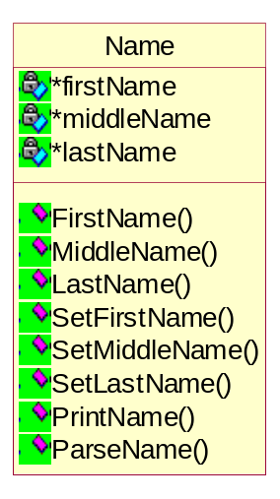

Slide 9
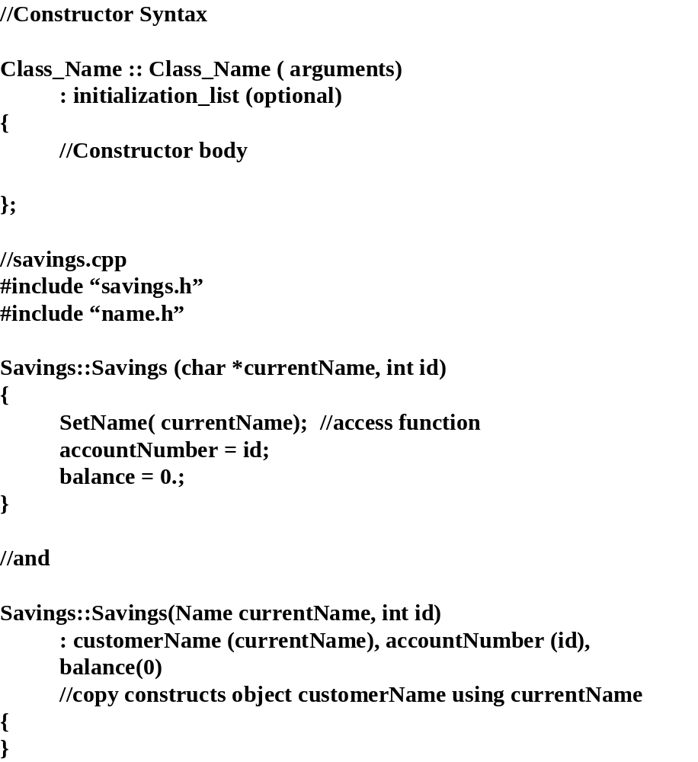
What happens if we use
a pointer implementation i.e.
currentName is pointer? The
copy constructor is not called.
The pointer is just assigned.

Slide 10
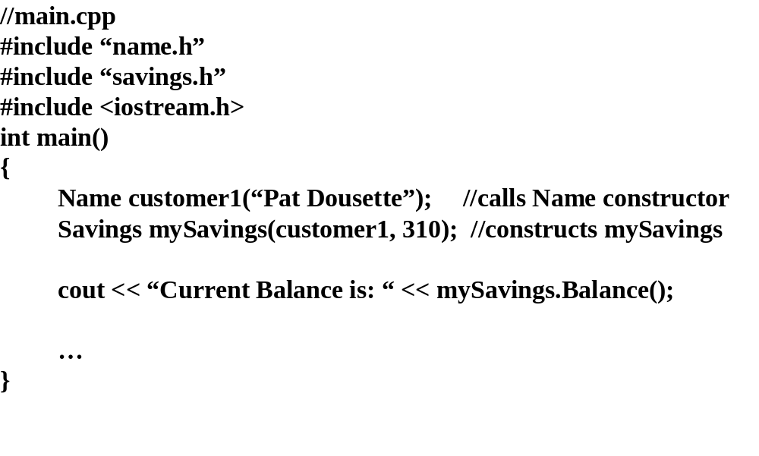

Slide 11
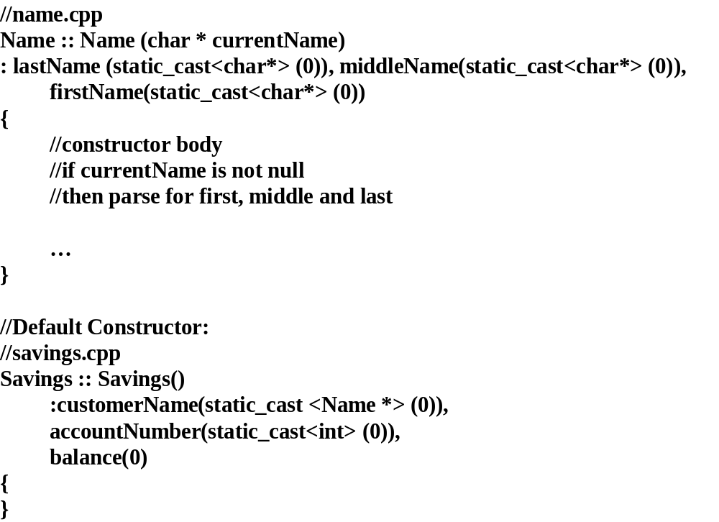

Slide 12
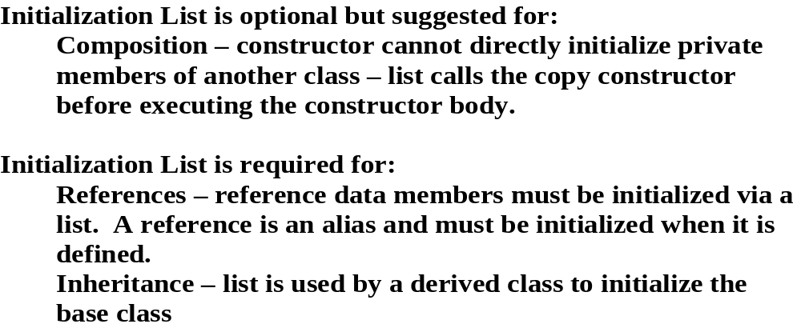

Slide 13
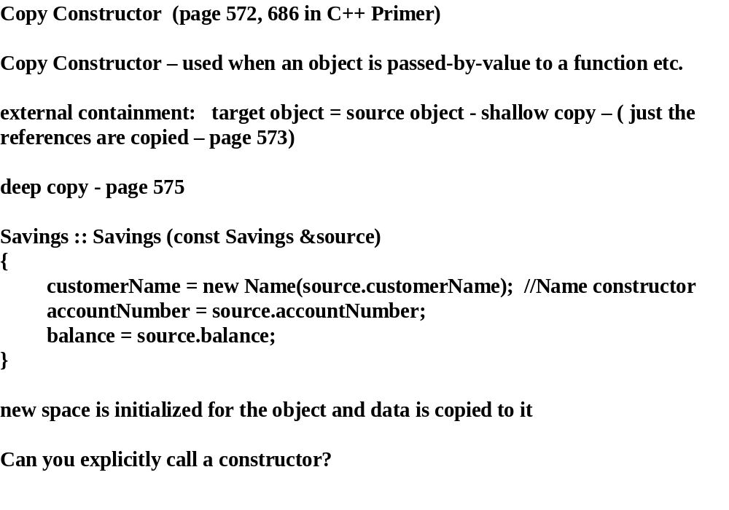
See misc.ppt

Slide 14
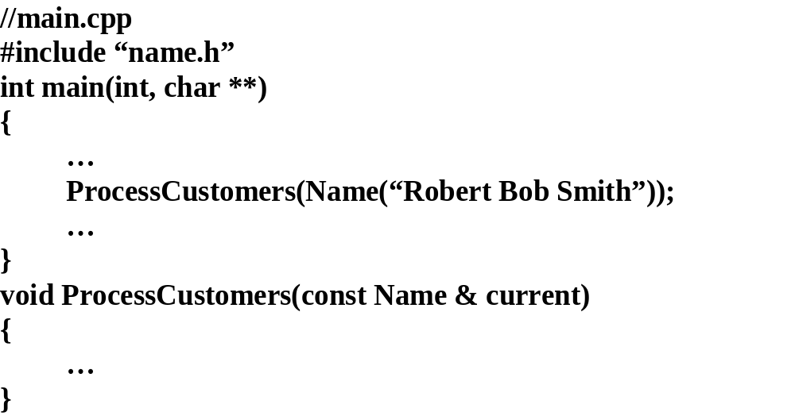

Slide 15
Constructing arrays of objects
class MyClass
{
private:
int counter;
public:
void Initialize();
int Counter(void);
…
};
Declaration and usage;
MyClass myObjects[3]; //default constructor
//or parameterless constructor
for (i= 0; …)
{
myObjects[i].Initialize();
cout << myObjects[i].Counter();
}
….
Or
//call user defined constructor for each element
….
MyClass myObjects[3] = {MyClass(i), MyClass (j), MyClass(k)};
….
class MyClass
{
private:
int counter;
public:
MyClass(int i);
int Counter(void);
…
};

Slide 16
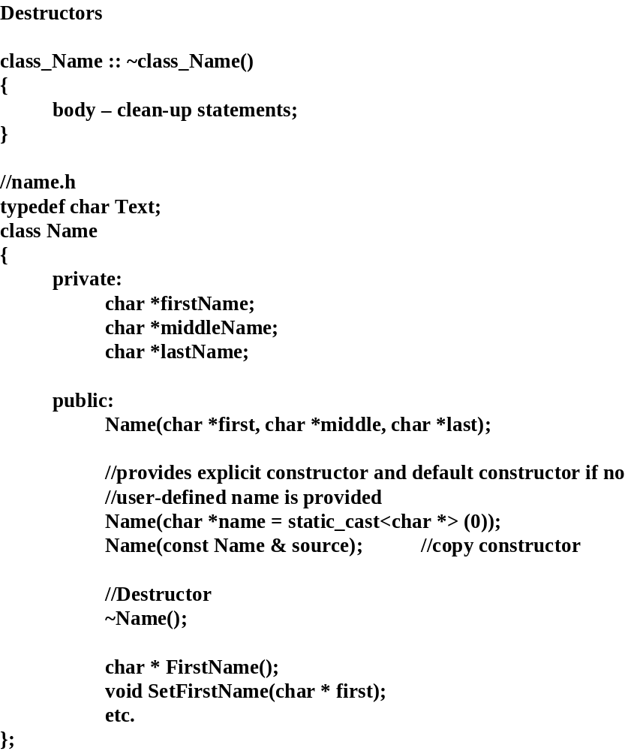

Slide 17
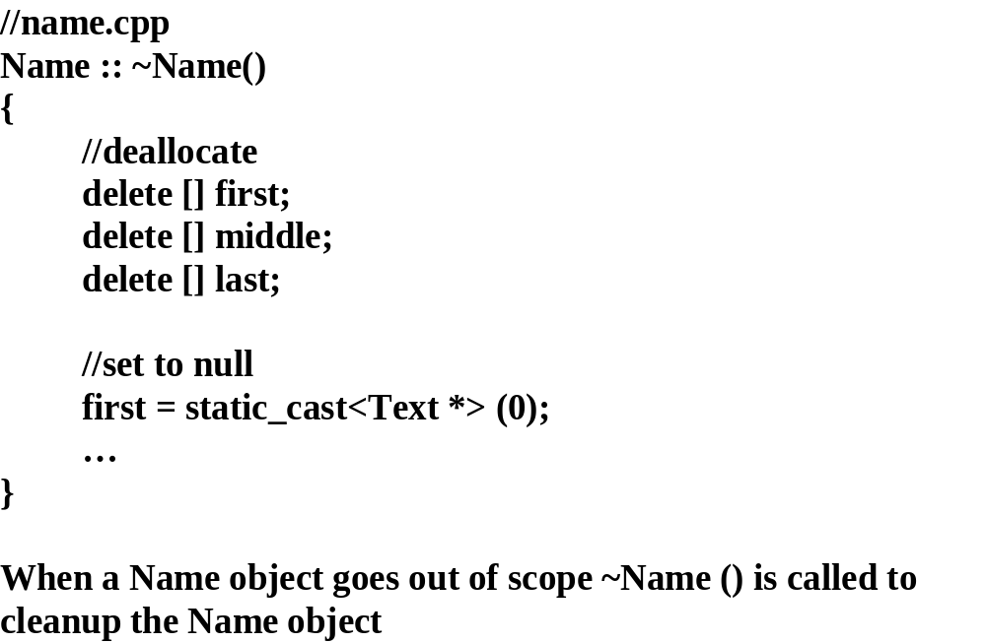

Slide 18
C++ automatically provides the following methods for your classes (unless you provide
your own):
  a constructor,
  a copy constructor,
  an assignment operator,
  two address-of operators (const and non-const), and
  a destructor.
class Empty { }; // You write this ...
class Empty // You really get this ...
{
public:
  Empty() {} // constructor
  ~Empty() {} // destructor
  Empty(const Empty &rhs); // copy constructor
  Empty &operator=(const Empty &rhs); // assignment operator
  Empty *operator&(); // address-of
  const Empty *operator&() const; // operators
};//end class Empty
If a class has no valid meaning for these functions, you should declare an implementation in the private section of the class. Such a function should probably throw an exception.
  This ensures that the compiler will not use the default implementations, that it will not allow users to invoke that function, and that if a member function uses it by accident, it may at least be caught at runtime.

Slide 19
Compiler generated constructor/
destructor/copy constructors
copy constructor - watch for “shallow copies” (when class has external
containment)
no
destructor needed for internal containment
general guideline:
do not rely on compiler generated default functions
It is a good idea to always define a constructor, copy constructor, and a destructor for every class you write, even if they don't do anything.

Slide 20
Usage of default constructor.
//test.cpp
#include "test.h"
Name::Name()
{
SetWeight(100);
height = 0;
name[0] = '\0';
}
Name::Name(int newWeight)
{
weight = newWeight;
}
void Name::SetWeight(int newWeight)
{
weight = newWeight;
}
int Name::Weight()
{
return weight;
}
//Testing Class constructors - test.h
class Name
{
private:
int weight;
int height;
char name[20];
public:
Name();
Name (int newWeight);
void SetWeight(int defaultWeight);
int Weight();
};
//main.cpp
#include "test.h"
#include <stdio.h>
void main(void)
{
printf("Test program\n");
Name myName;
Name oldName(300);
printf("My weight is: %d", myName.Weight());
printf("Old weight is: %d", oldName.Weight());
}
Name myName(); //did not compile
//did not recognize myName.Weight()
//as an instance of class Name

Slide 21
Functions:
Member functions
: constructor,
destructor, regular, static
Inline - member or non-member
Operator - member or non-member
Friend - privileged non-member
Virtual (later)

Slide 22
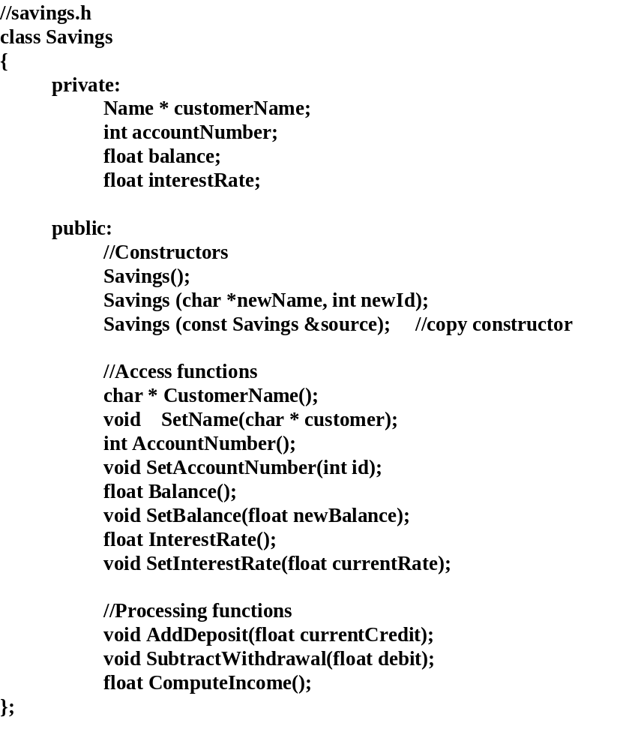
Regular Member Functions

Slide 23
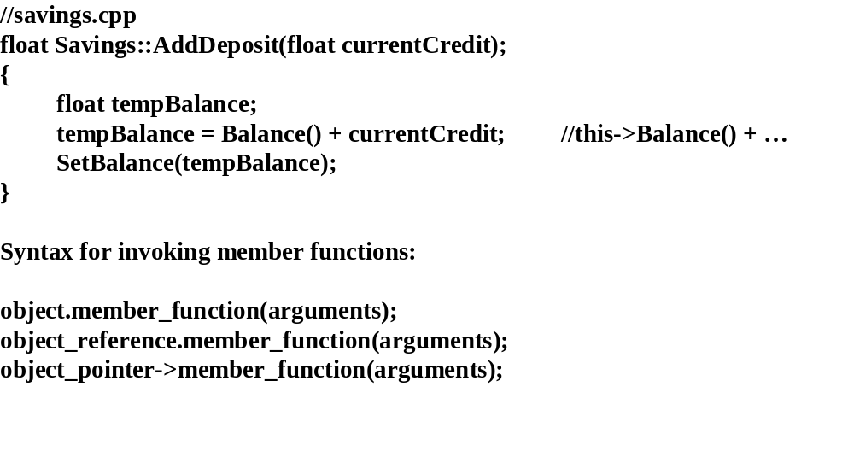

Slide 24
//
main.cpp
#
include <
iostream.h>
#
include “
savings.h”
#
include “
name.h”
int main(void)
{
Savings customer (“Patricia J. Dousette”, 235);
float credit = 100.;
customer.AddDeposit(credit);
cout << “Balance for “ <<
customer.CustomerName() << “ = “
<<
customer.Balance();
….
“this” pointer

Slide 25
//
main.cpp
#
include <
iostream.h>
#
include “
savings.h”
#
include “
name.h”
int main(void)
{
Savings *customer = new
Savings(“Patricia J. Dousette”, 235);
float credit = 100.;
customer->AddDeposit(credit);
cout << “Balance for “ <<
customer->CustomerName() << “ = “
<<customer->Balance();
….
“this” pointer

Slide 26
Static Member Functions
class Savings
{
private:
Name *
customerName;
int
accountNumber;
float balance;
static float
interestRate;
public:
//Constructors
Savings();
Savings (char *
newName,
int
newId);
Savings (
const Savings &source);
//
copy constructor
//Access functions
char *
CustomerName();
void
SetName(Name * customer);
int
AccountNumber();
void
SetAccountNumber(
int id);
float Balance();
void
SetBalance(float
newBalance);
float
InterestRate();
void
SetInterestRate(float
currentRate);
//Processing functions
void
AddDeposit(float
currentCredit);
void
SubtractWithdrawal(float debit);
float
ComputeIncome();
};

Slide 27
Accessing static data
int main()
{
Savings customer;
//create dummy object
cout << “Interest Rate = “ <<
customer.InterestRate();
//provides access to
interestRate
…
}
but, the
interestRate() access function does not actually need an object to
operate on, only operating on static data, so...
static
float
InterestRate();
static
SetInterestRate(float currentRate);
cout << “Interest Rate = “ << Savings :: InterestRate();
//OK
Static functions allow access to the static data without an object.

Slide 28
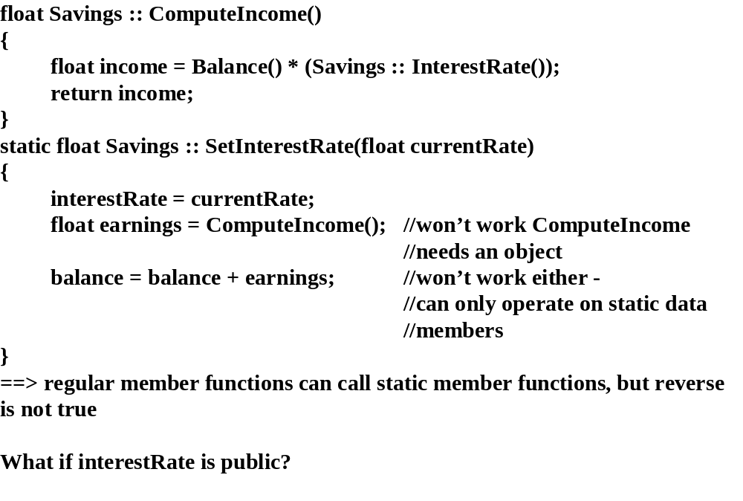

Slide 29
Syntax for invoking static member functions:
object.static_member_function(arguments);
object_reference.static_member_function(arguments);
object_pointer
->static_member_function(arguments);
class_name ::
static_member_function (arguments);
general guideline
: use the last line syntax so that a static member function
does not appear to be operating on an object, but the class that the static data is
a member of is clear.

Slide 30
Friend Classes
Just when you think complete encapsulation is provided...
a class can become a “friend” of another class and have access to its private data,
but use sparingly because of tight coupling

Slide 31
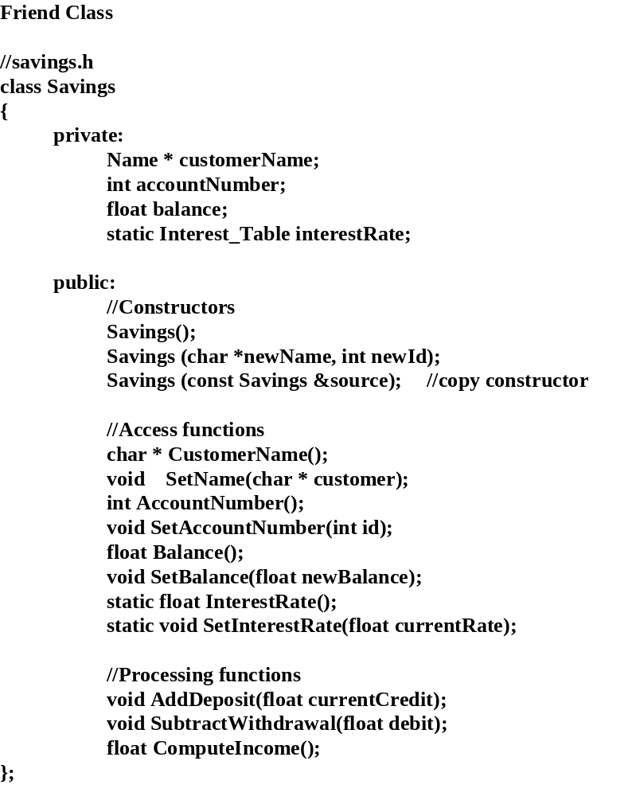

Slide 32
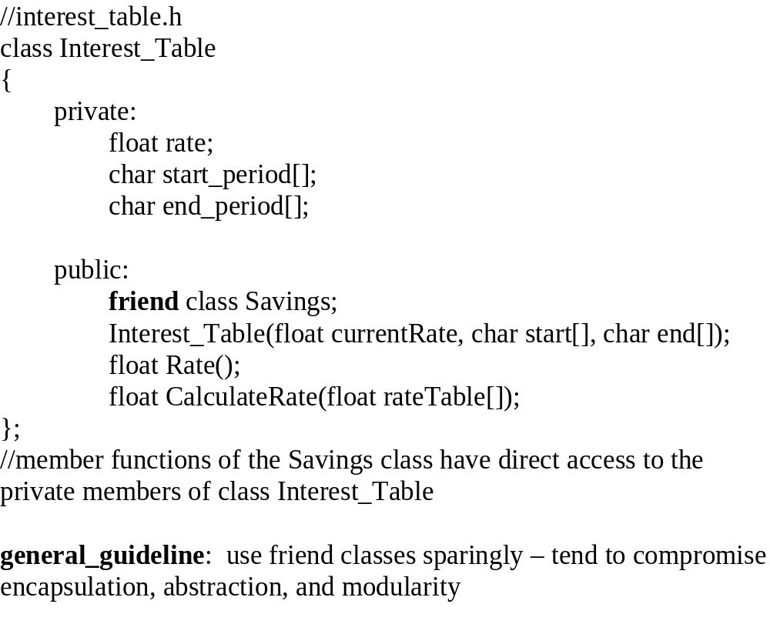

Slide 33
Interface Class
A class that has no implementation or data, only pure virtual member functions, including the destructor. Sometimes called a "pure virtual class".
// An Interface, does not contain any
// concrete member functions or any attributes:
// can be “implemented” in different ways
class Interface
{
  public:
    Interface (){}
    virtual ~ Interface (){}
    virtual void foo() = 0; // A pure virtual member function
};

