Slide 1
Dynamic Memory Allocation

Slide 2
Different types of memory:
Heap(free store) - dynamically allocated objects/arrays - at runtime
Permanent - static/global variables, objects, arrays
Stack - local variables, objects, arrays
Assignment by the compiler is based on scope of the data
ex:
List customerList; //declared before main ==> object is constructed in permanent memory
Account *List:: GetAccount(int id)
{
Account currentCustomer;
//when get_account is entered currentCustomer object is
.
constructed and allocated to the
stack

Slide 3
Summary
DMA is used when space cannot be determined during development -- space requirements aren’t known
until the program is executing e.g. a data base program allocates memory as tables are created and data is
entered
In C the tools for this were provided by a library “malloc”, in C++ DMA features are provided as part of
the language i.e. new and delete
Features obtain requested memory and manage the space, a pointer to the space is returned if allocation is
successful, a null pointer is returned if the allocation is unsuccessful
Allocation is done by run-time system memory management algorithms e.g. first fit and best fit
If memory becomes fragmented (or used up), unsuccessful allocation requests must be handled by the
application which should take steps to recover gracefully
The allocation process is transparent to the application and is handled by the language tools:

Slide 4
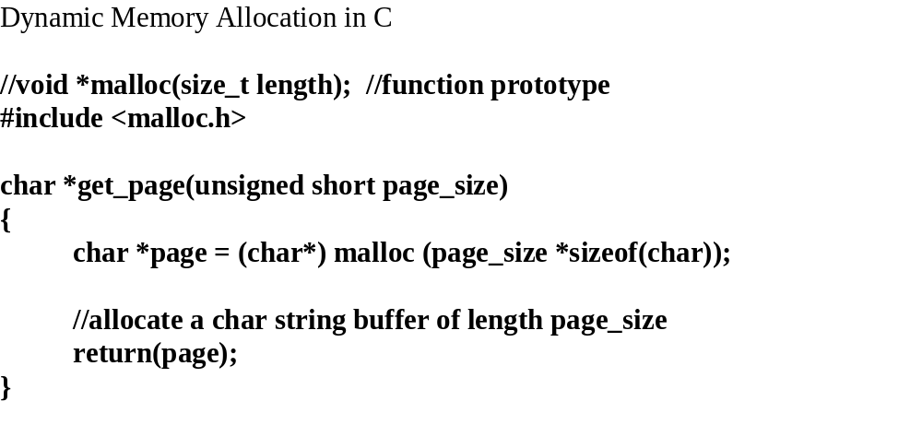
Dynamic Memory Allocation
Object size
Heap
Application or
Client
DMA
Object location
//void free(void *begin);
In C everything must be explicit and in order:
allocation
initialization of space
deallocation
clean-up of pointers
Or there will be memory leakage!
void
free_page(char *page)
{
if (page)
//if page exists,
deallocate page
{
free (page);
}
}

Slide 5
DMA in C++
Allocation/deallocation:
syntax:
Type *object =
new
Type (constructor arguments if any);
Type *array =
new
Type [size];
//an array of objects
Type *multi-array [M] =
new
Type [n,M]
//M must be a constant
delete
object; //pointers
delete
[] array;
//no dimension
Type is any built-in type or a class.

Slide 6
The application is responsible for:
size of space - data from user, or external source, or by calculation
initialization, manipulation, and management of the data in the space - should be initialized after allocation, it can contain data from a previous allocation
deallocation - when usage is complete, return the memory to the heap

Slide 7
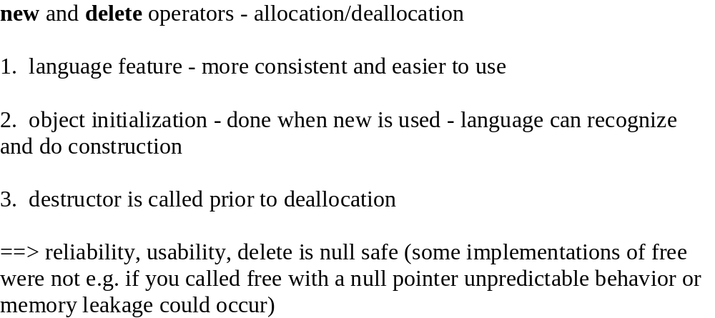
DMA in C++

Slide 8
Simple examples:
float *radius = new (0.0);
// if allocation successful then *radius = 0.0.
// if not then radius is null
//equivalent to:
float *radius;
radius = (float*) malloc( sizeof(float));
if (radius)
*radius = 0.0;
Type *array = new
Type[length];
//equivalent to:
Type *array =
static_cast<
Type*> (
new(
sizeof(Type) *length));
// if (
array !=
static_cast <
Type*> (0))
//
for (
int i=0;
i<length; i++)
//
call default constructor for array[i]
steps:
1. allocation via new operator
2. calls default constructor for each element
3. pointer conversion
4. memory space computation
if allocation is unsuccessful a null address is returned, otherwise the address of the allocated space is
returned.

Slide 9
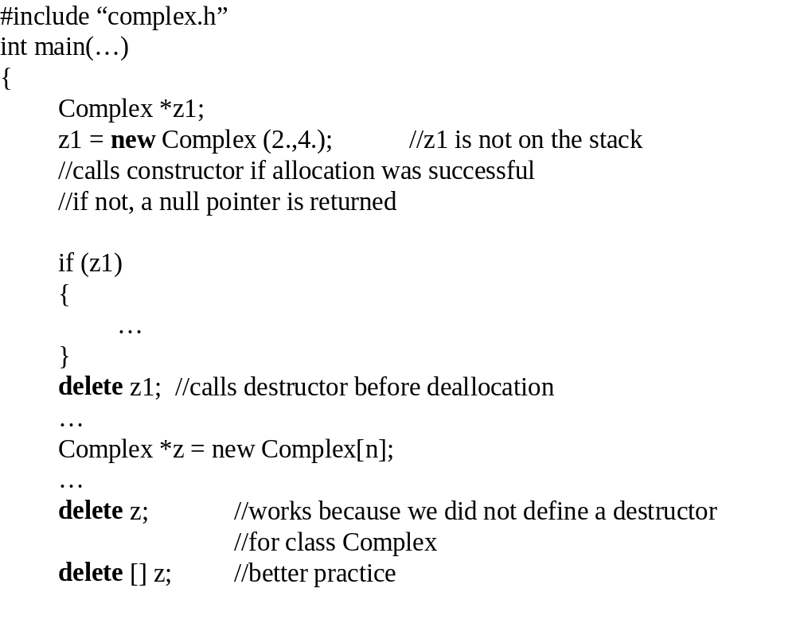

Slide 10
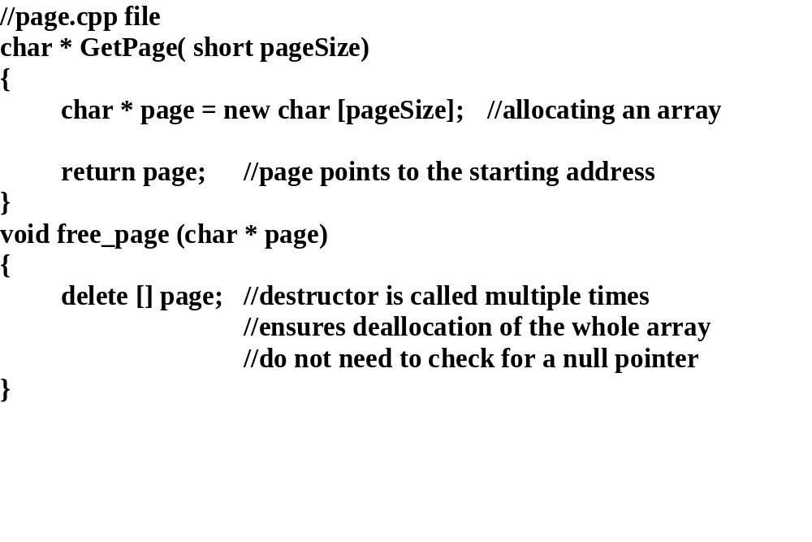

Slide 11
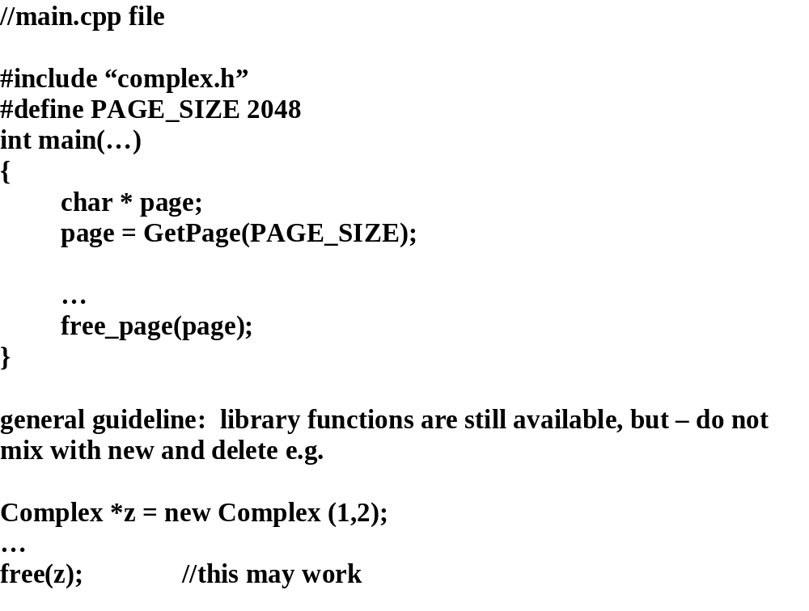

Slide 12
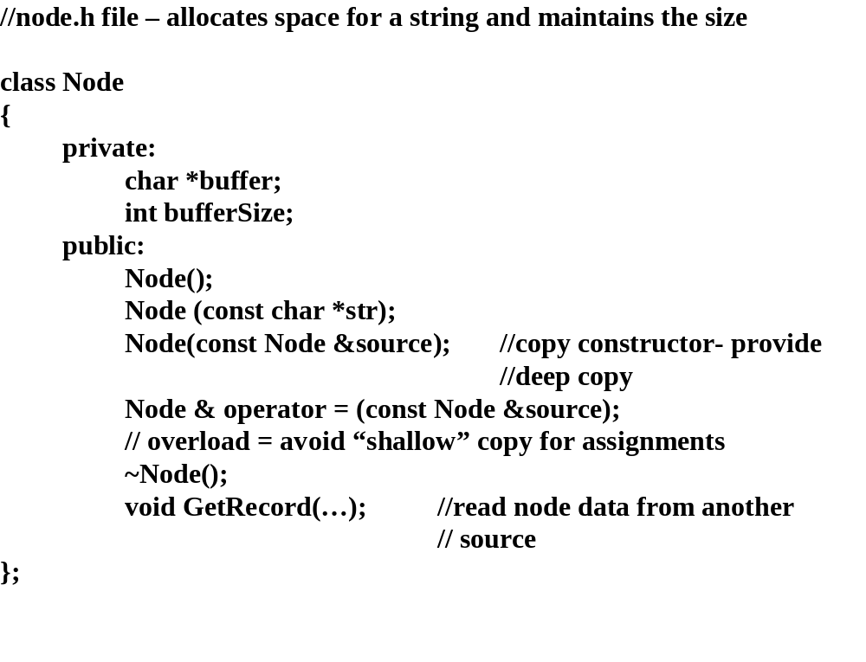

Slide 13
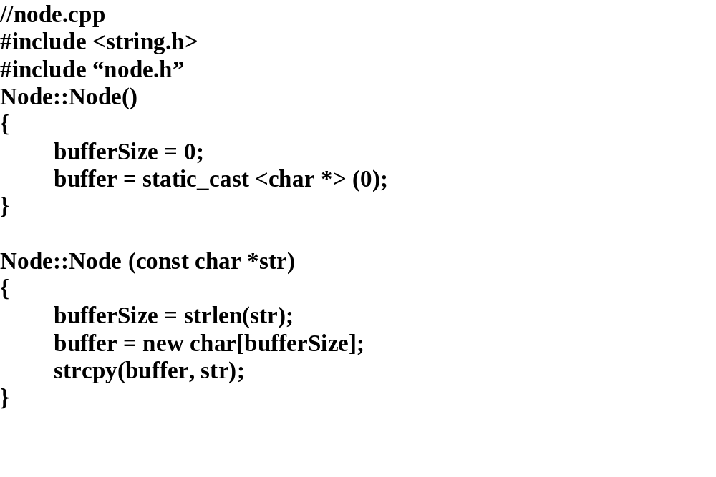

Slide 14
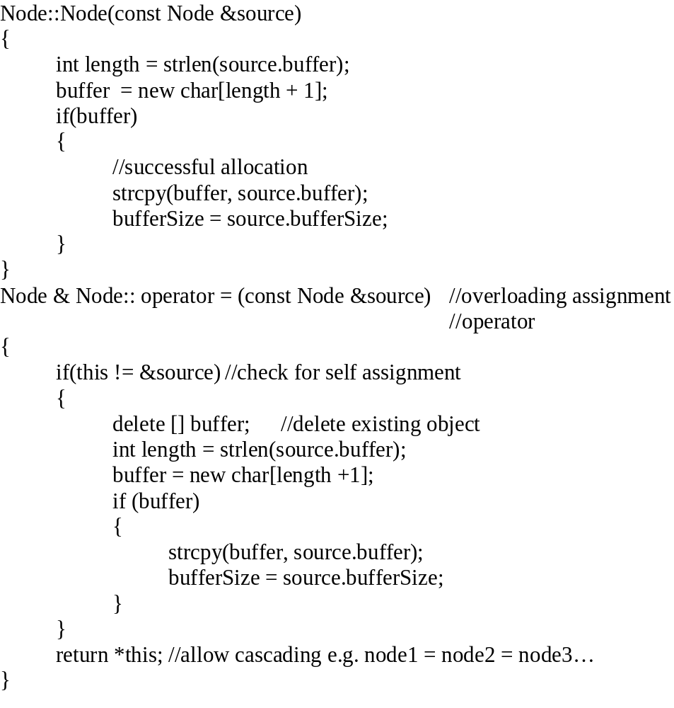
//node.cpp (cont.)

Slide 15
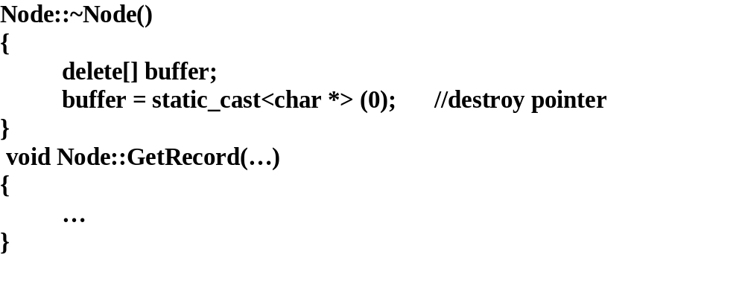

Slide 16
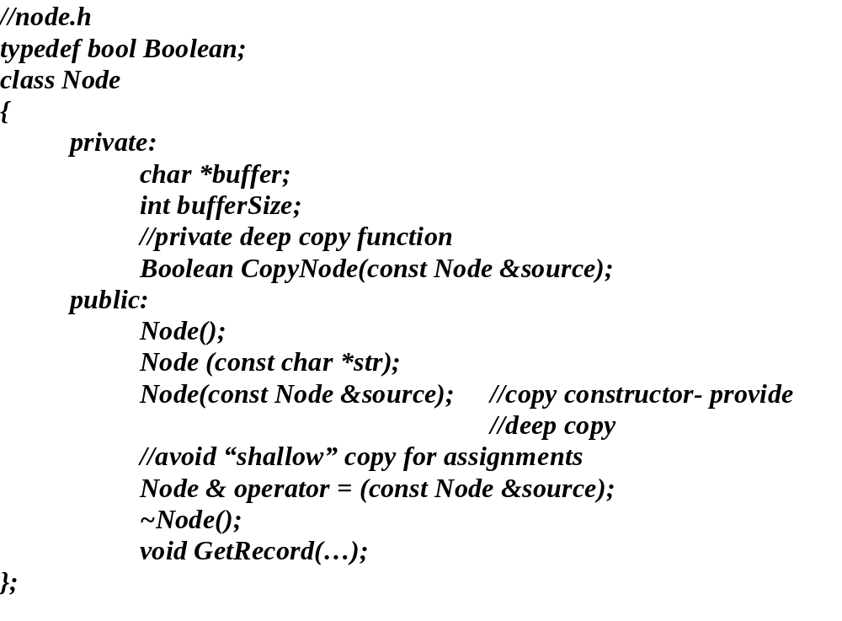
Note: The copy constructor and the overloaded assignment operator look very much alike so write a utility function and make it private.

Slide 17
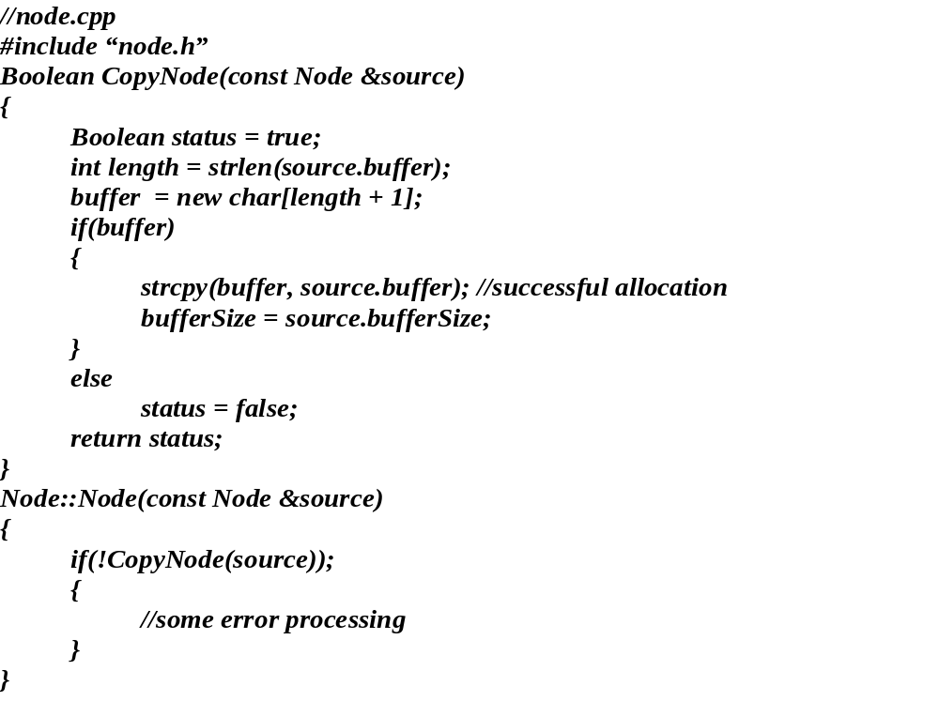

Slide 18
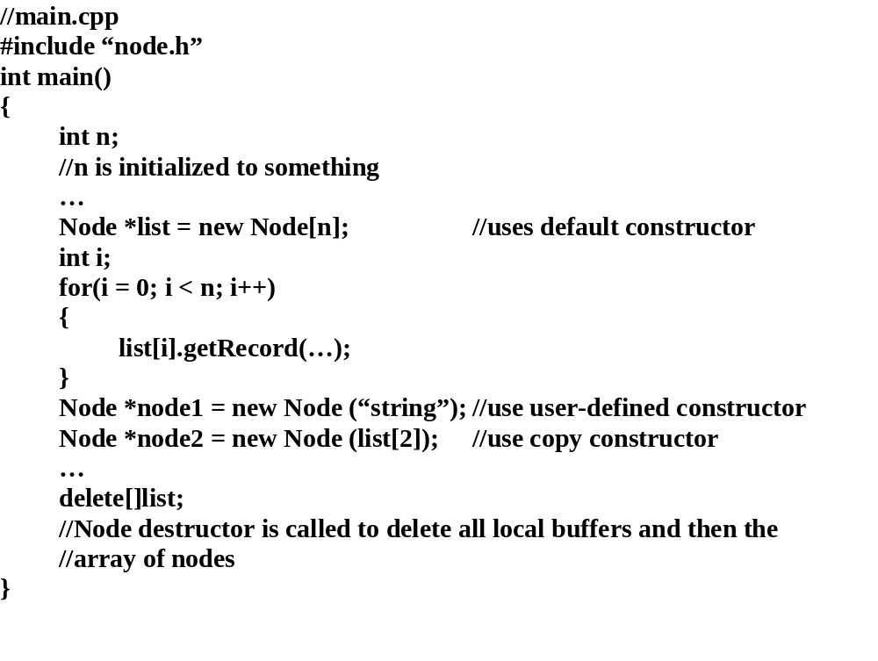
Allocating and deallocating nodes.

Slide 19
typedef bool Boolean;
class Name
{
private:
Text *first, *middle , *last;
//external containment
Boolean ParseName(void);
//private utility functions, not accessible to clients
Boolean CopyName(const Name &source);
public:
//constructors
Name
(const Text *current_name = static_cast <Text *> (0));
Name (const Name &source);
//copy constructor
Name & operator = (const Name &source);
//overloaded = to provide deep copy
//destructor
~Name();
};
//use new and delete to allocate space for class Name string buffer
//functions provide deep copy by allocating unique string buffers for objects

Slide 20
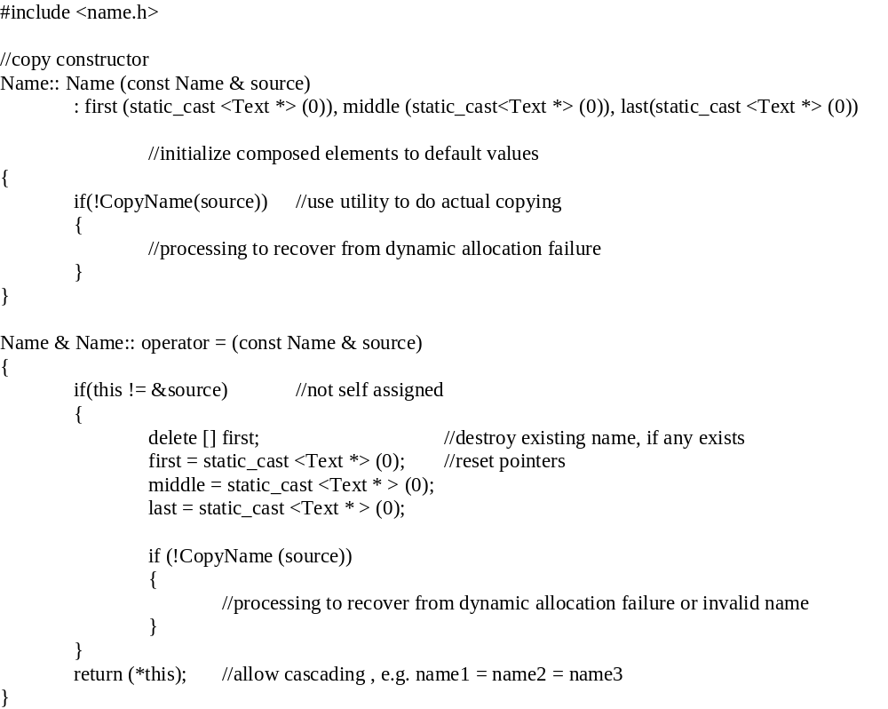

Slide 21
//
name.cpp
#
include “
name.h”
int main (
int, char**)
{
// allocate a Name object and initialize it with user defined data constructor
Name *customer1 = new Name( “Patricia Joanne Dousette”);
//allocate a Name object and use the default constructor
Nam
e *customer2 = new Name;
//allocate a Name object and use the copy constructor
Name *customer3 = new Name (*customer1);
…
}

Slide 22
consider:
Name *customer = new Name (
read_buffer());
// allocates a Name object and uses the return value of
read_buffer() to initialize the object
if the allocation fails, the call to read_buffer() may not occur ==> compiler dependent
Guideline: do not use operators (e.g. ++) or operations that modify the state of an object in the
argument list OR explicitly check the state of the object should the allocation fail

Slide 23
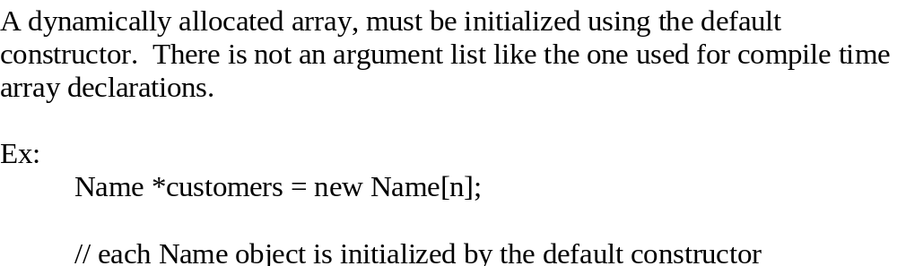

Slide 24
Multi-dimensional arrays
row (first dimension) may be a variable, but
column dimension (and others) must be a constant expression
Type * pointer[m] = new Type [n][m]
similar to C - compiler needs to know length of rows to handle linear address space, but the number of rows
is not necessary for the address calculation
0,0
0,1
0,2
0,m-1
1,0
2,0
.
n-1,0
translates to:
0,0
.
.
0,m-1
1,0
.
1,m-1
.
.
n-1,m-1
ex:
float *matrix[7] = new float [n][7];
//allocates a memory block for n rows and 7 columns of
floating point numbers

Slide 25
Lifetime
Dynamically allocated objects - exist until delete is called or the program terminates
Objects can be allocated and
deallocated in different functions
//
main.c
#include “name.h”
#include “customer.h”
int main(…)
{
Name *customer = CreateCusto
mer();
//allocate and initialize
.
DestroyCustomer (customer);
//deallocate
}
//Note: pointer cannot be lost

Slide 26
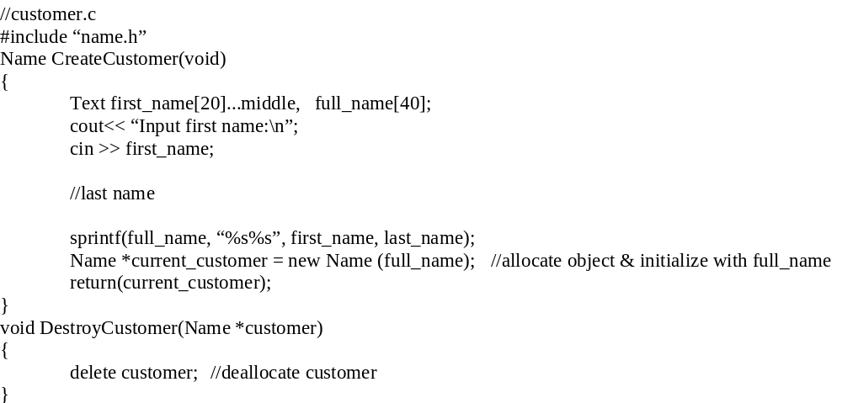

Slide 27
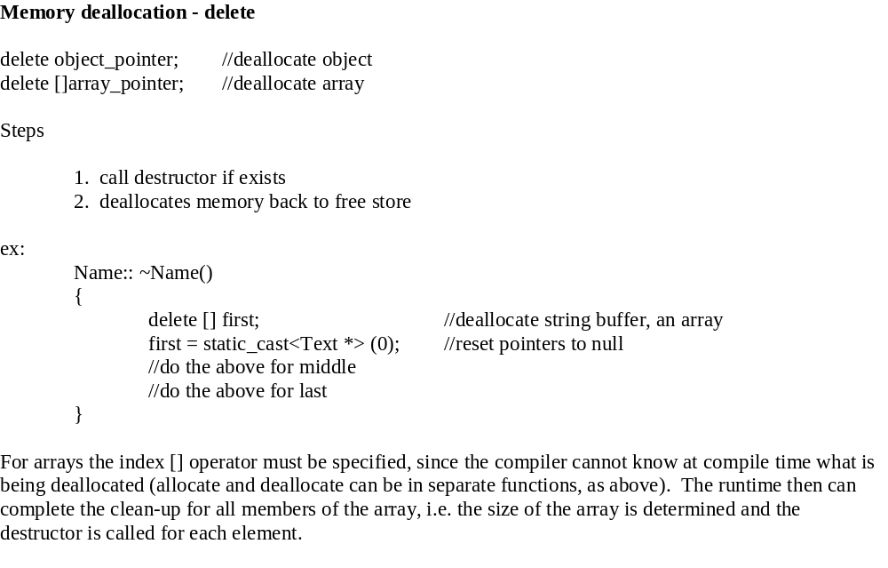

Slide 28
If the index operator is not used for an array the programs reliability may be affected and memory leakage may occur
ex:
Name *customers = new Name[n];
.
delete customers;
//the destructor is invoked only for the first element of the array
//the o
ther Name objects are not destructed or deallocated, but the
//pointer to them is lost.
also:
//don’t use [] for single objects either
Name *customer = new Name (“Patricia Joanne Dousette”);
.
delete [] customer;
//unpredictable behavior

Slide 29
Dynamic Allocation Failure and Recovery
Consider the new operator allocation algorithm:
Allocate block of size n
if allocation is not successful then
if user-defined error handler exists then
call user-defined error handler
reattempt allocation
e
lse
use null address
end if
end if
return address
The client program may define and install an error handler, which should attempt to obtain more memory,
possibly by freeing up some previously allocated memory.

Slide 30
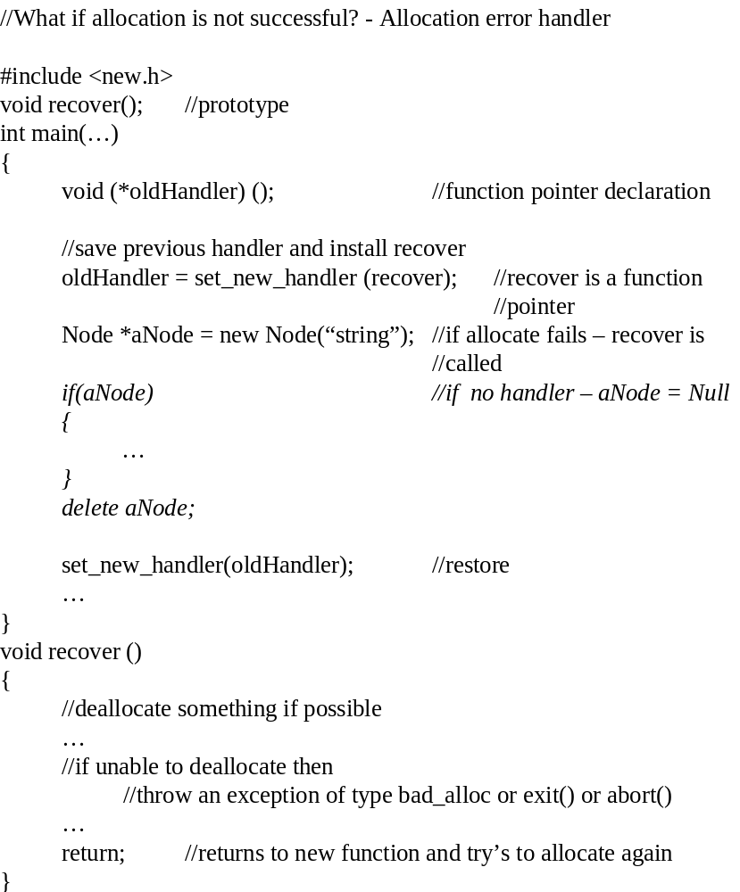
#include “node.h”

Slide 31
steps:
1.
execute recover function
2.
obtain memory
3.
new operator
reattempts the allocation
or abort
prototype: void recover() - based on ANSI standard requirement
if more memory is obtained then control returns to the new operator for reallo
cate attempt
if not then recover() must execute exit/abort/exception other wise an infinite loop will occur
since exit/abort is not “graceful” degradation it is usually not acceptable
therefore an exception is the only acceptable approach if memory is not obtained
//raise an exception, by throwing an instance of the bad_alloc class (a standard class
//library)

Slide 32
Miscellaneous facts:
By default , this error handling mechanism is disabled, after enabling it can be disabled by the following:
set_new_handler (NULL);
//reset to default condition (disable any error handler)
Garbage collection - not part of new and delete, is part of the Java runtime, beginning to be part of some new runtime environments

Slide 33
Custom Memory Management
Provided by overloading the new and delete operators
page 420 C++ Primer
Compiler restriction: both new and delete overloaded functions must be static member functions.
Syntax:
static void* className:: operator new (size_t);
//no “this” pointer
//memory is allocated first
//then the object is constructed
//size_t is the number of bytes required for the class
static void className:: operator delete ( void *);
//similarly for delete the destructor is called first so the object is destroyed i.e. no object to
//operate on ==> static function (should be null safe)

