Slide 1
Functions

Slide 2
Organized by syntax, relationship with a class, and how used in the design of a class
a. Class member functions - further decomposed into constructor, destructor, static, and regular
member functions
b. Inline functions: compiler embeds the function statements directly into the calling functions
statements. Why? Performance. Inlines are typically small. Why? For a large function the
increase in performance is lost in the noise.
c. Operator functions: operator overloading of existing operators for a class. Why? More
intuitive, better data abstraction e.g. overloading + sign to add two complex numbers:
z1 + z2 vs. z1.add(z2)
d. Friend functions: privileged non-member functions that have access to private data members
of a class.
e. Virtual functions: used in conjunction with inheritance to create polymorphism - discussed in
detail later.

Slide 3
inline Functions:
function call overhead = context switch, arguments pushed on stack, execution is transferred to
function address, data is popped off the stack, function is executed, return value is pushed, return
address is obtained and execution is transferred back to the calling function where there is another
context switch
macros can be used to increase performance, but they can have side effects, or have data
conversion problems, so…
Syntax: inline return_type function_name (argument list);

Slide 4
//complex.h
typedef float Coordinate;
class Complex
{
private:
Coordinate
real,
imaginary;
public:
inline Complex(Coordinate x=0, Coordinate y=0);
inline Complex(Coordinate
new_x, Coordinate new_y);
inline Coordinate Real(void) const;
inline Coordinate Imaginary (void) const;
};
inline Complex :: Complex (Coordinate x, Coordinate y)
: real(x), imaginary(y)
{
}
inline Coordinate Complex:: Real (void) const
{
return (real);
}
…

Slide 5
inline - for performance, functions should be short, no loops, not recursive. Avoids macro problems.
Functions should be defined in header file or source file where used. When a member function is
defined within the class definition it is usually inline, but not a good practice. Code is harder to read.
Use key word inline and define elsewhere in the header file.

Slide 6
#
include <
iostream.h>
#
include “
complex.h”
int main (
int, char **)
{
Coordinate x1 =2., x2 =3.;
Coordinate y1 =4., y2 =-8.;
Complex z1(x1 + x2, y1 + y2);
//equivalent to: z1.real = x1 + x2;
//
z1.imaginary = y1 + y2;
cout << “\
n\t Real (z1) : “<< z1.Real();
//equivalent to:
cout << “\
n\t Real(z1):” << z1.real;
//etc.
return 0;
}

Slide 7
inline function body should be either in the .h file or the source file where it is called. Why? So the
compiler knows the functions definition.
side effect = larger executable file
rule of thumb - inlines should be no more than 3 basic C++ statements i.e. this is the break even point,
function overhead is negligible when functions are large or complex (contains floating point calculations)
==> larger object file with negligible performance benefit
When a member function is defined within the class definition, the compiler may treat the function as
inline:
public:
Complex (Coordinate x=0, Coordinate y=0)
: real(x), imaginary (y) {};
Coordinate Real(void) const
{return (real);};
approach seems convenient, but adversely effects readability and maintainability

Slide 8
inline - is a request to the compiler--it may ignore the request and the function will be treated as normal
conditions:
loop
- an inline contains a loop construct - ex: factorial (no recursion)
answer = 1;
for ( i=1, i<=n, i++)
answer = answer *i
;
recursiveness
- an inline function cannot be recursive, because the # of recursion levels is
unknown to the compiler
answer = factorial(n-1) *n;
address
of a function - when an inline function is accessed by address an “outline” version is
created, a normal call remains inline. As good programming practice do not define a function as
inline if it will later be called by its address
Compilers usually have an option for turning off “inlining” - a complex inline function should be tested
both ways for the sake of reliability

Slide 9
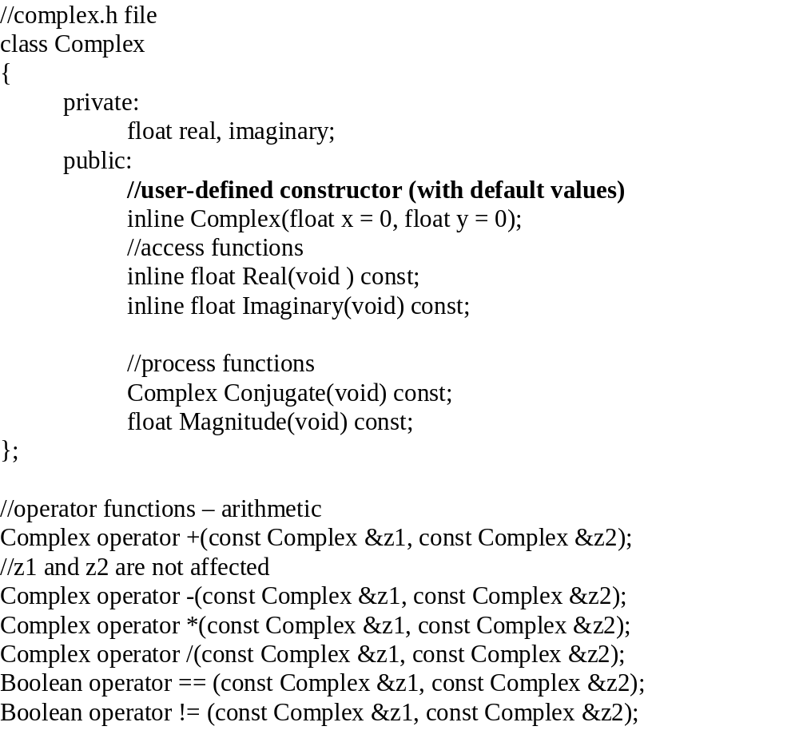
Operator Functions
Operator Functions
return
_type operator symbol (argument list)
{
function body;
}
Non-Member

Slide 10
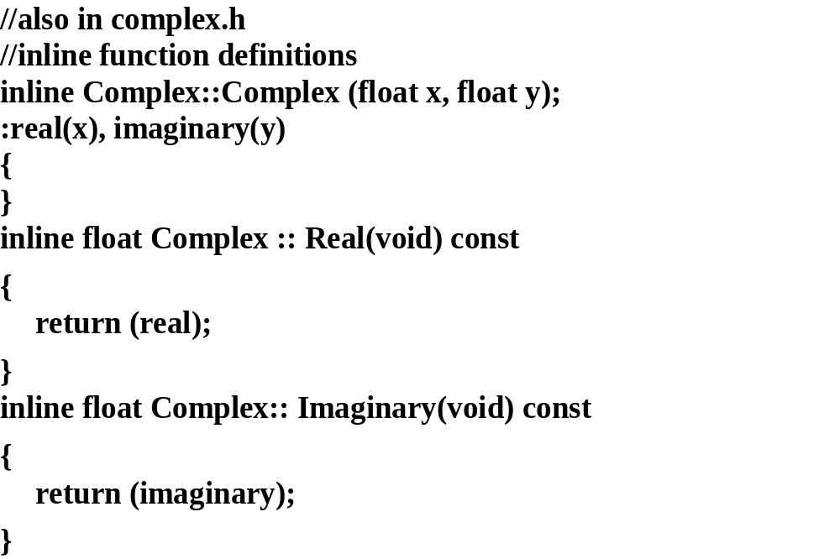

Slide 11
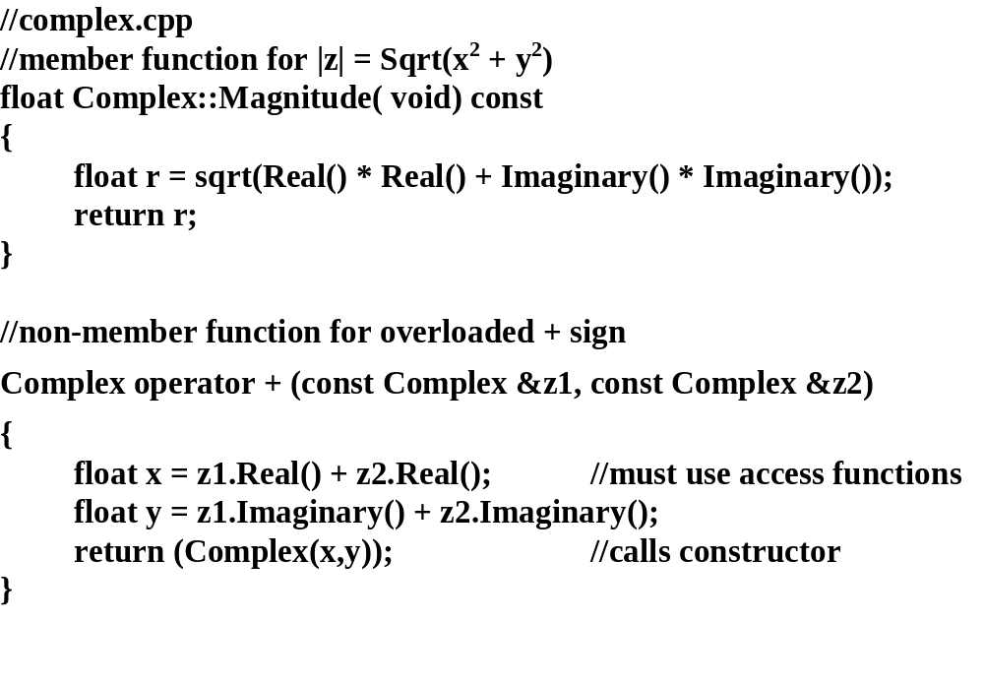

Slide 12
// Relational operator overload
bool operator ==(
const Complex &z1,
const Complex &z2)
{
char buffer [30];
Coordinate x1, x2, y1, y2;
bool equal = true;
sprintf(buffer, “%.5f”, z1.Real());
//convert real part to string & round
// off to 5 places
x
1 = (Coordinate) (atof(buffer));
//prevents comparison of very small #’s
//same for x2, y1, y2
if (x1 != x2 || y1 != y2)
{
//for !=
bool not_equal = true;
if (z1 == z2) // if (operator == (z1, z2))
{
not_equal = false;
}
return not_equal;
equal = false;
}
return equal;
}

Slide 13
//application source file
#include <
iostream.h>
#include “
complex.h”
int main (void)
{
Complex z1(1,0), z2(3,4), z3;
z3 = z1 + z2;
//z3 = operator + (z1, z2);
float magnitude:
magnitude = z3.Magnitude();
cout << “Magnitude = “ << magnitude <<
endl;
if (z1==z2)
//
(operator ==(z1,z2);)
{
…
}

Slide 14
Implicit type conversion
Complex z1(1.0, 2.0), z3;
x = y + 8.
//
legal mathematically with complex #s
z3 = z1 + 8.;
//Will this work? Should it work?
Implicit Conversion
C++ allows a built-in data type to be implicitly promoted to an instance of a
class(object) in order
to evaluate an expression or complete an assignment.
ex:
Complex z1 = 8. + z2;
//z1 = operator + (Complex (8,0), z2);
a temporary object is constructed using the appropriate constructor
convenient, but some overhead comes along with it

Slide 15
To disallow implicit conversion, do not define class constructors to use default values e.g.
inline Complex (Coordinate x=0, Coordinate y=0)
//constructor with default values
instead,
inline Complex();
inline Complex ( Coordinate x, Coordinate y);
then
z1 = 8. + z3; //will not compile - no temporary object can be created
==> cannot mix real and complex numbers! used to achieve reliability at the cost of some flexibility

Slide 16
Alternative approach - designer adds functions to create different permutations of complex arithmetic, i.e. it is perfectly legal to add a real and complex # so define a function to do it
==> no overhead as associated with implicit conversion, promotes reliability, and flexibility
ex;
Complex operator +(float x, const Complex &z2);
Complex operator +(const Complex &z1, float y);

Slide 17
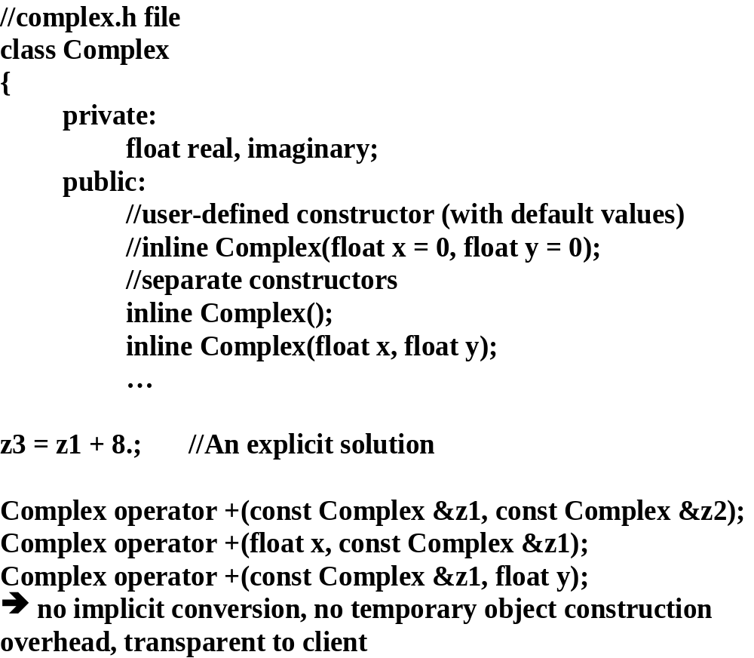

Slide 18
#
include <
iostream.h>
#
include “
complex.h”
int main(void)
{
Complex
z1(3,4), z2, z3;
if(z1 + z2 == z2 +z1)
//operator ==(z1+z2, z2 +z1);
{
cout << “ \
n\t Addition is commutative”;
}
z2 = z1 + 4.;
// z2 = operator +(Complex, float);
.
.
etc.
}
==> designer must provide the additional resources, but if conversion is common
it will be worth it

Slide 19
Operator overload functions have been defined as non-member functions. Why? To force them to use the class access and constructor functions--encapsulate the data.
Advantage:
If data representation is changed to polar notation only the lowest level functions i.e. the access/constructor functions have to be changed--arithmetic functions do not have to be changed since they are independent of the data representation.

Slide 20
Binary
operators (two arguments)
Binary operators may be implemented as member or non-member functions, but implementations are
treated differently by the compiler:
ex:
non-member:
a = b op c;
//a= operator op (b,c); b and c are op
erands/arguments
member:
a =b.operator op (c);
//member function representation
b represents an object (instantiation of a class), c is the argument
So what implementation is appropriate?
Non-member functions (with default value constructor) supported:
z3 = z1 + z2;
z1 = z3 + 8;
z1 = 8 + z3;
Member function - left operand/object via the “this” pointer, right operand is the argument

Slide 21
Binary Operators
Member implementation
//
complex.h file
class Complex
{
private:
float real, imaginary;
public:
//user-defined constructor (with default values) inline
Complex(float x = 0, float y = 0);
//access functions
inline float Real(void )
const;
inline float Imaginary(void)
const;
//process functions
Complex Conjugate(void)
const;
float Magnitude(void)
const;
Complex operator +(
const Complex &z2);
};

Slide 22
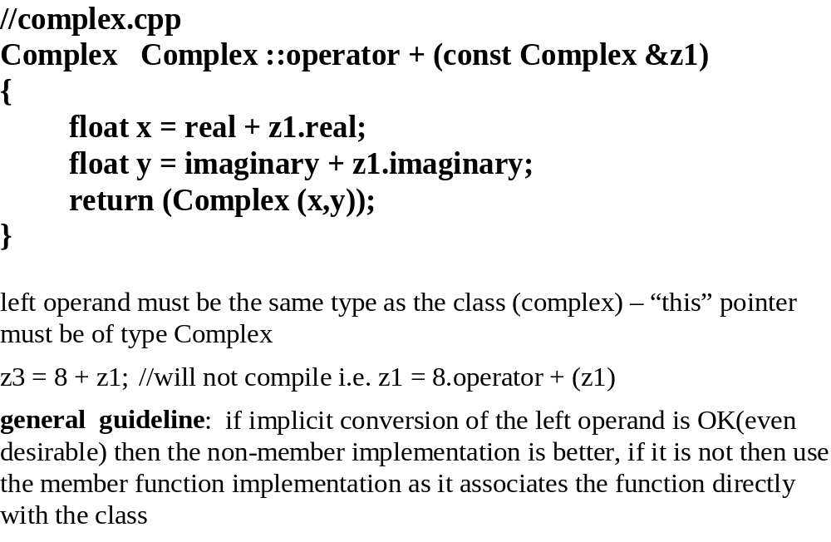

Slide 23
int main(void)
{
Complex z1(1), z2 (3,4), z3;
z3 = z1 + z2;
// z3 = z1.operator + (z2);
z1 = 8. +z3;
// z1 = 8.operator + (z3); won’t compile
In this case the non-member implementation has a little more flexibility
==> look at the left operand type when choosing an implementation i.e. if implicit conversion is applied to
the left operand then use non-member, when dealing only with objects choose the member implementation.
Why? The function is directly associated with the class -- encouraging encapsulation.

Slide 24
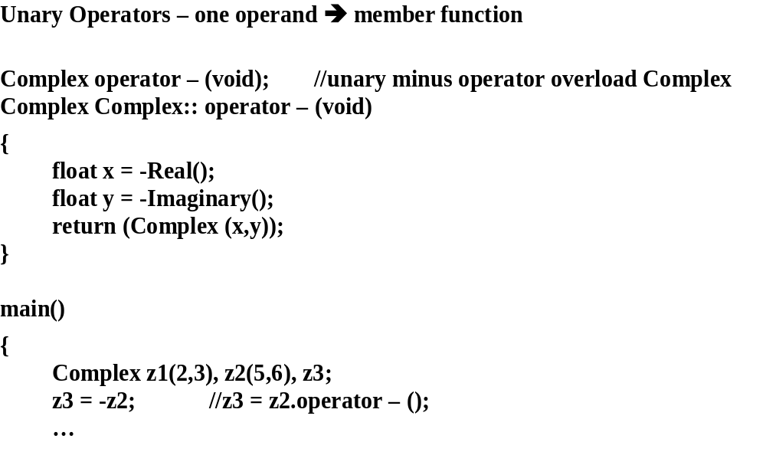

Slide 25
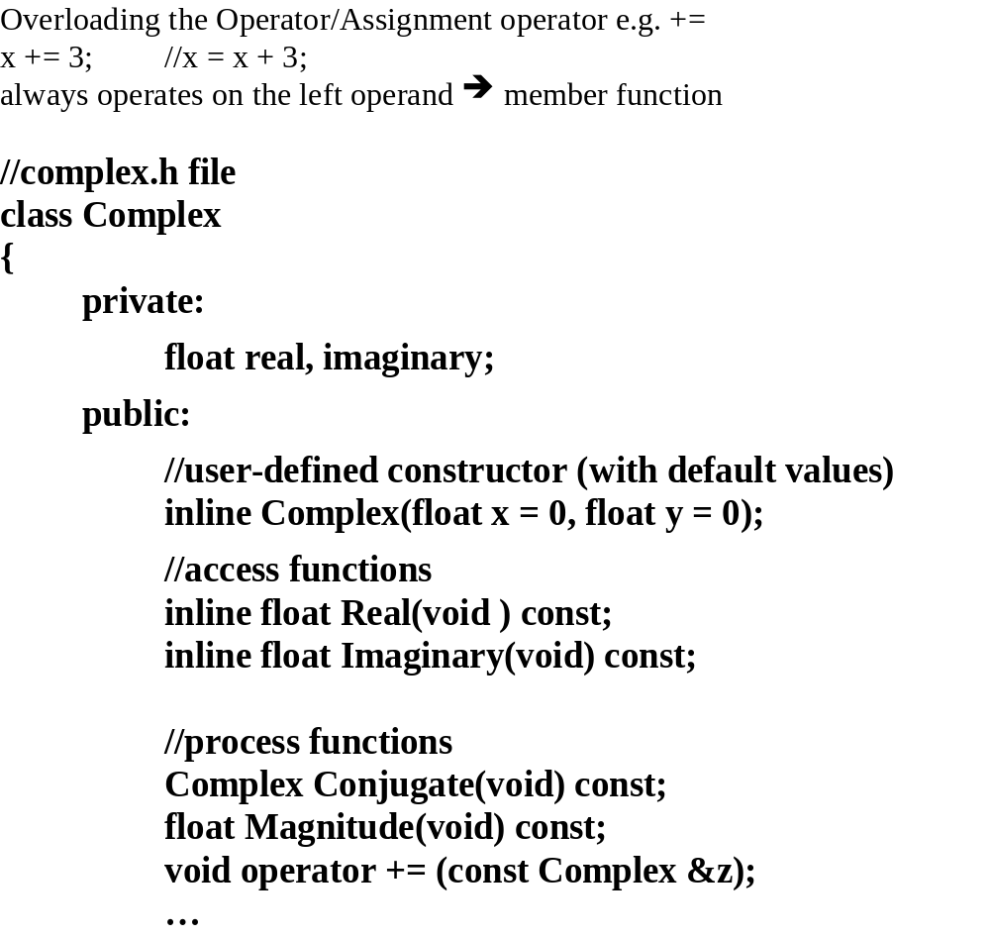

Slide 26
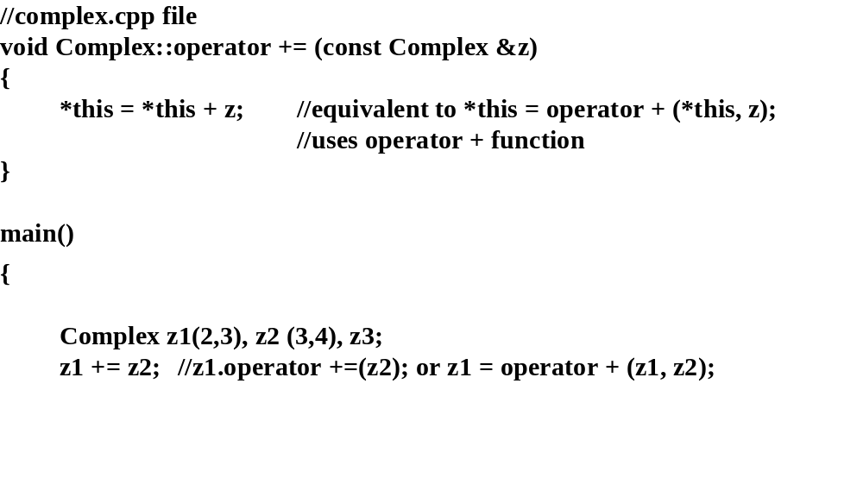

Slide 27
void operator *= (
const Complex &z);
//multiplication/assignment operator
//
complex.cpp
#
include “
Complex.h”
void Complex:: operator *= (
const Complex &z)
{
*this = *this *z;
//*this = operator *(*this, z);
}
assumes * function has been written
//compute: z1 *z2 = (x1 +y1i) * (x2 +y2i)
//real part x1 * x2 + y1*y2i2 = x1 * x2 - y1*y2
//imaginary part (x1*y2 + y1*x2)i
Above is left for a student exercise
#include <complex.h>
int main(void)
{
Complex z(2,3), z2(3,5);
//z = z*z2
z *= z2;
//z.operator *= (
z2);

Slide 28
Operator Overloading Restrictions:
1.
NOT
overloadable - ?, .(class member – dot), .*, (pointer to member), :: ,
sizeof
2.
Can’t overload operators for built-in types – one operand has to be a class
(user defined) type
3.
Can’t create a new operator e.g. **
4.
Precedence and
associativity – must always be taken into consideration
5.
A unary operation cannot be overloaded to do binary operations (except
for minus)
6.
An operator function cannot have default argument values
e.g.
Complex operator + (const Complex &z1, fl
oat x = 0);
7.
These operators can only be overloaded as member functions:
[] - array index
= - assignment operator
() - parenthesis operator
→
- object reference operator
general guideline:
use of operator overloading should provide an intuitive
logical user interface
e.g. overloading [] for a container class, not overloading an == operator
when it’s not clear what that means to the client

Slide 29
Friend functions
A privileged external (non-member) function associated with a class -- has access to the private and
protected members of the class
A friend function may be a member of another class or a non-member function.
As a non-member it is defined/invoked the same as a normal C function.
For clarity these functions are declared in the public section of the class even though
they are not member functions.
ex: Overload Stream I/O operators for Complex <<, defined to operate on the private members so needs to
be a
friend.

Slide 30
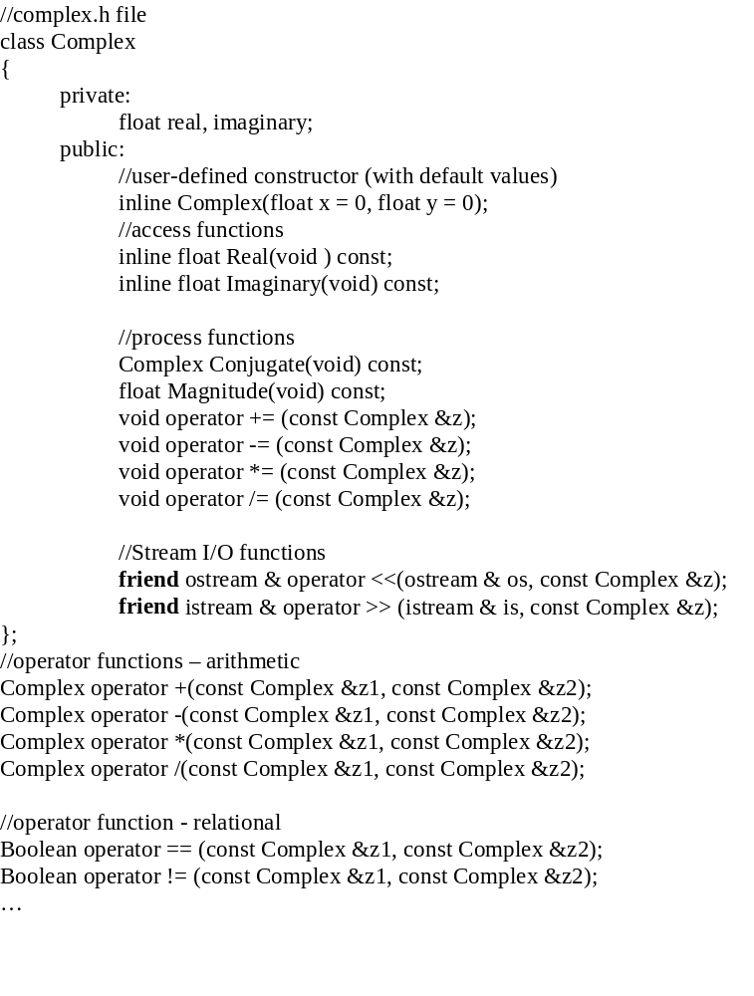

Slide 31
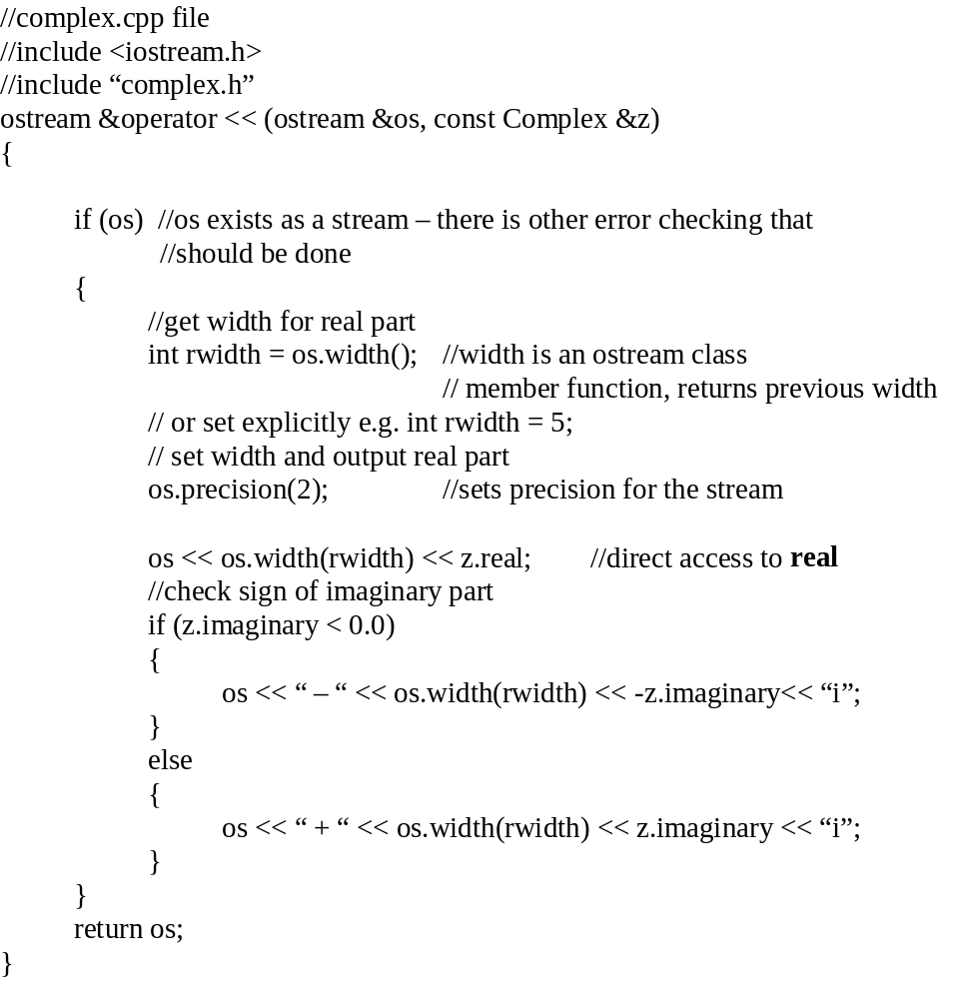
Not defined as a
member function!
A compile error
if not a “friend”.

Slide 32
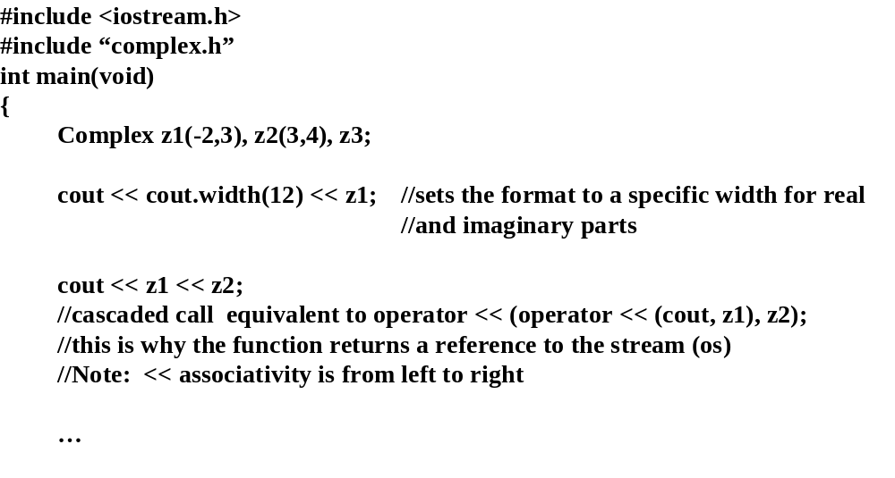

Slide 33
Usage:
cout <<
cout.width(12) << z1;
outputs contents of z1 using a 12-character field for both real and imaginary components
cout << z1 << z2;
same as:
operator << (operator << (cout, z1), z2);
//associativity is left to right
//cascaded operations
e
quivalent to:
operator << (cout, z1);
operator << (cout, z2);
z1 is sent to output stream, the stream output function returns a reference to the stream passed in, which is
then used for the next stream output function call, allowing the cascade. If the stream reference had not
been returned the cascade would not be possible--would produce a compile error.

Slide 34
Design of input stream operator function (>>) is similar to the above:
check for failures before reading,
if a failure then the referenced Complex object is set to default values,
check for end-of-stream condition, eof()
Left as an exercise for the student.

Slide 35
friend functions - bypass encapsulation, function is dependent on the class architecture and data
representation ==> use sparingly
alternative implementation - make them external and use class access functions to get the real and
imaginary parts:
(in complex.h remove
friend
keyword and move the function outside the class)
//complex.h
class Complex
{
private:
…
public:
…
};
ostream &operator << (ostream &os, const Complex &z);

Slide 36
//
complex.cpp file
#
include “
complex.h”
ostream & operator << (
ostream &
os,
const Complex &z)
//write a complex number
{
if(
os.fail() && !
os.bad())
//check for pending error - not serious
{
os.clear(
os.rdstate() &
~ios::failbit);
//get stream state,
clear
failbit
}
if (!
os.fail())
//continue, abort on error
{
int rwidth =
os.width();
//obtain current width -may have been set previously
os <<
os.width(rwidth) <<
z.Real();
// use
Width() to identify field width
if(
z.current_imaginary < 0.0)
//forma
t output based on sign of imaginary part
{
os<< “-” << os.width(rwidth) << -
z.Imaginary()
<< “i”;
}
else
{
os<< “+” << os.width(rwidth) <<
z.Imaginary() <<
“i”;
}
}
return (os);
}
The stream operators must be implemented as non-member (external or friend) functions since the left
operand is of type istream or ostream and not user-defined

Slide 37
Generic Stream I/O overloading software:
//
Type.h
class Type
{
//using friend implementation:
friend ostream & operator <<(ostream & const Type &);
….
….
//
Type.cpp
#
include “
Type.h”
function
_name()
{
Type object
;
cout << object;
}
Overloaded << cannot be a member of Type because the compiler cannot treat the above as:
cout.operator << (object)
since
cout is an output stream ==>:
operator << (
cout, object)
Why would you use a friend? Performance, along with existing tight coupling with the class (functionally), or
maybe no access functions are provided (not practical?)

Slide 38
Standard C++ Class Libraries
Stream I/O class library
complex class library
string class library
Stream I/O overloaded for all built-in types ==> type safe operations
Binary shift operators are the intuitive choice plus they have low precedence and left to right
associativity
Complex Class Library
interface is similar to what we have done
supports float, double, and long double data types
String Class Library
string is dynamically allocated
constructed and destructed
basic string functions
o
verloads relational, stream I/O, array index[] operators
provides deep copy assignment operator
relational operators provide object comparisons, and object/char* comparisons (avoids implicit
conversions)

Slide 39
Summary
Member functions support encapsulation
Inline functions provide performance enhancement (without side effects of macros)
Operator functions support an intuitive interface
details are hidden
restrictions discourage abuse, don’t prevent it
Operator
Usage and Type
?: . .* ::
Cannot overload (compiler restriction)
[] = () ->
Must be member functions
operator =, e.g. +=
Member function (guideline)
unary operator e.g. -
Member function (guideline)
other binary operators
Member or non-member based on left operand type
Avoid implicit conversion! Use multiple implementations to avoid overhead of conversions, don’t use
default value constructors if you don’t want implicit conversions
Friends - used sparingly.

Slide 40
String class
Why a string class? - because standard null-terminated strings cannot use any of the standard operators e.g. =, + etc. or take part in “normal” expressions:
char s1[20], s2[20], s3[20];
s1 = “Pat”; //not allowed;
s2 = “ Dousette”; //not allowed
s3 = s1 + s2; //not allowed
//must use library <string.h>
string class - a new data type ==> #include <string>
Constructors:
string();
string(const char * str);
string(const char * str, size_type n)
string(const string & str); //copy constructor - deep copy
etc.
basic_string
string
wstring
Chapter 16 in C++ Primer.

Slide 41
String class
Operators:
= , assignment [], subscripting
+, concatenation <<, output
+=, concatenation assignment >>, input
==, equality
!=, inequality
<, less than
<=, less than or equals
Mixing null-terminated strings (C-strings) with string objects:
string + string
string + C-string
C-string + string
string = C-string
etc.
Example:
string firstName(“Pat”);
string lastName(“Dousette”);
string myName;
myName = firstName + “J.” + lastName;
cout << myName << endl;

Slide 42
String class
Other member functions such as:
assign();
append();
insert();
replace();
erase();
find();
compare();
ex: string &assign(const string & strObj, size_type startIndex, size_type numChar);

