Slide 1
Inheritance

Slide 2
Two classes of Clients
Inheritance
Object model development
Class
User
Creator
(Clients)
Users: create instances of the class i.e. objects
Creators: create derived classes

Slide 3
Relationships
Window “has-a” Point – Composition/Aggregation
Window
Point
Inheritance is “parent-child” or an “is-a” relationship, Savings “is-an” Account
Account
Base
Derived
Checking
Savings
MM
Checking and Savings inherit state (attributes) and behavior from Account

Slide 4
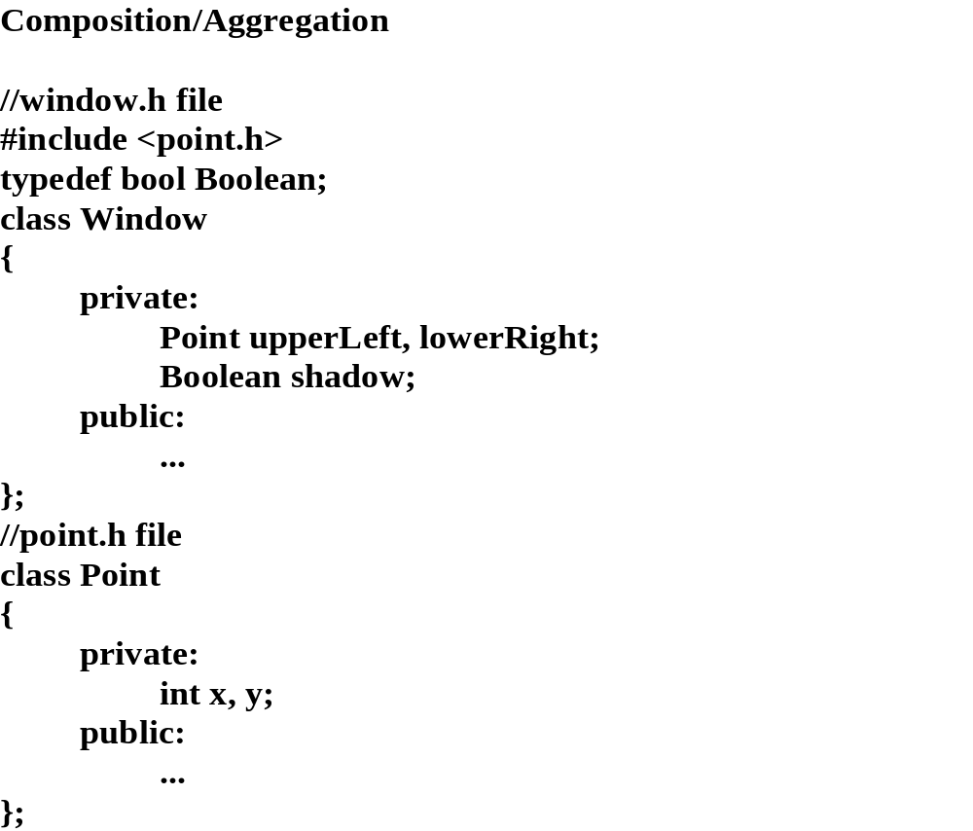
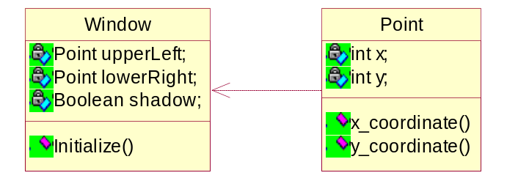

Slide 5
Window constructor - Point is constructed before Window is constructed
//
window.cpp file
Window::Window (short x1, short y1, short x2, short y2, int shadowFlag)
: lowerRight(x2,y2), upperLeft(x1,y1), shadow(shadowFlag)
//initialized in class order not li
st order
{
}
Window “has-a” Point -
memory layout
Window
Object
upperLeft
x,y
lowerRight
x,y
shadow

Slide 6
Usage and Characteristics of Inheritance
maintain common information
create a customized class
provide a common design interface ==> polymorphism

Slide 7
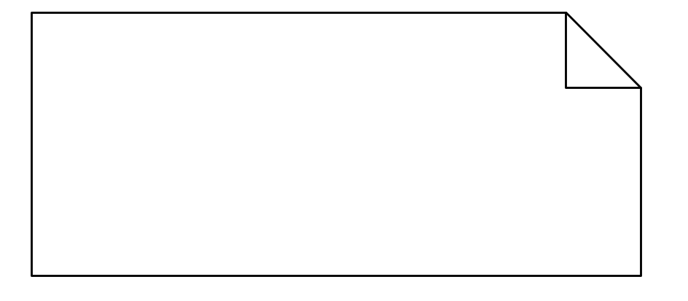
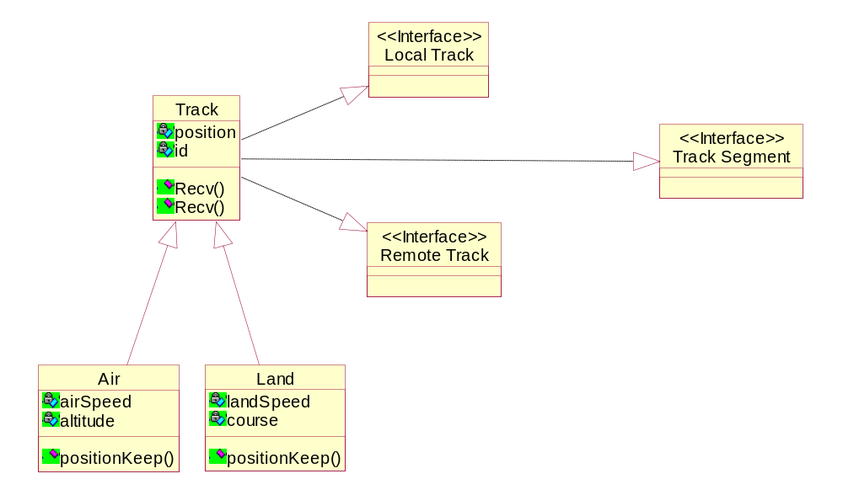
Sample - Inheritance Class Diagram
Dependency or, instantiates
Inheritance
An interface specifies the externally-visible methods of a class and/or component, and has no implementation of its own. An interface typically specifies only a limited part of the behavior of a class or component.

Slide 8
Class member access levels (for public inheritance)
public - all clients have access to the public interface (has no effect on member functions of the derived
class only on clients of the class) - derived class does not have access to the private interface
protected - data/function members - user/creator access is different
private - neither user nor creator has access to the private interface
Inheritance - access levels are: public, protected and private inheritance

Slide 9
Types of Inheritance
1. Public ==>
class Derived : public Base
- a user of the derived class knows about the base class as part
of the derived class. Public inheritance is part of the design interface i.e. changes to derived classes can
affect the client application (e.g. removal of a class etc.) (clients know about Account as part of Savings)
2. Protected ==>
class Derived : protected Base
- the Base class public and protected interface is now
protected when viewed from the derived class. The derived class has access to the base class interface (it is
a creator), a derived class user does not. (Savings has access to Account (creator), a Savings user does not)
3. Private ==>
class Derived : private Base
- neither a creator or user of the derived class can access the
base class interface

Slide 10
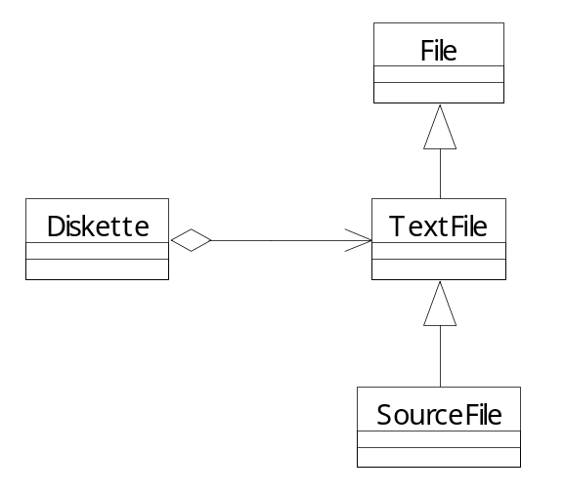
Inheritance hierarchy
class TextFile :public File
class SourceFile: public TextFile
Public: Source File has access to the public
and protected members of TextFile and File
class TextFile : protected File
Protected: the public and protected members of
File become protected through the TextFile class.
Access levels in TextFile are unchanged. Diskette
cannot access public/protected members of File.
SourceFile has access to the public and protected
members of TextFile and File
class TextFile : private File
Private: the public and protected members of File
are private to TextFile and SourceFile. Neither
TextFile or SourceFile can access the members of
File. Diskette cannot access public/protected
members of File.

Slide 11
private inheritance is almost never used - sort of defeats the purpose of inheritance
protected inheritance can usually be accomplished by protecting individual data members or by using
composition
public is by far the most common - preserves encapsulation, yet allows reuse of base class data and behavior

Slide 12
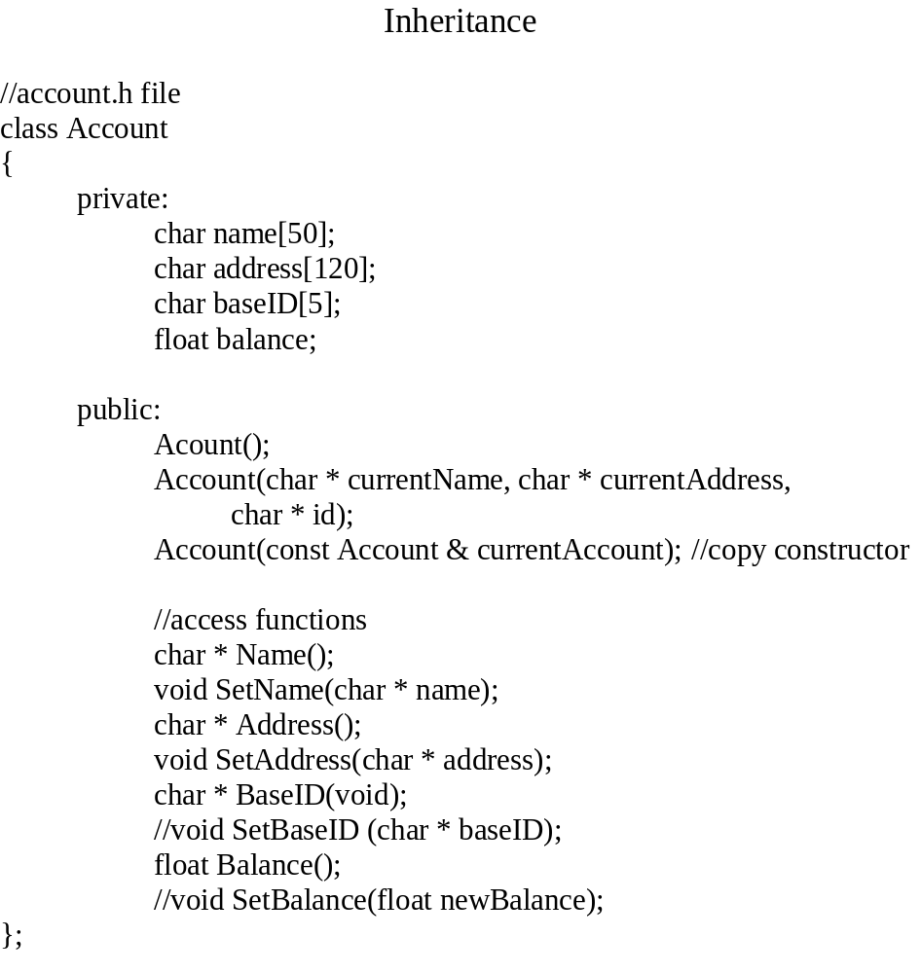
Account
Object
name[]
address[]
baseID[]
balance

Slide 13
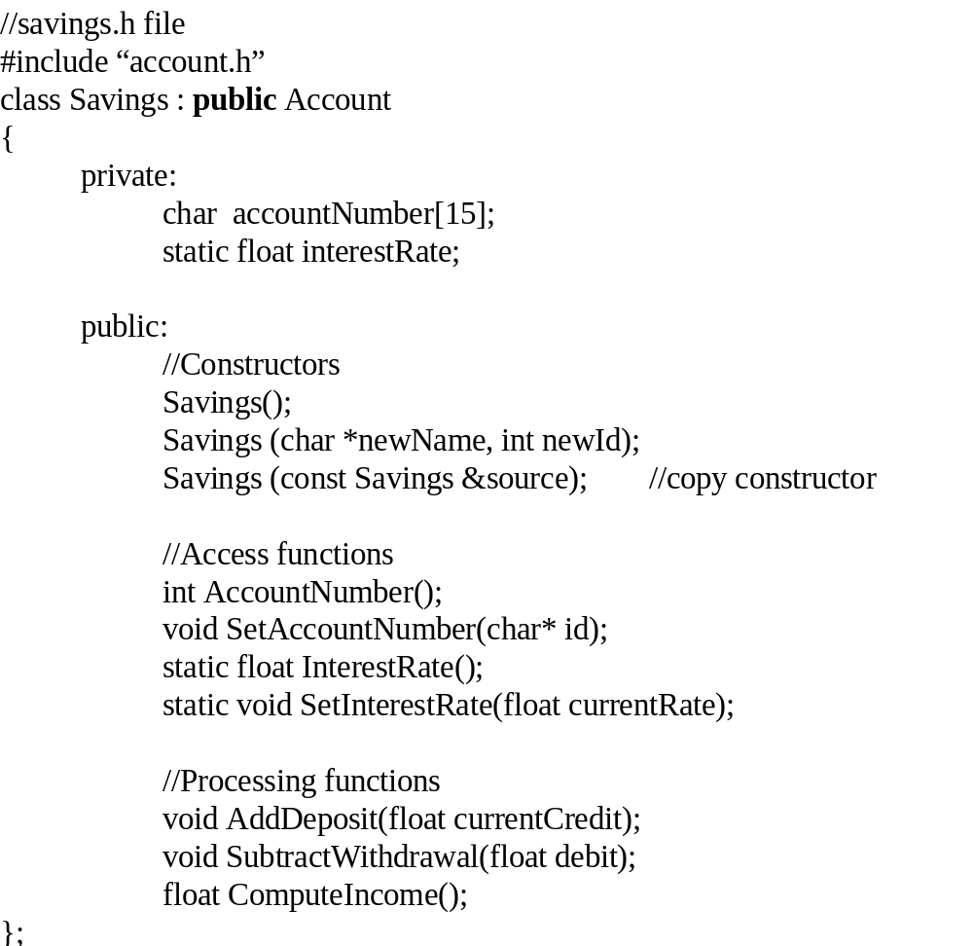
Savings Object
name[]
address[]
Account
baseID[]
balance
Savings
accountNumber[]
interestRate

Slide 14
creator
//
savings.cpp file
#
include “
account.h”
#
include “
savings.h”
#
include <
string.h>
void
Savings::SetAccountNumber (char *
savingsID)
{
//get
baseID #
char * base =
BaseID();
//Account class function
strcat (
savingsID, base);
//add it to savings ID
strcpy(
accountNumber,
savingsID);
//copy to Savings
//
accountNumber
}
float
Savings::ComputeIncome(void)
{
float income;
income = Balance() *
interestRate; //Account data
//or
income = balance *
interestRate;
//illegal - encapsulation is
//preserved
return i
ncome;
}
with public inheritance all clients (user and creator) have full access to
Account public members, but not to private members
==> inheritance access levels effect only clients of the derived class

Slide 15
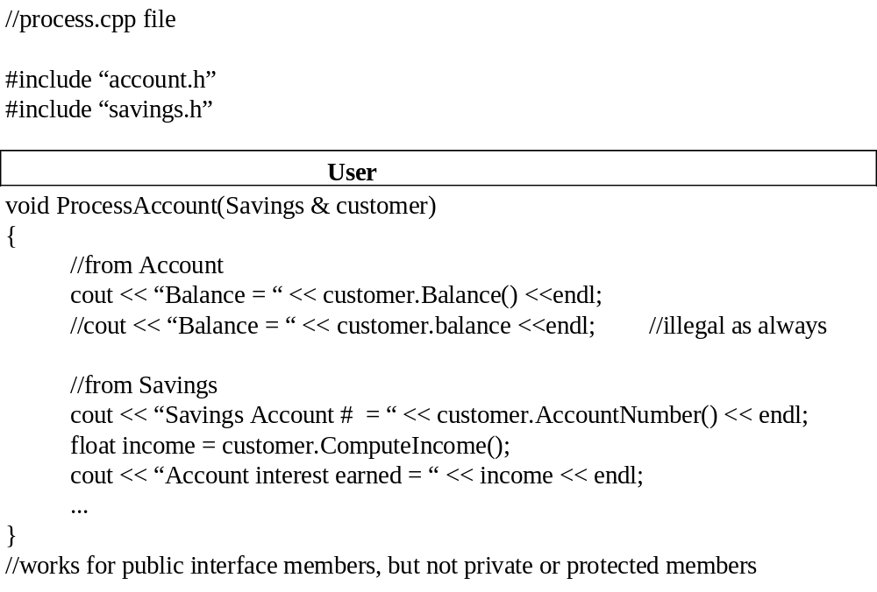

Slide 16
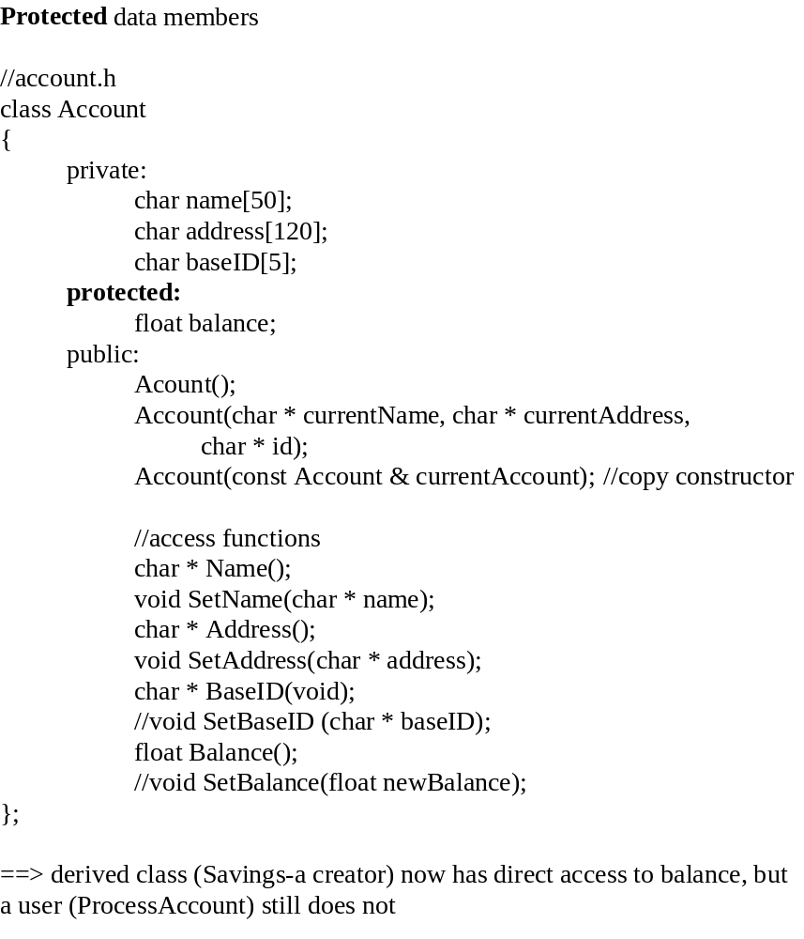

Slide 17
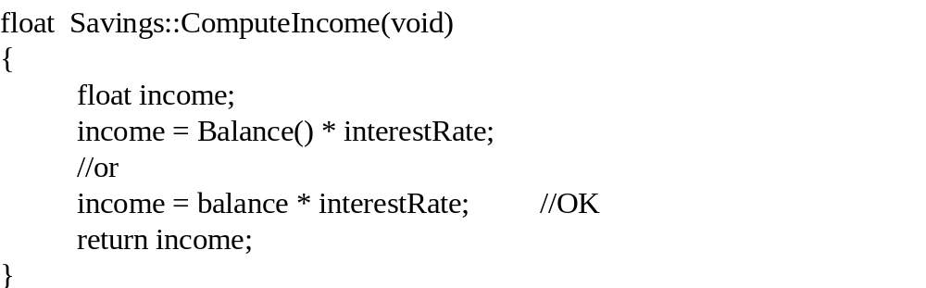

Slide 18
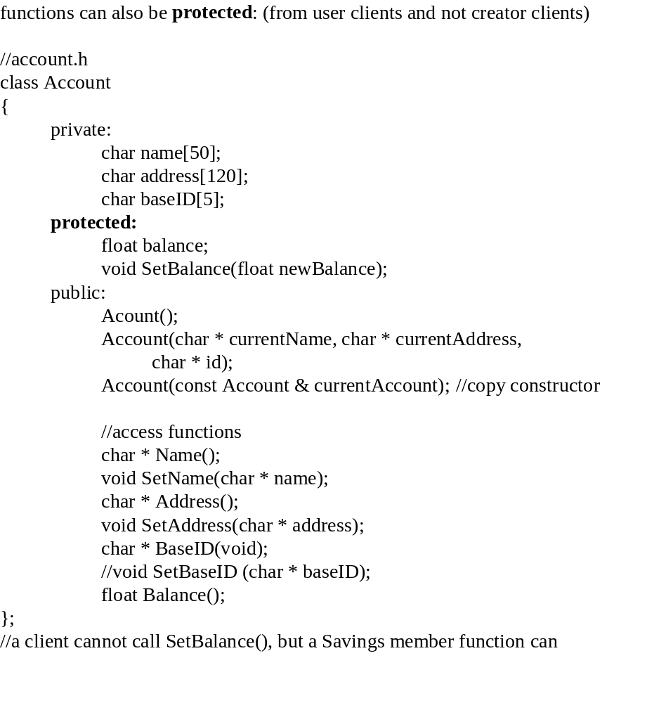

Slide 19
Creator
class
MoneyMarket : public Savings
{
private:
float debits;
public:
ComputeFinalBalance(void);
};
float
MoneyMarket::ComputeFinalBalance(void)
{
float
finalBalance = Balance() - debits +
ComputeIncome();
return finalBalance;
}
//will work for public and protected interface and not for private

Slide 20
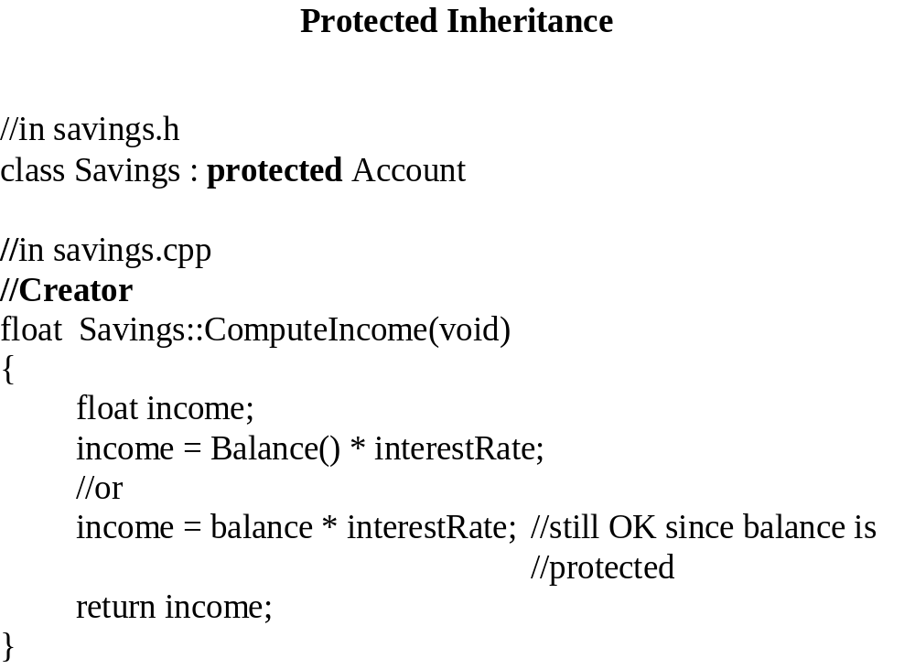

Slide 21
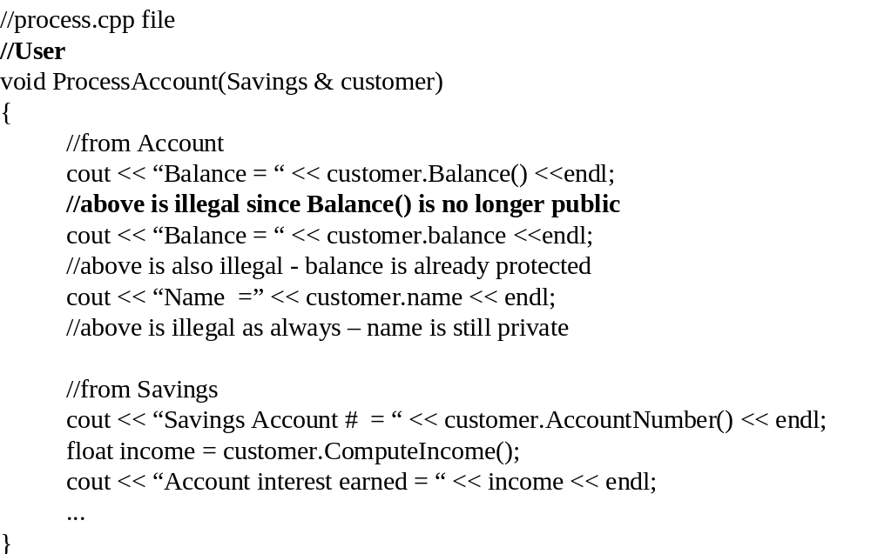

Slide 22
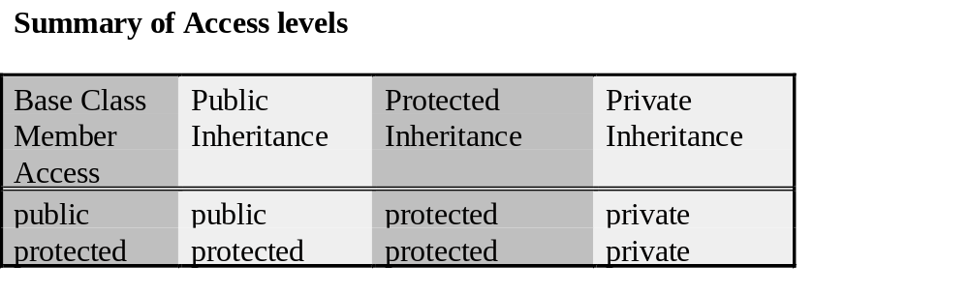

Slide 23
//
savings.h
#
include “
account.h”
class Savings :
private
Account
//==> Savings clients cannot access
//Account public interface
{
//but you can promote certain class
//members via declaration
private:
char
accountNumber[15];
stati
c float
interestRate;
protected:
Access Level Promotion
SetBalance();
//can only promote to the base class level
public:
//Constructors
Savings();
Savings (char *newName, int newId);
Savings (const Savings &source);
//copy constructor
//Access functions
int Acco
untNumber();
//void SetAccountNumber(char* id);
static float InterestRate();
static void SetInterestRate(float currentRate);
Balance();
//explicit promotion of Accounts functions
//Processing functions
void AddDeposit(float currentCredit);
vo
id SubtractWithdrawal(float debit);
float ComputeIncome();
};
ProcessAccounts() can now use the Balance() access function

Slide 24
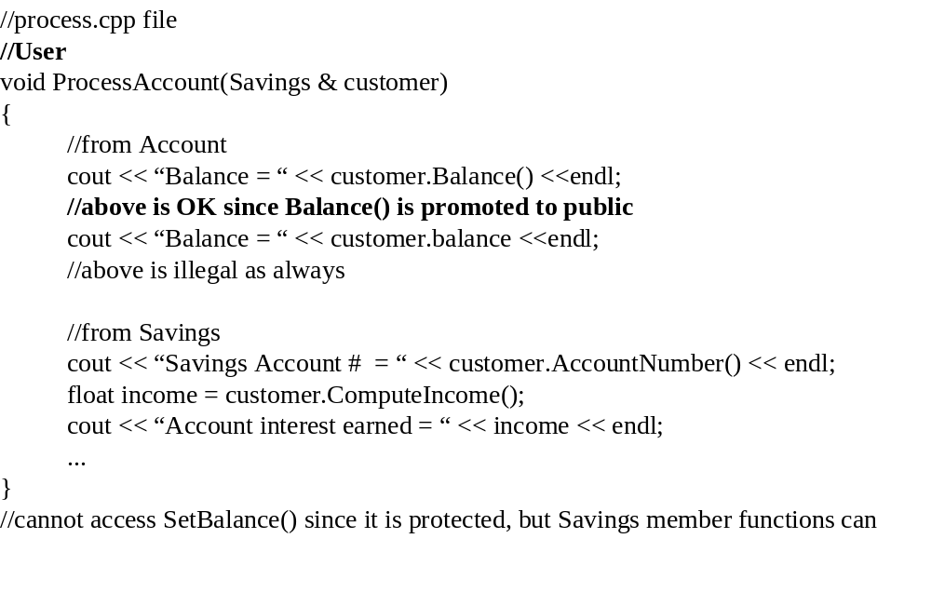

Slide 25
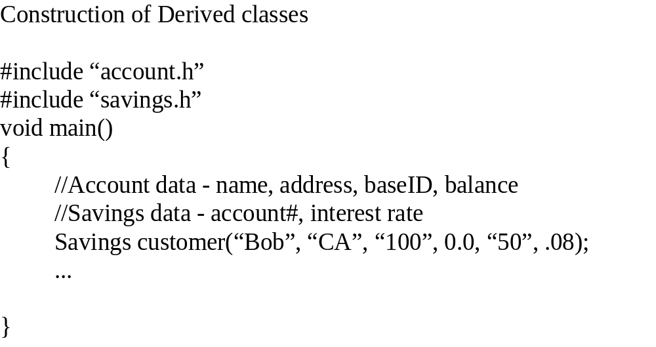

Slide 26
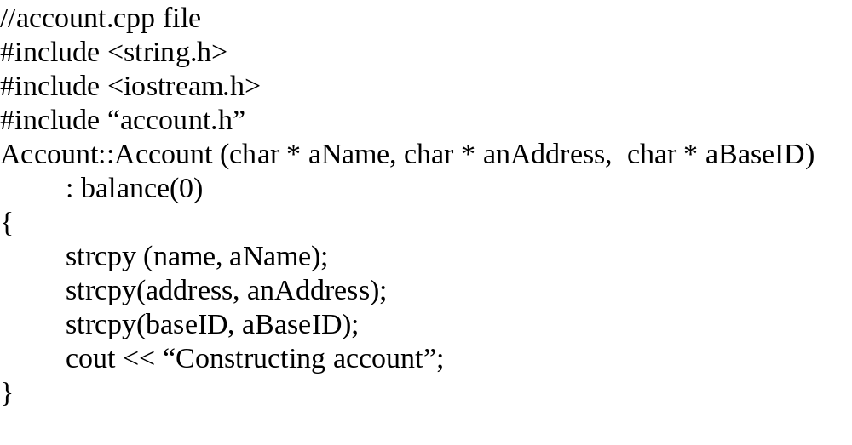

Slide 27
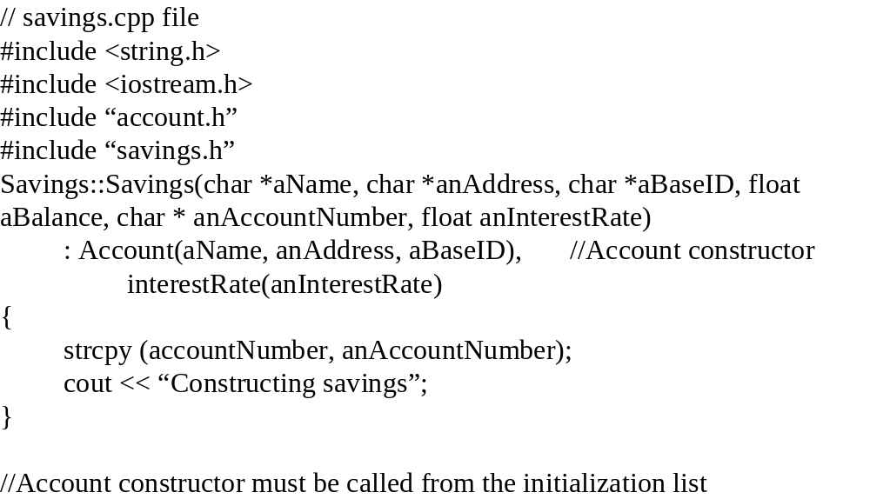

Slide 28
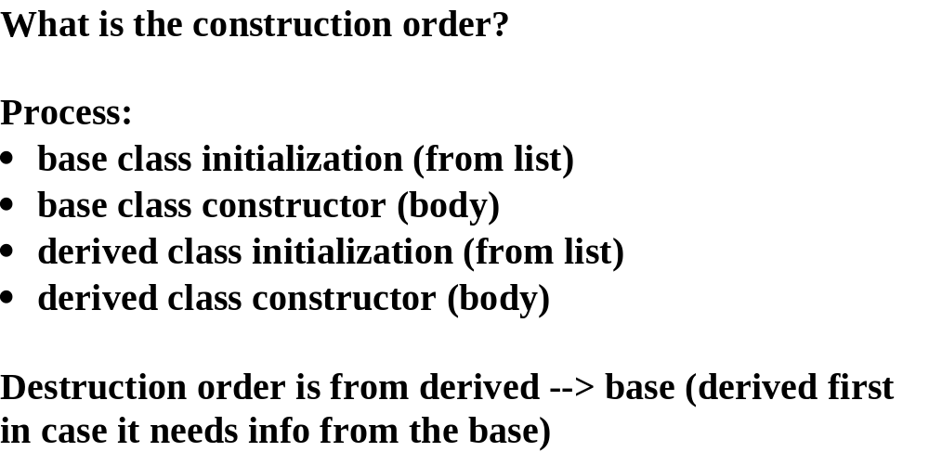

Slide 29
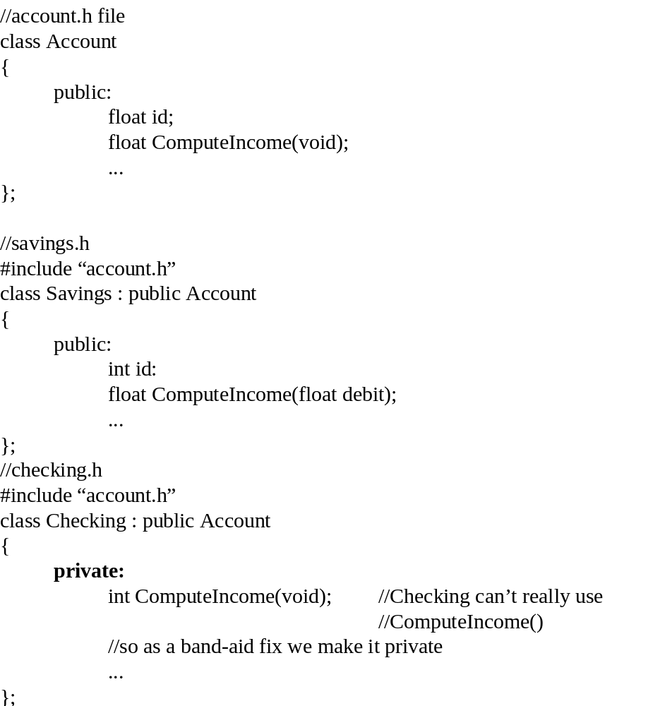
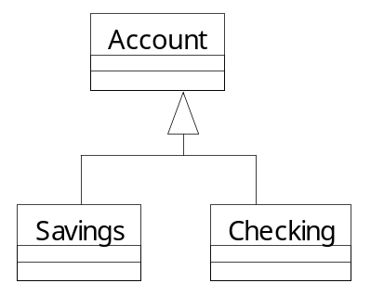
Overriding

Slide 30
int main (void)
{
float
sIncome,
aIncome, debit;
Savings
customer(...);
customer.id = 3;
//Savings dominates i.e.
//customer.Savings::id = 3;
customer.Account::id = 2.;
//explicitly initialize Account class id
sIncome =
customer.ComputeIncome(debit);
//Savings class function
Account *
ptr = &customer;
//Account(base) class pointer
aIncome =
ptr ->
ComputeIncome();
//Account(base) class function
Checking current(...);
ptr = &current;
int cIncome = ptr-> ComputeIncome(); //will not compile –
//Checking C
omputeIncome()
//is private
...
}
Compiler uses the access object type to determine which function to use,
except when explicitly using the class name.
general-guideline:
Avoid real name collisions, but overriding is OK.

Slide 31
class Account
{
private:
float accountId;
public:
Account();
//float id;
float AccountID();
void SetAccountID(float);
float ComputeIncome(float debit);
};
class Savings : public Account
{
private:
int savingsId;
public:
Savings();
//int id;
int SavingsID();
void SetSavingsID(int);
int ComputeIncome(int credit);
};
//function prototypes
void ProcessCustomer(Savings &current);
A complete Test

Slide 32
#include <iostream.h>
#include "Dominance.h"
Account::Account()
{
accountId = 0.;
}
float Account::AccountID()
{
return accountId;
}
void Account::SetAccountID (float number)
{
accountId = number;
}
float Account::ComputeIncome(float myDebit)
{
cout << " Account income " << endl;
return myDebit;
}
Savings::Savings()
:Account()
{
savingsId = 0;
}
int Savings::SavingsID()
{
return savingsId;
}
void Savings::SetSavingsID(int number)
{
savingsId = number;
}
int Savings::ComputeIncome(int myCredit)
{
cout << " Savings income " << endl;
return myCredit;
}

Slide 33
#include <iostream.h>
#include "Dominance.h"
void main(void)
{
Savings customer;
Account holder;
customer.SetSavingsID(3);
customer.Account::SetAccountID(4.);
//customer.SetAccountID(4.); // also OK
Account *ptr = &customer;
int balance = customer.ComputeIncome(100);
float balance1 = ptr->ComputeIncome(200);
float balance2 = customer.Account::ComputeIncome(300)
cout << "Savings balance = " << balance << endl;
cout << "Account balance ? " <<balance1 << endl;
cout << “Account balance = “<<balance2 << endl;
cout << "Savings id = " << customer.SavingsID() << endl;
cout << "Account id = " << customer.Account::AccountID() << endl;
ProcessCustomer (customer);
}
void ProcessCustomer(Savings &current)
{
cout<< "process output id = " << current.SavingsID();
}

Slide 34
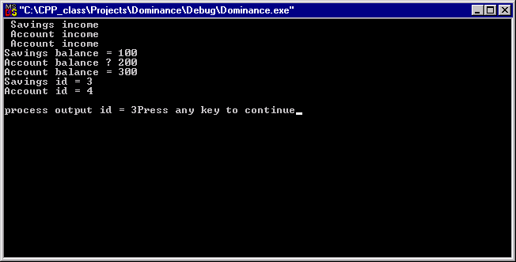

Slide 35
Dominance inside a constructor
//class to test dominance in constructor call in a simple
//inheritance architecture
#ifndef jtstdefine
#define jtstdefine
class JavaTest
{
private:
int counter;
public:
JavaTest();
void SetText(char *string);
};
#endif
//derived class
#ifndef jtdefine
#define jtdefine
#include "Java_test.h"
class JavaText:public JavaTest
{
private:
int jcounter;
public:
JavaText();
void SetText(char *string);
};
#endif

Slide 36
//definition of base class JavaTest functions
#include <iostream.h>
#include "Java_test.h"
JavaTest::JavaTest(void)
{
counter = 0;
SetText("Test1");
}
void JavaTest::SetText(char *bString)
{
cout << bString << endl;
cout << "base class SetText()" << endl;
}
//derived class JavaText function definitions
#include "Java_test.h"
#include "Java_text.h"
#include <iostream.h>
JavaText::JavaText()
:JavaTest()
{
jcounter = 0;
SetText("Test2");
}
void JavaText::SetText(char * dstring)
{
cout << dstring << endl;
cout << "derived class SetText()" << endl;
}

Slide 37
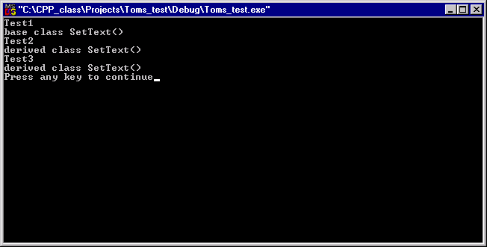
//Test program to test constructor dominance
#include <iostream.h>
#include "Java_test.h"
#include "Java_text.h"
int main (void)
{
JavaText myText;
myText.SetText("Test3");
return 0;
}

Slide 38
Pointer Conversion:
Base/derived pointers (assume public inheritance)
case 1: derived pointer → base pointer (yes - widening)
case 2: base pointer → derived pointer ? (yes with a cast - narrowing)

Slide 39
#
include “
account.h”
#
include “
savings.h”
int main(…)
{
Savings
customer(...);
Account *
aptr;
Savings *
sptr;
aptr = &customer;
//case 1 - base = derived
//
sptr =
aptr;
//case 2 - derived = base (need cast)
sptr =
static_cast <Savings *> aptr;
//be careful! – there is no
//guarantee that aptr is of type
//Account
float balance =
sptr ->
ComputeIncome(100); //Savings function? - yes, but
//unpredictable
aptr->ComputeIncome(300.); //base class function
...
ProcessCustomer (customer);
ProcessCustomer(*sptr);
...
}
A base class pointer can point to a derived object, but
only base member functions and data are accessible with it.

Slide 40
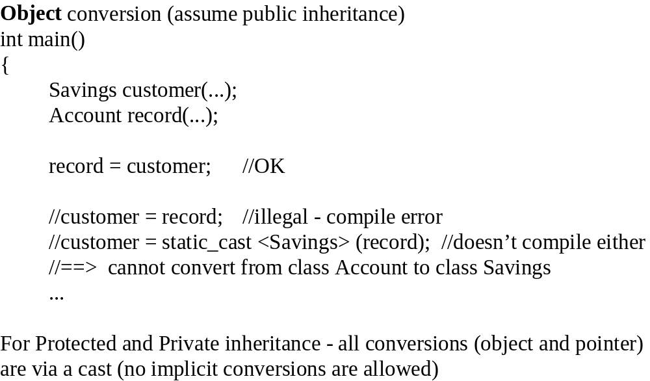
base = derived; /OK
derived = base; /not OK

Slide 41
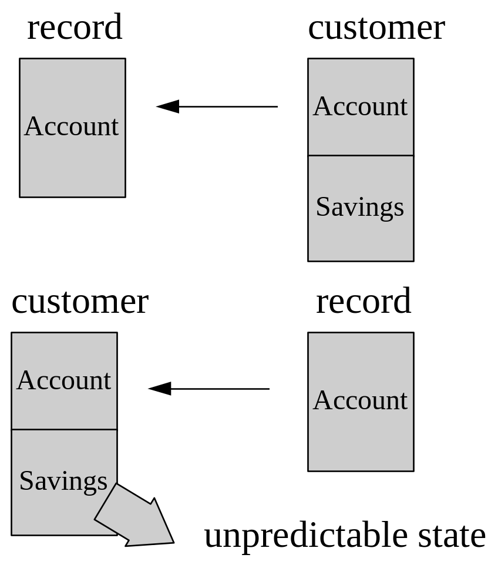
record = customer
customer = record

Slide 42
Multiple Inheritance
Checking
Savings
MoneyMarket
Criteria for use:
1. “is-a” for all base classes e.g. MoneyMarket is a Savings account, and MoneyMarket is a
Checking account
2. base 1 ^ base 2 ^ ...base n != 0;
base classes are conceptu
ally related e.g. Savings and
Checking are both types of an Account

Slide 43
MoneyMarket object
Construction/destruction order
construction - Savings -->
MoneyMarket
Savings
Checking
Money Market
destruction -
MoneyMarket --> Savings
Pointers to field relationships:
Savings *,
MoneyMarket * both point to Savings,
Checking * points to Checking

Slide 44
//Header file for multiple inheritance
class Savings
{
private:
float balance;
public:
Savings(float aBalance)
{
balance = aBalance;
cout << "Savings constructor" << endl;
}
float Balance(void) {return balance;}
};
class Checking
{
private:
float available;
public:
Checking(float funds)
{
available = funds;
cout << "Checking constructor" << endl;
}
float Available(void) {return available;}
};
class MoneyMarket : public Savings, public Checking
{
private:
float interest;
public:
MoneyMarket(float earned, float aBalance, float funds)
:Savings(aBalance), Checking(funds) //if these were not here
//we would need to define
//default constructors
{
interest = earned;
cout << "MM constructor" << endl;
}
float Interest(void) {return interest;}
};

Slide 45
//Test Program for Multiple Inheritance
#include <iostream.h>
#include "Multiple.h"
int main (void)
{
MoneyMarket MM(10., 20., 3000); //construct a MM object
cout <<"Available funds = " << MM.Available() << endl; //from Checking
cout <<"Balance =" << MM.Balance() << endl; //from Savings
cout <<"Interest earned = " << MM.Interest() << endl; //from MoneyMarket
return 0;
}

Slide 46
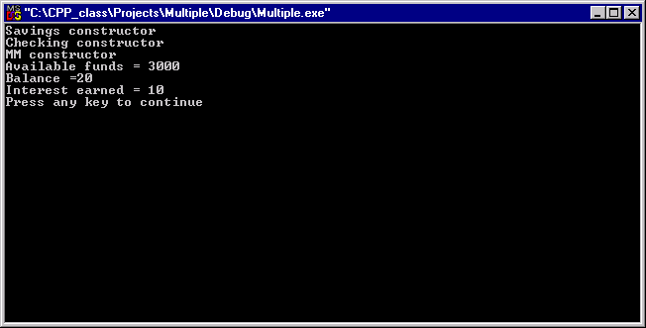

Slide 47
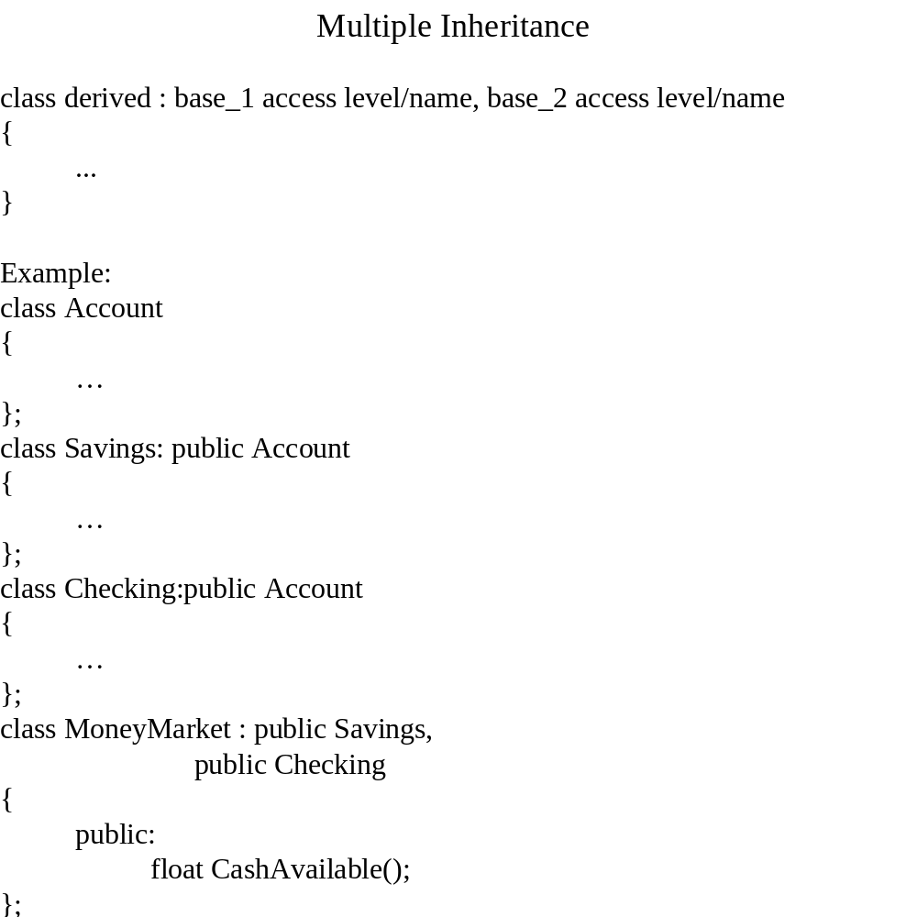
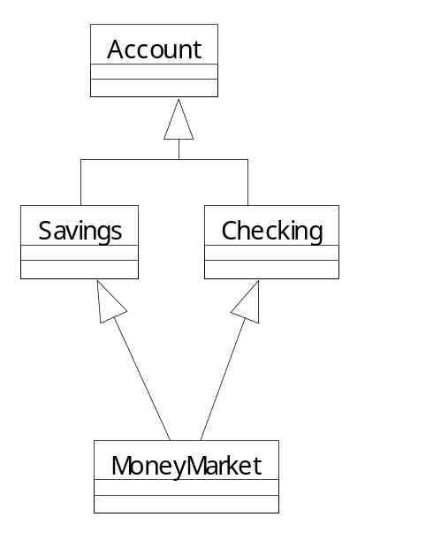
Money Market Object
Account
Checking
Account
Savings
MoneyMarket

Slide 48
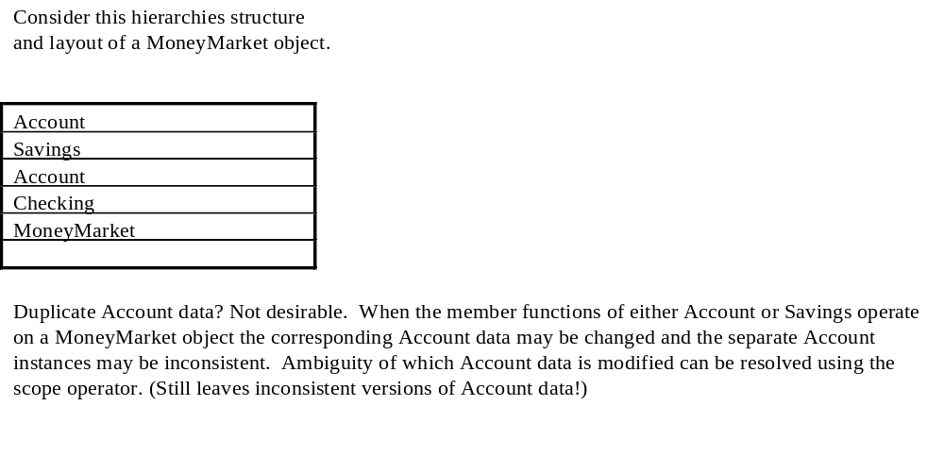

Slide 49
define virtual inheritance so that the structure is:
Account
Savings
Checking
MoneyMarket
The member functions of
MoneyMarket
, Savings and Checking operate on the protected and public
members of a common Account segment

Slide 50
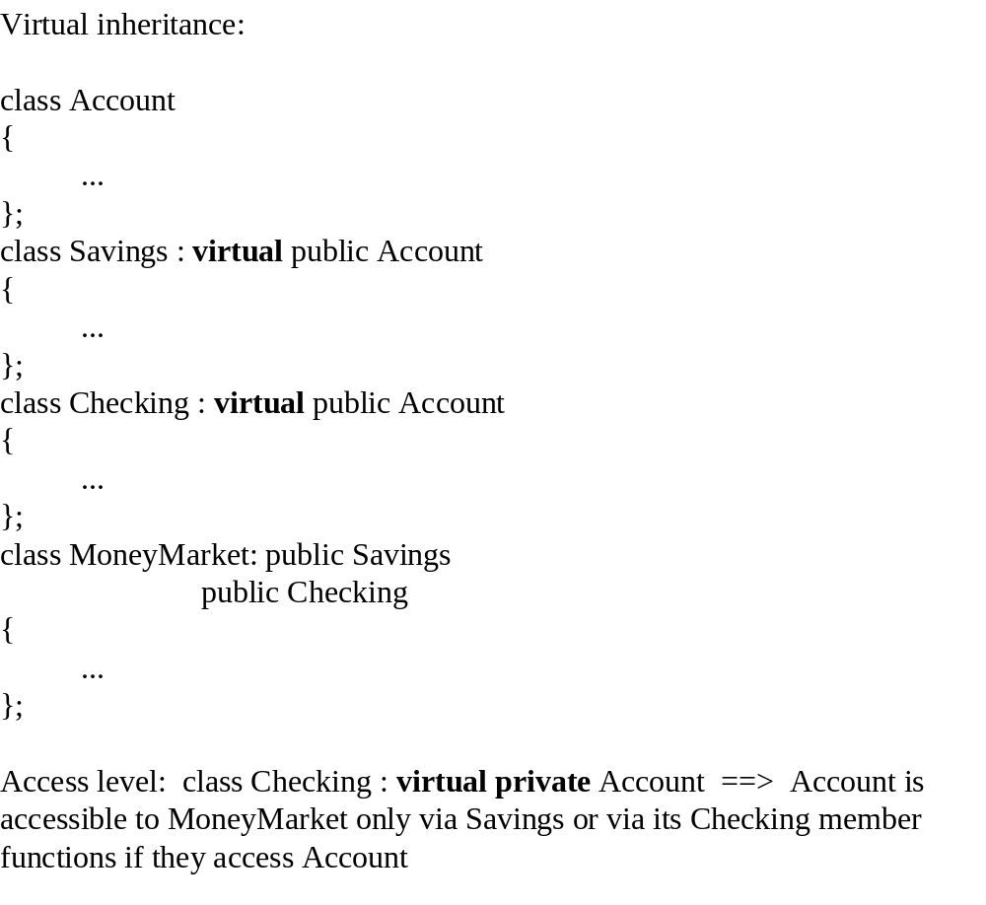
Money Market Object
Account
Savings
Checking
MoneyMarket

Slide 51
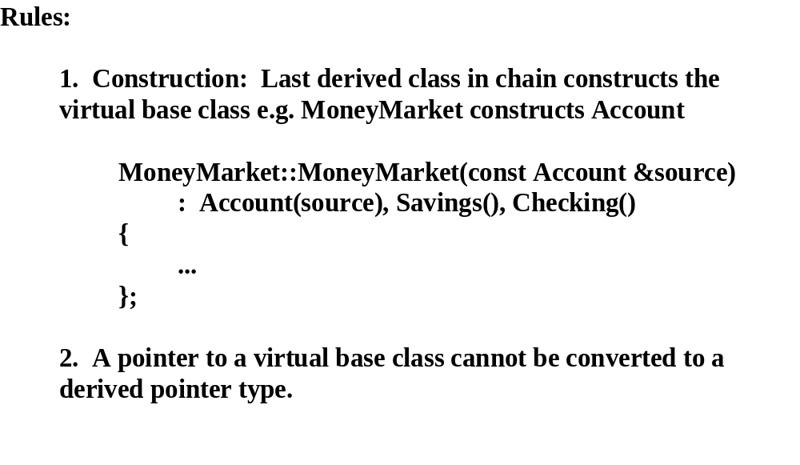

Slide 52
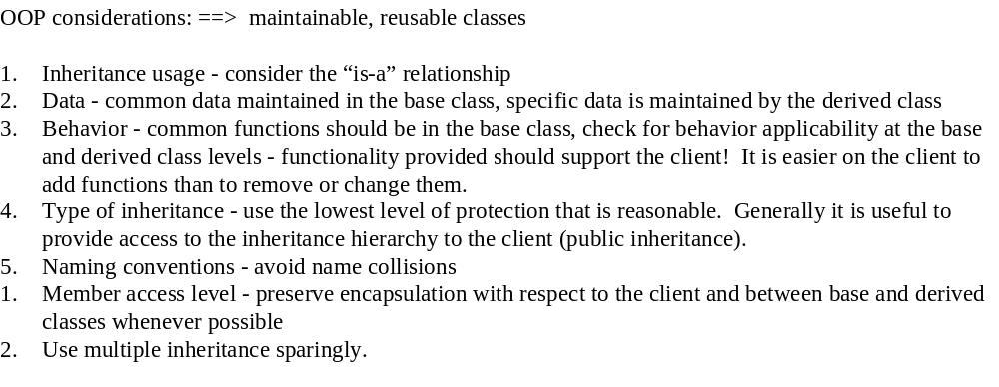

Slide 53
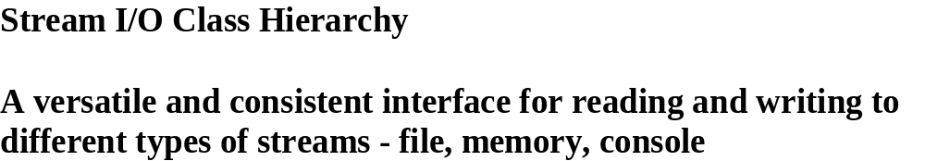

Slide 54
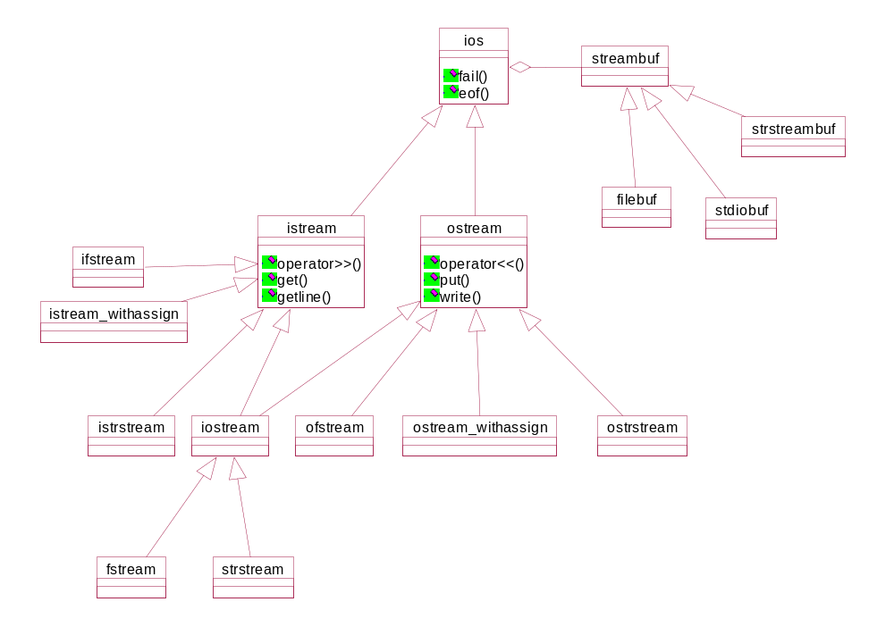

Slide 55
