Slide 1
Polymorphism
definition: the runtime ability to operate on and manipulate different derived objects in a uniform manner is called polymorphism (compile time polymorphism is provided by overriding)

Slide 2
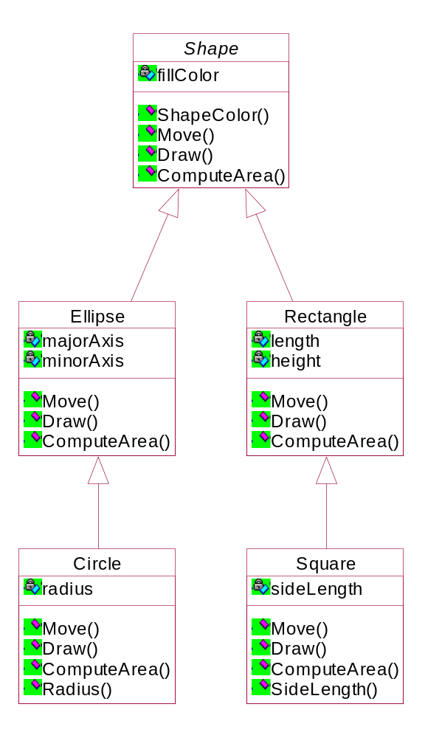
Inheritance Hierarchy

Slide 3
Polymorphism
In addition to common data and functions - would like to set-up a common design interface:
  base class specifies the features that will be supported by the derived classes i.e. the prototypes
  derived classes define and implement the specified function using the prototype interface of the base class: same names and functions
  application program accesses and operates on the different types of derived classes in a generic way e.g. via the Shape class ==> polymorphism

Slide 4
Polymorphism
Shape Class Component Diagram
Shape
color
Draw()
Move()
ComputeArea()
Ellipse
radius1
_Rectangle
radius2
length
height
Draw()
Draw()
Move()
Move()
ComputeArea()
ComputeArea()
Circle
_Square
radius
length
Draw()
Draw()
Move()
Move()
ComputeArea()
ComputeArea()

Slide 5
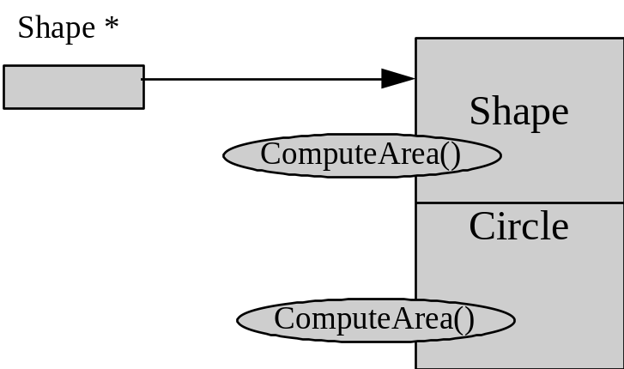
Polymorphic behavior:
void
ProcessShapes(Shape *list[],
int
numShapes)
{
for(
int j = 0; j <
numShapes; j++)
{
float area =
list[j]->
ComputeArea();
//heterogeneous list
cout << “Area = “ << area << endl;
}
return:
}
list[] is an array of base (Shape) class pointers
compiler invokes the appropriate ComputeArea() functions
object type cannot be determined till runtime ==>
dynamic binding
Normal inheritance provides static binding--object type is known at compile time: (limit: members of a derived class
are not accessible via a base class pointer)
int main(int, char**)
{
Circle sampleCircle(….);
TestFile (&sampleCircle);
float area = sampleCircle.ComputeArea(); //static
…
}
void TestFile(Shape * current)
{
cout = “Color = “ << current-->Color(); //legal
float circleRadius = current--> Radius(); //illegal
...

Slide 6
Heterogeneous List
Shape * list[]
Rectangle
Draw()
list->draw();
Application
Circle
Draw()
Since the list is based on an array of
Shape (base class) pointers , the derived
objects in the list are accessed and operated
on by the application using a generic method.
For the ProcessShapes function the type of
object must be determined at runtime in order
for the compiler to invoke the appropriate
derived class member function.
Ellipse
Draw()

Slide 7
//
shape.h file
enum Color {Red, Blue, Green, White, Black, Yellow};
class Shape
{
private:
int
fillColor;
public:
//constructor
inline Shape(
int interiorColor);
//access
inline int Color(void);
//Interface Prototype - no meaningful implementation at this
//level
int Draw(void) const;
int Move(int x, int y);
float ComputeArea(void);
inline Shape::Shape(int newColor)
...
: fillColor(newColor)
{
};
}
inline int Shape::Color(void)
{
return fillColor;
}

Slide 8
//Shape.cpp
//Shape class function definitions
#include <iostream.h>
#include "Shape.h"
int Shape::Draw(void) const
{
cout << "Shape Draw()" << endl;
return 0;
}
int Shape::Move(int a, int b)
{
cout << "Shape Move()" << endl;
return 0;
}
float Shape::ComputeArea(void)
{
cout << "Shape ComputeArea()" << endl;
return 0;
}

Slide 9
//
circle.h file
#include “
shape.h”
class Circle : public Shape
{
private:
int x, y;
//circle center coordinate
float radius;
public:
//constructor
Circle (
int x1,
int y1,
int radius1, int newColor);
//access function
float Radius();
//Grap
hic functions
int Draw(void) const;
int Move(int x1, int y1);
//Arithmetic function
float ComputeArea(void);
...
};

Slide 10
//Circle.cpp - class Circle function definitions
#include <iostream.h>
#include "Circle.h"
Circle::Circle(int a, int b, float rad, int cColor)
:Shape(cColor)
{
x = a;
y = b;
radius = rad;
}
float Circle::Radius()
{
return radius;
}
int Circle::Draw()const
{
cout << "Circle Draw()" << endl;
return 0;
}
int Circle::Move(int a, int b)
{
cout << "Circle Move()" << endl;
return 0;
}
float Circle::ComputeArea()
{
float area = 3.14*radius*radius;
cout << "Circle area = " << area << endl;
return area;
}

Slide 11
//Main.cpp file for the Shape/Circle classes
//Test program for the normal Shape/Circle inheritance hierarchy
#include <iostream.h>
#include "Circle.h"
int main(void)
{
//circle with center at (3,4), radius of 10 and color red
Circle *roundShape = new Circle(3,4,10,Red);
float area = roundShape->ComputeArea();
//invokes Circle ComputeArea() - static binding
float cRadius = roundShape->Radius(); //static binding
//allocate a new Circle but initialize a Shape pointer
Shape *current = new Circle(3,4,5,Blue);
current->Draw(); //invokes Shape Draw() - Limit
cout << "\n\tArea" << current -> ComputeArea();
//Shape ComputeArea()
//current->Radius(); //does not compile (Limit)
delete roundShape;
delete current;
return 0;
}

Slide 12
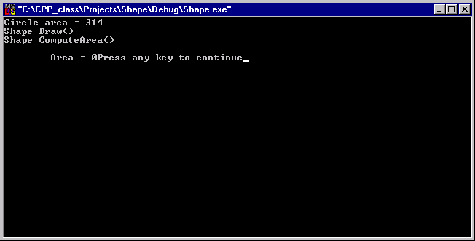

Slide 13
//
main.cpp (cont.)
void
ProcessShapes(Shape *list[], int numShapes)
{
for(
int j = 0; j <
numShapes; j++)
{
list[j]->
ComputeArea();
//Shape ComputeArea() is called
//but, implementation - none
}
return:
}
Sooo….inheritance alone does not provide polymorphism - client cannot access derived members via a base class pointer

Slide 14
//
shape.h file
enum Color {Red, Blue, Green, White, Black, Yellow};
class Shape
Shape
{
private:
int
fillColor;
public:
//constructor
Circle
inline Shape(
int
interiorColor);
inline
int
ShapeColor(void);
Use virtual to provide
dynamic binding
//Interface Prototype - no meaningful implementation
at this
level
virtual
int Draw(void)
const;
{ return 0;};
//do nothing function
virtual
int Move(
int x,
int y);
{ return 0;};
virtual
float
ComputeArea(void)
;
{return 0;};
};
inline
Shape::Shape(
int
newColor)
:
fillColor(
newColor)
{
//include the applicable subclass definitions in the hierarchy
}
#include “circle.h”
inline
int
Shape::ShapeColor(void)
#include “rectangle.h”
{
#include “square.h”
return
fillColor;
}

Slide 15
//
circle.h file
#
include “
shape.h”
class Circle : public Shape
{
private:
int x, y;
//circle center coordinate
float radius;
public:
//constructor
Circle (
int x1,
int y1,
int radius1,
int
newColor);
//access function
float Radius();
//Grap
hic functions - use of virtual keyword here is optional
virtual
int Draw(void)
const;
virtual
int Move(
int x1,
int y1);
//Arithmetic function
virtual
float
ComputeArea(void)
;
...
};
Inheritance + virtual functions provides the mechanism for dynamic binding

Slide 16
Note:
Generally, derived virtual functions have the same signature (return
type, arguments etc.) as defined in the base class. The exception is that a
virtual function in the base class can return a pointer or reference to a base
object, and the derived virtual function can return a pointer or a reference to
a derived object.
Rule: Virtual functions cannot be inline functions. Why not?

Slide 17
Rule: no inline virtual functions (Why not? because the compiler won’t know where to find them for
dynamic binding) - v-table is a function pointer table
Circle v-table
Circle object
hidden pointer
computeArea()
draw()
move()
Circle object
hidden pointer

Slide 18
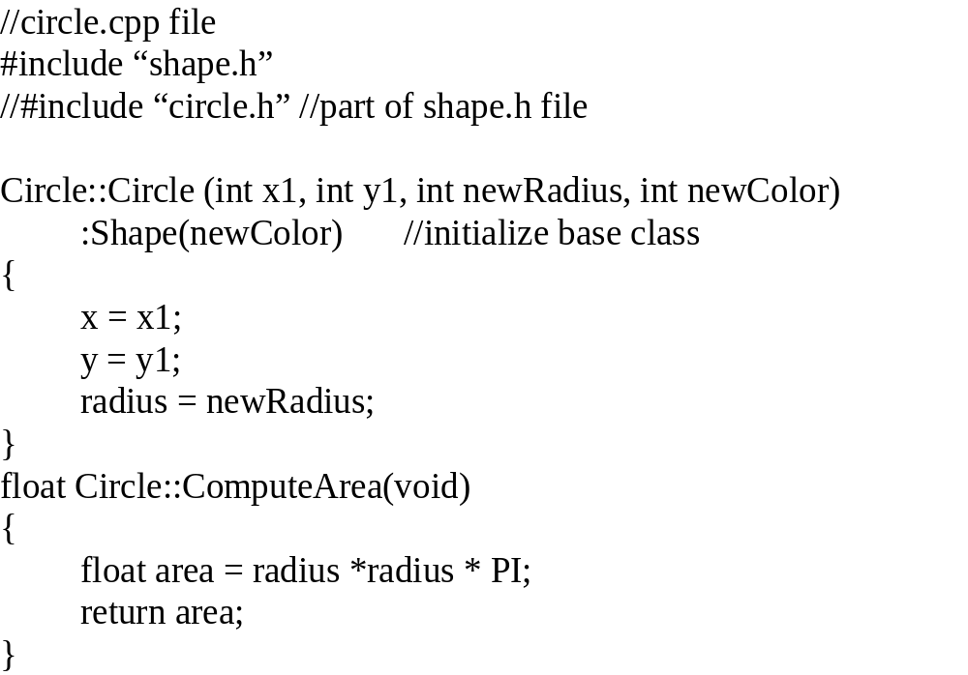

Slide 19
//circle.cpp (cont.)
int
Circle::Move(
int x1,
int y1)
{
int status;
//Move circle to new coordinate
x = x1;
y = y1;
//erase old circle - call graphics primitives
//redraw circle
s
tatus = Draw();
return status;
}
int
Circle::Draw(void)
const
{
//graphics primitives
}
similarly for the other shapes in the design hierarchy

Slide 20
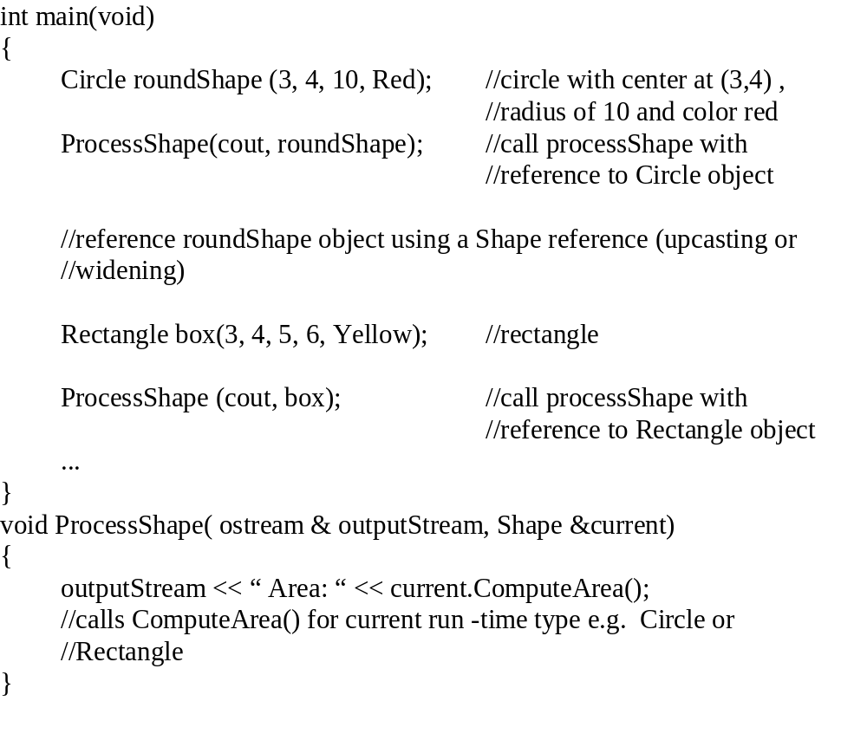

Slide 21
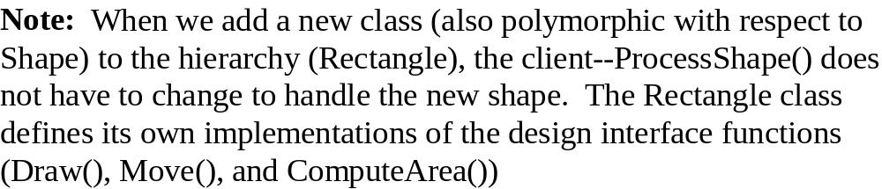
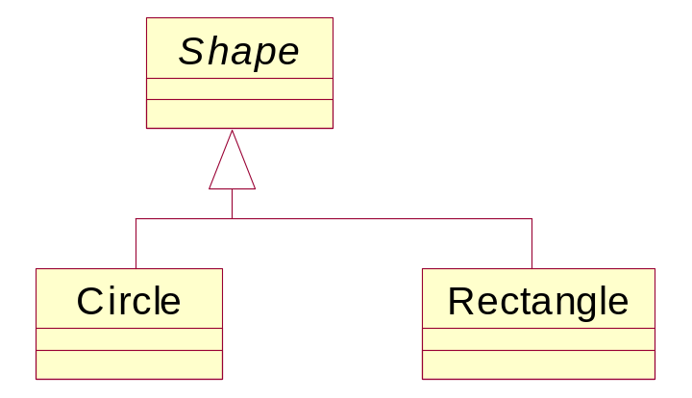

Slide 22
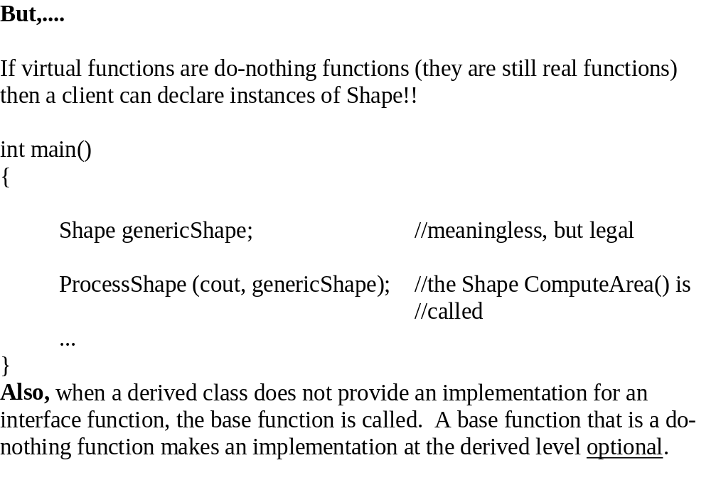

Slide 23
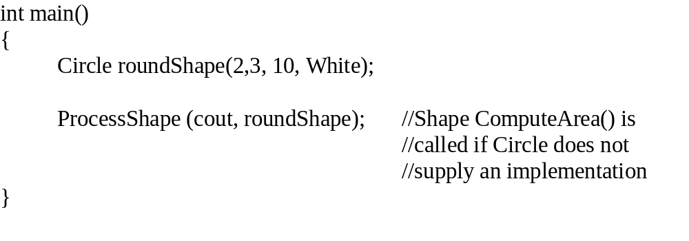
Shape
color
Draw()
Move()
ComputeArea()
Circle
radius
_Rectangle
length
height
Draw()
Draw()
Move()
Move()

Slide 24
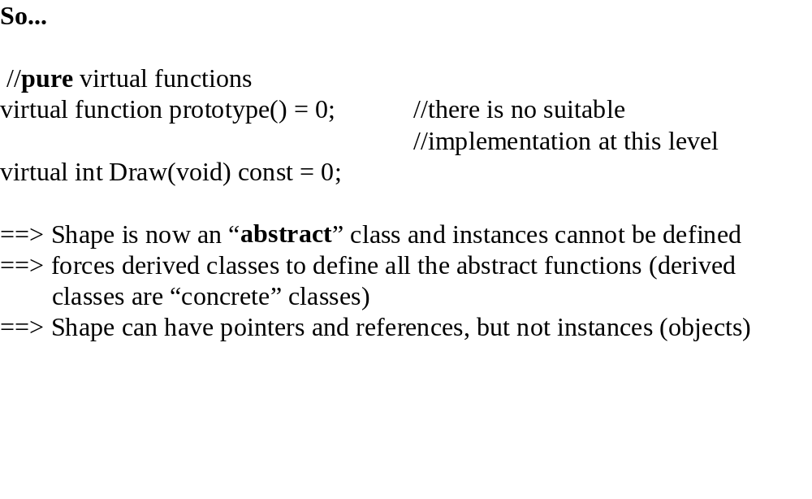

Slide 25
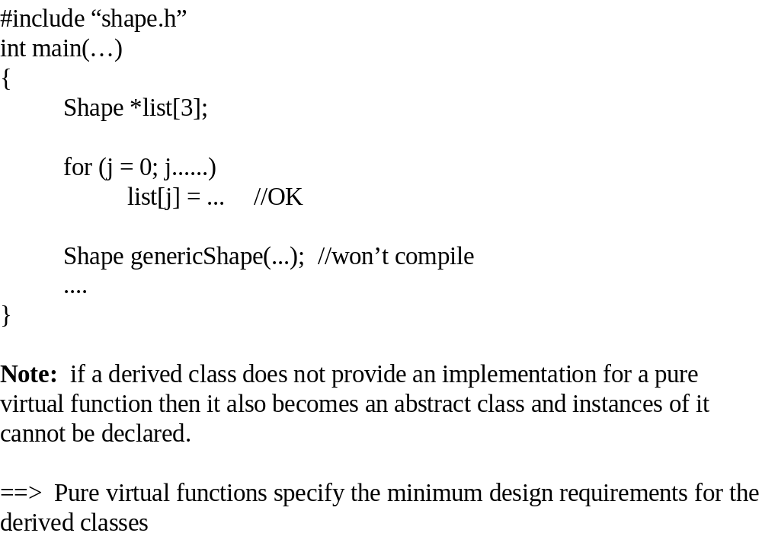

Slide 26
//
shape.h file
class Shape
{
private:
int
fillColor;
public:
//constructor
inline Shape(
int
interiorColor);
inline
int
ShapeColor(void);
//Interface Prototype - no meaningful implementation at this level
virtual
int Draw(void)
const = 0;
//pure virtual function
virtual
int Move(
int x,
int y) = 0;
virtual
float
ComputeArea (void)
= 0;
//
destructor
~Shape();
};
inline
Shape::Shape(
int
newColor)
:
fillColor(
newColor)
{
}
inline
int
Shape::ShapeColor(void)
{
return fillC
olor;
}

Slide 27
Rules:
1. Constructors cannot be virtual - since in the absence of a derived implementation the virtual
designation causes the base class constructor to be called, but both the base class and the derived
class must be constructed. Also the object type is always known at construction time so a
polymorphic constructor is never necessary:
Shape *current = new Circle(1,3, 4, Red);
//Type is Circle
2. Destructors must be virtual (but not pure) if other functions in class are virtual.
3. When a base class constructor or destructor invokes a virtual function, the base class version is
invoked. The derived data is not in a predictable state in either case so a real (derived)
implementation would be dangerous (if the function is pure then behavior is unpredictable).

Slide 28
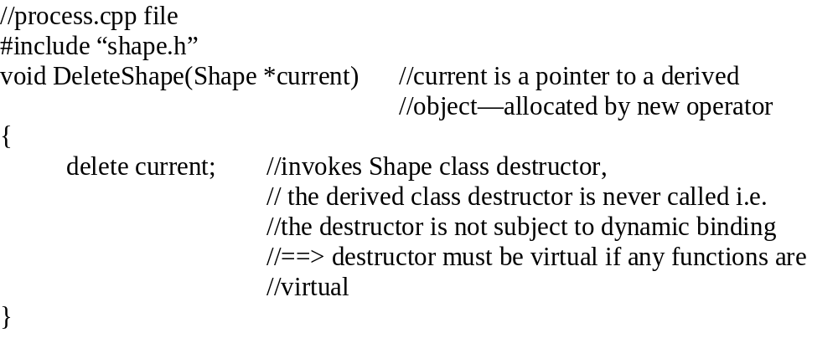
Rule 2 example -- with a non-virtual destructor
DeleteShape() cannot identify the derived object type at compile time. Therefore the destructor must be virtual so that the compiler can determine the derived type and the derived type destructor can be called.
Destructor cannot be pure virtual since the base destructor is always called--compiler will not allow it.

Slide 29
//
shape.h file
class Shape
{
private:
int fillColor
public:
//constructor
inline Shape( int interiorColor);
inline
int
ShapeColor(void);
//Interface Prototype - no meaningful implementation at this
//level
virtual
int Draw(void)
const = 0;
//pure virtual function
virtual
int Move( int x, int y) = 0;
virtual float ComputeArea (void) = 0;
//
destructor
virtual
~Shape();
};

Slide 30
Adding a class to the hierarchy.
//
Rectangle.h file
#
include “shape.h”
class Rectangle : public Shape
{
private:
int
xUL, yUL, xLR, yLR; //rectangle vertices
public:
//constructor
inline Rectangle( int x1, int y1, int x2, int y2, int interiorColor);
//Graphics functions
virtual int Draw(void) const;
virtual int Move( int x, int y);
virtual float ComputeArea (void) const;
//destructor
virtual ~Rectangle();
};
How is the client (i.e. processShape) affected by the new class?

Slide 31
Answer - not at all, resulting flexibility provides:
  enhanced maintainability
  reusability

Slide 32
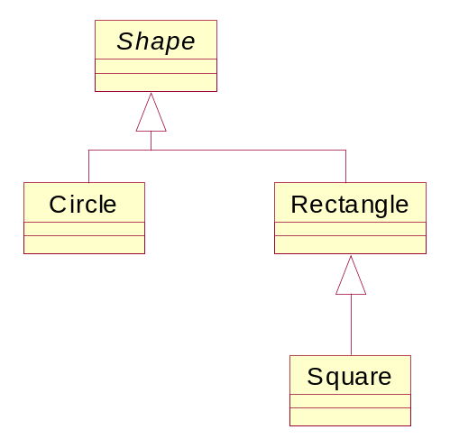
//class
Square : public Rectangle
#
include “
rectangle.h”
class Square : public Rectangle
{
public:
//constructor
Square(
int x1,
int y1,
int length,
int
interiorColor);
//Graphics functions
virtual
int Draw(void)
const;
//better implementation
virtual
int Move(
int x,
int y);
virtual
float
ComputeArea (void);
//if no implementation is
//provided, Rectangle’s is
//used
//
destructor
virtual ~Square();
};

Slide 33
Rule 3:
when a base class constructor or
destructor invokes a virtual function,
the base class version is invoked
//
shape.cpp file
Shape::Shape(int newColor
:fillColor(newColor)
{
Draw();
//calls Shape::Draw()
//if Draw() is pure, then this is a bad
practice
//==> unpredictable behavior
}
Note:
Rule does not apply to derived classes
At base class construction, derived elements that
Draw() may use have not been constructed/initialized!

Slide 34
Note:
Rule does not apply to derived classes
//
rectangle.cpp file
Rectangle::Rectangle(
int x1,
int y1,
int x2,
int y2,
int newColor)
:Shape(newColor),xUL (x1), yUL(y1), xLR(x2), yLR(y2)
{
Draw();
//calls Rectangle::Draw()
}
//square.cpp file
Square::Square(int x1, int y1, int newLength, int newColor)
:Rectangle(x1, y1, x1 + newLength, y1 - newLength, newColor)
//calls
//Rectangle Draw()
{
}
int Square::Draw(void) const
{
//graphics optimized for a square
...
}
//no implementation provided for Move() or ComputeArea(), since the
rectangle version is fine
What if Rectangle did not provide a Draw() function?

Slide 35
Answer: Rectangle would be an abstract class and Square
would have to provide implementations for all functions.
//
main.cpp
#
include “
shape.h”
int main(…)
{
Square square1(3, 4, 5, Green);
ProcessShape ( cout, square1);
//Rectangle ComputeArea() is called
...
}
void ProcessShape ( ostream & outputStream, Shape & current)
{
outputStream << “ Area: “ <<
current.ComputeArea();
//calls
ComputeArea() for current
//type - Square --> Rectangle
current.Draw(); //Square Draw() is called
}

Slide 36
Rule 3: Destructors (same as constructor) - a call
to a virtual function in a base class destructor causes
the base class implementation to be invoked. At base
destruction the derived part of the object has already
been destructed so the derived virtual function is not
appropriate. If the function is pure virtual then more
dire results could occur.

Slide 37
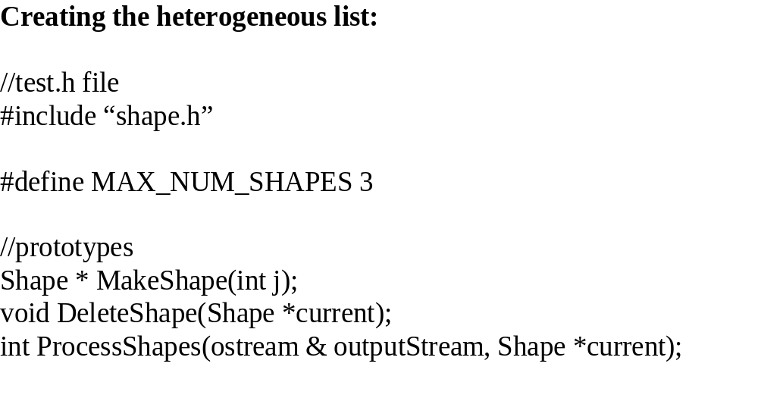

Slide 38
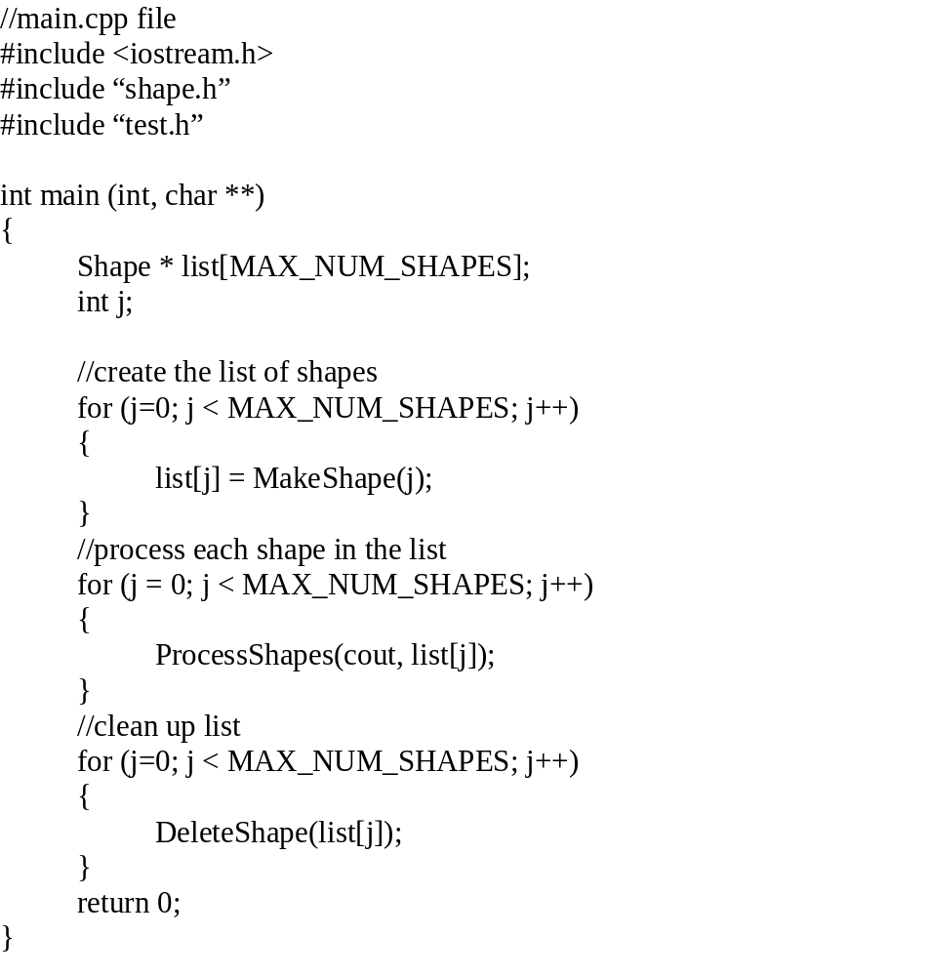

Slide 39
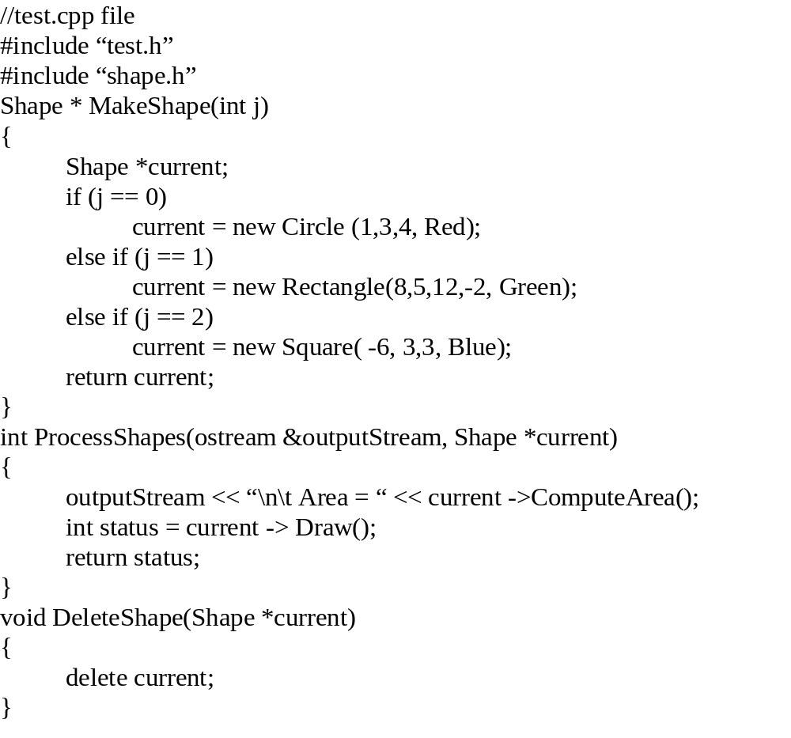

Slide 40
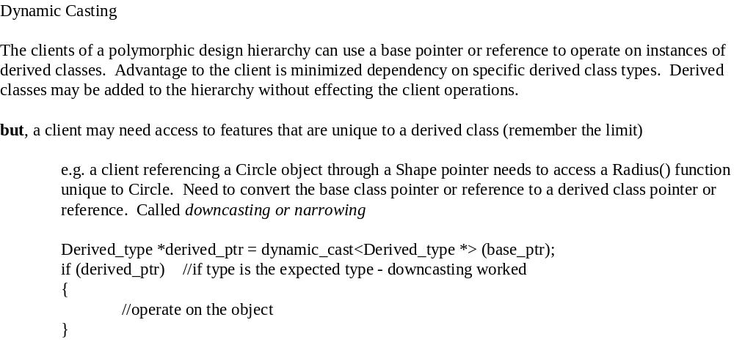

Slide 41
Dynamic casting process:
1.
Compare data type of derived object (what the
base_ptr is pointing to) to the specified type in the cast.
2.
If they match then the downcast is performed
3. The cast will fail if the types do not match (if base_ptr points to a Circle object then a dynamic
cast to a Rectangle pointer will fail -- a null pointer is returned)
The process is similar for base class references, but the failure is handled differently since a null address
cannot be returned. Instead the
bad_cast
exception is raised. We will cover this more when we talk about
C++ exception handling:
Casting syntax:
try
{
Type &
derived_reference =
dynamic_cast<Type &> (
base_reference);
//operate on the object
...
}
catch (
bad_cast)
//when cast fails
{
//recovery attempt etc.
}

Slide 42
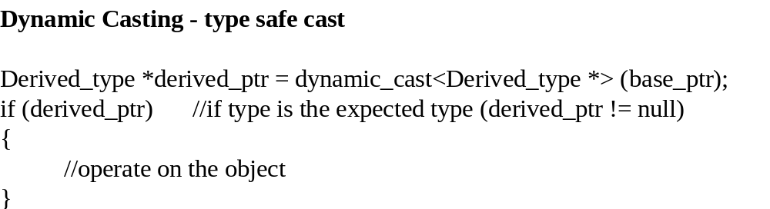

Slide 43
Example: Pointer
//
app.cpp
file
#
include “
shape.h”
void Highlight( Shape *current)
{
Circle *round =
dynamic_cast<Circle *> (current);
if (round)
{
cout << “Radius = “ << round->Radius();
}
...
}

Slide 44
Example: reference
//
app.cpp file
#
include “
shape.h”
void Highlight( Shape &current)
{
try
{
Circle &round =
dynamic_cast<Circle &> (current);
cout << “Radius = “ <<
round.Radius();
}
catch (
bad_cast)
//if shape is not a Circle do …
{
…
}
}
Highlight() keeps its parameter list independent of the
derived Shape object type, but is able to access Circle objects
unique features/data.

Slide 45
Dynamic casting really only applies to
polymorphic design hierarchies. This is because the type data is
stored in a v-table. If virtual functions do not exist there is no v-table and the results of the cast are
unpredictable.
A base class reference/pointer can be narrowed to an intermediate data type e.g. a Shape reference to a
Square object can be downcast to a Rectangle reference
Type conversions for complex hierarchies can be handled to provide access to derived capabilities.

Slide 46
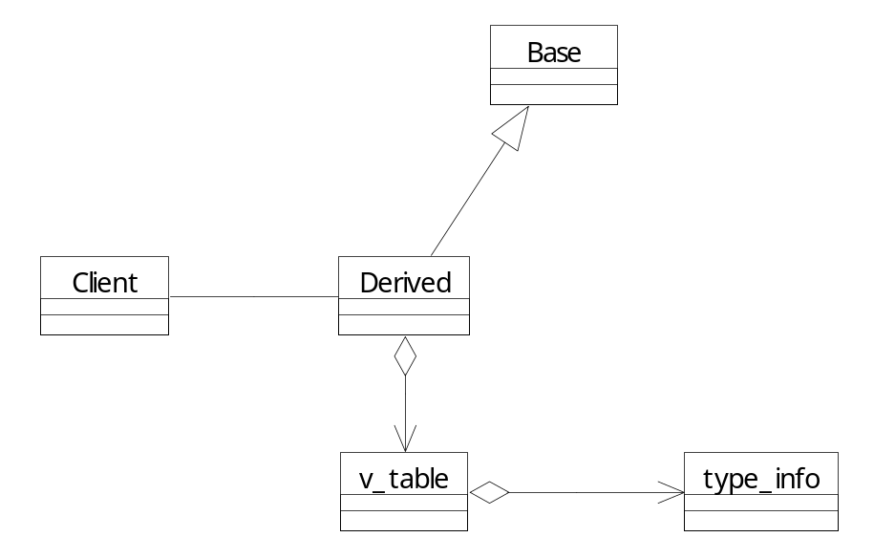
Run-Time Type Identification (RTTI)
type
_info class library and member functions
Return a reference
to a type_info object
that contains the type
information
const
type_info &
typeid(type *object_ pointer)
throw (bad_typeid); //thrown for a null pointer
const
type_info &
typeid(type *
object_reference);
const
type_info &
typeid(type);
const
type_info & operator == ();
const
type_info & operator != ();
const char * name();
Boolean
before();
//where type is in the hierarchy

Slide 47
RTTI - runtime type identification
//
shapeType.cpp file
#
include <
typeinfo.h>
#
include “
shape.h”
void
TypeShape(Shape *current)
{
cout << “Shape type: “ <<
typeid(*current).name() <<
endl;
if(
typeid(*current) ==
typeid(Circle))
//if current points to
a Circle
//
typeid(current).operator ==
typeid(Circle);
{
Circle *round =
dynamic_cast<Circle *> (current);
cout << Radius = “ << round ->Radius() <<
endl;
}
}

Slide 48
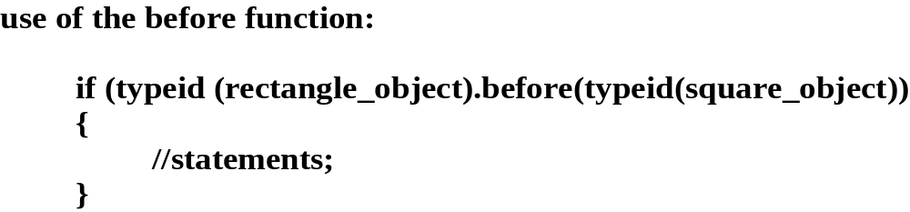
Note1: consider using RTTI before dynamic_casting e.g.
to recognize an object type and perform a task.
Note 2: In MS Visual C++ you must activate RTTI in order to use dynamic casting or RTTI. (Version 6 - Project Settings/C++/Enable RTTI) (Visual Studio – Project/Properties/C/C++/Language/enable RTTI)

Slide 49
OO Considerations:
1. Base virtual class functions should be applicable (have an
implementation) for
all
derived classes
2. Virtual functions that are not meaningful at the base level should be pure
virtual.
3. Base class can have non-virtual functions that provide common operations
for the derived classes e.g. Color(); Attributes and functions unique to
the derived class are non-virtual derived functions e.g. Radius();

