Slide 1
OOP and C++
Transition to C++

Slide 2
Additions/Changes to C++ (from C)
Access Modifiers
References
Overloading
Class structure
Casting
OOP features
  Inheritance
  Polymorphism
  Run-time Type checking
Exception Handling
Templates
Others – I/O, Strings etc.
I consider that C++ is really a separate language from C!!

Slide 3
Access modifiers/qualifiers
control how variables may be accessed or modified.
const or volatile precede the type modifier and
type names that they qualify
const int a= 10;
//constant variable
char * Search (const char * str, char);
//contents of
string pointed to
//by str cannot be modified by
//Search()
char * Name (void) const;
//read-only function - object
//attributes are unchanged

Slide 4
char a_string[] = “OAADS”;
char b_string[] = “R/SAOC”;
char *const logo = a_string; //constant pointer
logo = b_string //compile error
char *header = a_string; //normal pointer
const char *name = b_string; //constant data
name[0] = ‘B’; //compile error
const char *const id = b_string; //constant pointer to constant data
id = a_string; //compile error
id[0] = ‘D’; //compile error

Slide 5
ROM
RAM
logo
OAADS’\0’
a
_string
id
header
name
b_string
R/SAOC’\0’

Slide 6
References (see page 341 in the C++ Primer)
A reference is an alternative name for a variable:
Rodents is an alias for rats
The & symbol is not the address operator but is part of the type identifier i.e. char *
A reference must be initialized (preferably when it is declared)
  int rats = 11;
  int & rodents = rats;
  cout << “rats = “ << rats;
  cout << “rodents” << rodents;

Slide 7
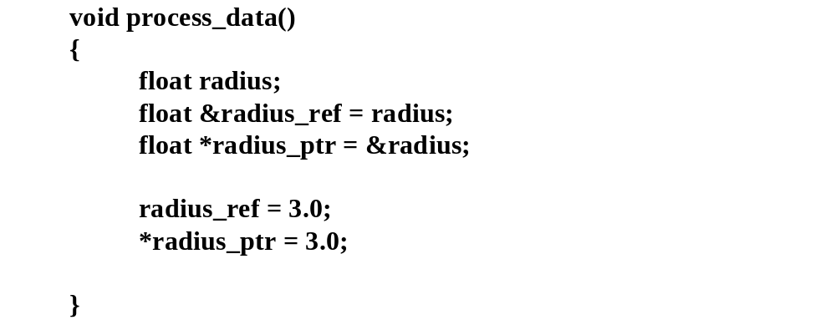
References vs. Pointers

Slide 8
void swap(float &x, float &y)
{
float temp;
temp=x;
x=y;
y=temp;
}
int
main()
{
float a,b;
swap(a,b);
//hard to tell this is reference
...
}
//x and y are treated as pointers by
// the compiler

Slide 9
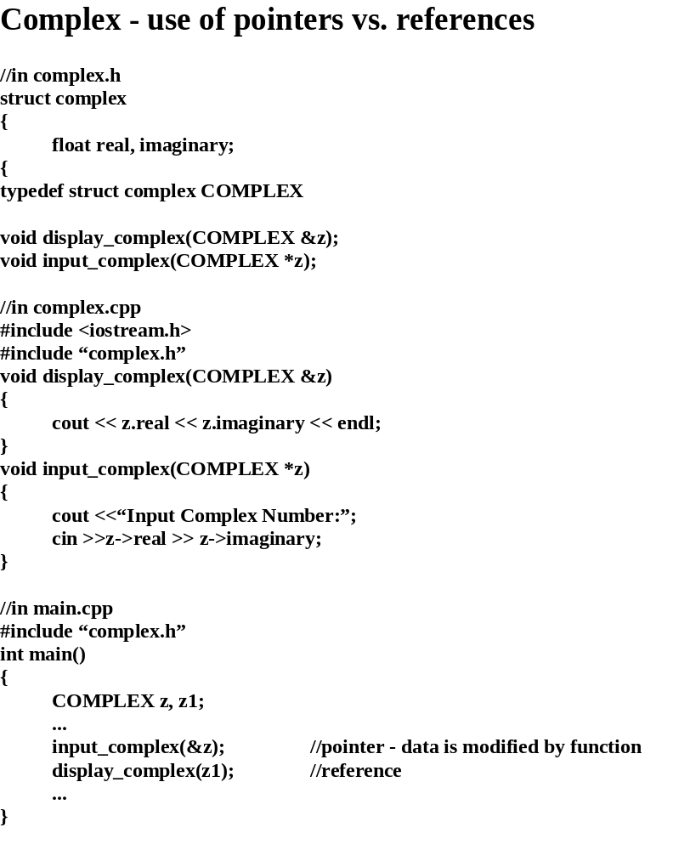

Slide 10
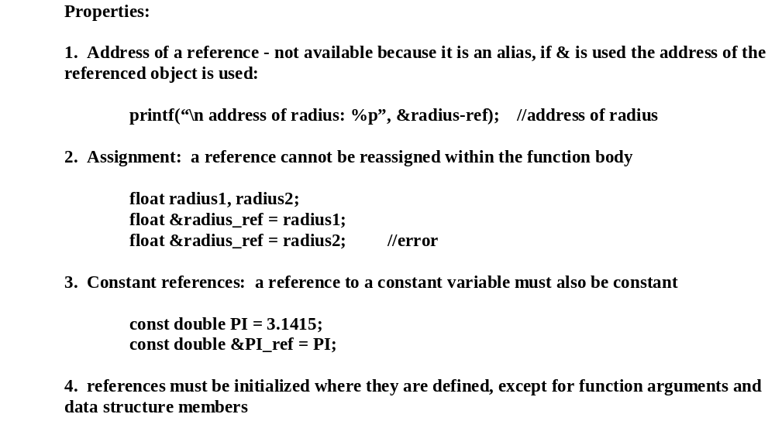
Reference rules/guidelines

Slide 11
References
Dangling references
  Make sure to assign references to variables
  If a function returns a reference to a variable, make sure the variable is static
    Otherwise, it is local and is destroyed after function ends

Slide 12
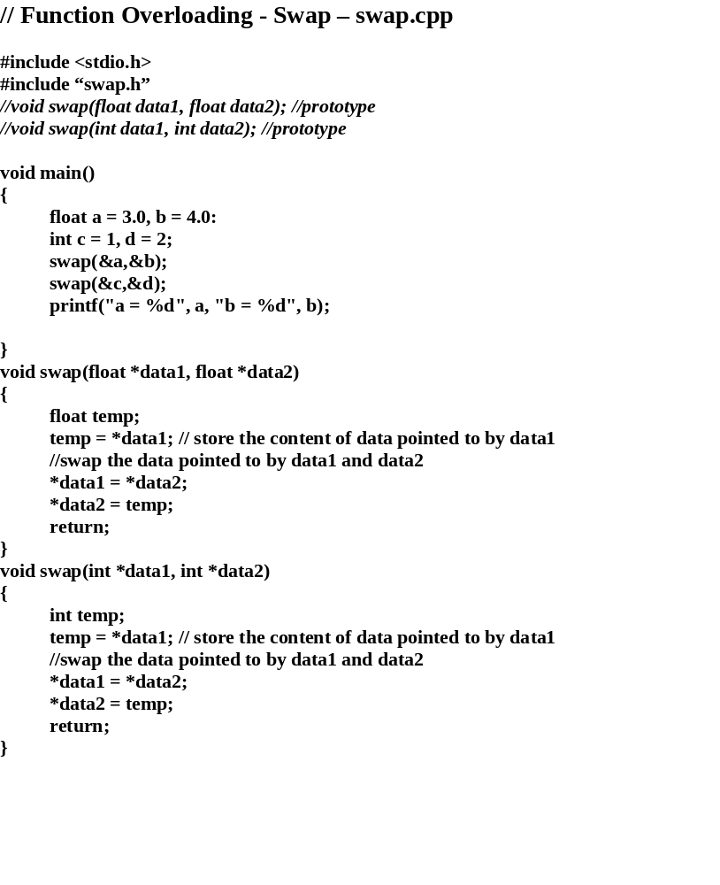

Slide 13
Class Definition - Overview
class
class_name
{
access
_type:
data
_type variable or object;
member function prototypes;
access
_type:
data
_type variable object:
member function prototypes;
....
};
access types: public, protected, private
member function syntax:
return
_ type
class_name::function_name(argument list);

Slide 14
Class Definition - Overview
//
complex.h
class COMPLEX
{
private:
float real, imaginary;
//data members or attributes
public:
float
complex_real(void);
//member functions
float
complex_imaginary(void);
};
//
main.cpp
#
include <
iostream.h>
#
include “
complex.h”
int main()
{
COMPLE
X z;
cout <<“\n real(z) = “ <<
z.complex_real();
}

Slide 15
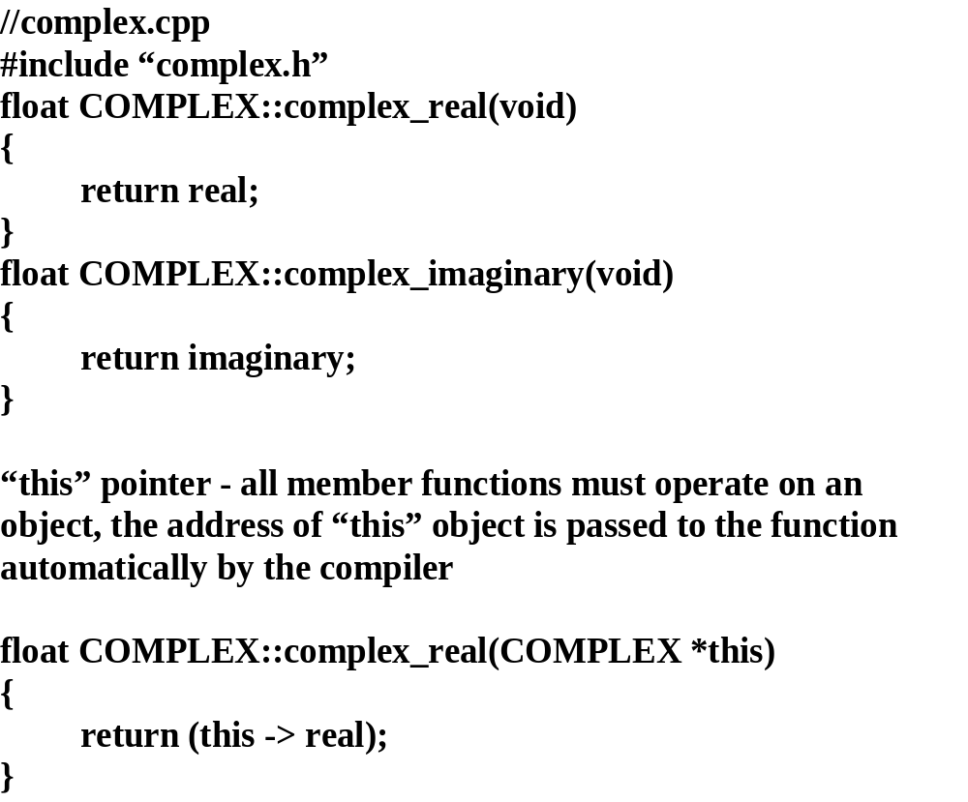

Slide 16
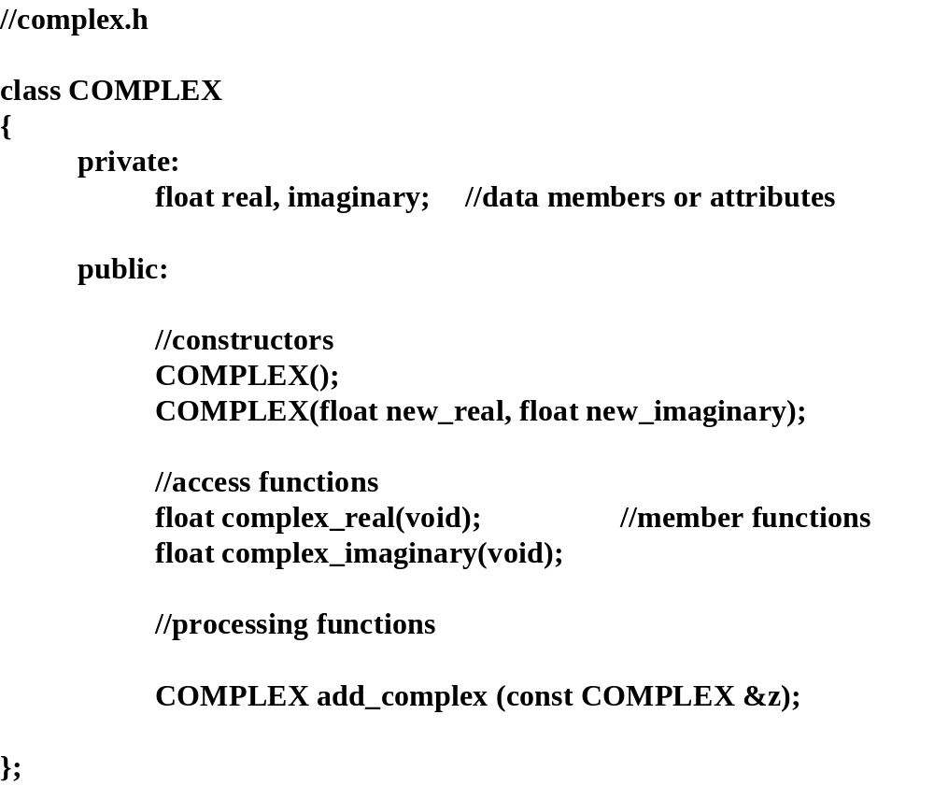

Slide 17
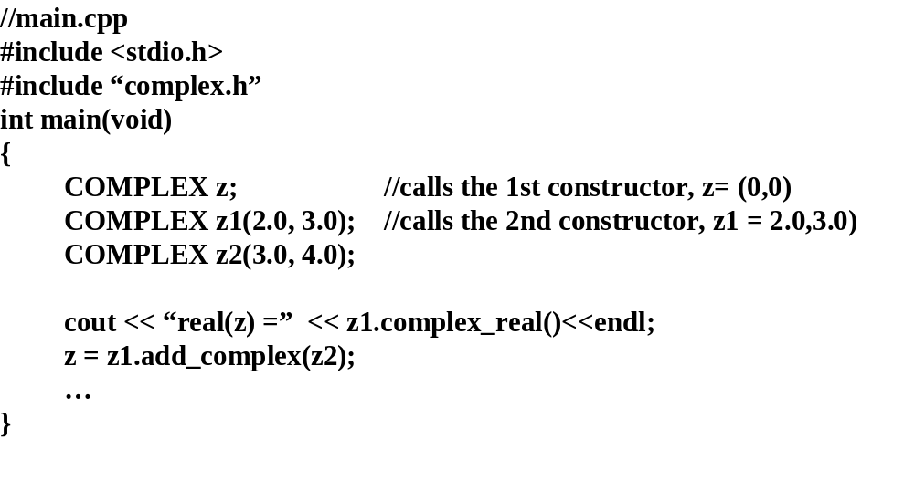

Slide 18
Constructors
//add to
complex.cpp
COMPLEX
::COMPLEX()
{
real = 0.0;
imaginary = 0.0;
}
COMPLEX
::COMPLEX(float
real_part, float
imaginary_part)
{
real =
real_part;
imaginary =
imaginary_part;
}
COMPLEX
COMPLEX
::
add_complex (
const COMPLEX &z)
{
float x =
complex_real() +
z.complex_real();
float y =
complex_imaginary() +
z.complex_imaginary();
COMPLEX result (
x,y);
//calls constructor
return result;
}

Slide 19
Operator Overloading
It would be nice to use the + operator for COMPLEX
…
COMPLEX z1(2.0, 3.0);
COMPLEX z2(4.0, 5.0);
COMPLEX z;
z = z1 + z2; //much more intuitive
…
Syntax:
return
_type
operator
op_symbol(arguments)
{
function body;
}

Slide 20
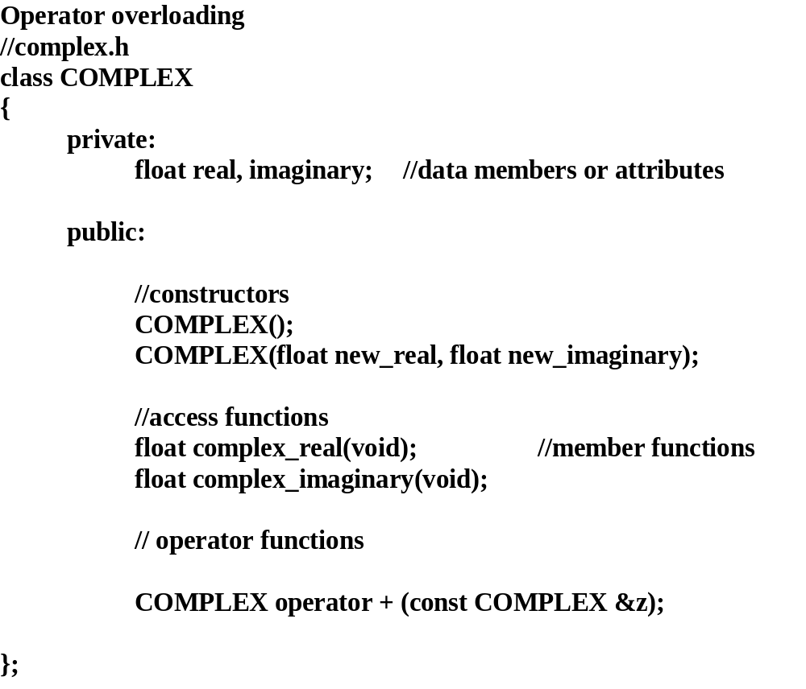

Slide 21
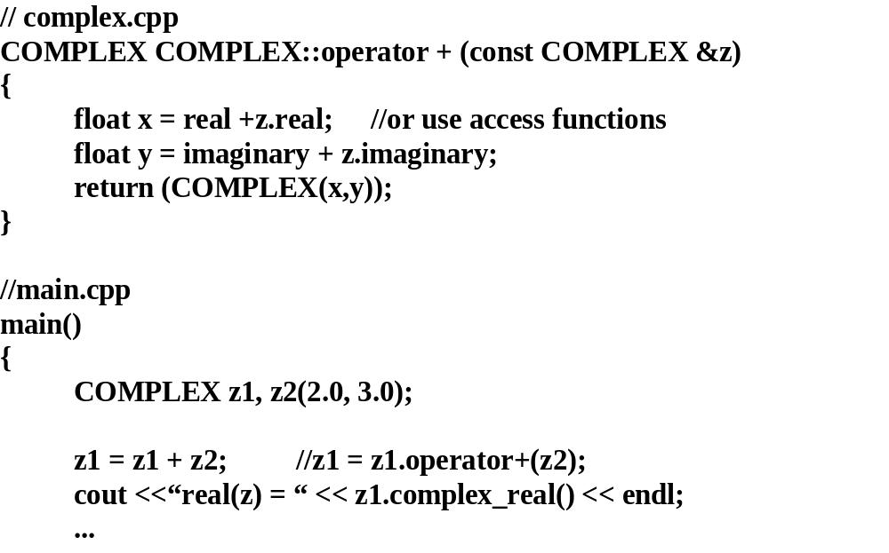

Slide 22
restrictions:
cannot overload built-in data types
can only overload existing operators (most, not all)
cannot create new operators
Restrictions: can’t overload the ?, the dot ., the .*(pointer to member), :: scope resolution,
sizeof()
Precedence and
associativity of the overloaded operators cannot be changed
Unary operators (except for -) cannot be used for binary operations
Z
n
==> COMPLEX operator ^ (COMPLEx &z, int n);
z3 = z2 ^4 +2
//z3 = z2 ⁽⁴ ⁺ ²⁾ - precedence of ^ is less than that of +
float operator + (float a, float b)
//not allowed
{
return (a/b);
}
float operator + (float a, COMPLEX z);
//OK, at least one user defined data type
COMPLEX operator ~(COMPLEX &z1, COMPLEX &z2)
z3 = z1 ~ z2 //can’t redefine the one’s compleme
nt operator to be binary

Slide 23
Useful operator overloading applications:
Math libraries (=,+, -, *, /, ++, -- etc.)
Stream I/O for Classes/Objects (<<, >>)
Relational operations for Classes/Objects ( ==, != etc.)
Dynamic Allocation (new, delete)
Array boundary checking ( [])
Deep copying (overloading = for external containment)
Multi-dimensional lists (a Matrix class could overload the parenthesis operator
e.g. matrix (i,j) = expression:)

Slide 24
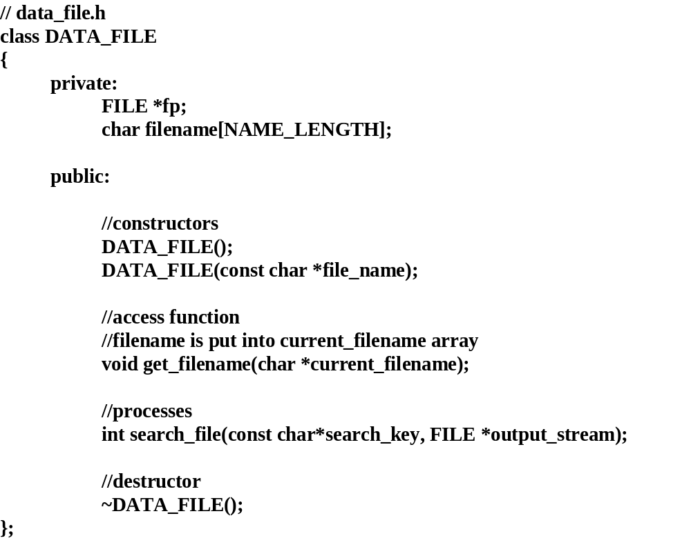
Destructors

Slide 25
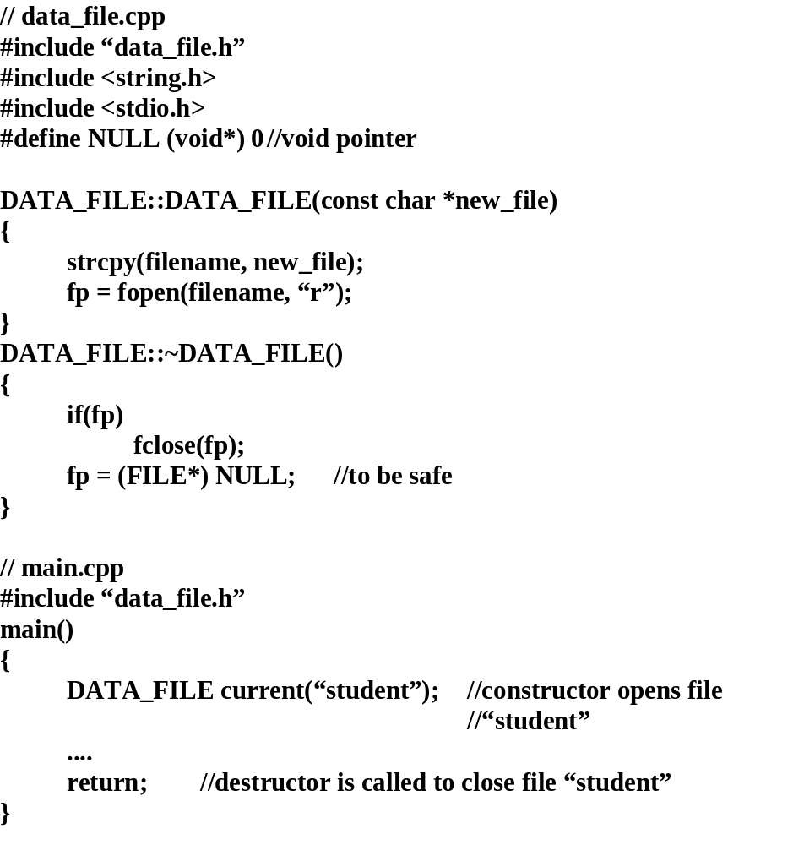

Slide 26
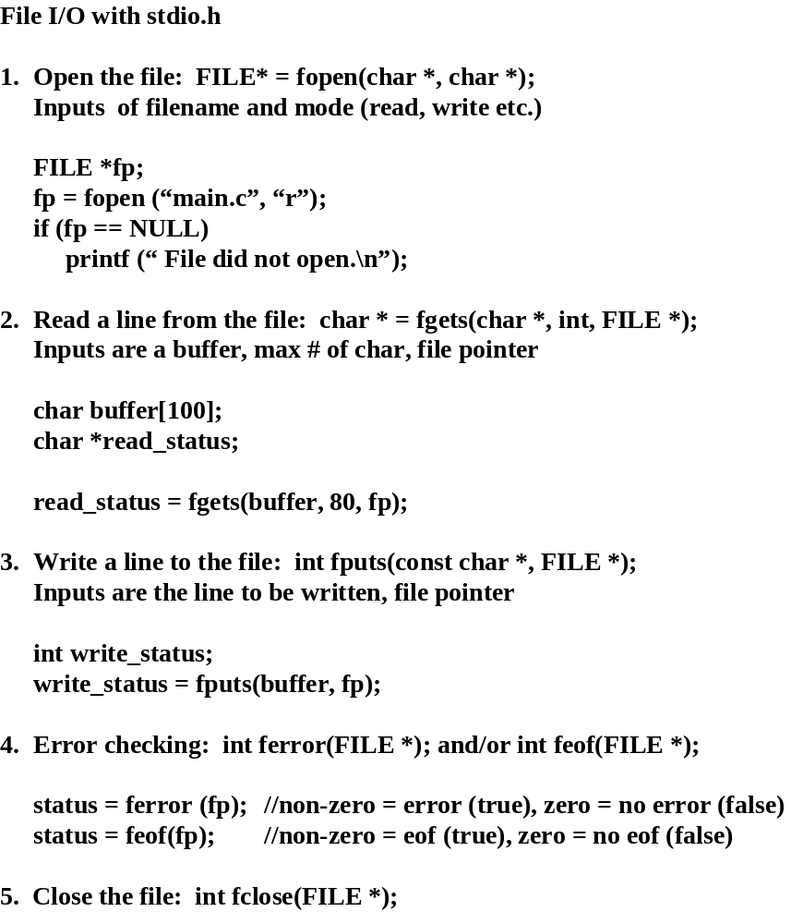

Slide 27
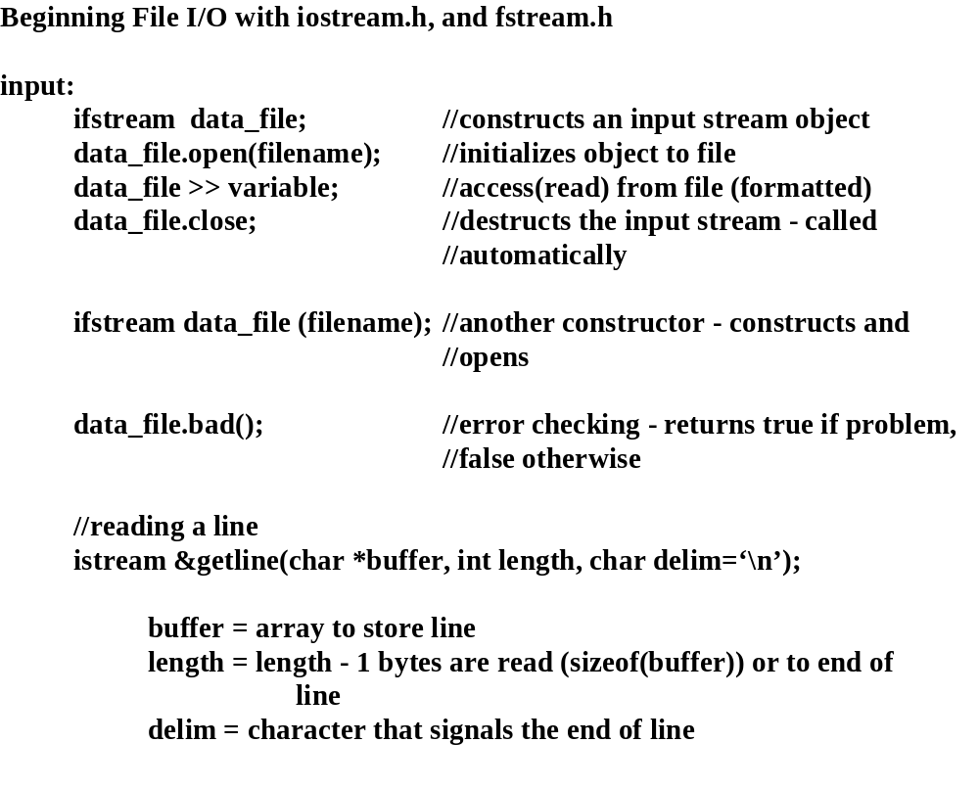

Slide 28
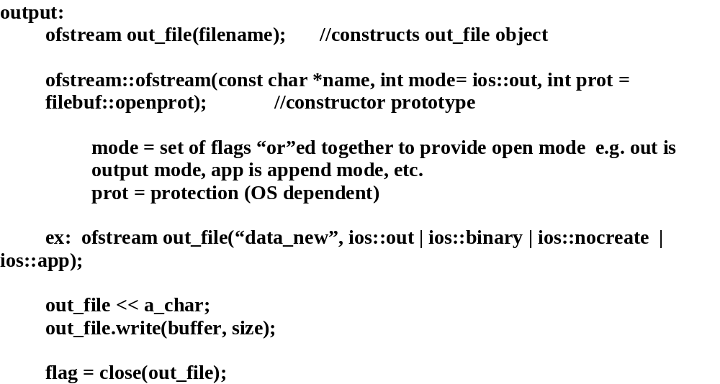

Slide 29
Casting in C++ - page 848 in C++ Primer
in C: variable = (Type) (expression);
//can still be used in C++
ex: (float)3 + 5 // (float(3)) + 5
in C++: variable = type(expression);
//a little less confusing
ex: float(3)+5
Expansion/Replacement in C++:
Static Cast:
variable =
static_cast <Type> (expression);
example viewgraph
Dynamic Cast:
derivedType *ptr = dynamic_cast<derivedType *> (base_pointer);
covered in Polymorphism
Reinterpret Cast:
variable = reinterpret_cast<Type> (expression);
use with
caution and generally for bit manipulation
ex:
//floating point value treated as a binary bit pattern
float number;
unsigned long data_point = reinterpret_cast <unsigned long> (number);

Slide 30
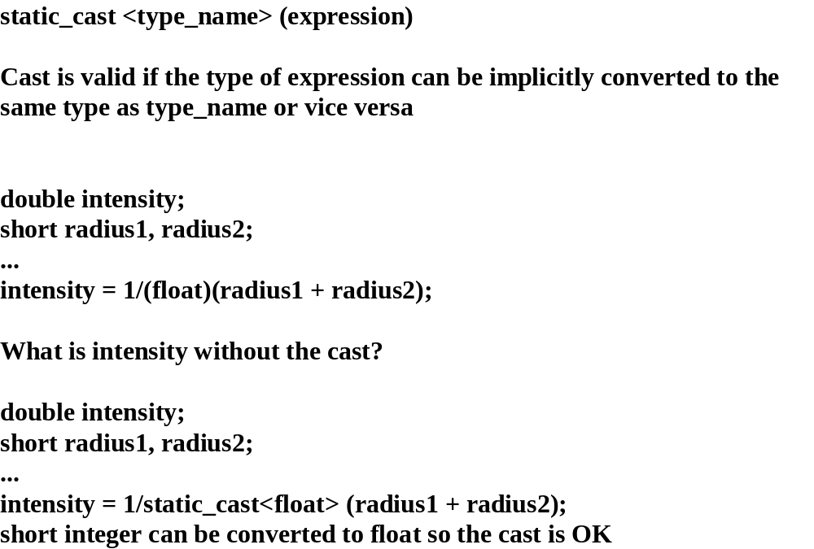
Static Cast Example

Slide 31
Constant Cast: Modify the type of a variable from/to const or volatile data
Variable = const_cast <Type> (constant_data);
Type *pointer = const_cast<Type> (&constant_data); //cannot change the Type
Example:
char *strcpy_special(char *target, const char *source, char
special, Boolean include_flag, unsigned max_char)
{
//copy characters from source to target until a
//special char has been reached, there are no more
//characters, or max_char has been reached
//source is read-only
…
return (const_cast<char *> (source)); //returns a pointer to the char in
//source not yet processed
//return value no longer points to read only data
//return (char *) source; //also compiles
}
Use reinterpret_cast and const_cast carefully to avoid
data corruption.

