Slide 1
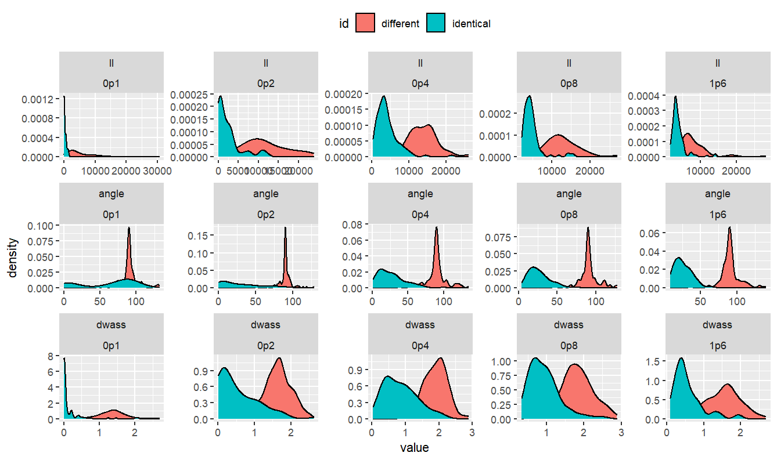
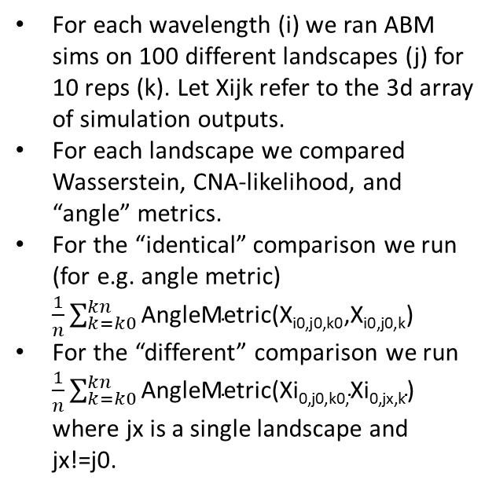
For each wavelength (i) we ran ABM sims on 100 different landscapes (j) for 10 reps (k). Let Xijk refer to the 3d array of simulation outputs.
For each landscape we compared Wasserstein, CNA-likelihood, and “angle” metrics.
For the “identical” comparison we run (for e.g. angle metric) $\frac{1}{n}\sum_{k=k0}^{kn}{\text{AngleMetric}\text{(}\text{Xi}\text{0,}\text{j}\text{0,}\text{k}\text{0,}\text{Xi}\text{0,}\text{j}\text{0,}\text{k}\text{)}}$
For the “different” comparison we run $\frac{1}{n}\sum_{k=k0}^{kn}{\text{AngleMetric}\text{(}\text{Xi}\text{0,}\text{j}\text{0,}\text{k}\text{0,}\text{Xi}\text{0,}\text{jx}\text{,}\text{k}\text{)}}$ where jx is a single landscape and jx!=j0.
The results show that each metric can be used to distinguish between true landscapes vs random landscapes. It looks like Wasserstein metric performs best for short wavelengths and angle metric does best for long wavelengths.

Slide 2
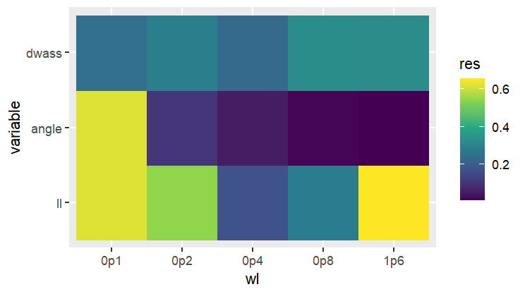
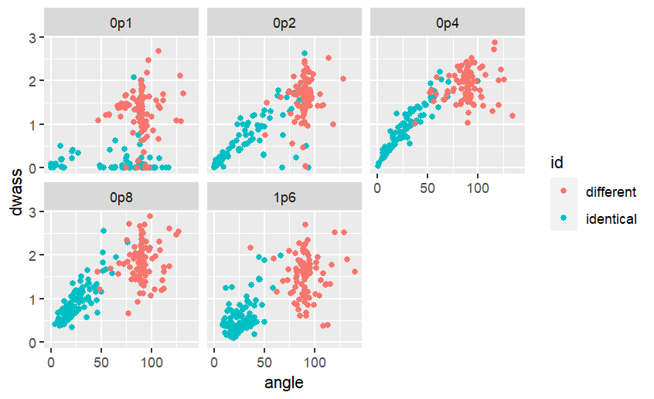
The heatmap summarizes the results from before (it integrates the product of the smoothed distributions in the previous slide), lower values indicated better performance.
If we make 2d scatter plots of the Wasserstein and angle metrics, we get very good separation. This indicates that the combination of these two metrics will help make good decisions about landscape accuracy.
One thing to note is that these results are probably sensitive to the length of time the ABM is run, as well as the landscape. For example the Wasserstein distance is clearly smaller for the shorter wavelengths vs longer ones.
Another thing is that here we do a comparison between identical wavelengths. In reality we wouldn’t know the wavelength so perhaps we are being unfair on ourself.
Next steps are to design a protocol that can effectively decide for a given landscape/data whether there is a good match.

Slide 3
Planned matching scheme
NB if we have two competing landscapes the decision is easy – simply which has the lowest score on (which metric? Maybe not so easy…). The following assumes we have fitted a landscape and we want to know is it good yes/no.
Run N reps of ABM using fitted landscape.
Run N reps of ABM using random landscapes

