Slide 1
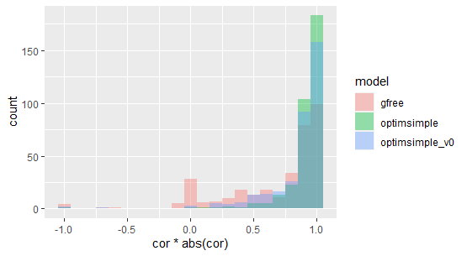
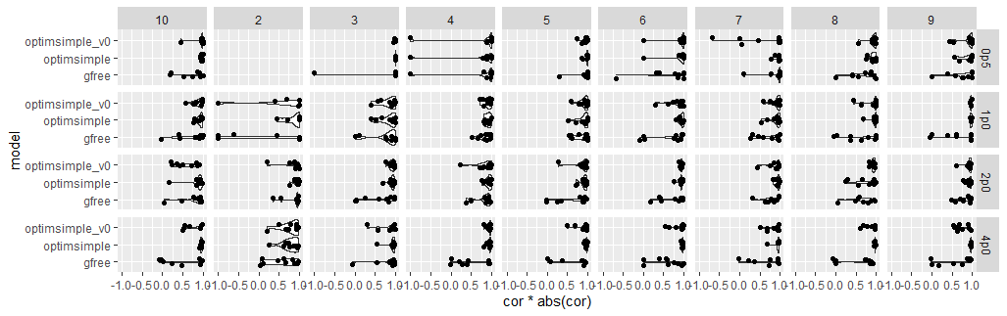
Results of different methods for predicting fitness of frequent clones.
Gfree is the method that doesn’t require growth data.
It is outperformed by methods that use growth data
I updated the method that uses growth data to be simpler to explain and the updated method works better

Slide 2
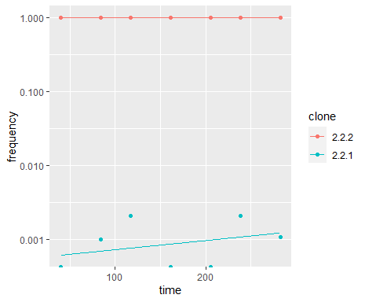
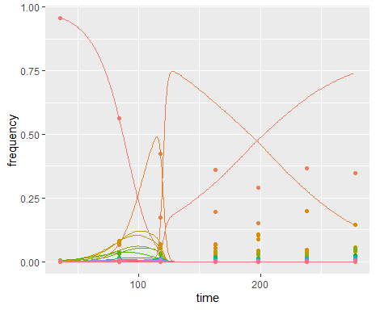
When the method without growth data fails it often does so for obvious reasons so it might stand to be improved
Here it looks like 221 is outcompeting 222 but it’s just random. Leads to a negative R2.
Here the optimization simply failed.

Slide 3
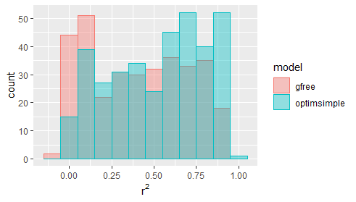
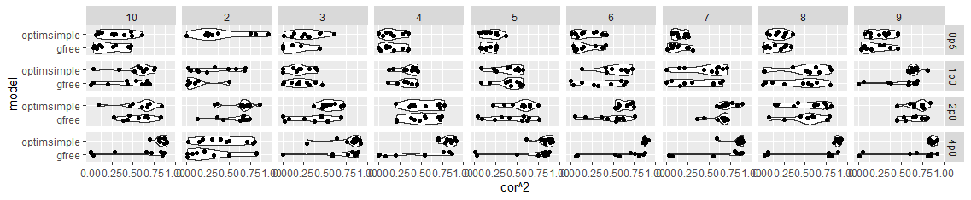
Results of predicting fitness of nearest neighbours of observed clones
Note that the predictions get better for simpler landscapes (different rows)
Errors from prior steps propagate through. Again growth data free method results could be improved by improving first step or simply screening out the times where it obviously failed.

Slide 4
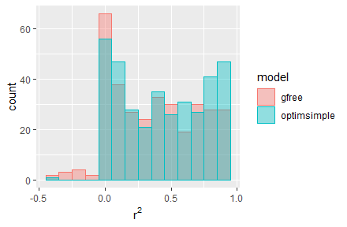
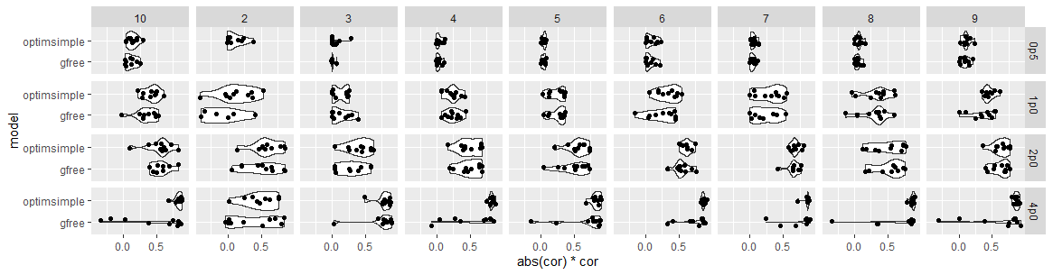
Results of predicting fitness at distance of +2 away from observed clones.
Note that for the roughest landscape the predictive value is basically zero which is expected.
For the simplest landscape & the method with growth data the r2 is close to one.

Slide 5
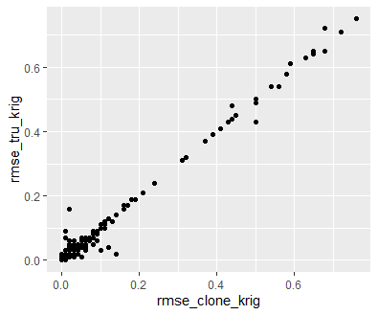
Validating the landscape
I think the previous idea of using the ability to predict population evolution to evaluate the accuracy of a landscape is not effective, particularly when there are low numbers of parallel evolution replicates. E.g. consider problems when we have an initially diploid cell evolving on a fitness landscape with a symmetric peak centred on exact triploid configuration… alternative approach:
Leave out some of the frequently observed clones from the entire optimization procedure
Try and predict their fitness using the landscape
Go back to step one and predict the clone fitness from the data.
If the landscape and direct estimates of fitness match up, we will say the landscape is predictive.
Figure shows a comparison of RMSE between landscape estimate and direct data estimate for clones (x axis) vs RMSE between ground truth and landscape estimate.

