Slide 1
Sales Data Forecasting Based on Prophet Time Series Model
Wei Chi
14 May 2025

Slide 2
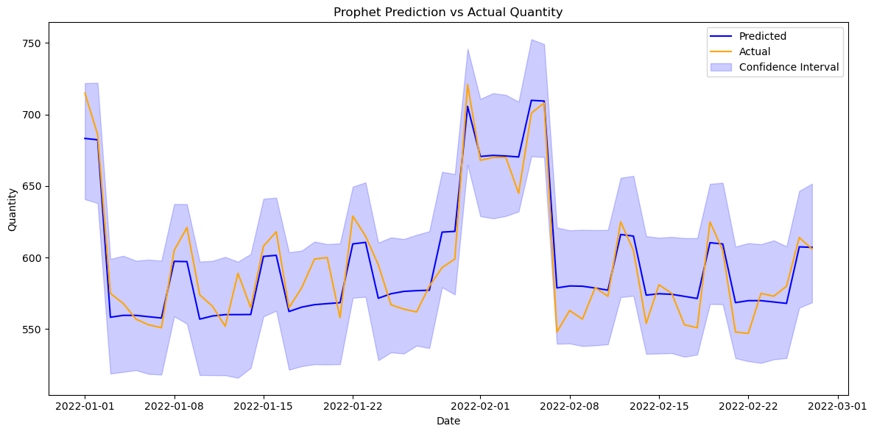
Forecasting MAPE: 0.0211 (2.11%)

Slide 3
Outline
Data Cleaning
Data Insight
The Prophet Model
SQL test

Slide 4
Data Cleaning
calendar_date Column:
Incorrect Format
Invalid Dates
Missing Values
day_of_week Column:
Incorrect Range
Missing Values
holiday Column:
Inconsistent
Holidays Not Matching
quantity Column:
Non-Numeric Values
Negative Values
Extreme Values
Missing Values

Slide 5
Data Cleaning
calendar_date Column: no problem
day_of_week Column: no problem
holiday Column: matplotlib
quantity Column: outlier detection using IQR

Slide 6
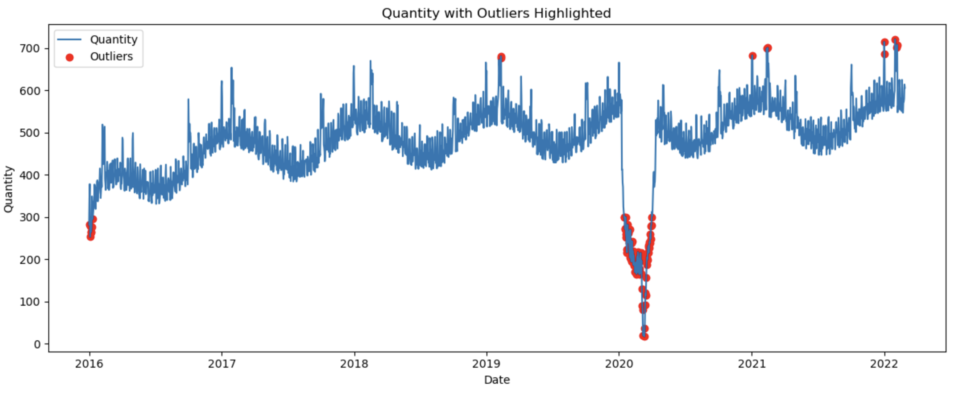
Data Cleaning
quantity Column:

Slide 7
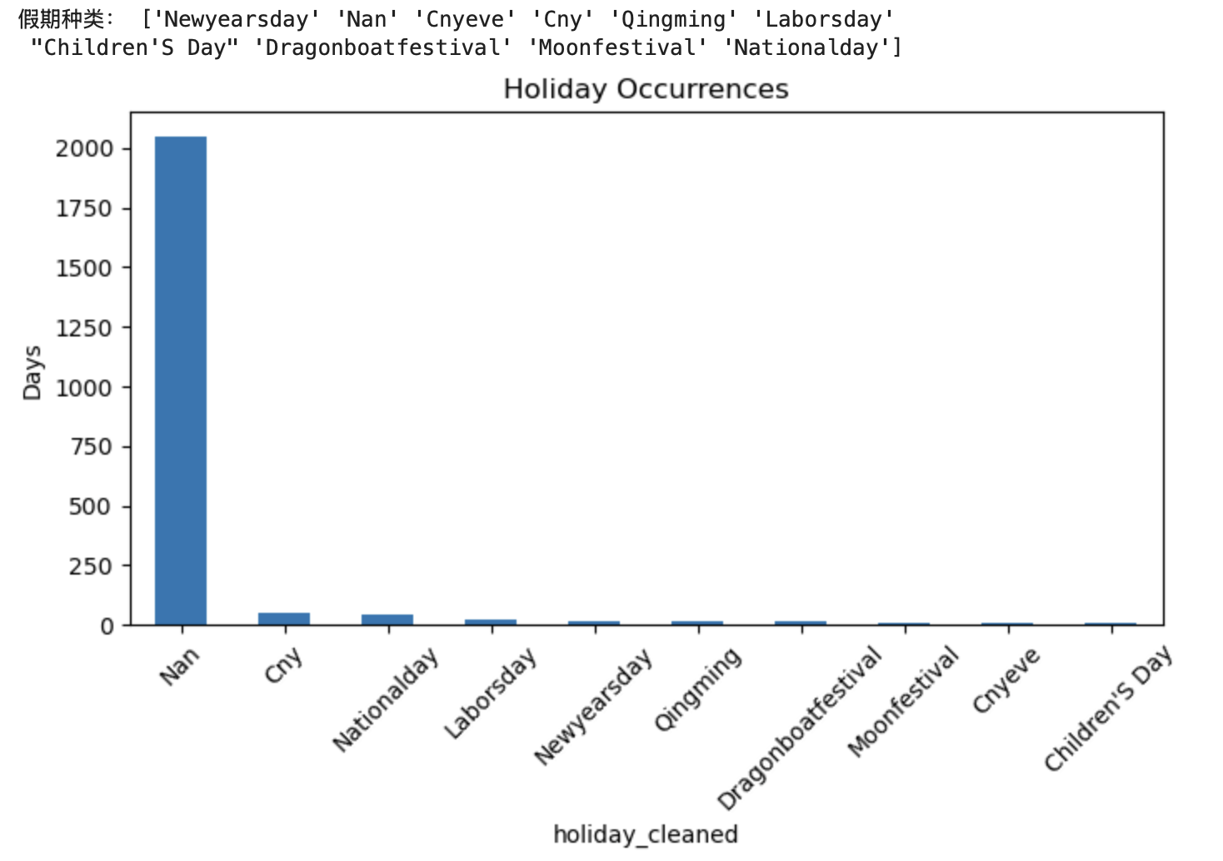
Data Cleaning
holiday Column:

Slide 8
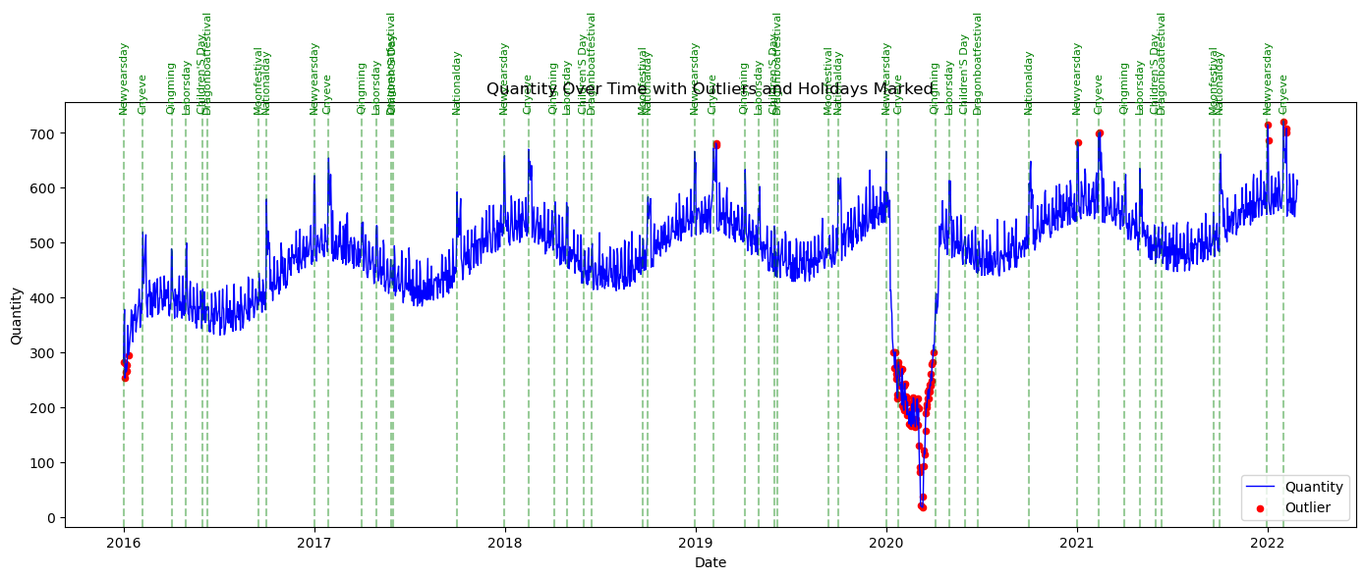
Data Insight:
holiday Column & Outlier quantity :

Slide 9
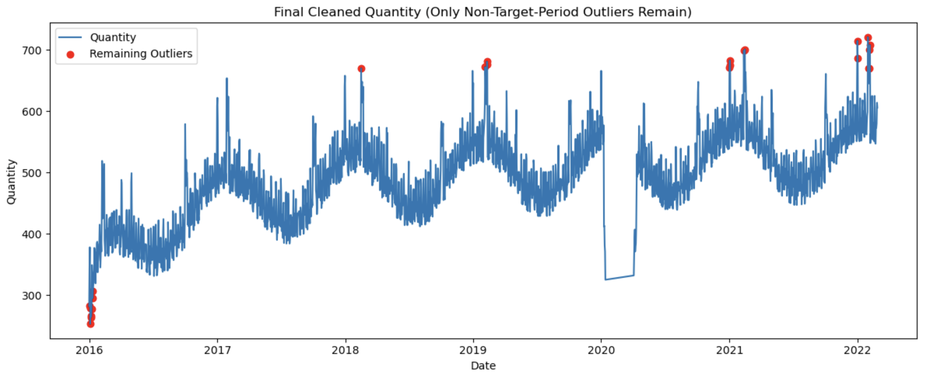
Data Cleaning
holiday Column:

Slide 10
The Prophet Model
The Prophet Model = Trend + Seasonality + Holiday
Why is it useful?
You can customize holidays and special events
It automatically handles missing data and outliers
It works well with daily, weekly, or monthly data
Easy to use, even with limited data science experience

Slide 11
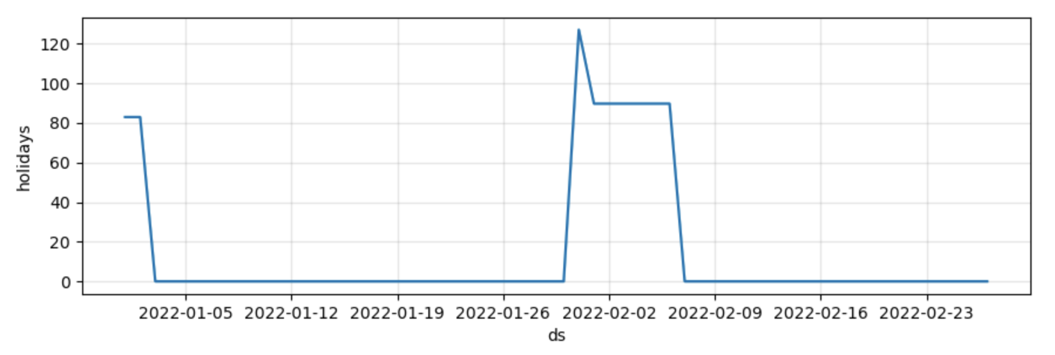
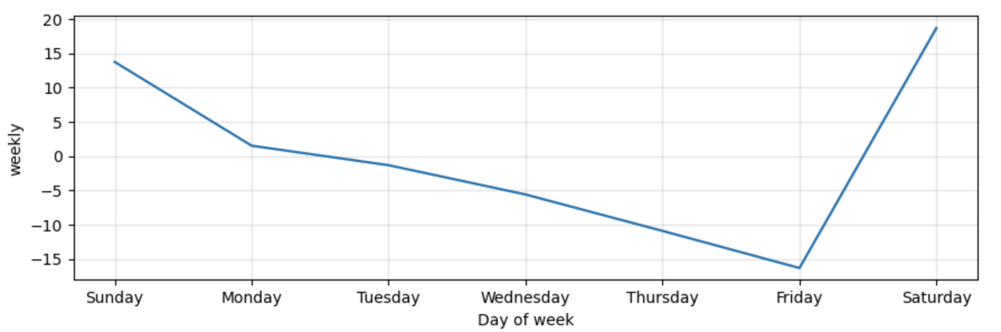
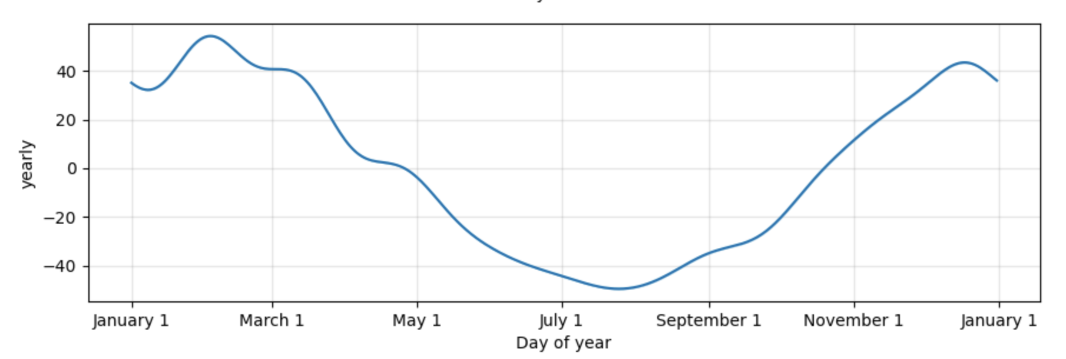
The Prophet Model = Trend + Seasonality + Holiday

Slide 12
Forecasting MAPE: 0.0211 (2.11%)

Slide 13
Forecasting daily sales for March-May 2022
Well… we all know what happened in Shanghai during 2022 March to May… It was a sad story…
Add the covid influence into the model like it was in the 2020
Add the holiday and the day_of_week data to the model

Slide 14
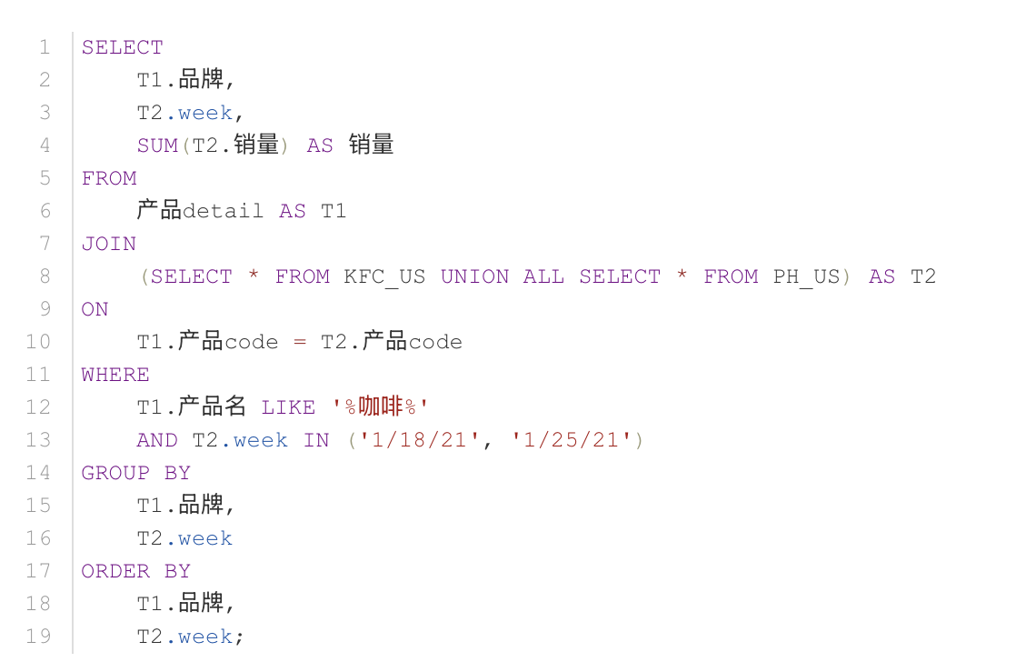
SQL test

