Slide 1
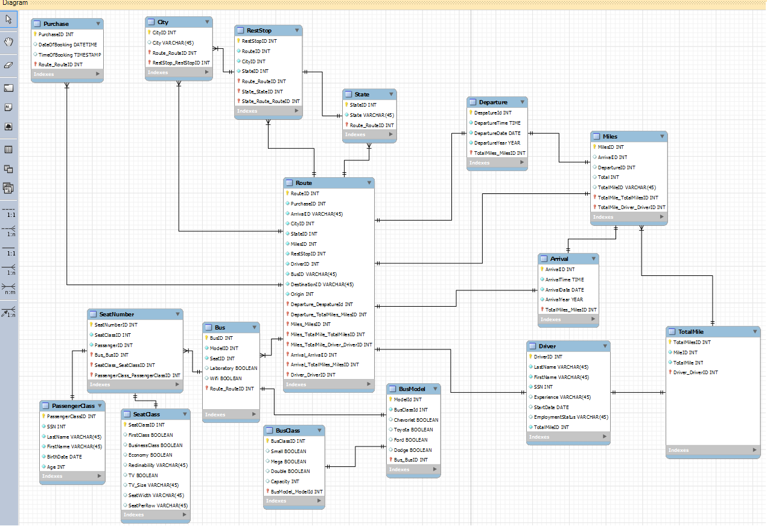

Slide 2
Does the bus going from Fort Lauderdale, FL (FLL) to Jacksonville, FL (JAX) have wifi and a bathroom?

Slide 3
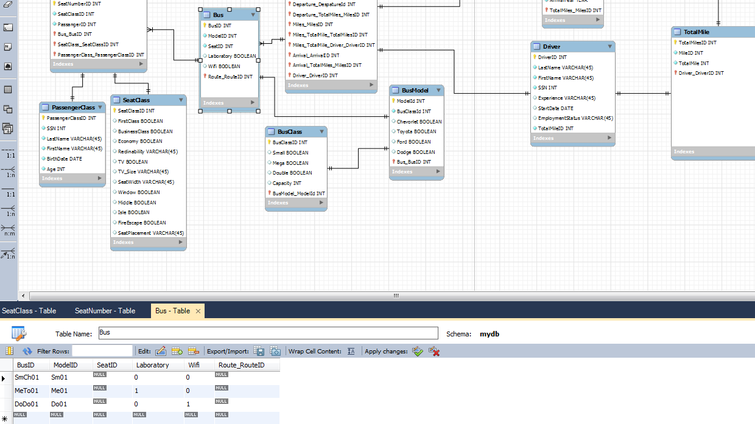

Slide 4
How many aisle seats does the bus going from Miami, FL (MIA) to Naples, FL (APF)

Slide 5
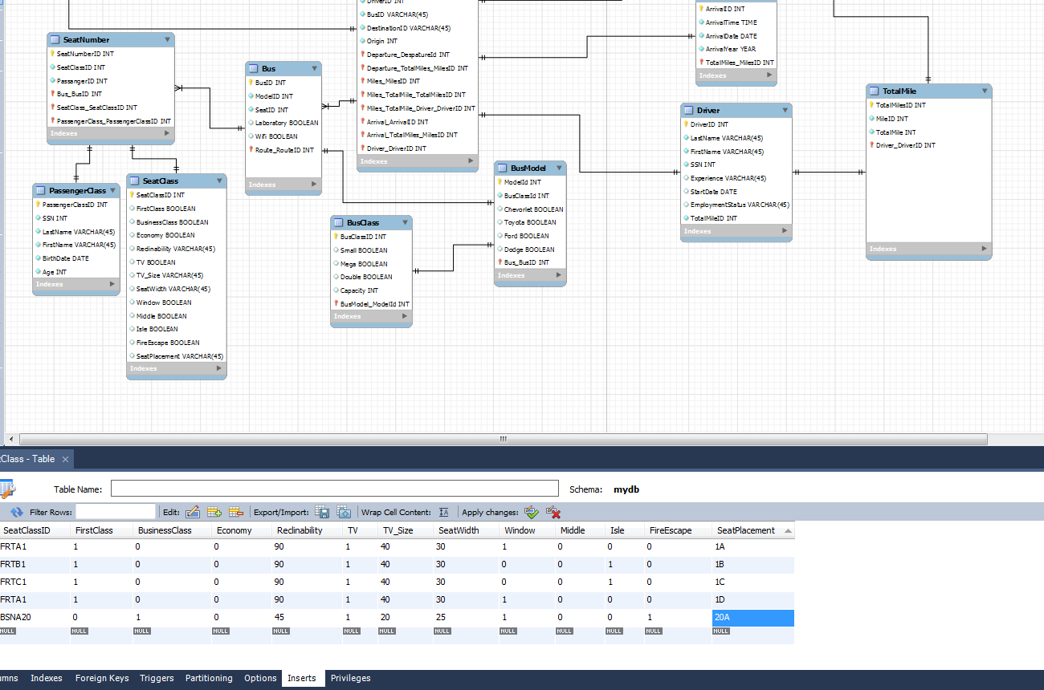

Slide 6
What’s is Scenic Route’s most busiest time of year?

Slide 7
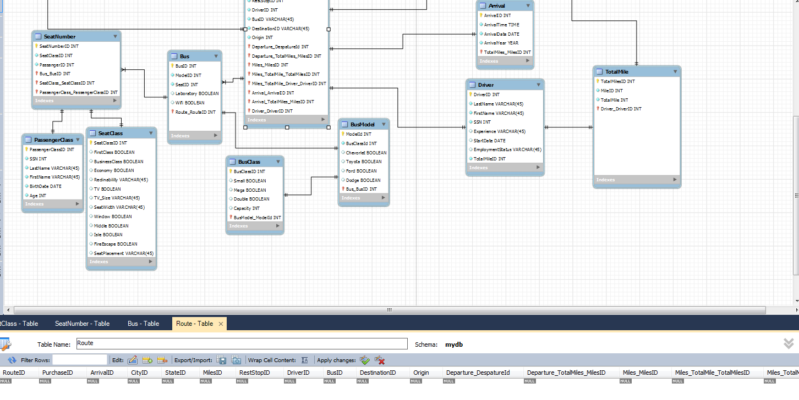

Slide 8
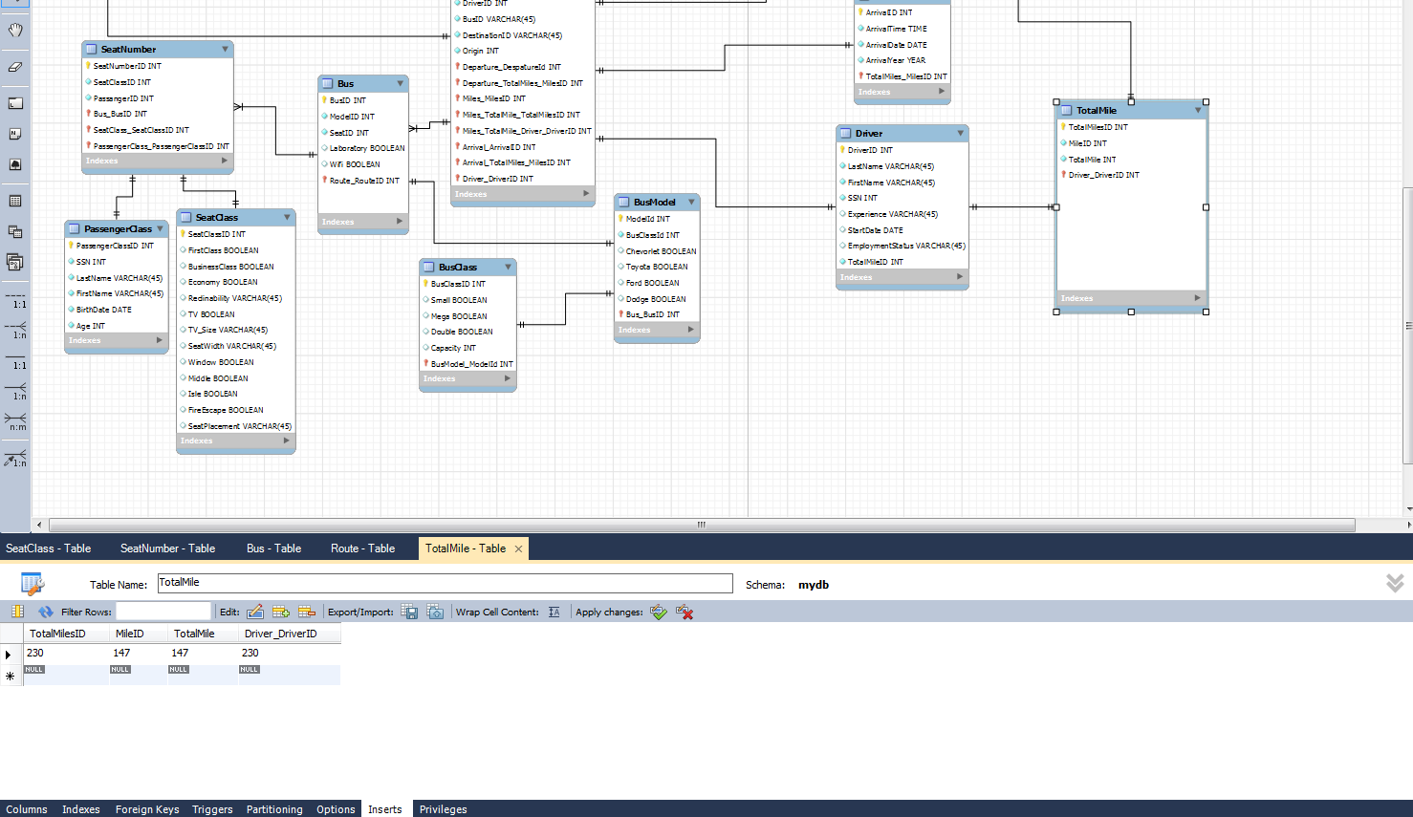
Which driver drove the most miles in 2013?

