Slide 1
Weekly Progress Report (07/28)
Topic：(Pending)
Name：徐銘亨 (Richard)
Teacher：鄭瑞光 (Ray)

Slide 2
Outline
1、Recently work -> Replicate Tobby’s experiment
-> Reach out to TEEP David and time schedule
2、Pending work -> Determine my topic on energy saving

Slide 3
Replicate Tobby’s experiment

Slide 4
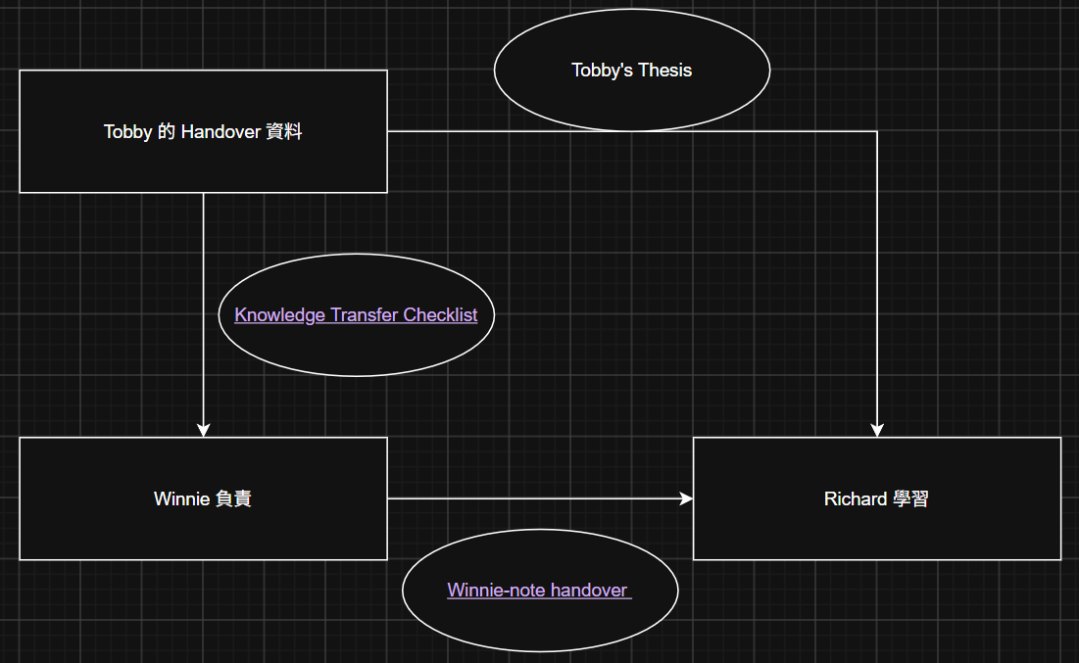
Replicate Tobby’s experiment - 1

Slide 5
Replicate Tobby’s experiment - 2
Winnie note - handover | Why
Clone Tobby’s repository | Generate the experiment graph Private access requires Git to download
Environment Installation | Installing the Python extension in VS Code doesn't mean the system can run Python. Version problem cause to bugs
Check the cloned repository | Clarify the path 99% of the work is in Data_modeling
Check access to the lab network | VAIVA simulator isn’t a public website. It requires the internal lab network.

Slide 6
Replicate Tobby’s experiment - 3
Problem | Solution
Locate the file path | cd, ls , dir ... Turn to AI for help
Link to VAIVA | 1、Check whether VAIVA is alive. -> ping 192.168.8.28 2、VPN or SSH
Internal Internet | Turn to Joshevan for help Get a file (This is yours. Never share it with others.) , Download WireGuard
Check the VAIVA timetable | Turn to Tobby for help.

Slide 7
Replicate Tobby’s experiment - 4
1、According to Tobby’s “Readme”, Start running the experiment 1 -> Fix some bugs
-> Check the timetable
-> Stop the program if necessary
-> Compare with the expected result

Slide 8
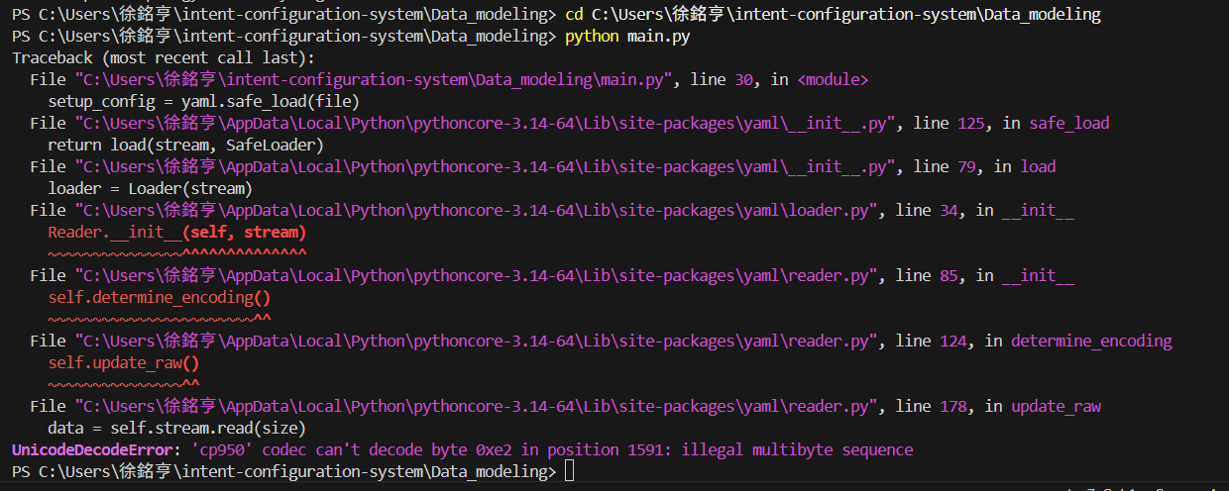
Replicate Tobby’s experiment - 5
1、UnicodeDecodeError
-> This was caused by a Chinese path.

Slide 9
Replicate Tobby’s experiment - 6
2、Fix UnicodeDecodeError
-> Open main.py by IDE
-> In option manu, select “view the line”
-> Fix the code to the line.

Slide 10
Replicate Tobby’s experiment - 7
Original
with open('config/config.yaml') as file:
setup_config = yaml.safe_load(file)
adjusted
with open('config/config.yaml', encoding='utf-8') as file:
setup_config = yaml.safe_load(file)

Slide 11
Replicate Tobby’s experiment - 8
1、Check timetable
-> At the same time, only one person can use the simulator
-> When encountering bugs, stop the program in the terminal (Ctrl +C), then the environment will be reset, which prevent all
events from entering a loop.

Slide 12
Replicate Tobby’s experiment - 9
1、compare the result (same_area_uniform)
-> I can’t view the picture through VS code, so open in folder directly -> Compare the file name carefully
-> Understand the meaning of the result

Slide 13
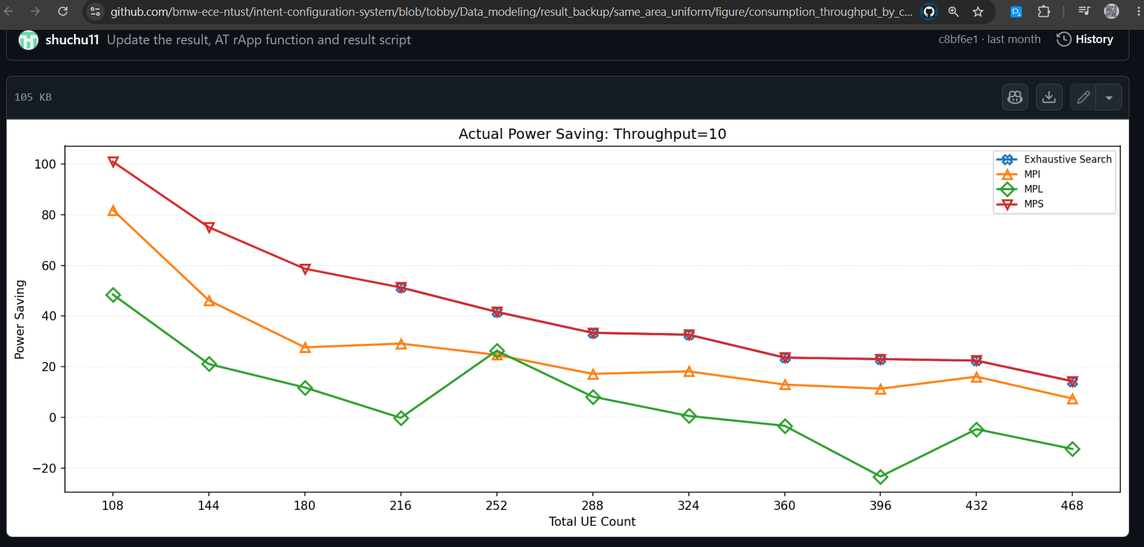
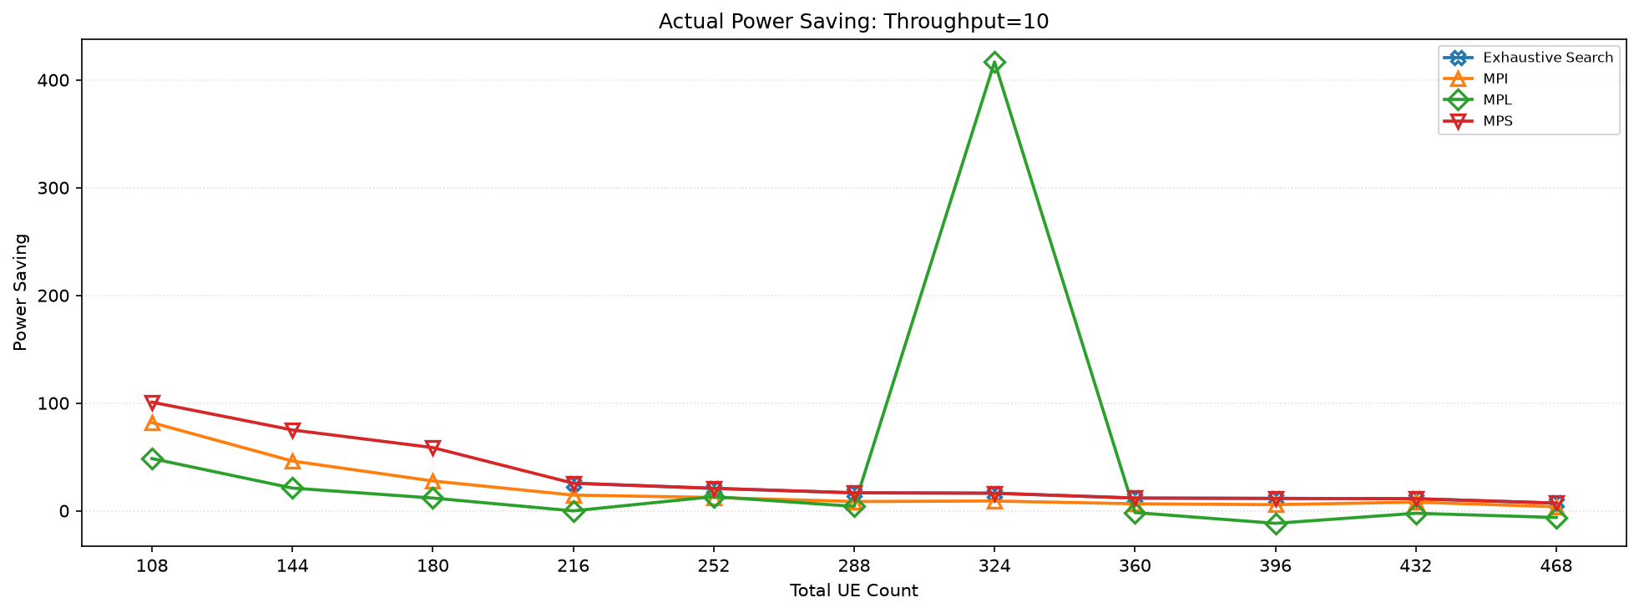
Replicate Tobby’s experiment - 10
Expected
Mine

Slide 14
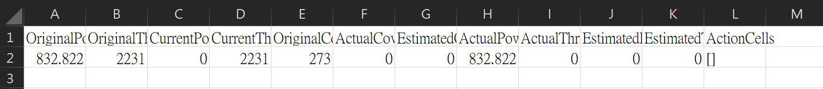
Replicate Tobby’s experiment - 11
2、Explain the abnormal result (same_area_uniform) -> Experiment I (strategyTestMode: True), verify the algorithm
-> The abnormal power-saving value was caused by missing
InfluxDB power data (CurrentPower = 0)

Slide 15
Replicate Tobby’s experiment - 12
1、compare the result (PMdiff_uniform)
-> I can’t view the picture through VS code, so open in folder directly -> Compare the file name carefully
-> Understand the meaning of the result

Slide 16
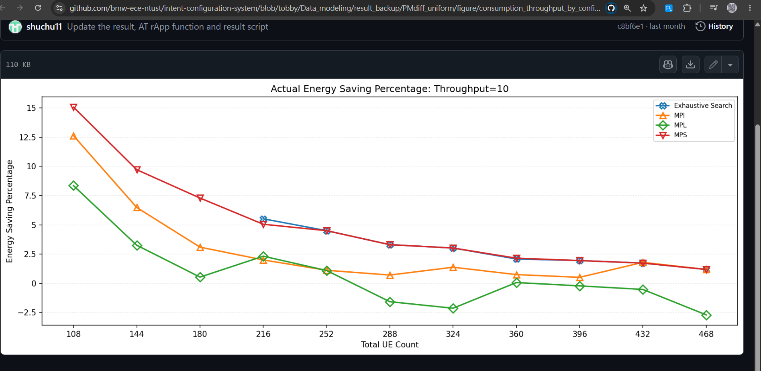
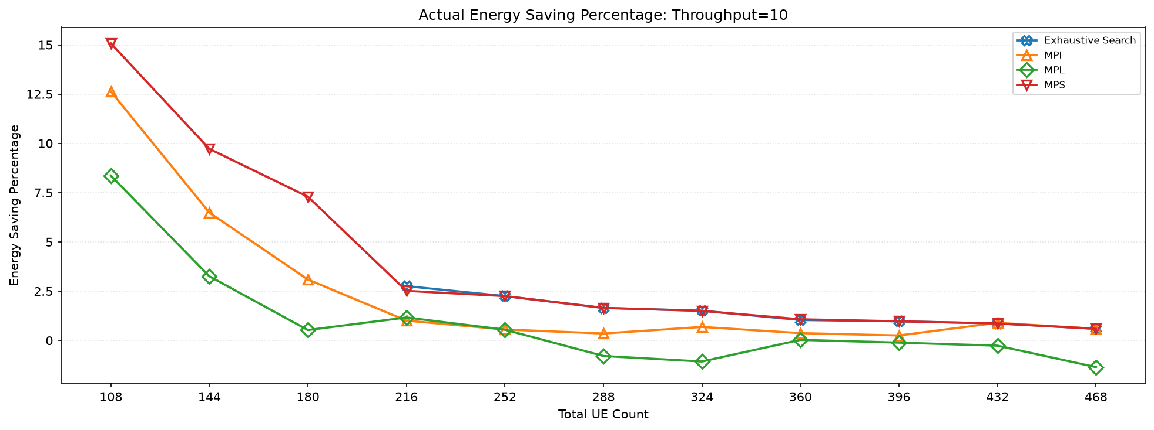
Replicate Tobby’s experiment - 13
Expected
Mine

Slide 17
Replicate Tobby’s experiment - 14
2、Explain the result(PMdiff_uniform) -> The trend is identical to expected result, some slightly
differences are caused by the the simulator's randomness
-> The “uniform” means each UE’s power consumption is the same,
the independent variable is the area.
-> The former is UEs in the same area, the latter is UEs in different area.

Slide 18
Replicate Tobby’s experiment - 15
1、Next step
-> Timetable is reserved by the seniors
-> The simulation takes a lot of time (about 5hrs in generating data)
-> Reference Tobby’s result and draw conclusions directly, as
background knowledge

Slide 19
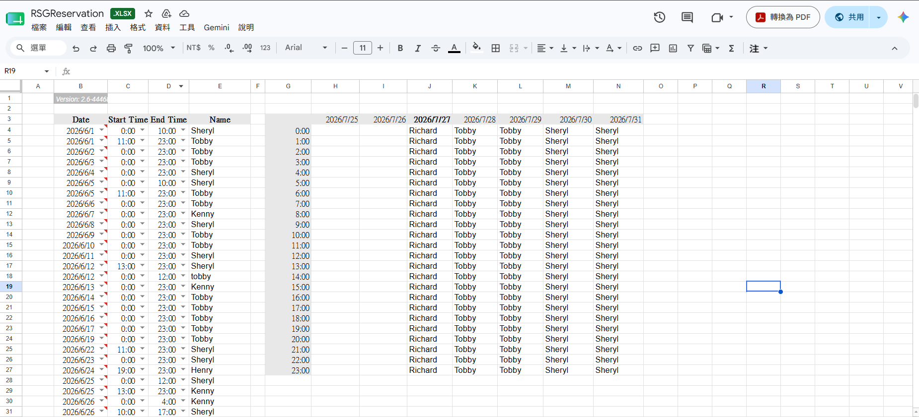
Replicate Tobby’s experiment - 16
1、Timetable is reserved by the seniors

Slide 20
Reach out to TEEP David Time schedule
and

Slide 21
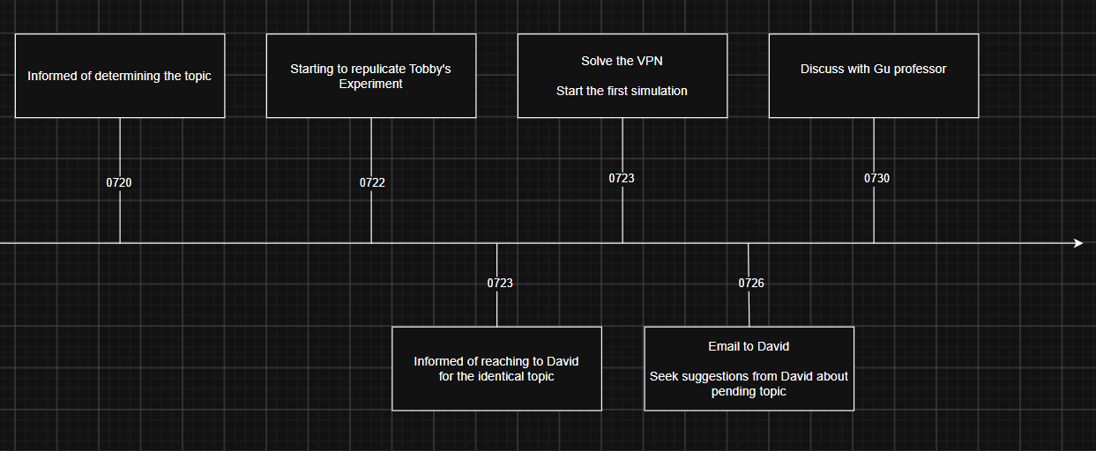

Slide 22
Pending works

Slide 23
Pending works
-> This organization comes from my Git.
Priority | Things | Impact | Plan
0 | Reading David StudyNotes | The clarity of the topic -> the progress after the new semester | Like replicating Tobby's experiment, use same approach to learn on it
1 | Do the StudyNotes on github | Check my progress | Post it firstly, Check its quality afterwards
2 | progress after the new semester | My GPA and future opportunities | Finish David's StudyNotes first
3 | Lab architecture | Resources | Review the files in LINE or talk with the seniors
1 | Discuss with prof. Gu | The clarity of the topic and future opportunities | Finish David Studynotes first so that I really understand what I need to do
3 | Take course | Future opportunities | Wait for the notice in August on LINE group

