Slide 1
Self-Introduction (07/30)
Topic：(Pending)
Name：徐銘亨 (Richard)
Teacher：鄭瑞光 (Ray)

Slide 2
Outline
1、How to contact me
2、What course I token
3、What I get about the lab

Slide 3
How to contact me

Slide 4
How to contact me
1、Gmail：richardjay0307@gmail.com
2、LINE
-> ID ：2005030764
-> Phone number：0972-488-764
3、git：https://github.com/Richard-NTUST/Researching-Material.git
-> update here
-> all report slides also in here

Slide 5
What course I token

Slide 6
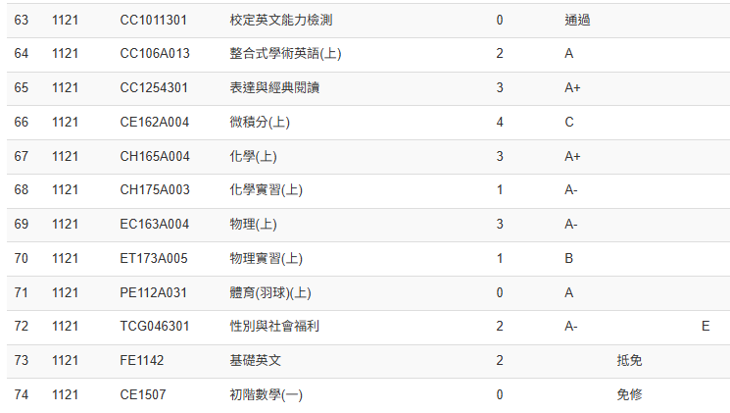
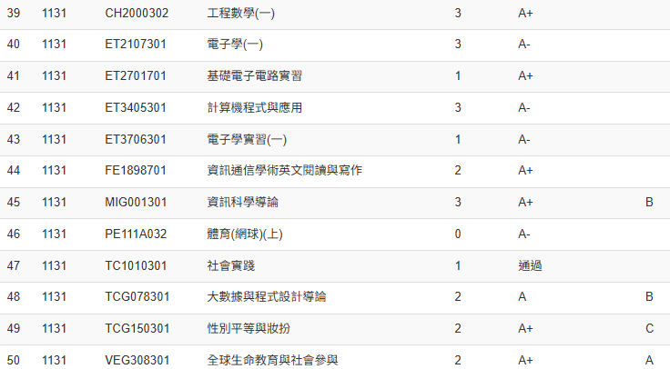
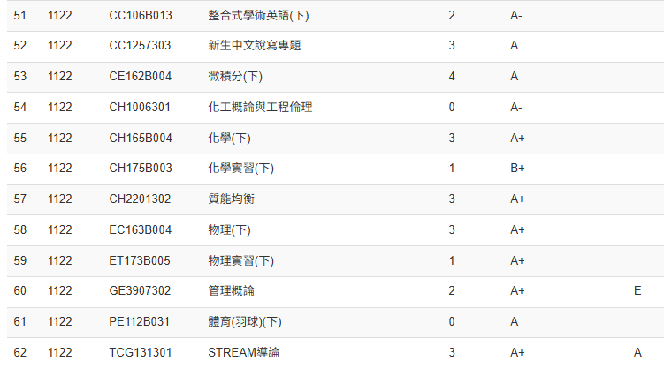
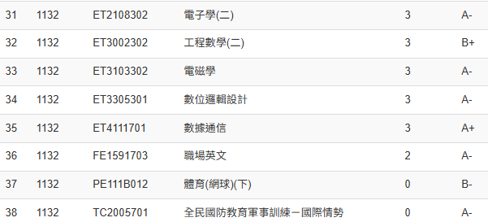
What course I token-1

Slide 7
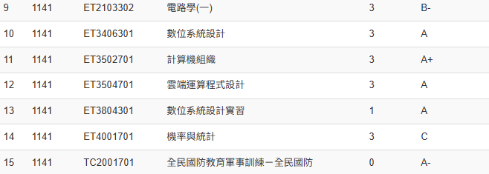
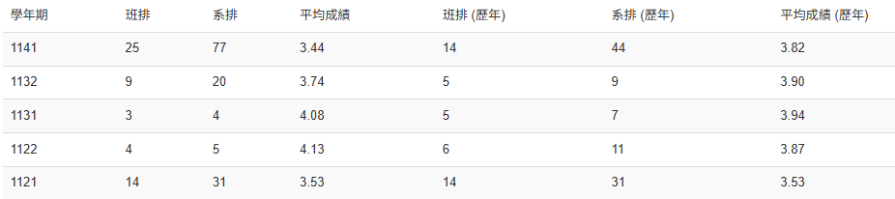
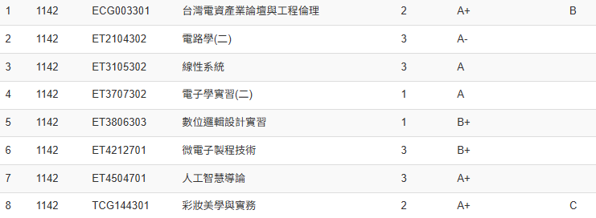
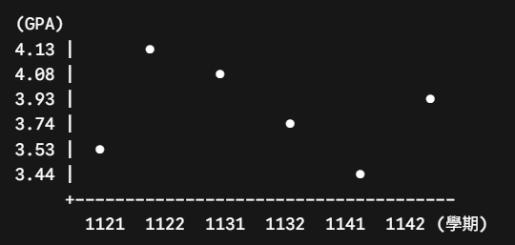
What course I token-2

Slide 8
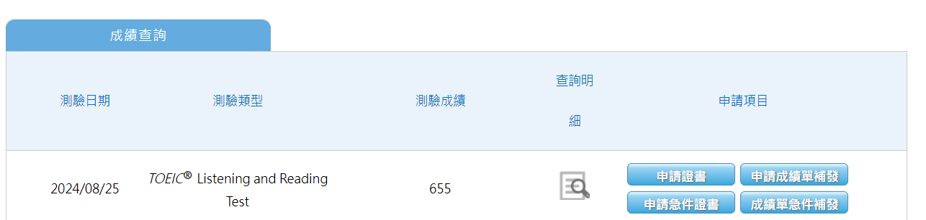
What course I token-3

Slide 9
What I get about the lab

Slide 10
What I get about the lab
1、Who is responsible for the VPN -> Joshevan
2、Who is responsible for the meeting links -> Will
3、How to put your progress -> following the SOP
4、How to draw the flowchart -> draw.io
5、How to start my topic -> refer to TEEP David notes

