Slide 1
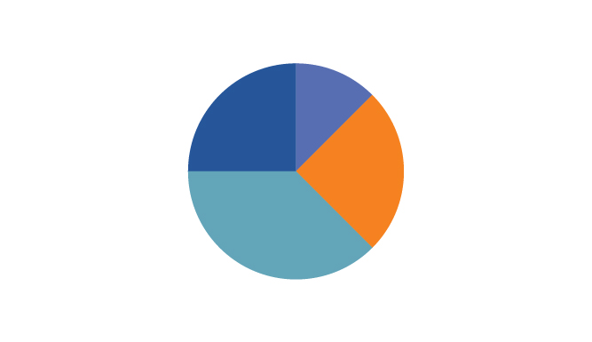

The Py-Charts
By Fares Kazemi, Edbert Widjaja, Grant Towers, Richard Turnbull

Slide 2

DISCLAIMER
The Py-Charts are not financial professionals and are not aware of your personal financial circumstances.
The following content is informational only and based on information when created. This is not tax or legal advice. Before making any financial decisions you should read the Product Disclosure Statement (PDS) and if necessary consult your licensed professional.
Notes:
Fares

Slide 3
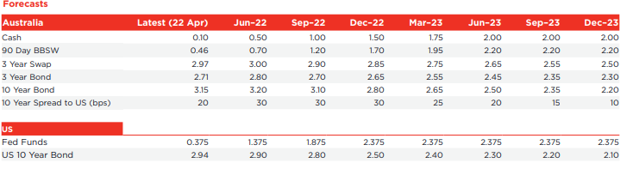
Cash Rate Status and Forecast
Rates stayed at 0.1% for extended period between 2020-2022.
This Tuesday - BANG! It Happened… Increase of 0.25% (for us, the start of peak 6…)
Future estimate data (WestPac Economics) estimates growth over the next two years - up to 2.00% as of Jun-2023.
Source: https://www.westpac.com.au/docs/pdf/aw/economics-research/WestpacWeekly.pdf
Notes:
Grant

Slide 4

Samuel is concerned about interest rates and the ASX - He thinks he should sell all of his shares…
What do you think?
We have analysed this, so you don’t have to….
Notes:
Grant

Slide 5
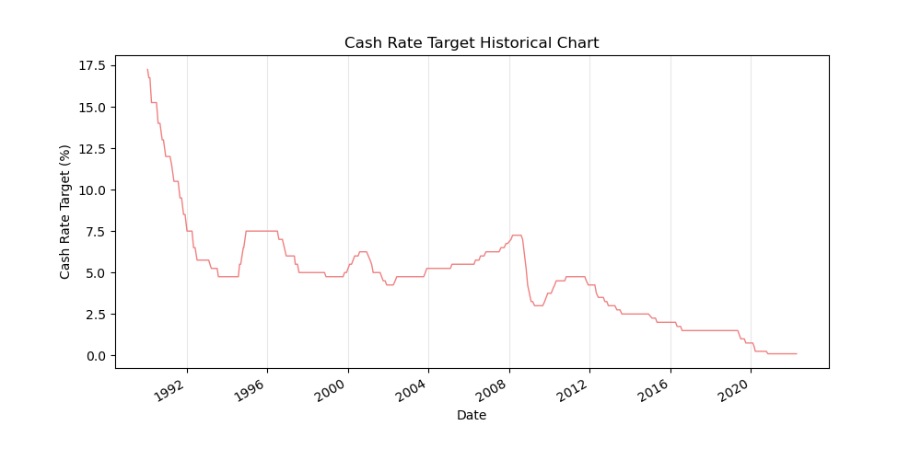
So what did we want to ask?
Objectives/Aims:
Our aim was to identify time periods where interest rates had been steady (at a low point), then increase over time.
We would then correlate the ASX200 percentage changes between set time periods (30, 60, 90, 120, 150 and 180 days after the initial rate change).
Using this correlation, we believe that we can PREDICT the ASX200 rates, for the recent rate rise (this Tuesday…).
Most importantly, earn us all some $.
Hypothesis:
There is correlation between the interest rates starting to increase and then the subsequent ASX market response.
Notes:
GRANT

Slide 6
Periods Analysed
Our group analysed 5 periods in Australian history, which matched our criteria - where the Cash target rate increased after a decrease
1994-07-26
1999-10-05
2006-04-04
2007-07-03 (GFC)
2009-09-02
Notes:
GRANT

Slide 7
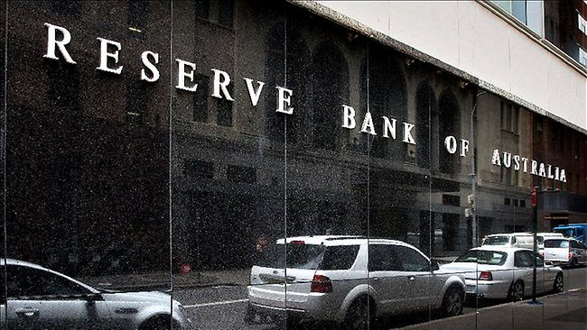
Interest Rates & The RBA
Target rate is a borrowing rate artificially set through Monetary Policy decisions, which are set by Central Banks worldwide.
The central bank within Australia responsible for changing rates is the Reserve Bank of Australia (RBA)
Notes:
Fares

Slide 8

Why Change them ?
Why does the RBA cut interest rates when the economy begins to struggle—or raise them when the economy is booming? The theory is that by cutting rates, borrowing costs decrease, and this prompts businesses to take out loans to hire more people and expand production.
The logic works in reverse when the economy is Hot and expanding too fast (Inflation exceeds sustainable levels), the RBA will in this case move to increase rates.
Notes:
Fares

Slide 9
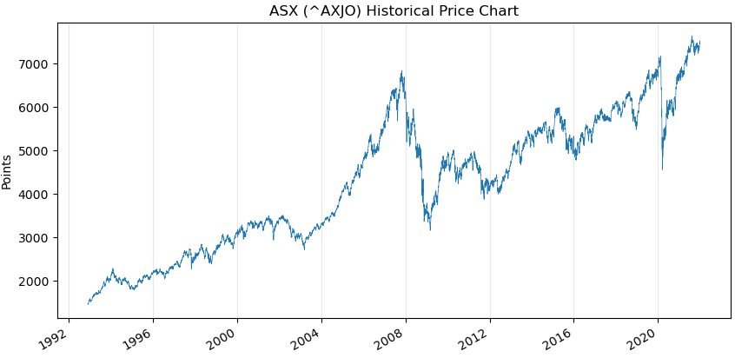
A history of the ASX 200 Index
Notes:
Richard

Slide 10
A history of the Cash Rate Target (Interest Rate)
Highest Rate = 17.5% (Jan-90)
GFC
COVID-19
Notes:
Richard

Slide 11
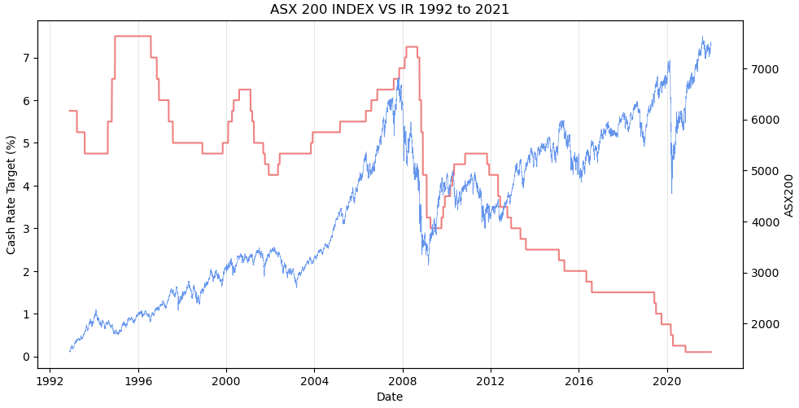
ASX 200 Index and Cash Rate Target
Note: Cash Rate (Left Axis) and ASX
Notes:
Richard

Slide 12
Overview of Data Collection and Analysis…
Jupyter Notebook (Share Screen)
Notes:
ED
Get all the relevant data: Interest rate data from RBA and Historical stock Price from an API or Module. In our case we used Pandas datareader which source the data from Yahoo.
Split the data on our chose dates and what timepoint from the dates we want to see -> put into a list
Using for loops, populate the data based on above points and store in a dataframe
Using groupby we group the data by peaks and store all first and last data from each corresponding peaks
From the lists we got from previous step, we splice the interest rate data for each peaks and its corresponding timepoint.
Do the same except for the ASX data and save dataframe as csv.
For each peak dataframe, are put into a list for analysis later.
We then populate the the peaks dataframe with ASX prices at each of the corresponding timepoint dates. Using try and except to make sure that we don’t get any errors where market is close on public holidays.
Run a function to populate the percentage difference from timepoint 0 (dates chosen) and each time points
Plot
Using previous list -> create multiple plots
Use linear regression model to correlate timepoint and percentage difference
Store dataset and format for readability

Slide 13
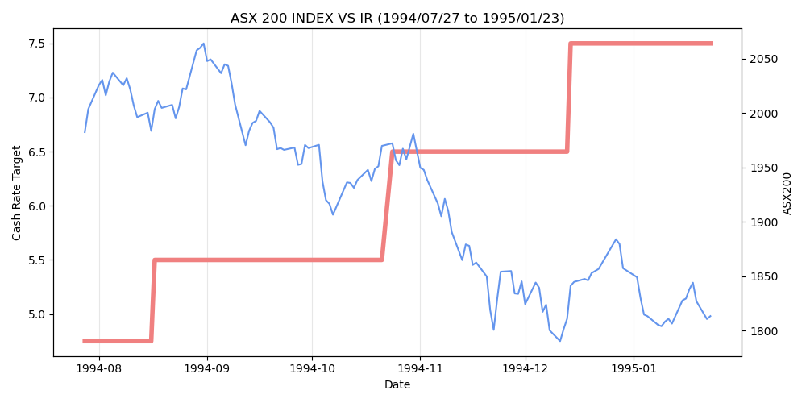
Rate Increase - Jul-94
Notes:
Richard

Slide 14
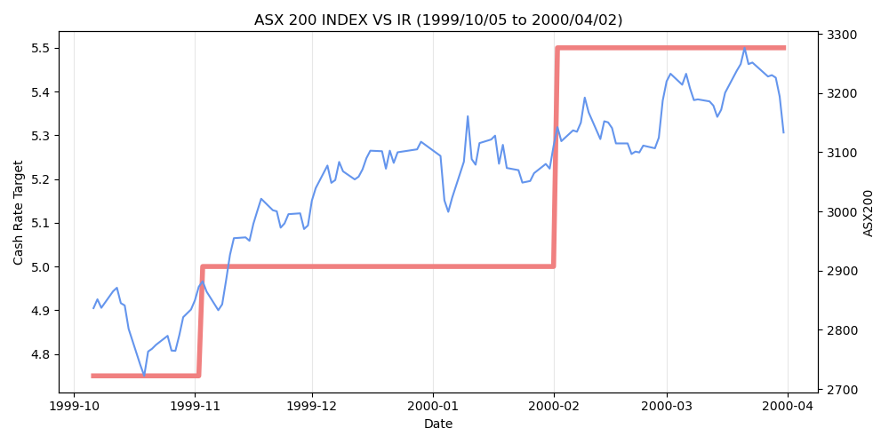
Rate Increase - Oct-99
Notes:
Richard

Slide 15
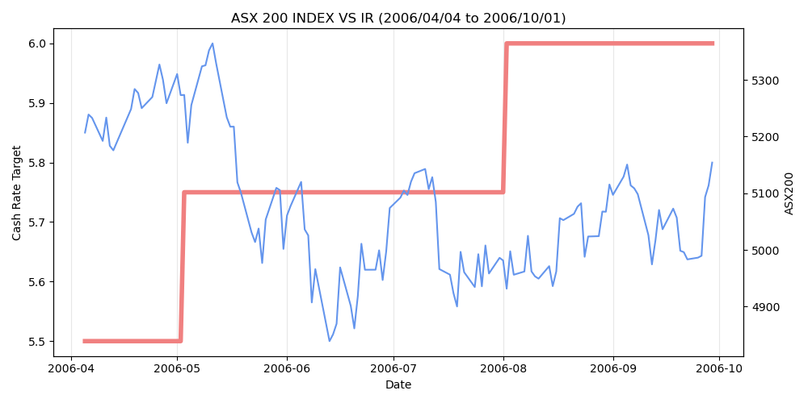
Rate Increase - Apr-06
Notes:
Richard

Slide 16
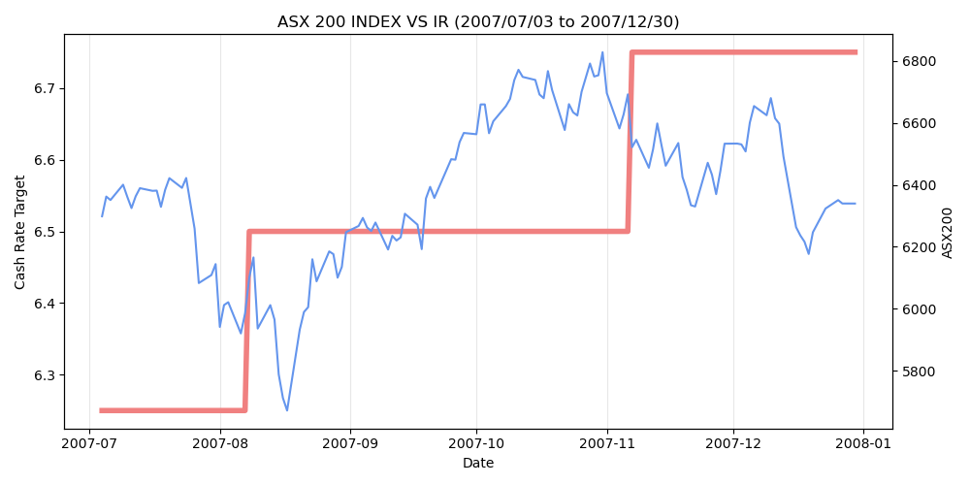
Rate Increase - Jul-07
Notes:
richard

Slide 17
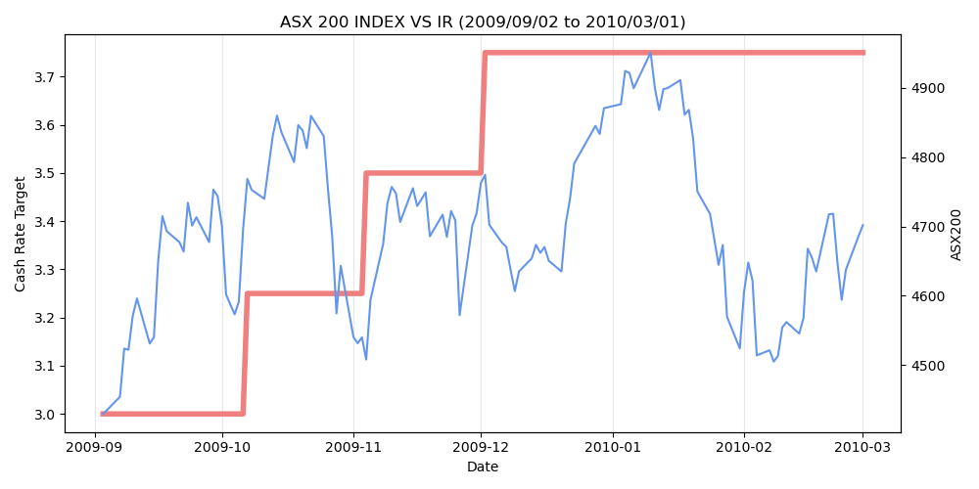
Rate Increase - Sep-09
Notes:
Richard

Slide 18
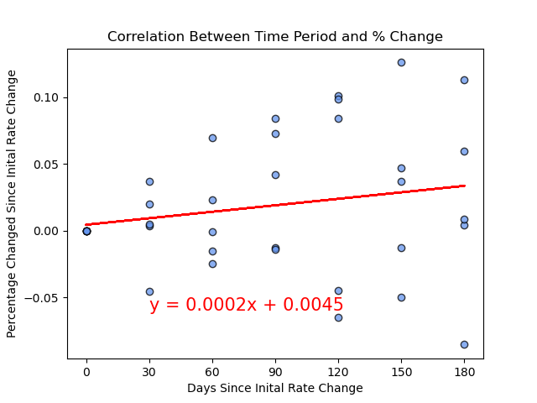
Linear Regression
This chart shows that there is little correlation between time periods in each rate increase occurrence.
The correlation coefficient (R Value) for this dataset is 0.18 (Low).
Notes:
Grant

Slide 19

What can we conclude ?
There is simply not enough evidence to support our hypothesis.
The data we have is not able to provide with any certainty that there is a favourable outcome.
Notes:
Grant

Slide 20


But what about the Predictions…?
As we know there little correlation, this is pure gambling now… - but here are our predictions…
Notes:
Grant

Slide 21




Everything is priced in ….
Notes:
Fares

Slide 22
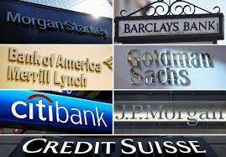
Costly analysis
Financial Data is expensive
Finnhub.io - $1000/month
Bloomberg API- $2000/month
Reuters Eikon API $1800/month
Notes:
Fares

Slide 23
Future testing
Analyse market X months before first anticipated IR hike
Inflation
Aus Dollar value
Unemployment rate
Bonds (2 year vs 10 year)
Polynomial relationship test rather than linear regression test
Notes:
Fares

Slide 24
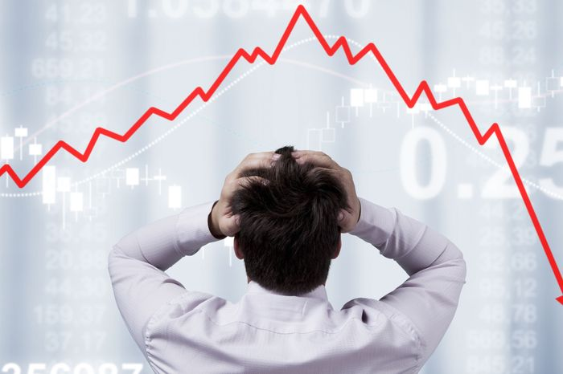
Q & A
Notes:
ALL

