Slide 1
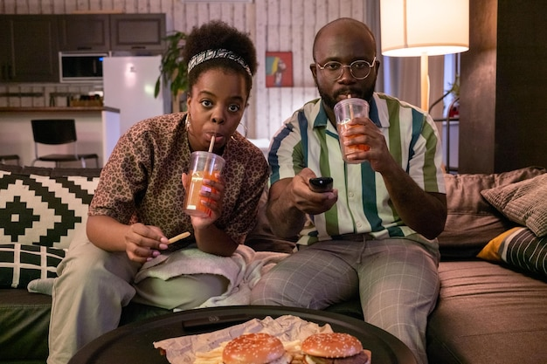
Scenario

Slide 2


Slide 3


Slide 4
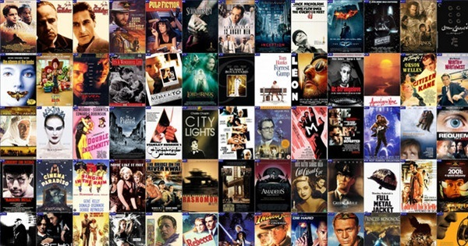

Slide 5


Slide 6
Movie Recommender
By Richard V

Slide 7
Initial Stages
10K Dataset
Exploratory Data Analysis (EDA)
Basic Model (Filter)

Slide 8
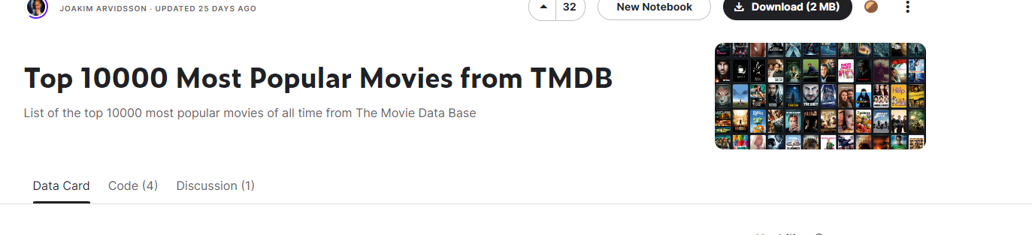
Where can I find the dataset?
https://www.kaggle.com/datasets/joebeachcapital/top-10000-most-popular-movies-from-imdb

Slide 9
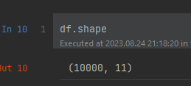
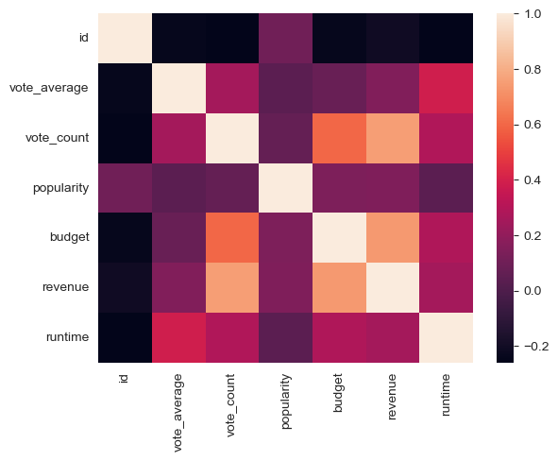
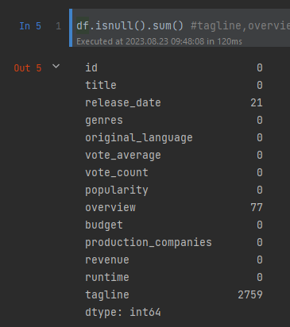
EDA

Slide 10
Demo: Filter

Slide 11
Intermediary Stage
Count Vectorizer
K-Means

Slide 12
Breaking it down into steps
Feature Engineering
Machine learning method?

Slide 13
Unsupervised Learning
Supervised learning is a subset of machine learning, where labelled datsets are used to train algorithms to classify or predict outcomes accuractely.
But what if the dataset is not labelled?

Slide 14
K-means clustering

Slide 15
Finding optimal K

Slide 16
Demo: Movie Recommender

Slide 17
End Stages
Seeing where it fails
How to improve it
What do I have that I can use as an extra feature
What can be done for next time?

Slide 18
User prompt
Spiderman or Spider-Man
Fuzzywuzzy

Slide 19
Least likely movies.

Slide 20
How we can improve it for next time
Incorporate larger datasets (there is one that is 20M rather than just 10k!)
Include more features for text vectorization (e.g. Cast, Directors) to increase accuracy of the recommender
Consider other unsupervised learning models, or transformer models. (There is the BERT transformer model which can process very large datasets very efficiently.

