Slide 1

Offuture
Team Limit
Notes:
Good morning everyone, thank you for taking the time to meet us. We are team limit, I’m Richard, This is Ka-hei, Vrutti, and Amrit. On todays agenda,

Slide 2
Agenda
Yearly total Sales/Profit
Market and country sales/profit analysis
Categories/products with most profit
Shipping costs relations
Diving into discounts
Q&A
Notes:
Richard

Slide 3
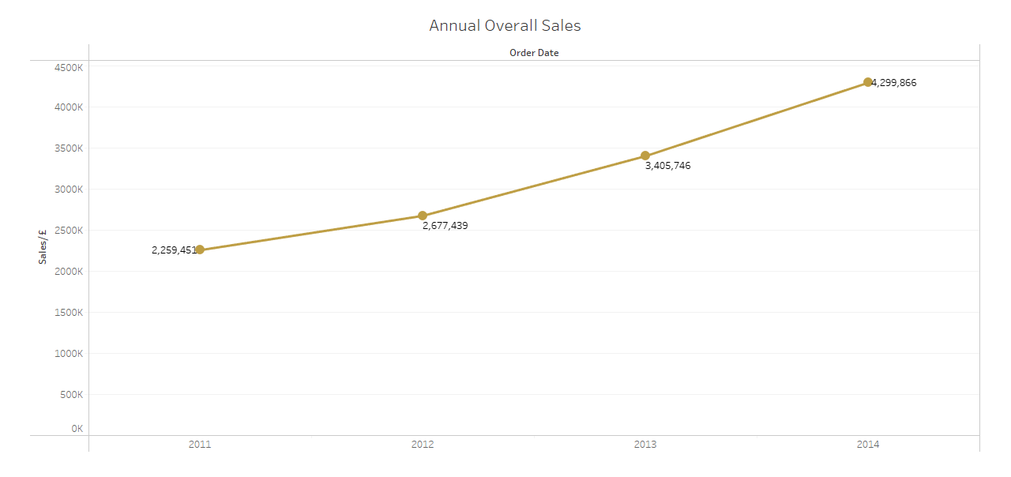
Total Sales Per Year
Sales in 2011 - £2,259,451
Sales in 2014 - £4,299,866
Each year the profits increase
Reason behind increase in yearly sales:
Users
Quantity
Notes:
Amrit 1. As you can see from the bar graph the sales in 2011 were $2,259,451 and in 2014 the sales were $4,299,866, you can clearly see that there is a steady increase each year with sales.
The increase in sales from 2011 to 2012 was 18%. The increase in sales from 2012 to 2013 was 27%. The increase in sales from 2013 to 2014 was 26%.
One potential reason behind the increase in sales may be because the number of users each year increased by 3 to 4,000. Additionally the quantity being ordered increase each year around 7 to 12,000, so this mean more people buying products and buying more products.

Slide 4
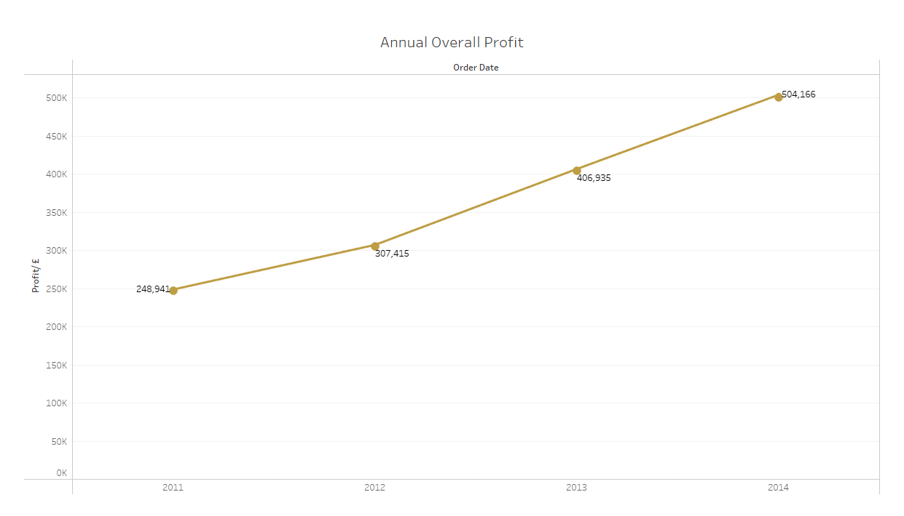
Total Profit Per Year
Profits in 2011 - £248,941
Profits in 2014 - £504,166
Each year the profits increase
Reason behind increase in yearly profits:
Users
Quantity
Notes:
Amrit 2. As you can see from the bar graph the profits in 2011 were $248,941 and in 2014 the profits were $504,166, you can clearly see that there is a steady increase each year with profits.
The increase in profits from 2011 to 2012 was 23%. The increase in profits from 2012 to 2013 was 32%. The increase in profits from 2013 to 2014 was 23%.
One potential reason behind the increase in profits may be because the number of users each year increased by 3 to 4,000. Additionally the quantity being ordered increase each year around 7 to 12,000, so this mean more people buying products and buying more products.

Slide 5
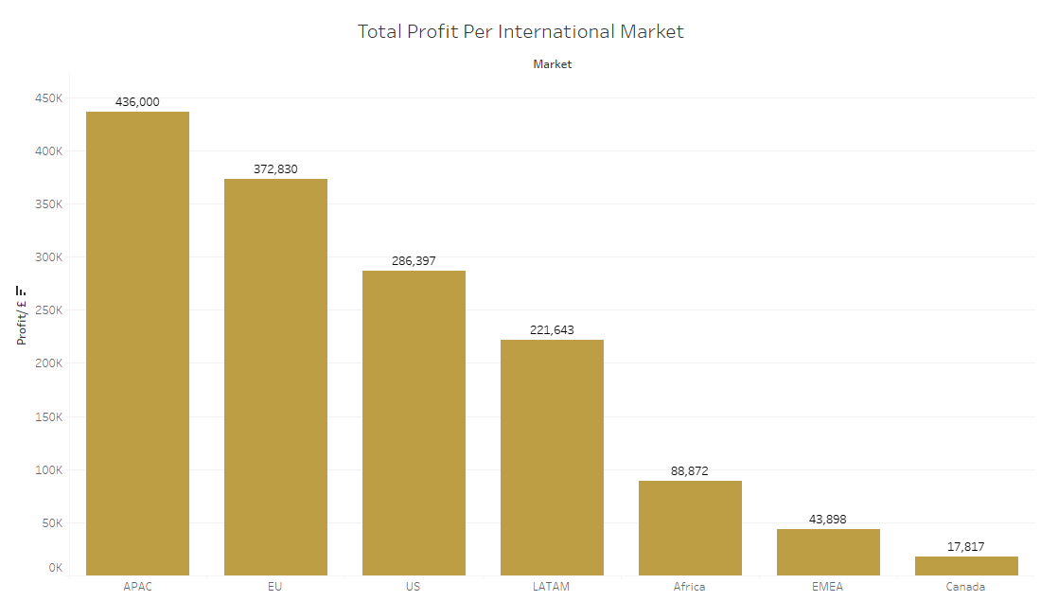
Profit per Market from 2011-2014
APAC (Asia-Pacific) makes 30% of total profit
EU (European Union) makes 25% of total profits
Canada 1%
Notes:
KAHEI slide 1

Slide 6
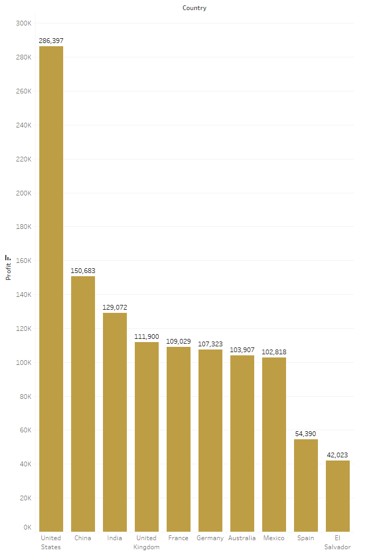
Top 10 Countries with Most Profit
USA makes 20% of total profit from a single country
UK, Spain, Germany, France from EU Market - 25%.
Australia, China, India from APAC - 26%
Mexico and El Salvador from LATAM - 10%
Profit has more than doubled for Spain and India from 2011 to 2014
China with lowest profit increase of 41%
Notes:
KH Slide 2

Slide 7
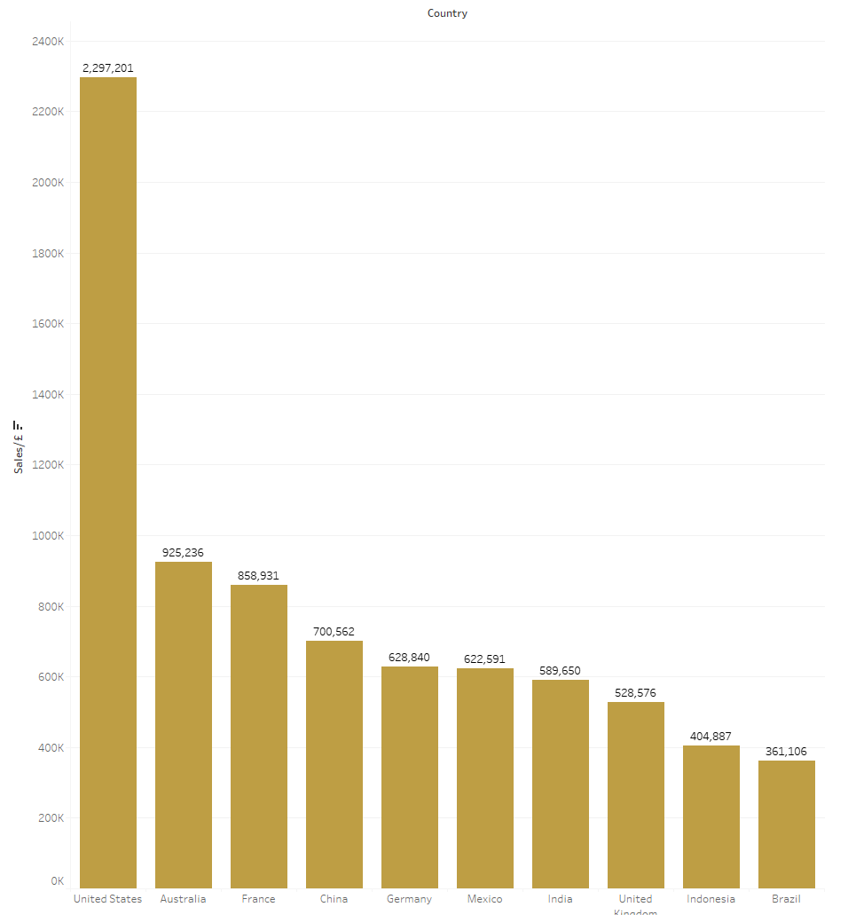
Top 10 Countries with Most Sales
US with 18% contribution to overall sales.
Sales have almost doubled from 2011 to 2014
China with 40% increase in sales
US with 52% sales
Notes:
KH Slide 3

Slide 8
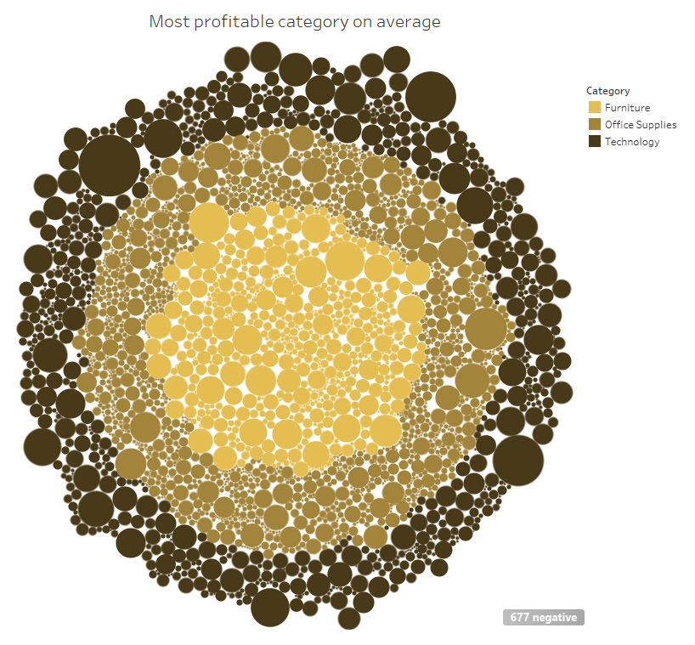
Most profitable Category on Average
Most profitable category on average is technology
Least profitable category on average is furniture
Notes:
Amrit 3. As you can see from the bubble graph on your left, it shows what the most profitable category is on average. There are three categories that offuture use to categorise their products which are technology, office supplies and furniture. The bubble graph is showing average profitable by category where the outer most ring is the most profitable category, in this case its technology, the middle ring is second most profitable category which is office supplies. And the inner most ring is the least profitable category which in this case is furniture. On potential reason why technology is the most profitable is that their products are more expensive than the other two categories, so they would be making more profit on an item in comparison with the other two categories

Slide 9
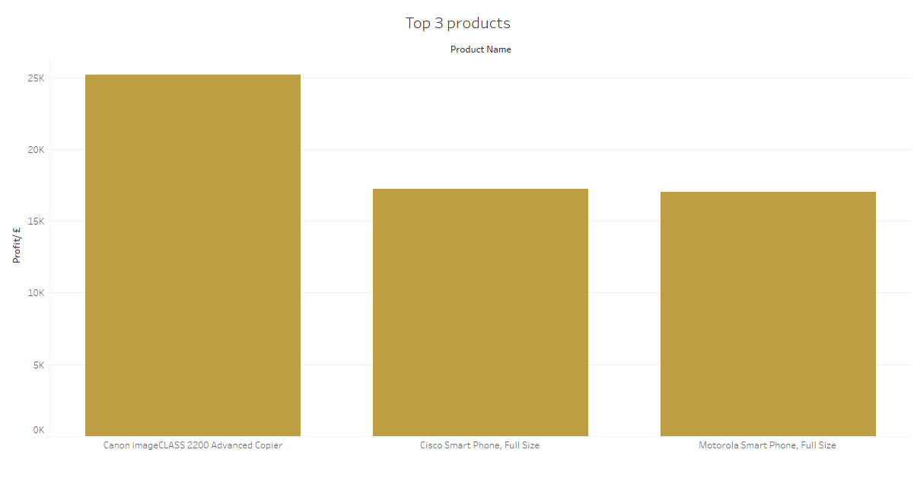
Most profitable Product
3 most profitable items are:
Canon Advanced copier
Cisco smart phone
Motorola smart phone
Top 3 profitable products belong to technology category
Notes:
Amrit slide 4 Now if we take an in-depth look at what are the most profitable products are we can see that the three most profitable products are the Canon advanced copier, then the cisco smart phone and the third most profitable product is the Motorola smart phone. All three of these products belong to the category of technology, which we spoke about in the slide before. The numbers above each bar represent the total amount of profit that was made on each product. So Canon Advanced copiers made $25,200 worth of profit

Slide 10
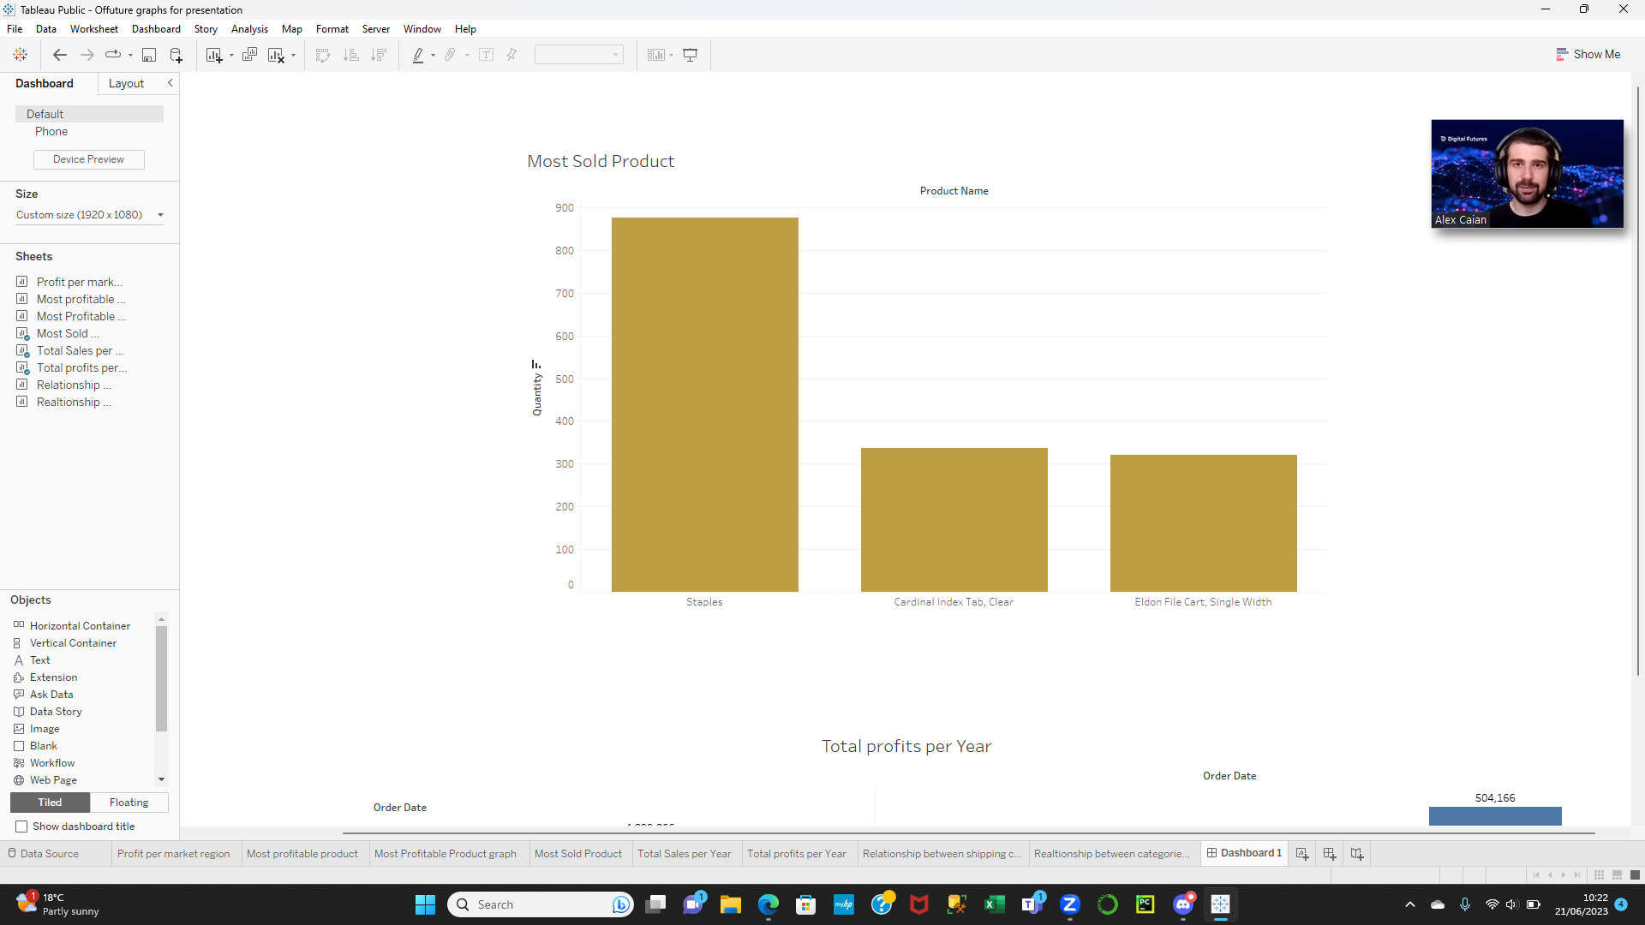
Most Sold Product
Top 3 most sold products:
Staples
Cardinal Index Tab, Clear
Eldon File Cart, Single Width
Cardinal index tabs – Office Supplies
Eldon File Cart - Office supplies
Staples – Furniture/office supplies
Notes:
Amrit slide 5 Now lets talk about the most product sold, on the screen we can see the top 3 most sold products. The most sold product is Staples that sold 876 items, then its which are the Cardinal Index tab which sold 337 items, then its Eldon File cart which sold 321 items.
There is no correlation that can be seen with most sold product and category as cardinal index tabs and Eldon File cart are categorised as Office supplies and Staples is categorised as Furniture with very few appearances in the office supplies category

Slide 11
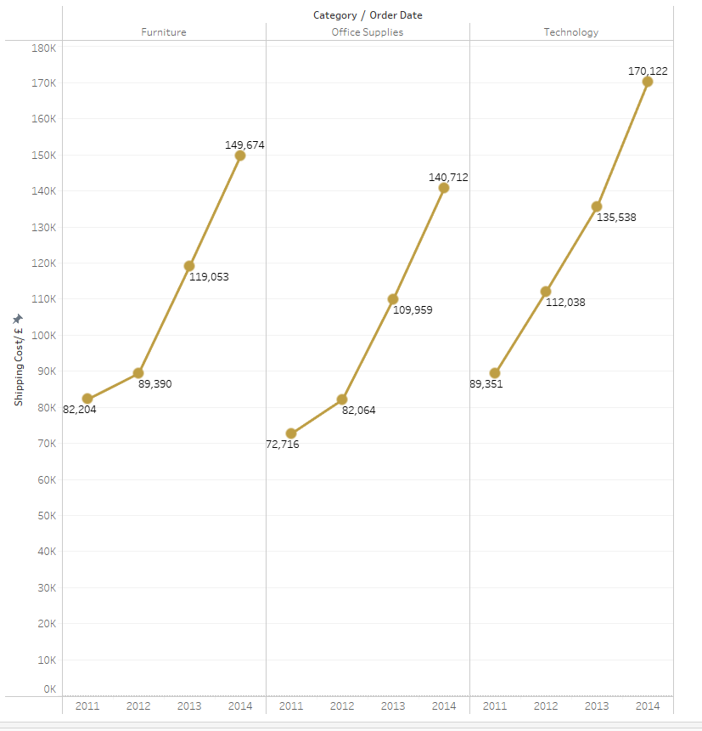
Annual Shipping costs by Category
The technology category has the highest shipping cost followed by furniture and office supplies categories
The growth rate of shipping cost from 2011 to 2014:
Office supplies - 93.59%
Technology - 90.54%
Furniture – 82.11%
Notes:
Vruti Slide 1

Slide 12
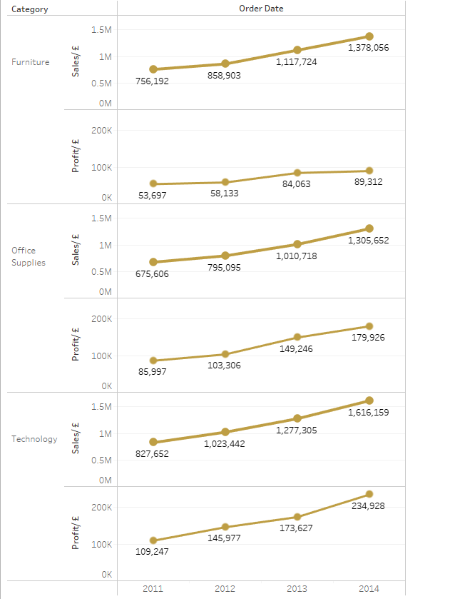
Annual Sales and Profit Analysis based on Product Category
The graph depicts a steady increase in sales and profit for all product categories from 2011 to 2014
Each year, the highest sales are observed in the technology category, followed by the furniture and office supplies categories
The technology category consistently demonstrates the highest profit, followed by the office supplies and furniture categories
Notes:
Vruti Slide 2

Slide 13
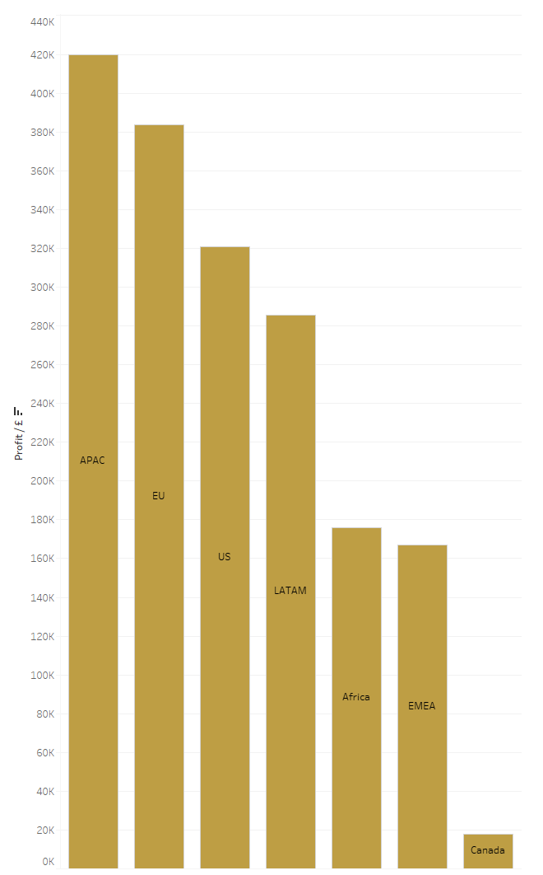
Diving discounts |
When they aren’t applied, APAC is also the most profitable region.
Where all markets profit.
Notes:
Richard Slide 1– Thank you Vruti. Now we’ll be diving into discounts applied on profits. In each market, when discounts aren’t applied, all markets profit, with APAC being the most profitable region.

Slide 14
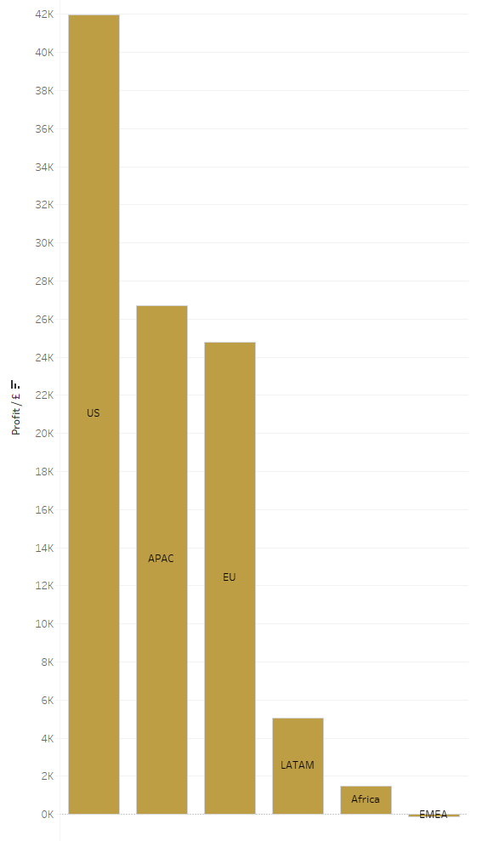
Diving discounts ||
Around 60% discounts is where profit starts to fall.
EMEA starts to lose profit
Notes:
Richard Slide 2 – However, when we start to look at discounted transactions, up to the 60% mark, we found that Europe, the middle east and Africa start to lose profit on discounted transactions

Slide 15
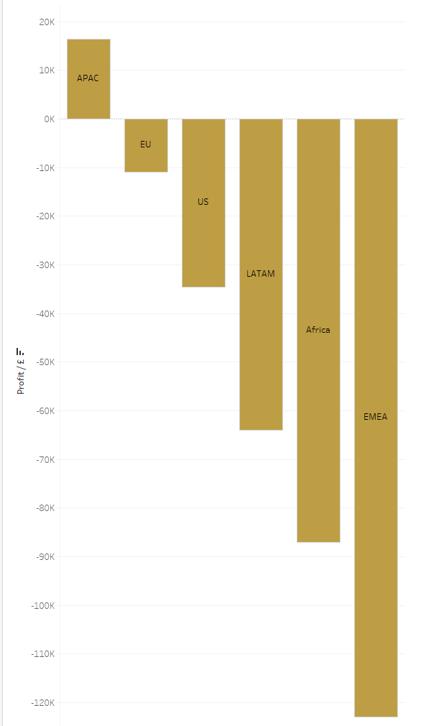
Diving discounts |||
When discounts are applied, all markets aside from APAC, lose profit.
Notes:
Richard Slide 3 – and If we look at all discounted transactions up to 70%, then all regions lose profit aside from APAC.

Slide 16
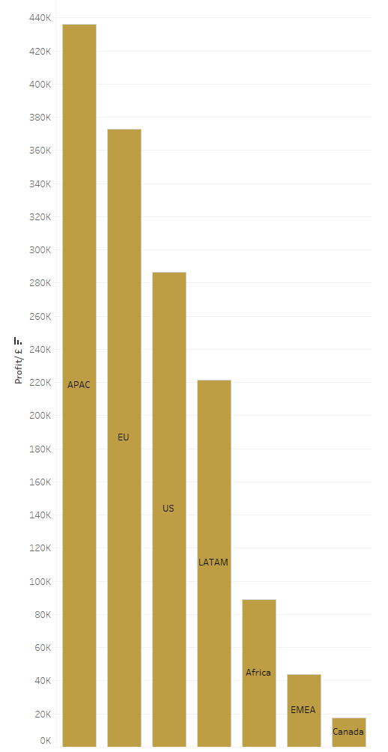
Diving discounts ||||
However overall, the loss in profit via discounts aren’t enough to make markets lose overall profit.
Notes:
Richard Slide 4 – But overall profit in all transactions, discounts or not, all the markets profit overall. So discounts aren’t found to make a significant impact on overall profit.

Slide 17
Q&A?
Notes:
Richard Slide 4 (Thank you for listening to our presentation. We have time for a couple of questions would anyone like to ask any?

Slide 18
Not included below.
Tableau Link
https://public.tableau.com/shared/HHDWKHBMM?:display_count=n&:origin=viz_share_link

Slide 19
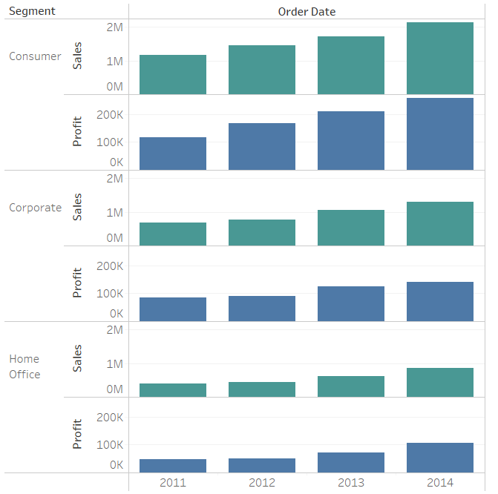
Annual Sales and Profit Analysis based on Segment
The graph depicts steady increase in sales and profit for all the segments from the year 2011 to 2014.
The highest sales and profit can be seen for consumer segment, followed by corporate and home office segments.

