Slide 1
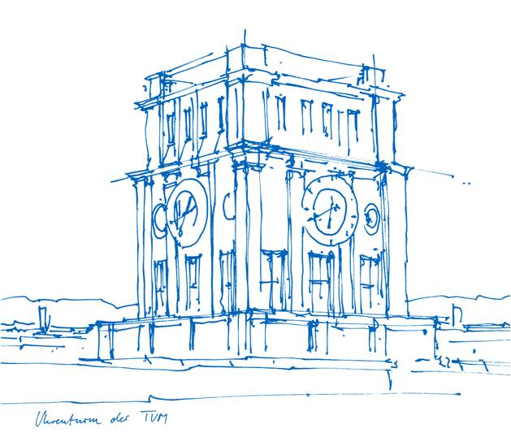
Practical Course Wearable Robotics
Group 2: Wrist Pronation / Supination
Lingfeng Gu, Richard Willke Nikolas Kaarsberg
Technische Universität München
TUM School of Computation, Information and Technology
Institute for Congitive Systems
Munich, 9. January 2024

Slide 2
Structuring
Use Case – what tasks? Which Scenarios? - Lingfeng
Approach – which DoF? Which goals (continuous based, activity based)? - Lingfeng
Mechanical Design - Nikolas
Control / Sensing - Richard
Future Work – How much did we fuck up? - Richard
Priorities:
  Force sensor placement
  EMG integration
  PRESENTATION
  Documentation

Slide 3

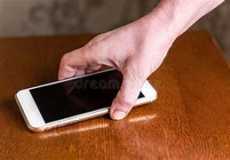

Use Case
Scenarios:
  Picking up Cup for people with fast muscular fatigue
  Learning of picking up motion for people with impaired RoM
Notes:
Picking up tasks / Grasping action
Goal: Helping People with muscular distrophy

Slide 4
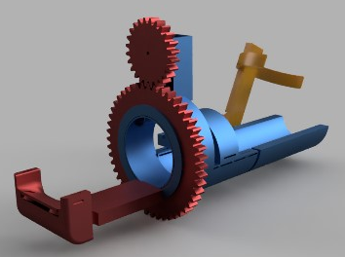
Approach
Main Motion Contributers:
  Elbow Flexion / Extension
  Wrist Pronation / Supination
  Assistive Modes:
    Continuous Assistance
    Activity Triggered
  Requirements:
    Ease of use
    Reliability
    Comfort
    Realtime Capable
Notes:
2 DoF exoskeleton for muscular support
Elbow Flexion and Extension & Wrist Pronation / Supination as most important contributers for this task
Continuos assistance for first scenario
Activity triggered assistance for second scenario
Requirements:
Ease of use
Reliability
Comfort
Realtime capable

Slide 5
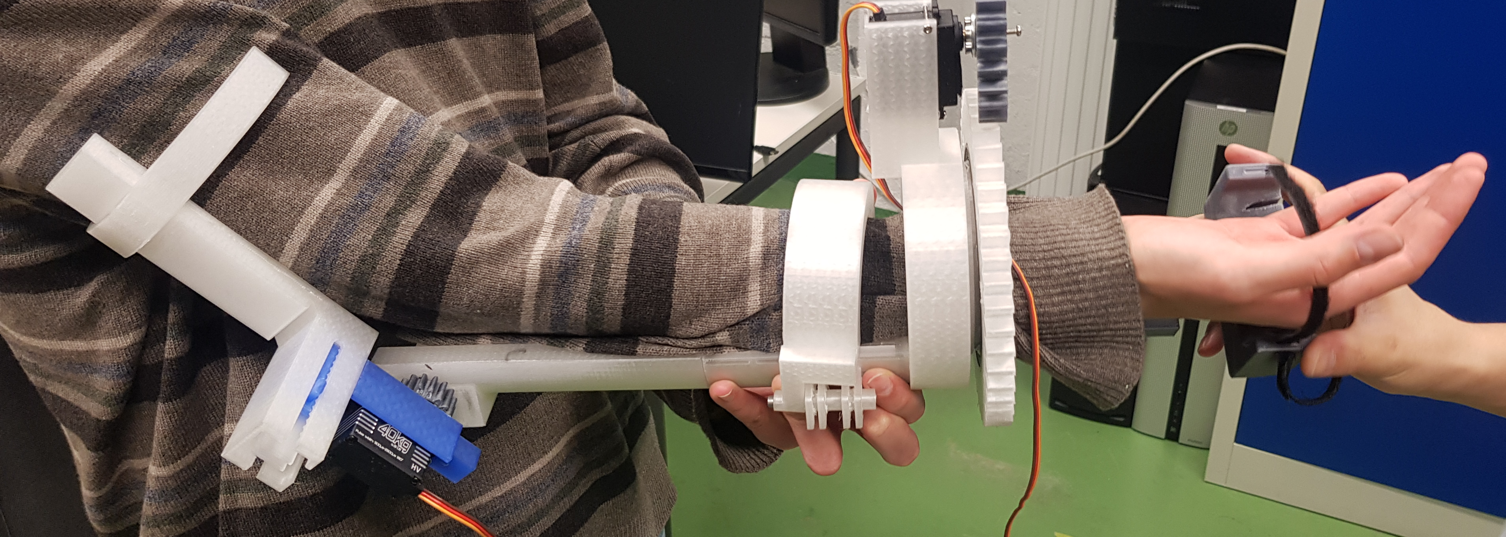
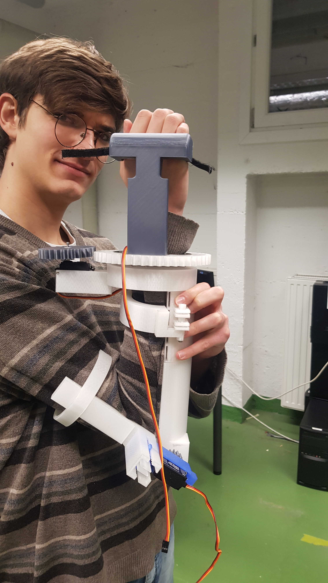
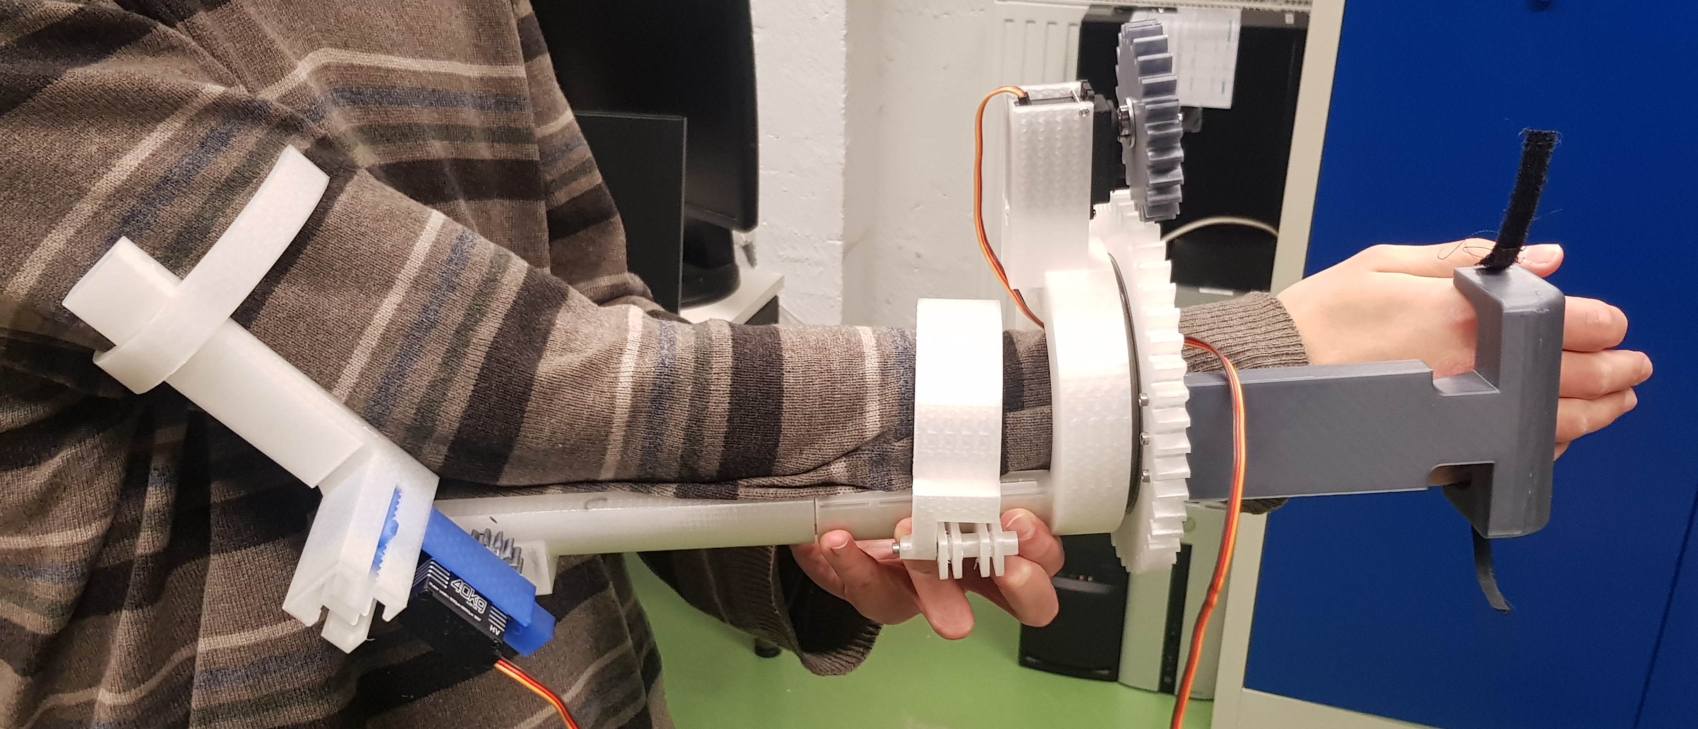
Mechanical Design

Slide 6
Controls and Sensing
ESP32exo.ino
triggeredControl
__init__
deg2rad
assist_loop2
open_serial_port.py
exoControl
__init__
deg2rad
rad2deg
checkRange
control_loop
exo_control.py

Slide 7
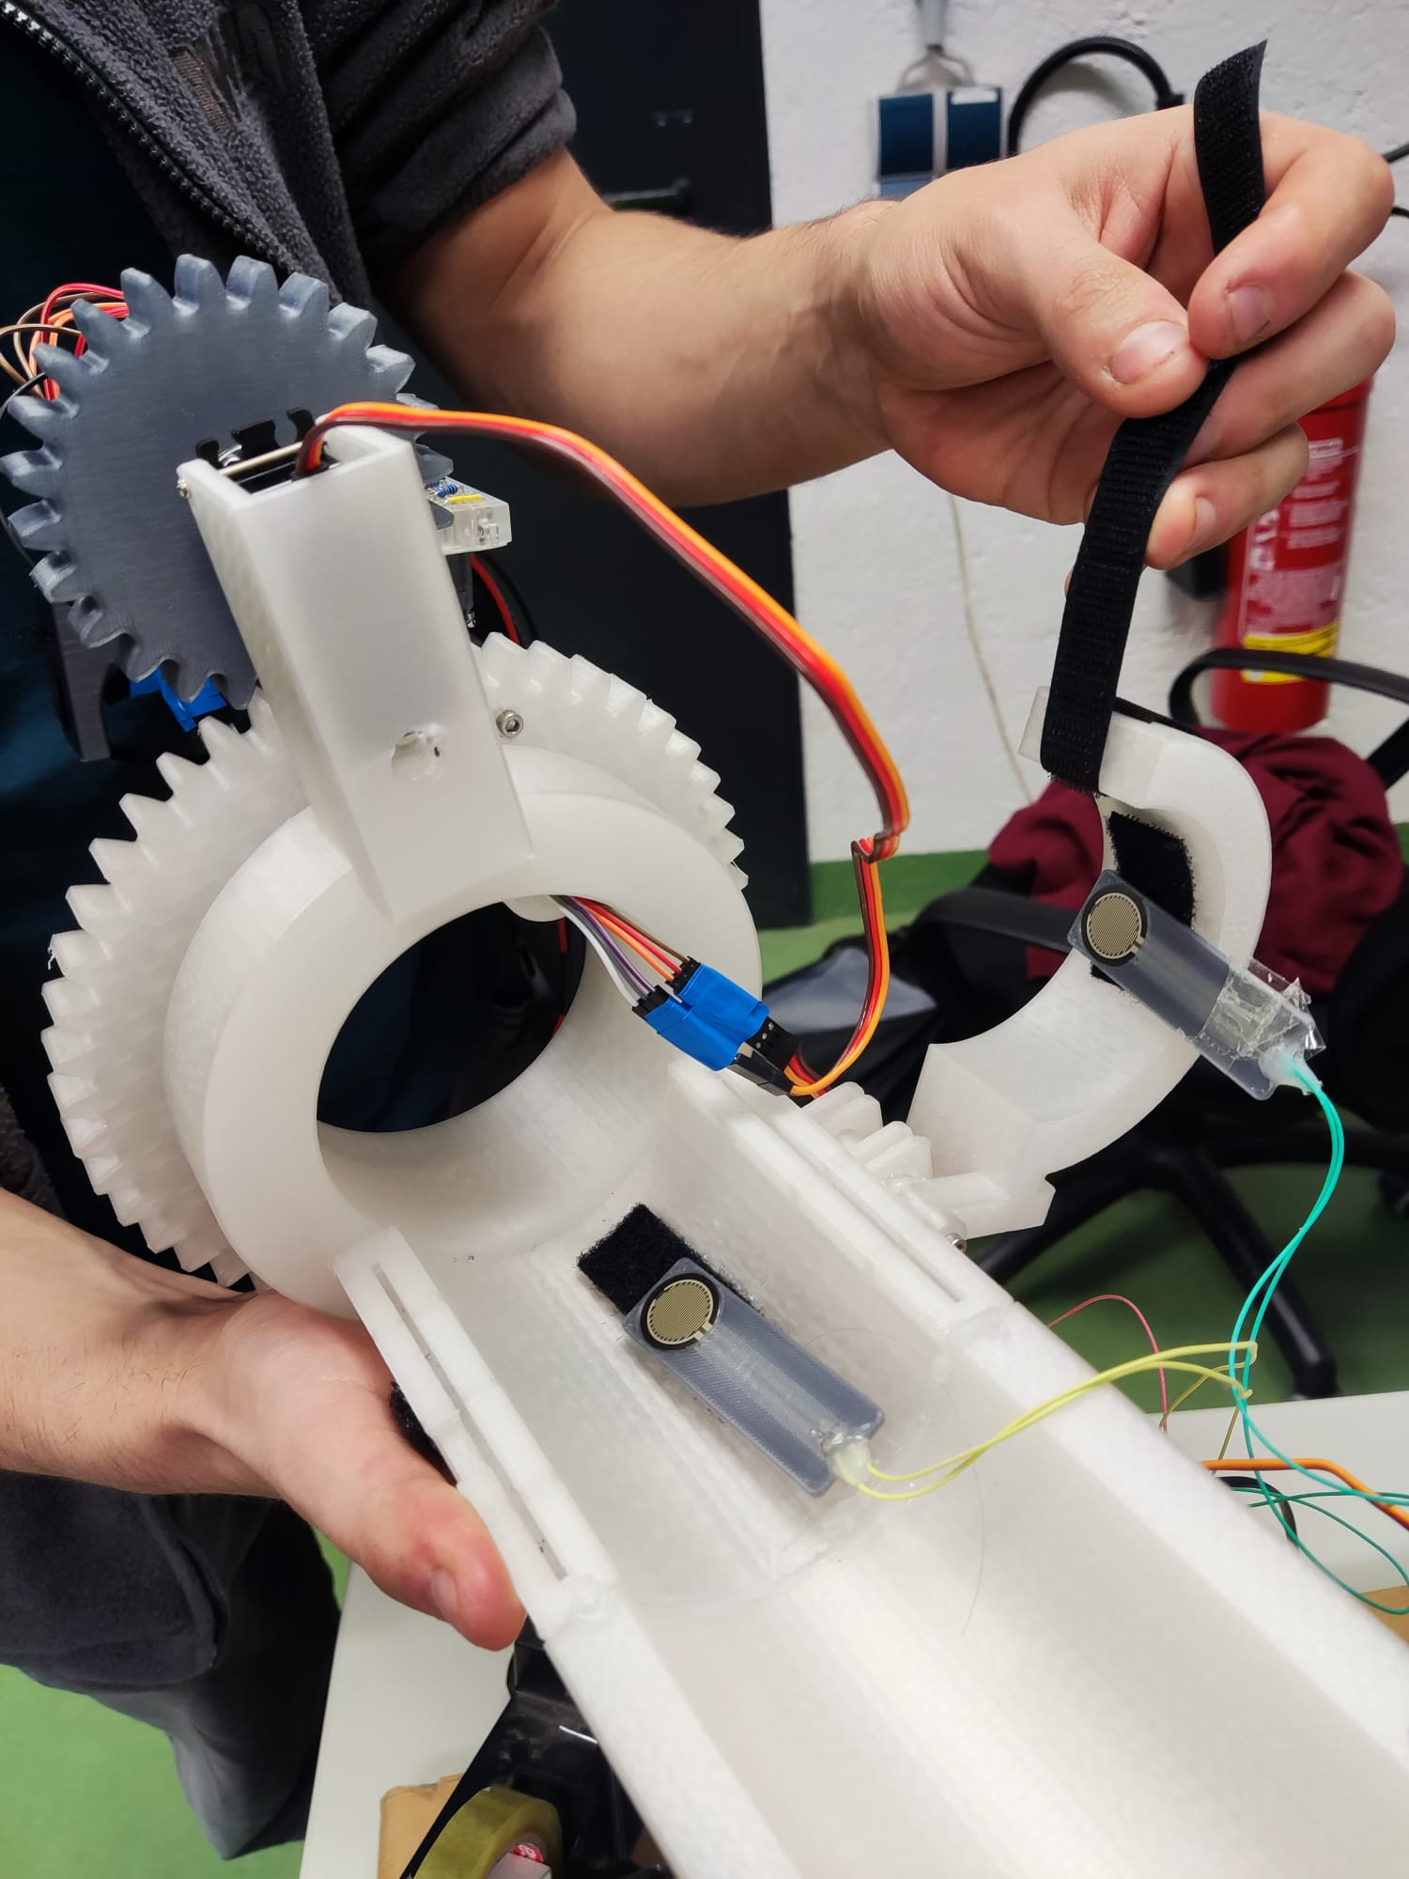
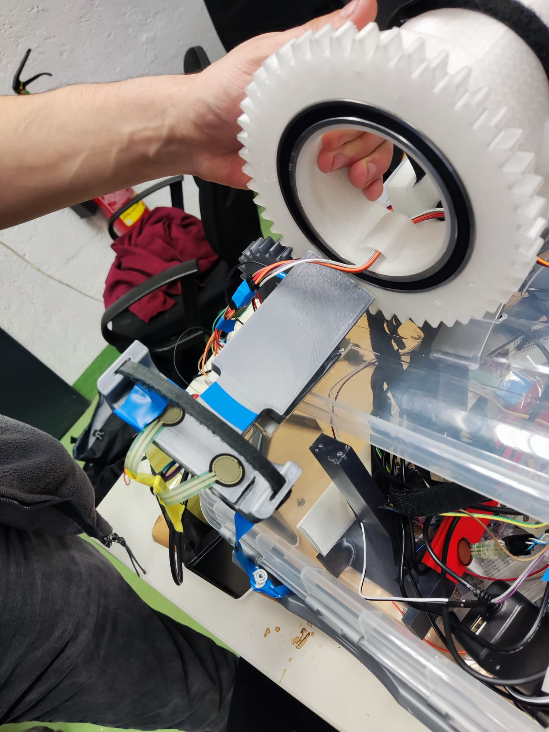
Controls and Sensing
Notes:
Using Force Sensors for both Control Modes
Sensors located along the outer knuckles of the hand and inner / outer side of lower arm
Used to calculate the wrench for both motions

Slide 8
Results and Future Work

Slide 9
Thank you for your attention!
Lingfeng Gu, Richard Willke, Nikolas Kaarsberg | Wearable Robotics | Wrist Pronation & Supination

